Slide 1

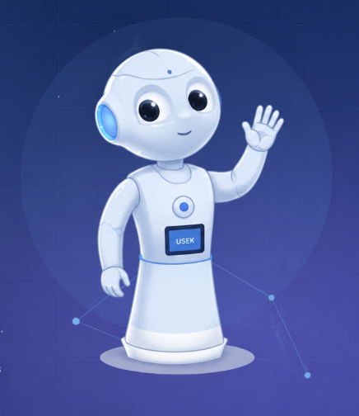
AI · ROBOTICS · HRI
Pepper-azzi
AI Teaching Assistant Using Pepper Robot
COURSE Human-Robot Interaction (HRI)
SUPERVISOR Dr. Elie Saad
TEAM PEPPERAZZI
Maria Kanaan · Tatiana Abi Fadel · Charbel Salloum · Kevin Skayem · Joseph Naous
USEK · School of Engineering · Spring 2025–2026

Slide 2
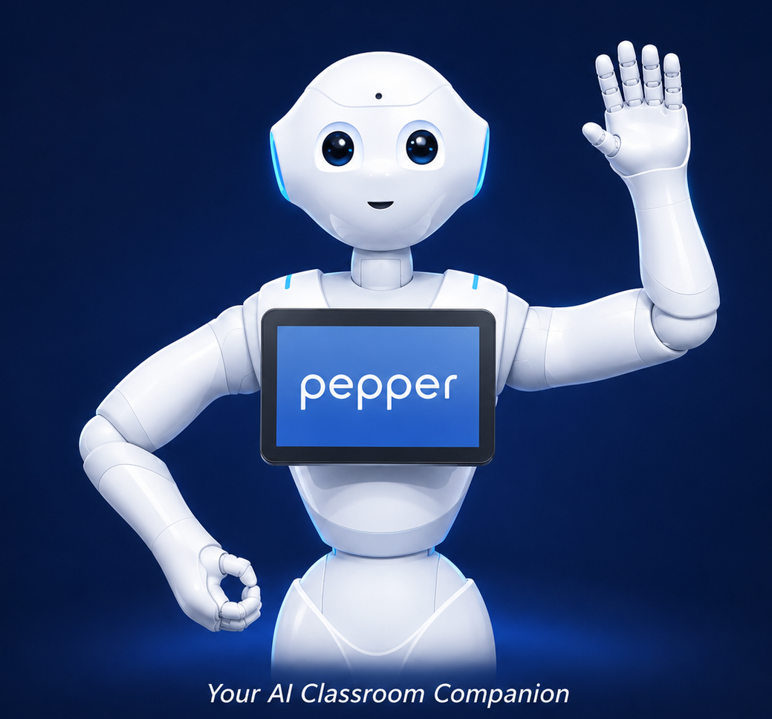
PEPPERAZZI · HRI PROJECT
Introduction
Meet Pepper — an AI-powered teaching assistant built on the Pepper humanoid robot to transform the classroom experience.
Designed for the USEK HRI course, Pepper interacts with students through speech, motion, and a tablet interface. It explains lessons, answers questions in real-time using Gemini AI, runs interactive quizzes, applies fun AI image filters, records attendance via face recognition, and gathers session rating — all in one seamless classroom flow.

Slide 3


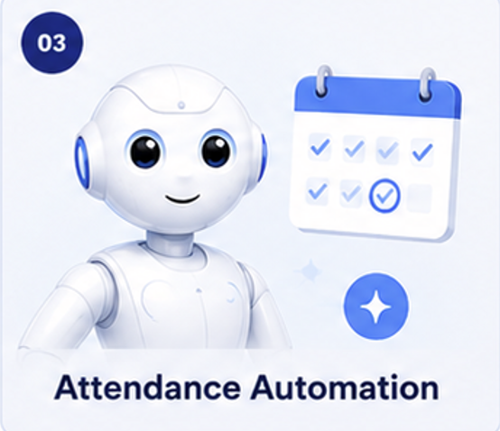
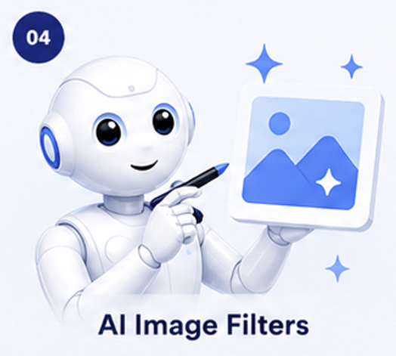
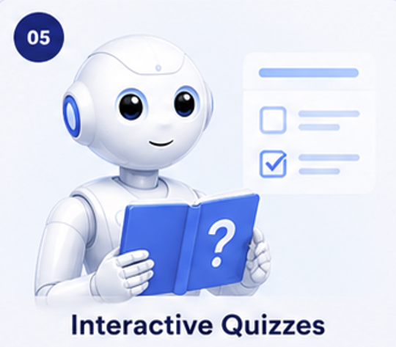
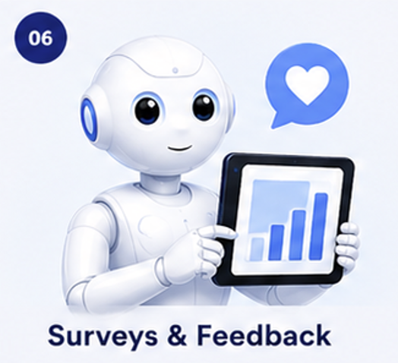
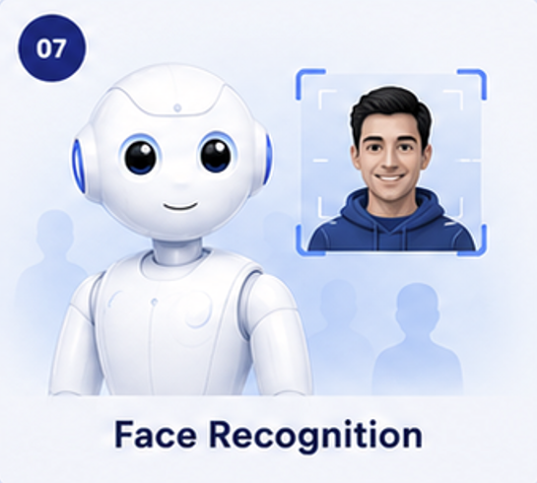
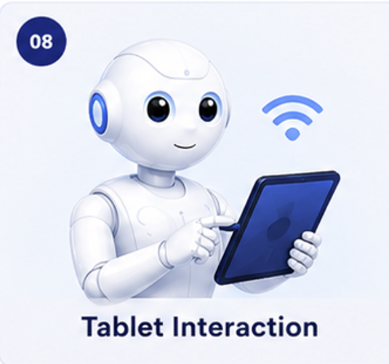
PEPPERAZZI · HRI PROJECT
Objectives
Eight goals that shape our Pepper-azzi interaction

Slide 4
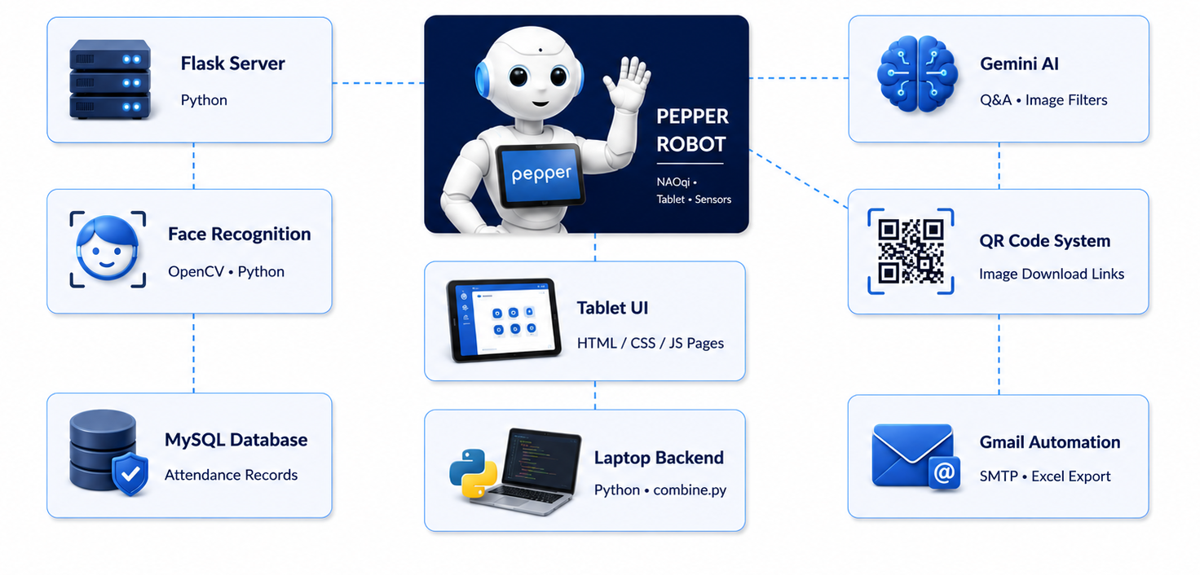
PEPPERAZZI · HRI PROJECT
System Architecture
How Pepper's hardware, AI services, and tablet UI connect

Slide 5
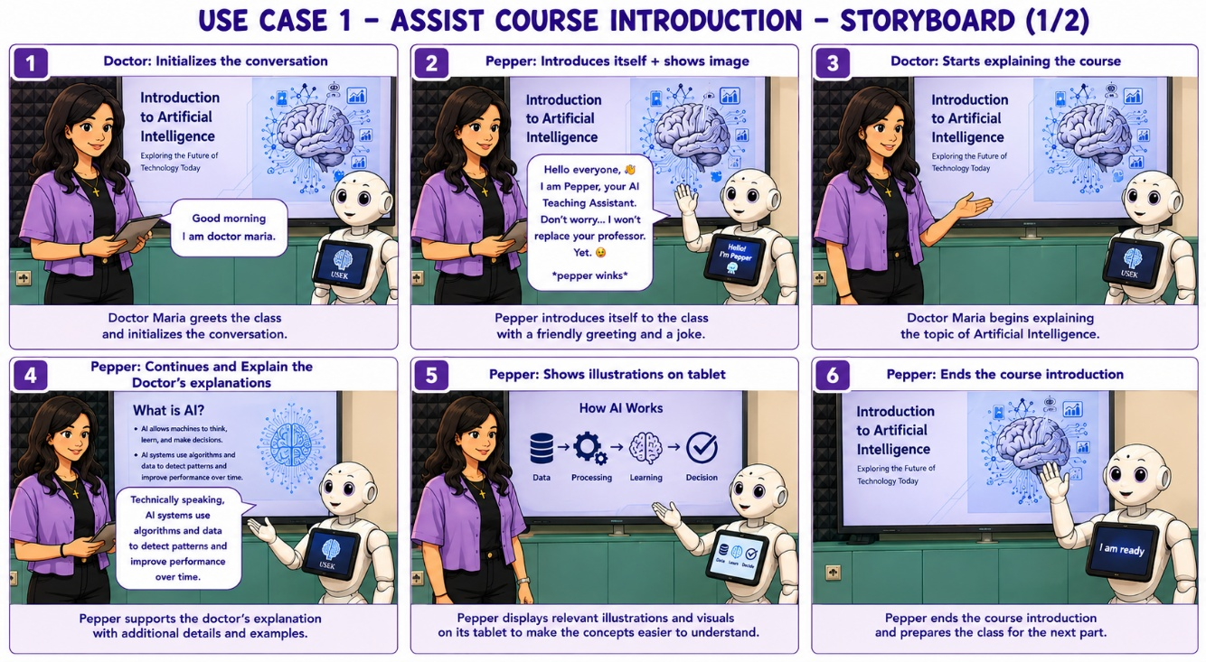




PEPPERAZZI · HRI PROJECT
Part 1 · Assist Course Introduction storyboard
01
Course Co-Host
Pepper assists the doctor during the AI course introduction.
Greets students along side Dr. Maria
Displays AI illustrations on tablet
Adds humor and live commentary
Smooth gesture + voice sync

Slide 6
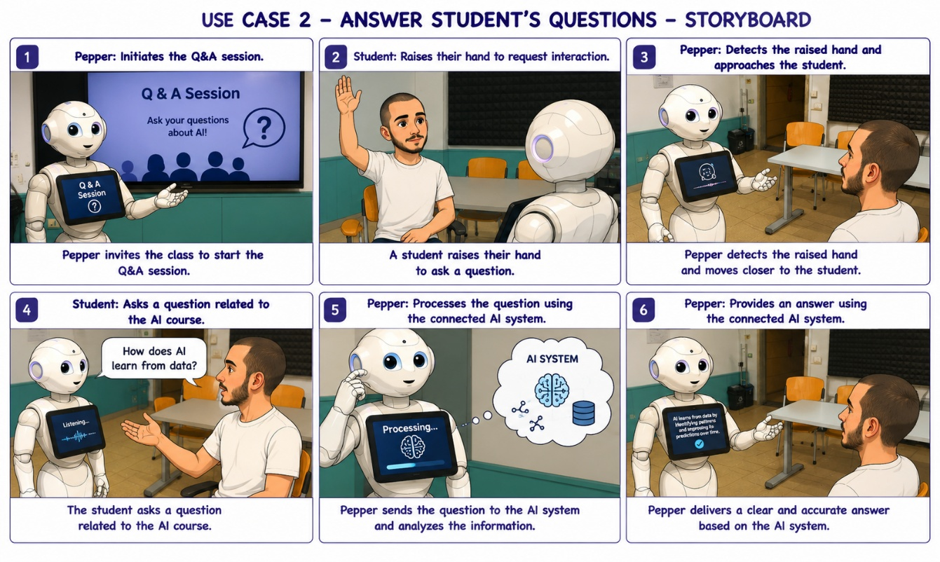


PEPPERAZZI · HRI PROJECT
Part 2 · Answer Student Questions Storyboard
02
AI Q&A Session
Pepper detects raised hands and answers using Gemini AI.
Students raise their hands
Pepper detects and approaches
Gemini AI generates the answer
Live chat displayed on tablet

Slide 7
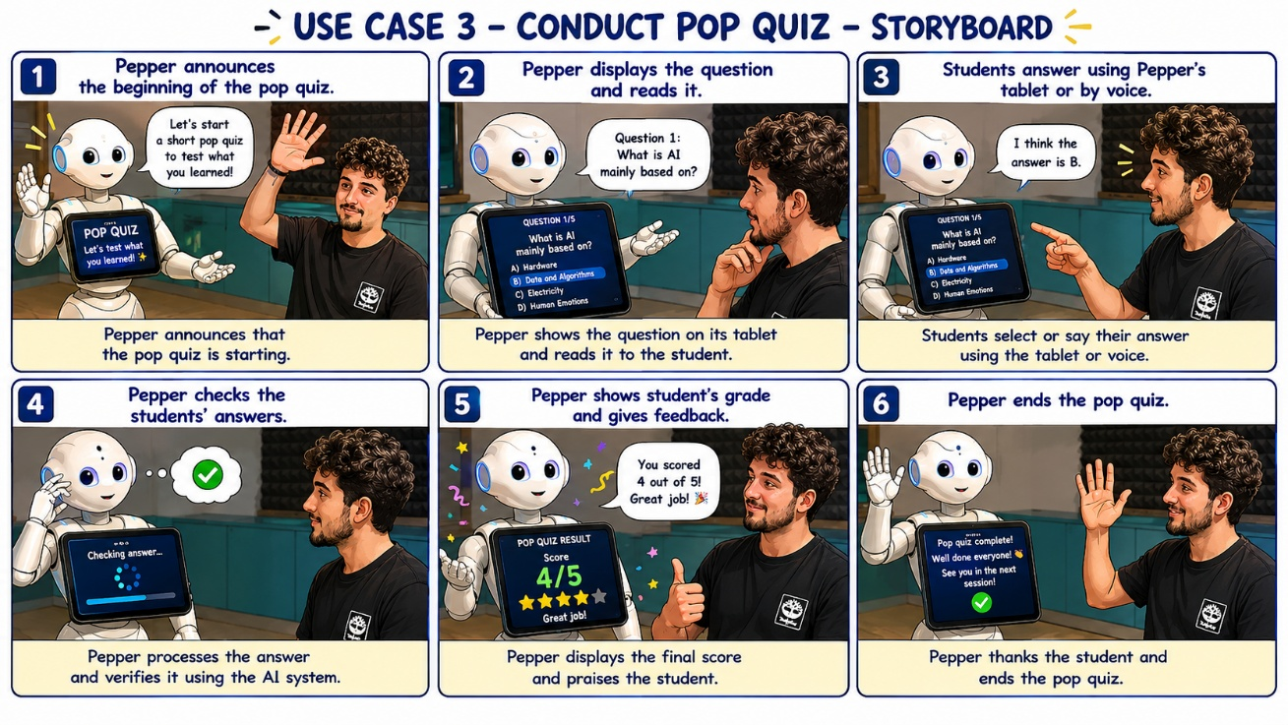



PEPPERAZZI · HRI PROJECT
Part 3 · Conduct Pop Quiz Storyboard
03
Pop Quiz
Pepper tests student understanding with a 5-question quiz.
Questions auto-loaded from JSON
Students answer via tablet or voice
Pepper checks and scores answers
Final score

Slide 8
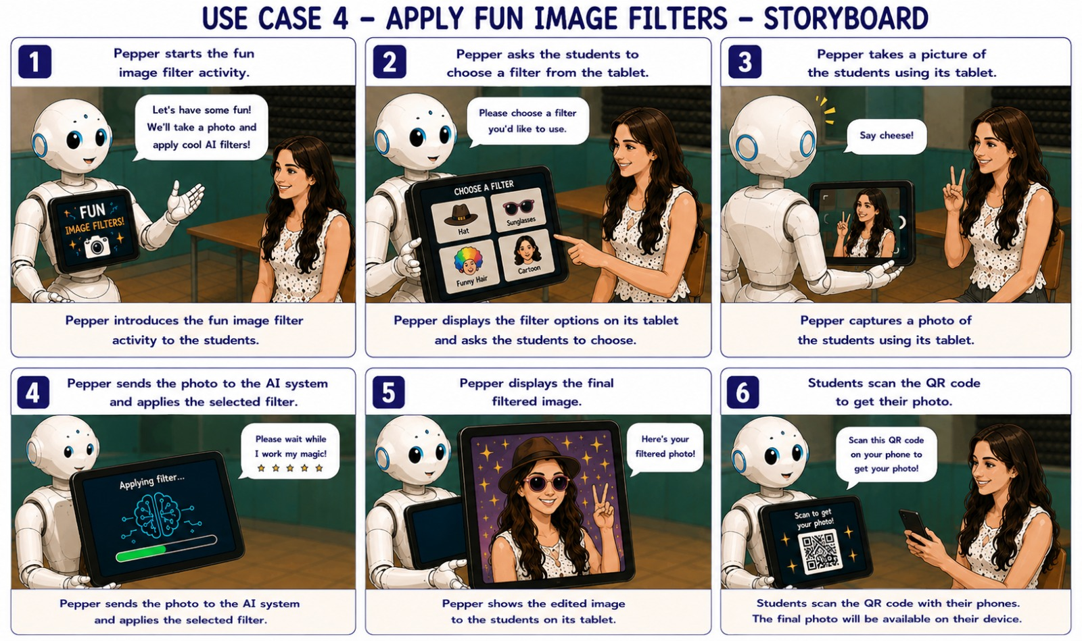



PEPPERAZZI · HRI PROJECT
Part 4 · Apply Fun Image Filters Storyboard
04
AI Image Filters
Capture, transform, and share photos — powered by Gemini.
Students pick filter on tablet
Pepper captures the photo
AI applies hats, glasses, cartoons
QR code lets students download it

Slide 9
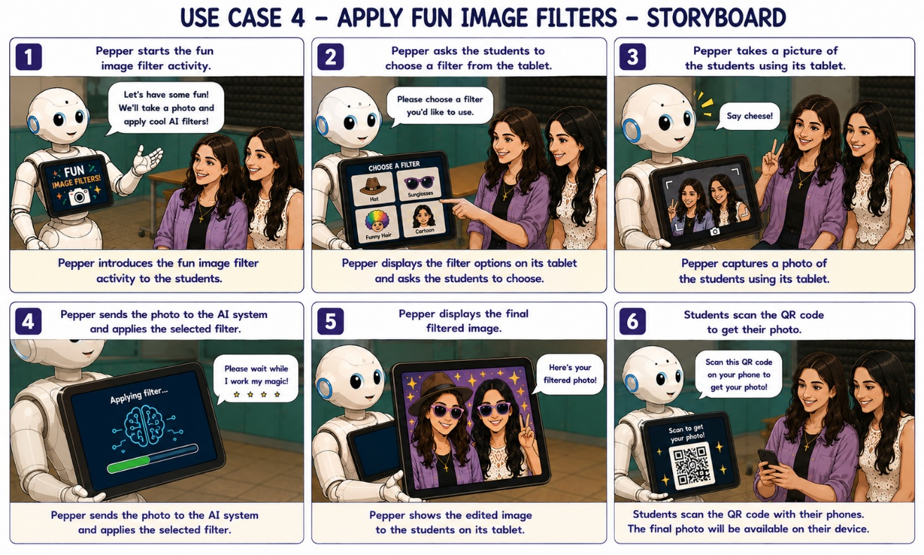
PEPPERAZZI · HRI PROJECT
Part 4 · Apply Fun Image Filters Storyboard
04
AI Image Filters
Capture, transform, and share photos — powered by Gemini.
Can detect many faces and apply filters on them

Slide 10
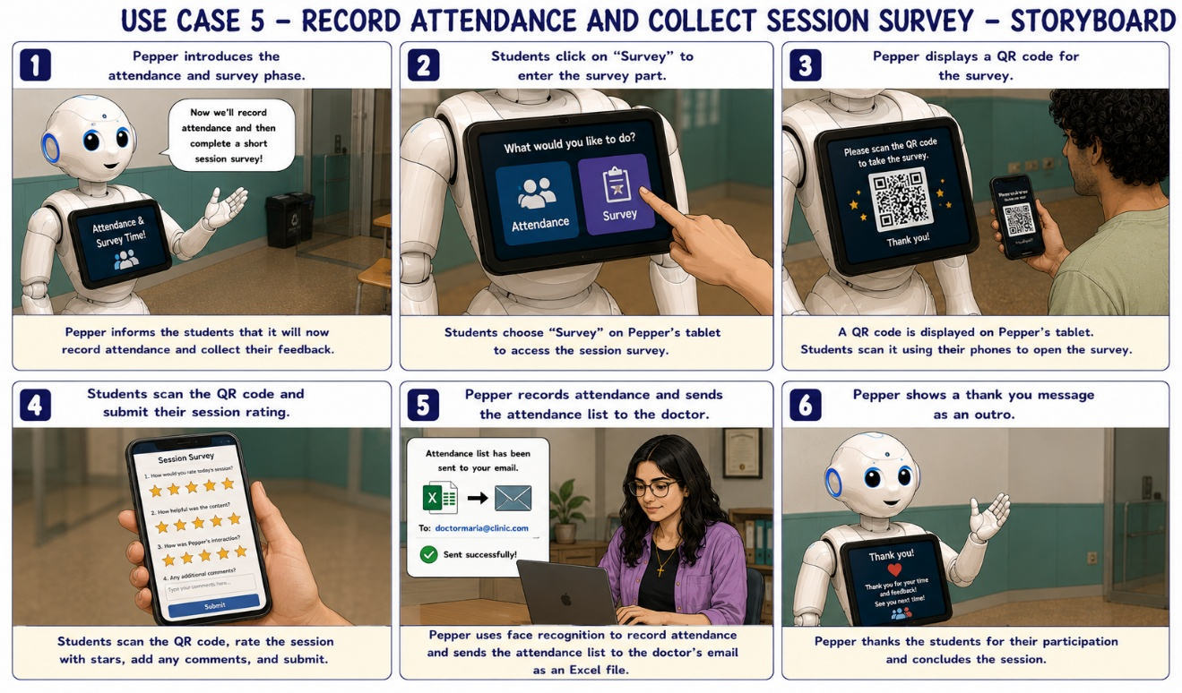



PEPPERAZZI · HRI PROJECT
Use Case 5 · Attendance & Survey
05
Attendance & Feedback
Wrap up the session — automatically.
Face recognition records presence
Excel report emailed to instructor
QR code opens survey on phone
Students rate session (5 stars)

Slide 11
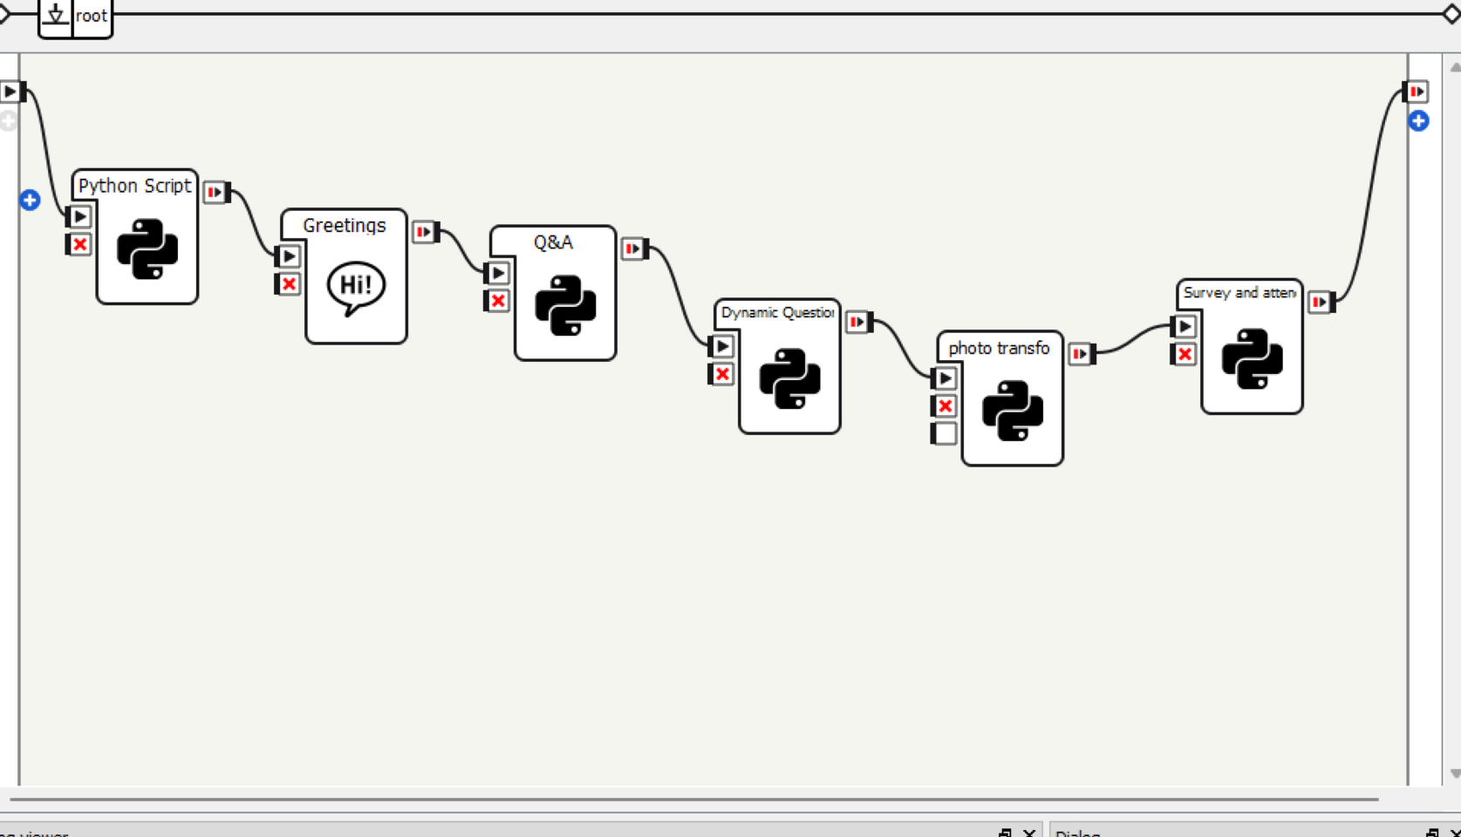





PEPPERAZZI · HRI PROJECT
Implementation
Choregraphe Workflow
Technology Stack
Backend
Python · Flask · NAOqi
Tablet UI
HTML / CSS / JavaScript
AI
Gemini API · OpenCV
Storage
MySQL · Excel · QR
Email
Gmail SMTP automation
Greetings → Q&A → Quiz → Photo Transform → Attendance & Survey

Slide 12

PEPPERAZZI · HRI PROJECT
Video
What Pepper-azzi delivers in action
Video Link
Live Demo Video

Slide 13
CONCLUSION
Pepper made the classroom alive.
Thank you
Team Pepper-azzi · USEK · Spring 2025–2026

