Slide 1
Interactive File Management System
Simulating Core File Operations
Presentation By:
Sai Kiran
Kaustubh Adhav
Harsh Patel
Dhruvik Patel

Slide 2
Overview
This project implements a file system GUI using Dear ImGui, a graphical interface library. It enables users to perform file system operations including file and directory management, disk usage monitoring, and file modification.
Implemented in C++ with OpenGL for rendering.

Slide 3
Implemented Functions
Create Directory | List Directory Contents
Delete Directory | Rename File/Directory
Create File | Move File/Directory
Delete File | Copy File
Write to File | Change File Permissions
Read File | Get Disk Usage
Get File Info

Slide 4

Libraries and Their Uses
Standard C++ Libraries:
<iostream>, <fstream>, <string>, <vector>, <filesystem> <sys/stat.h>, <sys/types.h>
Dear ImGui: UI elements for file operations.
GLFW: OpenGL context management and user input.
OpenGL: Graphics rendering.
POSIX APIs: OS-level file operations.

Slide 5
Directory Structure
├── FileSys_GUI
├── imgui
├── Output_Screenshots
└── README.md

Slide 6

Detailed File Analysis
file_operations.cpp: - Implements core file operations (e.g., create, delete, list, write).
file_operations.h: - Function prototypes for file_operations.cpp.
main.cpp: - GUI integration with file operations using Dear ImGui.
Makefile: - Automates build process.

Slide 7
file_operations.cpp
Purpose:
Implements the core file system operations, handling functionalities like creating, deleting, and managing files and directories.
Main Libraries Used:
<filesystem>: For interacting with the file system.
<sys/stat.h>: To manage file and directory attributes.
Key Functions:
create_directory: Creates a new directory.
delete_directory: Deletes an existing directory.
list_directory_contents: Lists all files and subdirectories in a specified directory.
create_file: Creates a new file in a directory.
delete_file: Deletes a specified file.
write_to_file: Writes data to a file.
read_file: Reads content from a file.
change_permissions: Updates file permissions.
Role in the Project:
Acts as the backbone for all file system-related functionalities, enabling the GUI to execute the desired operations seamlessly.

Slide 8

file_operations.h
Header file declaring functions for file and directory operations.
Provides an interface to the main program to utilize these operations.
Purpose:
Defines the prototypes for functions implemented in file_operations.cpp.
Included Libraries:
While it doesn't directly use libraries, it includes essential standard libraries like <string> and <vector> for handling strings and dynamic collections.
Role in the Project:
Serves as the header file that declares all file system operations such as creating, deleting, and managing files and directories, which are implemented in the corresponding .cpp file.

Slide 9
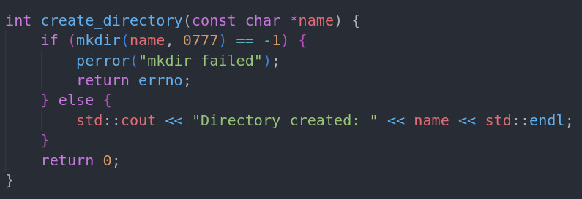
Create Directory

Slide 10
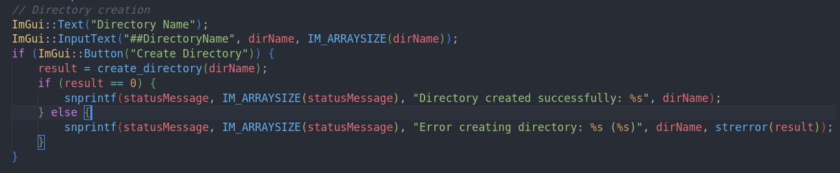
Create Directory

Slide 11
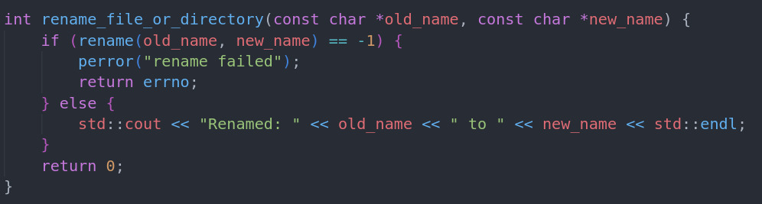
Rename File/Directory

Slide 12
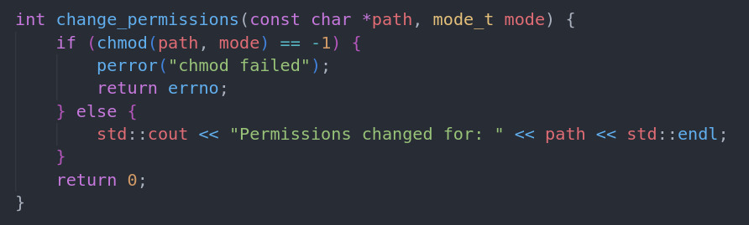
Change Permissions

Slide 13
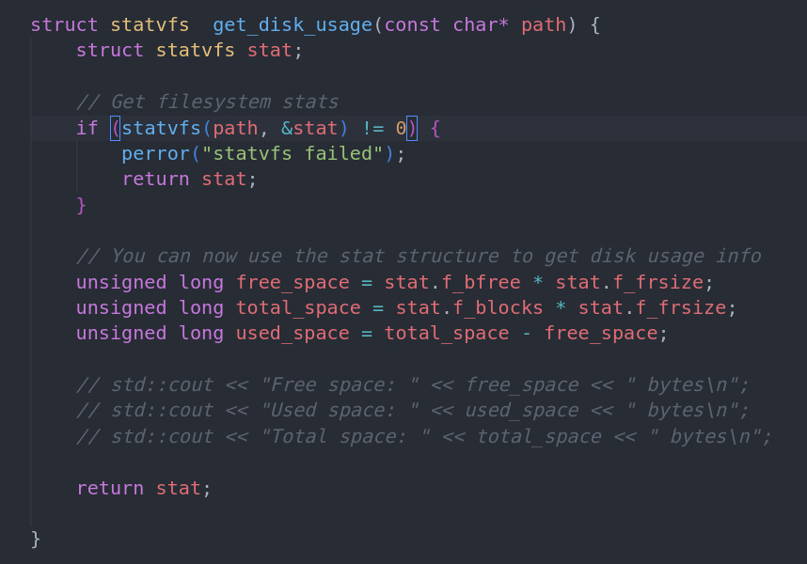
Disk Usage

Slide 14
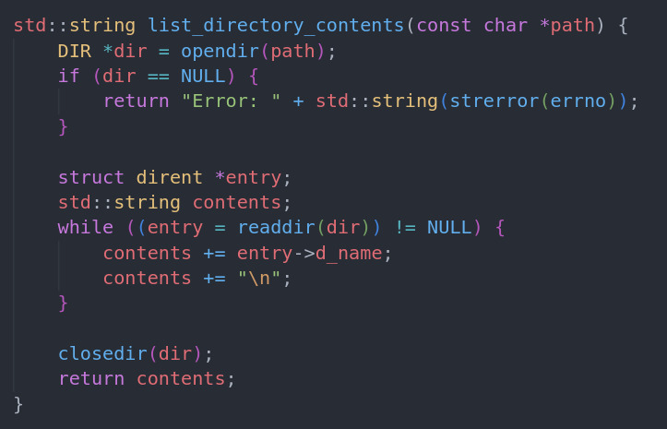
List Directory

Slide 15
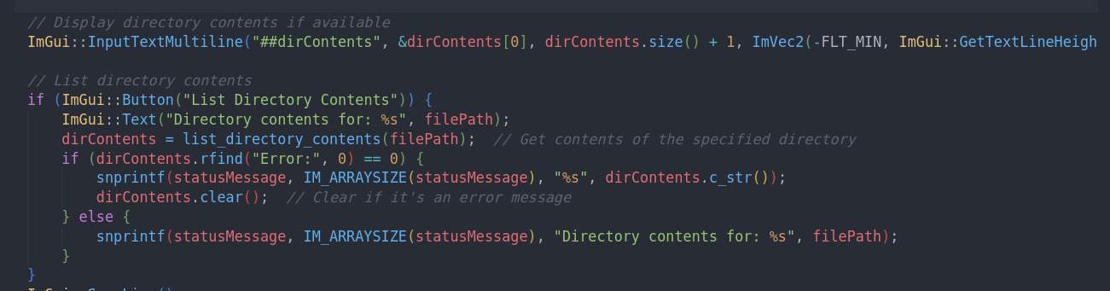
List Directory

Slide 16
main.cpp
Sets up the graphical interface using Dear ImGui:
Includes libraries for GUI functionality (imgui.h, etc.)
Provides an interactive GUI for file system operations:
Creating files
Deleting files
Reading files
Listing directory contents
Updates status messages for user feedback.

Slide 17
makefile
Provides build instructions for cross-platform compilation:
Linux: Links GLFW and OpenGL using pkg-config
Defines rules for compiling .cpp files and producing the executable.

Slide 18
Steps To Build And Run The Program
1. Install necessary libraries:
sudo apt update
sudo apt install gcc pkg-config g++ build-essential libglfw3-dev libgl1-mesa-dev libx11-dev libxrandr-dev libxi-dev libxxf86vm-dev libxcursor-dev cmake
2. Clone Dear ImGui repository:
git clone --recursive https://github.com/ocornut/imgui -b docking
3. Build the project:
cd file_system_gui
make
4. Run the GUI interface:
./file_Sys_gui

Slide 19
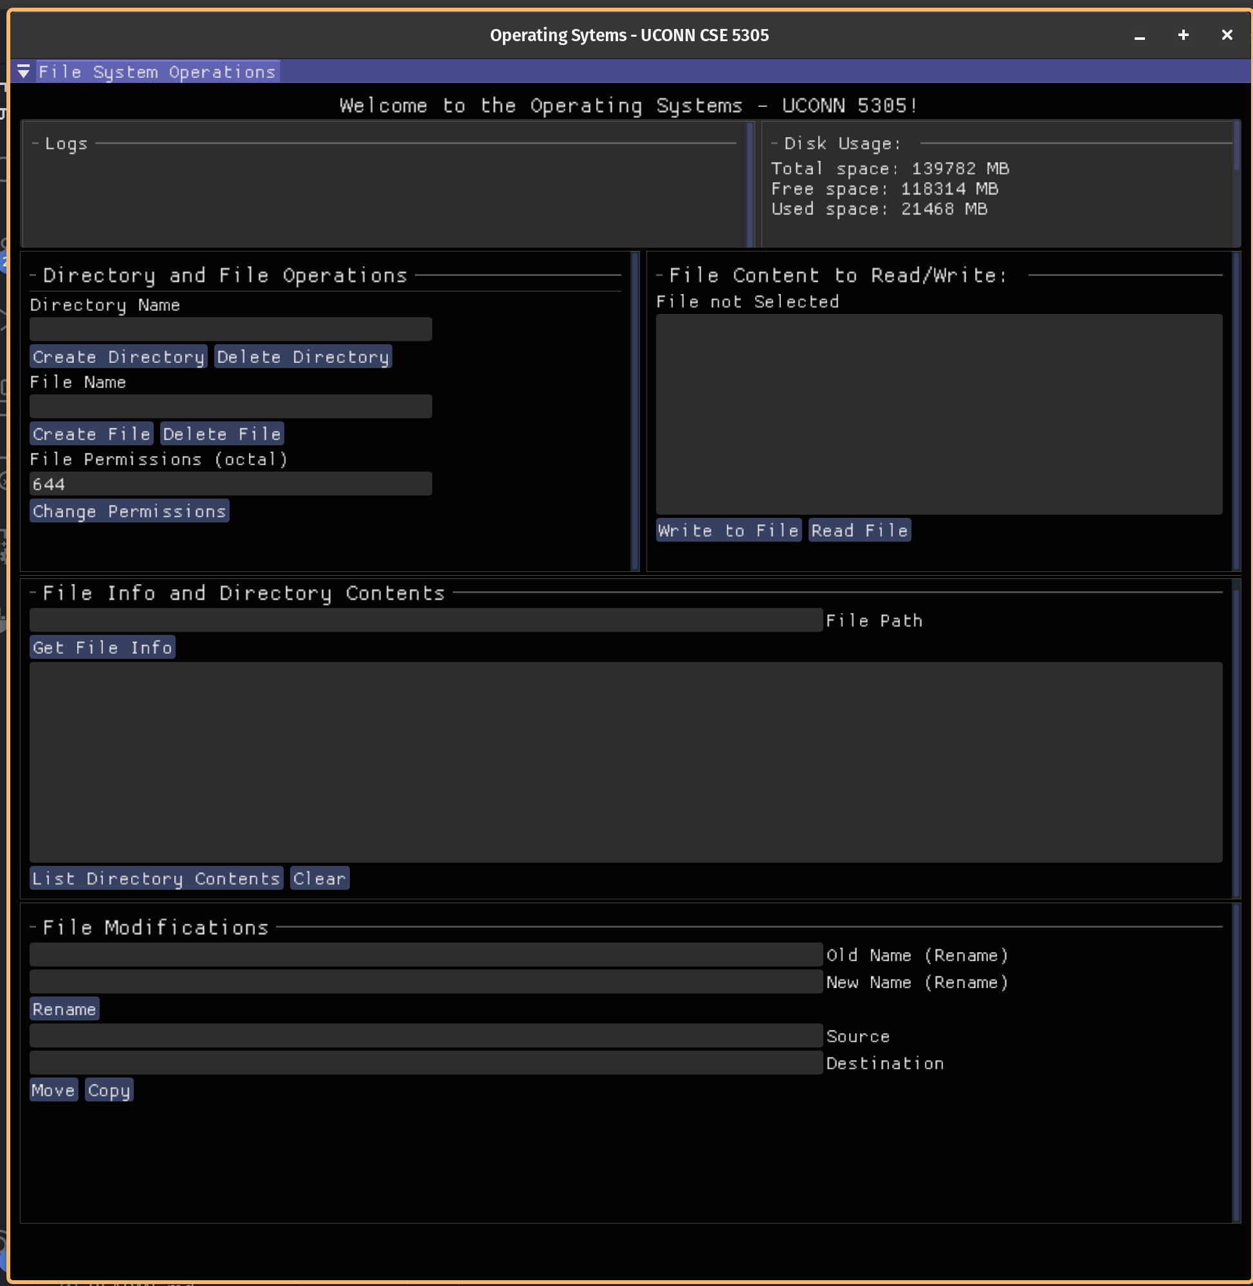
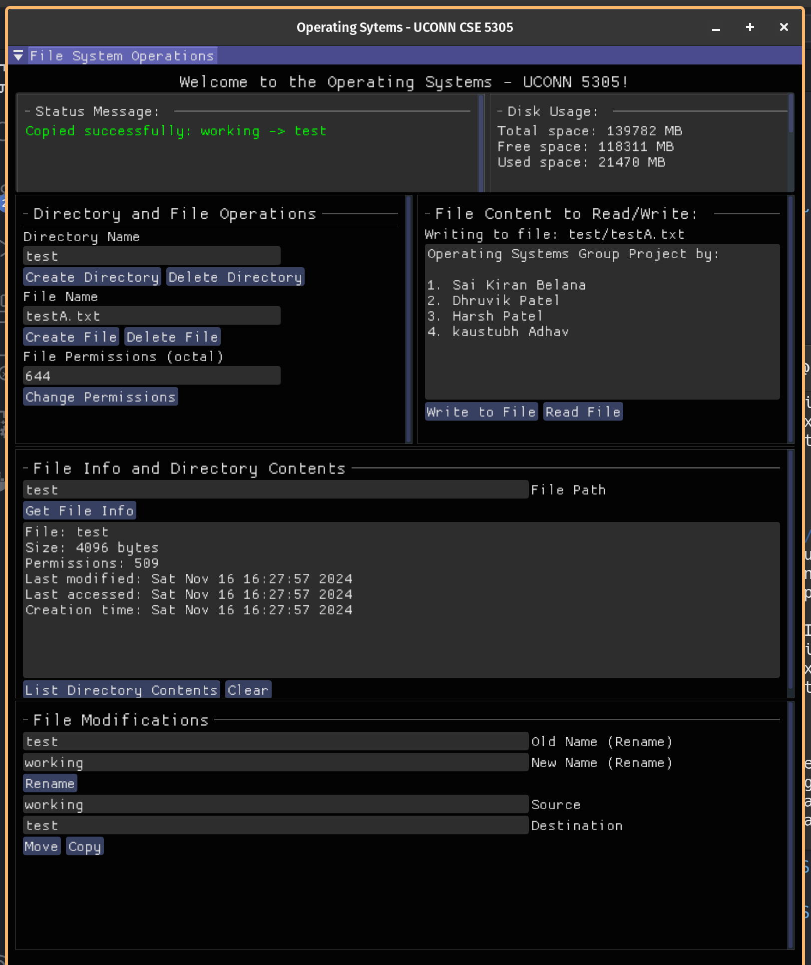
Screenshots

Slide 20
Thank You

