Slide 1


Comparing CPU Schedulers in C
Kyle Madsen Alex Manasoiu Ryan Brown Treven Mckeone

Slide 2

Project Goals
Goal of this project was to compare the performance between various CPU schedulers.
Ability to either select a single scheduler or compare the results of two or more schedulers
Results include the completion time of the list of processes, the average waiting time, and the average turnaround time
Ability to customize 1 or more processes to be used in the schedulers

Slide 3
Implemented Schedulers
First In, First Out (FIFO)
Shortest Job First (SJF)
Longest Job First (LJF)
Round Robin (RR)
Priority Scheduling
Shortest Remaining Time-to-Complete First (SRTCF)
Longest Remaining Time-to-Complete First (LRTCF)

Slide 4
First In, First Out (FIFO)
Otherwise known as First Come, First Serve (FCFS)
Execute the process that came in first
Pros:
Easy to implement
Cons:
Highest average wait time
Simplicity != efficiency

Slide 5
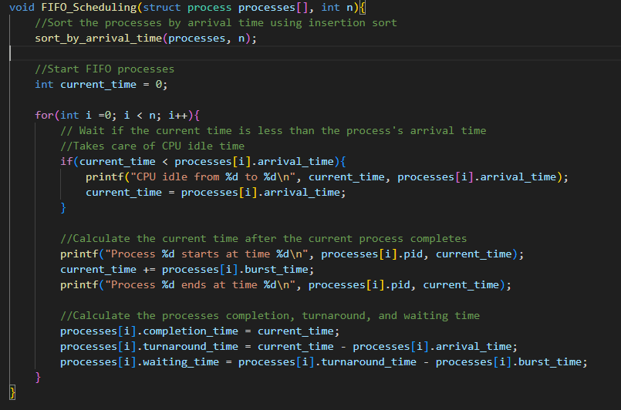
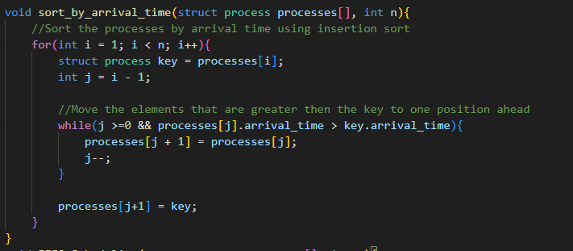
First In First Out

Slide 6
Shortest Job First (SJF)
The process with the shortest CPU burst time is the next to be execute
Defaults to FIFO
Pros:
Shortest average waiting time
Useful for executing a lot of processes
Cons:
Starvation can happen with longer processes
Requires predicting the length of requests
Convoy effect

Slide 7
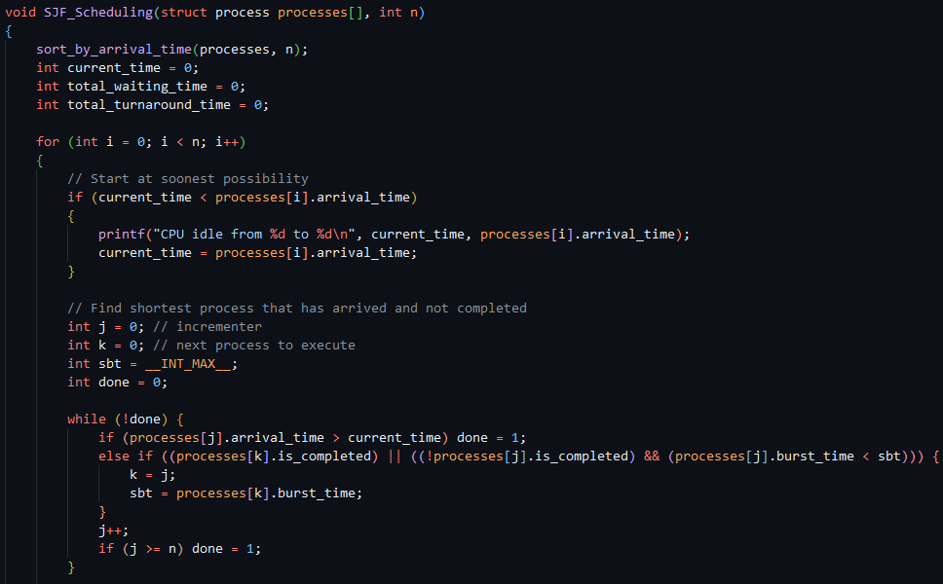
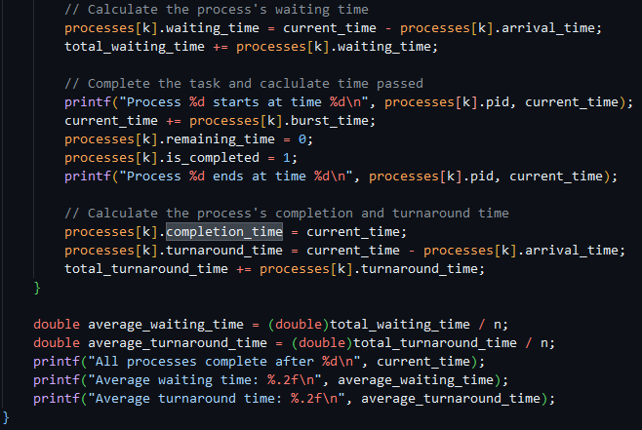
Shortest Job First

Slide 8
Longest Job First (LJF)
The process with the longest CPU burst time is the next to execute
Pros:
Jobs finish closer to each other
Cons:
Incredibly high waiting times
Convoy effect

Slide 9
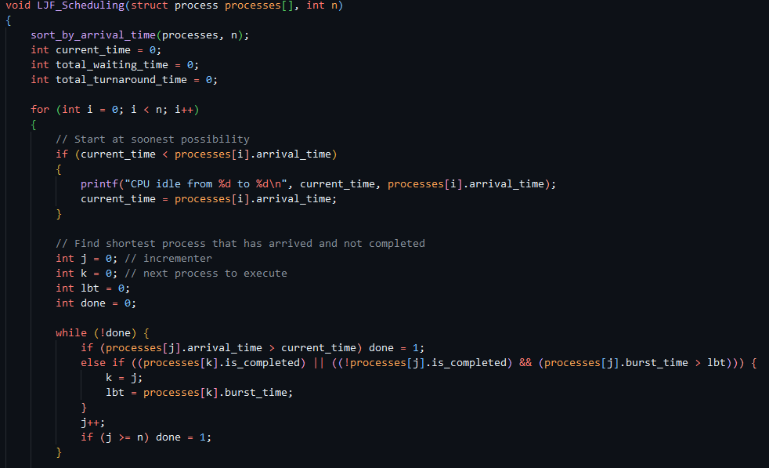
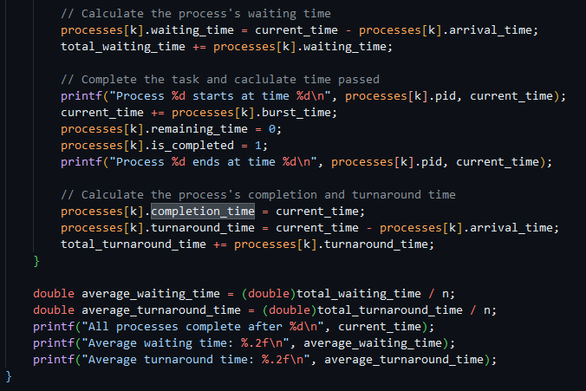
Longest Job First

Slide 10
Round Robin (RR)
Pros:
Fairness
Responsiveness
Simplicity
Predictability
Cons:
High Context
Poor For Long Processes
Time Quantum Sensitivity

Slide 11
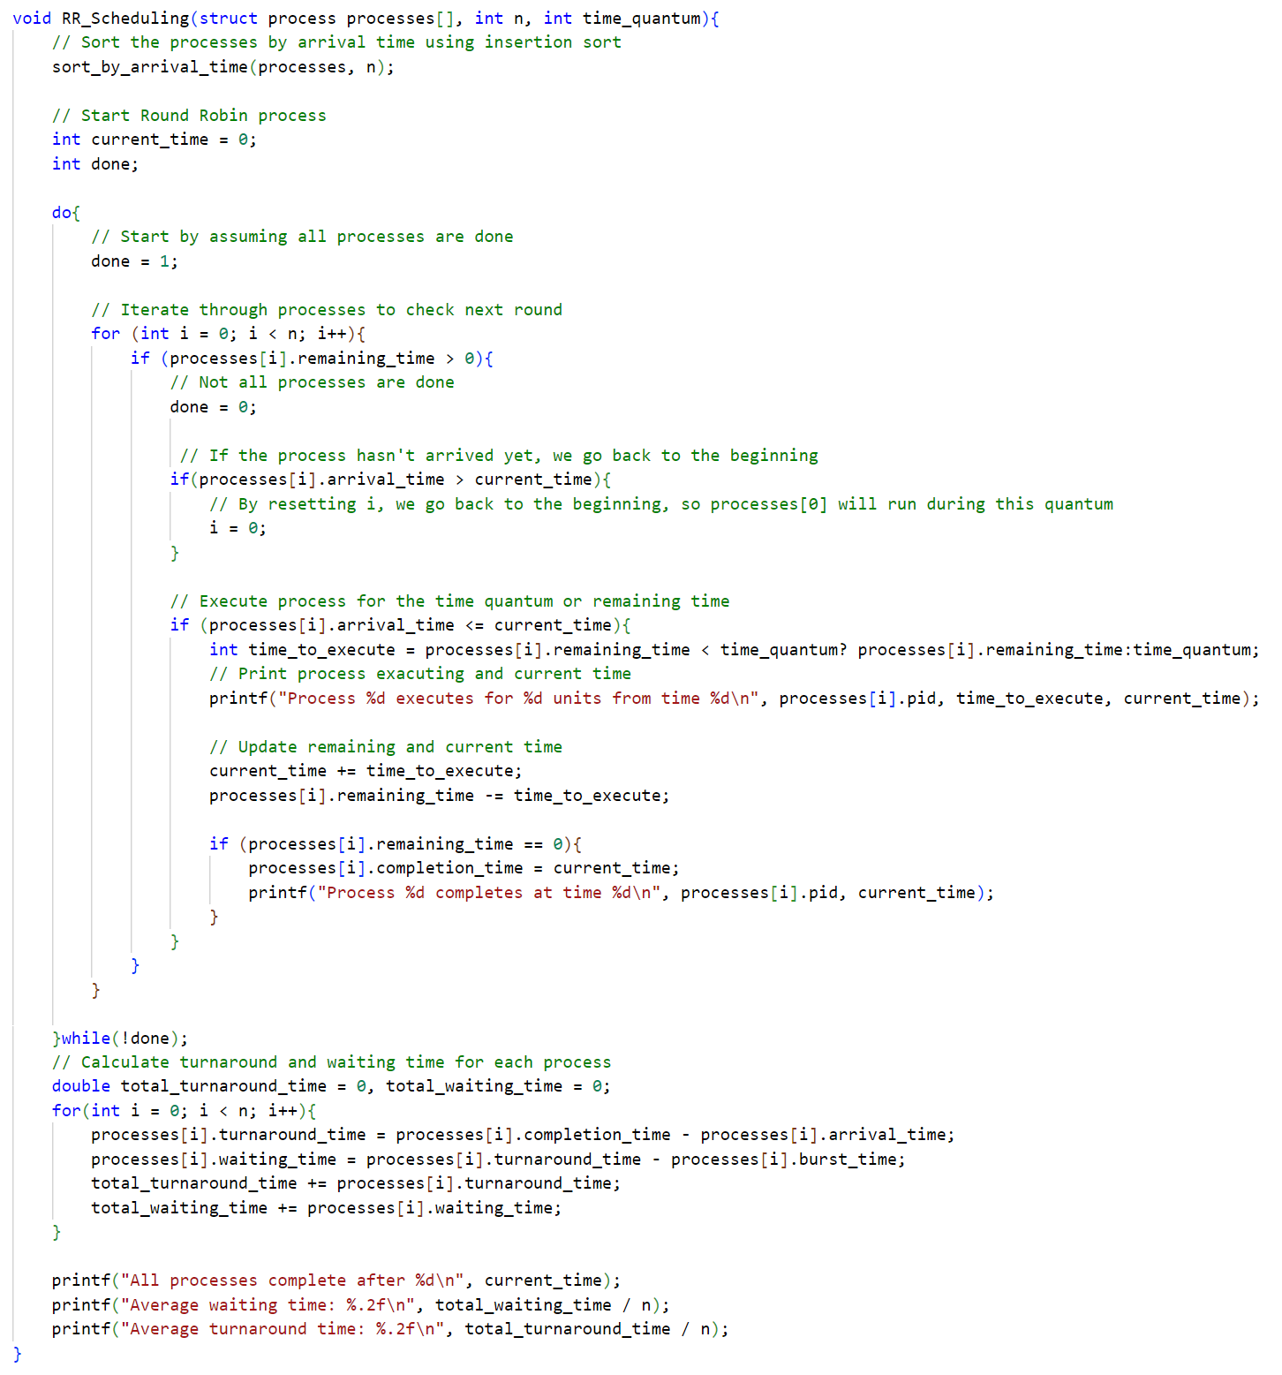
Round Robin

Slide 12
Priority Scheduling
Each process has a priority number
The process with the lowest priority number is executed next
Defaults to FIFO
Pros:
Simple to understand and program
Can have a lower average wait time than FIFO
Cons:
Priority must be assigned before execution
Starvation

Slide 13
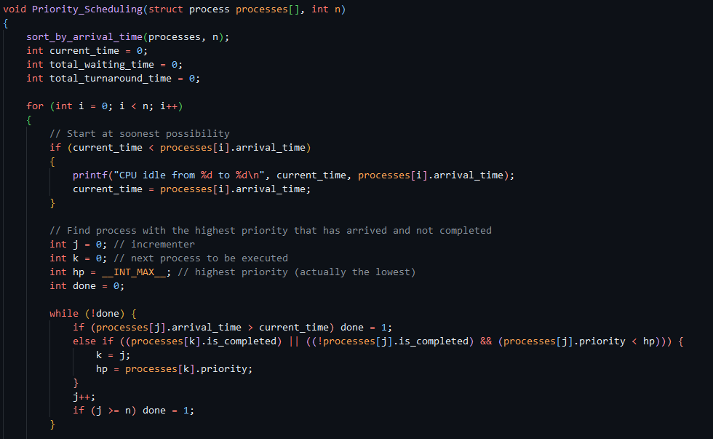
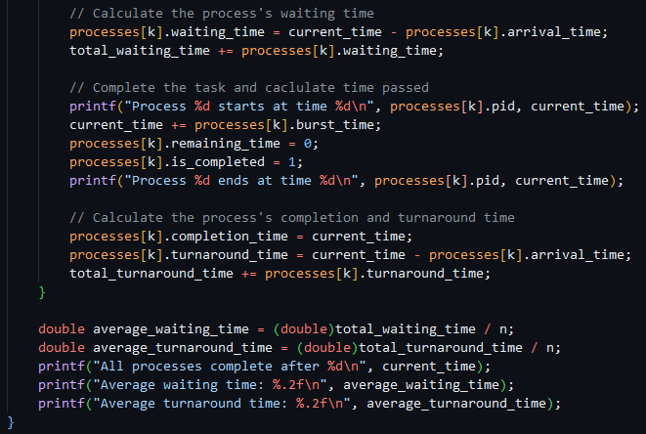
Priority Scheduling

Slide 14
Shortest Remaining Time-to-Complete First (SRTCF)
Prioritizes whichever job has the shortest remaining time until it completes
If a job with a shorter time to completion arrives, the current job will halt and the new job will start running instead
Pros:
Better than SJF in more realistic scenarios, where jobs are arriving at different times
Average waiting and turnaround times are low
Cons:
Need to know the exact burst time of a job
Potential for lots of context switching
Starvation is possible if short jobs keep arriving

Slide 15
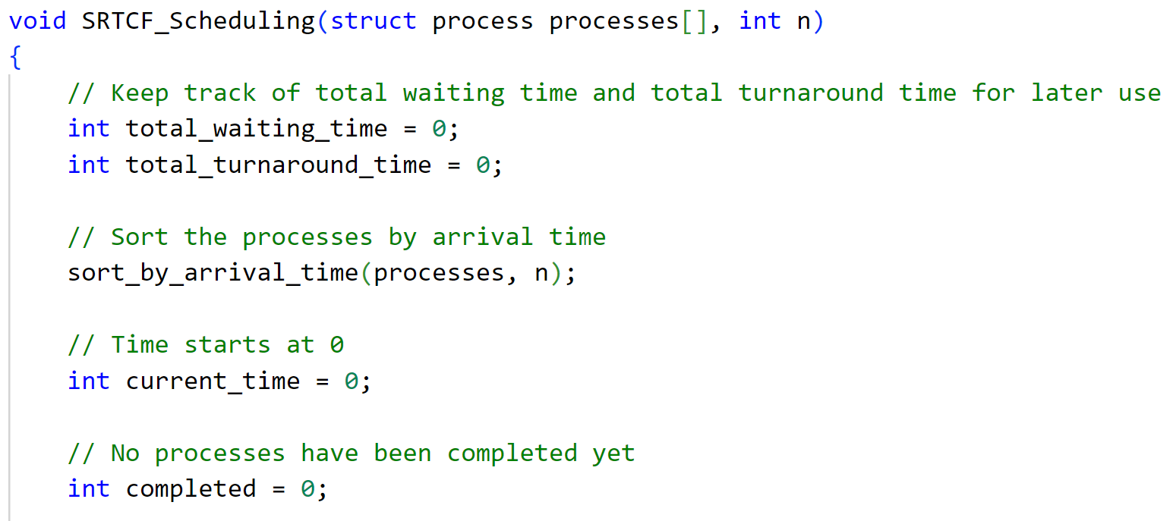
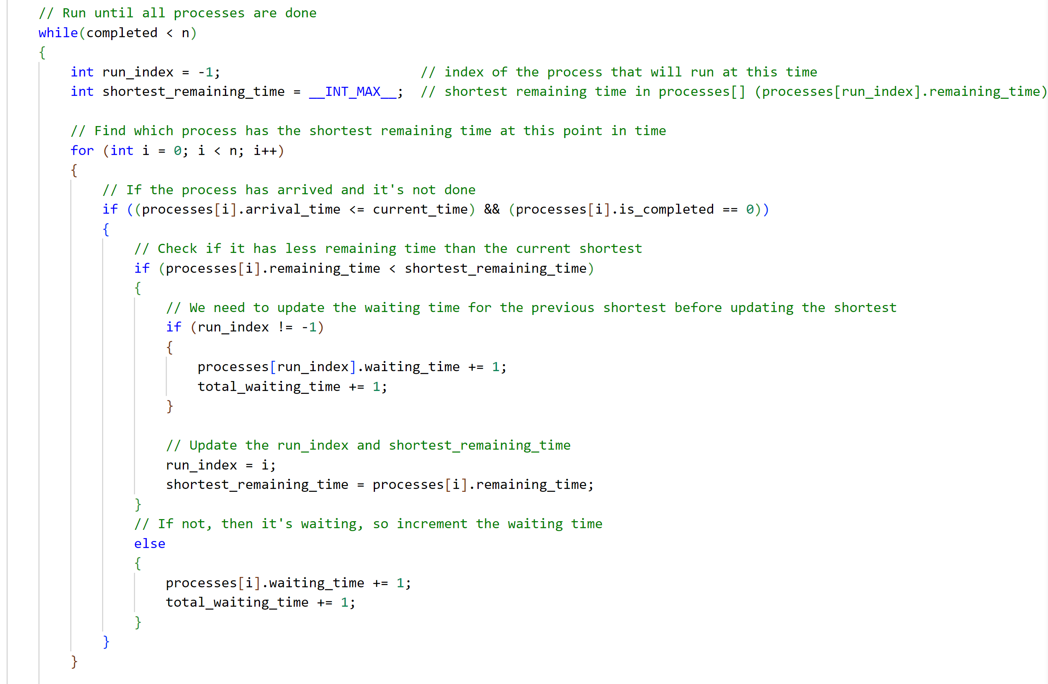
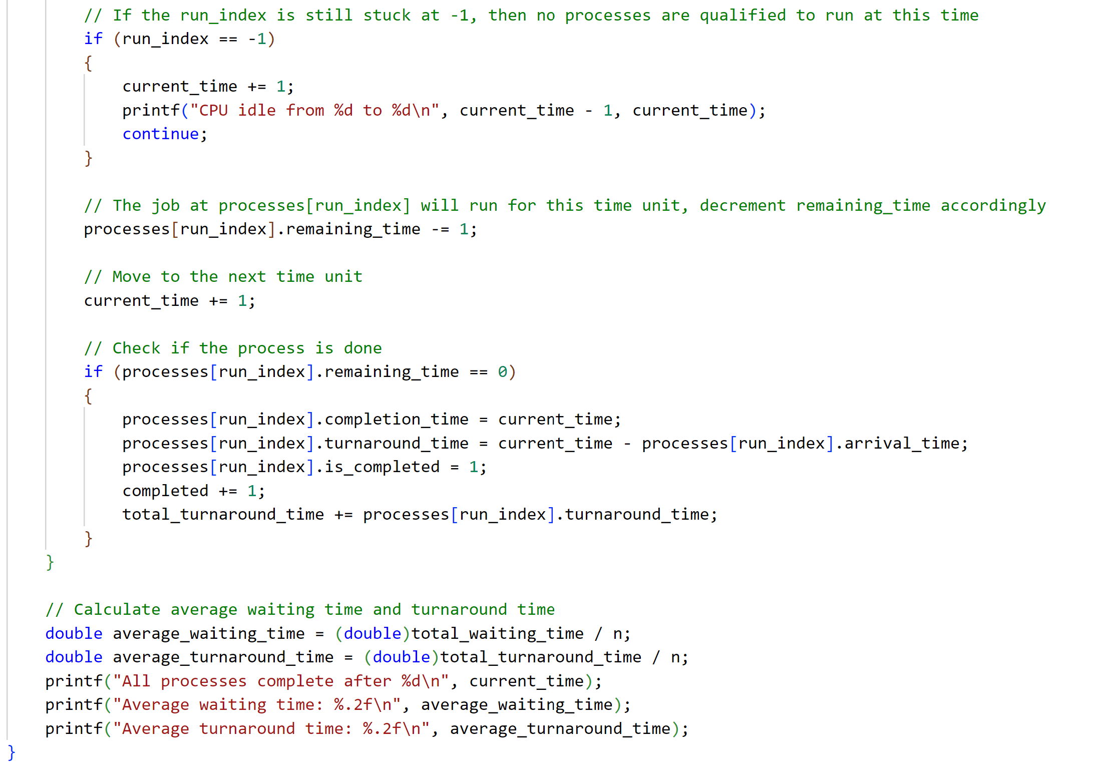
Shortest Remaining Time-to-Complete First

Slide 16
Longest Remaining Time-to-Complete First (LRTCF)
Prioritizes whichever job has the longest remaining time until it completes
If a job with a higher time to completion arrives, the current job will halt and the new job will start running instead
Pros:
All jobs will finish relatively close together
The longest job will always complete first
Cons:
Average waiting and turnaround times are very high
Shorter jobs may be stifled if longer jobs keep arriving

Slide 17
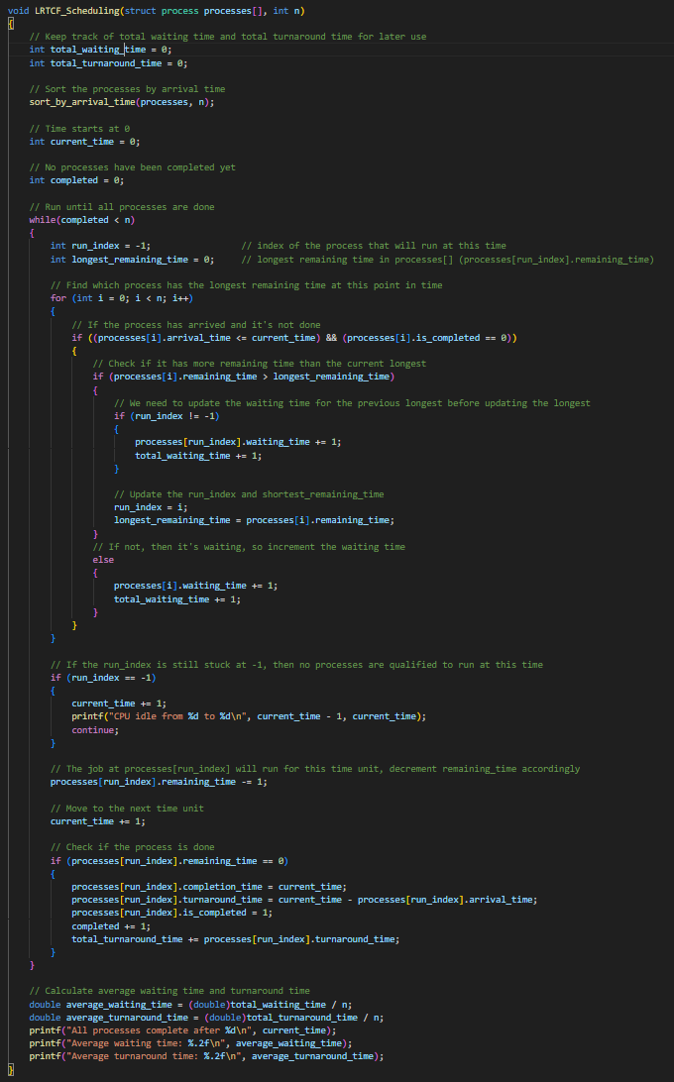
Longest Remaining Time-to-Complete First

Slide 18
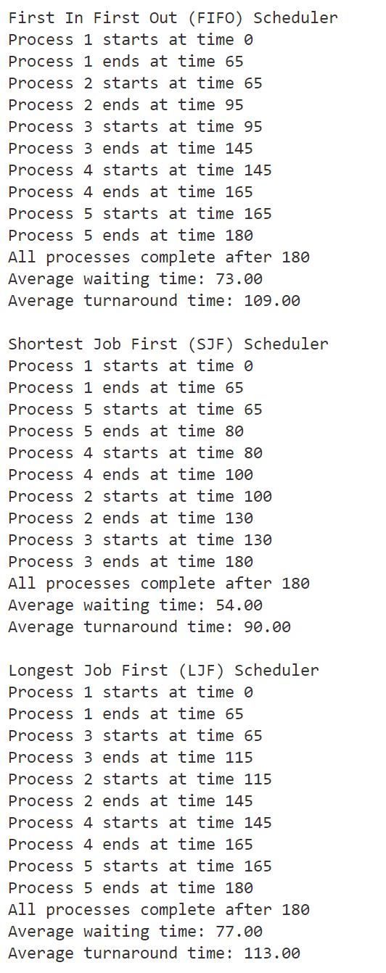
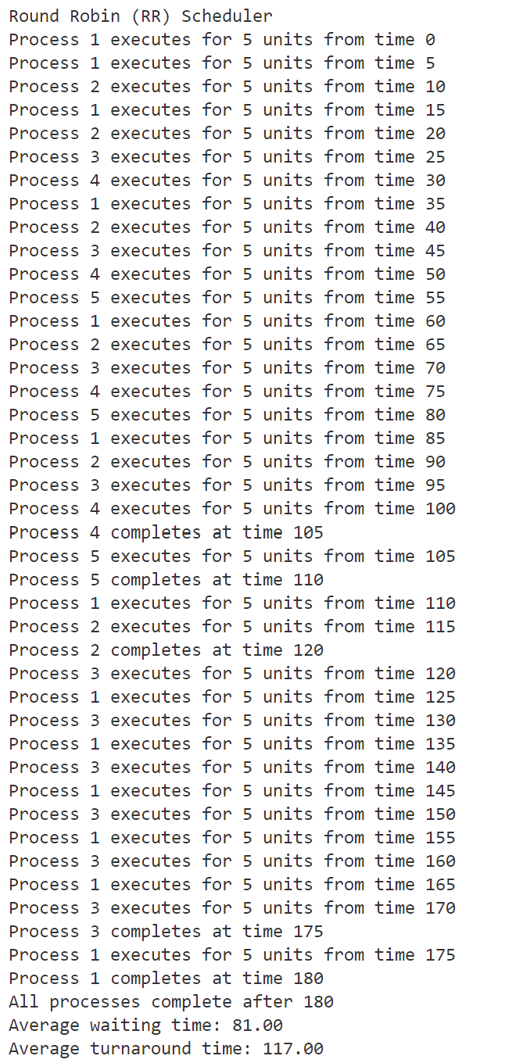
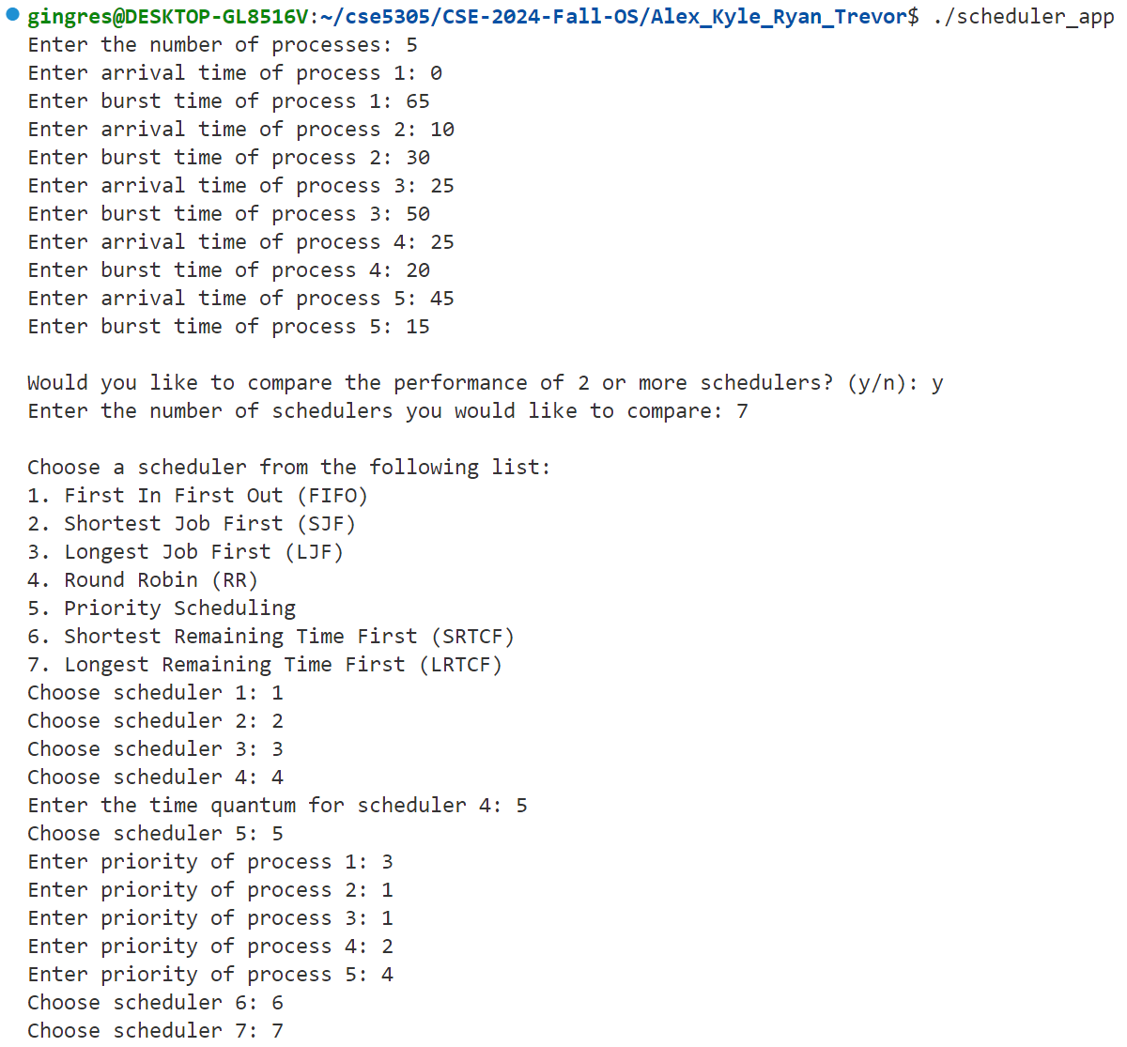
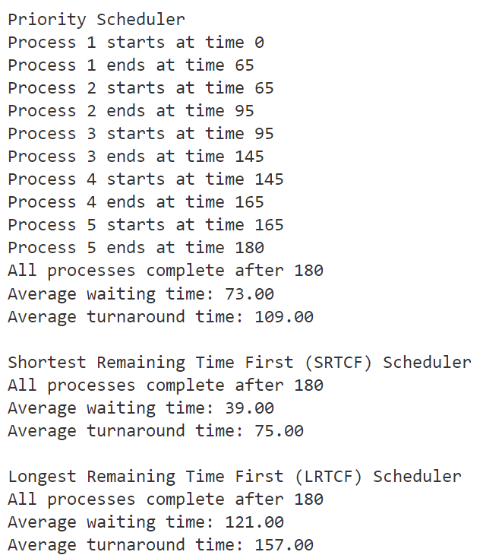
Results

