Slide 1
EVOLUTION OF OPERATING SYSTEM
Kevin Andres Sarmiento – 1152061
Kevin Alexis Eslava - 1152066

Slide 2

UNIX
Unix has evolved over the last 5 decades, shaping modern operating systems, large, complex and long-lived software technologies.
As an operating system, it has left an undeniable mark on the history of computing, while at the same time having greatly influenced the current state of software, network, and hardware engineering.

Slide 3

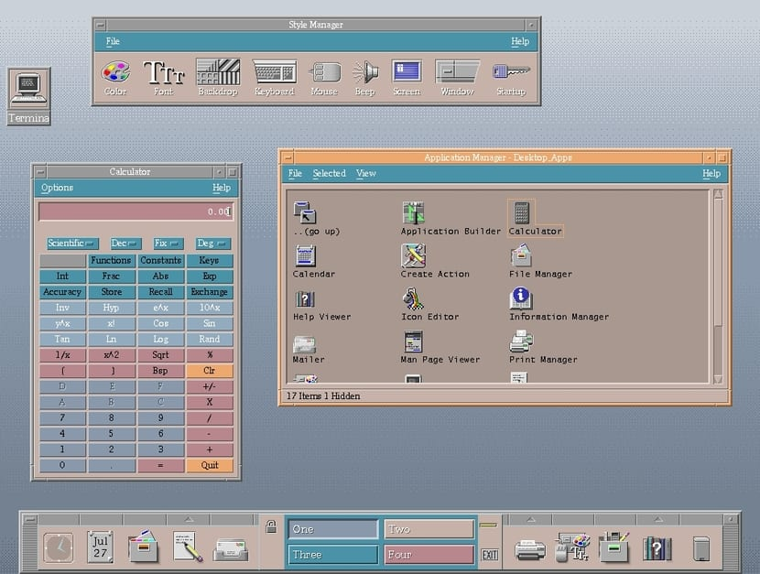
UNIX
It is a timesharing operating system, it controls the resources of a computer and allocates them among the users.

Slide 4
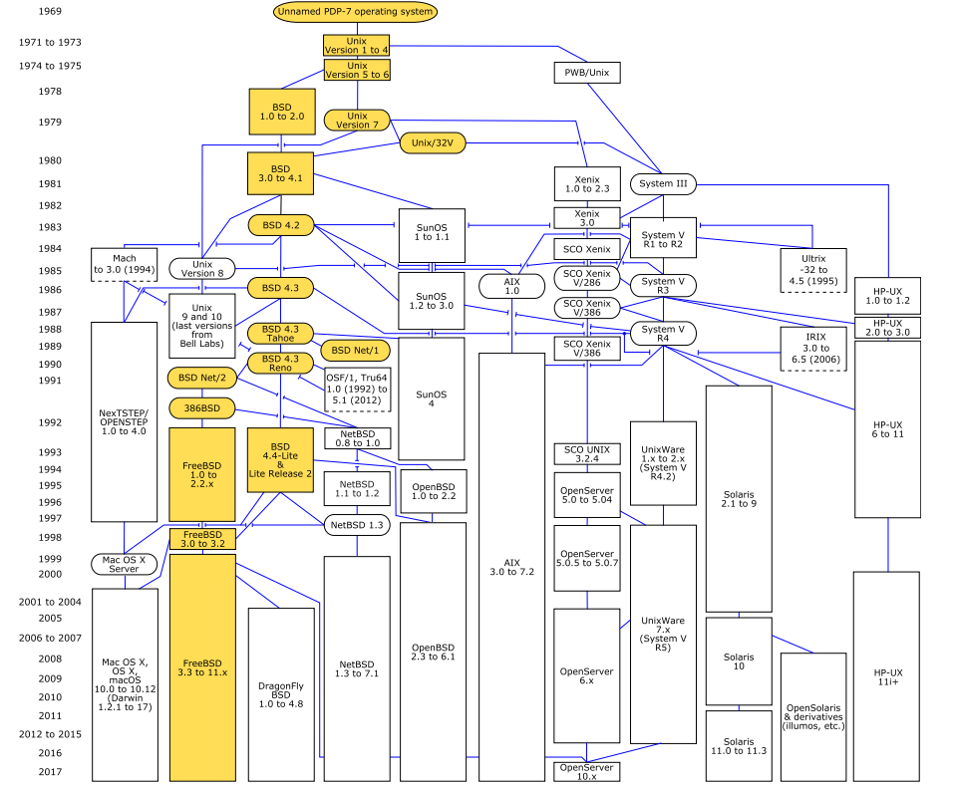
UNIX
Solaris
AIX
HPUX
NetBSD
OpenBSD
FreeBSD

Slide 5
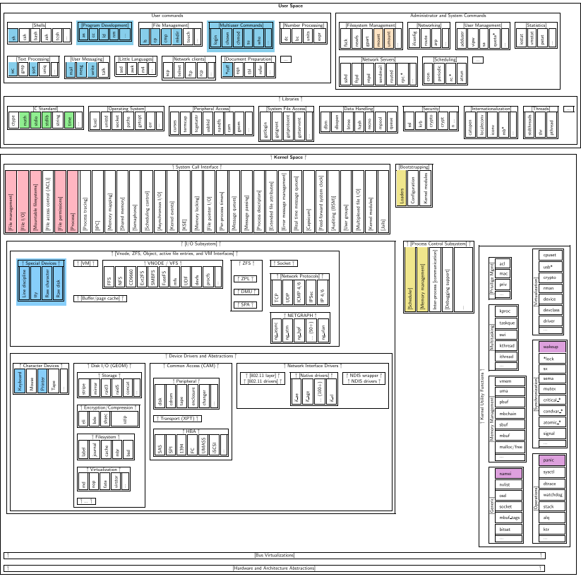
UNIX
The UNIX structure conforms to a typical layer model, so that each layer can only communicate with the layers that are immediately below and above it.

Slide 6
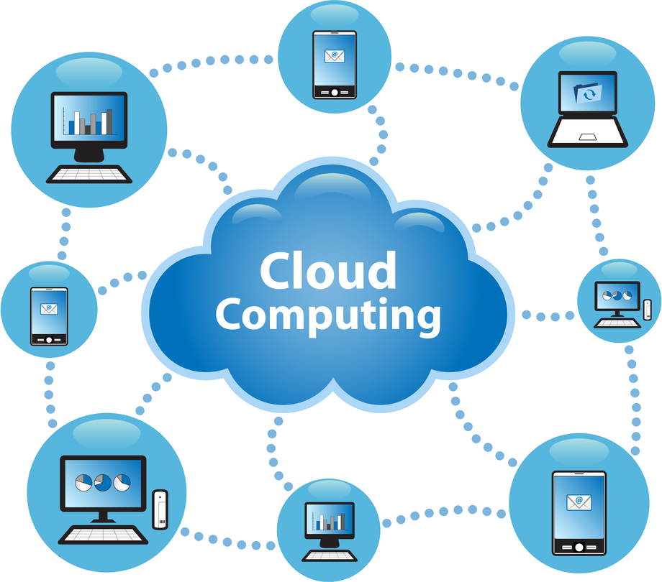
CLOUD OPERATING SYSTEM
The cloud operating system (cloud OS) is used for managing the cloud resources such that they can be used
effectively and efficiently.
And also it is the duty of cloud OS to provide convenient interface for users and applications.

Slide 7

CLOUD OPERATING SYSTEM
Improve the performance and efficiency of the computing resources used, never waste the computing power provided.
Improve user experiences, improve programming interfaces.
- Amazon AWS
- Google GAE
- Microsoft Azure
- Alibaba Cloud

Slide 8
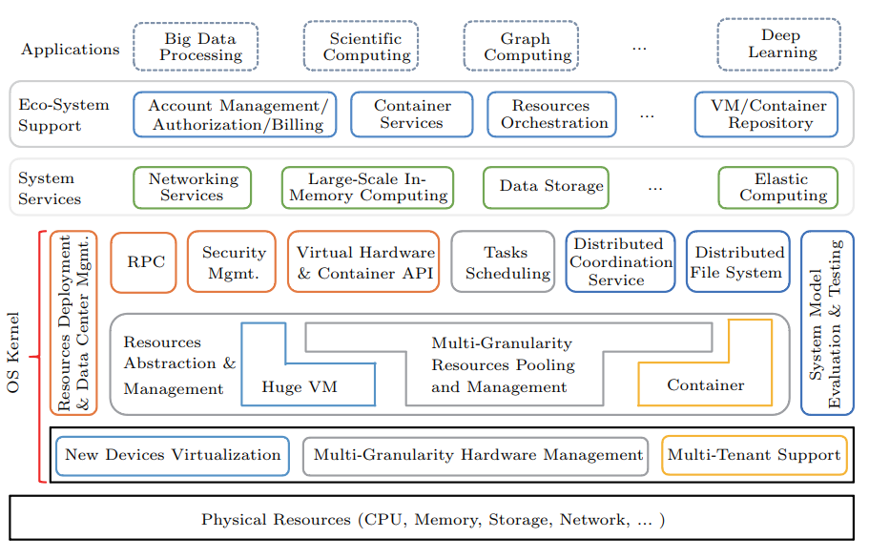
CLOUD OPERATING SYSTEM
Architecture of the cloud OS.

Slide 9

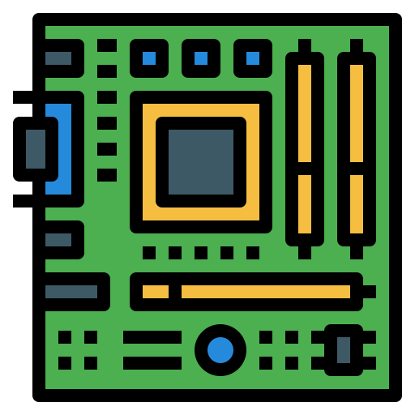
iOS
iOS is a single-user operating system, that is, it can serve a single user.
Both the operating system and the final product are produced by Apple, therefore you cannot make an iOS operating system work on a different device, since there is no license for installing the iOS operating system on hardware devices.
https://www.flaticon.es/icono-gratis/programador_560277?term=usuario&page=1&position=4&origin=tag&related_id=560277
https://www.flaticon.es/icono-gratis/tarjeta-madre_2729156?term=hardware&page=1&position=5&origin=search&related_id=2729156

Slide 10
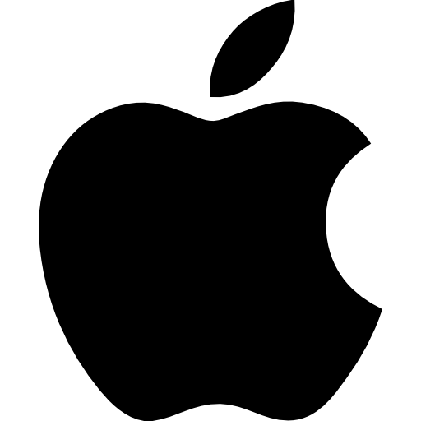

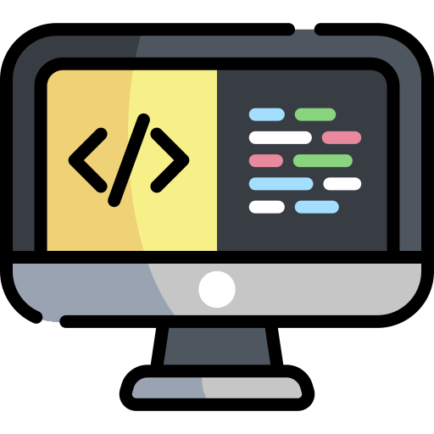
iOS
It can only be installed on Apple devices.
Do not provide your source code to other users
Each app is a separate shell, it only affects itself.
https://www.flaticon.es/icono-gratis/tortuga_5218843?term=tortuga&page=1&position=17&origin=search&related_id=5218843
https://www.flaticon.es/icono-gratis/logotipo-de-apple_747?term=apple&page=1&position=1&origin=search&related_id=747
https://www.flaticon.es/icono-gratis/codigo_1903496?term=c%C3%B3digo&page=1&position=7&origin=search&related_id=1903496

Slide 11
iOS
1976 - Beginnings of the operating system, Steve Jobs, Steve Wozniak, Ronald Wayne.
1984 - Macintosh- Introduced by Steve Jobs - computer that changes people's vision forever.
2007 - iPhone: runs on 'iPhone OS'
2014 - iOS 8 is the successor to the iOS 7 operating system
12 March 2015 - iOS 8.3 Beta 3
1977 - Apple I (designed by Wozniak) and Apple II First Apple product.
2001 - Mac OS X, it was slow and lacking some important features with hardly any software, the second version 10.1.
2010 - iOS successor to iPhone OS 1.
9 March 2015 - Update to iOS 8.2

Slide 12
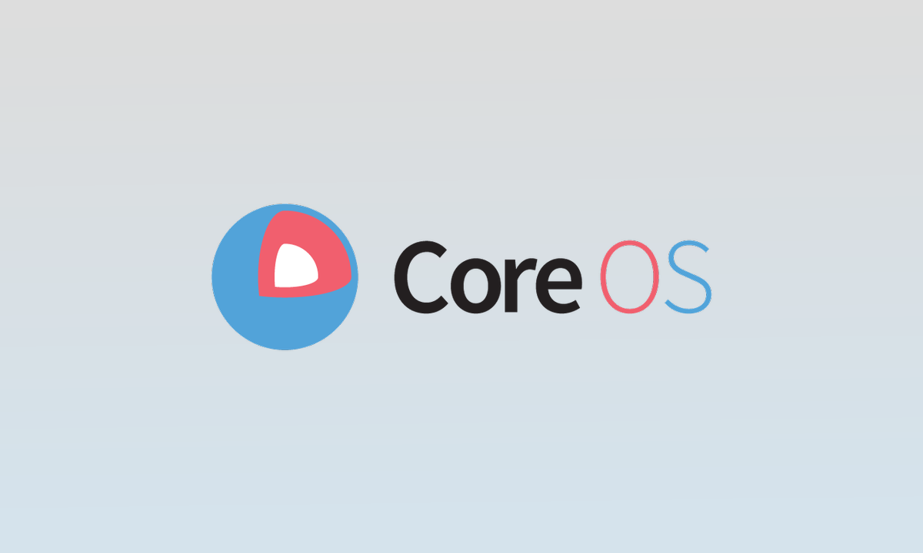
iOS
Core OS(kernel) of the operating system, core services, media and user interface.
The Core OS level contains a kernel system, file manager, security system, and a number of device drivers, etc.
Core OS is the closest to hardware with a multitasking UNIX kernel.
The kernel of the iOS operating system is called XNU and is a Darwin kernel.
https://www.muylinux.com/2020/02/06/red-hat-fin-ciclo-coreos-container-linux/

Slide 13
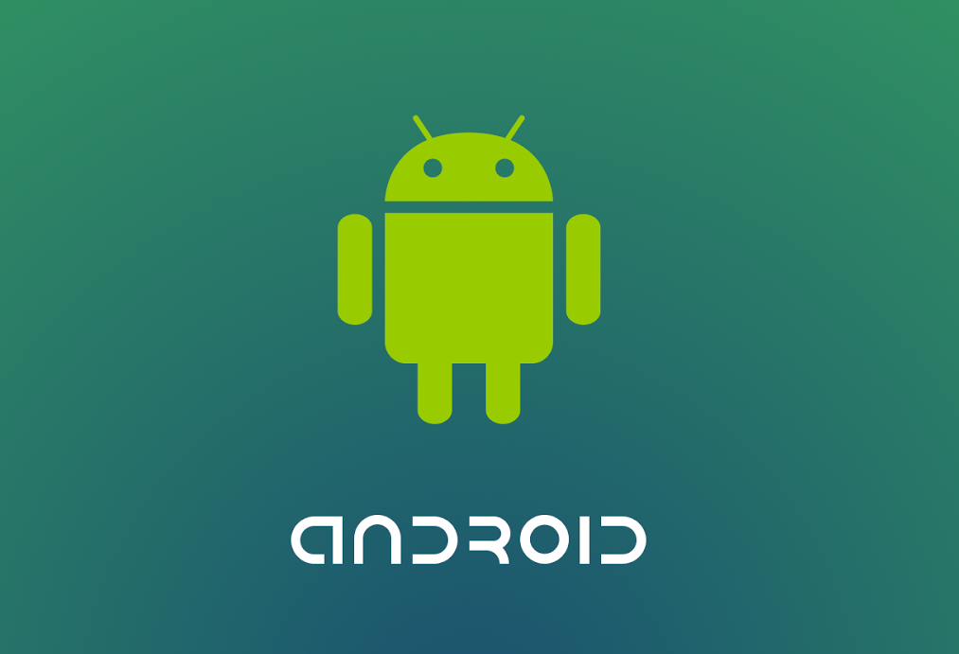
The Android Operating System
The Android operating system and its video call services show how this operating system is different from others: it is based on Linux and may be considered a variant of embedded Linux
Android is a single-user operating system developed by Google, based on Linux Kernel 2.5 and other open source software.
https://blog.personal.com.py/android-culmina-el-2018-como-el-sistema-operativo-mas-utilizado/

Slide 14
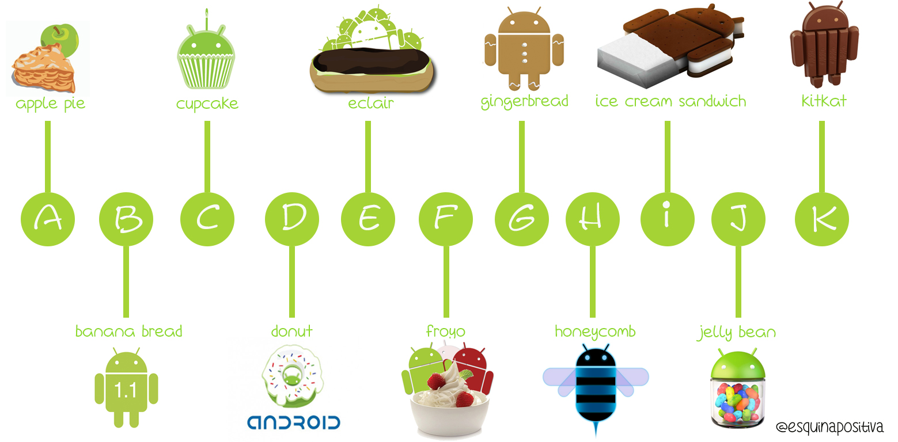
The Android Operating System
Alfa (1.0)
Beta (1.1)
Cupcake (1.5)
Donut (1.6)
Éclair (2.0-2.1)
Frozen Yogurt "Froyo" (2.2-2.2.3)
Gingerbread (2.3-2.3.7)
Honeycomb (3.0-3.2.6)
Ice Cream Sandwich (4.0-4.0.4)
Jelly Bean (4.1-4.3.1)
KitKat (4.4-4.4.4, 4.4W-4.4W.2)
Lollipop (5.0-5.1)

Slide 15
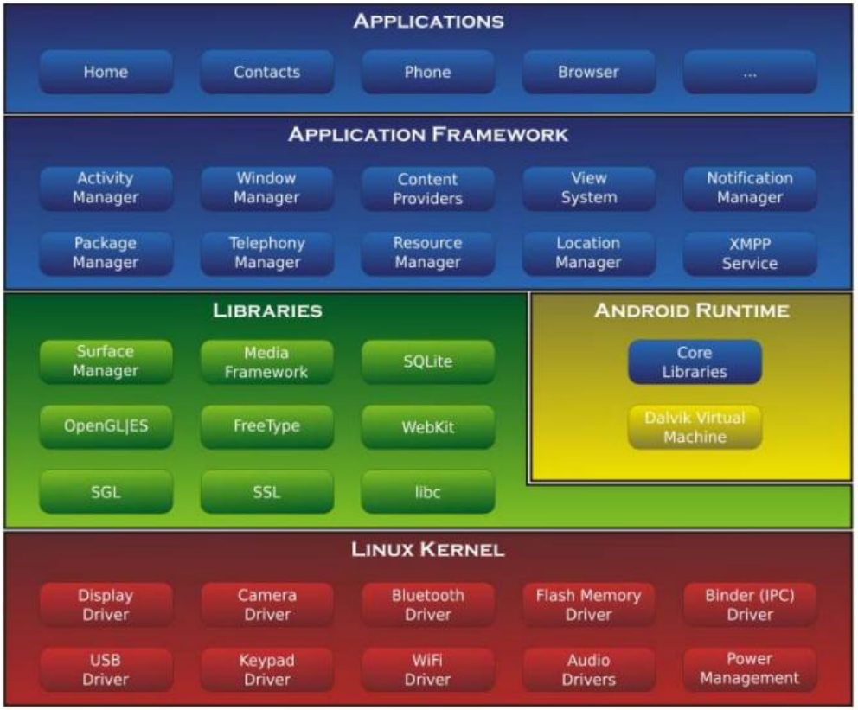
The Android Operating System
Linux is just part of this architecture, and is placed at the lowest level. As in the case of the OS from Apple, we do not see the Android OS as a Linux operating system, and thus most developers do not have access at this level
From the point of view of its developer, the Android OS has a Kinux kernel, based on Java (with Eclipse plugin); it has its own Google virtual machine, called Dalvik, and the Linux features are not accessible to users.

