Slide 1
EVOLUTION OF OPERATING SYSTEM
Kevin Andres Sarmiento – 1152061
Kevin Alexis Eslava - 1152066

Slide 2

UNIX
Unix has evolved over the last 5 decades, shaping modern operating systems, large, complex and long-lived software technologies.
As an operating system, it has left an undeniable mark on the history of computing, while at the same time having greatly influenced the current state of software, network, and hardware engineering.

Slide 3

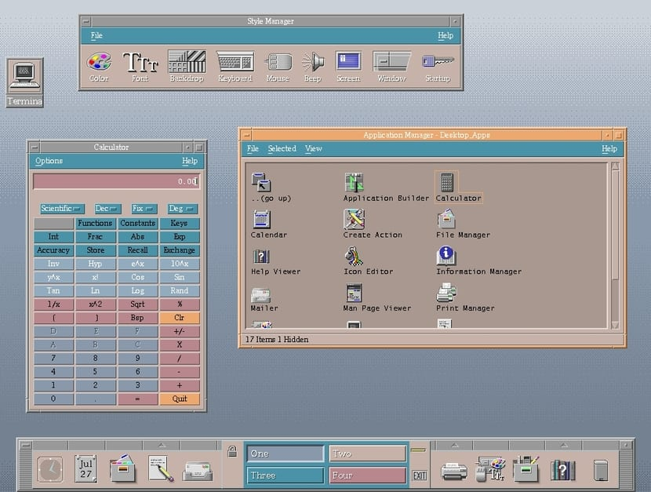
UNIX
It is a timesharing operating system, it controls the resources of a computer and allocates them among the users.

Slide 4
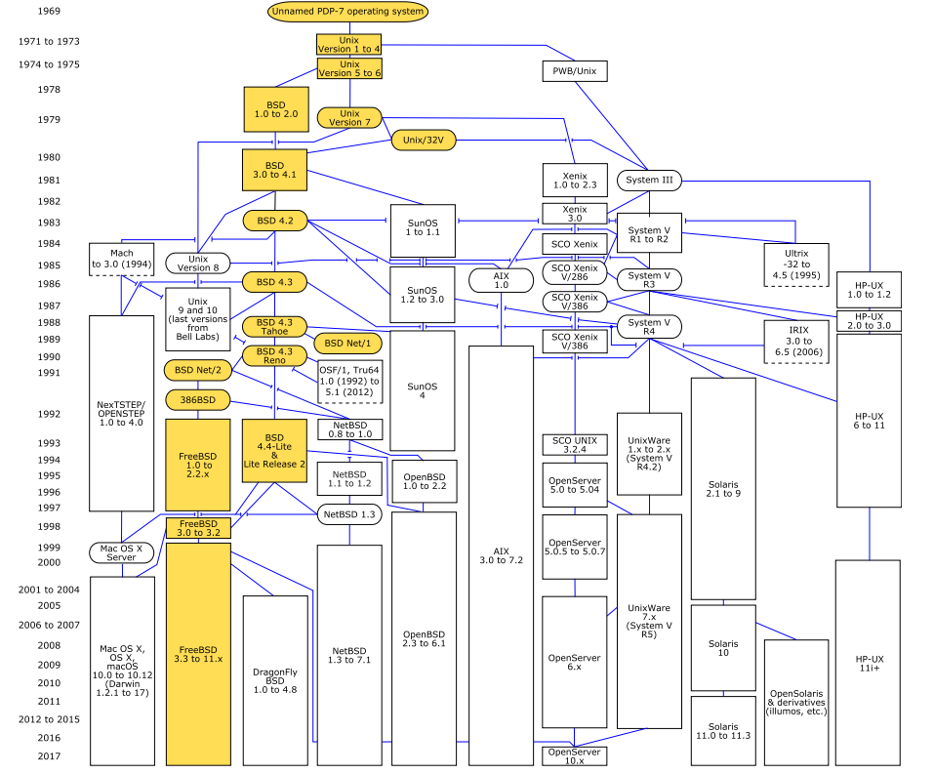
UNIX
Solaris
AIX
HPUX
NetBSD
OpenBSD
FreeBSD

Slide 5
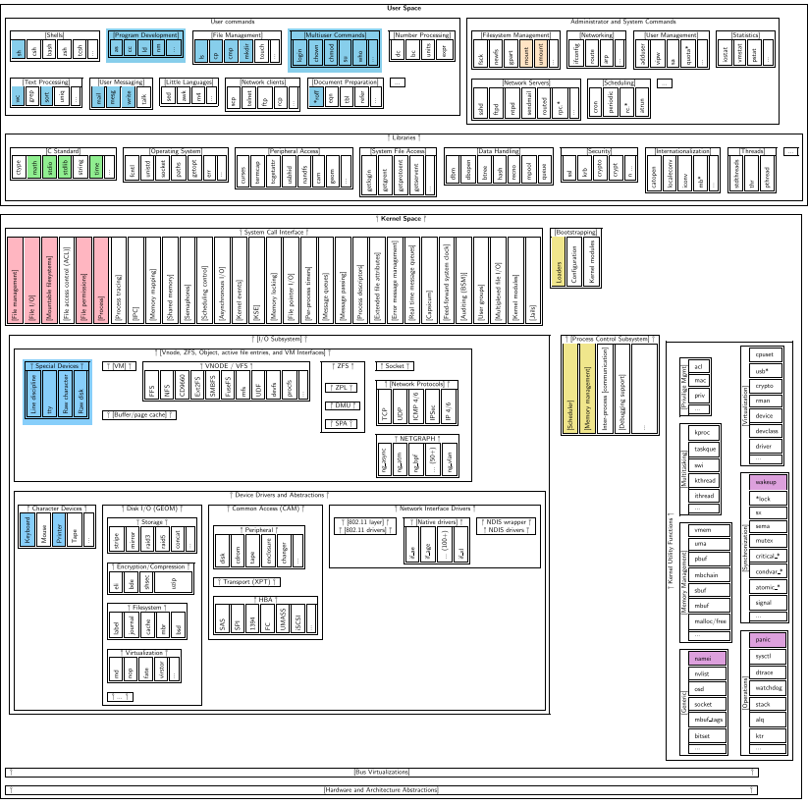
UNIX
The UNIX structure conforms to a typical layer model, so that each layer can only communicate with the layers that are immediately below and above it.

Slide 6

CLOUD OPERATING SYSTEM
The cloud operating system (cloud OS) is used for managing the cloud resources such that they can be used
effectively and efficiently.
And also it is the duty of cloud OS to provide convenient interface for users and applications.

Slide 7

UNIX
Improve the performance and efficiency of the computing resources used, never waste the computing power provided.
Improve user experiences, improve programming interfaces.
- Amazon AWS
- Google GAE
- Microsoft Azure
- Alibaba Cloud

Slide 8
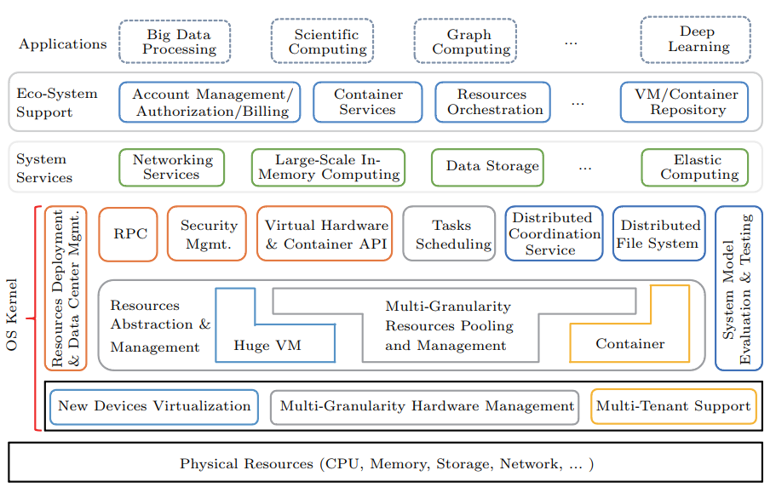
UNIX
Architecture of the cloud OS.

