Slide 1
Cloud computing: chat with node.js
Philipp Bahnmüller
Kevin Schrötter

Slide 2
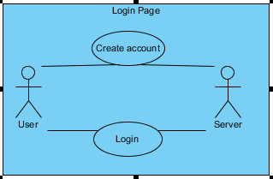
Use case diagrams

Slide 3
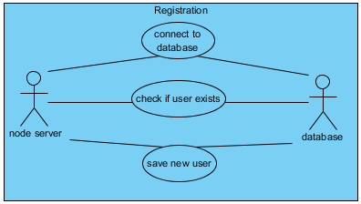
Use case diagrams

Slide 4
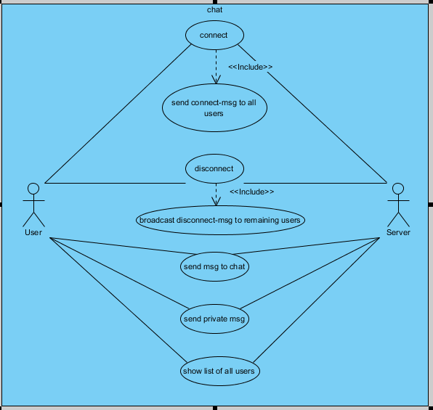
Use case diagrams

Slide 5
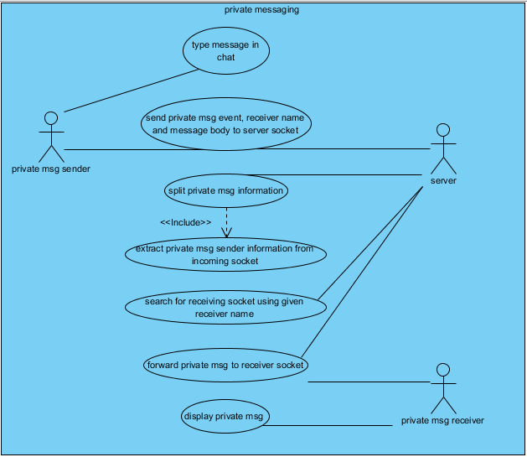
Use case diagrams

Slide 6
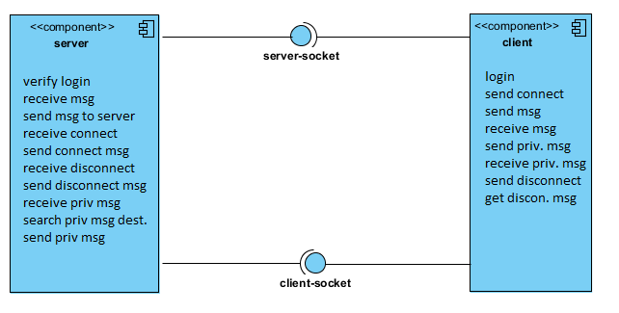
Component diagram

Slide 7
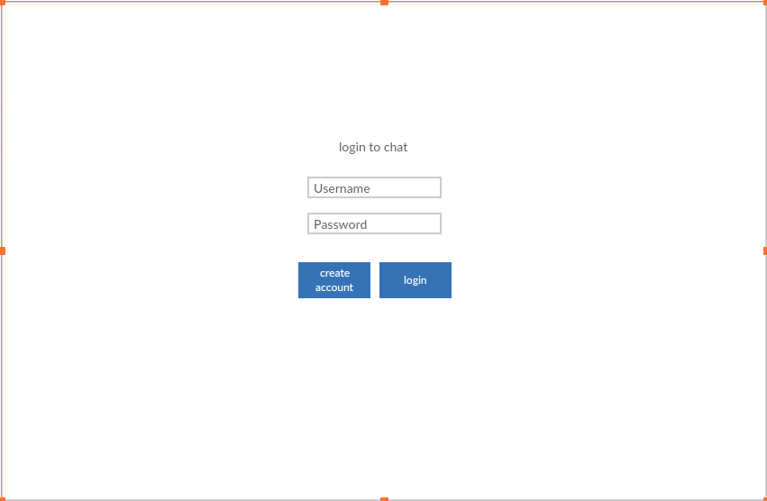
Mockup login

Slide 8
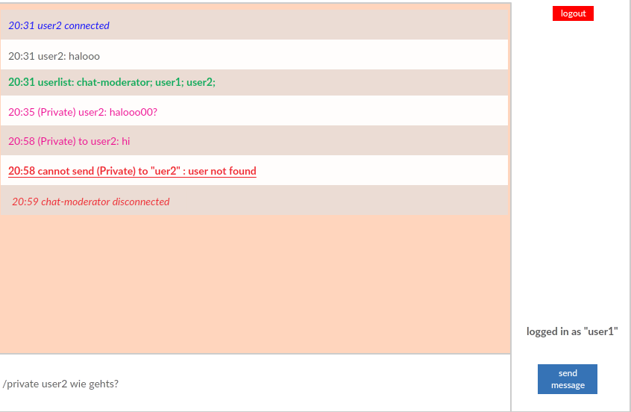
Mockup login

Slide 9
Lessons learnt
Express static folder for loading local files on the client side
Add properties to existing objects
Socket: disconnect immediately closes socket for the client side
Socket changes when changing html page
Loops are not asynchronous

Slide 10
Live Demo

