Slide 1


FriendsTrackerWorldwide FTW
Philipp Bahnmueller
Felix Rosa
Kevin Schroetter

Slide 2
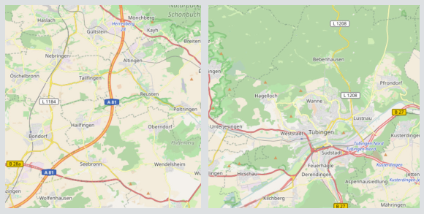
First thoughts
Use Mobile Device GPS-Data and internet
Draw GPS-Location on a Map
Have a friendlist for sharing locations
Add friends using friend requests
Place personal markers on a map
Calculate distances between GPS-Locations
FTW: Philipp Bahnmueller, Felix Rosa, Kevin Schroetter

Slide 3
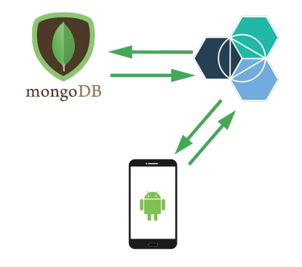
Components
MongoDB Database
Save User and Marker information
Access through internet
FTW Application
Interact with the Map
Manage Friends and Markers
FTW Restful API
Communication between APP and DB
FTW: Philipp Bahnmueller, Felix Rosa, Kevin Schroetter

Slide 4
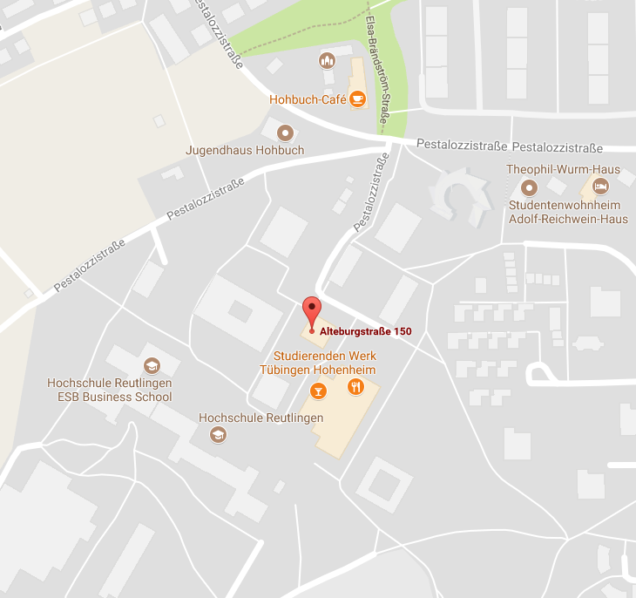
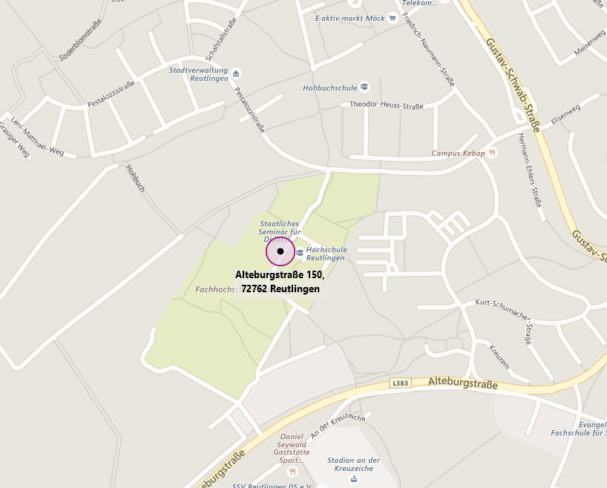
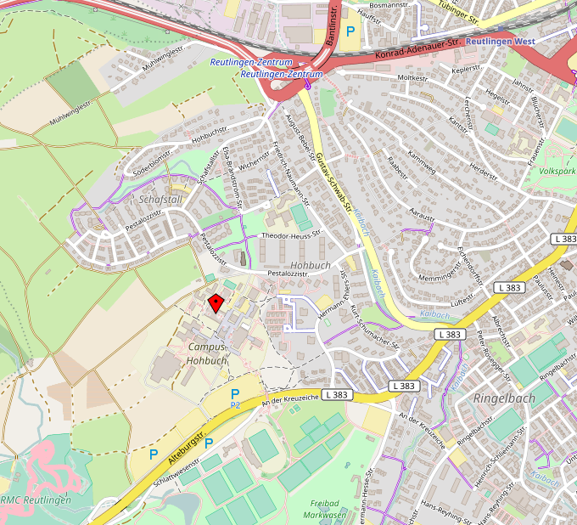
Map APIs
Google Maps
2500 requests free
Android standard map
Google commercials
Bing Maps
No free model
OpenStreetMap
Completely free
Custom map
No commercial
Open source
FTW: Philipp Bahnmueller, Felix Rosa, Kevin Schroetter

Slide 5
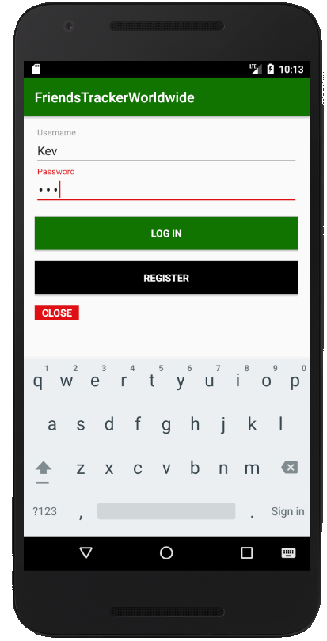
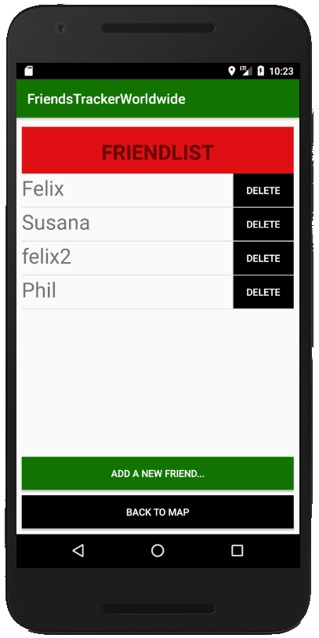
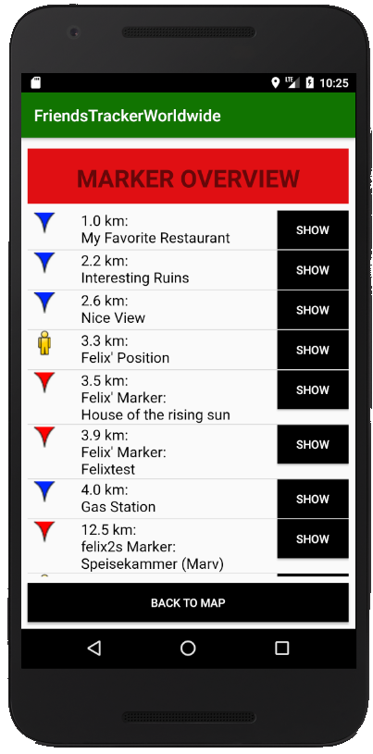
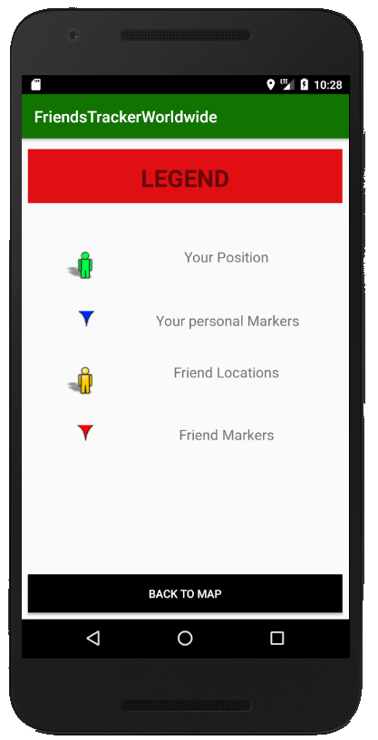
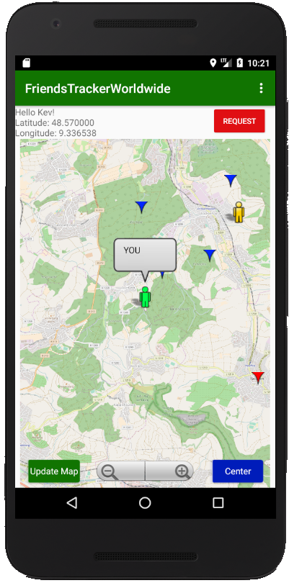
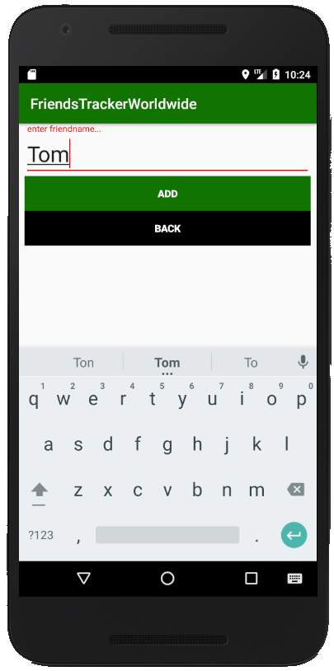
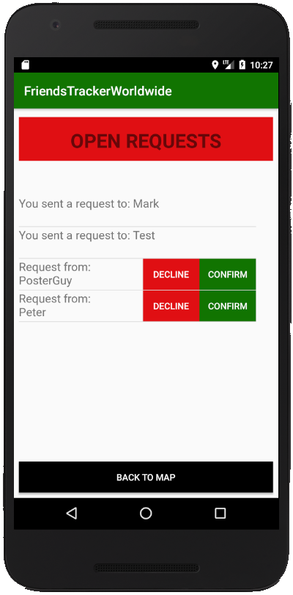
Activities
R E Q U E S T S
M A P
A D D
L O G I N
F R I E N D S
D I S T A N C E
L E G E N D
FTW: Philipp Bahnmueller, Felix Rosa, Kevin Schroetter

Slide 6
Activities - LoginActivity
Enter user with validation check
Enter password with validation check
LOG IN through API
REGISTER through API
CLOSE for closing the Activity
FTW: Philipp Bahnmueller, Felix Rosa, Kevin Schroetter

Slide 7
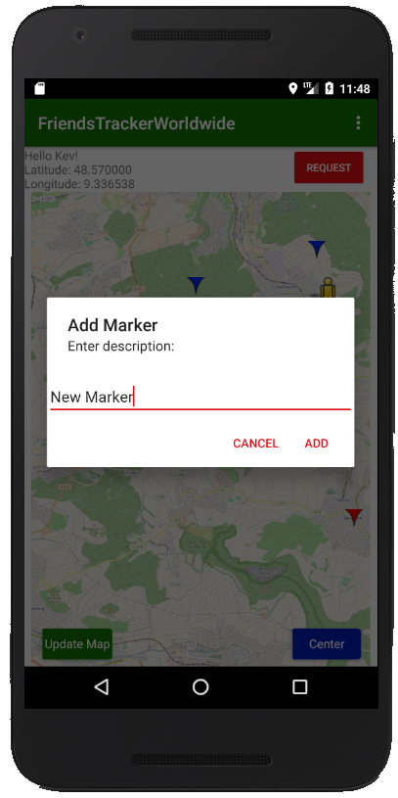
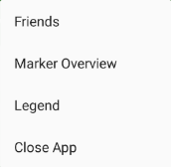



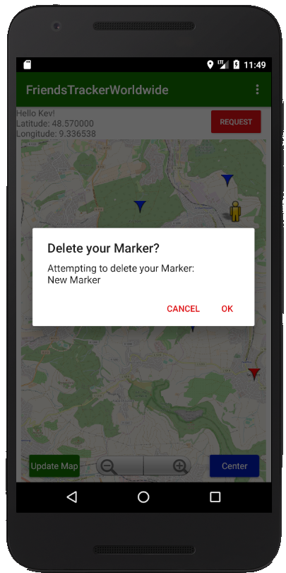
Activities - MainActivity
Refresh your own GPS-Location all 30 seconds
Show Items with Descriptions
Add personal Markers
Delete personal Markers
Update Interface manually
Center Map on your position
Navigate around the Map
Navigate to other activities
FTW: Philipp Bahnmueller, Felix Rosa, Kevin Schroetter

Slide 8
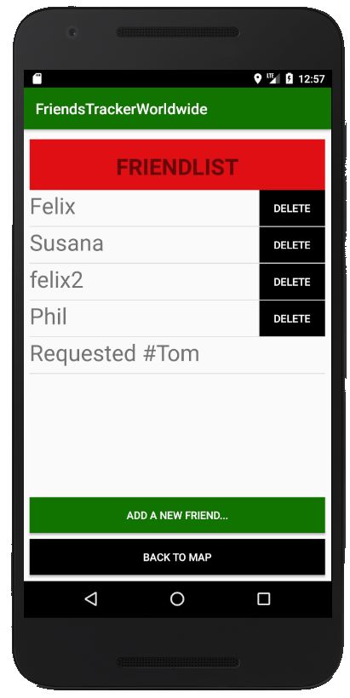



Activities - FriendActivity
Display all friends
Delete friends directly from within the list
Navigate to AddFriendActivity
Feedbeck when recently sent a friend request
FTW: Philipp Bahnmueller, Felix Rosa, Kevin Schroetter

Slide 9
Activities - AddFriendActivity
Add a new Friend through the FTW API
Validation of entered friendname
FTW: Philipp Bahnmueller, Felix Rosa, Kevin Schroetter

Slide 10
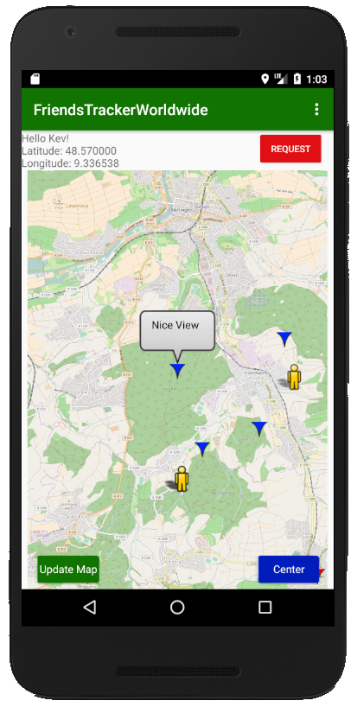

Activities - OverviewActivity
Display all Personal Markers
Display all Friend Markers
Display all Friends Locations
Sort list entries by distance to Your Location
Directly focus the selected Item via SHOW
FTW: Philipp Bahnmueller, Felix Rosa, Kevin Schroetter

Slide 11



Activities - RequestActivity
See your Sent Friend Requests
View Open Friend Requests
Confirm Requests
Decline Requests
FTW: Philipp Bahnmueller, Felix Rosa, Kevin Schroetter

Slide 12
Activities - LegendActivity
Get information about Map Icons for:
Your Position
Your personal Markers
Friend Locations
Friend Markers
FTW: Philipp Bahnmueller, Felix Rosa, Kevin Schroetter

Slide 13
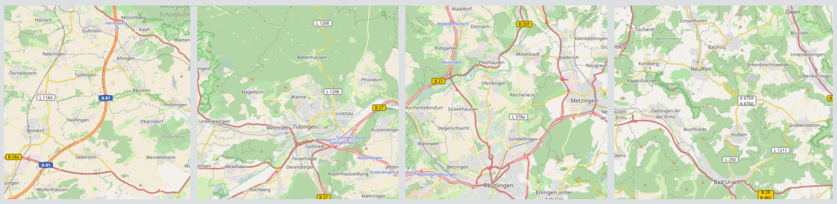

LIVE DEMO
FTW: Philipp Bahnmueller, Felix Rosa, Kevin Schroetter

