Slide 1
Fish Trap
PIT Tags
Window Counts
Trap Rate
Night Passage Rate
Total Fish Crossing Dam
Re-ascension Rate
Origin Proportions
Unique Escapement
Unique
Wild, Hatchery, HNC Escapement

Slide 2
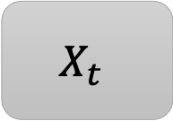

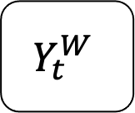

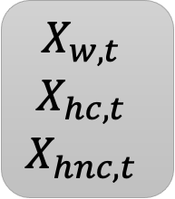
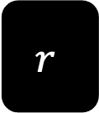
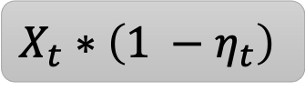
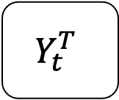

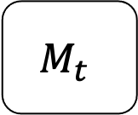
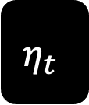
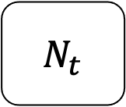
$$Y_{t}^{T}$$
$$M_{t}$$
$N_{t}$
$$Y_{t}^{W}$$
$$ν_{t}$$
$$θ_{t}$$
$$r$$
$$η_{t}$$
$$X_{t}$$
$$\begin{matrix}ω_{w,t} \\ ω_{hc,t} \\ ω_{hnc,t}\end{matrix}$$
$$X_{t}∗\left(1 −η_{t}\right)$$
$$\begin{matrix}X_{w,t} \\ X_{hc,t} \\ X_{hnc,t}\end{matrix}$$

Slide 3
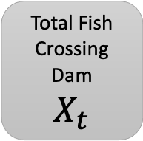

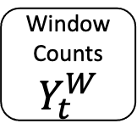
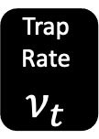
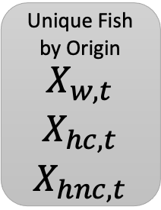
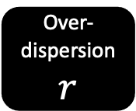
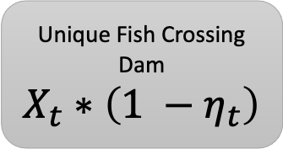
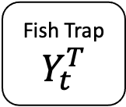

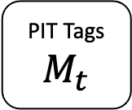
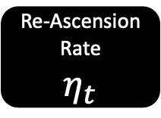
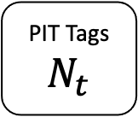
Fish Trap
$$Y_{t}^{T}$$
PIT Tags
$$M_{t}$$
PIT Tags
$N_{t}$
Window Counts
$$Y_{t}^{W}$$
Trap Rate
$$ν_{t}$$
Day Rate
$$θ_{t}$$
Over-dispersion
$$r$$
Total Fish Crossing Dam
$$X_{t}$$
Re-Ascension Rate
$$η_{t}$$
Origin Proportions
$$\begin{matrix}ω_{w,t} \\ ω_{hc,t} \\ ω_{hnc,t}\end{matrix}$$
Unique Fish Crossing Dam
$$X_{t}∗\left(1 −η_{t}\right)$$
Unique Fish by Origin
$$\begin{matrix}X_{w,t} \\ X_{hc,t} \\ X_{hnc,t}\end{matrix}$$

