Slide 1
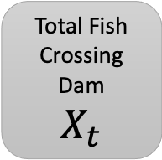

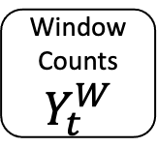
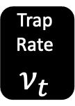
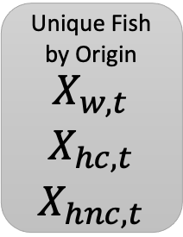
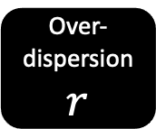
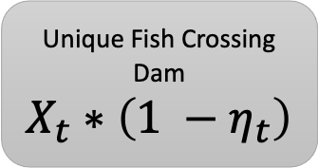
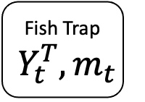

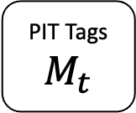
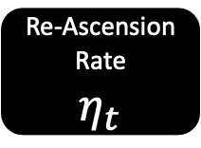
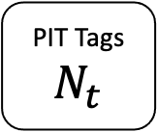
Fish Trap
$$Y_{t}^{T},m_{t}$$
PIT Tags
$$M_{t}$$
PIT Tags
$N_{t}$
Window Counts
$$Y_{t}^{W}$$
Trap Rate
$$ν_{t}$$
Day Rate
$$θ_{t}$$
Over-dispersion
$$r$$
Total Fish Crossing Dam
$$X_{t}$$
Re-Ascension Rate
$$η_{t}$$
Origin Proportions
$$\begin{matrix}ω_{w,t} \\ ω_{hc,t} \\ ω_{hnc,t}\end{matrix}$$
Unique Fish Crossing Dam
$$X_{t}∗\left(1 −η_{t}\right)$$
Unique Fish by Origin
$$\begin{matrix}X_{w,t} \\ X_{hc,t} \\ X_{hnc,t}\end{matrix}$$

