Slide 1
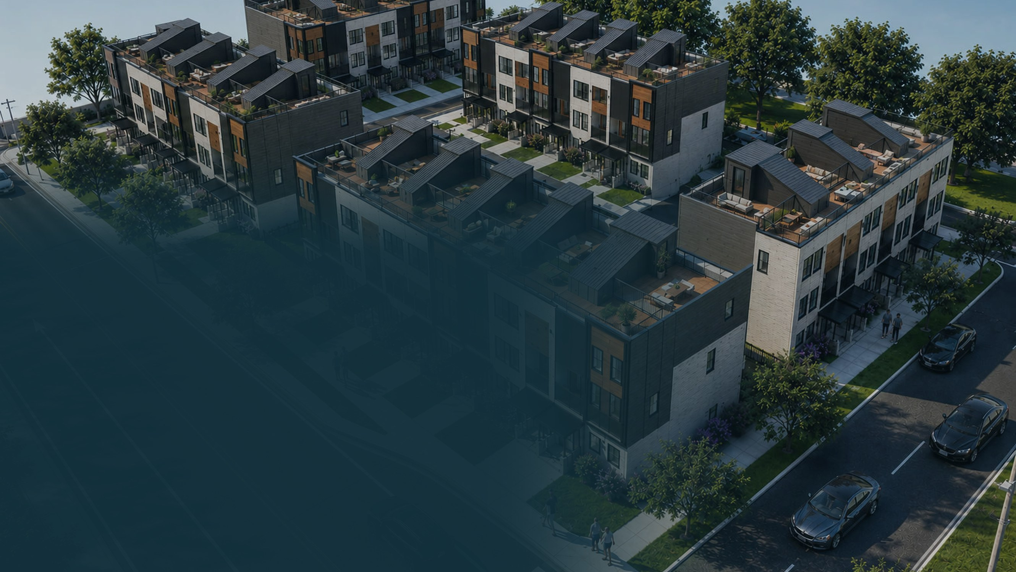
AK CAPITAL × BONDY CONSTRUCTION & DESIGN
3331 Trumbull
Twenty-five for-sale townhomes on a full city block in North Corktown, Detroit — built in two phases.
13 + 12
$700K
20%
UNITS, PHASE 1 / PHASE 2
PHASE 1 DEBT RAISE
FIXED, PAID QUARTERLY
DEBT INVESTMENT · SECURED PROMISSORY NOTE · AUGUST 2026
Debt only — no equity is offered. Confidential, prepared for the named recipient only. Not an offer to sell securities.

Slide 2
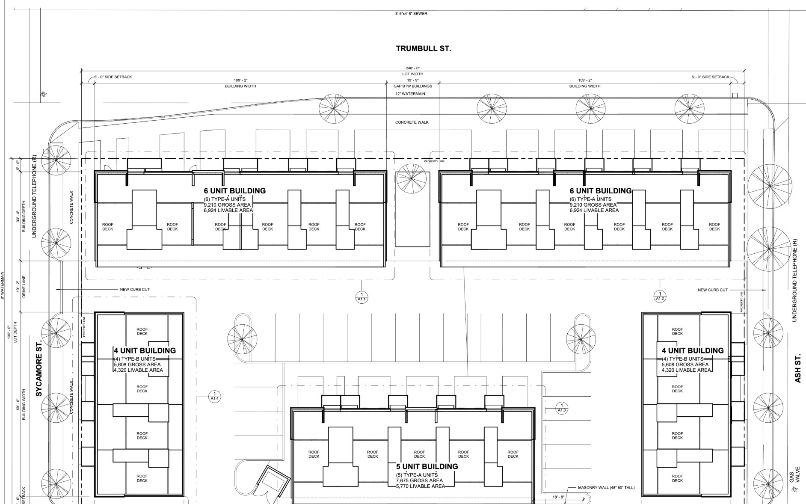
THE OPPORTUNITY
A city block, built in two bites
3331 Trumbull is a full city block in North Corktown, master-planned by 4545 Architecture: five buildings around a private parking court with 248 feet of frontage where Trumbull meets Sycamore and Ash. All 25 homes get an attached garage and a private rooftop deck with skyline views.
Permitting completed June 2026. Rather than build all 25 at once, the project runs in two phases — 13 homes, then 12 — so Phase 1 proceeds fund Phase 2 and investor principal returns off the first closings.
25
$10.76M
TOWNHOMES
5 BUILDINGS
TOTAL PROJECTED
REVENUE
ARCHITECTURAL SITE PLAN · SP1.1 · 4545 ARCHITECTURE
$2.67M
24.8%
PROJECTED
NET PROFIT
PROJECTED
NET MARGIN
3331 TRUMBULL | AK CAPITAL INVESTMENTS LLC × BONDY CONSTRUCTION & DESIGN
2

Slide 3
THE PLAN
Thirteen homes first. Then twelve.
Phasing cuts the capital at risk roughly in half, proves absorption before the second half breaks ground, and lets Phase 1 closings do two jobs at once — return investor principal and fund Phase 2.
PHASE 1
PHASE 2
13 homes
Buildings 1–3
12 homes
Buildings 4–5
Funded by a First Merchants construction loan — secured at 6% — alongside the $700,000 investor note tranche
Seven $100,000 secured notes — the full raise, and the only raise
Pre-sales launch during construction; closings begin as buildings deliver
Funded from Phase 1 closing proceeds — no second investor raise
Breaks ground while Phase 1 is still closing out
Completes the block and the $10.76M projected sellout
8 of 13
PHASE 1 CLOSINGS RETURN
INVESTOR PRINCIPAL IN FULL
Eight closings throw off roughly $3.4M of gross sale proceeds and $855,204 of cumulative net profit against $700,000 of principal — 1.22× coverage measured on profit alone, after the construction lender is fully repaid on those units. The remaining five Phase 1 homes and all of Phase 2 close free of the note.
3331 TRUMBULL | AK CAPITAL INVESTMENTS LLC × BONDY CONSTRUCTION & DESIGN
3

Slide 4
THE DEBT INVESTMENT
Fixed return, real security, short clock
20% fixed
$5,000
18–24 mo
2nd position
ANNUAL RATE, INTEREST-ONLY
PER QUARTER, PER $100K NOTE
TERM — EARLY AT 8 OF 13
RECORDED DEBT + GUARANTEE
NOTE ECONOMICS
1 NOTE
3 NOTES
7 NOTES
Principal
$100,000
$300,000
$700,000
PHASE 1 CAPITAL STACK
Quarterly interest
$5,000
$15,000
$35,000
Senior construction loan
First Merchants Bank · secured at 6%
Interest per year
$20,000
$60,000
$140,000
Investor notes
Total interest — 24 months
$40,000
$120,000
$280,000
$700,000 · 2nd position
Total cash returned — 24 months
$140,000
$420,000
$980,000
Sponsor equity & land
Site owned since 2022
This is a debt investment, not equity — you are lending to the borrower under a secured promissory note. Interest is a fixed contractual obligation, not a projection and not a share of profits; there is no upside beyond the stated rate. Seven $100,000 notes, accredited investors only.
First Merchants has financed $10M+ of Bondy projects since 2019, all obligations met per terms.
3331 TRUMBULL | AK CAPITAL INVESTMENTS LLC × BONDY CONSTRUCTION & DESIGN
4

Slide 5
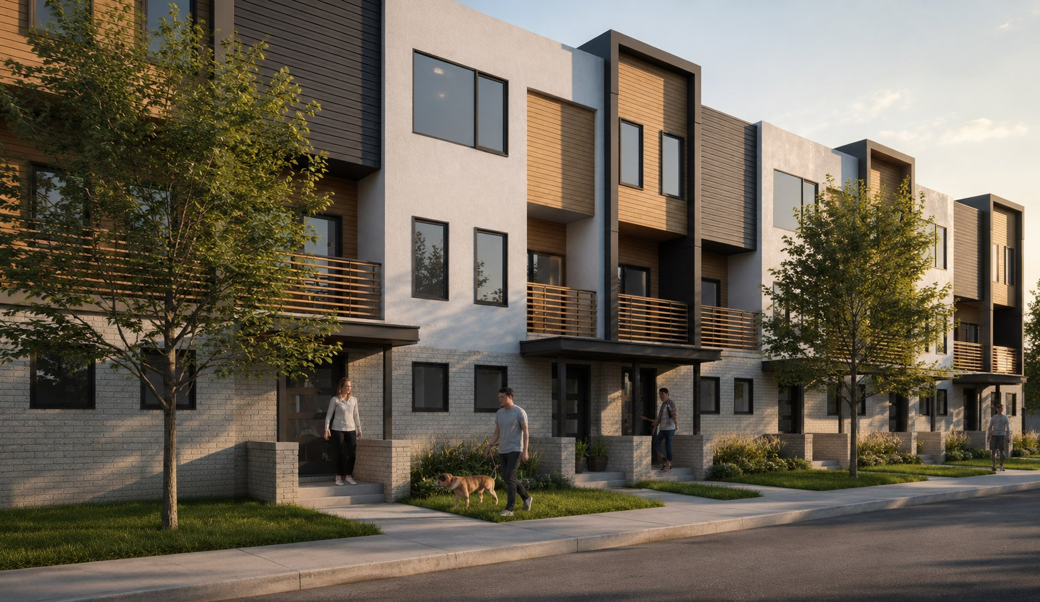
THE PRODUCT
Two proven floorplans, all under $450K
TYPE A · 17 HOMES
TYPE B · 8 HOMES
$432,870
$409,384
$282 / SF · launch pricing
$292 / SF · launch pricing
3 BR / 2.5 BA
1,535 sf
Tuck-under garage
Private roof deck
2 BR / 2.5 BA
1,402 sf
Tuck-under garage
Private roof deck
FINISHES & UPGRADE REVENUE
Granite and quartz tops, engineered wood and tile floors, full-glass shower enclosures, Andersen windows, smart thermostats. Launch pricing produces a $10.6M sellout before upgrades; the proforma carries a $125,000 upgrade-revenue allowance on top.
3331 TRUMBULL | AK CAPITAL INVESTMENTS LLC × BONDY CONSTRUCTION & DESIGN
5

Slide 6
MARKET EVIDENCE
Priced $30–50/sf under closed comps
These are recorded closings from the same submarket, the same architect, and the same builder — not projections. 3331 Trumbull launches below every one of them.
COMMUNITY
SIZE (SF)
SOLD $/SF
STATUS
3331 Trumbull — North Corktown (subject)
1,402–1,535
$282–292
Launch pricing
THE HEADROOM
Sycamore Park — Bondy, 1 block from site
1,261–1,585
$312–327
Sold out
$285
Terraces at Woodbridge — same architect
1,278–1,592
$313–341
6 closings
3331 TRUMBULL BLENDED
LAUNCH PRICE PER SF
Harrison 12 — Bondy, North Corktown
843–1,511
$289–326
Sold out
Scripps District — Woodbridge
1,331–1,618
$256–286
~65% of 61 sold
$320
The Coachman — Corktown
696–1,500
$349–428
Sold out
The Eleventh — Corktown
2,030–2,054
$229–292
Sold out
SYCAMORE PARK BLENDED —
BONDY-BUILT, ONE BLOCK AWAY,
SOLD OUT AT SETTLEMENT
Sources: Realcomp IDX sold records (June–July 2026 pulls), ALTA seller settlement statements, and builder price lists, per Bondy Construction & Design. Full comp book with unit-level closings is in the diligence package. All figures should be independently verified.
3331 TRUMBULL | AK CAPITAL INVESTMENTS LLC × BONDY CONSTRUCTION & DESIGN
6

Slide 7
FINANCIALS
Sales proforma — all 25 units
LINE ITEM
AMOUNT
Gross unit sales (25 units)
$10,633,862
$285
$106,900
Upgrade revenue allowance
$125,000
BLENDED LAUNCH
PRICE PER SF
PROJECTED NET
PROFIT PER UNIT
Total projected revenue
$10,758,862
Total development cost
($7,387,024)
Gross profit
$3,371,838
24.8%
36.2%
Closing costs
($699,326)
PROJECTED
NET MARGIN
PROJECTED
RETURN ON COST
Projected net profit
$2,672,512
Source: 3331 Trumbull for-sale proforma, June 2026. Figures reflect launch pricing across both phases before upgrade contracts. All figures should be independently verified.
6%
9%
The construction loan is secured at 6%. Every figure above is underwritten at 9%, with construction overage allowances carried in the budget — so the projected margin is modeled three points above the debt cost actually in hand, before any of that cushion is counted.
CONSTRUCTION DEBT
SECURED
CARRIED IN THE
PROFORMA ABOVE
3331 TRUMBULL | AK CAPITAL INVESTMENTS LLC × BONDY CONSTRUCTION & DESIGN
7

Slide 8
TRACK RECORD
Closed on this block, three times
Bondy Construction & Design has built and sold out three townhome developments within blocks of 3331 Trumbull. These are closed transactions from the firm's real-estate-owned schedule — purchase, build cost, sale price, and realized profit.
SOLD AUG 2021
SOLD AUG 2024
SOLD MAR 2025
North Corktown 11
Harrison 12
Sycamore Park
3301 Cochrane St · 11 units
2746 Harrison St · 12 units
1600 Sycamore St · 10 units
SALE PRICE
NET PROFIT
SALE PRICE
NET PROFIT
SALE PRICE
NET PROFIT
$4,650,000
$1,030,000
$4,250,000
$750,000
$4,352,000
$982,000
33
$13.25M
$2.76M
20.8%
$83,697
UNITS DELIVERED
& SOLD
COMBINED
SALE PROCEEDS
REALIZED
NET PROFIT
REALIZED
NET MARGIN
REALIZED NET
PROFIT PER UNIT
Source: Bondy Construction & Design real-estate-owned and experience schedule, 21 March 2026. 3331 Trumbull's projected 24.8% margin and $106,900 net profit per unit sit modestly above what these three projects actually realized.
3331 TRUMBULL | AK CAPITAL INVESTMENTS LLC × BONDY CONSTRUCTION & DESIGN
8

Slide 9
SPONSORSHIP
The builder behind the neighborhood
Luke Bondy — CEO, Bondy Construction & Design Vertically integrated developer and licensed general contractor across Southeast Michigan. Builder and owner on 140+ residential for-sale units with more than $100M of completed construction, plus a ~50-unit rental portfolio he owns and his team operates. Kevin Simpson — Co-Developer & Investor Relations, AK Capital Investments Real estate investor across single-family, multifamily, and commercial. Delta Air Lines pilot and former U.S. Army Blackhawk pilot; leads investor reporting and capital structure for the project.
COMPLETED PROJECTS
TYPE
UNITS
Wesburn Villas
Townhomes
28
iPG — Detroit
Townhomes
16
Harrison 12 — North Corktown
Townhomes
12
North Corktown 11
Townhomes
11
Sycamore Park — North Corktown
Townhomes
10
2221 & 2225 Wabash — Detroit
Multi
3
Total delivered
6 projects
80
$100M+
140+
50+
Source: Bondy Construction & Design firm profile, July 2026. Banking reference: First Merchants Bank has financed $10M+ of Bondy projects since 2019, with all obligations met per terms — reference letter available on request.
COMPLETED
CONSTRUCTION
UNITS BUILT
& SOLD
RENTAL UNITS
OWNED
3331 TRUMBULL | AK CAPITAL INVESTMENTS LLC × BONDY CONSTRUCTION & DESIGN
9

Slide 10
EXECUTION
How the two phases run
2021–2025
JUNE 2026
NOW
MONTHS 2–14
MONTHS 14–20
MONTHS 14–26
MONTHS 26–32
Proof, delivered
Permitting complete
Phase 1 capital close
Phase 1 build
Phase 1 closings
Phase 2 build
Sellout
Cochrane 11, Harrison 12, and Sycamore Park built and sold out within blocks of the site.
Architecture, structure, and MEP documented by 4545 Architecture. Land owned since 2022.
$700,000 of secured notes closes alongside the First Merchants construction loan.
13 homes across Buildings 1–3. Pre-sales launch during the build.
Homes deliver and close in sequence. Investor principal returns in full at the eighth closing.
12 homes across Buildings 4–5, funded from Phase 1 proceeds — no second raise.
Phase 2 closes out the block against a $10.76M projected sellout.
Why the raise is capped: the raise is $700,000 — seven $100,000 secured notes to a small group of accredited investors — closing alongside the First Merchants construction loan to fund Phase 1. Phase 2 requires no additional raise.
3331 TRUMBULL | AK CAPITAL INVESTMENTS LLC × BONDY CONSTRUCTION & DESIGN
10

Slide 11
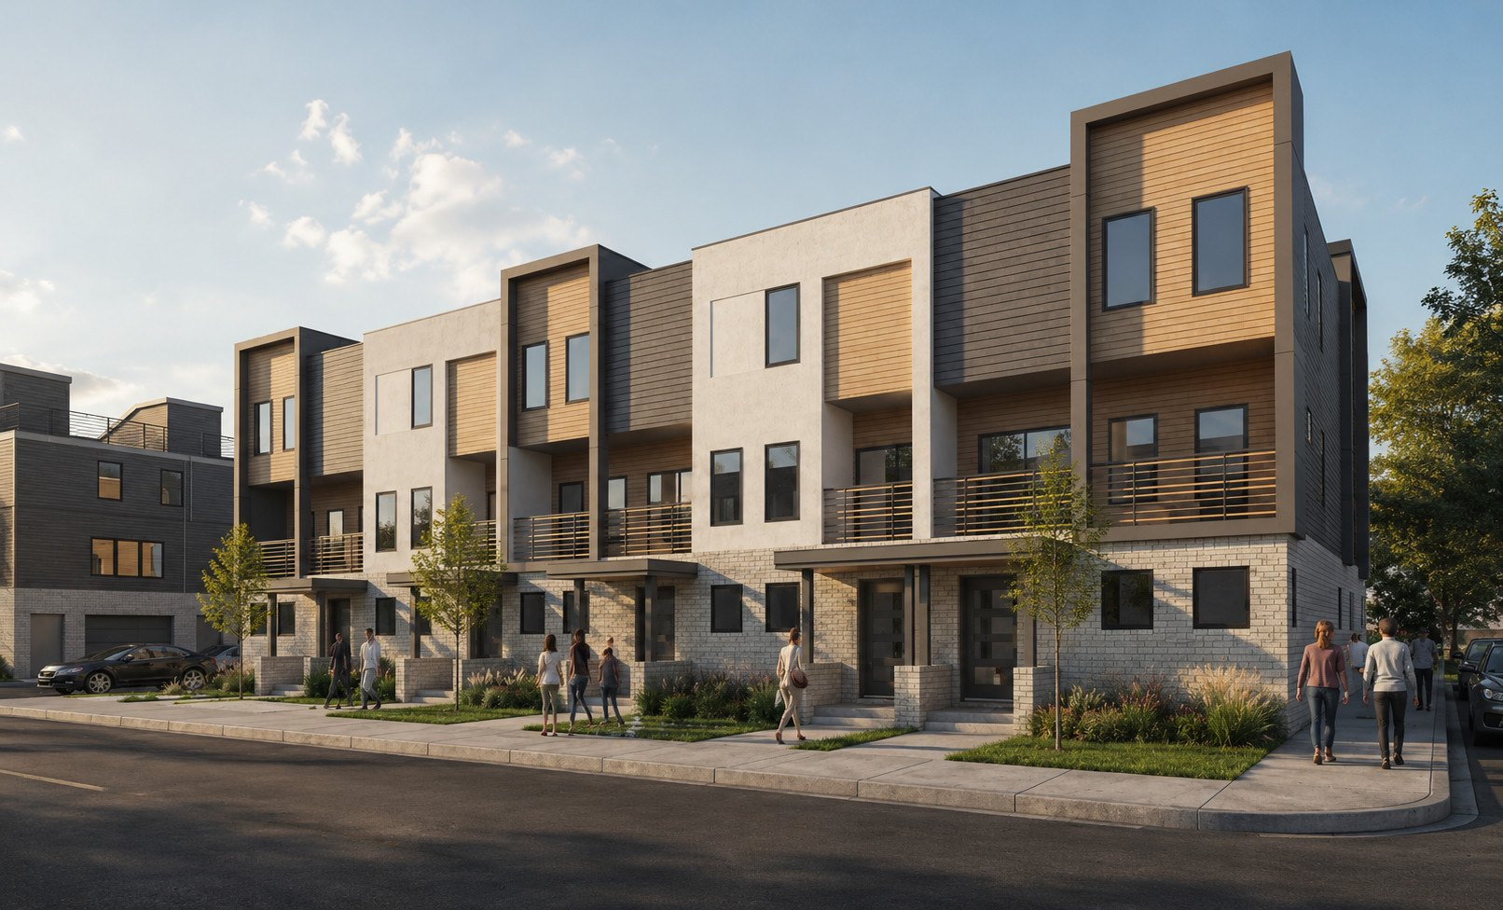
NEXT STEPS
Let's build it.
01
Reserve your notes
$100,000 each — seven available in the Phase 1 tranche.
02
Review the documents
Promissory note, personal guarantee, comp book, CD set, and the June 2026 proforma.
03
Fund at close
Capital closes alongside the First Merchants construction loan and Phase 1 breaks ground.
Kevin Simpson · Co-Developer & Investor Relations
AK Capital Investments LLC
Kevin@AKCapital.fund · trumbullnorth.com
This overview is a summary for discussion purposes only and is not an offer to sell or a solicitation of an offer to buy any security. Any offering is made only to accredited investors through definitive documents. Figures reflect launch pricing, third-party sold records, the Bondy Construction & Design real-estate-owned schedule dated 21 March 2026, and the June 2026 proforma; all figures should be independently verified. Real estate investments involve risk, including loss of principal. Past performance of prior projects does not guarantee future results.

