Slide 1
VM
VM
App
App
App
App
GuestOS
Kernel 1
GuestOS
Kernel 2
App
App
HostOS
HostOS
Hardware
Hardware

Slide 2
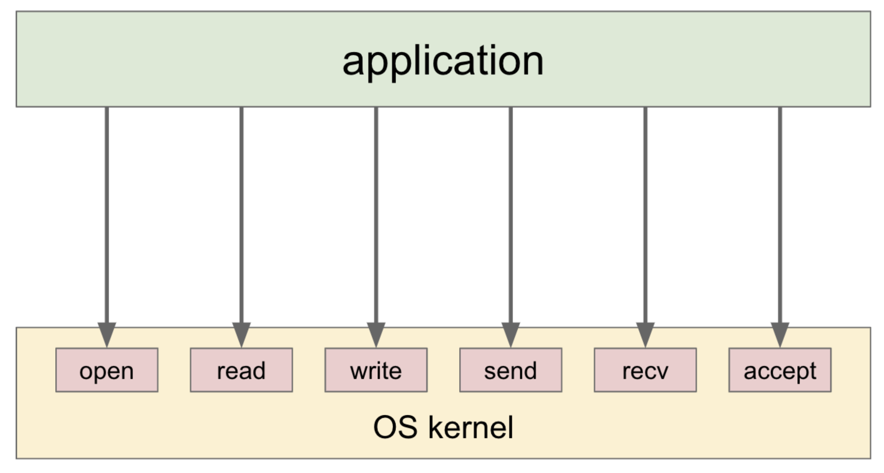
helloworld

Slide 3
S1 = This is a berry 🫐. This is cherry 🍒.
S2 = is

