Slide 1
AI-Benchmark
Saisangararamaleengam Alagapan

Slide 2
MobileNet-V2
There are a class of efficient models called MobileNets for mobile and embedded vision applications. MobileNets are based on a streamlined architecture that uses depth-wise separable convolutions to build light weight deep neural networks.
MobileNetV2 is the next generation and significant improvement over MobileNetV1 and pushes the state of the art for mobile visual recognition including classification, object detection and semantic segmentation.
MobileNetV2 models are faster for the same accuracy across the entire latency spectrum. In particular, it uses 2x few operations, need 30% fewer parameters and are about 30-40% faster on a Google Pixel phone than MobileNetV1 models, all while achieving higher accuracy.
It has two types of blocks. One is residual block with stride of 1. Another one is block with stride of 2 for downsizing.
There are 3 layers for both types of blocks. This time, the first layer is 1*1 convolution with ReLU6. The second layer is the depth wise convolution. The third layer is another 1*1 convolution but without any non-linearity.

Slide 3
Inception-V3
Inception V3 is a widely-used image recognition model that has shown to attain greater than 78.1% accuracy on the ImageNet dataset. The model is the culmination of many ideas developed by multiple researchers over the years.
The model itself is made up of symmetric and asymmetric building blocks, including convolutions, average pooling, max pooling, concats, dropouts, and fully connected layers.
It is a convolutional neural network that is trained on more than a million images from the ImageNet database. The network is 48 layers deep and can classify images into 1000 object categories, such as keyboard, mouse, pencil, and many animals. The network has an image input size of 299-by-299.
It incorporated all the upgrades that was stated for Inception v2, and in addition used the following:
RMSProp Optimizer
Factorized 7*7 convolutions
BatchNorm in the Auxillary Classifiers.
Label Smoothing

Slide 4
Inception-V4
Inception V4 evolved from GoogLeNet / Inception-v1, has a more uniform simplified architecture and more inception modules than Inception-v3.
It introduced specialized “Reduction Blocks” which are used to change the width and height of the grid. The earlier versions didn’t explicitly have reduction blocks, but the functionality was implemented.
Outperform previous iterations “by virtue of size alone”
Ensemble of 3x Inception-Resnet(v2) and 1x Inception-v4 produces 3.08% top-5 error
Residual connections consistently provide
Faster training
Slightly better prediction

Slide 5
Inception-ResNet-V2
It is a convolutional neural network that is trained on more than a million images from the ImageNet database. The network is 164 layers deep and can classify images into 1000 object categories such as keyboard, mouse, pencil, and many animals. The network has an image input size of 299-by-299.
Residual connections in Inception-Resnet
Replaced filter concatenation
Required some dimensionality adjustments
Little effect on final accuracy (compared to similar-size pure Inception)
Decreased training time
Potential network death – training instability

Slide 6
ResNet-V2-50 & ResNet-V2-152
ResNet, short for Residual Networks is a classic neural network used as a backbone for many computer vision tasks. The fundamental breakthrough with ResNet was it allowed people to train extremely deep neural networks with 150+layers successfully. Prior to ResNet training very deep neural networks was difficult due to the problem of vanishing gradients.
ResNet first introduced the concept of skip connection. It works to mitigate the problem of vanishing gradient by allowing the alternate shortcut path for gradient to flow through.
They allow the model to learn an identity function which ensures that the high layer will perform at least as good as the lower layer, and not worse.
ResNet-V2-152 is same as ResNet-V2-50 but the main difference is that it has 152 layers in it. Other than this difference, everything else is common between ResNet-V2-50 and ResNet-V2-152.

Slide 7
VGG-16
It is a convolutional neural network that is trained on more than a million images from the ImageNet database. The network is 16 layers deep and can classify images into 1000 object categories, such as keyboard, mouse, pencil, and many animals. The network has an image input size of 224-by-224.
This model achieves 92.7% top-5 test accuracy in ImageNet, which is a dataset of over 14 million images belonging to 1000 classes. It was one of the famous model submitted to ILSVRC-2014. It makes the improvement over AlexNet by replacing large kernel sized filters with multiple 3x3 kernel-sized filters one after another. VGG16 was trained for weeks and used NVIDIA Titan Black GPU’s.
In the “Very Deep Convolutional Networks for Large-Scale Image Recognition” paper, it is demonstrated that the representation depth is beneficial for the classification accuracy, and the state-of-the-art performance on the ImageNet challenge dataset can be achieved using a conventional ConvNet architecture with substantially increased depth.

Slide 8
SRCNN 9-5-5
Deep learning method for single image super-resolution (SR) directly learns an end-to-end mapping between the low/high-resolution images. The mapping is represented as a deep convolutional neural network (CNN) that takes the low-resolution image as the input and outputs the high-resolution one and are successful too.
Deep CNN has a lightweight structure yet demonstrates state-of-the art restoration quality, and achieves fast speed for practical on-line usage. Different network structures and parameter settings are explored to achieve trade-offs between performance and speed.
With a lightweight structure, the SRCNN has achieved superior performance than the state-of-the art methods. Additional performance can be further gained by exploring more filters and different training strategies and could be applied to other low-level vision problems, such as image deblurring or simultaneous SR+denoising.

Slide 9
VGG-19
It is a convolutional neural network that is trained on more than a million images from the ImageNet database. The network is 19 layers deep and can classify images into 1000 object categories, such as keyboard, mouse, pencil, and many animals. The network has an image input size of 224-by-224.
A highly accurate single-image super-resolution (SR) method uses a very deep convolutional network inspired by VGG-net used for ImageNet classification and it is found that increasing the network depth shows a significant improvement in accuracy.
By cascading small filters many times in a deep network structure, contextual information over large image regions is utilized in an efficient way but with very deep networks, convergence speed becomes a critical issue during training. To overcome this, simple yet effective training procedure is used.
Residual-learning and extremely high learning rates is used to optimize a very deep network fast and because of this convergence speed is maximized and gradient clipping is also used to ensure training stability. This is readily applicable to other image restoration problems such as denoising and compression artifact removal.

Slide 10
ResNet-SRGAN
Generative adversarial networks (GANs) provide a powerful framework for generating plausible-looking natural images with high perceptual quality. The GAN procedure encourages the reconstructions to move towards region of the search space with high probability of containing photo realistic images and thus closer to the natural image manifold.
SRGAN is a GAN based network, where the generator (G) learns to generate SR images from LR images as close as possible to HR. The discriminator (D) learns to distinguish generated SR images from real images.
The G takes advantage of ResNet and sub-pixel convolution for up sampling. It also combines perceptual loss with generative or adversarial loss for the computation of its loss.
It is evident that ResNet based GAN that combines perceptual loss with generative loss and applying sub-pixel convolution for up sampling can generate better photo realistic super-resolved images.

Slide 11


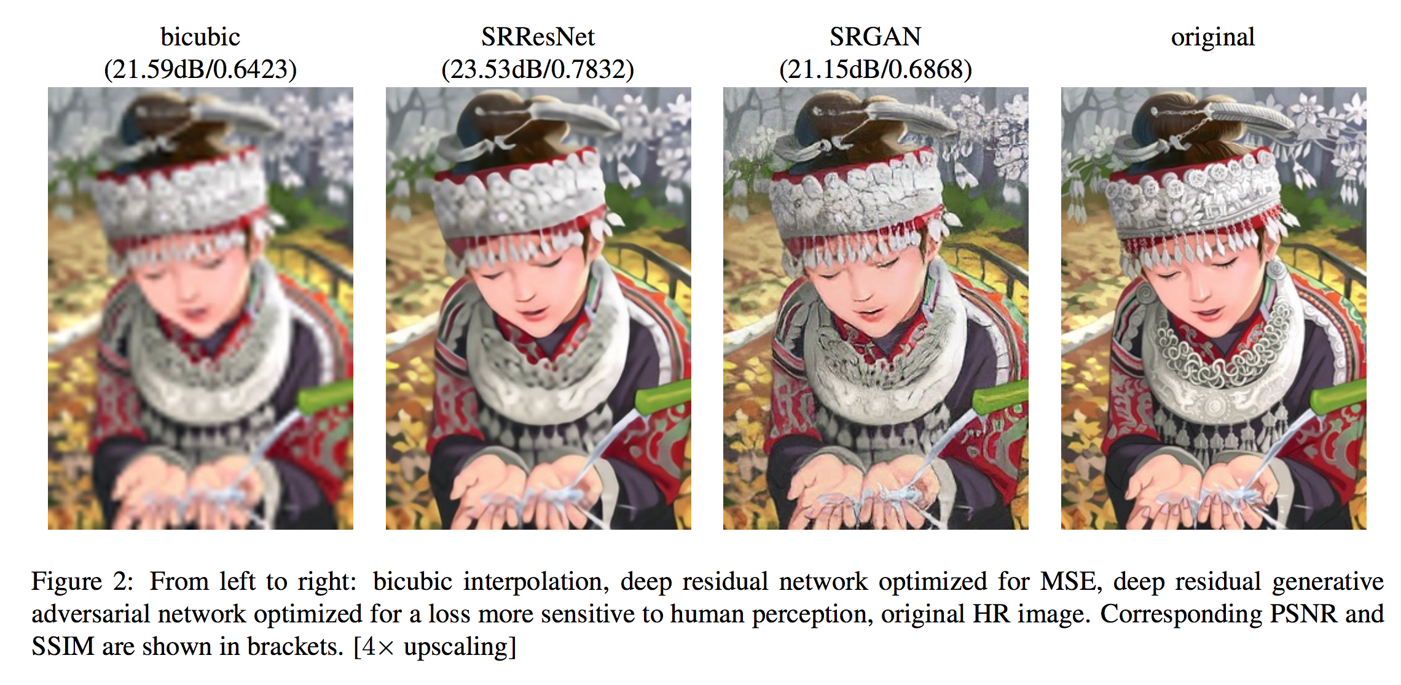



ResNet-SRGAN Example Image

Slide 12
ResNet-DPED
Despite a rapid rise in the quality of built-in smartphone cameras, their physical limitations – small sensor size, compact lenses and the lack of specific hardware impede them to achieve the quality results of DSLR cameras. An end-to-end deep learning approach is presented that bridges the gap by translating ordinary photos into DSLR quality images.
The translation function using a residual convolutional neural network that improves both color rendition and image sharpness is proposed in “DSLR-Quality Photos on Mobile Devices with Deep Convolutional Networks” paper. DPED, a large-scale dataset that consists of real photos captured from three different phones and one high-end reflex camera is also presented.
End-to-end deep learning uses a composite perceptual error function that combines content, color and texture losses and DPED suggested an efficient way of calibrating the images so that they are suitable for image-to-image learning. Quantitative and qualitative assessments reveal that the enhanced images demonstrate a quality comparable to DSLR taken photos, and this method itself can be applied to cameras of various quality levels.

Slide 13
U-Net
There is a large consent that successful training of deep networks requires many thousand annotated training samples. In “U-Net: Convolutional Networks for Biomedical Image Segmentation” paper, a network and training strategy that relies on the strong use of data augmentation to use the available annotated samples more efficiently is presented.
U-Net is a convolutional neural network that was developed for biomedical image segmentation at the Computer Science Department of the University of Freiburg, Germany. The network is based on the fully convolutional network and its architecture was modified and extended to work with fewer training images and to yield more precise segmentations. Segmentation of a 512x512 image takes less than a second on a modern GPU.
The u-net architecture achieves very good performance on very different biomedical segmentation applications. It only needs very few annotated images and has a very reasonable training time of only 10 hours on a Nvidia Titan GPU (6 GB) with the help of data augmentation and its elastic deformations.

Slide 14
Nvidia-SPADE
Spatially-adaptive normalization is just a normalization technique like Batch Norm, Instance Norm, etc. and it is used in GANs to generate synthetic photo-realistic images from the segmentation mask.
Earlier models used the seg map only at the input layer but as seg map was only available in one layer the information contained in the seg map washed away in the deeper layers. SPADE solves this problem by giving seg map as input to all the intermediate layers.
Experiments on several challenging datasets demonstrate the advantage of the proposed method over existing approaches, regarding both visual fidelity and alignment with input layouts. This model allows user control over both semantic and style.
This spatially-adaptive normalization utilizes the input semantic layout while performing the affine transformation in the normalization layers and the proposed normalization leads to the first semantic image synthesis model that can produce photorealistic outputs for diverse scenes including indoor, outdoor, landscape, and street scenes.

Slide 15
Nvidia-SPADE Example Image

Slide 16
ICNet
Real-time semantic segmentation is a challenging task because reducing a large portion of computation for pixel-wise label inference is difficult even though there are many practical applications for it.
To overcome this task, an image cascade network which incorporates multi-resolution branches under proper label guidance is proposed in “ICNet for Real-Time Semantic Segmentation on High-Resolution Images” paper. In-depth analysis of the framework and introduction of the cascade feature fusion unit to quickly achieve high quality segmentation is also provided.
ICNet also incorporates effective strategies to accelerate network inference speed without sacrificing much performance and the major contributions include the new framework for saving operations in multiple resolutions and the powerful fusion unit.
It can benefit many other tasks that require fast scene and object segmentation and greatly enhances the practicality of semantic segmentation in other disciplines.

Slide 17
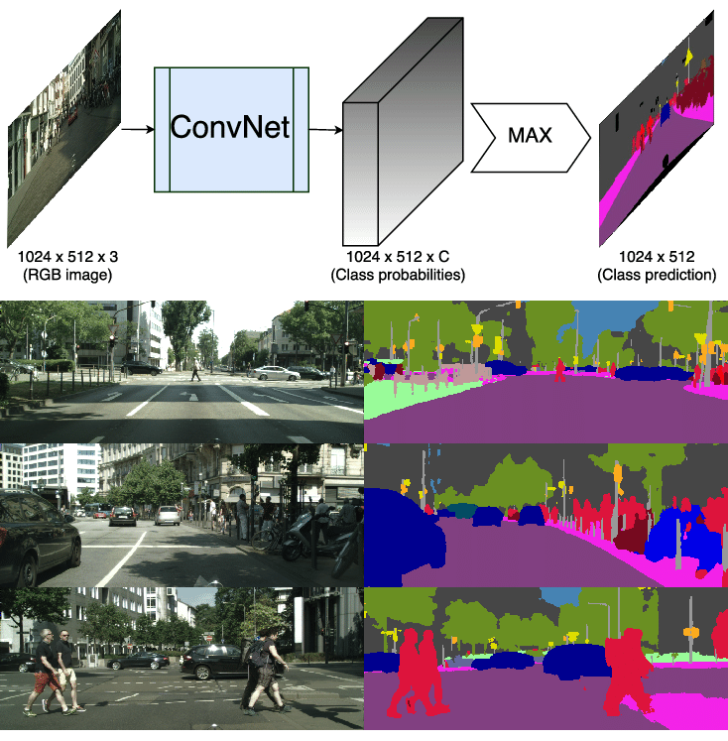
ICNet Example Image

Slide 18
PSPNet
Scene parsing is challenging for unrestricted open vocabulary and diverse scenes. In “Pyramid Scene Parsing Network” paper, the capability of global context information by different region-based context aggregation through the pooling module together with the proposed pyramid scene parsing network (PSPNet) is utilized.
PSPNet provides a superior framework for pixel level prediction and this approach achieves state-of-the-art performance on various datasets. A single PSPNet yields the new record of mIoU accuracy 85.4% on PASCAL VOC 2012 and accuracy 80.2% on Cityscapes.
This is used to understand complex scenes and the global pyramid pooling feature provides additional contextual information. This can also be used for semantic segmentation and advance related techniques.

Slide 19
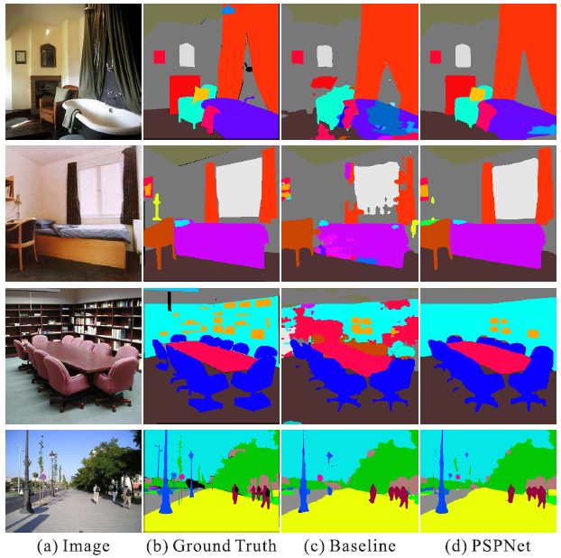
PSPNet Example image

Slide 20
DeepLab
Deep convolutional neural networks (DCNNs) trained on numerous images with strong pixel-level annotations have recently significantly pushed the state-of-art in semantic image segmentation. Its goal is to assign semantic labels (e.g. person, dog, cat, etc.) to every pixel in the input image.
More challenging problem of learning DCNNs for semantic image segmentation from either (1) weakly annotated training data such as bonding boxes or image-level labels or (2) a combination of few strongly labeled and many weakly labeled images, sourced from one or multiple datasets is studied in “Weakly- and Semi-Supervised Learning of a Deep Convolutional Network for Semantic Image Segmentation” paper.
Expectation-Maximization (EM) methods for semantic image segmentation model training under these weakly supervised and semi-supervised settings is developed. Exploiting extra weak or strong annotations from other datasets can lead to large improvements.

Slide 21
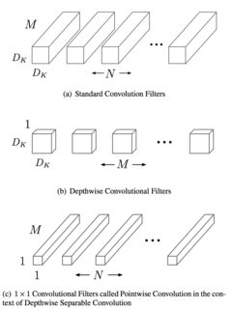
Difference between MobileNet and Inception
The major difference between Inception and MobileNet is that MobileNet uses Depthwise separable convolution while Inception uses standard convolution. This results into lesser numbers of parameters in MobileNet compared to Inception. However, this results in slight decrease in the performance as well.
In standard convolution the filter operates on the M channels on the input image all-together and outputs N feature maps. i.e. the matrix multiplication between the input and filter is multidimensional.
However, in a depthwise separable convolution the M single channel filters will operate on a single cube in the input feature and once the M filter outputs are obtained a pointwise filter of size 1x1xM will operate on it to give N output feature maps. This can be understood from the figure.

Slide 22
Inception, ResNet, MobileNet
Inception, ResNet, and MobileNet are the convolutional neural networks commonly used for an image classification task.
Inception is created to serve the purpose of reducing the computational burden of deep neural nets while obtaining state-of-art performance. As the network goes deeper, the computational efficiency will also decrease, therefore the authors of Inception were interested in finding a solution to scale up neural nets without increasing computational cost.
While Inception focuses on computational cost, ResNet focuses on computational accuracy. Intuitively, deeper networks should not perform worse than the shallower networks, but in practice, the deeper networks performed worse than the shallower networks, caused not by overfitting, but by an optimization problem. Shortly, the deeper the network, the harder the network to be optimized.

Slide 23
Inception, ResNet, MobileNet (Contd.)
The trend in the computer vision is to make deeper and more complicated network to achieve higher accuracy. However, deeper networks come with the tradeoff of size and speed. MobileNet is developed to solve this problem, which is a network for embedded vision applications and mobile devices.
The Inception module computes multiple different transformations over the same input map in parallel, connecting the results into a single output. For each layer, it does a 5x5 convolution, 3x3 convolution, and max pooling, each carries different information, which of course is computationally costly. Therefore the authors of Inception decided to overcome this problem by introducing the dimension reductions by using 1x1 convolution. Therefore it has the compressed version of the spatial information.
ResNet proposed a solution of using the network layers to fit a residual mapping instead of directly trying to fit a desired underlying mapping. It helps the problem of vanishing gradients, in which the gradient signals from the error function decreased-

Slide 24
Inception, ResNet, MobileNet (Contd.)
exponentially as they are backpropagated. By the time the error signals reached the earlier layer, they were so small and become insignificant. In ResNet, the gradient signal could travel back to early layers via this “shortcut” method, therefore many layers of the network could be created without having accuracy trade-off.
The idea behind MobileNet is to use depthwise separable convolutions to build lighter deep neural networks. MobileNet uses the regular convolution only in the first layer and the next layers are the depthwise separable convolutions which are the combination of the depthwise and pointwise convolution.
The depthwise convolution is used to filter the input channels and pointwise convolution has 1x1 filter which is used to merge the output channels of the depthwise convolution to create new features. By doing so, the computational work needed to be done is less than the regular convolutional networks.

Slide 25
Findings (Questions)
Why Inception ResNet-V2 has no cpu at the beginning? And why does it take time to hit up?
Why does some neural networks take more CPU and memory?
Why does it take much time to run one application?
What is the difference between the applications?

