Slide 1



Parallelizing Packet Processing in Container Overlay Networks
(EuroSys '21)
Jiaxin Lei¹, Manish Munikar², Kun Suo³, Hui Lu¹, Jia Rao²
¹Binghamton University
²The University of Texas at Arlington
³Kennesaw State University
Notes:
Hello everyone
my name is Jiaxin Lei from Binghamton University.
Today, I’m going to talk about our paper
“Parallelizing Packet Processing in Container Overlay Networks”.
This is a joint work with Hui Lu who is my advisor, Manish Munikar, Jia Rao from University of Texas at Arlington, and Kun Suo from Kennesaw State University

Slide 2
Containers are taking over the cloud
Lightweight
OS level virtualization
High application density
Efficient resource utilization
Notes:
Let me introduce the container overlay networks first.
Containers are taking over the cloud.
They provide lightweight operating system level virtualization
with the fast startup, high application-density and efficient resource utilization.

Slide 3



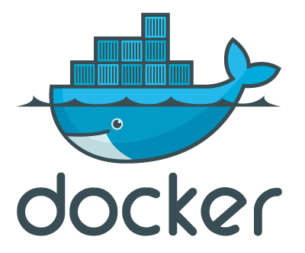

Containers are taking over the cloud
Lightweight
OS level virtualization
High application density
Efficient resource utilization
Based on report, Google launches over 7k+ containers per sec for its searching service.
Notes:
It is reported that Google launches over 7,000 containers every second in its search engine.
With the help of orchestration tools like Kubernetes and Docker Swarm, services of a distributed application can be packaged into multiple containers
automatically and dynamically deployed across physical or virtual machines.
But here’s a question, how could these containers communicate with each other?

Slide 4
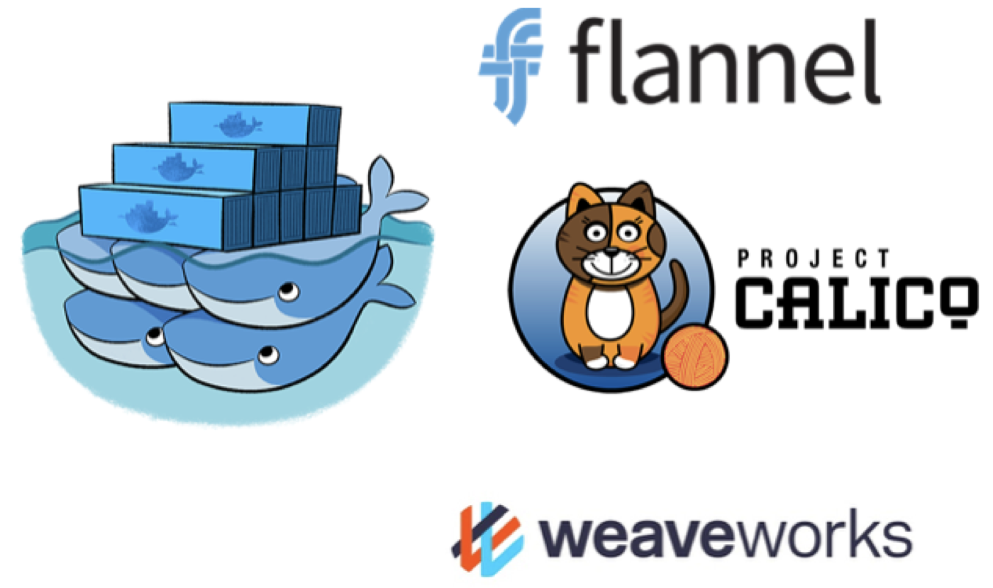
How do containers communicate?
Overlay networks provide connectivity
Typical solutions: Docker Overlay, Flannel, Calico, Weave…
Generally build upon a tunneling approach like VxLAN protocol
Notes:
So next, let me introduce the Overlay Network, which is the de facto technique providing the customized connectivity among containers.
Some example overlay solutions are like Docker Overlay, Flannel, Calico and Weave.
They are generally built upon the tunneling approach like the VxLAN protocol.

Slide 5
How do containers communicate?
Overlay networks provide connectivity
Typical solutions: Docker Overlay, Flannel, Calico, Weave…
Generally build upon a tunneling approach like VxLAN protocol
Original Packet
Inner Ethernet Header
Inner IP Header
Payload
Notes:
VxLAN protocol enables the container network traffic to go through the physical network
by encapsulating the original container packet

Slide 6
How do containers communicate?
Overlay networks provide connectivity
Typical solutions: Docker Overlay, Flannel, Calico, Weave…
Generally build upon a tunneling approach like VxLAN protocol
VxLAN Encapsulation
Original Packet
Outer Ethernet Header
Outer IP Header
Outer UDP Header
VxLAN Header
Inner Ethernet Header
Inner IP Header
Payload
FCS
Notes:
within its host header.

Slide 7
How do containers communicate?
Overlay networks provide connectivity
Typical solutions: Docker Overlay, Flannel, Calico, Weave…
Generally build upon a tunneling approach like VxLAN protocol
VxLAN Encapsulation
Original Packet
Outer Ethernet Header
Outer IP Header
Outer UDP Header
VxLAN Header
Inner Ethernet Header
Inner IP Header
Payload
FCS
VxLAN Flags
Reserved
VxLAN Network Identifier
Reserved
Notes:
With a unique VxLAN id, containers belonging to a same virtual network can be identified and isolated to communicate with its private IP address.

Slide 8
How do containers communicate?
Overlay networks provide connectivity
Typical solutions: Docker Overlay, Flannel, Calico, Weave…
Generally build upon a tunneling approach like VxLAN protocol
VxLAN Encapsulation
Original Packet
Outer Ethernet Header
Outer IP Header
Outer UDP Header
VxLAN Header
Inner Ethernet Header
Inner IP Header
Payload
FCS
VxLAN Flags
Reserved
VxLAN Network Identifier
Reserved
Notes:
While actually the packets are routed through the underlying public network with the hosts IP address.
So what is the overhead of this kind of complicated packet encapsulation?

Slide 9
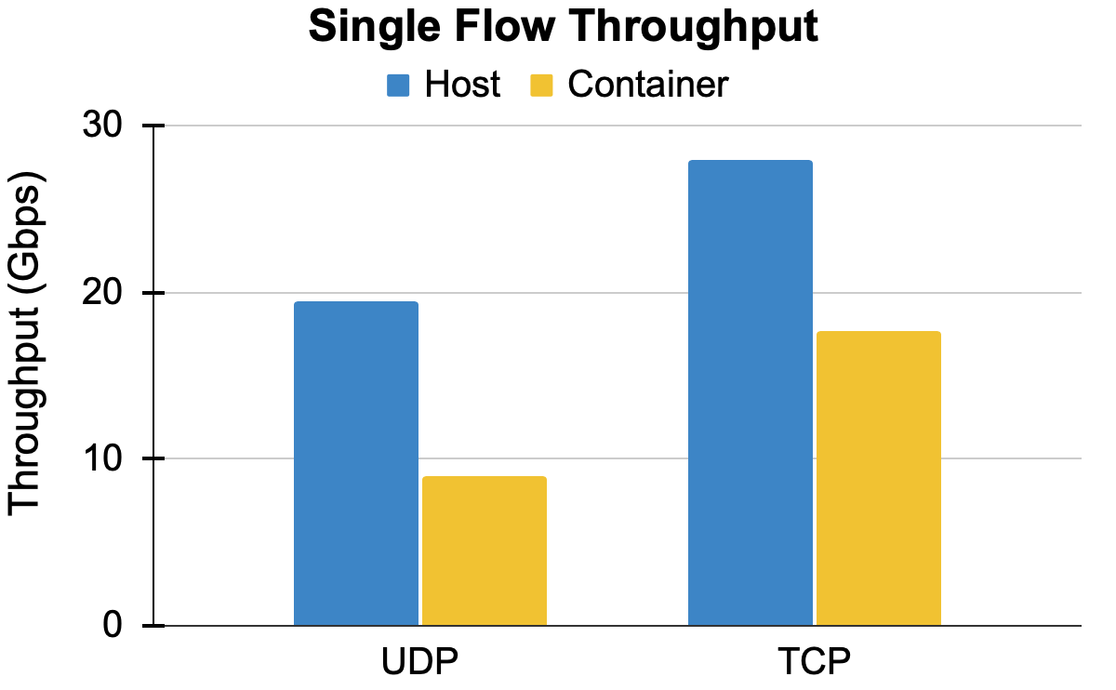
Performance overhead of overlay networks
Machines are connected via a 100 GbE NIC.
Notes:
Let me show some data.
We were motivated by the single flow performance tests. Our two test machines are directly connected via a 100Gb Network Card.
For single flow throughput test,

Slide 10
Performance overhead of overlay networks
Machines are connected via a 100 GbE NIC.
47%
53%
Notes:
comparing to the host network, container overlay networks drops by 53% and 47% for UDP and TCP separately.

Slide 11
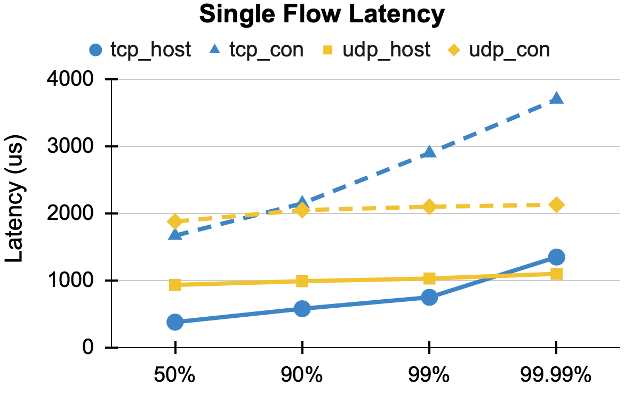
Performance overhead of overlay networks
Machines are connected via a 100 GbE NIC.
Notes:
For single flow latency test

Slide 12
Performance overhead of overlay networks
Machines are connected via a 100 GbE NIC.
3X (TCP)
2X (UDP)
Notes:
container overlay networks increase by at least 2x for UDP and 3x for TCP.

Slide 13
Why is overlay network slow?
L 7
L 3&4
L 2
Hardware
Notes:
So why is overlay network so slow? What is the essential root cause here?
To explain this

Slide 14
Why is overlay network slow?
Host Networks
L 7
Application (receiver)
L 3&4
L 2
Hardware
pNIC
Notes:
let's first check out how a host-level packet is processed in Linux.
When a packet arrives at the NIC

Slide 15
Why is overlay network slow?
Host Networks
L 7
Application (receiver)
L 3&4
L 2
IRQ
Hardware
pNIC
Notes:
it is first copied to the device buffer then triggers a hardware IRQ.
Next, kernel responds to this hardware IRQ

Slide 16
Why is overlay network slow?
Host Networks
L 7
Application (receiver)
L 3&4
SoftIRQ
L 2
IRQ
Hardware
pNIC
Notes:
Then starts the packet receiving path by raising a software IRQ.
Afterwards, packet will be processed at different protocol layers in the context of softIRQ.
Finally packet will be copied to the user-space buffer then delivered to the application.

Slide 17
Why is overlay network slow?
Host Networks
IRQ + SoftIRQ
L 7
Application (receiver)
L 3&4
SoftIRQ
L 2
IRQ
Hardware
pNIC
Notes:
We can see, for a host network packet, there's only one IRQ and one softIRQ incurred here..

Slide 18
Why is overlay network slow?
Host Networks
IRQ + SoftIRQ
Overlay Networks
L 7
Application (receiver)
Container (receiver)
L 3&4
VxLAN
Container vNIC
SoftIRQ
L 2
IRQ
Container bridge
Hardware
pNIC
pNIC
Notes:
However, packet processing in container overlay networks is a more complex pipeline that contains multiple network devices and stages.

Slide 19
Why is overlay network slow?
Host Networks
IRQ + SoftIRQ
Overlay Networks
L 7
Application (receiver)
Container (receiver)
L 3&4
VxLAN
Container vNIC
SoftIRQ
L 2
SoftIRQ
IRQ
Container bridge
IRQ
Hardware
pNIC
pNIC
Notes:
When the first softIRQ is being processed, the network stack will identify that this is an encapsulated overlay packet.
So it will do the decapsulation in protocol stack to remove the outer header
Then keep moving the inner packet into container bridge device and container virtual NIC

Slide 20
Why is overlay network slow?
Host Networks
IRQ + SoftIRQ
Overlay Networks
L 7
Application (receiver)
Container (receiver)
L 3&4
VxLAN
SoftIRQ
SoftIRQ
Container vNIC
SoftIRQ
L 2
SoftIRQ
IRQ
Container bridge
IRQ
Hardware
pNIC
pNIC
Notes:
By raising the 2nd and 3rd softIRQs.
Eventually packet will be delivered to the target container application.

Slide 21
Why is overlay network slow?
Host Networks
IRQ + SoftIRQ
Overlay Networks
IRQ + 3X SoftIRQs
L 7
Application (receiver)
Container (receiver)
L 3&4
VxLAN
SoftIRQ
SoftIRQ
Container vNIC
SoftIRQ
L 2
SoftIRQ
IRQ
Container bridge
IRQ
Hardware
pNIC
pNIC
Notes:
So here, container overlay packet incurs one hardware IRQ, three software IRQs which are triggered by the different network devices separately.

Slide 22
Why is overlay network slow?
Host Networks
IRQ + SoftIRQ
Overlay Networks
IRQ + 3X SoftIRQs
Overhead
Additional devices
Prolonged path
Excessive and serialized softIRQs
L 7
Application (receiver)
Container (receiver)
L 3&4
VxLAN
SoftIRQ
SoftIRQ
Container vNIC
SoftIRQ
L 2
SoftIRQ
IRQ
Container bridge
IRQ
Hardware
pNIC
pNIC
Notes:
To summarize, comparing with the host network
additional network devices, prolonged packet processing path and excessive, serialized SoftIRQs lead to high overhead of container overlay networks.
The performance issue of overlay networks is well-identified.

Slide 23
Existing solutions to accelerate overlay networks
Kernel bypass (DPDK+mTCP[NSDI’14])
✔ Avoids OS overheads with network stack tailored to applications
❌ Operators have no control over network stack; have to trust applications
Notes:
There are some existng works targeting to solve this problem.
For example, In a kernel bypass design like DPDK, packets are directly processed in a customized user-level network stack such as mTCP.
This solution avoids Operating System overheads such as softirqs and context switchings.
But, it requires application developers to change the application code and also operators have no control of network stack.

Slide 24
Existing solutions to accelerate overlay networks
Kernel bypass (DPDK+mTCP[NSDI’14])
✔ Avoids OS overheads with network stack tailored to applications
❌ Operators have no control over network stack; have to trust applications
Connection-level metadata transformation (Slim[NSDI’19], FreeFlow[NSDI’19])
✔ Avoids overhead of virtual devices; fast as host network
❌ Limited scalability; only for TCP; not support data-plane policies
Notes:
In another kind of design like Slim, it creates a new connection-level metadata transformation protocol. With this new customized protocol, we can avoid the overhead of additional virtual devices and prolonged data path.
It is fast but this design has some limitations like the limited scalability and the limited support for enforcing network policies.

Slide 25
Existing solutions to accelerate overlay networks
Kernel bypass (DPDK+mTCP[NSDI’14])
✔ Avoids OS overheads with network stack tailored to applications
❌ Operators have no control over network stack; have to trust applications
Connection-level metadata transformation (Slim[NSDI’19], FreeFlow[NSDI’19])
✔ Avoids overhead of virtual devices; fast as host network
❌ Limited scalability; only for TCP; not support data-plane policies
Hardware offload (Mellanox ASAP², AccelNet[NSDI’18])
✔ Fastest, completely avoids CPU overheads
❌ Requires new/expensive hardware; SR-IOV limitations
Notes:
The last kind of solution is hardware offloading.
For example, AccelNet from Microsoft deploys the state of art FPGA-based smartNICs in their datacenter
to offload the most cpu-intensive network processing tasks onto this customized hardware.
But this kind of solution usually require the expensive hardware.

Slide 26
Our solution - FALCON
FALCON = Fast and Balanced Container Networking
Key idea: Utilize idle CPU resources to accelerate packet processing
Notes:
Our solution solves this problem in a different way.
We target salvaging the commodity OS kernel to specifically support the overlay networks.
The key idea of our design FALCON is leveraging the multi-core architecture to utilize idle CPU resources to accelerate packet processing.

Slide 27
Our solution - FALCON
FALCON = Fast and Balanced Container Networking
Key idea: Utilize idle CPU resources to accelerate packet processing
Software-based solution
Full network isolation / flexibility
Completely backward compatible
Immediately deployable in real systems
Better performance
Notes:
It is a complete software-based and backward compatible solution.
We improved the performance of overlay networks while still providing the full feature of Linux network stack such as isolation, flexibility, and scalability.
Next, Let’s go through our design.

Slide 28
FALCON - SoftIRQs Pipelining
Blue - 1st SoftIRQ ; Green - 2nd SoftIRQ; Yellow - 3rd SoftIRQ
....
3
2
1
Stage 1+2+3
Core0
1
2
3
1
2
3
1
2
Application
Core1
Core2
Time
Notes:
The first design in Falcon is SoftIRQ Pipelining.
As shown in this figure, the blue blocks represent packet processing inside the first softIRQs
green is the second one and yellow is the third.

Slide 29
FALCON - SoftIRQs Pipelining
Blue - 1st SoftIRQ ; Green - 2nd SoftIRQ; Yellow - 3rd SoftIRQ
These 3 stages can be dispatched and parallelized
....
3
2
1
Stage 1+2+3
Core0
1
2
3
1
2
3
1
2
Application
Core1
Core2
Time
Notes:
Remember that
softIRQs in packet processing path are triggered by different network devices separately. So these three different stages can be dispatched and parallelized.

Slide 30
FALCON - SoftIRQs Pipelining
Stage transition functions (Hashing)
....
3
2
1
Stage 1
Core0
1
2
3
4
5
6
Stage 2
Core1
1
2
3
4
5
6
Stage 3
Core2
1
2
3
4
5
6
Application
Time
Notes:
Based on our code-level research, we identified stage transition functions in the kernel.
This function is used to enqueue the packet to next device then raise a new softirq for the following packet processing.

Slide 31
FALCON - SoftIRQs Pipelining
Stage transition functions (Hashing)
4 tuples (IPs+Ports) -> 5 tuples (IPs+Ports+DeviceID)
....
3
2
1
Stage 1
Core0
1
2
3
4
5
6
Stage 2
Core1
1
2
3
4
5
6
Stage 3
Core2
1
2
3
4
5
6
Application
Time
Notes:
In the original design, this function does the hash-based calculation to determine the target cpu using 4 tuples:
source IP port, and destination Ip port.
We modified this functions to also consider the device ID.
In this way, different softirqs of the same flow will be raised on different cpu cores.

Slide 32
FALCON - SoftIRQs Pipelining
Stage transition functions (Hashing)
4 tuples (IPs+Ports) -> 5 tuples (IPs+Ports+DeviceID)
Parallelization (Overlapping SoftIRQs)
Maintain In-order
....
3
2
1
Stage 1
Core0
1
2
3
4
5
6
Stage 2
Core1
1
2
3
4
5
6
Stage 3
Core2
1
2
3
4
5
6
Application
Time
Notes:
Our design implements the single flow parallelization by these overlapping SoftIRQs.
And also we maintain the packet order
because the SoftIRQs are still raised stage by stage.
Based on our tests, softIRQs pipelining performs well when all the three stages have similar processing cost, such as UDP flows.

Slide 33
FALCON - SoftIRQs Splitting
For TCP, the 1st stage is heavily loaded
SKB allocation + GRO processing
....
3
2
1
Stage 1
Core0
1
2
3
1
Stage 2
Core1
1
2
3
Stage 3
Core2
1
2
3
Application
Time
Notes:
But for TCP flow, especially with the large packet size, when GRO enabled,
GRO is an in kernel packet processing optimization which aggregates multiple received small packet into one big packet.
the 1st stage is much more expensive than others.
The other stages are invoked only for a fraction of the packets.
In this case, even we enabled SoftIRQs pipeling, the processing is still not efficient due to
the heavily loaded 1st stage.
So we proposed the second design - SoftIRQs Splitting.
With dynamic tracing, we found that the 1st stage of TCP packet processing is mainly dominated by two functions: SKB allocation and GRO processing.

Slide 34
FALCON - SoftIRQs Splitting
For TCP, the 1st stage is heavily loaded
SKB allocation + GRO processing
Enable the transition function when doing GRO
....
3
2
1
Stage 1 (SKBalloc)
Core0
1
2
3
4
5
Stage 1 (GRO)
Core1
1
2
3
4
5
Stage 2
Core2
1
2
3
4
5
Stage 3
Core3
1
2
3
4
5
Application
Notes:
So we implemented it by enabling the transition function when entering the GRO routine.
In this way, we successfully keep splitting one heavy softirq into two lighter softirqs.

Slide 35
FALCON - SoftIRQs Balancing
0
1
2
Dispatch SoftIRQs onto overloaded core can even make performance worse
hash
hash
hash
0
1
2
3
70%
90%
25%
45%
Notes:
The last part in Falcon is softIRQs balancing.
We realized that if a cpu core is already heavily loaded, especially in multiple-flow case
then even if we dispatch a softirq onto that core, the softirq processing will have a long waiting time before it is scheduled to run.
The packets can even be dropped if the input packet queue is full.
This can make the performance worse.
So to avoid this, we developed a simple but effective balancing algorithm.

Slide 36
FALCON - SoftIRQs Balancing
0
1
2
Dispatch SoftIRQs onto overloaded core can even make performance worse
Rehashing based on load
hash
hash
hash
rehash
0
1
2
3
70%
90%
25%
45%
Notes:
By periodically monitoring the current load on all cpu cores, We create a new attribute in per-CPU core data structure to represent the current loading state.
When doing dispatching, if the target core is heavily loaded, we will do the rehash to get the second choice of the destination core.

Slide 37
FALCON - SoftIRQs Balancing
0
1
2
Dispatch SoftIRQs onto overloaded core can even make performance worse
Rehashing based on load
hash
hash
hash
rehash
0
1
2
3
70%
90%
25%
100%
Notes:
We also realized that, when the whole system is heavily loaded, FALCOn incurs additional overhead
due to the loss of packet locality.
In this case, there is no available cpu resources for parallelization.
Therefore, it can even degrade performance.

Slide 38
FALCON - SoftIRQs Balancing
2
2
2
1
1
1
Dispatch SoftIRQs onto overloaded core can even make performance worse
Rehashing based on load
When whole system is overloaded, FALCON can be dynamically disabled.
0
0
0
0
1
2
3
70%
90%
25%
100%
Notes:
To avoid this, we dynamically disable Falcon when the overall system load is greater than a threshold.
It is 90% by default and also it is configurable.

Slide 39
Evaluation - Setup
Hardware: Intel 40 logical cores @ 2.2GHz, 128 GB RAM
NIC: Mellanox ConnectX-5 EN (100 Gbps)
Software: Ubuntu 18.04 with Linux kernel v5.4
Performance comparisons: Host vs. Container vs. FALCON
Experiments:
Single-flow and multi-flow microbenchmarks
Load balancing
Cloudsuite benchmark (memcached)
Notes:
At the last part, I am going to talk about the evaluation.
Our testbed contains two servers equipped with 40 logical cores intel cpu and 128 GB memory.
They are connected via the Mellanox 100Gb NIC.
The base OS we used is Ubuntu 18.04 with Linux kernel 5.4.

Slide 40
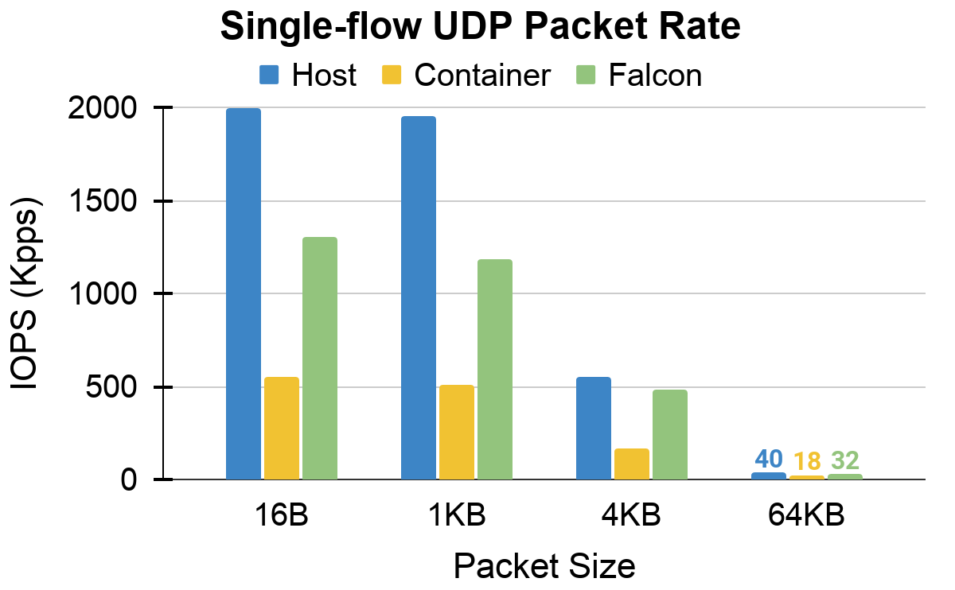
Single-flow Performance
More than 2X improvement than vanilla container
> 2X
Notes:
First, let's take a look at the IOPS performance of a single UDP flow.
As shown in the figure, with various packet size from 16B to 64KB, we achieve more than 2x performance improvement compared with the vanilla container network.

Slide 41
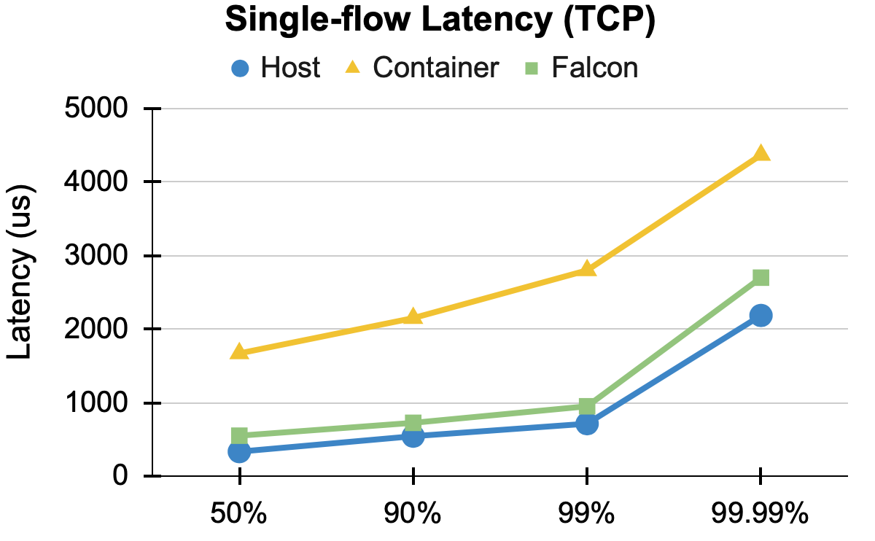
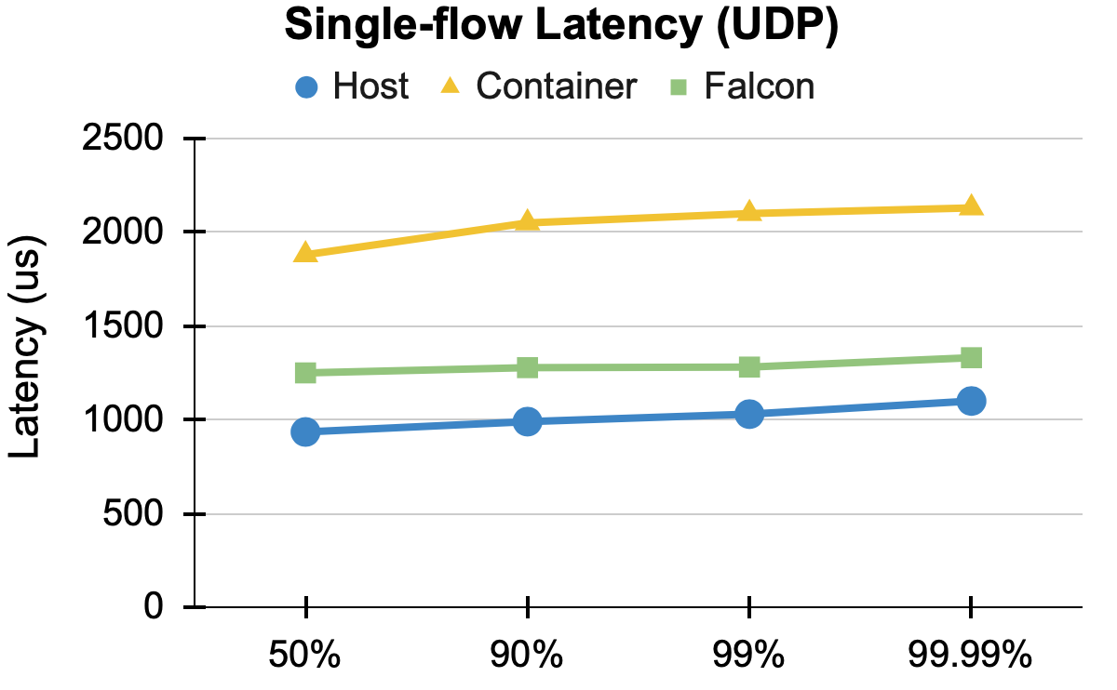
Single-flow Performance
Both median and tail latency get close to host networks.
close to host
Notes:
We also observed the similar improvement for single-flow latency.
Due to serialized execution of multiple stages on the same core, the container latency is more than 2x than host network.
However, Falcon achieves both median and tail latency much close to the host network.

Slide 42
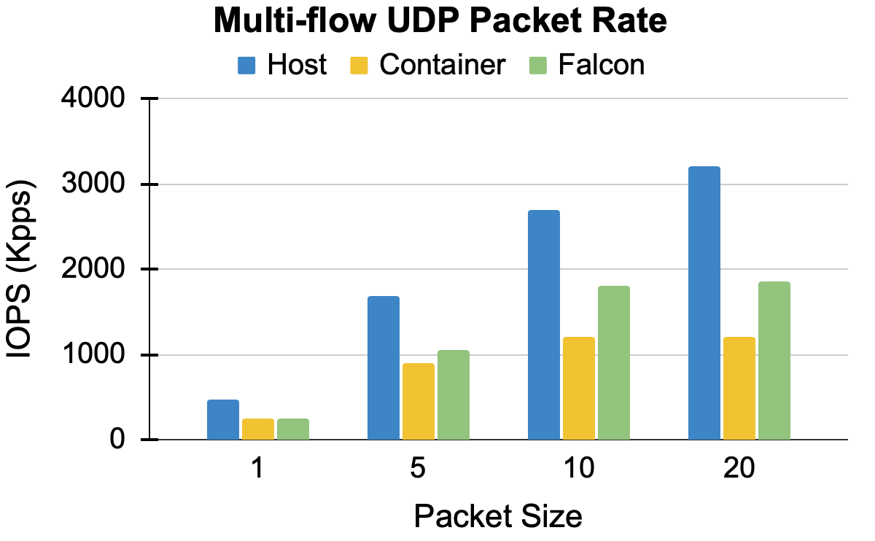
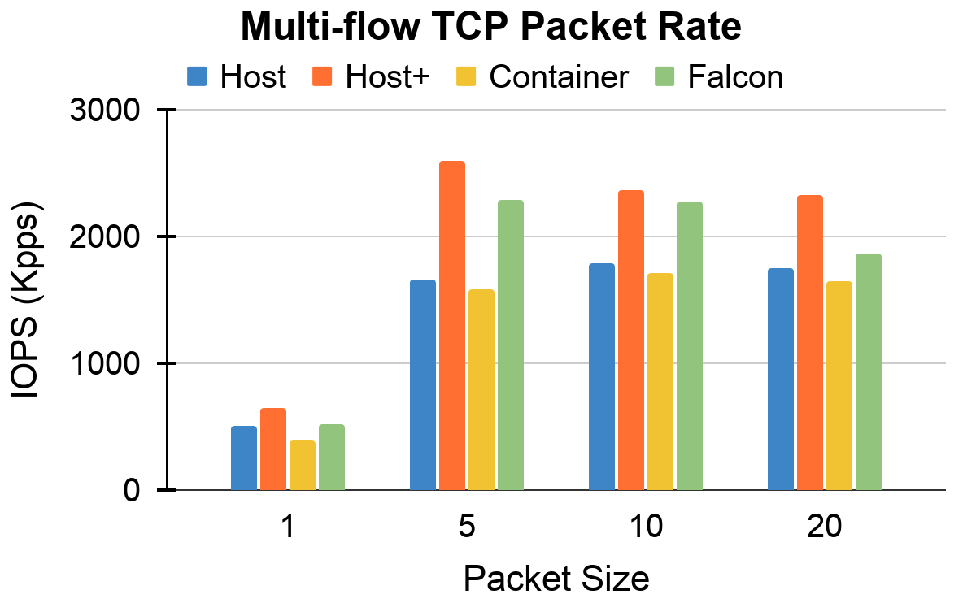
Multi-flow Performance
UDP: as much as 55% improvement
TCP: improve host network by 56%, overlay network by 45%
45%
55%
56%
Notes:
For multi-flow tests, we changed the flow number from 1 to 20. The packet sizes were set to 16 B and 4 KB for UDP and TCP.
For UDP, We can see, Falcon can consistently improve the vanilla container by as much as 55%.
For TCP, we further enabled GRO-splitting for the host network, which is marked as Host+.
GRO-splitting even helped achieve up to 56% throughput improvement in Host+ than the vanilla host network.
And also for overlay networks, Falcon outperformed the vanilla by as much as 45%.

Slide 43
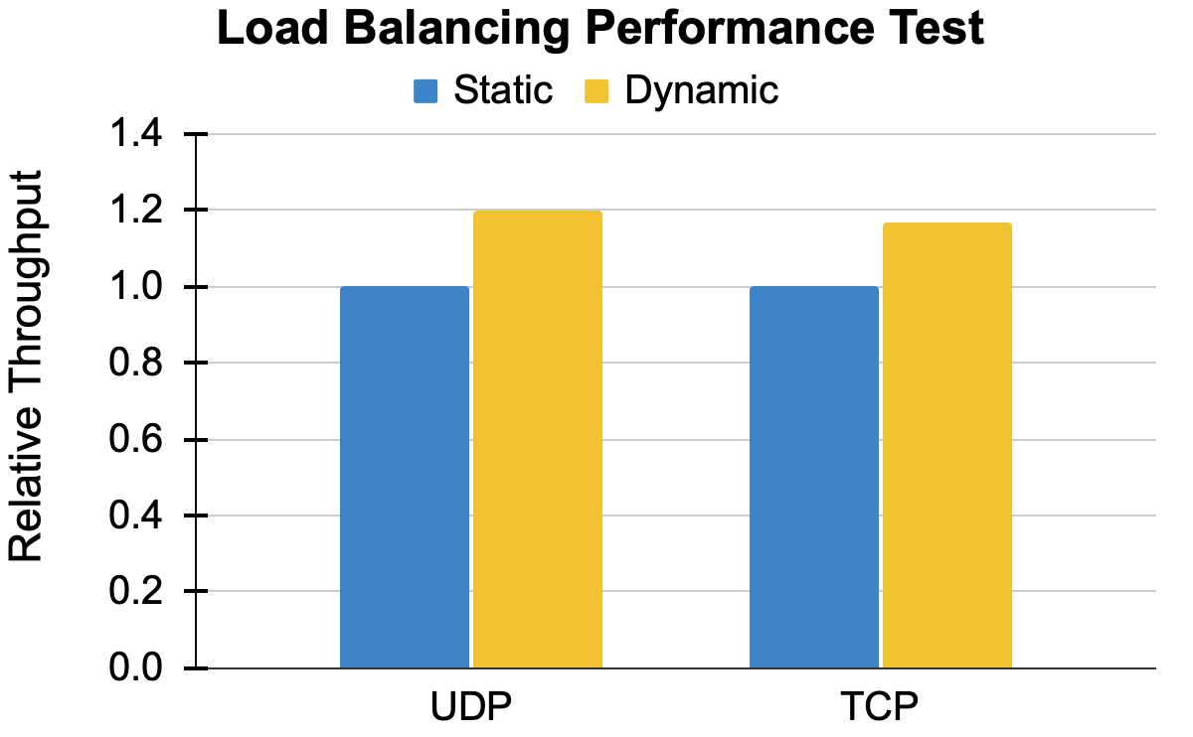
Load Balancing
Increase the intensity of certain flows suddenly
Improvement: UDP - 18% ; TCP - 15%
+18%
+15%
Notes:
Then we demonstrate the significance of Falcon’s balancing algorithm
we created hotspots by suddenly increasing the intensity of certain flows, resulting in some overloaded cores.
Our proposed two-choice balancing algorithm achieved 18% higher throughput in UDP about 15% higher throughput in TCP.

Slide 44
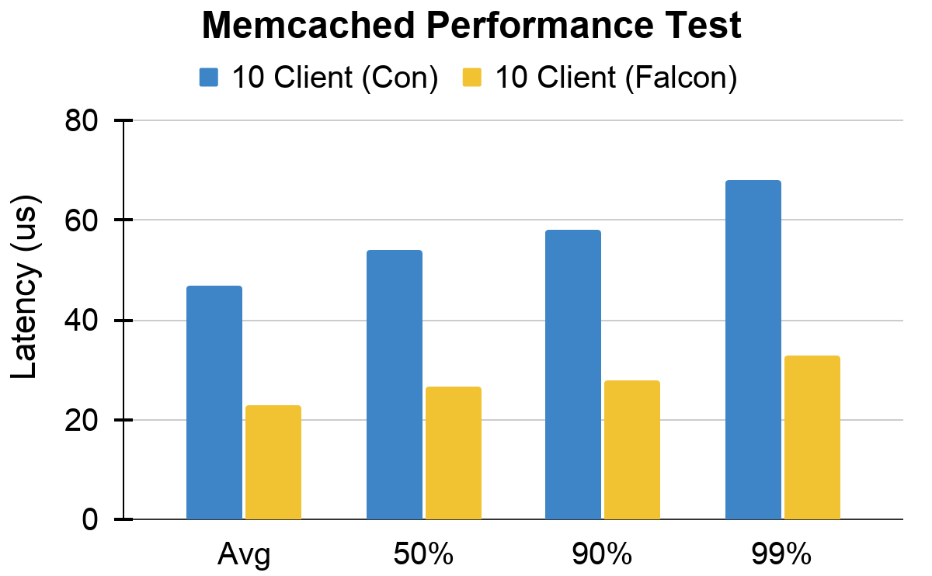
Memcached Performance
With 10 clients, Falcon reduces the average and tail latency by 51% and 53%
53%
51%
Notes:
Next, We further measured the average and tail latency using memcached data caching benchmark in Cloudsuite.
For With 10 clients, Falcon reduces the average and tail latency by 51% and 53%

Slide 45
Conclusions
Excessive, serialized and expensive SoftIRQs incur significant performance loss for overlay networks.
FALCON parallelizes the SoftIRQs processing by utilizing the multicore architecture.
FALCON can significantly improve the performance of container overlay networks.
Our implementation is open-sourced at: github.com/munikarmanish/falcon
Thank you!
Notes:
Let me summarize our work.
We demonstrate that the performance loss in container overlay networks is due to the serialized, excessive and expensive softirqs.
Our solution Falcon parallelizes the softirq processing with three designs: softIRQ pipelining, splitting and dynamic balancing.
We enable fine-grained, low-cost flow parallelization on multicore machines then significantly improve the performance of container overlay networks.
If you are interested, please check out our paper. We have more design details and more evaluation test results shown in the paper. Thank you.

