Slide 1
VM
VM
App
App
App
App
GuestOS
Kernel 1
GuestOS
Kernel 2
App
App
HostOS
HostOS
Hardware
Hardware

Slide 2
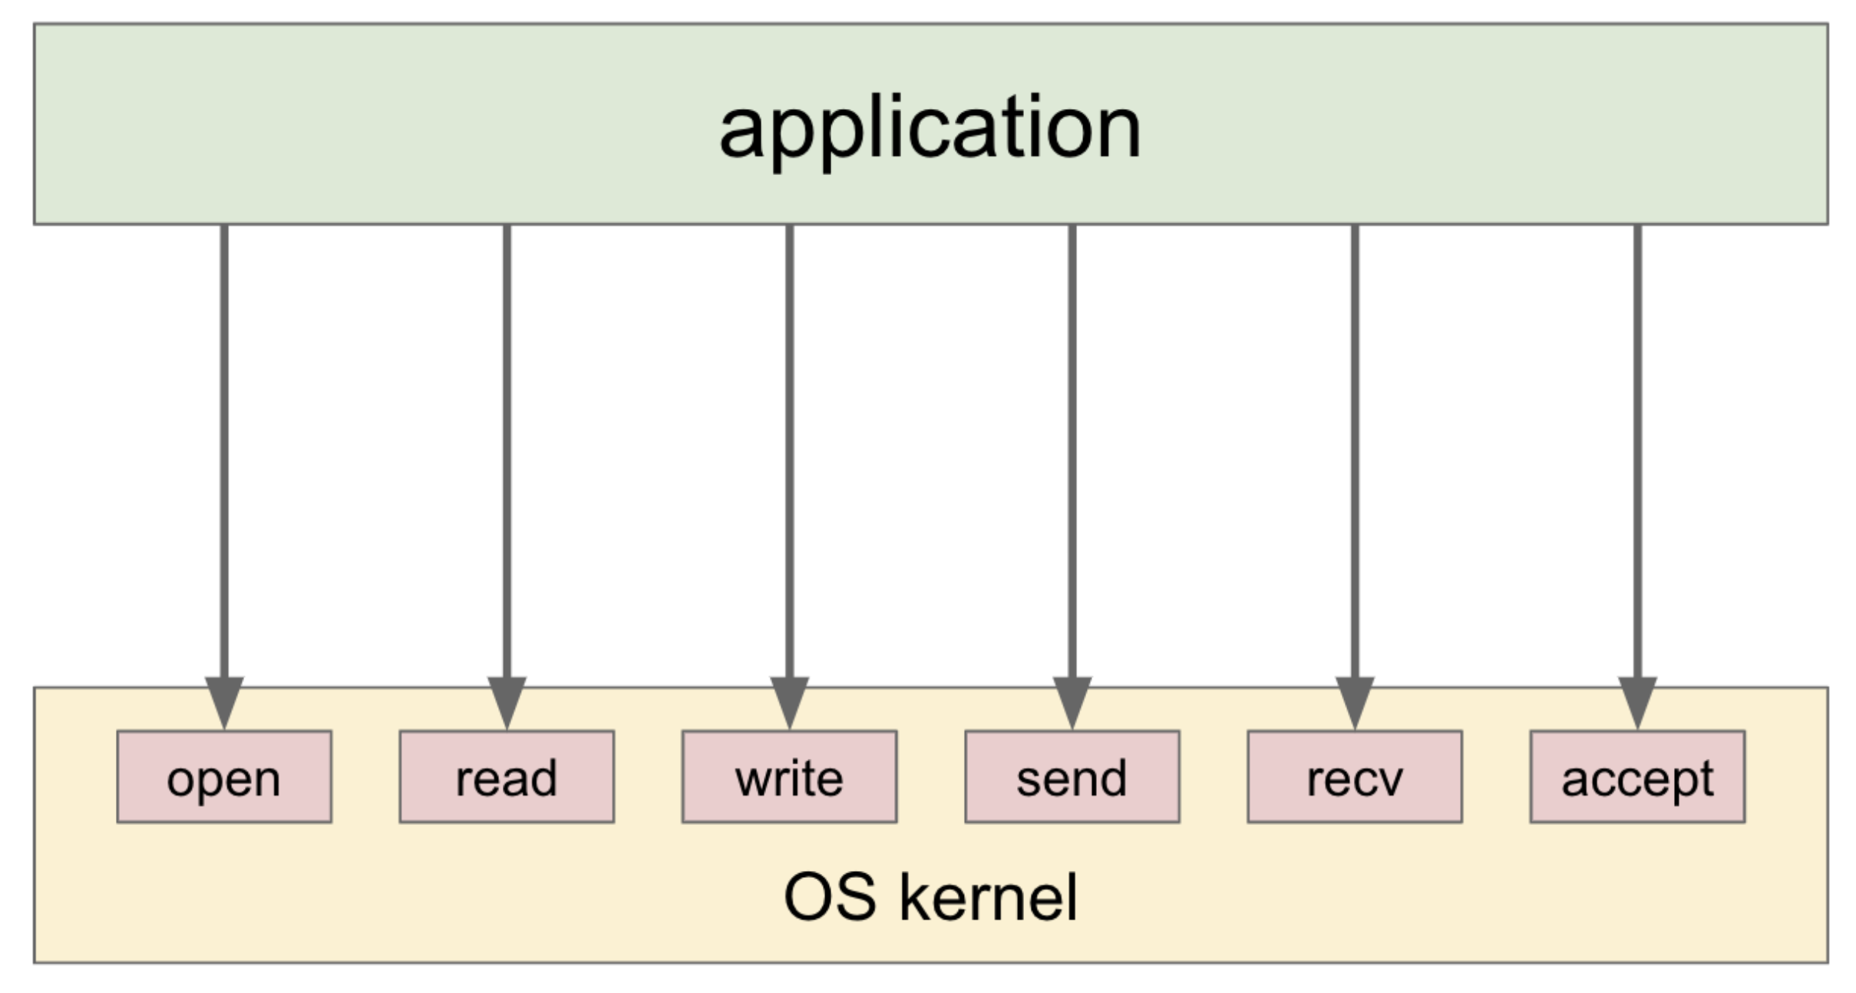
helloworld

Slide 3
S1 = This is a berry 🫐. This is cherry 🍒.
S2 = is

Slide 4
The number of substrings thread 1 found by Sisi is ...
The number of substrings thread 2 found by Sisi is ...
The number of substrings thread 10 found by Sisi is ...
Total substrings found by by Sisi is ...

Slide 5
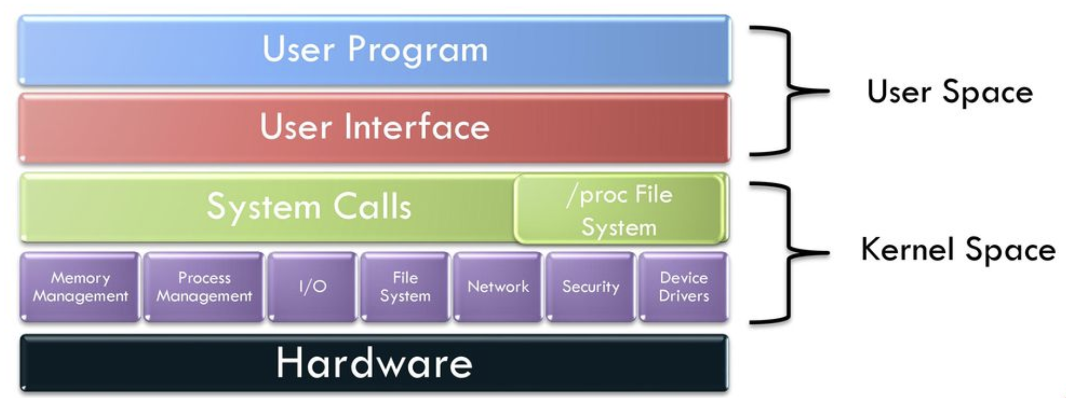
Process virtual memory
mmap
Disk file

