Slide 1
CS 4504 Parallel and Distributed Computing Project 2 Introduction
Kun Suo
Computer Science, Kennesaw State University
https://kevinsuo.github.io/

Slide 2
Assignment
Given two character strings s1 and s2. Write a Pthread program to find out the number of substrings, in string s1, that is exactly the same as s2.
https://github.com/kevinsuo/CS3502/blob/master/project-pthread.c

Slide 3
Assignment Examples
number_substring(“abcdab”, “ab”) = 2,
number_substring(“aaa”, “a”) = 3,
number_substring(“abac”, “bc”) = 0.
Subsequence
not substring

Slide 4
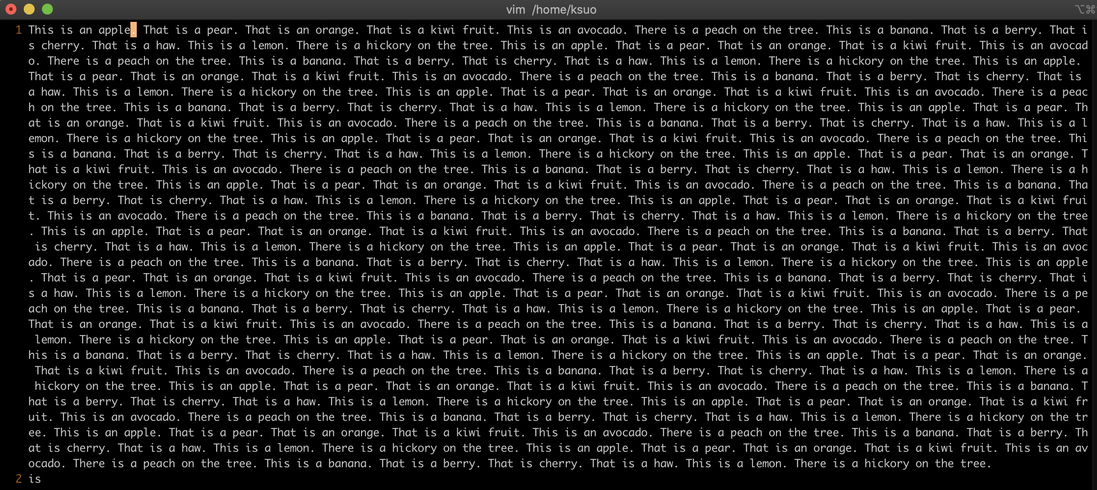
Assignment
Input file: https://github.com/kevinsuo/CS3502/blob/master/strings.txt

Slide 5
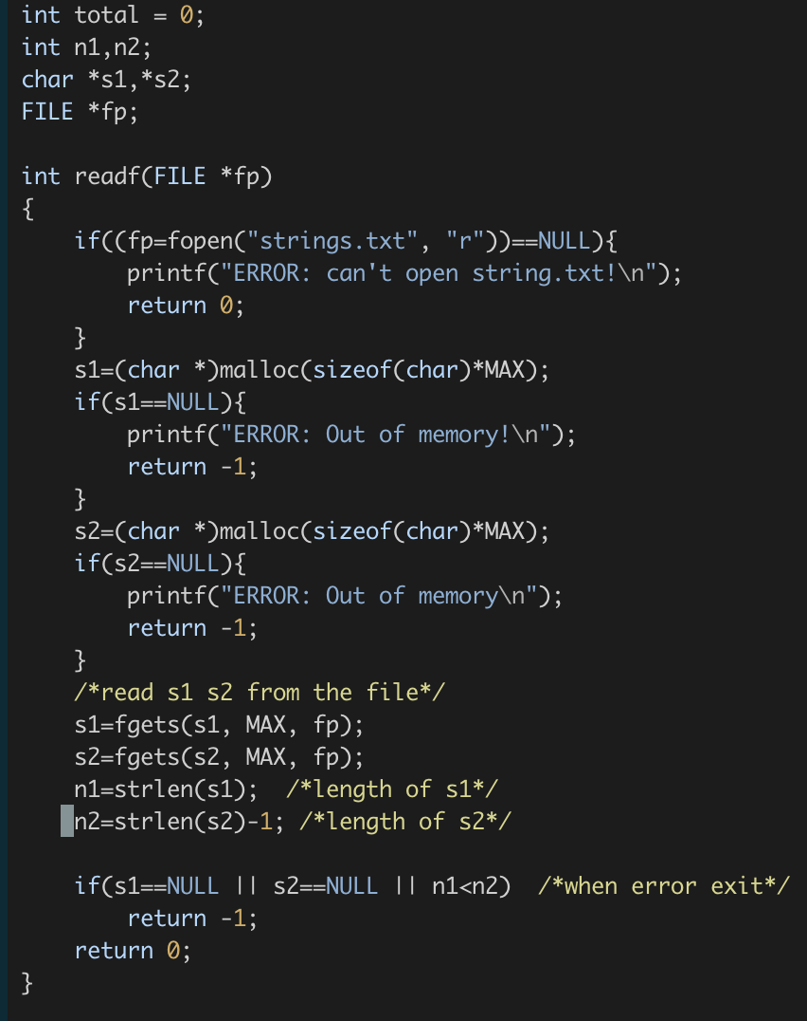
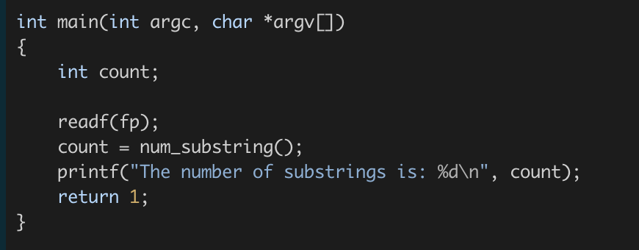
Use strlen(s2)-1
Because there exist a ‘\n’ at the end of s2

Slide 6
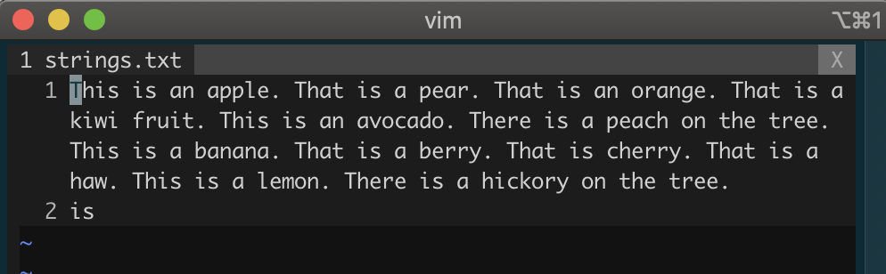
‘\n’ at the end of s2
Use strlen(s2)-1
Because there exist a ‘EOF’ at the end of s2

Slide 7
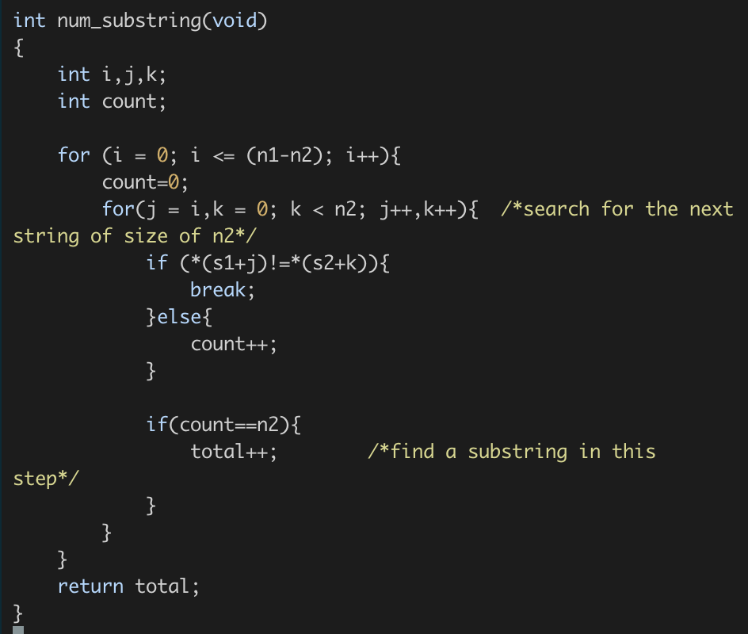
n1
S1
i
i
n2
S2
S2

Slide 8
i
n1
S1
j
n2
S2
k
0
n2

Slide 9
i
S1
n1
j
*(s1+j)
S2
*(s2+k)
0
k
n2

Slide 10
i
S1
n1
j
*(s1+j)
S2
*(s2+k)
0
k
n2

Slide 11

Assignment
(Different text files output is also different. For the strings.txt, the output is 55)

Slide 12
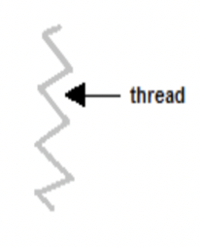
Assignment
Write a parallel program using Pthread based on this sequential solution.
S1
S2
S2
S2

Slide 13
Corner Case in Assignment
num_substring (T1, S2)
num_substring (T2, S2)
num_substring (Tk, S2)
i
s
S1
T1
T2
Tk
S2
S2
S2

Slide 14

Verify whether your parallel thread is correct
Modify the strings.txt by yourself
Compare the sequential and parallel program results that whether they are the same

Slide 15
Submission
source code
output screenshot of your parallel code
a report describe your code logic

