Slide 1
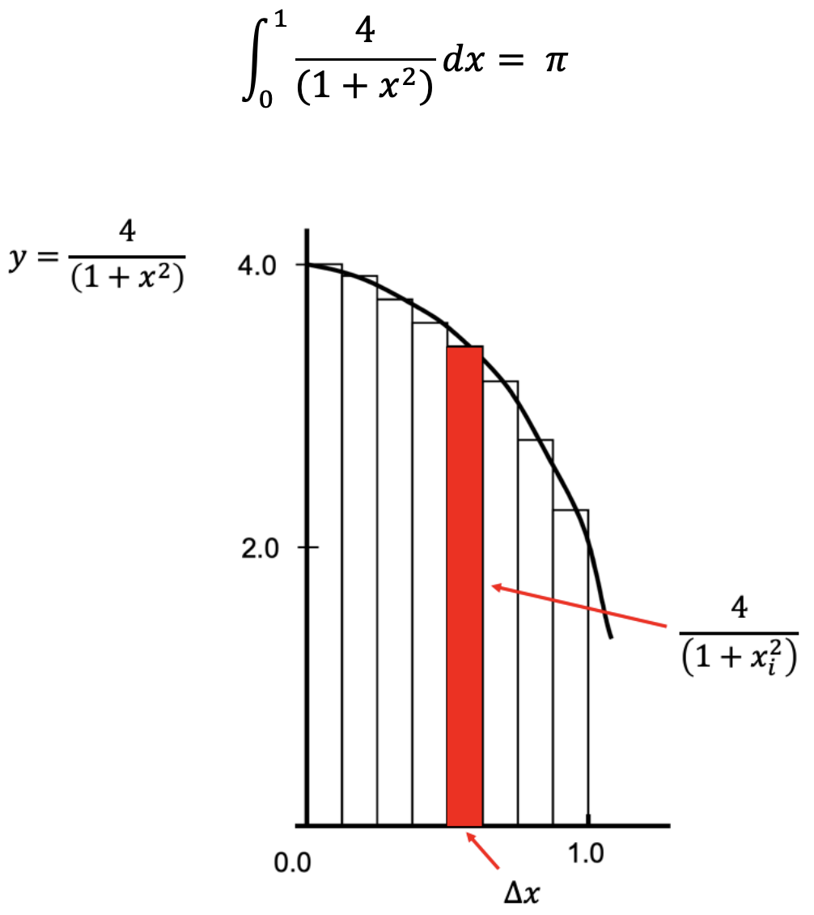

Hint of Project
height=
x_{i}
width=step

Slide 2
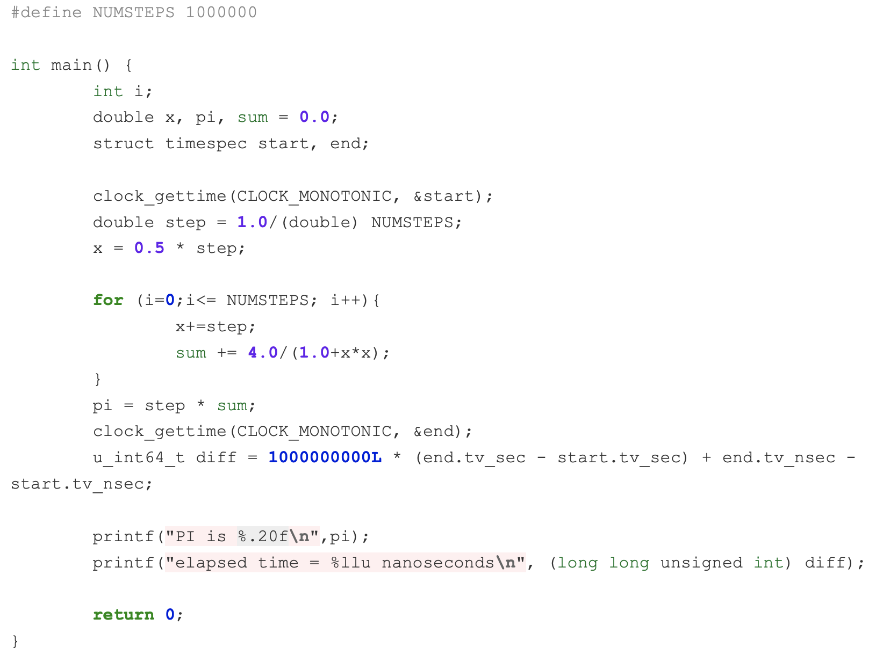

Hint of Project
$$∆x$$
y
size of rectangle

Slide 3

Hint of Project
I send
Rank = 1
Rank = 2
Rank = n
Rank = 0
I receive

Slide 4
Hint of Project
Rank = 1
Rank = 2
Rank = n
Jump over num_procs
rank_ID

Slide 5
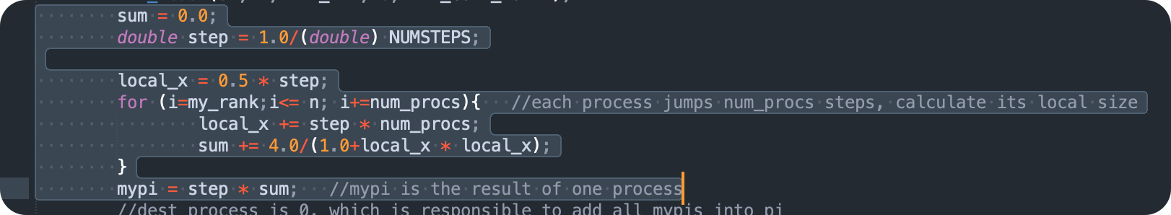

Hint of Project

Slide 6
Hint of Project
Rank = 1
Rank = 2
Rank = n
Jump over num_procs
rank_ID

Slide 7
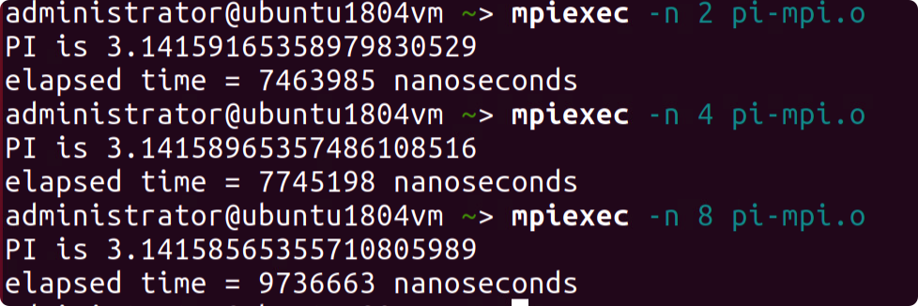



Hint of Project
Result in a.aa:
2 digits
3.332 ≈ 3.33 + 1.999 = 5.329 ≈ 5.33
1.555 + 1.777 + 1.999 = ?
3.776 ≈ 3.78 + 1.555 = 5.335 ≈ 5.34

