Slide 1



Parallelizing Packet Processing in Container Overlay Networks
(EuroSys '21)
Jiaxin Lei¹, Manish Munikar², Kun Suo³, Hui Lu¹, Jia Rao²
¹Binghamton University
²The University of Texas at Arlington
³Kennesaw State University
Notes:
Hello everyone, my name is Jiaxin Lei from Binghamton University.
Today I’m going to talk about our paper “Parallelizing Packet Processing in Container Overlay Networks”.

Slide 2
Containers are taking over the cloud
Lightweight
OS level virtualization
Higher application density
Better resource utilization
Notes:
Let me introduce the container overlay networks to you first.
Containers are taking over the cloud. They provide lightweight operating system level virtualization
with the faster startup, higher application-density and better resource utilization.

Slide 3



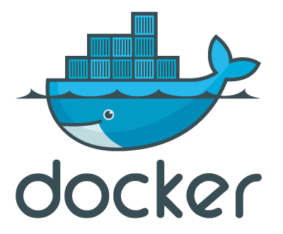

Containers are taking over the cloud
Lightweight
OS level virtualization
Higher application density
Better resource utilization
Based on report, Google launches over 7k+ containers per sec for its searching service.
Notes:
It is reported that Google launches over 7,000 containers every second in its search engine.
With the help of orchestration tools like Kubernetes and Docker Swarm, services of a distributed application can be packaged into multiple containers
automatically and dynamically deployed across physical or virtual machines.
Here’s a question, how could these containers communicate with each other?

Slide 4
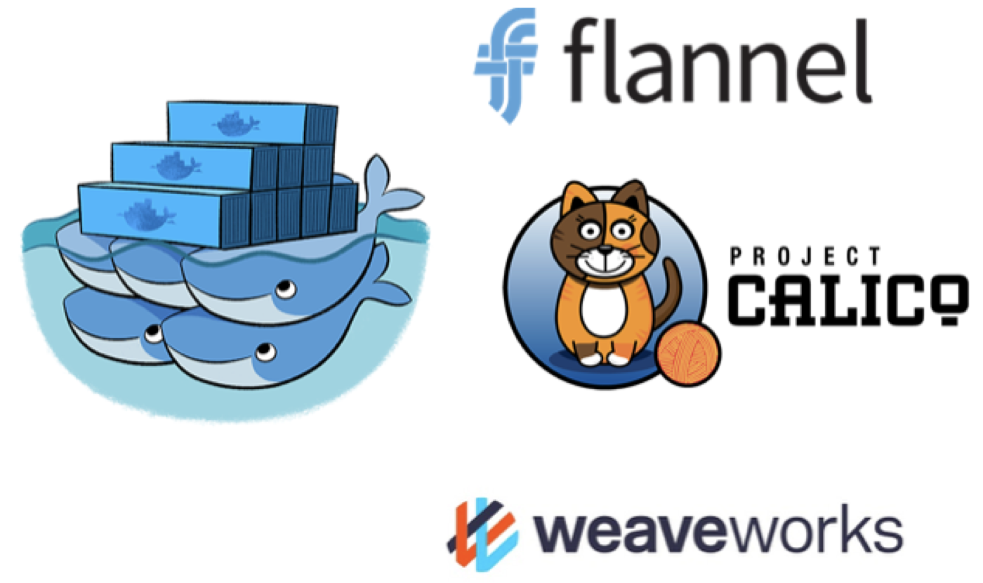
How do containers communicate?
Overlay networks provide connectivity
Typical solutions: Docker Overlay, Flannel, Calico, Weave…
Generally build upon tunneling approach like VxLAN protocol
Notes:
So next, let me introduce the Overlay Network, which is the de facto technique providing the customized connectivity among containers.
Some example overlay solutions are like Docker Overlay, Flannel, Calico and Weave.
They are generally built upon the tunneling approach like the VxLAN protocol.

Slide 5
How do containers communicate?
Overlay networks provide connectivity
Typical solutions: Docker Overlay, Flannel, Calico, Weave…
Generally build upon tunneling approach like VxLAN protocol
Original Packet
Inner Ethernet Header
Inner IP Header
Payload
Notes:
VxLAN protocol enables the container network traffic to go through the physical network
by encapsulating the original container packet

Slide 6
How do containers communicate?
Overlay networks provide connectivity
Typical solutions: Docker Overlay, Flannel, Calico, Weave…
Generally build upon tunneling approach like VxLAN protocol
VxLAN Encapsulation
Original Packet
Outer Ethernet Header
Outer IP Header
Outer UDP Header
VxLAN Header
Inner Ethernet Header
Inner IP Header
Payload
FCS
Notes:
within its host header.

Slide 7
How do containers communicate?
Overlay networks provide connectivity
Typical solutions: Docker Overlay, Flannel, Calico, Weave…
Generally build upon tunneling approach like VxLAN protocol
VxLAN Encapsulation
Original Packet
Outer Ethernet Header
Outer IP Header
Outer UDP Header
VxLAN Header
Inner Ethernet Header
Inner IP Header
Payload
FCS
VxLAN Flags
Reserved
VxLAN Network Identifier
Reserved
Notes:
Via a unique VxLAN id, containers belonging to a same virtual network can be identified and isolated to communicate with its private IP address.

Slide 8
How do containers communicate?
Overlay networks provide connectivity
Typical solutions: Docker Overlay, Flannel, Calico, Weave…
Generally build upon tunneling approach like VxLAN protocol
VxLAN Encapsulation
Original Packet
Outer Ethernet Header
Outer IP Header
Outer UDP Header
VxLAN Header
Inner Ethernet Header
Inner IP Header
Payload
FCS
VxLAN Flags
Reserved
VxLAN Network Identifier
Reserved
Notes:
While actually the packets are routed through the underlying public network with the hosts IP address.
So what is the overhead of this kind of complicated packet encapsulation?

Slide 9
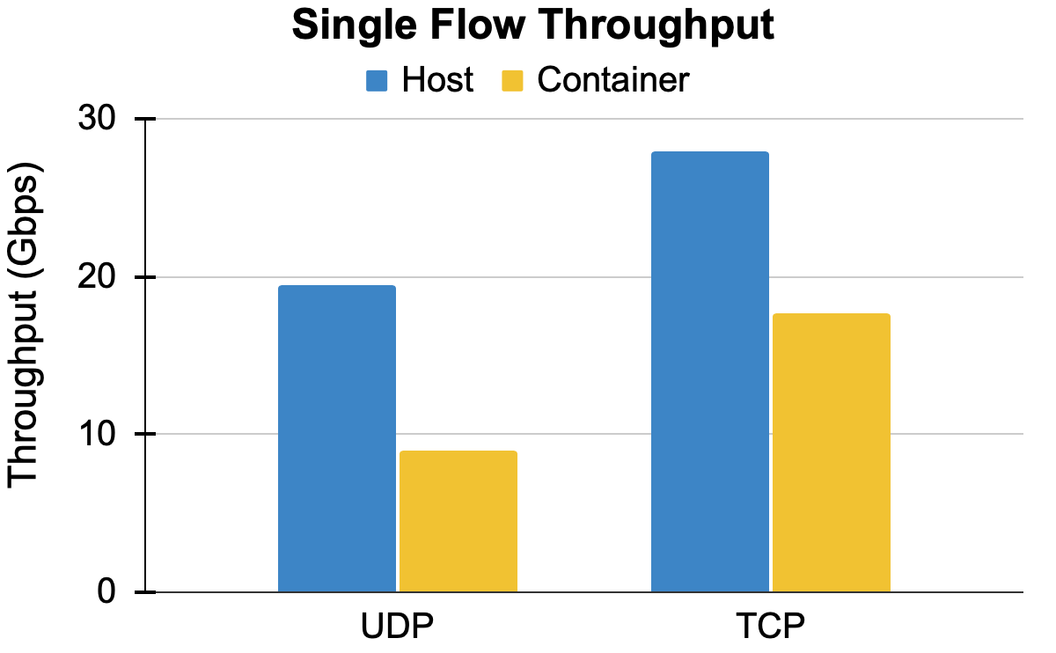
Performance overhead of overlay networks
Machines are connected via 100 GbE NIC.
Notes:
Let me show you some data.
We were motivated by the single flow performance tests. Our two test machines are directly connected via a 100Gb Network Card.
For single flow throughput test,

Slide 10
Performance overhead of overlay networks
Machines are connected via 100 GbE NIC.
47%
53%
Notes:
comparing to the host network, throughput of container overlay networks drops by 53% and 47% for UDP and TCP separately.

Slide 11
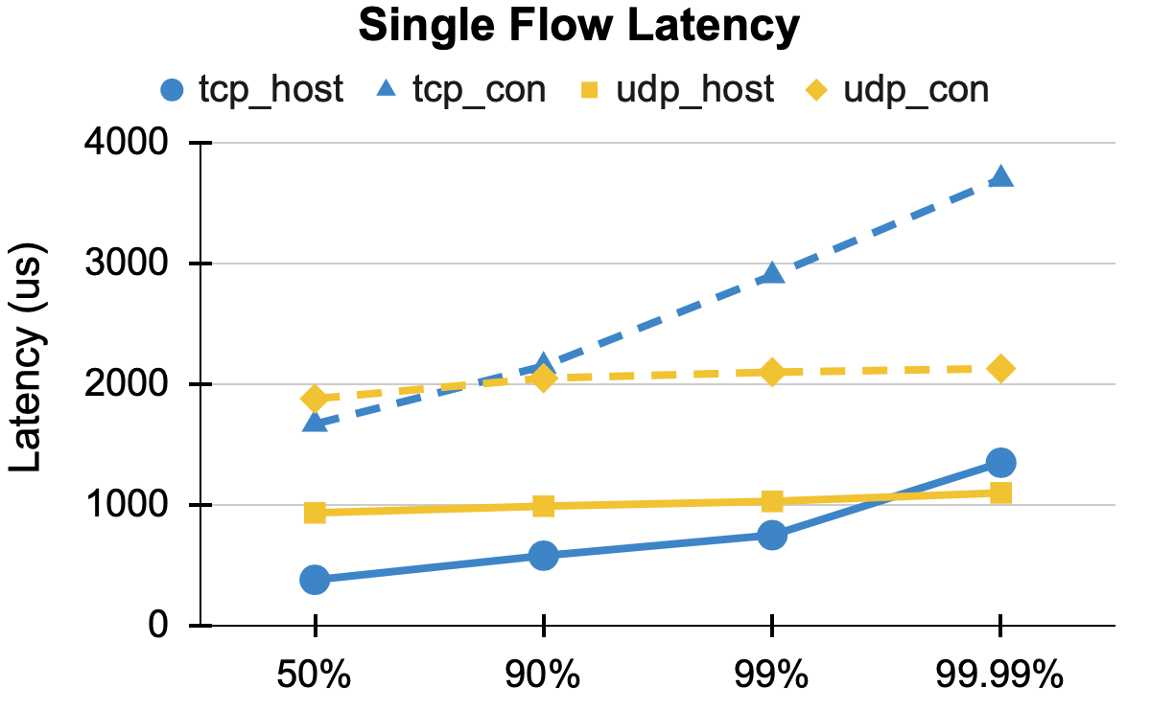
Performance overhead of overlay networks
Machines are connected via 100 GbE NIC.
Notes:
For single flow latency test

Slide 12
Performance overhead of overlay networks
Machines are connected via 100 GbE NIC.
3x (TCP)
2x (UDP)
Notes:
container overlay network degrades by at least 2x for UDP and 3x for TCP.

Slide 13
Why is overlay network slow?
L 7
L 3&4
L 2
Hardware
Notes:
So why is overlay network so slow? What is the essential reason here?
To explain this

Slide 14
Why is overlay network slow?
Host Networks
L 7
Application (receiver)
L 3&4
L 2
Hardware
pNIC
Notes:
let's first check out how a host-level packet is processed in Linux.
When a packet arrives at the NIC

Slide 15
Why is overlay network slow?
Host Networks
L 7
Application (receiver)
L 3&4
L 2
IRQ
Hardware
pNIC
Notes:
it is first copied to the device buffer then triggers a hardware IRQ.
Next, kernel responds to this hardware IRQ

Slide 16
Why is overlay network slow?
Host Networks
L 7
Application (receiver)
L 3&4
SoftIRQ
L 2
IRQ
Hardware
pNIC
Notes:
Then starts the packet receiving path by raising a software IRQ.
Next, packet will be processed at different protocol layers in the context of softIRQ.
Finally packet will be copied to the user-space buffer then delivered to the application.

Slide 17
Why is overlay network slow?
Host Networks
IRQ + SoftIRQ
L 7
Application (receiver)
L 3&4
SoftIRQ
L 2
IRQ
Hardware
pNIC
Notes:
We can see, for a host network packet, there's only one IRQ and one softIRQ incurred here..

Slide 18
Why is overlay network slow?
Host Networks
IRQ + SoftIRQ
Overlay Networks
L 7
Application (receiver)
Container (receiver)
L 3&4
VxLAN
Container vNIC
SoftIRQ
L 2
IRQ
Container bridge
Hardware
pNIC
pNIC
Notes:
However, packet processing in container overlay networks is a pipeline that contains multiple network devices and stages.

Slide 19
Why is overlay network slow?
Host Networks
IRQ + SoftIRQ
Overlay Networks
L 7
Application (receiver)
Container (receiver)
L 3&4
VxLAN
Container vNIC
SoftIRQ
L 2
SoftIRQ
IRQ
Container bridge
IRQ
Hardware
pNIC
pNIC
Notes:
When the first softIRQ is being processed, the network stack will identify that this is an encapsulated overlay packet.
So it will do the decapsulation in protocol stackto remove the outer header
Then keep moving the inner packet into container bridge device and container virtual NIC

Slide 20
Why is overlay network slow?
Host Networks
IRQ + SoftIRQ
Overlay Networks
L 7
Application (receiver)
Container (receiver)
L 3&4
VxLAN
SoftIRQ
SoftIRQ
Container vNIC
SoftIRQ
L 2
SoftIRQ
IRQ
Container bridge
IRQ
Hardware
pNIC
pNIC
Notes:
By raising the 2nd and 3rd softIRQs.
Eventually packet will be delivered to the target container application.
By raising the 2nd and 3rd softIRQs.
Eventually packet will be delivered to the target container application.

Slide 21
Why is overlay network slow?
Host Networks
IRQ + SoftIRQ
Overlay Networks
IRQ + 3xSoftIRQs
L 7
Application (receiver)
Container (receiver)
L 3&4
VxLAN
SoftIRQ
SoftIRQ
Container vNIC
SoftIRQ
L 2
SoftIRQ
IRQ
Container bridge
IRQ
Hardware
pNIC
pNIC
Notes:
So here, container overlay packet incurs one hardware IRQ, three software IRQs which are triggered by the different network devices separately.

Slide 22
Why is overlay network slow?
Host Networks
IRQ + SoftIRQ
Overlay Networks
IRQ + 3xSoftIRQs
Overhead
Additional devices
Prolonged path
Excessive and serialized softIRQs
L 7
Application (receiver)
Container (receiver)
L 3&4
VxLAN
SoftIRQ
SoftIRQ
Container vNIC
SoftIRQ
L 2
SoftIRQ
IRQ
Container bridge
IRQ
Hardware
pNIC
pNIC
Notes:
To summarize, comparing with the host network
additional network devices, prolonged packet processing path and excessive and serialized SoftIRQs lead to high overhead of container overlay networks.
The performance issue of overlay networks is well-identified.

Slide 23
Existing solutions to accelerate overlay networks
Kernel bypass (DPDK+mTCP)
✔ Avoids OS overheads, network stack tailored to application
❌ Operator has no control over network stack, have to trust application
Notes:
There are some existng works targeting to solve this problem.
For example, In a kernel bypass design like DPDK, packets are directly processed in a customized user-level nework stack such as mTCP.
This solution avoids Operating System overheads such as softirqs and context switchings.
But, it requires application developers to change the application and also operators have no control of network stack.

Slide 24
Existing solutions to accelerate overlay networks
Kernel bypass (DPDK+mTCP)
✔ Avoids OS overheads, network stack tailored to application
❌ Operator has no control over network stack, have to trust application
Connection-level metadata transformation (Slim, FreeFlow)
✔ Avoids overhead of virtual devices, fast as host network
❌ Limited scalability; only for TCP; doesn't support data-plane policies
Notes:
In another kind of design like Slim, it creates a new connection-level metadata transformation protocol. With this new customized protocol, we can avoid the overhead of additional virtual devices and prolonged data path.
It is fast but this design has some limitations like limited scalability and limited support for deploying network policies.

Slide 25
Existing solutions to accelerate overlay networks
Kernel bypass (DPDK+mTCP)
✔ Avoids OS overheads, network stack tailored to application
❌ Operator has no control over network stack, have to trust application
Connection-level metadata transformation (Slim, FreeFlow)
✔ Avoids overhead of virtual devices, fast as host network
❌ Limited scalability; only for TCP; doesn't support data-plane policies
Hardware offload (Mellanox ASAP², AccelNet)
✔ Fastest, completely avoids CPU overheads
❌ Requires new/expensive hardware; SR-IOV limitations; limited isolation/flexibility/scalability
Notes:
The last kind of solution is hardware offloading.
For example, AccelNet from Microsoft deploys the state of art FPGA-based smartNICs in their datacenter
to offload the most cpu-intensive network processing tasks
onto this customized hardware.
But this kind of solution usually require the expensive hardware.

Slide 26
Our solution - FALCON
FALCON = Fast and Balanced Container Networking
Key idea: Utilize idle CPU resources to accelerate packet processing
Notes:
Our solution solves this problem in a different way.
We target salvaging the commodity OS kernel to specifically support the overlay networks.
The key idea of our design FALCON is leveraging the multi-core architecture to utilize idle CPU resources to accelerate packet processing.

Slide 27
Our solution - FALCON
FALCON = Fast and Balanced Container Networking
Key idea: Utilize idle CPU resources to accelerate packet processing
✅ Software-based solution
✅ Full network isolation / flexibility
✅ Completely backward compatible Immediately deployable in real systems
✅ Better performance
Notes:
It is a complete software-based and backward compatible solution.
We improved the performance of overlay networks while still providing the full feature of Linux network stack such as isolation, flexibility, and scalability.
Next, Let’s go through our design.

Slide 28
FALCON - SoftIRQs Pipelining
Blue - 1st SoftIRQ ; Green - 2nd SoftIRQ; Yellow - 3rd SoftIRQ
....
3
2
1
Core0
1
2
3
1
2
3
1
2
Application
Core1
Core2
Time
Notes:
The first design in Falcon is SoftIRQ Pipelining.
As shown in this figure, the blue blocks represent packet processing inside the first softIRQs
green is the second one and yellow is the third.

Slide 29
FALCON - SoftIRQs Pipelining
Blue - 1st SoftIRQ ; Green - 2nd SoftIRQ; Yellow - 3rd SoftIRQ
These 3 stages can be dispatched and parallelized
....
3
2
1
Core0
1
2
3
1
2
3
1
2
Application
Core1
Core2
Time
Notes:
Remember that
softIRQs in packet processing path are triggered by different network devices separately. So these three different stages can be dispatched and parallelized.

Slide 30
FALCON - SoftIRQs Pipelining
Stage transition functions (Hashing)
....
3
2
1
Core0
1
2
3
4
5
6
Core1
1
2
3
4
5
6
Core2
1
2
3
4
5
6
Application
Time
Notes:
Based on our code-level research, we identified stage transition functions in the kernel.
This function is used to enqueue the packet to next device then raise a new softirq for the following packet processing.

Slide 31
FALCON - SoftIRQs Pipelining
Stage transition functions (Hashing)
4 tuples (IPs+Ports) -> 5 tuples (IPs+Ports+DeviceID)
....
3
2
1
Core0
1
2
3
4
5
6
Core1
1
2
3
4
5
6
Core2
1
2
3
4
5
6
Application
Time
Notes:
In the original design, this function does the hash-based calculation to determine the target cpu using 4 tuples:
source IP port, and destination Ip port.
We modified this functions to also consider the device ID.
In this way, different softirqs of the same flow will be raised on different cpu cores.

Slide 32
FALCON - SoftIRQs Pipelining
Stage transition functions (Hashing)
4 tuples (IPs+Ports) -> 5 tuples (IPs+Ports+DeviceID)
Parallelization (Overlapping SoftIRQs)
Maintain In-order
....
3
2
1
Core0
1
2
3
4
5
6
Core1
1
2
3
4
5
6
Core2
1
2
3
4
5
6
Application
Time
Notes:
Our design implements the single flow parallelization by these overlapping SoftIRQs.
And also we maintain the packet order
because the SoftIRQs are still raised stage by stage.
Based on our tests, softIRQs pipelining performs well when all the three stages have similar processing cost, such as UDP flows.

Slide 33
FALCON - SoftIRQs Splitting
For TCP, the 1st stage is heavily loaded
SKB allocation + GRO processing
....
3
2
1
Core0
1
2
3
1
Core1
1
2
3
Core2
1
2
3
Application
Time
Notes:
But for TCP flow, especially with the large packet size, when GRO enabled, the 1st stage is much more expensive than others.
The other stages are invoked only for a fraction of the packets.
In this case, even we enabled SoftIRQs pipeling, the processing is still not efficient due to
the heavily loaded 1st stage.
So we proposed the second design - SoftIRQs Splitting.
With dynamic tracing, we found that the 1st stage of TCP packet processing is mainly dominated by two functions: SKB allocation and GRO processing.

Slide 34
FALCON - SoftIRQs Splitting
For TCP, the 1st stage is heavily loaded
SKB allocation + GRO processing
Enable transition function when doing GRO
....
3
2
1
Core0
1
2
3
4
5
Core1
1
2
3
4
5
Core2
1
2
3
4
5
Core3
1
2
3
4
5
Application
Notes:
So we implemented it by enabling the transition function when entering the GRO routine.
In this way, we successfully keep splitting one heavy softirq into two lighter softirqs.

Slide 35
FALCON - SoftIRQs Balancing
0
1
2
Dispatch SoftIRQs onto overloaded core can even make performance worse
hash
hash
hash
0
1
2
3
70%
90%
25%
45%
Notes:
The last design is softIRQs balancing. We realized that if a cpu core is already heavily loaded, especially in multiple flows case, then even if we dispatch a softirq onto that core, that softirq processing will have a long wait time before it is scheduled to run. Even the packets can be dropped if the input packet queue is full. This can make the performance worse. To avoid this, we developed a simple but effective balancing algorithm.

Slide 36
FALCON - SoftIRQs Balancing
0
1
2
Dispatch SoftIRQs onto overloaded core can even make performance worse
Rehashing based on load
hash
hash
hash
rehash
0
1
2
3
70%
90%
25%
45%

Slide 37
FALCON - SoftIRQs Balancing
0
1
2
Dispatch SoftIRQs onto overloaded core can even make performance worse
Rehashing based on load
hash
hash
hash
rehash
0
1
2
3
70%
90%
25%
100%

Slide 38
FALCON - SoftIRQs Balancing
2
2
2
1
1
1
Dispatch SoftIRQs onto overloaded core can even make performance worse
Rehashing based on load
When whole system is overloaded, FALCON can be dynamically disabled.
0
0
0
0
1
2
3
70%
90%
25%
100%

Slide 39
Evaluation - Setup
Hardware: Intel 40 logical cores @ 2.2GHz, 128 GB RAM
NIC: Mellanox ConnectX-5 EN (100 Gbps)
Software: Ubuntu 18.04 with Linux kernel v5.4
Performance comparisons: Host vs. Container vs. FALCON
Experiments:
Single-flow and multi-flow microbenchmarks
Load balancing
Cloudsuite benchmark (memcached)

Slide 40
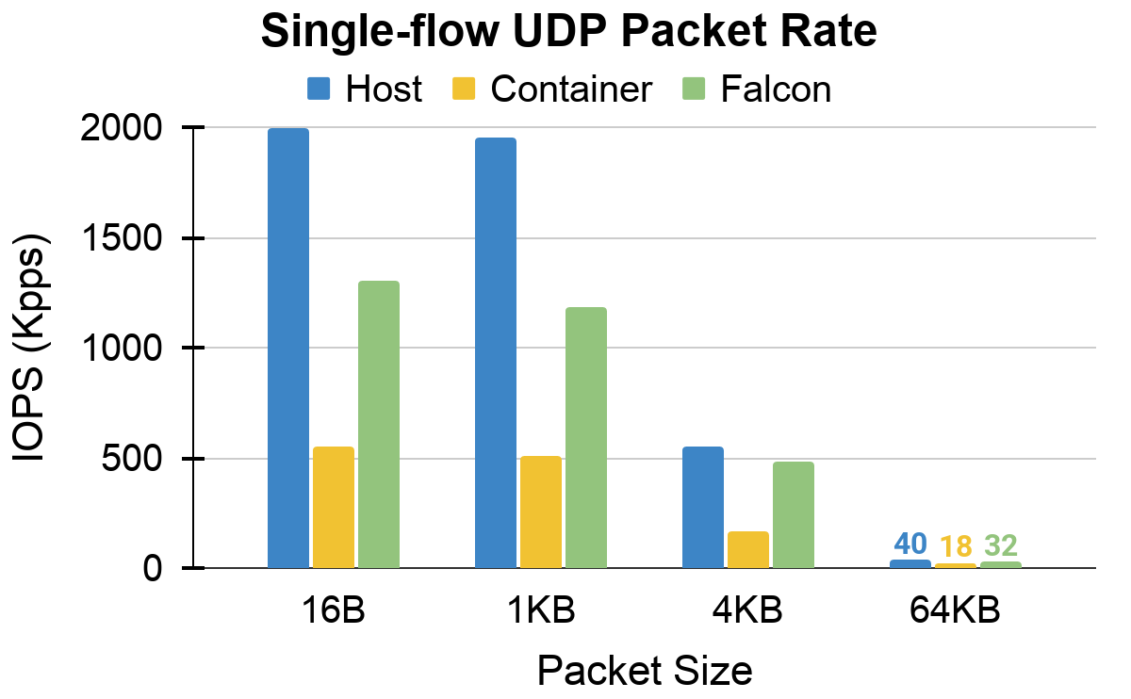
Single-flow Performance
More than 2x improvement than vanilla container

Slide 41
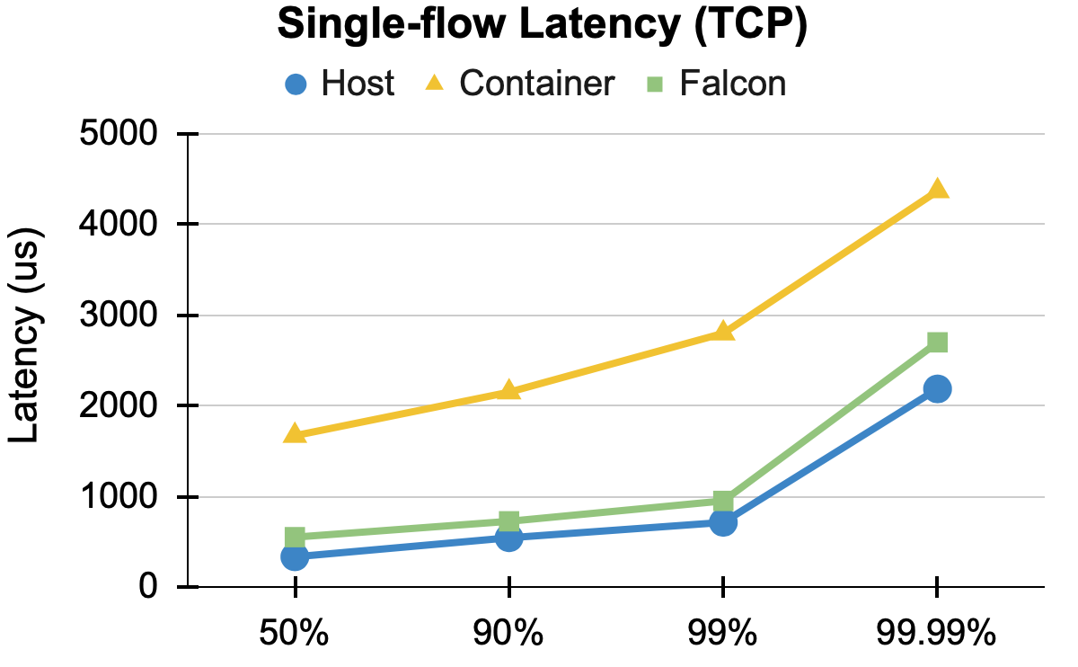
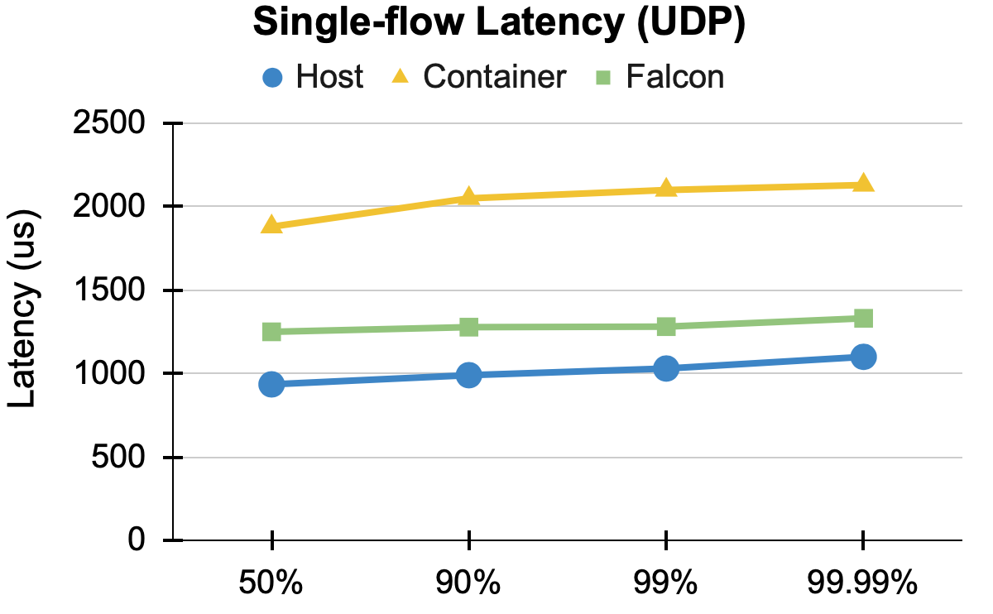
Single-flow Performance
Both median and tail latency get close to host networks

Slide 42
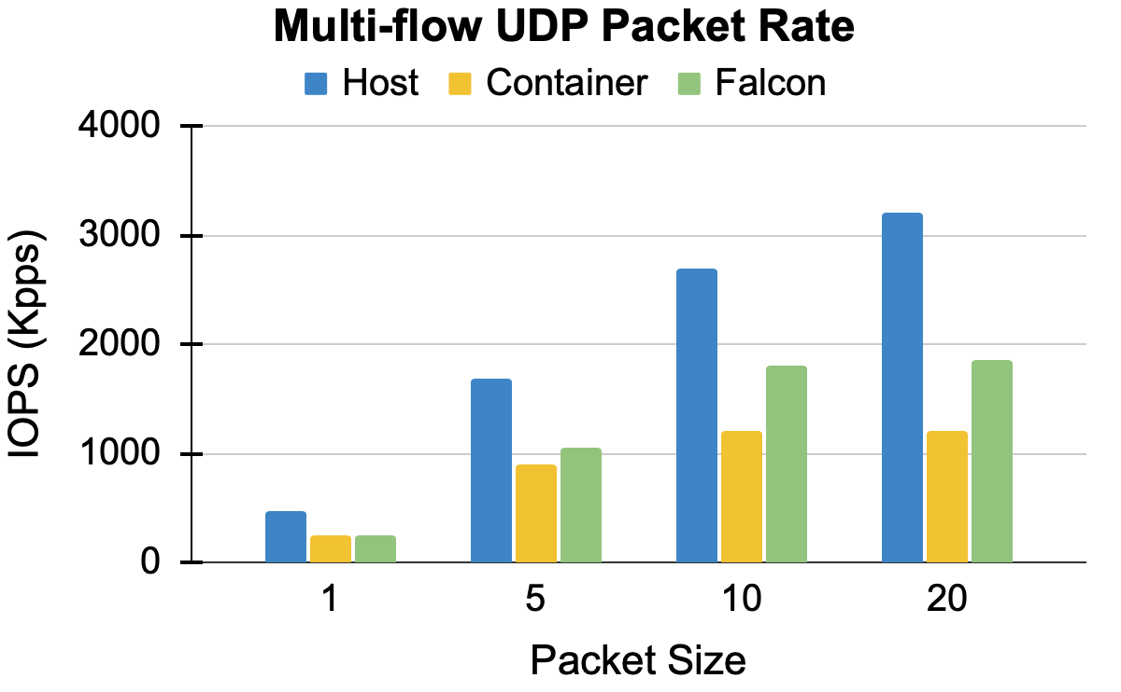
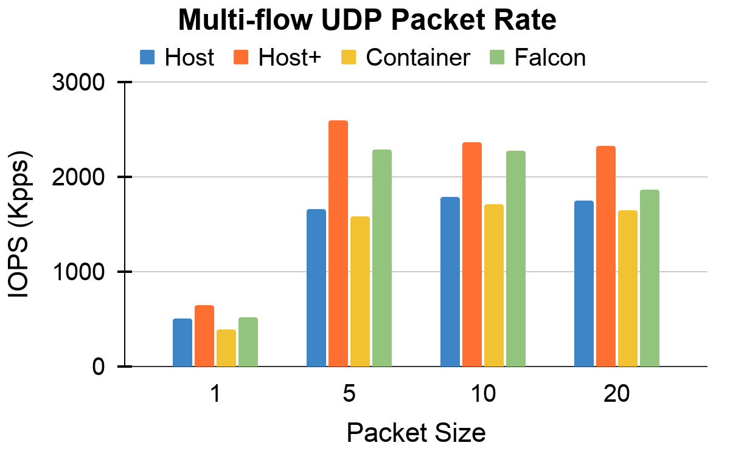
Multi-flow Performance

Slide 43
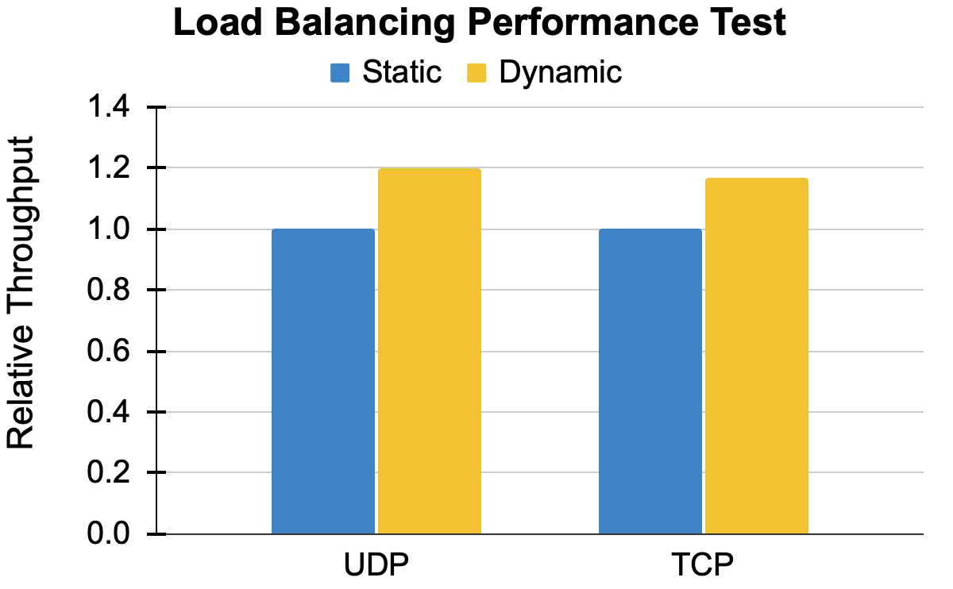
Load Balancing

Slide 44
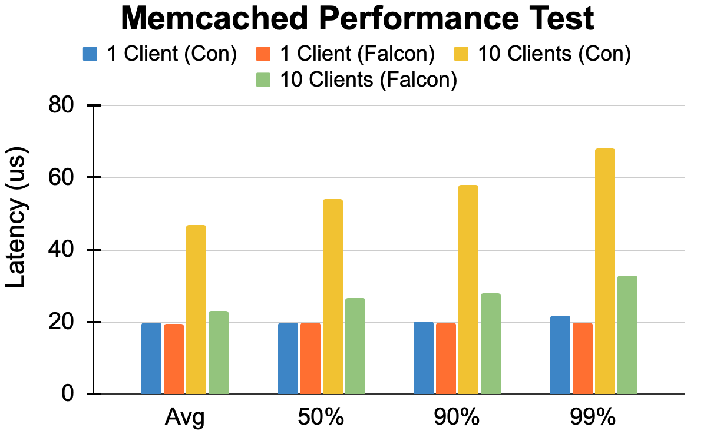
Memcached Performance

Slide 45
Conclusion
Overlay packet processing in OS is not optimized to utilize multicore system.
FALCON accelerates the performance of overlay networks...
Without losing any security, generality, or compatibility.
Purely software-based solution that is immediately deployable.
Our implementation is open-sourced at: github.com/munikarmanish/falcon
Thank you!

Slide 46
Backup Slides

Slide 47
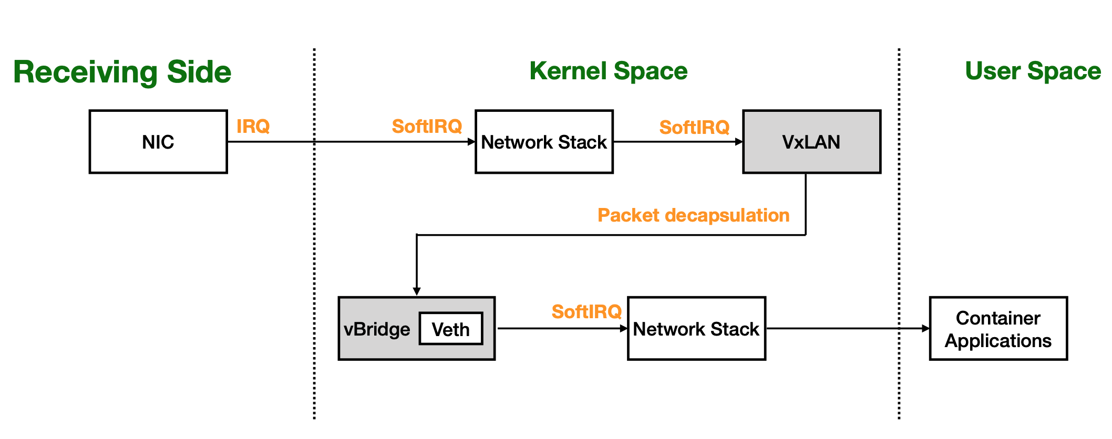
Why is overlay network slow?
Additional virtual devices
Prolonged packet processing path
Serialization of single-flow processing
Quick saturation
Longer queueing delays
Load imbalance
<show the packet path from NIC to Application>

Slide 48
How do containers communicate?
Host mode (containers use host network namespace)
✔ Simple and fast
❌ No network isolation/flexibility
Macvlan mode (assign multiple MAC to same physical NIC)
✔ Fast and some isolation/flexibility
❌ Complex host network routing management
Overlay mode (packet encapsulation)
✔ Full network isolation and flexibility
❌ High overheads / slow

Slide 49
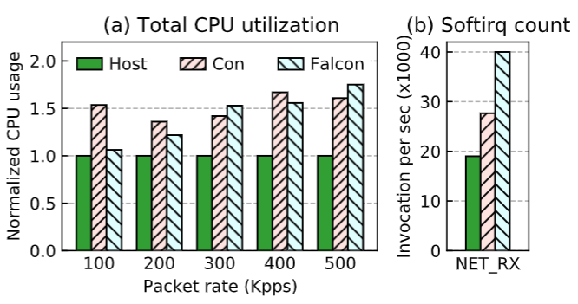
Overheads and Limitations
Higher overall CPU utilization
More softirq invocations
Loss of data locality
Notes:
This can also be moved to "backup slides".

Slide 50
Existing optimizations in Linux
IRQ coalescing
GRO/GSO
RSS/RPS
L 7
Application (receiver)
Container (receiver)
L 3&4
VxLAN
SoftIRQ
SoftIRQ
Container vNIC
SoftIRQ
L 2
SoftIRQ
IRQ
Container bridge
IRQ
Hardware
pNIC
pNIC
Notes:
There ARE some packet processing optimizations in Linux such as IRQ coalescing, GRO and RPS. But these are designed for general packet processing, and do not address the specific problems of overlay networks.

Slide 51
Evaluation - Setup
Hardware: Intel Xeon Silver 4114 with 40 logical cores @ 2.2GHz, 128 GB RAM
NIC: Mellanox ConnectX-5 EN (100 Gbps)
Software: Ubuntu 18.04 with Linux kernel v5.4
Performance comparisons: Host vs. Container vs. FALCON
Experiments:
Single-flow and multi-flow microbenchmarks
Cloudsuite benchmark (memcached & nginx)
Load balancing

Slide 52
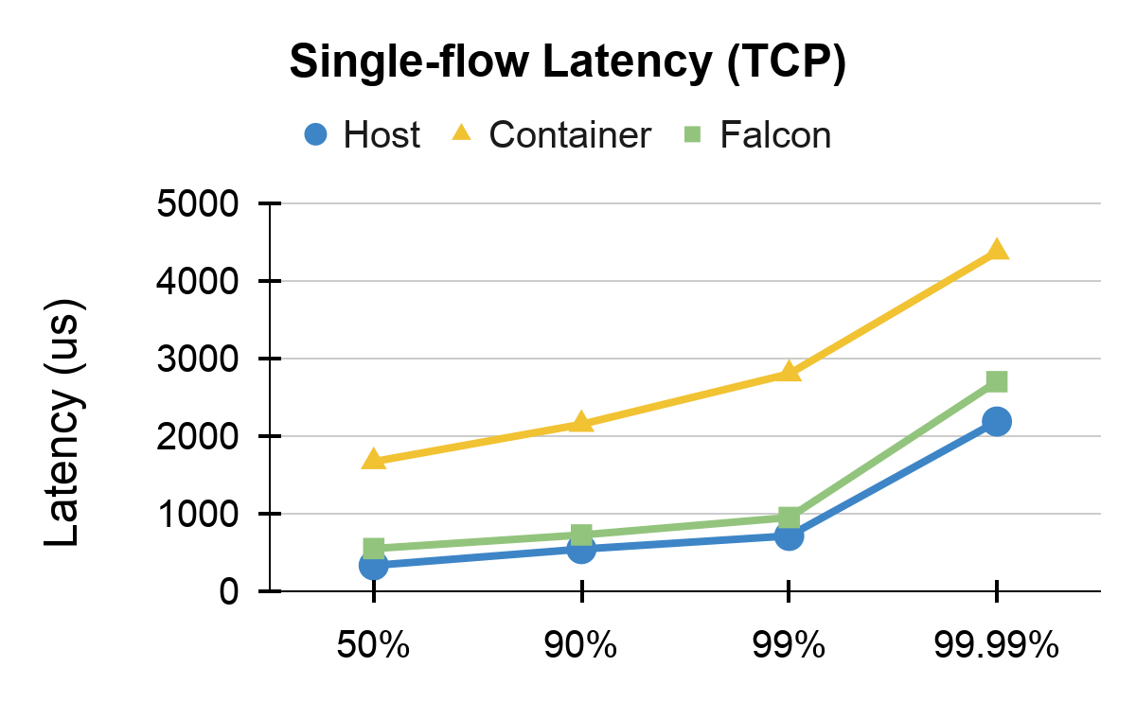
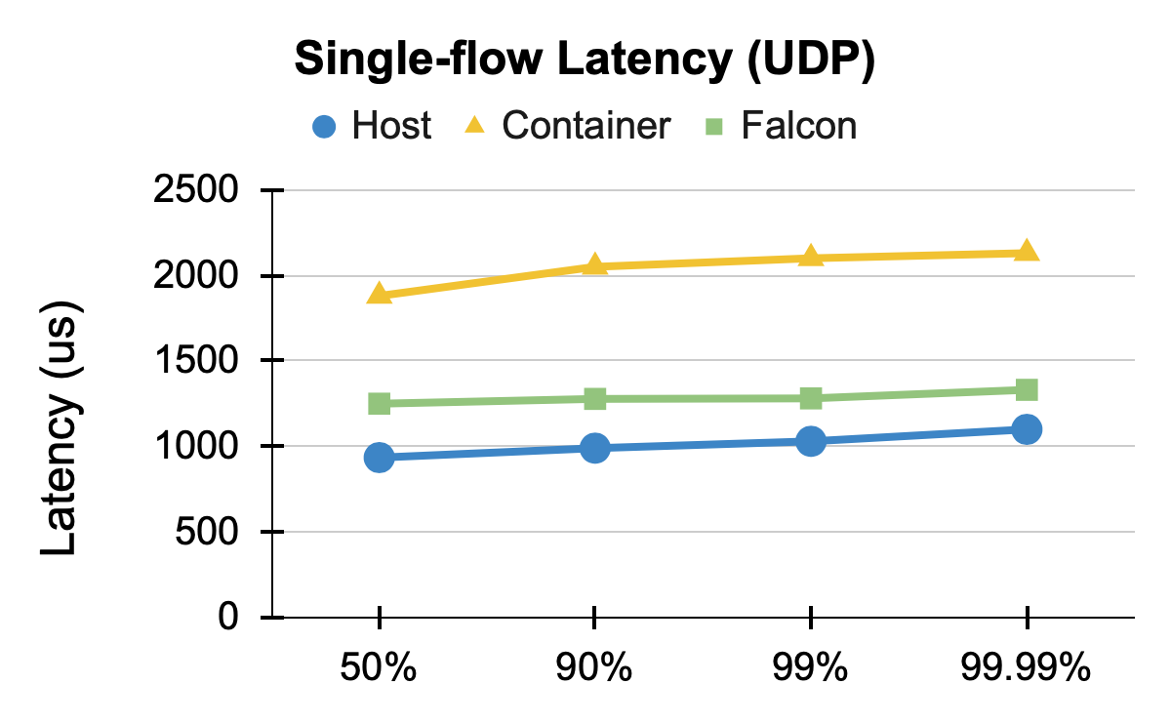
Single-flow performance

Slide 53
FALCON Design - SoftIRQ Pipelining
....
3
2
1
Core0
1
2
3
1
2
3
Application
Core1
Core2
Time
Notes:
The first design in FALCON is softirq pipelining. Remember we said that different stages of different packets are independent and parallelizable. That's what we're trying to parallelize here. We try to make sure the different softirqs for the same flow are raised on different cores so that those softiqs can overlap and also the load is more balanced on multiple cores. To implement this, we identified stage transition functions in the kernel that are called to enqueue the packet to next device and raise softirq. We modified those functions to also use the device ID when hashing to select the core. In this way, different softirqs of the same flow are raised on different cores. This still ensures that all the packets of the same flow are processed and delivered in-order.
This technique is most useful when all the stages have similar processing cost, such as UDP flows. There are flows where one stage is much more expensive than others. An example is a TCP flow with GRO enabled. With GRO, most of the TCP packet processing happens on the first stage; the other stages are invoked only for a fraction of the packets. For such flows, we propose a second design.

Slide 54
FALCON Design - SoftIRQ Pipelining
....
3
2
1
Core0
1
2
3
Core1
1
2
3
Core2
1
2
3
Application
Time
Notes:
The first design in FALCON is softirq pipelining. Remember we said that different stages of different packets are independent and parallelizable. That's what we're trying to parallelize here. We try to make sure the different softirqs for the same flow are raised on different cores so that those softiqs can overlap and also the load is more balanced on multiple cores. To implement this, we identified stage transition functions in the kernel that are called to enqueue the packet to next device and raise softirq. We modified those functions to also use the device ID when hashing to select the core. In this way, different softirqs of the same flow are raised on different cores. This still ensures that all the packets of the same flow are processed and delivered in-order.
This technique is most useful when all the stages have similar processing cost, such as UDP flows. There are flows where one stage is much more expensive than others. An example is a TCP flow with GRO enabled. With GRO, most of the TCP packet processing happens on the first stage; the other stages are invoked only for a fraction of the packets. For such flows, we propose a second design.

Slide 55
FALCON Design - SoftIRQ Splitting
Physical NIC
4
3
2
1
Core1
..
2
1
NAPI
Core2
3
2
1
Application
Notes:
In this design, we split one heavy softirq into two lighter softirqs, so that our pipelining technique is more effective. For instance, we implemented softirq splitting on the first stage of a TCP flow. With dynamic tracing, we found that the first stage of a TCP flow is dominated by two main functions: SKB allocation and GRO processing. So we split them into two different softirqs that can be pipelined onto different cores.

Slide 56
FALCON Design - SoftIRQ Splitting
....
3
2
1
Core0
1
2
3
Core1
1
2
3
Core2
1
2
3
Application
Time
Notes:
The first design in FALCON is softirq pipelining. Remember we said that different stages of different packets are independent and parallelizable. That's what we're trying to parallelize here. We try to make sure the different softirqs for the same flow are raised on different cores so that those softiqs can overlap and also the load is more balanced on multiple cores. To implement this, we identified stage transition functions in the kernel that are called to enqueue the packet to next device and raise softirq. We modified those functions to also use the device ID when hashing to select the core. In this way, different softirqs of the same flow are raised on different cores. This still ensures that all the packets of the same flow are processed and delivered in-order.
This technique is most useful when all the stages have similar processing cost, such as UDP flows. There are flows where one stage is much more expensive than others. An example is a TCP flow with GRO enabled. With GRO, most of the TCP packet processing happens on the first stage; the other stages are invoked only for a fraction of the packets. For such flows, we propose a second design.

Slide 57
FALCON Design - SoftIRQ Splitting
....
3
2
1
Core0
1
2
3
Core1
1
2
3
Core2
1
2
3
Core3
1
2
3
Application
Time
Notes:
The first design in FALCON is softirq pipelining. Remember we said that different stages of different packets are independent and parallelizable. That's what we're trying to parallelize here. We try to make sure the different softirqs for the same flow are raised on different cores so that those softiqs can overlap and also the load is more balanced on multiple cores. To implement this, we identified stage transition functions in the kernel that are called to enqueue the packet to next device and raise softirq. We modified those functions to also use the device ID when hashing to select the core. In this way, different softirqs of the same flow are raised on different cores. This still ensures that all the packets of the same flow are processed and delivered in-order.
This technique is most useful when all the stages have similar processing cost, such as UDP flows. There are flows where one stage is much more expensive than others. An example is a TCP flow with GRO enabled. With GRO, most of the TCP packet processing happens on the first stage; the other stages are invoked only for a fraction of the packets. For such flows, we propose a second design.

Slide 58
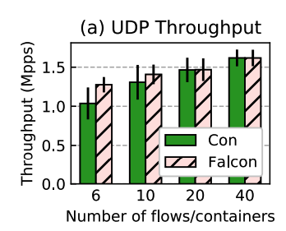
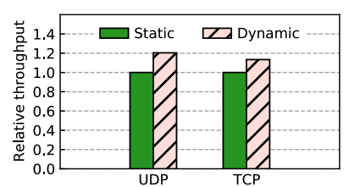
Load Balancing

