Slide 1
A Rudimentary File System in User Space 2d Lt Kevin M. Trigg

Slide 2
Overview
Project goals
Research
System Architecture
Implementation
Future development

Slide 3
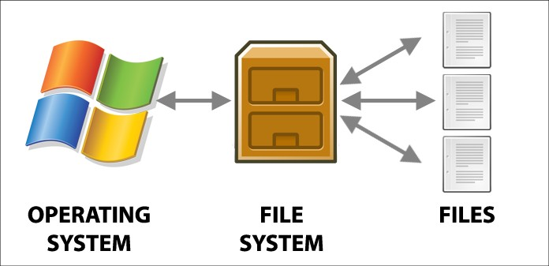
Project Goals
File system aligned to the needs of Project 1
Write files
Update files
List file contents
List directory contents

Slide 4
Research
File System in User Space (FUSE) in Linux
libFUSE
FAT inspired architecture
Scope limitations
No directories
Gutted file attributes/permissions
Notes:
libFUSE –passthrough, file name as current time, non kernel polling

Slide 5
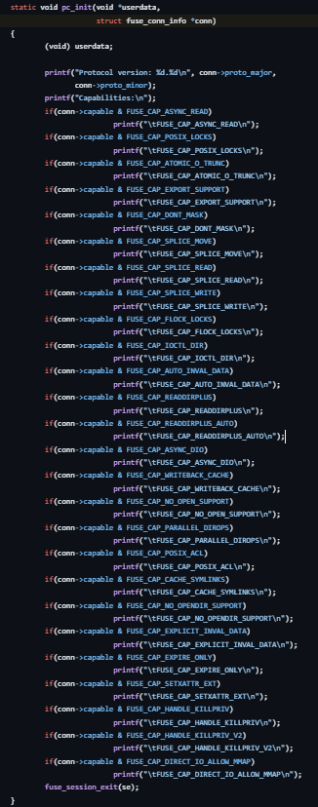



Slide 6
Research
File System in User Space (FUSE) in Linux
libFUSE
FAT inspired architecture
Scope limitations
No directories
Gutted file attributes/permissions
Notes:
libFUSE –passthrough, file name as current time, non kernel polling

Slide 7
System Architecture
File availability bitmap
1111 1111 1111 1111 1111 1111 1111 1111 1111 1111 1111 1111 1111 1111 1111 1111 1111 1111 1111 1111 1111 1111 1111 1111 1111 1111 1111 1111 1111 1111 1111 1111 1111 1111 1111 1111 1111 1111 1111 1111 1111 1111 1111 1111 1111 1111 1111 1111 1111 1111 1111 1111 1111 1111 1111 1111 1111 1111 1111 1111 1111 1111 1111 1111
File Allocation Table (FAT)
[file name] [file type] [used blocks] [block offset] [file size]
32 Bytes 1 byte 8 bytes 1 byte 2 bytes
Data

Slide 8
Implementation
Constructor/destructor -simple
Create file -fair
Write -moderate
Find write location -painful
Find empty block -fair
Dir -simple
List -simple

Slide 9
Implementation -Create
Create file( filename){
Input sanitation checks
Is the name a proper length?
Is the first character value null?
Storage location checks
Is there an open file location in FCB?
Was the file already created?
Write the file attributes in the first open slot in file table
//other blocks start null anyways
}

Slide 10
Implementation -Write
write( filename, data){
Get write location
…
Write data to block
Write byte by byte
Update block offset to maintain correct position
If the offset exceeds the size of a block loop to 0
}

Slide 11
Implementation –Write cont.
Get write location
What block to write to?
Get the last non null block used from the file table
What offset within that block?
Get the value from the files attributes
Error check on if those values are possible
Last block used and need a new block?
Sanity check, impossible location? Cascade failure up
What if a new block is needed?
Go through bitmap for an open block
Update occupied blocks list in both bitmap and file with new block

Slide 12
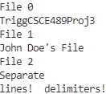
Implementation –Dir/List
list(filename){
Find the correct file in the FCB
Loop through each block in that file
If the block location is null, break
Print out the entire block
}
dir(){
loop through each file in the FCB
loop through the name of each file
print the contents of the name
space between files
}

Slide 13
Future Development
Directories
Overwriting data
File Ownership/ restrictions
dynamically sized systems
FUSE implementation
Linux mounting

Slide 14
Summary
Project goals
Research
System Architecture
Implementation
Future development

Slide 15
Sources
Libfuse. (n.d.). Libfuse/libfuse: The reference implementation of the linux fuse (filesystem in userspace) interface. GitHub. https://github.com/libfuse/libfuse
Silberschatz, A., Galvin, P., & Gagne, G. (2012). Operating System Concepts, 9th edition. John Wiley & Sons.
Understanding File Systems. (n.d.). Kingston Technology. https://www.kingston.com/en/blog/personal-storage/understanding-file-systems
Wirzenius, L., Oja, J., Stafford, S., & Weeks, A. (2001, December 3). Filesystems . Linux System Administrators Guide. https://tldp.org/LDP/sag/html/filesystems.html

