Slide 1
https://phet.colorado.edu/sims/html/faradays-law/latest/faradays-law_en.html
https://www.walter-fendt.de/html5/phnl/generator_nl.htm

Slide 2
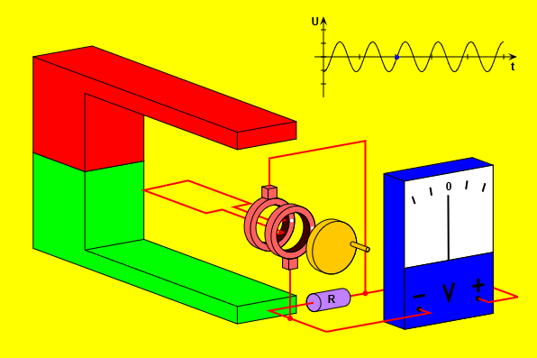

Slide 3
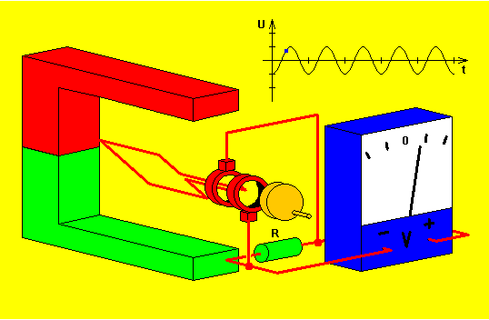

Slide 4


Slide 5
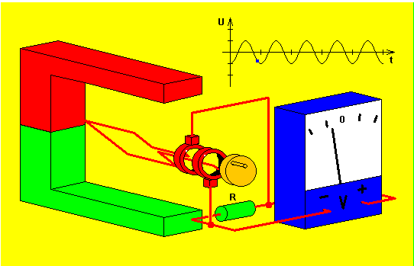

Slide 6


