Slide 1
Chapter 5
Assembling, Linking, and Executing Programs

Slide 2
Editor; Create
Prog.ASM
Create an Assembler
Source Program (.ASM)
Editor
Prog.ASM
Assemble the source
program, create an
Object Program (.OBJ)
Assembler
Assemble
(optional)
Prog.LSTProg.CRF
Prog.OBJ
Link the program, create
an Executable Program
(.EXE)
Link
Linker
Execute
Prog.EXE
Load and execute the
.EXE Program
Steps in Assembly, Link, and Execute

Slide 3
1a. The assembly step involves translating the source code into object
牽涉
code and generating an intermediate .OBJ file.
中間的
1b. One of the assembler’s tasks is to calculate the offsets for every data
工作
item in the data segment and for every instruction in the code segment.
1c. The assembler creates a header immediately in front of the generated
緊接著
.OBJ module; part of the header contains information about incomplete
不完整的
addresses.

Slide 4
2a. The Link step involving converting the .OBJ module to an .EXE
machine code module.
2b. The linker’s task include completing any addresses left open by the
assembler and combining separately assembled programs into one
executable module.
3a. Load the program for execution. The loader knows where the
program is going to load in memory, it is able to resolve any
remaining addresses still left incomplete in the header.
3b. The loader drops the header and creates a program segment prefix
(PSP) immediately before the program loaded in memory.

Slide 5
Assembling a Source Program
Optional output files from the assembly step are object (.OBJ), listing
(.LST), and cross reference (.CRF or .SBR).
1. OBJ file is required for linking a program into executable form.
2. LST file contains error diagnostics and generated machine code.
診斷
3. CRF file is useful for a large program when you want to see which
instructions reference which data items. Requesting a .CRF file causes
the assembler to generate statement numbers for items in the .LST file.

Slide 6
D:\MASM611\BIN> ml /Fl /Fr a05asm1.asm
Microsoft (R) Macro Assembler Version 6.11 03/08/06 22:36:55
A04ASM1 (EXE) Move and add operations Page 1 - 1
page 60,132
TITLE A04ASM1 (EXE) Move and add operations
; ---------------------------------------------
0000 STACK SEGMENT PARA STACK 'Stack'
0000 0020 [ DW 32 DUP(0)
0000
]
0040 STACK ENDS
; ----------------------------------------------
0000 DATASEG SEGMENT PARA 'Data'
0000 00D7 FLDD DW 215
0002 007D FLDE DW 125
0004 0000 FLDF DW ?
0006 DATASEG ENDS
; -----------------------------------------------
0000 CODESEG SEGMENT PARA 'Code'
0000 MAIN PROC FAR
ASSUME SS:STACK,DS:DATASEG,CS:CODESEG
0000 B8 ---- R MOV AX,DATASEG ;Set address of data
0003 8E D8 MOV DS,AX ; segment in DS
0005 A1 0000 R MOV AX,FLDD ;Move 0215 to AX
0008 03 06 0002 R ADD AX,FLDE ;Add 0125 to AX
000C A3 0004 R MOV FLDF,AX ;Store sum in FLDF
000F B8 4C00 MOV AX,4C00H ;End processing
0012 CD 21 INT 21H
0014 MAIN ENDP ;End of procedure
0014 CODESEG ENDS ;End of segment
END MAIN ;End of program
Machine code
Offset addresses of data item and machine code

Slide 7
1. The program is organized into three segments, each with its own
offset values for data or instructions.
2. Segment statement generates no machine code. The loader stores the
contents of each segment in memory and initializes its address in a
segment register, Stack in SS, DATASEG in DS, CODESEG in CS.
3. Stack segment: defines 32 words of 0. A realistic size for a stack
because a large program may require many interrupts for I/O and calls
to subprograms, all involving use of stack.
4. Data segment: FLDD defines a word initialized with 215 = 00D7H, offset
is 0000, FLDE: 125 = 007DH, offset is 0002,
FLDF: DW with ? an un-initialized constant showing as 0000,offset 0004

Slide 8
5. Code segment:
ASSUME SS:STACK,DS:DATASEG,CS:CODESEG
0000 B8 ---- R MOV AX,DATASEG ;Set address of data
0003 8E D8 MOV DS,AX ; segment in DS
The system determines this address when the object program is linked
and loaded for execution. The loader may locate a program anywhere
in memory, the assembler leaves the address open and indicates the fact
with an R (re-locatable); the loader is to replace the incomplete address
可重新定址
with the actual one.

Slide 9
Segments and Groups Table
This table shows any defined segments and groups, listing in alphabetic
Sequence by name.
Microsoft (R) Macro Assembler Version 6.11 03/08/06 22:36:55
A04ASM1 (EXE) Move and add operations Symbols 2 - 1
Segments and Groups:
N a m e Size Length Align Combine Class
CODESEG . . . . . . . . . . . . 16 Bit 0014 Para Private 'CODE'
DATASEG . . . . . . . . . . . . 16 Bit 0006 Para Private 'DATA'
STACK . . . . . . . . . . . . . 16 Bit 0040 Para Stack 'STACK'
Procedures, parameters and locals
Microsoft (R) Macro Assembler Version 6.11 03/08/06 22:36:55
A04ASM1 (EXE) Move and add operations Symbols 3 - 1
Procedures, parameters and locals:
N a m e Type Value Attr
MAIN . . . . . . . . . . . . . . P Far 0000 CODESEG Length= 0014 Public

Slide 10
Symbols Table
Microsoft (R) Macro Assembler Version 6.11 03/08/06 22:36:55
A04ASM1 (EXE) Move and add operations Symbols 4 - 1
Symbols:
N a m e Type Value Attr
FLDD . . . . . . . . . . . . . . Word 0000 DATASEG
FLDE . . . . . . . . . . . . . . Word 0002 DATASEG
FLDF . . . . . . . . . . . . . . Word 0004 DATASEG
0 Warnings
0 Errors
This table provides the names of data fields in the data segment and
The labels applied to instructions in the code segment.
Main, Type P Far means far procedure, as the entry pointer for execution,
must be known outside this program.

Slide 11
Using Simplified Segment Directives
Microsoft (R) Macro Assembler Version 6.11 03/11/06 22:21:55
A04ASM2 (EXE) Move and add operations Page 1 - 1
page 60,132
TITLE A04ASM2 (EXE) Move and add operations
;-----------------------------------------------------
.MODEL SMALL
.STACK 64 ;Define stack
0000 .DATA ;Define data
0000 00D7 FLDD DW 215
0002 007D FLDE DW 125
0004 0000 FLDF DW ?
;-----------------------------------------------------
0000 .CODE ;Define code segment
0000 MAIN PROC FAR
0000 B8 ---- R MOV AX, @data ;Set address of data
0003 8E D8 MOV DS,AX ; segment in DS
0005 A1 0000 R MOV AX,FLDD ;Move 0215 to AX
0008 03 06 0002 R ADD AX,FLDE ;Add 0125 to AX
000C A3 0004 R MOV FLDF,AX ;Store sum in FLDF
000F B8 4C00 MOV AX,4C00H ;End processing
0012 CD 21 INT 21H
0014 MAIN ENDP ;End of procedure
END MAIN ;End of program

Slide 12
Segments and Groups:
N a m e Size Length Align Combine Class
DGROUP . . . . . . . . . . . . . GROUP
_DATA . . . . . . . . . . . . . 16 Bit 0006 Word Public 'DATA'
STACK . . . . . . . . . . . . . 16 Bit 0040 Para Stack 'STACK'
_TEXT . . . . . . . . . . . . . 16 Bit 0014 Word Public 'CODE'
Procedures, parameters and locals:
N a m e Type Value Attr
MAIN . . . . . . . . . . . . . . P Far 0000 _TEXT Length= 0014 Public
Symbols:
N a m e Type Value Attr
@code . . . . . . . . . . . . . Text _TEXT
@data . . . . . . . . . . . . . Text DGROUP
@stack . . . . . . . . . . . . . Text DGROUP
FLDD . . . . . . . . . . . . . . Word 0000 _DATA
FLDE . . . . . . . . . . . . . . Word 0002 _DATA
FLDF . . . . . . . . . . . . . . Word 0004 _DATA
0 Warnings
0 Errors

Slide 13
TWO-PASS ASSEMBLER
1. Assemblers makes two or more passes through a source program to
resolve forward references to addresses not yet encountered.
解決 遭遇
2. During pass 1, the assembler reads the entire source program and
所有的
constructs a symbol table of names and labels, that is, names of data
建立
fields and program labels and their offset within the segment.
Pass 1 determines the amount of code to be generated for each instruction.
3. During pass 2, the assembler uses the symbol table. Now that it knows
the length and relative position of each data and instruction, it can
complete the object code for each instruction. It can produce .OBJ,.LST,
and cross-reference .CRF files.

Slide 14
Linking an OBJ Program
The linker performs the following functions:
1. Combines, if requested, more than one separately assembled module
into one executable program.
2. generate an .EXE module and initializes it with special instructions.
3. link step produces .EXE, .MAP, and .LIB files.
ml /Fm a05asm1.asm
A05asm1.map
Start Stop Length Name Class
00000H 0003FH 00040H STACK STACK
00040H 00045H 00006H DATASEG DATA
00050H 00063H 00014H CODESEG CODE
Program entry point at 0005:0000

Slide 15
The Cross-Reference Listing ml /Fr a05asm1.asm
CREF a05asm1.sbr, a05asm1.ref
Microsoft Cross-Reference Version 6.11 03/11/06 23:32:22
Symbol Cross-Reference (# definition) Cref-1
CODESEG
a05asm1.asm. . . . . . . . . 14# 16 26
DATASEG
a05asm1.asm. . . . . . . . . 8# 16 17 12
FLDD
a05asm1.asm. . . . . . . . . 9# 20
FLDE
a05asm1.asm. . . . . . . . . 10# 21
FLDF
a05asm1.asm. . . . . . . . . 11# 22
MAIN
a05asm1.asm. . . . . . . . . 15# 27
STACK
a05asm1.asm. . . . . . . . . 4# 16 6 25
Line in .LST where symbol is defined

Slide 16
Writing .COM Programs
1. A .COM program uses one segment for instructions and data, less than
64K, including the program segment prefix (PSP).
2. A .COM program is smaller than .EXE program that has a 512-byte header.
3. Segments of .EXE and .COM files:
ES
SS
DS
CS
ES
DS
CS
PSP
PSP
Stack
Code
segment
Data
segment
Code
segment
SS
Stack
.EXE segments .COM segments

Slide 17
Initialization of .COM Program
1. When the program loader loads a .COM for execution, it initializes CS
, DS, SS, and ES with the address of the PSP. Because CS and DS
now contain the correct initial segment address, a .COM program does
not need to initialize them.
2. PSP is 100H bytes in size. You have to code a directive, ORG 100H
following .CODE statement. .ORG tell assembler to set its location
counter at 100H, so the assembler begins generating the OBJ code at
an offset of 100H bytes past the start of the PSP.

Slide 18
.COM Source Program with Conventional Segments
TITLE A05COM1 COM program to move and add data
CODESEG SEGMENT PARA 'Code'
ASSUME CS:CODESEG,DS:CODESEG,SS:CODESEG,ES:CODESEG
ORG 100H ;Start at end of PSP
BEGIN: JMP MAIN ;Jump past data
; ----------------------------------------------------
DATAX DW 215 ;Data definitions
DATAY DW 125
DATAZ DW ?
; ----------------------------------------------------
MAIN PROC NEAR
MOV AX,DATAX ;Move 0215 to AX
ADD AX,DATAY ;Add 0125 to AX
MOV DATAZ,AX ;Store sum in DATAZ
MOV AX,4C00H ;End processing
INT 21H
MAIN ENDP
CODESEG ENDS
END BEGIN

Slide 19
.COM Program with Simplified Segment Directives
TITLE A05COM2 COM program to move and add data
.MODEL TINY
.CODE
ORG 100H ;Start at end of PSP
BEGIN: JMP MAIN ;Jump past data
; ----------------------------------------------------
DATAX DW 215 ;Data definitions
DATAY DW 125
DATAZ DW ?
; ----------------------------------------------------
MAIN PROC NEAR
MOV AX,DATAX ;Move 0215 to AX
ADD AX,DATAY ;Add 0125 to AX
MOV DATAZ,AX ;Store sum in DATAZ
MOV AX,4C00H ;End processing
INT 21H
MAIN ENDP
END BEGIN
ml /AT a05com1.asm If you run the .COM file under debug, use
D CS:100 to view the data and instructions.

Slide 20
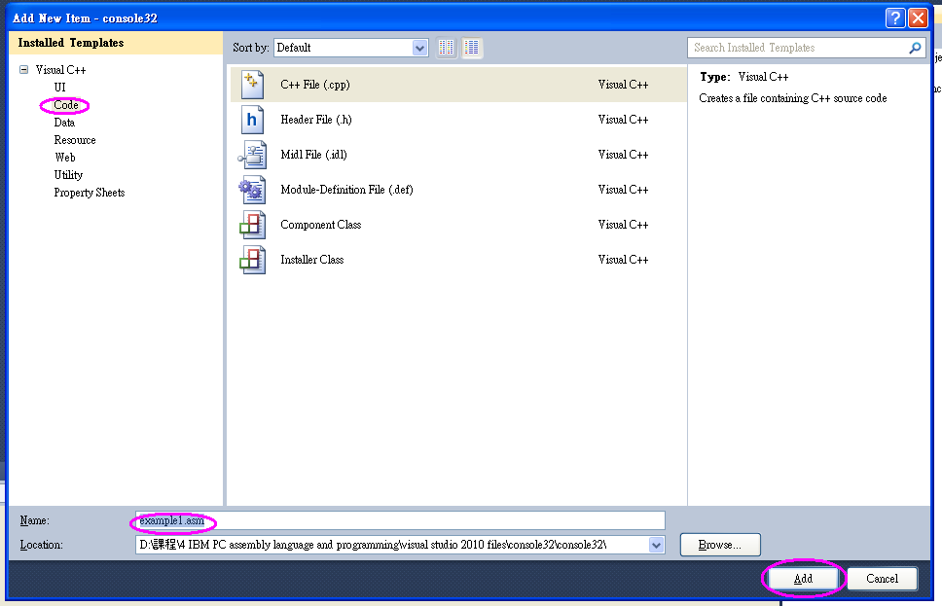
Console32 in Visual Studio 2010:
Solution Explorer ➔ Right-click Source Files➔ click Add, then New Item
➔ Select Code under Categories➔ Type name: example1.asm ➔click Add

Slide 21
.586
.MODEL FLAT
.STACK 4096 ; reserve 4096-byte stack
.DATA ; reserve storage for data
number DWORD -105
sum DWORD ?
.CODE ; start of main program code
main PROC
mov eax, number ; first number to EAX
add eax, 158 ; add 158
mov sum, eax ; sum to memory
mov eax, 0 ; exit with return code 0
ret
main ENDP
END ; end of source code

Slide 22
Console32 Practice:
.DATA
sum DWORD ?
Write an assembly program in console32 for the following:
(a) move the immediate value hex 40 to the EAX register,
(b) shift EAX contents four bit left (SHL EAX, 4),
(c) move immediate value hex 1A to EBX,
(d) multiply EAX by EBX (MUL EBX),
(e) move result of (d) to sum
DEBUG (F5) and Step over (F10) to trace and to check contents of
memory and registers and flags.

Slide 23
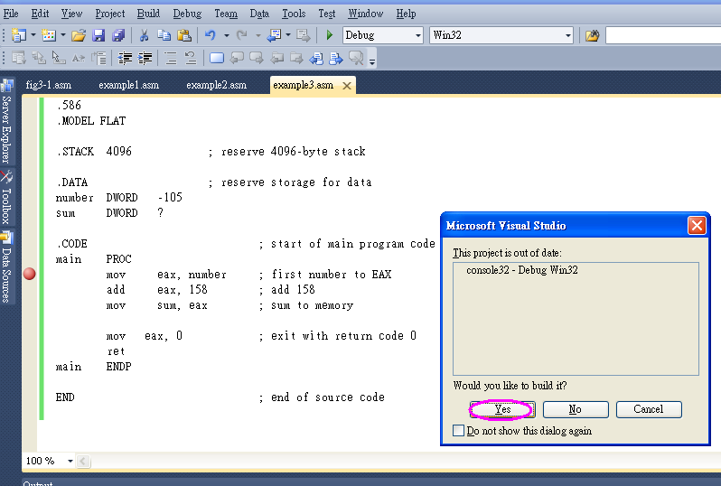
Create breakpoints by clicking in the left bar
➔Debug
➔ Start Debugging (F5)
➔Step over instructions (F10)

Slide 24
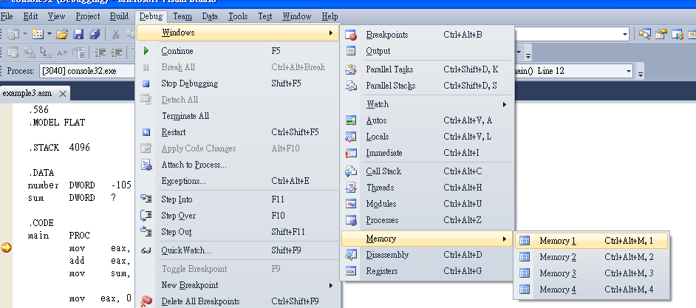
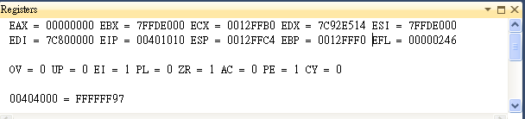
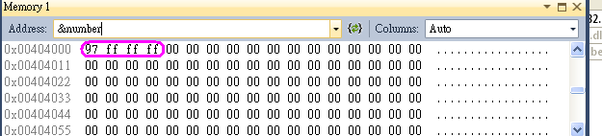
See content of registers: Debug ➔ Windows ➔ Registers
See content of memory:
Debug ➔ Windows ➔ Memory ➔ Memory 1➔ type ‘&number’ in Address box

