Slide 1
課程:
System Software and Assembly Language
Textbook:
1. IBM PC Assembly Language and Programming,
5th edition, Peter Abel 全華圖書代理
2. System Software, 3rd edition, Leland L. Beck
台北圖書代理

Slide 2
Chapter 1 Basic Feature of PC Hardware
Bit: 0 → off, 1→on
Bytes: 8 bits + 1 parity bit
0 0 0 0 0 0 0 0 1
data bits (odd) parity

Slide 3
Bit content (A):
Bit number:
0 1 0 0 0 0 0 1
7 6 5 4 3 2 1 0
each byte in memory has a unique address
記憶體 獨自的 位址
word: 2-byte (16-bit)
Doubleword: 4-byte (32-bit)
Quadword: 8-byte (64-bit)
Paragraph: 16-byte (128-bit)
Kilobyte (KB): 2¹⁰=1024, Megabyte (MB): 2²⁰=1,048,576

Slide 4
Binary Arithmetic
二進位 算數運算
Decimal Binary
60 00111100
+53 +00110101
113 01110001
Decimal Binary
65 01000001
-65 +10111111
00 (1)00000000
no overflow:
Carry into and out of the sign bit

Slide 5
Decimal Binary
1 00000001
+(-1) +11111111
0 (1)00000000
Hexadecimal representation
十六進位的 表法
Binary: 0101 1001 0011 0101 1010 1001 1100 1110
Hexadecimal: 5 9 3 5 A 9 C E

Slide 6
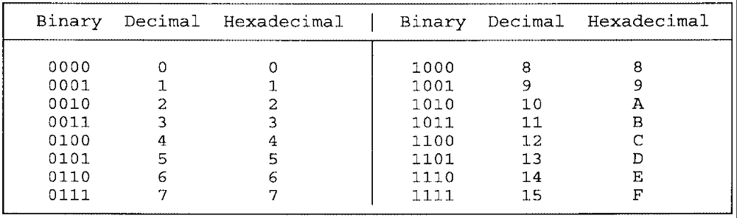
二進位 十進位 十六進位
7
+3
A
F
+F
1E
FF
+ 1
100
38
+18
50

Slide 7
ASCII CODE: American Standard Code for Information Interchange
標準 資訊 交換
2⁸ = 256 characters
A: 0100 0001 41H
B: 0100 0010 42H

Slide 8
PC COMPONENTS
Processor: Execution Unit (EU) + Bus Interface Unit
執行 介面
EU
AH AL
BH BL
BIU
CH CL
DH DL
Program Control
SP
CS
DS
BP
SI
SS
DI
ES
Bus
Control
Unit
Bus
1
ALU算數邏輯單位
2
CU: Control Unit
3
Instruction Queue
指令 佇列
4
.
.
Flags Register
.
.
Instruction Pointer
n

Slide 9
EU: execute instructions (執行指令), arithmetic and logic operations
算數 邏輯 運算
Arithmetic and Logic Unit (ALU) + Control Unit (CU) + registers
BIU: 1. manage bus control unit:
transfer data to EU, to memory, to external I/O devices
傳輸
2. segment registers:
節區 control memory addressing
3. instruction queue:
look ahead and prefetch instructions
預取
EU, BIU work in parallel, with the BIU keeping one step ahead.
平行
EU notifies the BIU when it need to access to data in memory or I/O devices.
告知 存取
EU requests machine instruction from the BIU instruction queue.
要求
The top instruction is the currently executable one.
現在地 可執行

Slide 10
Internal Memory,內部記憶體
ROM: read only memory
RAM: random access memory,隨機存取記憶體
Start address purpose
Dec Hex
960K F0000
768K C0000
640K A0000
Zero 00000
64K base system ROM
192K memory expansion area (ROM)
128K video display area (RAM)
640K memory (RAM)
BIOS data area
Interrupt vector table
Map of base memory for 8086

Slide 11
ROM:
Basic I/O System (BIOS) begins at address 768K, handling I/O devices
管理
ROM begins at 960K: control the computer’s basic functions, such as
power-on self test, dot patterns for graphics, the disk self-loader
形狀 繪圖
RAM:
worksheet for temporary storage and execution of the program
草稿 暫時的 儲存 執行
when power on, ROM boot-up procedure loads a portion of operation
程序 部分 作業
system into RAM.
Turning off the power erases the contents of RAM, but does not affect ROM.
消除 內容 影響

Slide 12
Addressing Data in Memory
1,315_{十進位} = 0529H requires two bytes, or one word, of memory
The processor stores the data in memory in reverse-byte sequence.
(little endian)
相反
Register
Memory
05 29
29 05
Content, 內容
Address, 位址
Address 04A26H 04A27H

Slide 13
Segments and Addressing
節區 定址
In real mode, the three main segments:
Code segment (addressed by CS register):
the first executable instruction is at the start of the segment.
可執行的
Data segment (addressed by DS register):
defined data, constants, and work area
已定義的
Stack segment (addressed by SS register):
堆疊
(1) data or addresses need to be saved temporarily
暫時地
(2) or for use by called subroutines
副程式

Slide 14
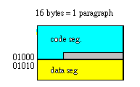
Absolute address: such as 04A26H, a 20-bit value directly reference
絕對 數值 參用
a memory location.
Segment: offset address:
DS segment address: 038E0H
offset + 0032H
actual address: 03912H
Segment boundary: a segment begins on a paragraph boundary.
邊界 段, 16 or 10H bytes
location 038E0H → stored in the register as 038E

Slide 15
Segment registers
CS register: starting address of a program’s code
DS register: starting address of a program’s data
SS register: starting address of a program’s stack segment.
ES register: used by string (character) operations
Pointer registers
指標
Instruction Pointer (IP) register:
IP: the offset address of the next instruction to execute
Segment address in CS 39B4[0]H
offset address in IP + 051 4 H
address of next instruction 3A054H

Slide 16
Stack Pointer (SP) register: offset value refer to the current processed word
正在 處理的
Segment address in SS 4BB30H
offset in SP + 412H
address in stack 4BF42H
Base Pointer (BP) register: 1. reference data and addresses a program
參考
passes by the stack ( SS: BP).
2. combined with DI and SI for special addressing
結合
Index Registers
索引
SI register: Source index register used for string operations. (DS:SI)
字串
DI register: Destination index register used for string operations. (ES:DI)

Slide 17
General-Purpose Registers 一般用途暫存器
AX register: accumulator, used for I/O and arithmetic operations
累加器
BX register: base register, 1. index for extend addressing: (BX:DI), (BX:SI)
2. computation
計算
CX register: count register, 1. a value to control loop or shift operations
計數 迴圈 移位
2. computation
DX register: data register, 1. I/O operations
2. multiply and divide operations. (DX+AX)
乘 除
AH
AL
31
15
7
0
AX
EAX
64 bit: RAX

Slide 18
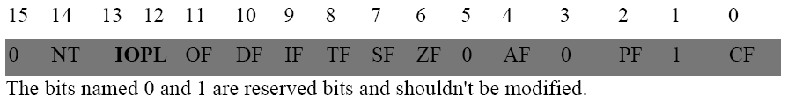
Flags Register
OF (overflow): overflow of high-order bit following arithmetic.
溢位 計算
DF (direction): left or right for moving or comparing string data. (STD: right->left
方向 比較 字串 CLD: left->right )
IF (interrupt): external interrupt, such as keyboard to be processed or not.
中斷 外部 鍵盤 處理
TF (trap): set single-step mode operation for debugging.
陷阱 單步
SF (sign): resulting sign of an arithmetic operation, 0: positive, 1: negative
正 負
ZF (zero): result of an arithmetic or comparison operation, 0: nonzero, 1:zero
AF (auxiliary carry): carry out of bit 3 into bit 4 in an arithmetic operation
輔助的
PF (parity): indicates the number of 1-bits in the least byte after operation.
CF (carry): carries from a high-order bit following an arithmetic operation
last bit for a shift(位移) or rotate(旋轉) operation.

Slide 19
Hardware Interrupts examples:
Request from the keyboard for input:
要求
1. interrupt current operations
現在
2. call a BIOS routine
程式
3. returns to the interrupt program
Divide by 0: causes the system to terminate processing
終止 處理
Software Interrupt example:
The program request to display data on the screen.
顯示 螢幕

Slide 20
