Slide 1
Chapter 2
Instruction Addressing and Execution
指令 定址 執行

Slide 2
Features of an Operation System:
File management: maintain the directories and files
管理 維護 目錄
Input/Output: programs input/output data to system by interrupts.
Program loading: accessing the program from disk, placing in memory
存取
initializing it for execution
初始化 執行
Memory management: allocates space in memory for program code
分配
and data
Interrupt handling: for programs to access external devices by interrupts
中斷 處理 外部的

Slide 3
The BIOS BOOT PROCESS
驅動 程序
The first instruction to execute when turning on the computer
is at address:
CS:IP = FFFF: 0000 = FFFF0H
the entry point to BIOS in ROM
進入

Slide 4
The BIOS BOOT PROCESS
驅動 程序
1. BIOS routines beginning at FFFF0H check ports to identify
識別
and initialize devices attached to the computer and providing
初始化 連接
service for reading to and writing from the devices.
2. BIOS then establishes two data areas:
a. Interrupt Vector Table. In low memory at location 0
256 4-bytes (segment: offset form) addresses.
b. BIOS Data Areas. Beginning at location 40[0], concerned with
the status of the attached devices
3. access bootstrap loader to load system files into memory
靴帶
and transfer control to them.
轉移

Slide 5
Two type of executable programs: .COM and .EXE
可執行的
.COM: code, data, stack in one segment
small utility program or a resident program
常駐
.EXE: code segment, data segment, stack segment

Slide 6
When loading an .EXE program into memory, the loader doing
1. Accesses the .EXE program from the disk
2. Constructs a 256-byte (100H) program segment prefix (PSP) on a
建立 程式前置區
paragraph boundary in internal memory.
邊界
3. Store the program in memory immediately following the PSP
4. Loads the address of the PSP in the DS and ES registers
5. Loads the address of code segment in CS,
set IP to the offset of the first instruction.
6. Loads the address of the stack in SS, set SP to the size of the stack
7. transfer control to the program for execution
轉移

Slide 7
The Stack
The program calls a subroutine.
副程式
It saves the return address in the stack.
Pass data by placing it in the stack for accesses by subroutine
The program performs calculations using registers:
執行 計算
  save the present contents of the registers on the stack
內容
  make the calculations
  restore the data from the stack

Slide 8
AX: 026BH, BX: 04E3H, SP: 36
1. empty stack
offset stack frame sp = 36
34 0000
32 0000
30 0000
2E 0000
3. PUSH BX
offset stack frame
34 6B02
32 E304 sp = 32
30 0000
2E 0000
2. PUSH AX
offset stack frame
34 6B02 sp = 34
32 0000
30 0000
2E 0000

Slide 9
4. POP BX
offset stack frame
34 6B02 sp = 34
32 E304
30 0000
2E 0000
5. POP AX
offset stack frame sp= 36
34 6B02
32 E304
30 0000
2E 0000

Slide 10
PUSH and POP coded in reverse sequence
相反的 順序
PUSHF, POPF: save and restore the status of flags
PUSHA and POPA: save and restore the contents of
AX, BX, CX, DX, SP, BP, SI, DI.
And increment/decrement SP by 16.
增加 減少

Slide 11
Basic steps processor takes in executing an instruction
1. Fetch the next instruction to be executed from memory
and place it in the instruction queue.
佇列
2. Decode the instruction:
calculate addresses that reference memory,
deliver data to the ALU, 參考
and increment IP register.
增加
3. Execute the instruction:
perform the requested operation,
store the results in a register or memory,
set flags such as zero or carry where required.
需要的

Slide 12
Pentium’s pipelining capability enables it to overlap operations
重疊 運算
1
2
3
Fetch Decode Execute
Fetch Decode Execute
Fetch Decode Execute

Slide 13
For an .EXE program
CS register provides the address of the beginning
of a program’s code segment,
DS register provides the address of the beginning of the
data segment,
Code segment contains instructions to be executed
Data segment contains data that the instructions reference
IP register indicates the offset address of the current
instruction in the code segment that is to be executed
Instruction operand indicates an offset address in the
data segment to be referenced

Slide 14
CS:IP = 05BEH:0023H DS = 05D1[0]H
the address of the next instruction:
CS segment address: 05BE0H
IP offset: + 0023H
Instruction address: 05C03H
machine code symbolic code
A0 16 00 MOV AL, [0016]
CS
………………….A01600
offset 0023
05BE
AX
4A
DS
……….4A
offset 0016
05D1

Slide 15
Store contents of AX register (0248H) in two adjacent
臨接的
bytes in the data segment at offset 0016H:
MOV [0016], AX
……………48 02
offset in data segment: 0016, 0017
DS

Slide 16
Instruction Operands
指令 運算元
WORDX DW 0
…
…
MOV CX, WORDX
MOV CX, 25
MOV CX, BX
MOV CX, [BX]
;Define WORDX as word
;Move contents of WORDX to CX
;Move value 25 to CX
;Move contents of BX to CX
;Move contents of location addressed by BX
use the offset address in BX (combined with DS, as DS:BX) to
結合
locate a word in memory and move its contents to CX
找出

Slide 17
Protected Mode:
Under Window’s protected mode, the processor can switch from one task
to another.
When running in protected mode, a program’s linear address space is 4 GB,
using addresses 0 to FFFFFFFF hexadecimal. (the flat segmentation model)
Segment registers (CS, DS, SS, ES, FS, GS) point to segment descriptor tables,
which keeps track of locations of individual program segments.
A typical protected-mode program has three segments:
code, data, and stack, using the CS, DS, and SS segment registers:
• CS references the descriptor table for the code segment
• DS references the descriptor table for the data segment
• SS references the descriptor table for the stack segment
At least two segments are required, one for code and one for data.
Each segment is defined by a segment descriptor,

Slide 18
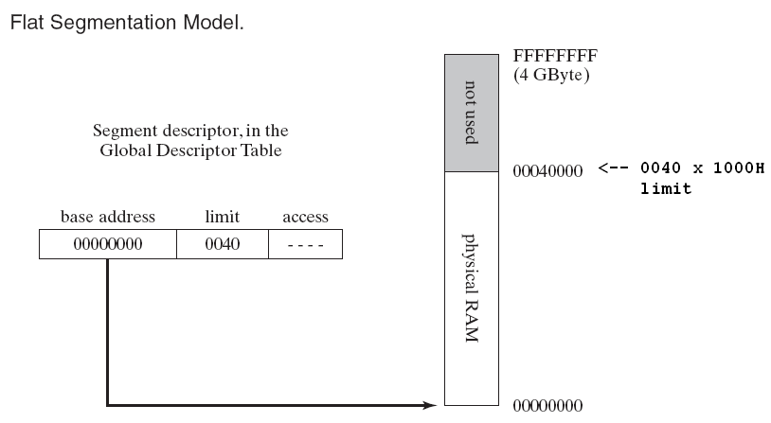
A 64-bit integer stored in a table known as the global descriptor table (GDT).
A segment descriptor whose base address field points to the first available
location in memory (00000000). In this figure, the segment limit is 0040.
The access field contains bits that determine how the segment can be used.
Modern operating systems based on x86 architecture use the flat segmentation model.

Slide 19
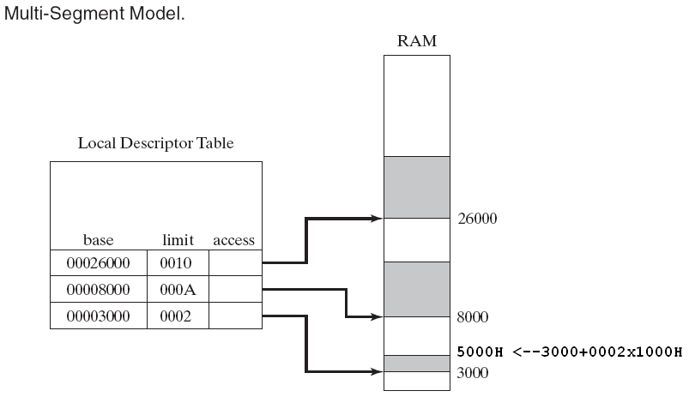
In the multi-segment model, each task or program is given its own table of
segment descriptors, called a local descriptor table (LDT).
Each descriptor points to a segment, which can be distinct from all segments
used by other processes.
Each segment has its own address space.

