Slide 1
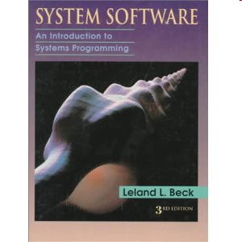
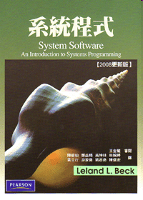
System
Programming
Textbook: System Software:
An Introduction to Systems Programming
Leland L. Beck
3rd Edition
Addison-Wesley, 1997

Slide 2
System Programming
Chapter 1: Background
Chapter 2: Assemblers
Chapter 3: Loaders and Linkers
Chapter 4: Macro Processors
Chapter 5: Compilers
Chapter 6: Operating Systems
Chapter 7: Other System Software
Chapter 8: Software Engineering Issues

Slide 3
Chapter 1
Background

Slide 4
Outline
Introduction
System Software and Machine Architecture
The Simplified Instructional Computer (SIC)
  SIC Machine Architecture
  SIC/XE Machine Architecture
  SIC Programming Examples
Traditional (CISC) Machines
RISC Machines

Slide 5
1.1 Introduction
System Software consists of a variety of programs that support the operation of a computer.
This software makes it possible for the user to focus on an application or other problem to be solved, without needing to know the details of how the machine works internally.

Slide 6
1.1 Introduction
Machine dependency of system software
  System programs are intended to support the operation and use of the computer.
  Machine architecture differs in:
    Machine code
    Instruction formats
    Addressing mode
    Registers
Machine independency of system software
  General design and logic is basically the same:
    Code optimization
    Subprogram linking

Slide 7
1.2 System Software and Machine Architecture
One characteristic in which most system software differs from application software is machine dependency.
System programs are intended to support the operation and use of the computer itself, rather than any particular application.
e.g. of system software
  Text editor, assembler, compiler, loader or linker, debugger, macro processors, operating system, database management systems, software engineering tools, …

Slide 8
1.2 System Software and Machine Architecture
Text editor
  To create and modify the program
Compiler and assembler
  To translated these programs into machine language
Loader or linker
  The resulting machine program was loaded into memory and prepared for execution
Debugger
  To help detect errors in the program

Slide 9
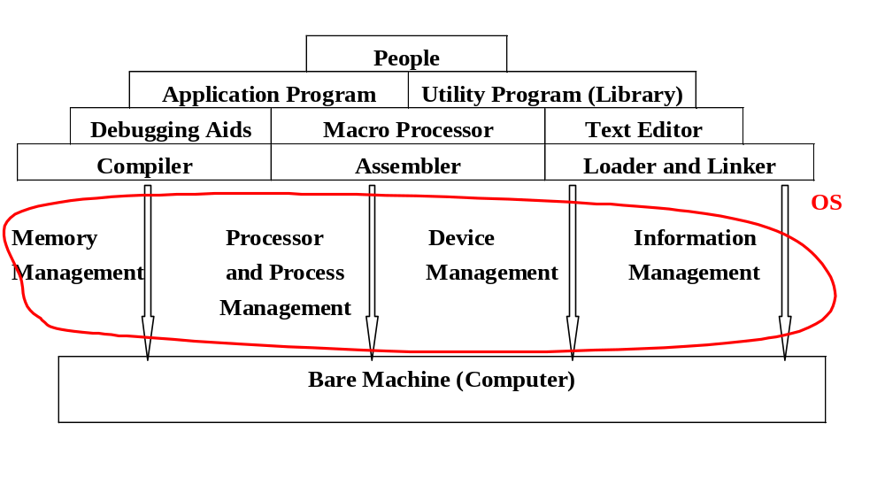
系統程式所包含的範圍
SP

Slide 10
1.3 The Simplified Instructional Computer
Like many other products, SIC comes in two versions
  The standard model
  An XE version
    “extra equipments”, “extra expensive”
The two versions has been designed to be upward compatible
  SIC (Simplified Instructional Computer)
  SIC/XE (Extra Equipment)
    http://en.wikipedia.org/wiki/Simplified_Instructional_Computer

Slide 11
1.3 The Simplified Instructional Computer
SIC
  Upward compatible
  Memory consists of 8-bit bytes, 3 consecutive bytes form a word (24 bits)
  There are a total of 32768=2¹⁵ bytes (32 KB) in the computer memory.
  5 registers, 24 bits in length
    A 0 Accumulator (累加)
    X 1 Index (索引) register
    L 2 Linkage (聯結) register (used when execute JSUB)
    PC 8 Program counter (similar to CS:IP in Intel IA32)
    SW 9 Status word(狀態字組) (contain Condition Code)

Slide 12
1.3.1 SIC Machine Architecture
Data Formats
  Integers are stored as 24-bit binary number
  2’s complement representation for negative values
    +3 = 00000000 00000000 00000011
    -3 = 11111111 11111111 11111100 ← 1’s complement
    + 00000000 00000000 00000001
    = 11111111 11111111 11111101 ← 2’s complement
  Characters are stored using 8-bit ASCII codes
  No floating-point hardware on the standard version of SIC

Slide 13

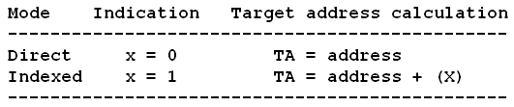
1.3.1 SIC Machine Architecture
Instruction format
  24-bit format
  The flag bit x is used to indicate indexed-addressing mode
Addressing Modes
  There are two addressing modes available in SIC
    Indicated by x bit in the instruction
    (X) represents the contents of reg. X

Slide 14
1.3.1 SIC Machine Architecture
Instruction set
  Compatible to Format 3 of SIC/XE
  For examples:
    Load and store registers (LDA, LDX, STA, STX, etc.)
    Integer arithmetic operations (ADD, SUB, MUL, DIV)
    Compare instruction (COMP)
    Conditional jump instructions (JLT, JEQ, JGT), unconditional jump (J)
    JSUB jumps to the subroutine, placing the return address in register L.
    RSUB returns by jumping to the address contained in register L

Slide 15
1.3.1 SIC Machine Architecture
I/O
  I/O are performed by transferring 1 byte at a time to or from the rightmost 8 bits of register A.
  Each device is assigned a unique 8-bit code.
  Test Device (TD): tests whether the addressed device is ready to send or receive
  Read Data (RD)
  Write Data (WD)

Slide 16
1.3.2 SIC/XE Machine Architecture
1 megabytes (1024 KB = 2²⁰) in memory
3 additional registers, 24 bits in length
  B 3 Base register; used for addressing
  S 4 General working register
  T 5 General working register
1 additional register, 48 bits in length
  F 6 Floating-point accumulator (48 bits)

Slide 17

1.3.2 SIC/XE Machine Architecture
Data format
  24-bit binary number for integer, 2’s complement for negative values
  48-bit floating-point data type
  The exponent is between 0 and 2047
  f*2^{(e-1024)}
  0: set all bits to 0
  Exponent = 00000000000=0: 2⁰⁻¹⁰²⁴ = 2⁻¹⁰²⁴
  Exponent = 11111111111=2047: 2²⁰⁴⁷⁻¹⁰²⁴ = 2¹⁰²³

Slide 18

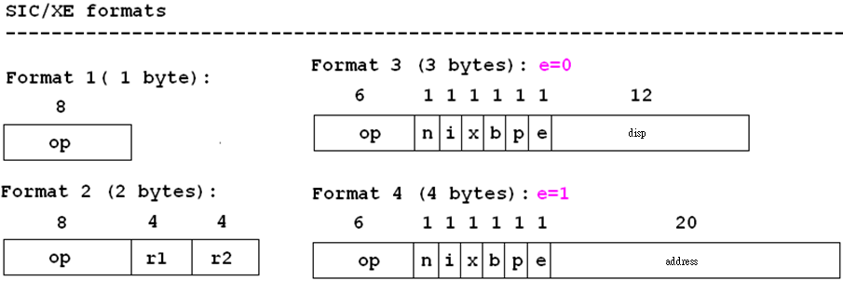
1.3.2 SIC/XE Machine Architecture
Instruction formats
  Don’t refer memory at all - formats 1 and 2
  Relative addressing (相對位址) - format 3 (e=0)
  Extend the address to 20 bits (絕對位址) - format 4 (e=1)
0
1

Slide 19
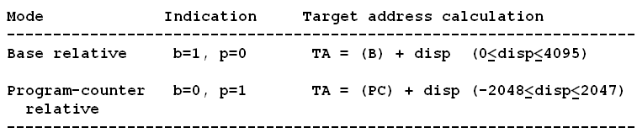
1.3.2 SIC/XE Machine Architecture
Addressing modes
  n i x b p e
  Simple n=0, i=0 (SIC) or n=1, i=1, TA=disp
  Immediate n=0, i=1 Disp=Value
  Indirect n=1, i=0 TA=(Operand)=(TA₁)
  Base relative b=1, p=0 TA=(B)+disp
  0 <= disp <= 4095
  PC relative b=0, p=1 TA=(PC)+disp
  -2048 <= disp <= 2047

Slide 20
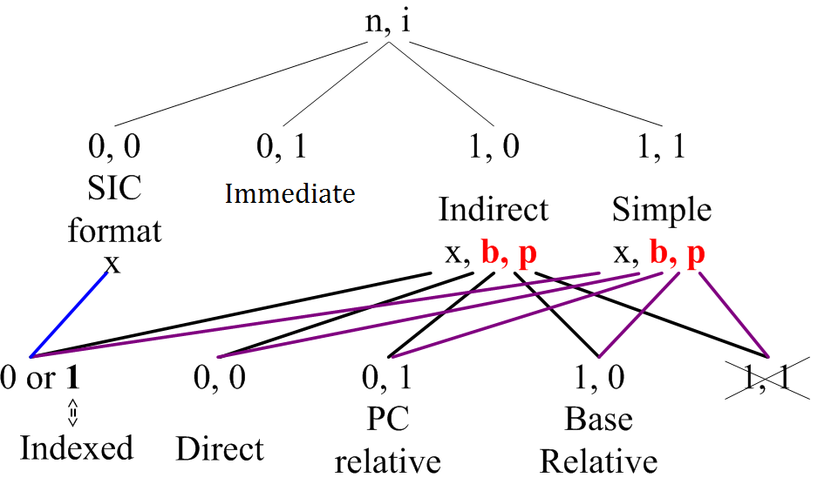

Slide 21
1.3.2 SIC/XE Machine Architecture
Addressing mode
  Direct b=0, p=0 TA=disp
  Indexed x=1 TA_{new}=TA_{old}+(X)
  Indexed+Base relative x=1, b=1, p=0 TA=(B)+disp+(X)
  Indexed+PC relative x=1, b=0, p=1 TA=(PC)+disp+(X)
  Indexed+Direct x=1, b=0, p=0 TA=disp+(X)
  Format 4 e=1
See Appendix A and Fig. 1.1 Example

Slide 22
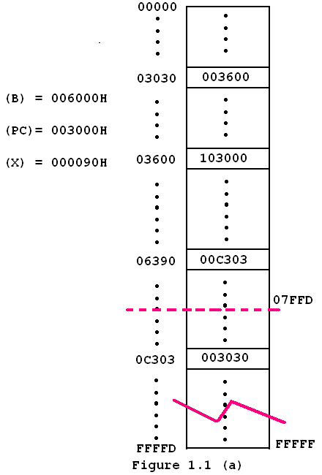
Figure 1.1
Memory address
  00000H
  (0000 0000 0000 0000 0000)
  ~FFFFFH (Byte)
  (1111 1111 1111 1111 1111)

Slide 23
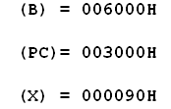
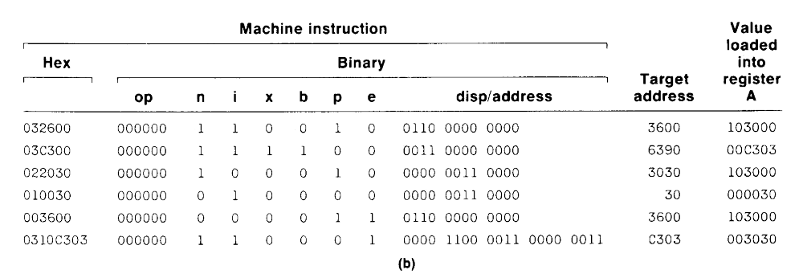
Disp+(PC) =
0
Disp+(X)+(B)=
0
(Disp+(PC))=
0
0

Slide 24
1.3.2 SIC/XE Machine Architecture
Instruction set
  Format 1, 2, 3, or 4
  Load and store registers (LDB, STB, etc.)
  Floating-point arithmetic operations (ADDF, SUBF, MULF, DIVF)
  Register-to-register arithmetic operations (ADDR, SUBR, MULR, DIVR)
  A special supervisor call instruction (SVC) is provided
I/O
  1 byte at a time: TD, RD, and WD
  SIO, TIO, and HIO are used to start, test, and halt the operation of I/O channels.

Slide 25
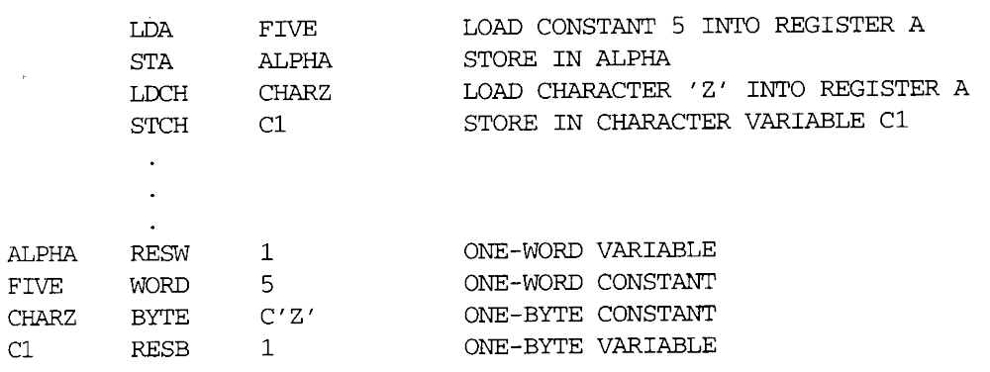
1.3.3 SIC Programming Examples
Sample data movement operations
  No memory-to-memory move instructions (Fig. 1.2)
    LDA five LDA #5
    … …
    five word 5
_____________________________________________

Slide 26
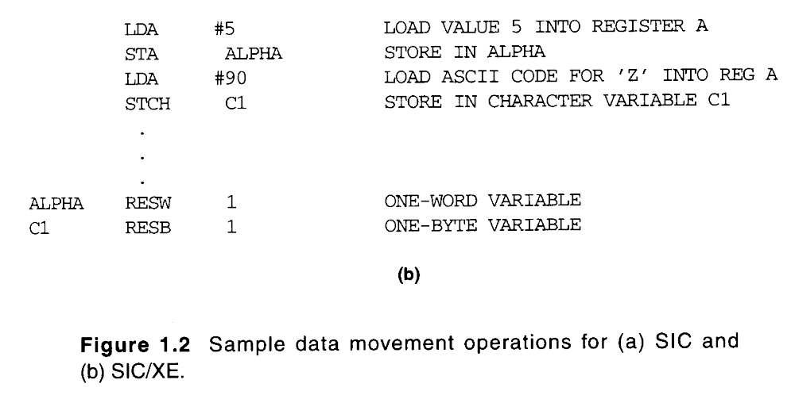
1.3.3 SIC Programming Examples
=00005A

Slide 27
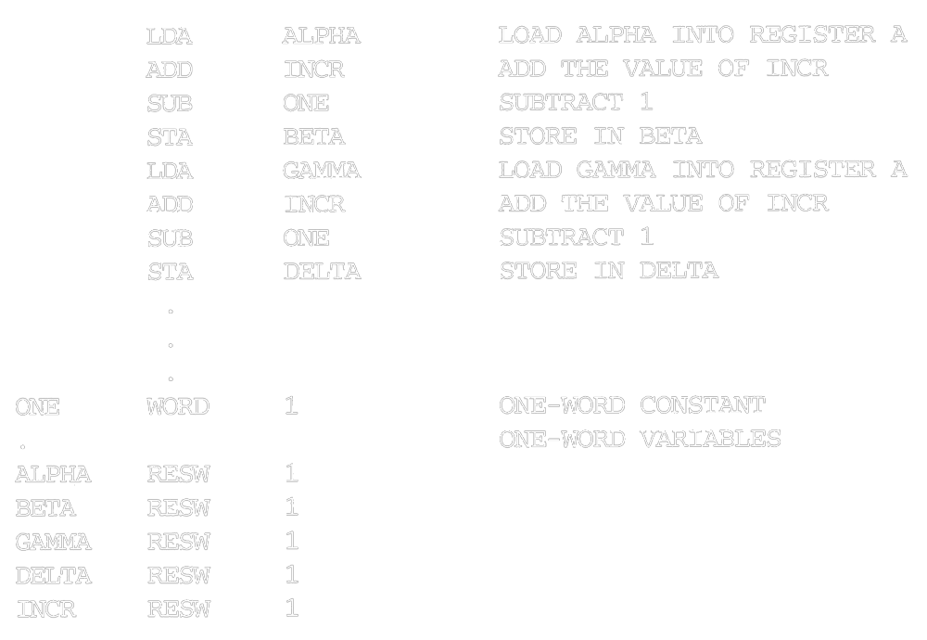
1.3.3 SIC Programming Examples
Sample arithmetic operations
  (ALPHA+INCR-1) assign to BETA (Fig. 1.3)
  (GAMMA+INCR-1) assign to DELTA

Slide 28
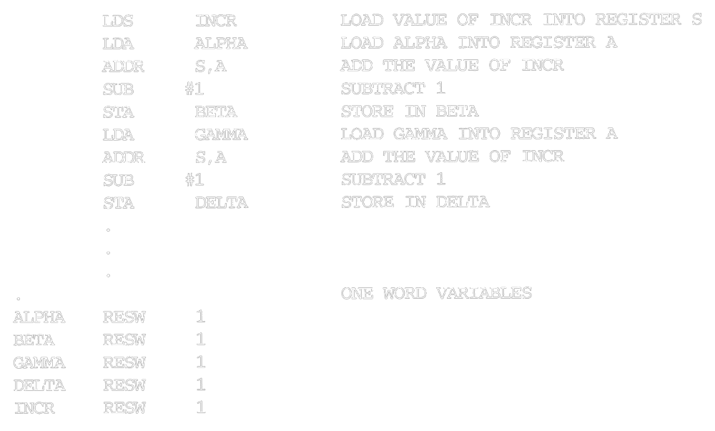
1.3.3 SIC Programming Examples
SIC/XE example

Slide 29
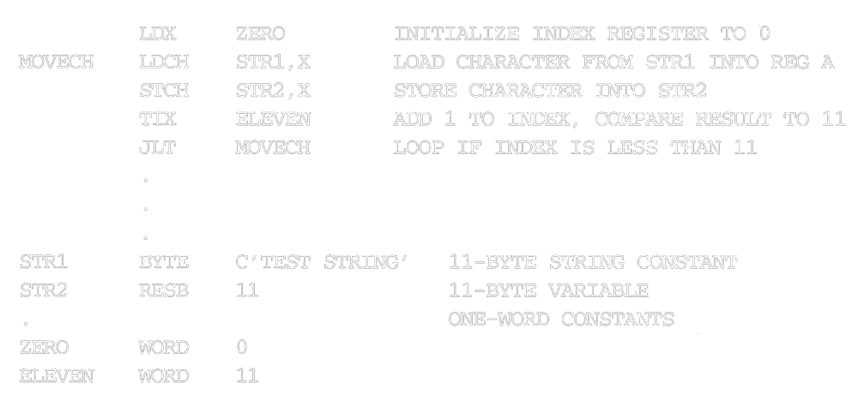
1.3.3 SIC Programming Examples
String copy - SIC example

Slide 30
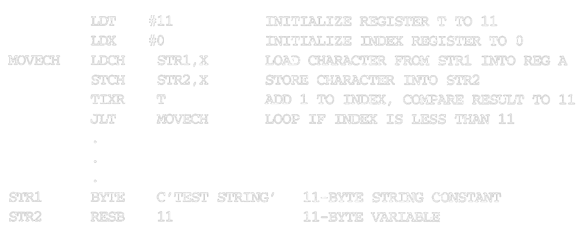
1.3.3 SIC Programming Examples
String copy - SIC/XE example

Slide 31
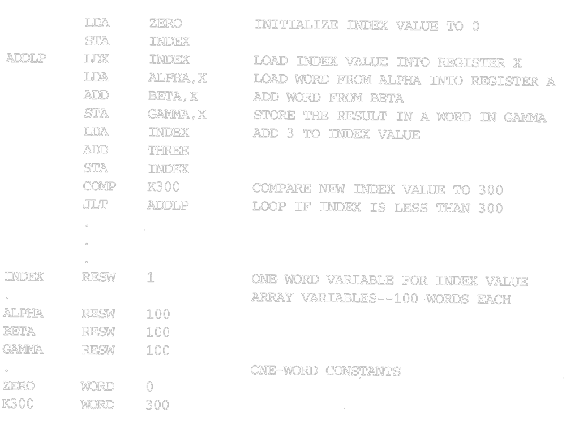
1.3.3 SIC Programming Examples
THREE WORD 3

Slide 32
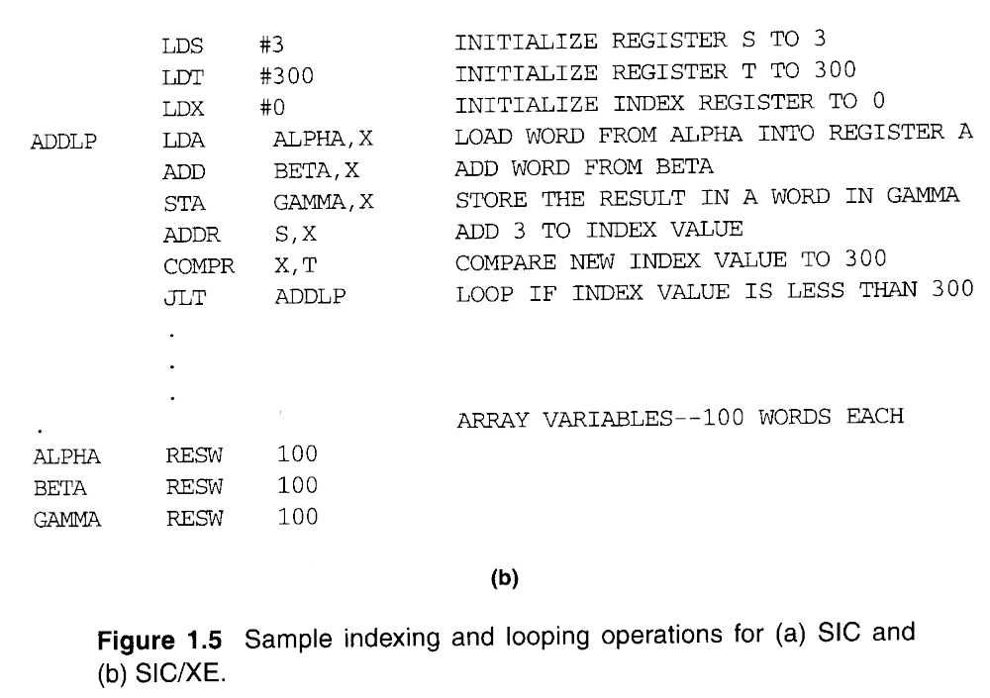
1.3.3 SIC Programming Examples

Slide 33
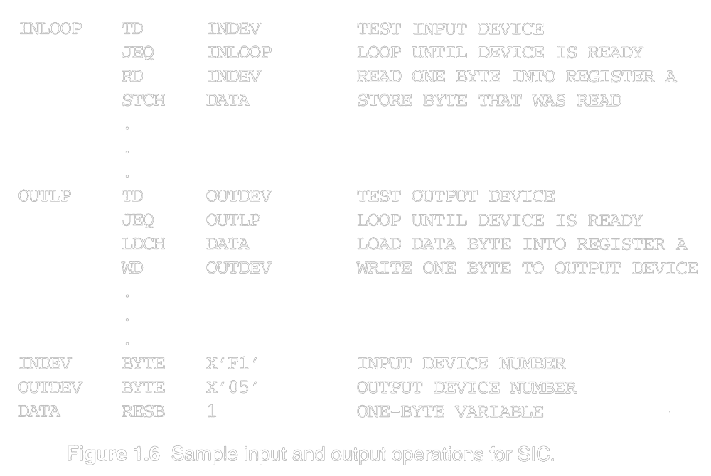
1.3.3 SIC Programming Examples

Slide 34
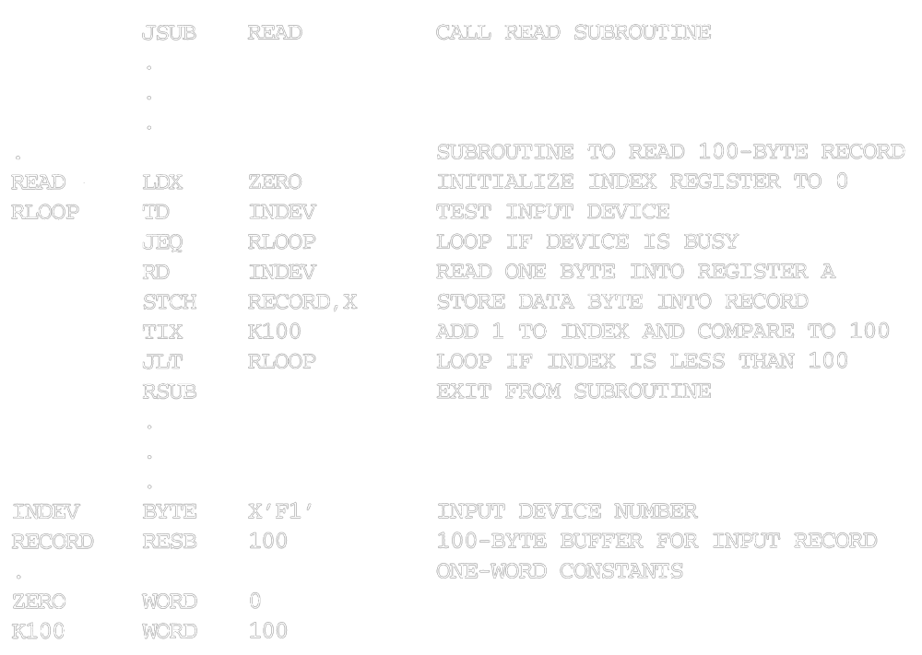
1.3.3 SIC Programming Examples

Slide 35
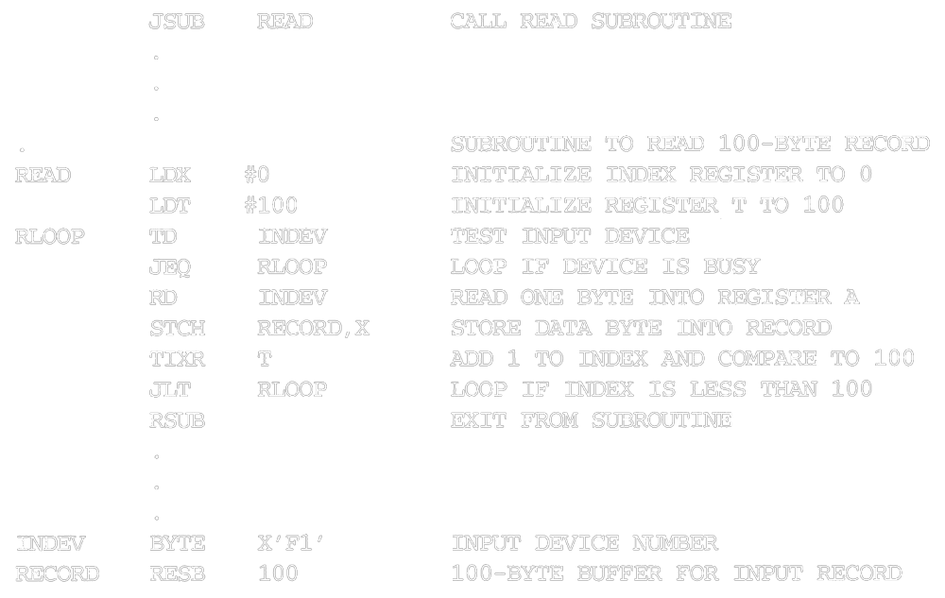
1.3.3 SIC Programming Examples

Slide 36
Traditional (CISC) Machines
Complex Instruction Set Computers (CISC)
  complicated instruction set
  different instruction formats and lengths
  many different addressing modes
  CISC machines: http://en.wikipedia.org/wiki/Complex_instruction_set_computing
    VAX or PDP-11 from DEC
    Intel x86 family
    Motorola 6800, 6809 and 68000-families
    Zilog Z80, Z8 and Z8000-families

Slide 37
RISC Machines
Reduced Instruction Set Computer (RISC) system
  Instruction
    standard, fixed instruction format
    single-cycle execution of most instructions
    memory access is available only for load and store instruction
    other instructions are register-to-register operations
    a small number of machine instructions, and instruction format
    Instructional-level parallelism
  A large number of general-purpose registers
  A small number of addressing modes
  RISC machines: http://en.wikipedia.org/wiki/Reduced_instruction_set_computing
    SPARC family
    PowerPC family
    Cray T3E
    ARM architecture processors in smart phones and tablet

