Slide 1
Chapter 2
Assemblers
Assembler
Linker
Source
Program
Object
Code
Executable
Code
Loader

Slide 2
Outline
2.1 Basic Assembler Functions
  A simple SIC assembler
  Assembler tables and logic
2.2 Machine-Dependent Assembler Features
  Instruction formats and addressing modes
  Program relocation
2.3 Machine-Independent Assembler Features
2.4 Assembler Design Options
  Two-pass
  One-pass
  Multi-pass

Slide 3
2.1 Basic Assembler Functions
Figure 2.1 shows an assembler language program for SIC.
  The line numbers are for reference only.
  Indexing addressing is indicated by adding the modifier “,X”
  Lines beginning with “.” contain comments only.
  Reads records from input device (code F1)
  Copies them to output device (code 05)
  At the end of the file, writes EOF on the output device, then executes RSUB to the operating system

Slide 4
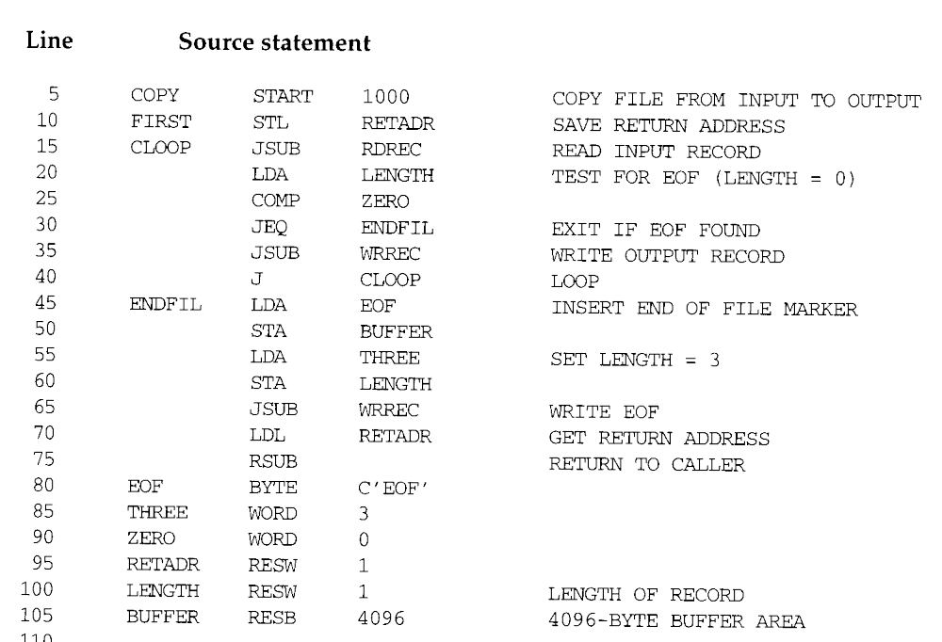

Slide 5
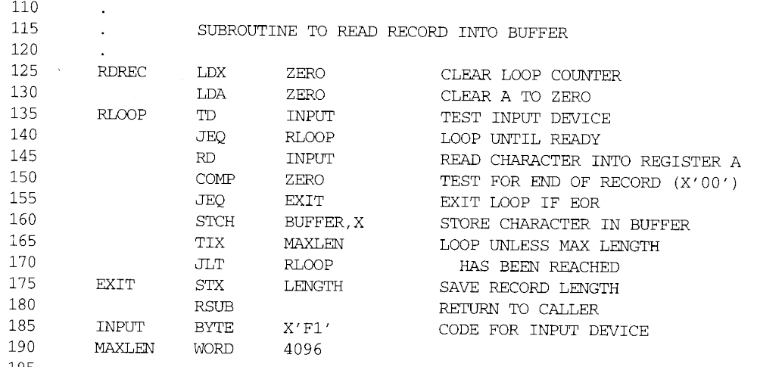

Slide 6
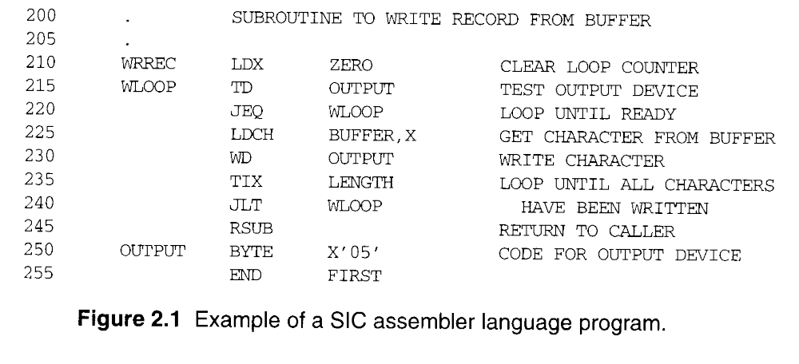

Slide 7
2.1 Basic Assembler Functions
Assembler directives (pseudo-instructions)
  START, END, BYTE, WORD, RESB, RESW.
  These statements are not translated into machine instructions.
  Instead, they provide instructions to the assembler itself.

Slide 8
2.1 Basic Assembler Functions
Data transfer (RD, WD)
  A buffer is used to store record
  Buffering is necessary for different I/O rates
  The end of each record is marked with a null character (00₁₆)
  Buffer length is 4096 Bytes
  The end of the file is indicated by a zero-length record
  When the end of file is detected, the program writes EOF on the output device and terminates by RSUB.
Subroutines (JSUB, RSUB)
  RDREC, WRREC
  Save link (L) register first before nested jump

Slide 9
2.1.1 A simple SIC Assembler
Figure 2.2 shows the generated object code for each statement.
  Loc gives the machine address in Hex.
  Assume the program starting at address 1000H.
Translation functions
  Translate STL to 14.
  Translate RETADR to 1033.
  Build the machine instructions in the proper format (,X).
  Translate EOF to 454F46.
  Write the object program and assembly listing.

Slide 10
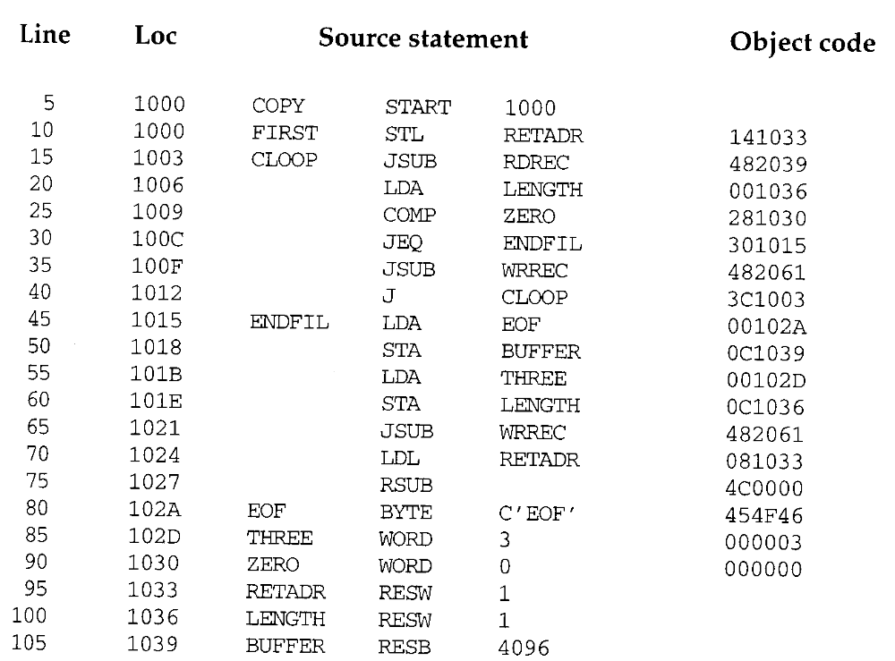

Slide 11
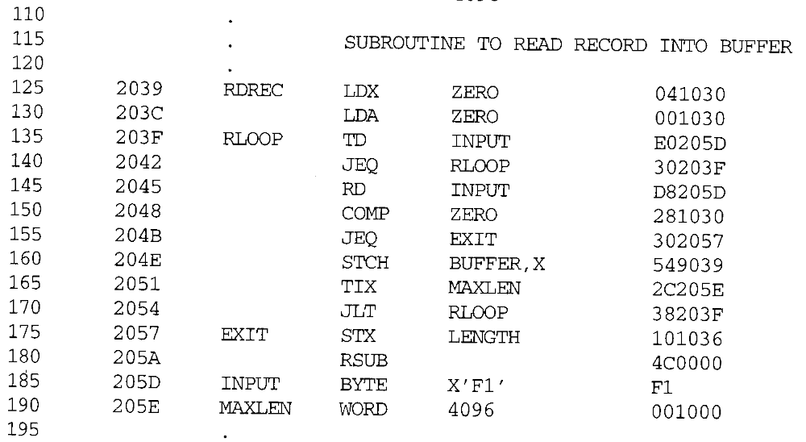

Slide 12
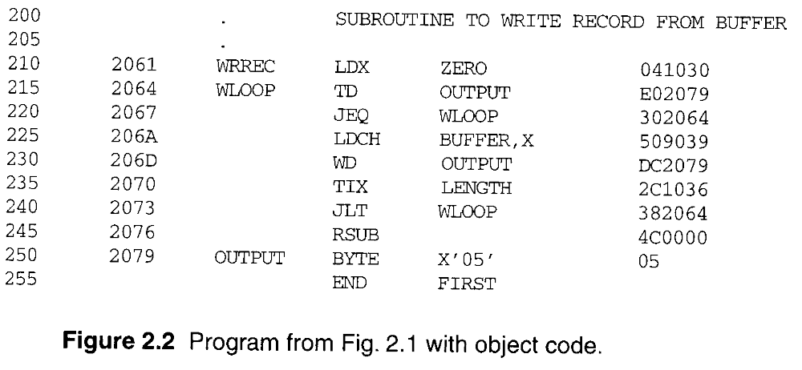

Slide 13
2.1.1 A simple SIC Assembler
A forward reference
  10 1000 FIRST STL RETADR 141033
  A reference to a label (RETADR) that is defined later in the program
Most assemblers make two passes over the source program.
  Pass 1 scans the source for label definitions and assigns address (Loc).
  Pass 2 performs most of the actual translation.

Slide 14
2.1.1 A simple SIC Assembler
Forward reference
  Reference to a label that is defined later in the program.
Loc Label OP Code Operand
1000 FIRST STL RETADR
1003 CLOOP JSUB RDREC
… … … … 1012 J CLOOP
… … … … 1033 RETADR RESW 1

Slide 15
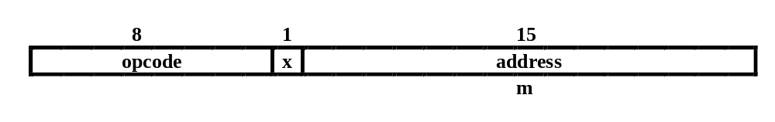
2.1.1 A simple SIC Assembler
Example of Instruction Assemble
  Forward reference
  STCH BUFFER, X
549039
(54)₁₆ 1 (001)₂ (039)₁₆

Slide 16
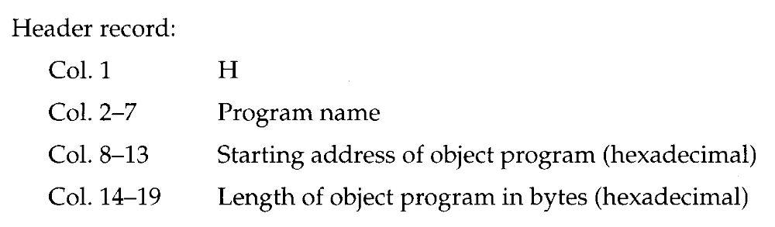
2.1.1 A simple SIC Assembler
The object program (OP) will be loaded into memory for execution.
Three types of records
  Header: program name, starting address, length.
  Text: starting address, length, object code.
  End: address of first executable instruction.

Slide 17
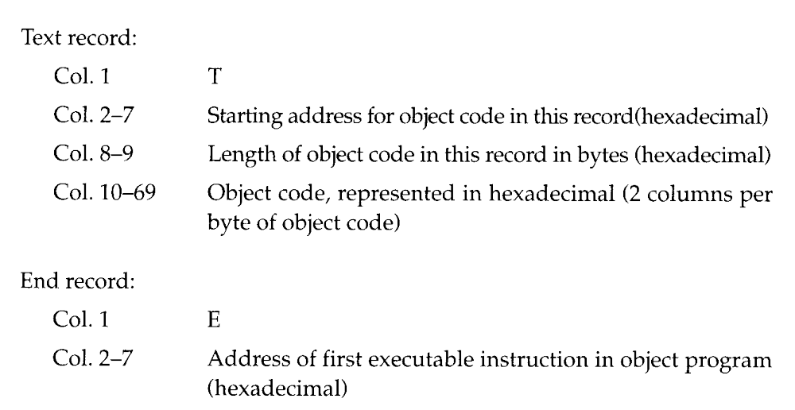
2.1.1 A simple SIC Assembler

Slide 18
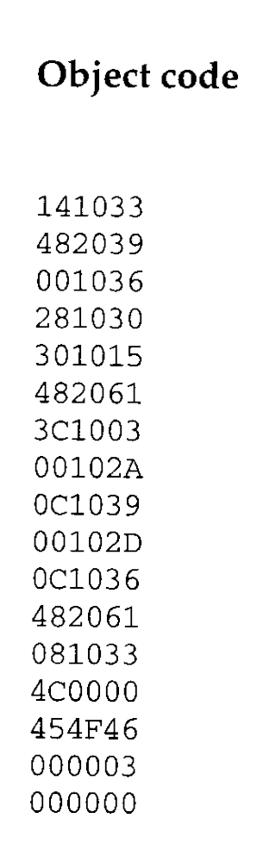
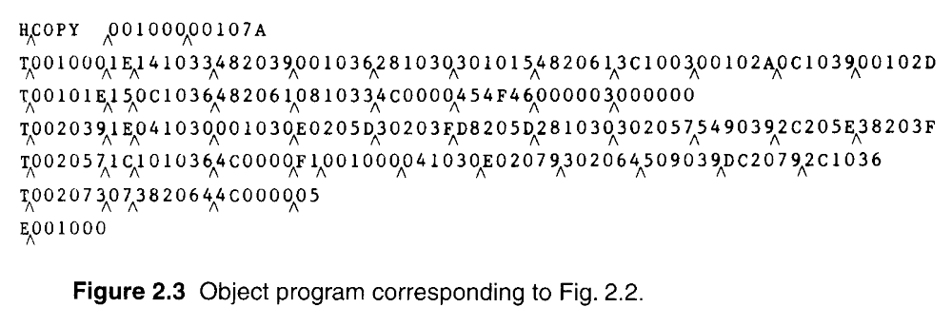
2.1.1 A simple SIC Assembler
The symbol ^ is used to separate fields.
  Figure 2.3
  1E(H)=30(D)=16(D)+14(D)
  H: hexadecimal
  D: Decimal

Slide 19
2.1.1 A simple SIC Assembler
Assembler’s Functions
  Convert mnemonic operation codes to their machine language equivalents
    STL to 14
  Convert symbolic operands (referred label) to their equivalent machine addresses
    RETADR to 1033
  Build the machine instructions in the proper format
  Convert the data constants to internal machine representations
  Write the object program and the assembly listing

Slide 20
2.1.1 A simple SIC Assembler
The functions of the two passes assembler.
  Pass 1 (define symbol)
    Assign addresses to all statements (generate LOC).
    Check the correctness of Instruction (check with OP table).
    Save the values (address) assigned to all labels into SYMBOL table for Pass 2.
    Perform some processing of assembler directives. (LOC 累加)
  Pass 2
    Assemble instructions (generating op code by the OP table, and finding address by the SYMBOL table).
    Generate data values defined by BYTE, WORD.
    Perform processing of assembler directives not done during Pass 1.
    Write the OP (Fig. 2.3) and the assembly listing (Fig. 2.2).

Slide 21
2.1.2 Assembler Tables and Logic
Our simple assembler uses two internal tables: The OPTAB and SYMTAB.
  OPTAB is used to look up mnemonic operation codes and translate them to their machine language equivalents.
    LDA→00, STL→14, …
  SYMTAB is used to store values (addresses) assigned to labels.
    COPY→1000, FIRST→1000 …
Location Counter LOCCTR
  LOCCTR is a variable for assignment addresses.
  LOCCTR is initialized to address specified in START.
  When reach a label, the current value of LOCCTR gives the address to be associated with that label.

Slide 22
2.1.2 Assembler Tables and Logic
The Operation Code Table (OPTAB)
  Contain the mnemonic operation & its machine language equivalents (at least).
  Contain instruction format & length.
  Pass 1, OPTAB is used to look up and validate operation codes.
  Pass 2, OPTAB is used to translate the operation codes to machine language.
  In SIC/XE, assembler search OPTAB in Pass 1 to find the instruction length for incrementing LOCCTR.
  Organize as a hash table (static table).

Slide 23
2.1.2 Assembler Tables and Logic
The Symbol Table (SYMTAB)
  Include the name and value (address) for each label.
  Include flags to indicate error conditions
  Contain type, length.
  Pass 1, labels are entered into SYMTAB, along with assigned addresses (from LOCCTR).
  Pass 2, symbols used as operands are look up in SYMTAB to obtain the addresses.
  Organize as a hash table (static table).
  The entries are rarely deleted from table.
COPY 1000
FIRST 1000
CLOOP 1003
ENDFIL 1015
EOF 1024
THREE 102D
ZERO 1030
RETADR 1033
LENGTH 1036
BUFFER 1039
RDREC 2039

Slide 24
2.1.2 Assembler Tables and Logic
Pass 1 usually writes an intermediate file.
  Contain source statement together with its assigned address, error indicators.
  This file is used as input to Pass 2.
Figure 2.4 shows the two passes of assembler.
  Format with fields LABEL, OPCODE, and OPERAND.
  Denote numeric value with the prefix #.
  #[OPERAND]

Slide 25
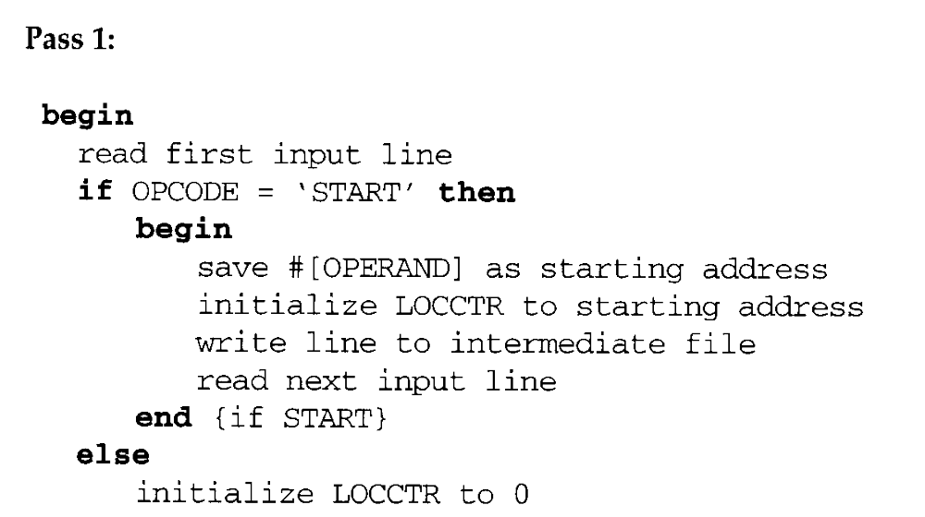

Pass 1

Slide 26
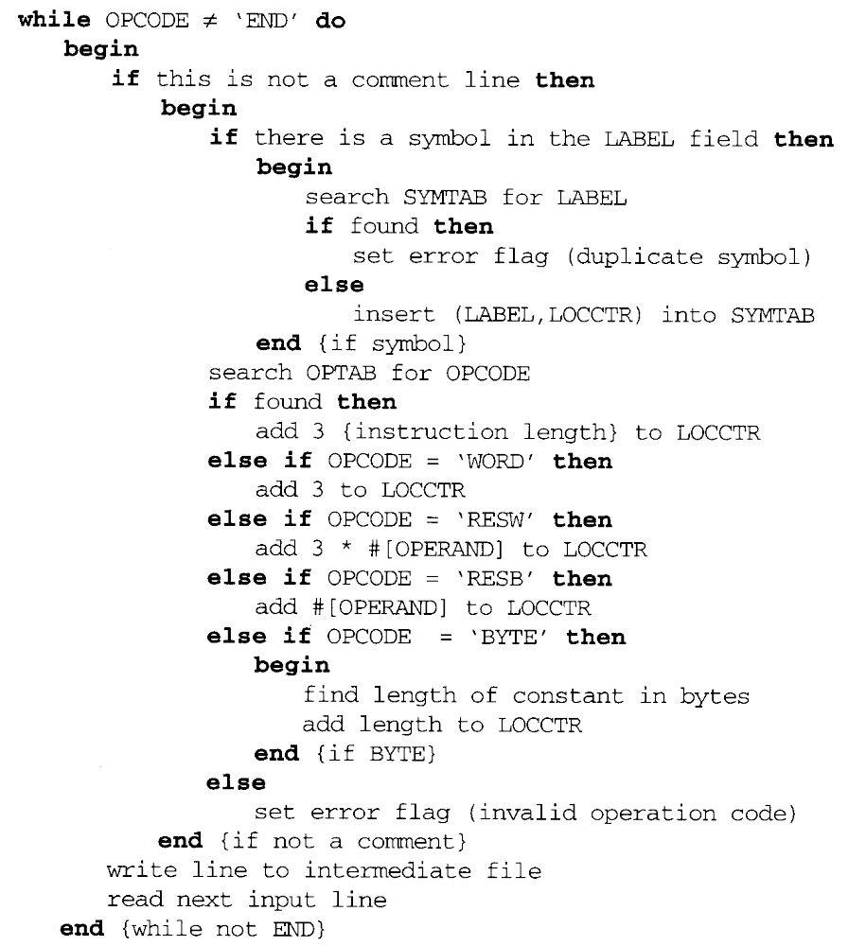

Slide 27
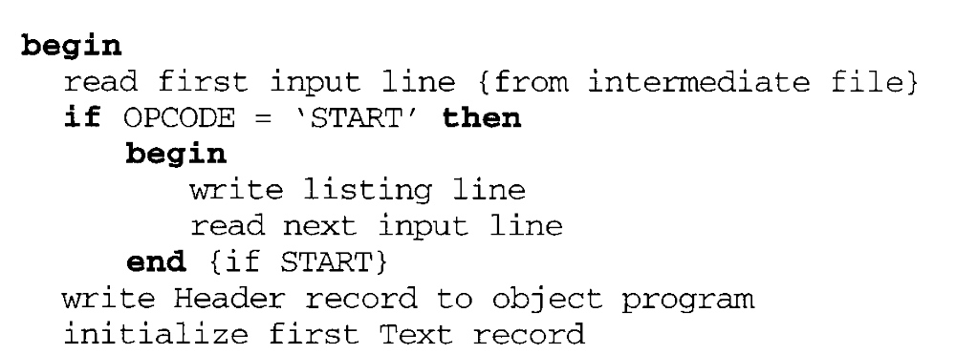
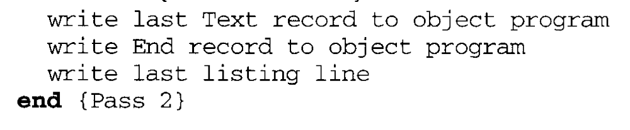
Pass 2

Slide 28
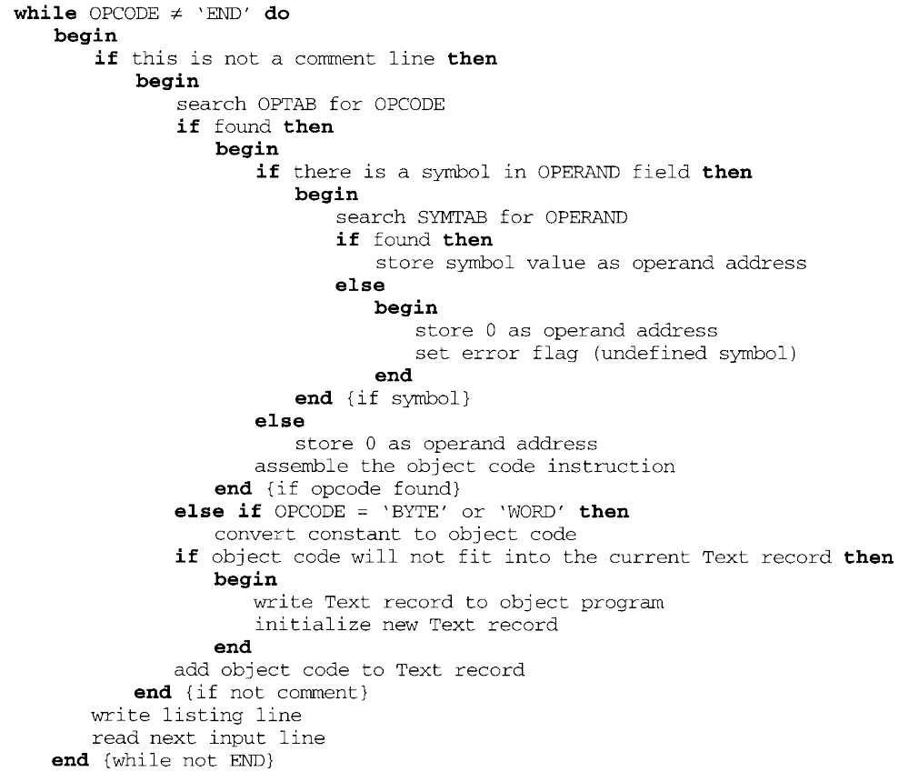

Slide 29
2.2 Machine-Dependent Assembler Features
Indirect addressing
  Adding the prefix @ to operand (line 70).
Immediate operands
  Adding the prefix # to operand (lines 12, 25, 55, 133).
Base relative addressing
  Assembler directive BASE (lines 12 and 13).
Extended format
  Adding the prefix + to OP code (lines 15, 35, 65).
The use of register-register instructions.
  Faster and don’t require another memory reference.

Slide 30
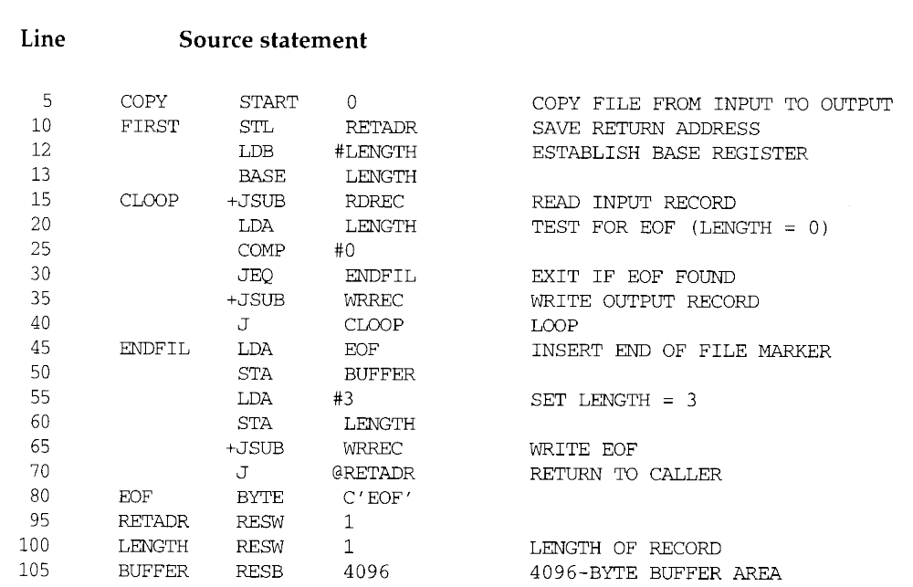
Figure 2.5: First

Slide 31
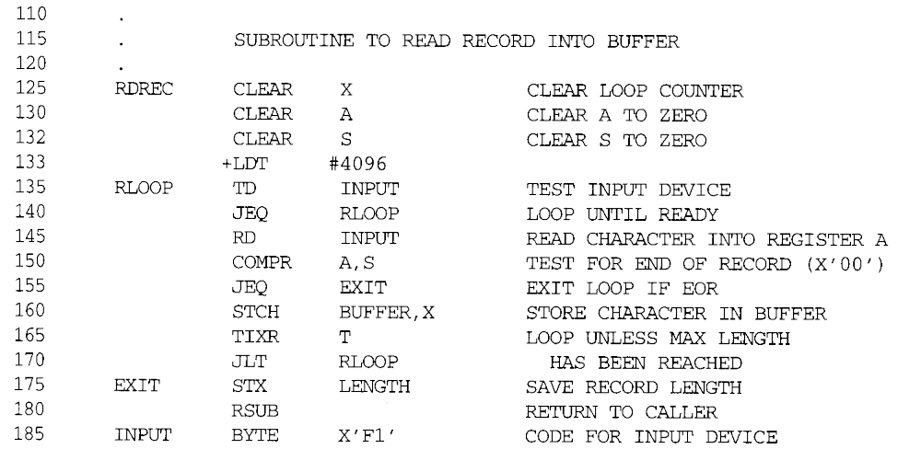
Figure 2.5: RDREC

Slide 32
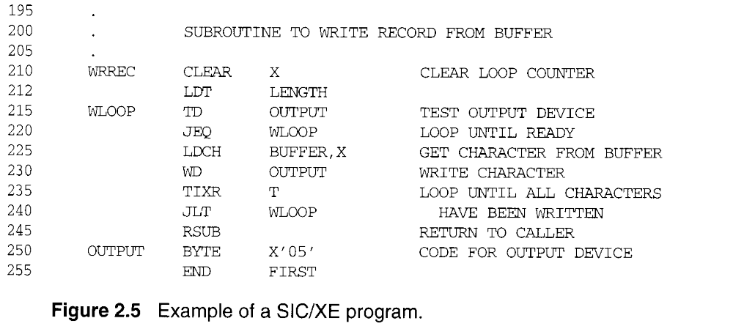
Figure 2.5: WRREC

Slide 33
2.2 Machine-Dependent Assembler
Features
SIC/XE
  PC-relative/Base-relative addressing op m
  Indirect addressing op @m
  Immediate addressing op #c
  Extended format +op m
  Indexed addressing op m, X
  register-to-register instructions COMPR
  larger memory → multi-programming (program allocation)

Slide 34
2.2 Machine-Dependent Assembler
Features
Register translation
  register name (A, X, L, B, S, T, F, PC, SW) and their values
  (0, 1, 2, 3, 4, 5, 6, 8, 9)
  preloaded in SYMTAB
Address translation
  Most register-memory instructions use program counter relative or base relative addressing
  Format 3: 12-bit displacement (disp. address) field
    PC-relative: -2048~2047
    Base-relative: 0~4095
  Format 4: 20-bit address field (absolute addressing)

Slide 35
2.2.1 Instruction Formats & Addressing Modes
The START statement
  Specifies a beginning address of 0.
Register-register instructions
  CLEAR & TIXR, COMPR
Most register-memory instructions are assembled using Program-counter (PC) relative addressing
  The program counter is advanced after each instruction is fetched and before it is executed.
  PC will contain the address of the next instruction.
  10 0000 FIRST STL RETADR 17202D
  TA - (PC) = disp = 30H – 3H= 2D

Slide 36
140030
17202D
0001 0111 0010 0000 0010 1101
0001 0100 (14H)
  0006 - 001A = disp = -14 (H)
Find 14H 的2’complement
014= 0000 0001 0100
= 1111 1110 1011
+ 1
= 1111 1110 1100
= F E C

Slide 37
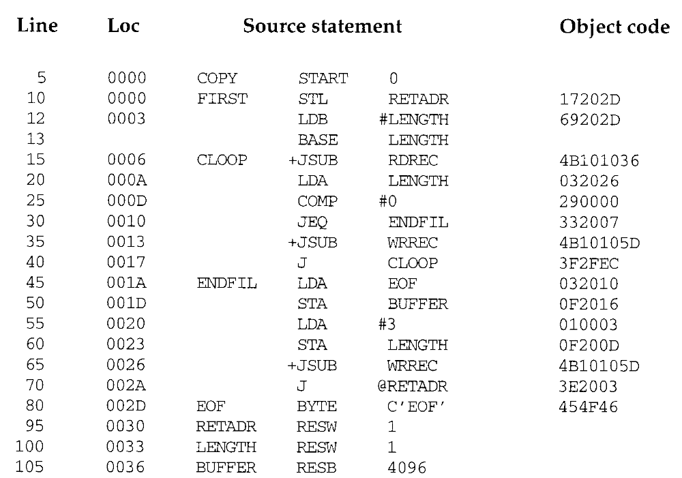

Slide 38
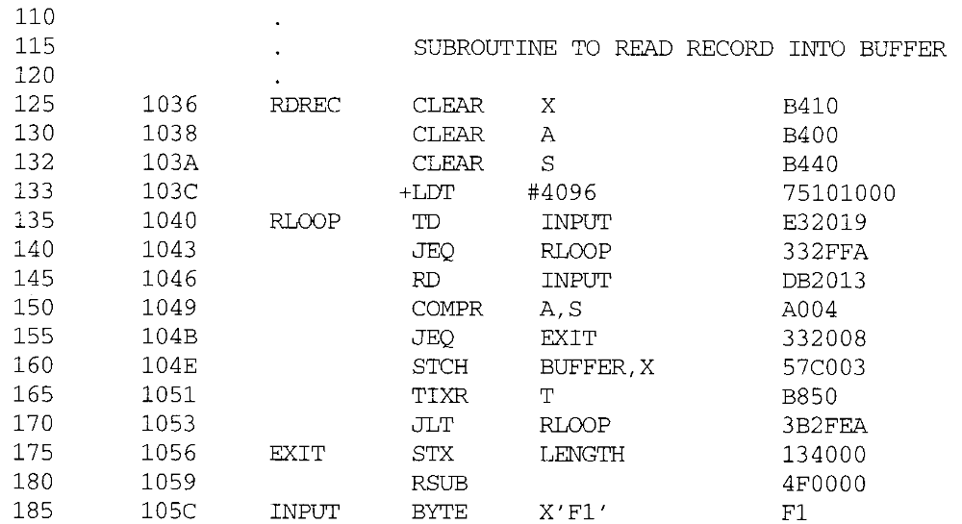

Slide 39
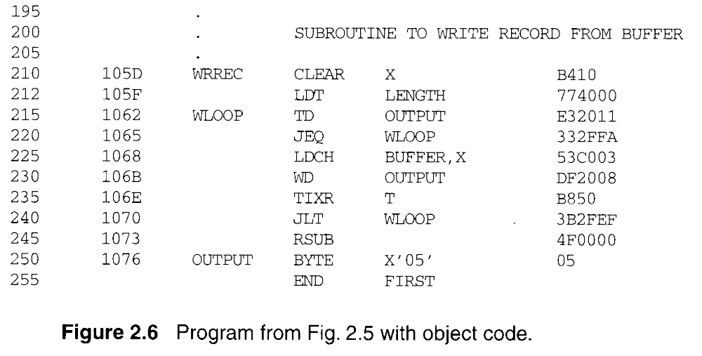

Slide 40
Second digit of Opcode:
n=1, i=1, OPcode+3, Simple
@m, n=1, i=0, OPcode+2, Indirect
#m, n=0, i=1, OPcode+1, Immediate
Third digit of assembled code:
xbpe 2: PC-relative
4: Base-relative
8: indexed(OP m,X)
1: extended(+OP, e=1 )
1100₂ = 0xC in lines 160 and 225
=> indexed Base relative addressing

Slide 41
2.2.1 Instruction Formats & Addressing Modes
  40 0017 J CLOOP 3F2FEC
  0006 - 001A = disp = -14 (H)
  Base (B), BASE LENGTH, LDB #LENGTH160 104E STCH BUFFER, X 57C003
  TA-(B) = 0036 - (B) = disp => 0036-0033 = 0003
Extended instruction
  15 0006 CLOOP +JSUB RDREC 4B101036
Immediate instruction
  55 0020 LDA #3 010003
  133 103C +LDT #4096 75101000
PC relative + indirect addressing (line 70)

Slide 42
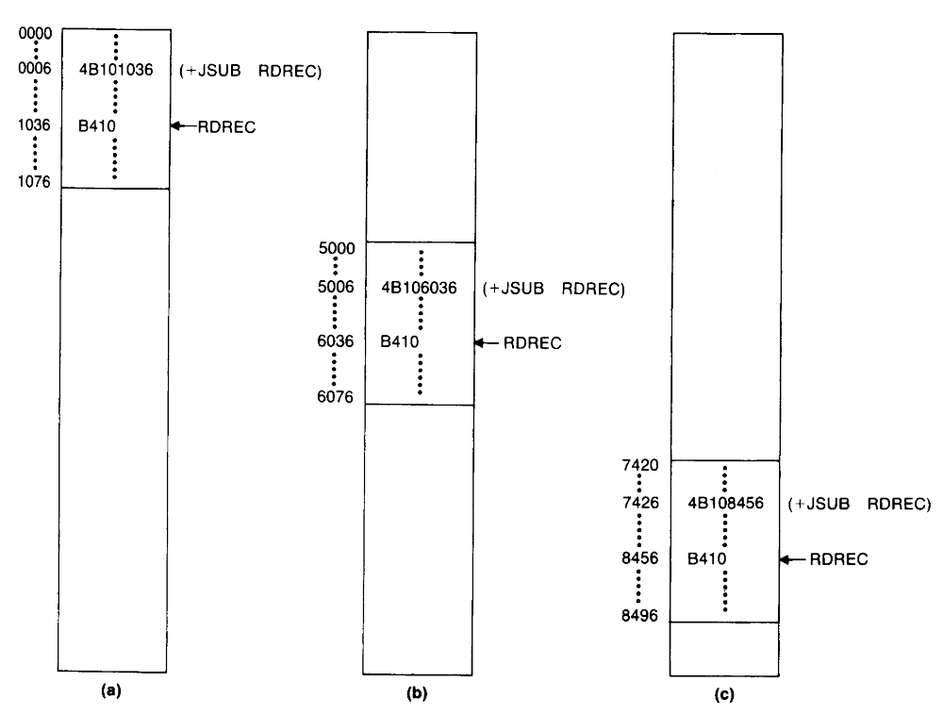
2.2.2 Program Relocation
Absolute program, relocatable program

Slide 43
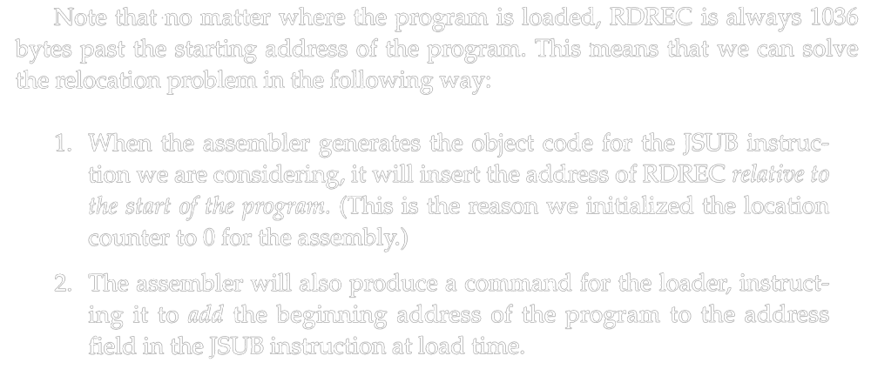
2.2.2 Program Relocation

Slide 44
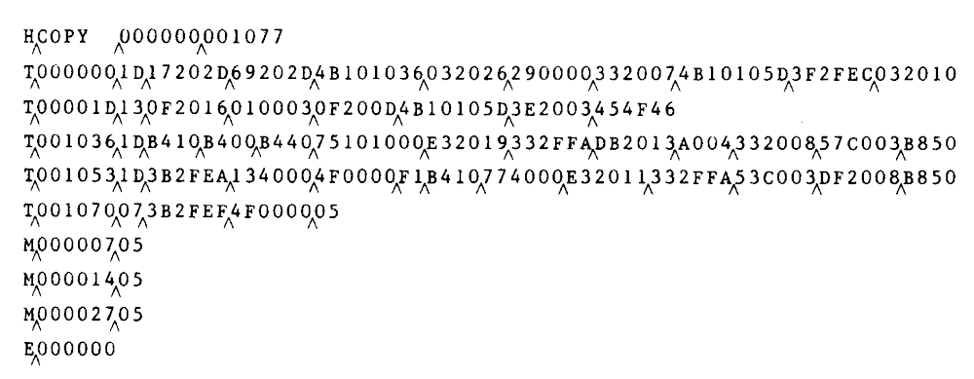

2.2.2 Program Relocation
Modification record (direct addressing)
  1 M
  2-7 Starting location of the address field to be modified, relative to the beginning of the program.
  8-9 Length of the address field to be modified, in half bytes.
  M^000007^05

Slide 45
2.3 Machine-Independent Assembler Features
Write the value of a constant operand as a part of the instruction that uses it (Fig. 2.9).
A literal is identified with the prefix =
  45 001A ENDFIL LDA =C’EOF’ 032010
  Specifies a 3-byte operand whose value is the character string EOF.
  215 1062 WLOOP TD =X’05’ E32011
  Specifies a 1-byte literal with the hexadecimal value 05

Slide 46
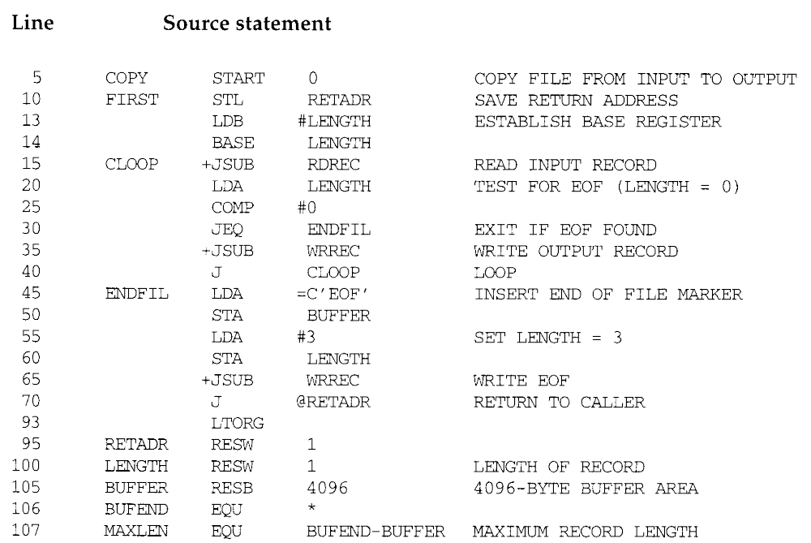

Slide 47
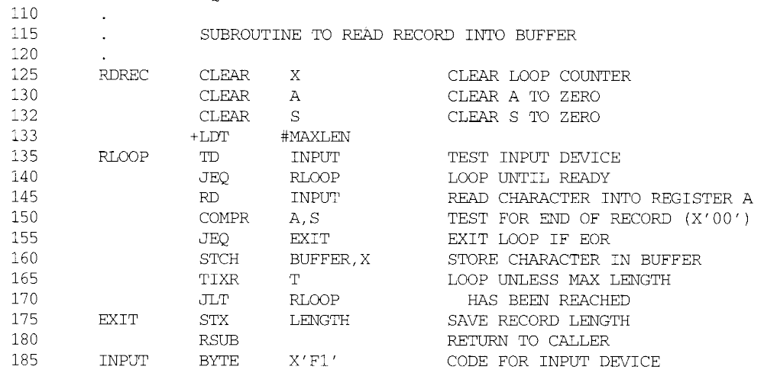
RDREC

Slide 48
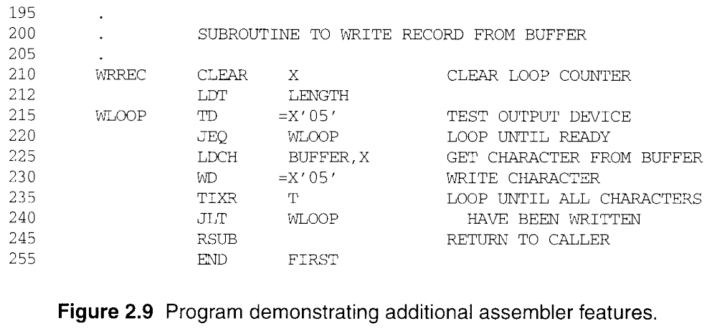
WRREC

Slide 49
2.3.1 Literals
Literal pools
  Assembler directive LTORG, it creates a literal pool that contains all of the literal operands used since the previous LTORG.
  At the end of the program (Fig. 2.10).
The difference between literal operands and immediate operands (=, #)
  Immediate addressing, the operand value is assembled as part of the machine instruction, no memory reference.
  With a literal, the assembler generates the specified value as a constant at some other memory location. The address of this generated constant is used as the TA for the machine instruction, using PC-relative or base-relative addressing with memory reference.

Slide 50
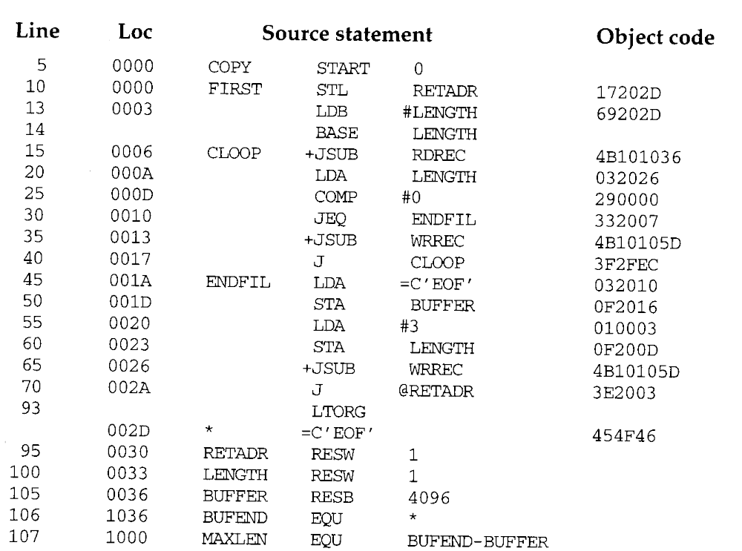

Slide 51
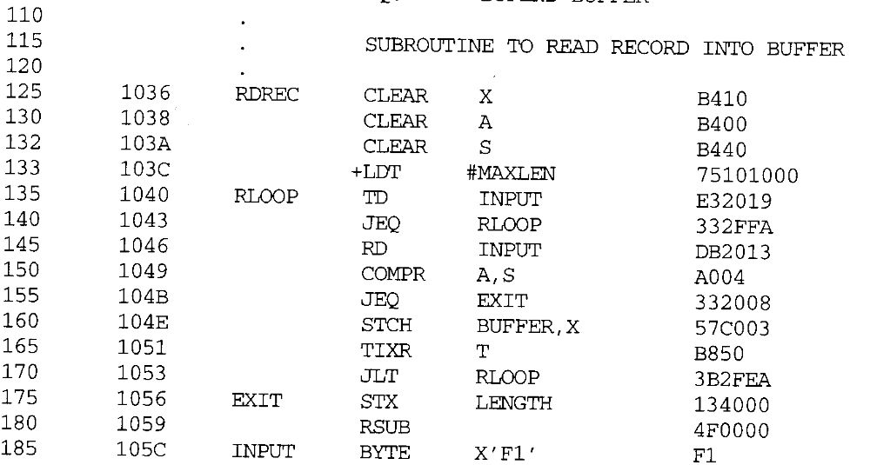
RDREC

Slide 52
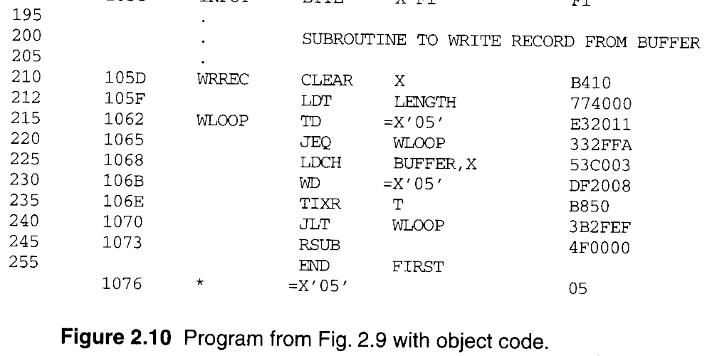
WRREC
1073 * =C’EOF’ 454F46

Slide 53
2.3.1 Literals
When to use LTORG (page 69, 4th paragraph)
  The literal operand would be placed too far away from the instruction referencing.
  Cannot use PC-relative addressing or Base-relative addressing to generate Object Program.
Most assemblers recognize duplicate literals.
  By comparison of the character strings defining them.
  =C’EOF’ and =X’454F46’

Slide 54
2.3.1 Literals
Allow literals that refer to the current value of the location counter.
  Such literals are sometimes useful for loading base registers.
  LDB =*
  ; register B=beginning address of statement=current LOC
  BASE *
  ; for base relative addressing
If a literal =* appeared on line 13 or 55
  Specify an operand with value 0003 (Loc) or 0020 (Loc).

Slide 55
2.3.1 Literals
Literal table (LITTAB)
  Contains the literal name (=C’EOF’), the operand value (454F46) and length (3), and the address (002D).
  Organized as a hash table.
  Pass 1, the assembler creates or searches LITTAB for the specified literal name.
  Pass 1 encounters a LTORG statement or the end of the program, the assembler makes a scan of the literal table.
  Pass 2, the operand address for use in generating OC is obtained by searching LITTAB.

Slide 56
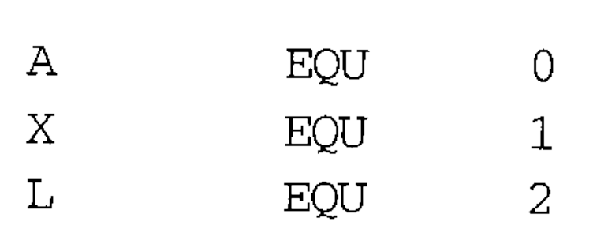
2.3.2 Symbol-Defining Statements
Allow the programmer to define symbols and specify their values.
  Assembler directive EQU.
  Improved readability in place of numeric values.
  +LDT #4096
  MAXLEN EQU BUFEND-BUFFER (4096)
  +LDT #MAXLEN
Use EQU in defining mnemonic names for registers.
  Registers A, X, L can be used by numbers 0, 1, 2.
  RMO 0, 1
  RMO A, X

Slide 57
2.3.2 Symbol-Defining Statements
The standard names reflect the usage of the registers.
  BASE EQU R1
  COUNT EQU R2
  INDEX EQU R3
Assembler directive ORG
  Use to indirectly assign values to symbols.
  ORG value
  The assembler resets its LOCCTR to the specified value.
  ORG can be useful in label definition.

Slide 58
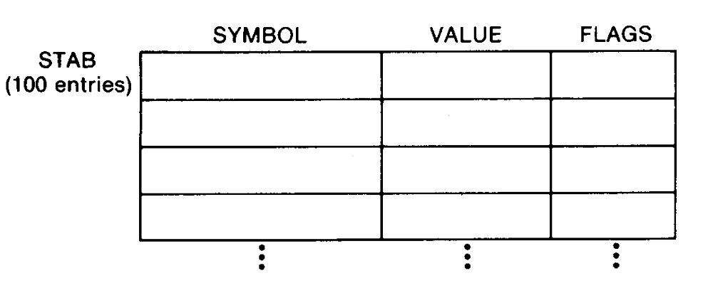
2.3.2 Symbol-Defining Statements
The location counter is used to control assignment of storage in the object program
  In most cases, altering its value would result in an incorrect assembly.
ORG is used http://home.educities.edu.tw/wanker742126/index.html
  SYMBOL is 6-byte, VALUE is 3-byte, and FLAGS is 2-byte.

Slide 59
2.3.2 Symbol-Defining Statements
  STAB SYMBOL VALUE FLAGS
  (100 entries) 6 3 2
  LOC
  1000 STAB RESB 1100
  1000 SYMBOL EQU STAB +0
  1006 VALUE EQU STAB +6
  1009 FLAGS EQU STAB +9
Use LDA VALUE, X to fetch the VALUE field form the table entry indicated by the contents of register X.

Slide 60
2.3.2 Symbol-Defining Statements
  STAB SYMBOL VALUE FLAGS
  (100 entries) 6 3 2
  1000 STAB RESB 1100
  ORG STAB
  1000 SYMBOL RESB 6
  1006 VALUE RESW 1
  1009 FLAGS RESB 2
  ORG STAB+1100

Slide 61
2.3.2 Symbol-Defining Statements
All terms used to specify the value of the new symbol --- must have been defined previously in the program.
  ...
  BETA EQU ALPHA
  ALPHA RESW 1
  ...
  Need 2 passes

Slide 62
2.3.2 Symbol-Defining Statements
All symbols used to specify new location counter value must have been previously defined.
  ORG ALPHA <= could not be
  BYTE1 RESB 1 assigned addresses
  BYTE2 RESB 1 during Pass 1
  BYTE3 RESB 1
  ORG
  ALPHA RESW 1
Forward reference
  ALPHA EQU BETA
  BETA EQU DELTA
  DELTA RESW 1 <= Need 3 passes

Slide 63
2.3.3 Expressions
Allow arithmetic expressions formed
  Using the operators +, -, ×, /.
  Division is usually defined to produce an integer result.
  Expression may be constants, user-defined symbols, or special terms.
  106 1036 BUFEND EQU *
  Gives BUFEND a value that is the address of the next byte after the buffer area.
Absolute expressions or relative expressions
  A relative term or expression represents some value (S+r), S: starting address, r: the relative value.

Slide 64
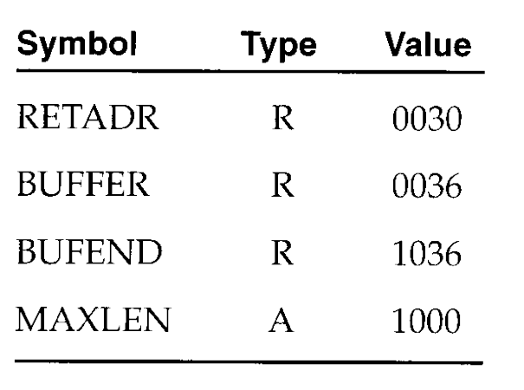
2.3.3 Expressions
  107 1000 MAXLEN EQU BUFEND-BUFFER
  Both BUFEND and BUFFER are relative terms.
  The expression represents absolute value: the difference between the two addresses.
  Loc = (S+r1) – (S+r2) = 1000 (Hex)
  The value that is associated with the symbol that appears in the source statement.
  BUFEND+BUFFER, 100-BUFFER, 3*BUFFER represent neither absolute values nor locations.
Symbol tables entries

Slide 65
2.3.4 Program Blocks
The source program logically contained main, subroutines, data areas.
  In a single block of object code.
More flexible (Different blocks)
  Generate machine instructions (codes) and data in a different order from the corresponding source statements.
Program blocks
  Refer to segments of code that are rearranged within a single object program unit.
Control sections
  Refer to segments of code that are translated into independent object program units.

Slide 66
2.3.4 Program Blocks
Three blocks, Figure 2.11
  default (USE), CDATA (USE CDATA), CBLKS (USE CBLKS).
Assembler directive USE
  Indicates which portions of the source program blocks.
  At the beginning of the program, statements are assumed to be part of the default block.
  Lines 92, 103, 123, 183, 208, 252.
Each program block may contain several separate segments.
  The assembler will rearrange these segments to gather together the pieces of each block.

Slide 67
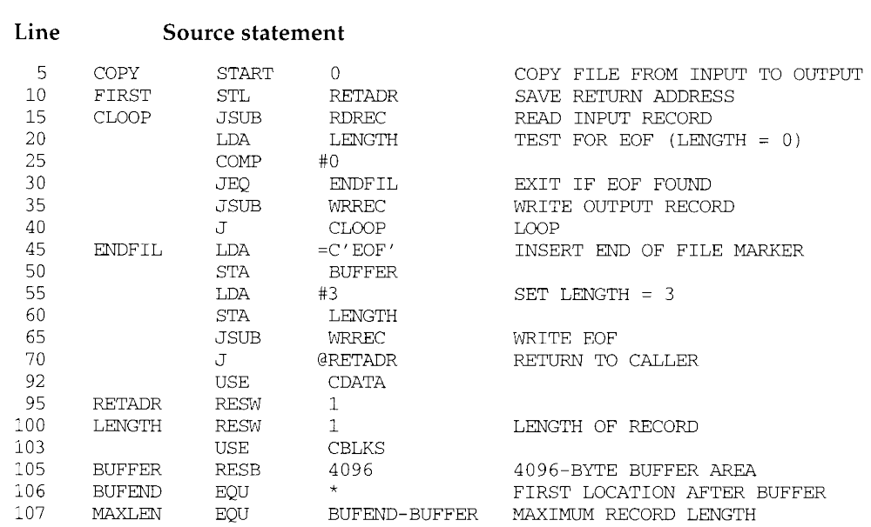
Main
USE

Slide 68
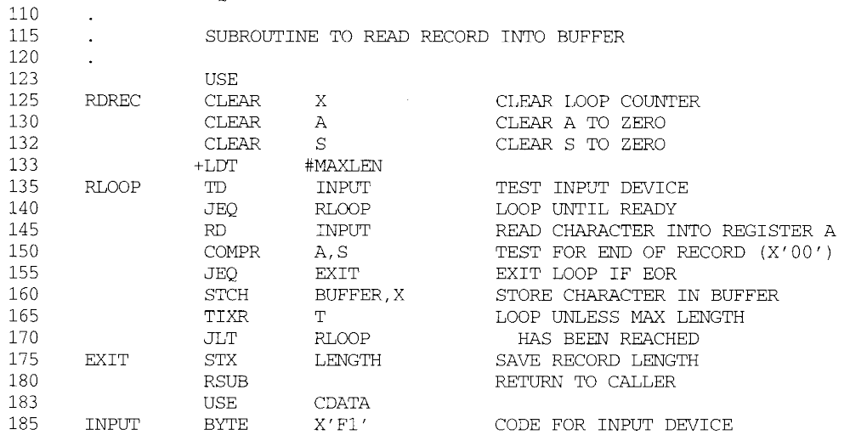
RDREC

Slide 69
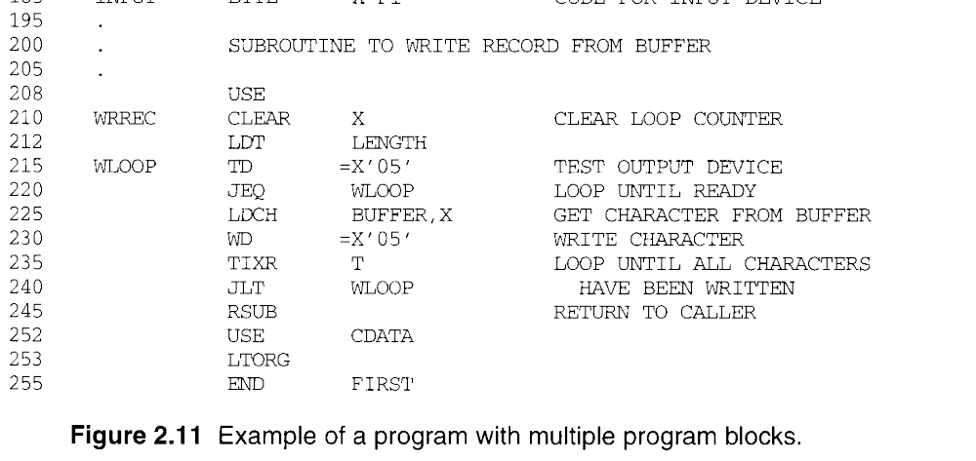
WRREC

Slide 70
2.3.4 Program Blocks
Pass 1, Figure 2.12
  The block number is started form 0.
  A separate location counter for each program block.
  The location counter for a block is initialized to 0 when the block is first begun.
  Assign each block a starting address in the object program (location 0).
  Labels, block name or block number, relative addr.
  Working table is generated
  Block name Block number Address End Length
  default 0 0000 0065 0066 (0000~0065)
  CDATA 1 0066 0070 000B (0000~000A)
  CBLKS 2 0071 1070 1000 (0000~0FFF)

Slide 71
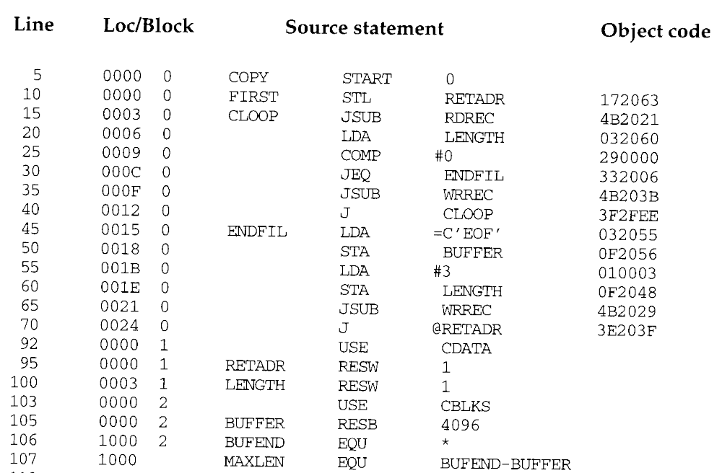

Slide 72
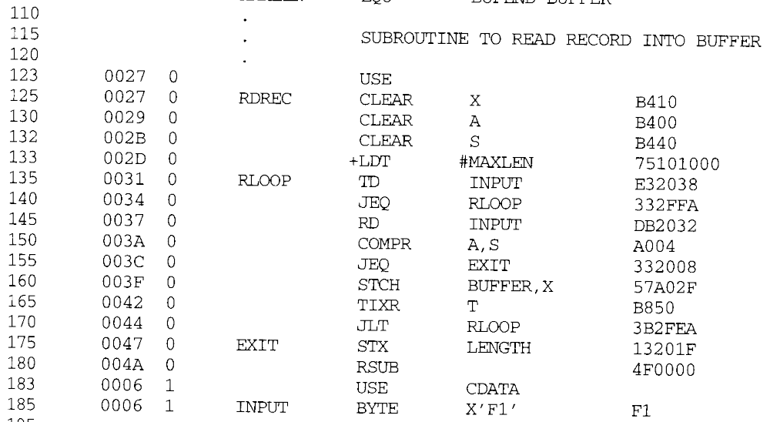

Slide 73
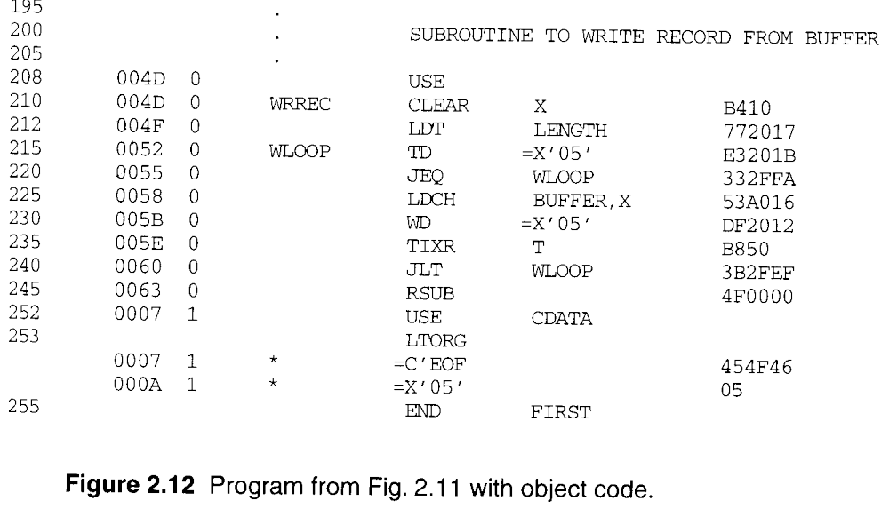

Slide 74
2.3.4 Program Blocks
Pass 2, Figure 2.12
  The assembler needs the address for each symbol relative to the start of the object program.
  Loc shows the relative address and block number.
  Notice that the value of the symbol MAXLEN (line 70) is shown without a block number.
  20 0006 0 LDA LENGTH 032060
  0003(CDATA) +0066 =0069 =TA
  using program-counter relative addressing
  TA - (PC) =0069-0009 =0060 =disp

Slide 75
2.3.4 Program Blocks
Separation of the program into blocks.
  Because the large buffer (CBLKS) is moved to the end of the object program.
  No longer need extended format, base register, simply a LTORG statement.
  No need Modification records.
  Improve program readability.
Figure 2.13
  Reflect the starting address of the block as well as the relative location of the code within the block.
Figure 2.14
  Loader simply loads the object code from each record at the dictated.
  CDATA(1) & CBLKS(1) are not actually present in OP.

Slide 76
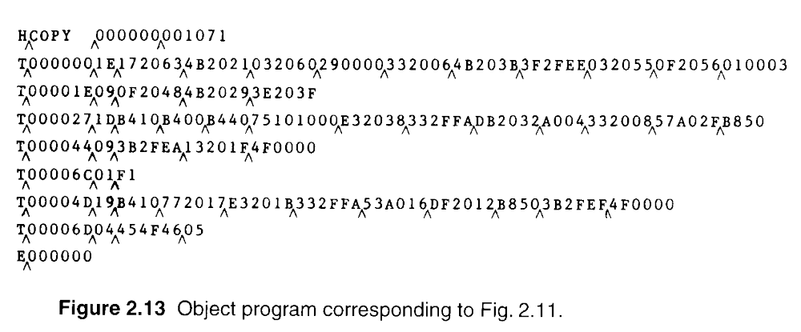
2.3.4 Program Blocks
Default 1
Default 2
CDATA 2
Default 3
CDATA 3

Slide 77
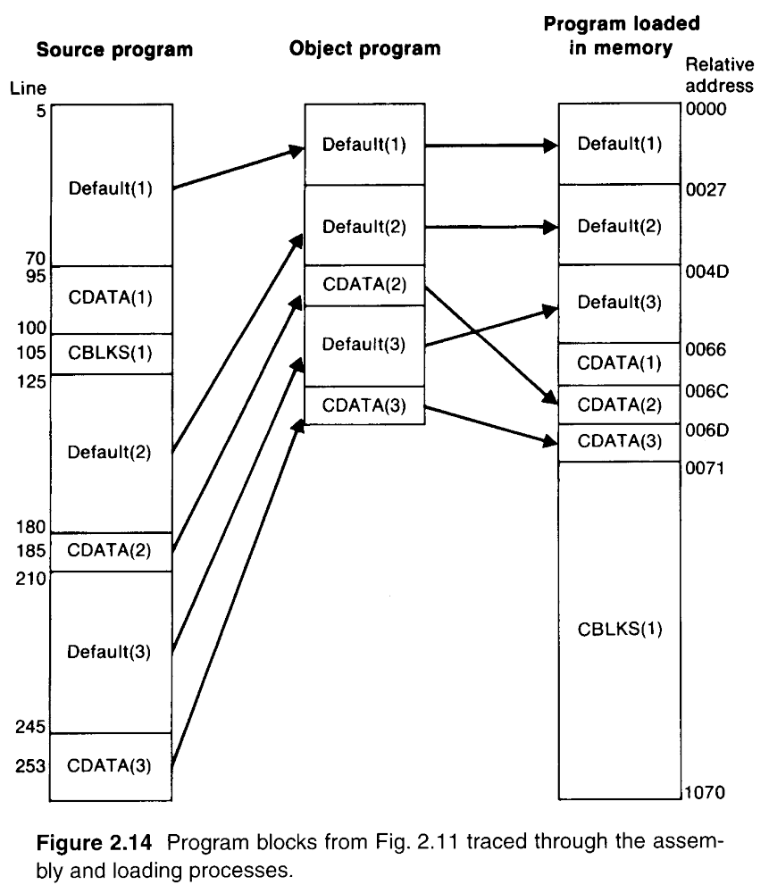

Slide 78
2.3.5 Control Sections & Program Linking
Control section
  Handling of programs that consist of multiple control sections.
  Each control section is a part of the program.
  Can be assembled, loaded and relocated independently.
  Different control sections are most often used for subroutines or other logical subdivisions of a program.
  The programmer can assemble, load, and manipulate each of these control sections separately.
  More Flexibility then the previous.
  Linking control sections together.

Slide 79
2.3.5 Control Sections & Program Linking
External references (external symbol references)
  Instructions in one control section might need to refer to instructions or data located in another section.
Figure 2.15, multiple control sections.
  Three sections, main COPY, RDREC, WRREC.
  Assembler directive CSECT.
  Assembler directives EXTDEF and EXTREF for external symbols.
  The order of symbols is not significant.
  COPY START 0
  EXTDEF BUFFER, BUFEND, LENGTH
  EXTREF RDREC, WRREC (symbol name)

Slide 80
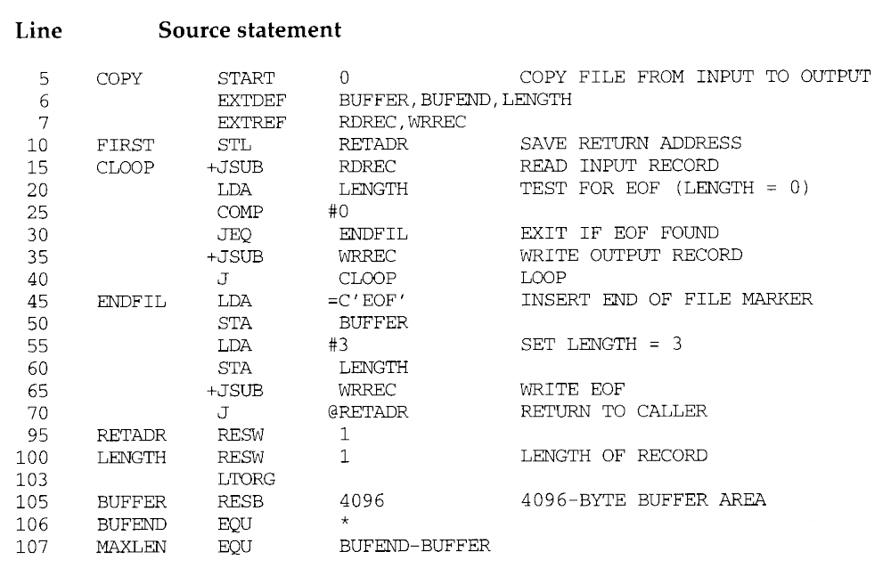
CSECT

Slide 81
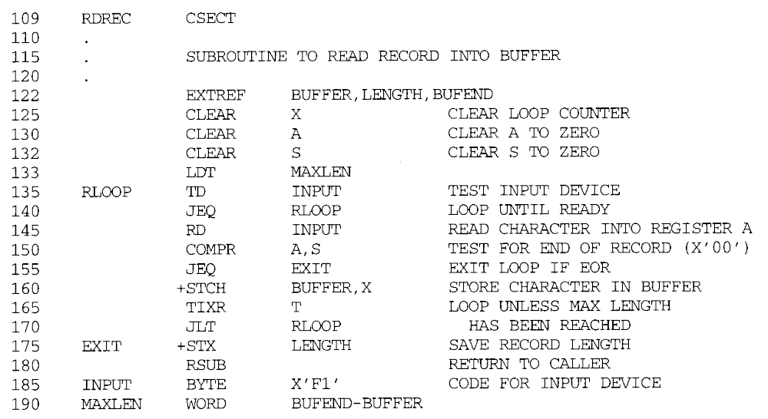

Slide 82
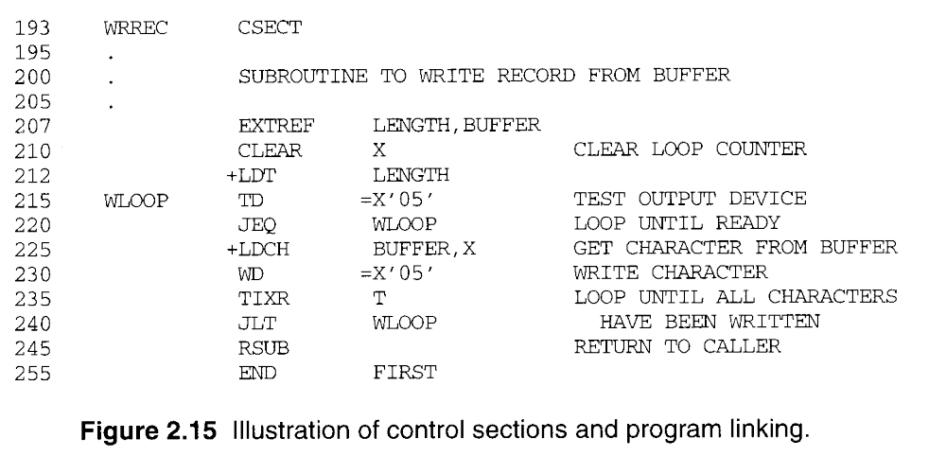

Slide 83
2.3.5 Control Sections & Program Linking
Figure 2.16, the generated object code.
  15 0003 CLOOP +JSUB RDREC 4B100000
  160 0017 +STCH BUFFER,X 57900000
  The LOC of all control section is started form 0
  RDREC is an external reference.
  The assembler has no idea where the control section containing RDREC will be loaded, so it cannot assemble the address.
  The proper address to be inserted at load time.
  Must use extended format instruction for external reference (M records are needed).
  190 0028 MAXLEN WORD BUFEND-BUFFER
  An expression involving two external references.

Slide 84
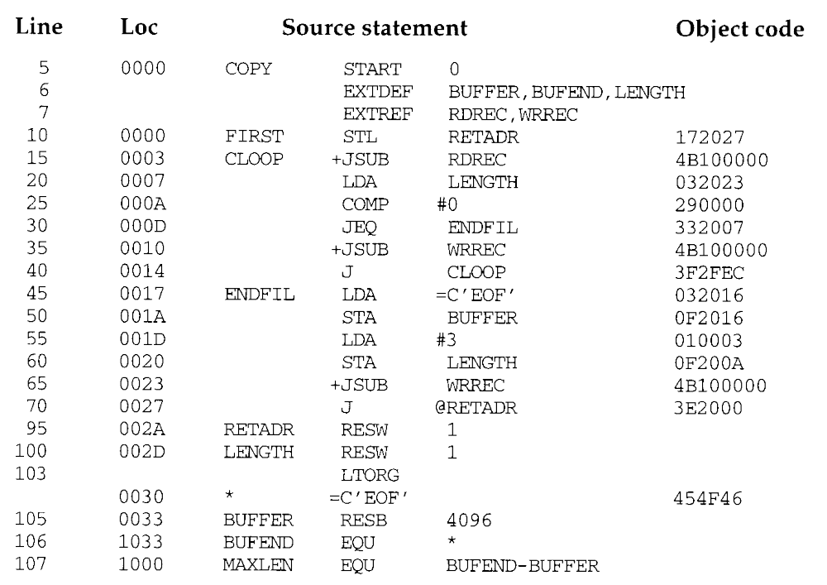

Slide 85
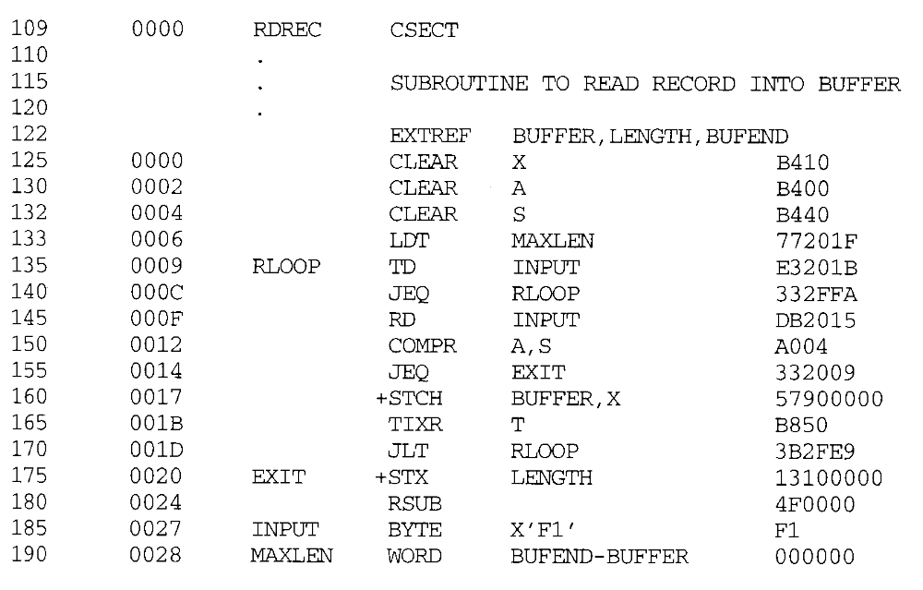

Slide 86
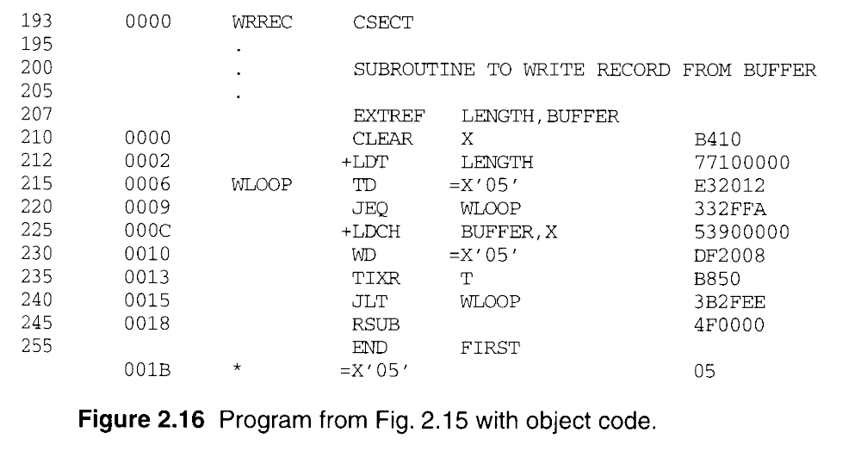

Slide 87
2.3.5 Control Sections & Program Linking
  The loader will add to this data area with the address of BUFEND and subtract from it the address of BUFFER. (COPY and RDREC for MAXLEN)
  Line 190 and 107, in 107, the symbols BUFEND and BUFFER are defined in the same section.
  The assembler must remember in which control section a symbol is defined.
  The assembler allows the same symbol to be used in different control sections, lines 107 and 190.
Figure 2.17, two new records.
  Defined record for EXTDEF, relative address.
  Refer record for EXTREF.

Slide 88
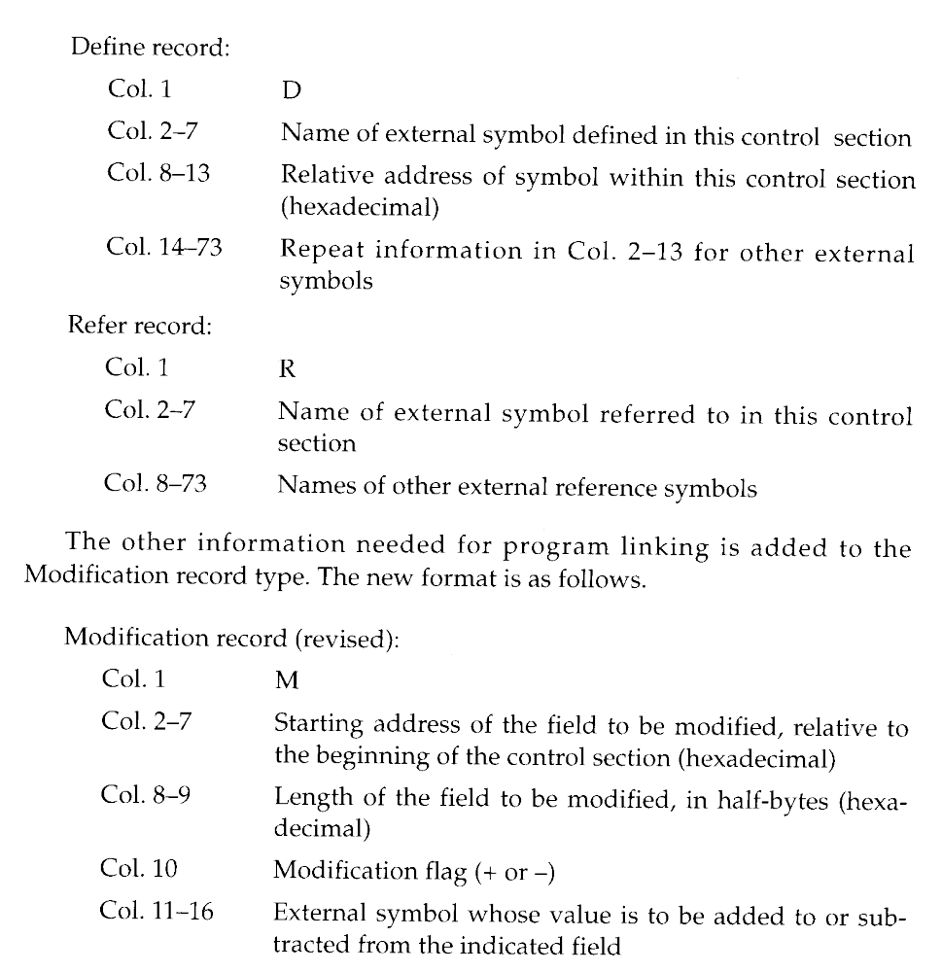

Slide 89
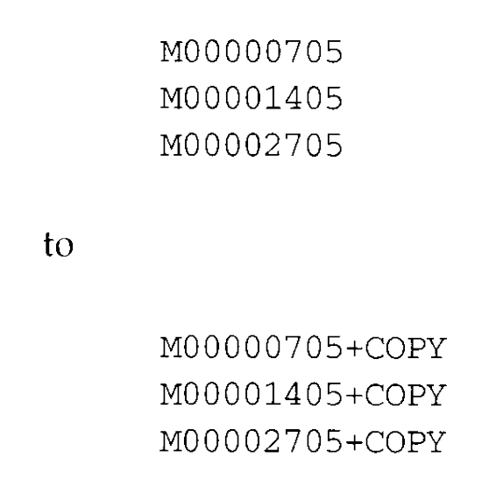
2.3.5 Control Sections & Program Linking
Modification record
  M
  Starting address of the field to be modified, relative to the beginning of the control section (Hex).
  Length of the field to be modified, in half-bytes.
  Modification flag (+ or -).
  External symbol.
  M^000004^05+RDREC
  M^000028^06+BUFEND
  M^000028^06-BUFFER
Use Figure 2.8 for program relocation.

Slide 90



Slide 91


Slide 92
2.4 Assembler Design Options
2.4.1 Two-Pass Assembler
Most assemblers
  Processing the source program into two passes.
  The internal tables and subroutines that are used only during Pass 1.
  The SYMTAB, LITTAB, and OPTAB are used by both passes.
The main problems to assemble a program in one pass involves forward references.

Slide 93
2.4.2 One-Pass Assemblers
Eliminate forward references
  Data items are defined before they are referenced.
  But, forward references to labels on instructions cannot be eliminated as easily.
  Prohibit forward references to labels.
Two types of one-pass assembler. (Fig. 2.18)
  One type produces object code directly in memory for immediate execution.
  The other type produces the usual kind of object program for later execution.

Slide 94


Slide 95


Slide 96


Slide 97
2.4.2 One-Pass Assemblers
Load-and-go one-pass assembler
  The assembler avoids the overhead of writing the object program out and reading it back in.
  The object program is produced in memory, the handling of forward references becomes less difficult.
  Figure 2.19(a), shows the SYMTAB after scanning line 40 of the program in Figure 2.18.
  Since RDREC was not yet defined, the instruction was assembled with no value assigned as the operand address (denote by - - - -).

Slide 98


Slide 99


Slide 100
2.4.2 One-Pass Assemblers
Load-and-go one-pass assembler
  RDREC was then entered into SYMTAB as an undefined symbol, the address of the operand field of the instruction (2013) was inserted.
  Figure 2.19(b), when the symbol ENDFIL was defined (line 45), the assembler placed its value in the SYMTAB entry; it then inserted this value into the instruction operand field (201C).
  At the end of the program, all symbols must be defined without any * in SYMTAB.
  For a load-and-go assembler, the actual address must be known at assembly time.

Slide 101
2.4.2 One-Pass Assemblers
Another one-pass assembler by generating OP
  Generate another Text record with correct operand address.
  When the program is loaded, this address will be inserted into the instruction by the action of the loader.
  Figure 2.20, the operand addresses for the instructions on lines 15, 30, and 35 have been generated as 0000.
  When the definition of ENDFIL is encountered on line 45, the third Text record is generated, the value 2024 is to be loaded at location 201C.
  The loader completes forward references.

Slide 102

ENDFIL
RDREC
EXIT
WRREC

Slide 103
2.4.2 One-Pass Assemblers
In this section, simple one-pass assemblers handled absolute programs (SIC example).

Slide 104

2.4.3 Multi-Pass Assemblers
Use EQU, any symbol used on the RHS be defined previously in the source.
  LOC Pass1 2 3
  1000 LDA #0 1000 1000 1000
  1003 ALPHA EQU BETA ???? ???? 1003
  1003 BETA EQU DELTA ???? 1003 1003
  1003 DELTA RESW 1 1003 1003 1003
  Need 3 passes!
Figure 2.21, multi-pass assembler

Slide 105

2.4.3 Multi-Pass Assemblers

Slide 106

2.4.3 Multi-Pass Assemblers

Slide 107

2.4.3 Multi-Pass Assemblers

Slide 108

2.4.3 Multi-Pass Assemblers

Slide 109

2.4.3 Multi-Pass Assemblers

