Slide 1
Chapter 3
Loaders and Linkers
Assembler
Linker
Source
Program
Object
Code
Executable
Code
Loader

Slide 2
3.1 Basic Loader Functions
In Chapter 2, we discussions
  Loading: brings the object program into memory for execution
  Relocating: modifies the object program so that it can be loaded at an address different from the location originally specified.
  Linking: combines two or more separate object program (see 2.3.5)
In Chapter 3, we will discussion
  A loader brings an object program into memory and starting its execution.
  A linker performs the linking operations and a separate loader to handle relocation and loading.

Slide 3
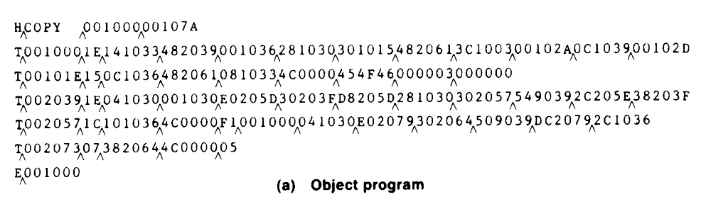
3.1 Basic Loader Functions
3.1.1 Design of an Absolute Loader
Absolute loader (for SIC), in Figures 3.1 and 3.2.
  Does not perform linking and program relocation.
  The contents of memory locations for which there is no Text record are shown as xxxx.
  Each byte of assembled code is given using its Hex representation in character form.

Slide 4
3.1.1 Design of an Absolute Loader
Absolute loader, in Figure 3.1 and 3.2.
  STL instruction, pair of characters 14, when these are read by loader, they will occupy two bytes of memory.
  14 (Hex 31 34) ----> 00010100 (one byte)
  For execution, the operation code must be stored in a single byte with hexadecimal value 14.
  Each pair of bytes must be packed together into one byte.
  Each printed character represents one half-byte.

Slide 5
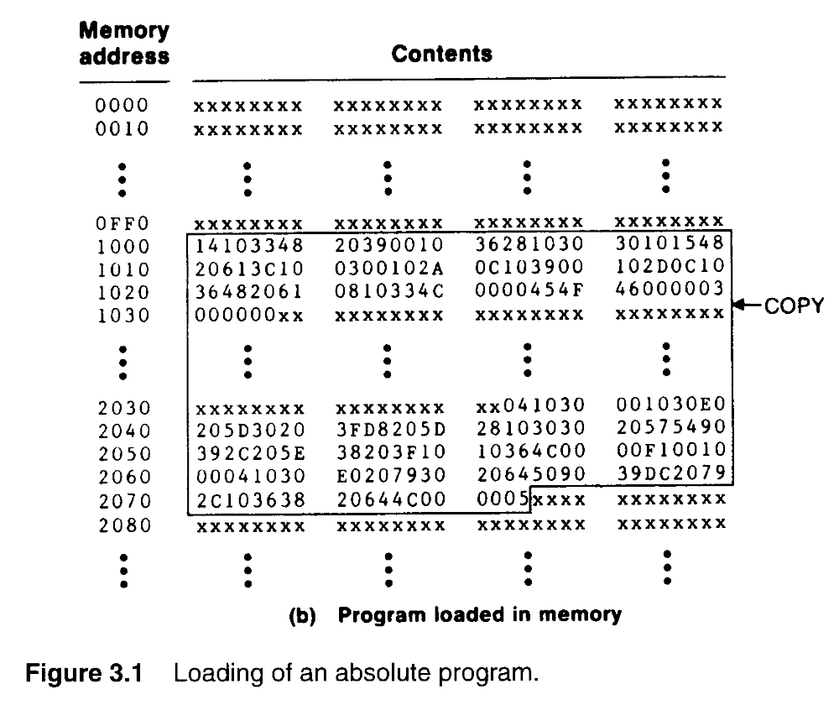

Slide 6
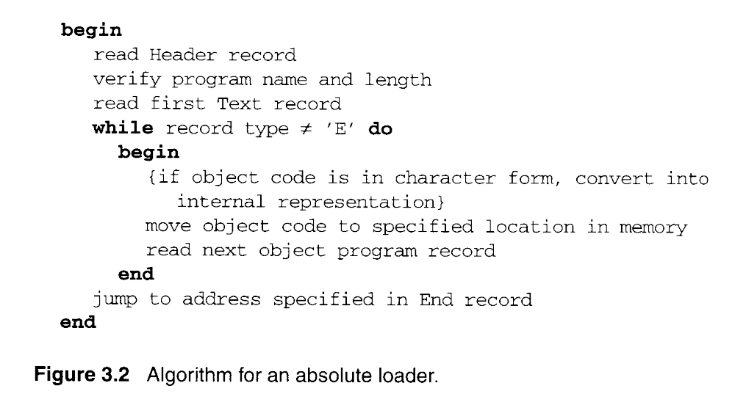

Slide 7
3.1.2 A Simple Bootstrap Loader
A bootstrap loader, Figure 3.3.
  Loads the first program to be run by the computer--- usually an operating system.
  The bootstrap itself begins at address 0 in the memory.
  It loads the OS or some other program starting at address 80.

Slide 8
3.1.2 A Simple Bootstrap Loader
A bootstrap loader, Figure 3.3.
  Each byte of object code to be loaded is represented on device F1 as two Hex digits (by GETC subroutines).
  The ASCII code for the character 0 (Hex 30) is converted to the numeric value 0.
  The object code from device F1 is always loaded into consecutive bytes of memory, starting at address 80.

Slide 9
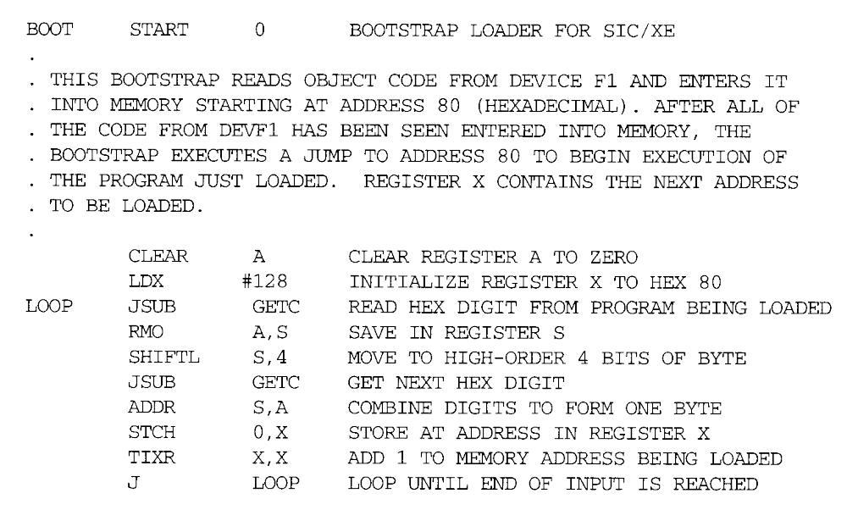

Slide 10
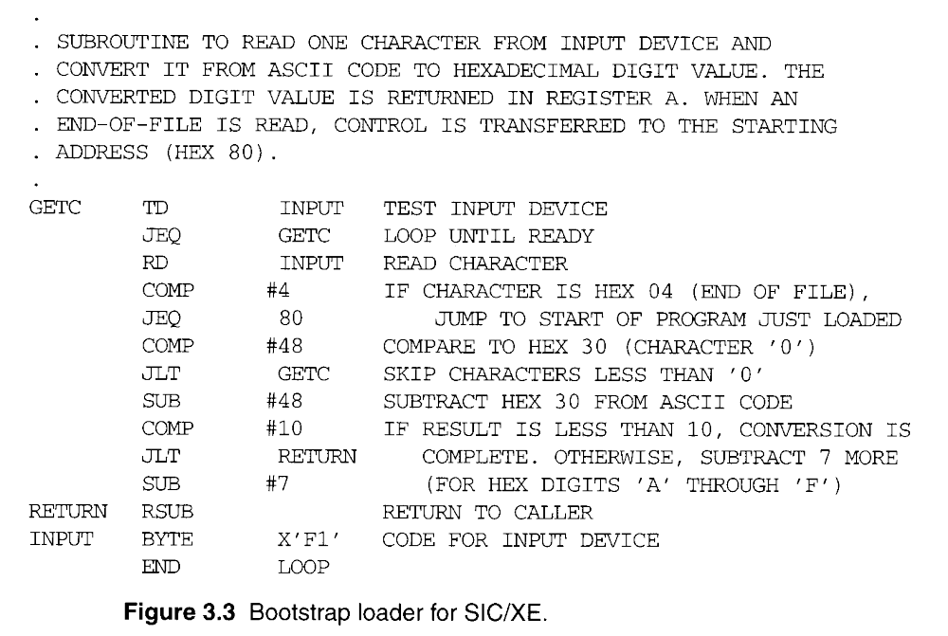

Slide 11
3.2 Machine-Dependent Loader Features
Absolute loader has several potential disadvantages.
  The actual address at which it will be loaded into memory.
  Cannot run several independent programs together, sharing memory between them.
  It is difficult to use subroutine libraries efficiently.
More complex loader.
  Relocation
  Linking
  Linking loader

Slide 12
3.2.1 Relocation
Relocating loaders, two methods:
  Modification record (for SIC/XE)
  Relocation bit (for SIC)

Slide 13
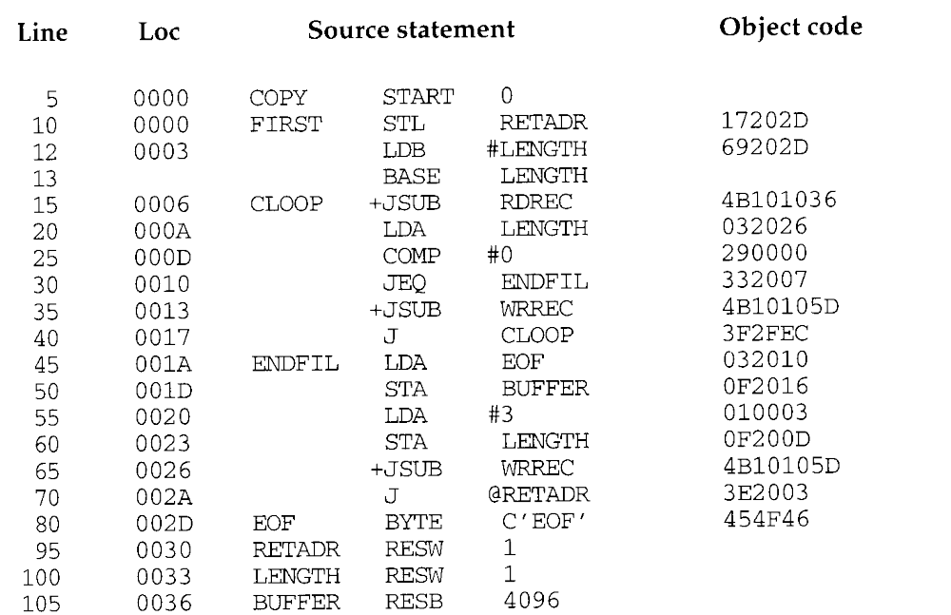

Slide 14
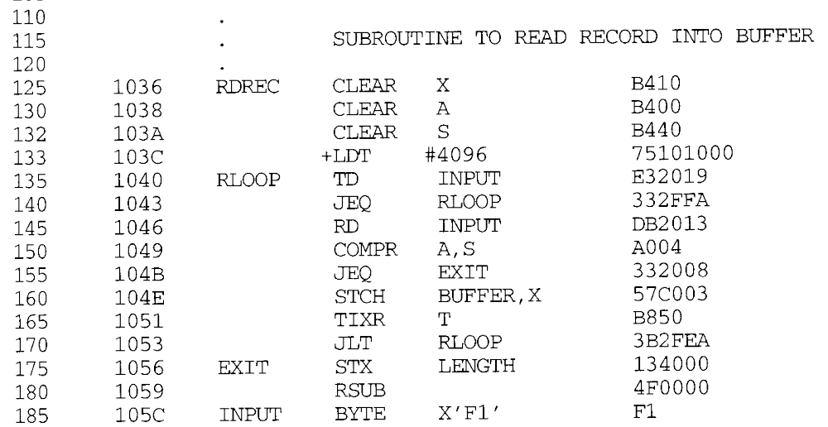

Slide 15
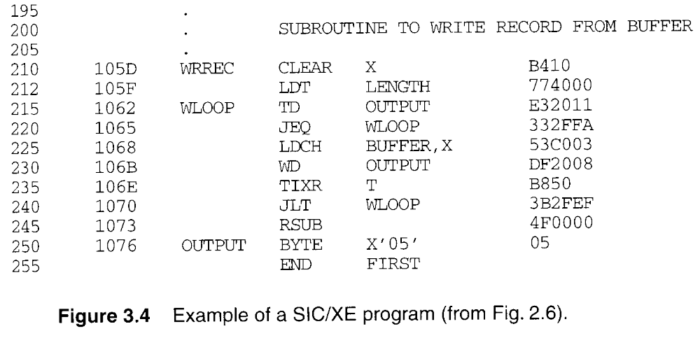

Slide 16
3.2.1 Relocation
Modification record, Figure 3.4 and 3.5.
  To describe each part of the object code that must be changed when the program is relocated.
  The extended format instructions on lines 15, 35, and 65 are affected by relocation. (absolute addressing)
  In this example, all modifications add the value of the symbol COPY, which represents the starting address.
  Not well suited for standard version of SIC, all the instructions except RSUB must be modified when the program is relocated. (absolute addressing)

Slide 17
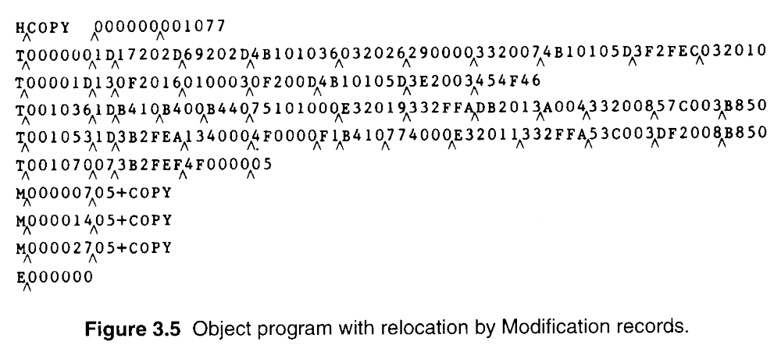

Slide 18
3.2.1 Relocation
Figure 3.6 needs 31 Modification records.
Relocation bit, Figure 3.6 and 3.7.
  A relocation bit associated with each word of object code.
  The relocation bits are gathered together into a bit mask following the length indicator in each Text record.
  If bit=1, the corresponding word of object code is relocated.

Slide 19
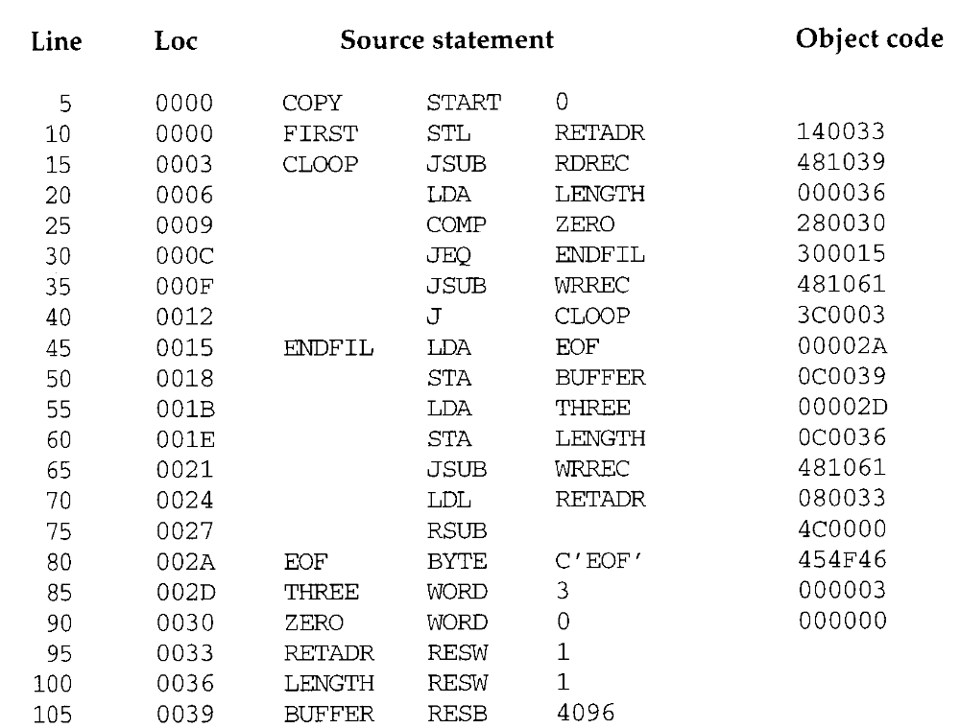
1
1
1
1
1
1
1
1
1
1
1
1
1
0
0
0
0

Slide 20
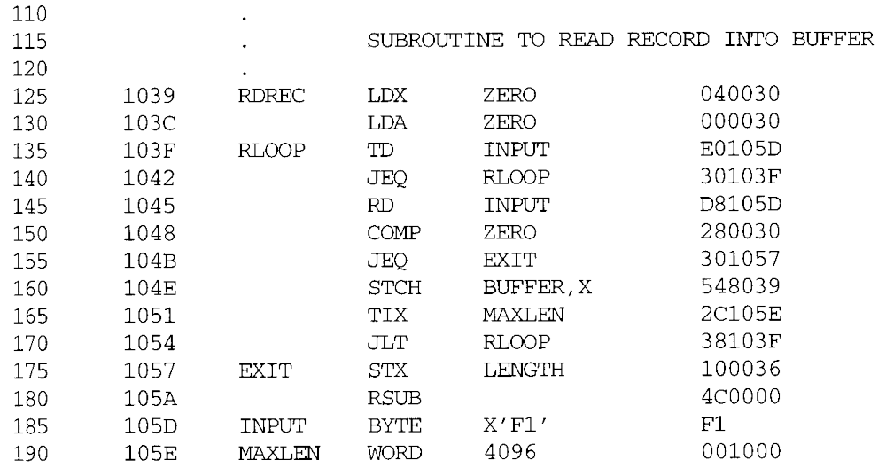
1
1
1
1
1
1
1
1
1
1
1
0
0
0

Slide 21
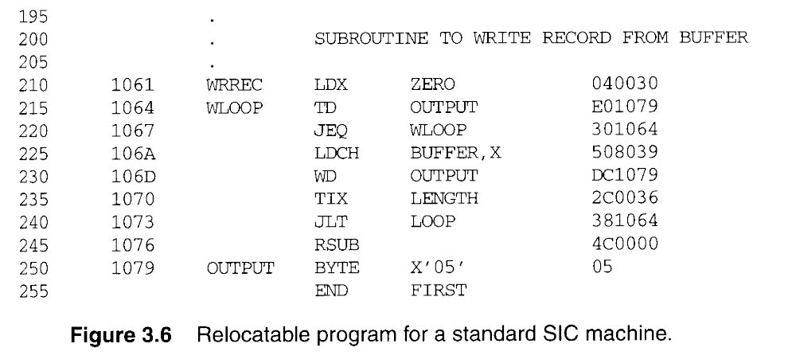
1
1
1
1
1
1
1
0
0

Slide 22
3.2.1 Relocation
Relocation bit, Figure 3.6 and 3.7.
  In Figure 3.7, T^000000^1E^FFC^ (111111111100) specifics that all 10 words of object code are to be modified.
  Any value that is to be modified during relocation must coincide with one of these 3-byte segments so that it corresponding to a relocation bit.
  On line 210 begins a new Text record even though there is room for it in the preceding record.
  Because of the 1-byte data value generated from line 185, this instruction must begin a new Text record in object program.

Slide 23
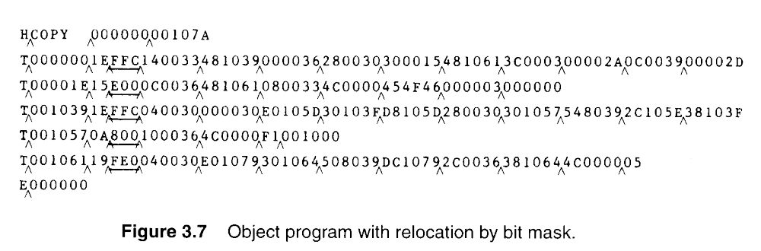
FFC = 1111 1111 1100
E00 = 1110 0000 0000

Slide 24
3.2.2 Program Linking
In Section 2.3.5 showed a program made up of three controls sections
  Assembled together or assembled independently.

Slide 25
3.2.2 Program Linking
Consider the three programs in Fig. 3.8 and 3.9.
  Each of which consists of a single control section.
  A list of items, LISTA---ENDA, LISTB---ENDB, LISTC---ENDC.
  Note that each program contains exactly the same set of references to these external symbols.
  Instruction operands (REF1, REF2, REF3).
  The values of data words (REF4 through REF8).
  Not involved in the relocation and linking are omitted.

Slide 26
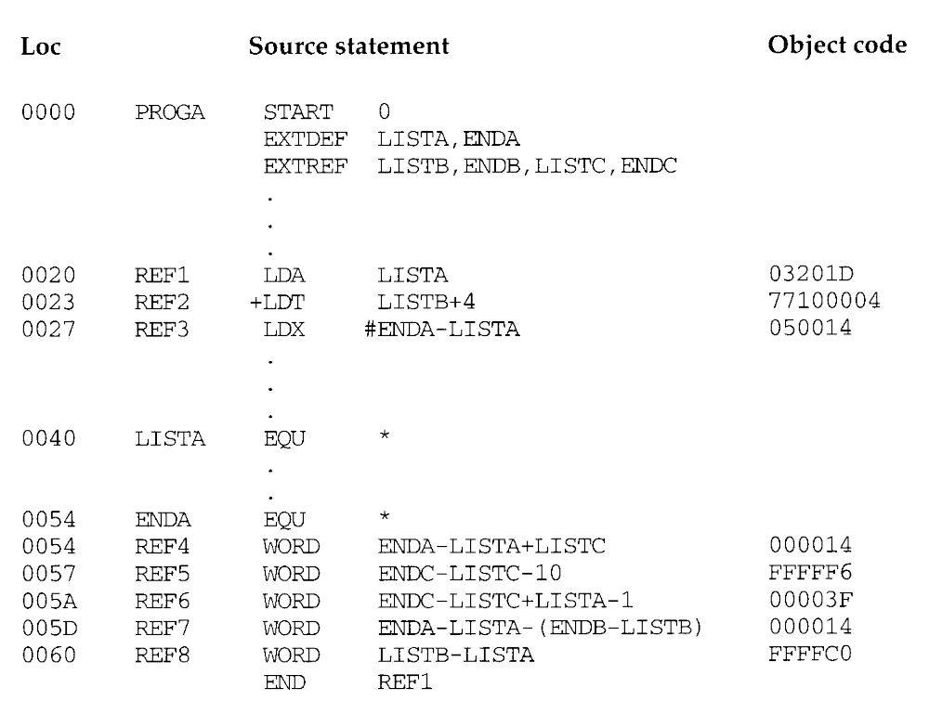

Slide 27
ENDA= (S+r1)= PROGA+ENDA=0000+0054
LISTA=(S+r2)=PROGA+LISTA=0000+0040
ENDA-LISTA=000014
ENDA-LISTA+LISTC=000014+(PROGC+LISTC)
00000A-> FFFFF5+1 -> FFFFF6
000040-> FFFFBF+1 -> FFFFC0
000010-> FFFFEF+1 -> FFFFF0

Slide 28
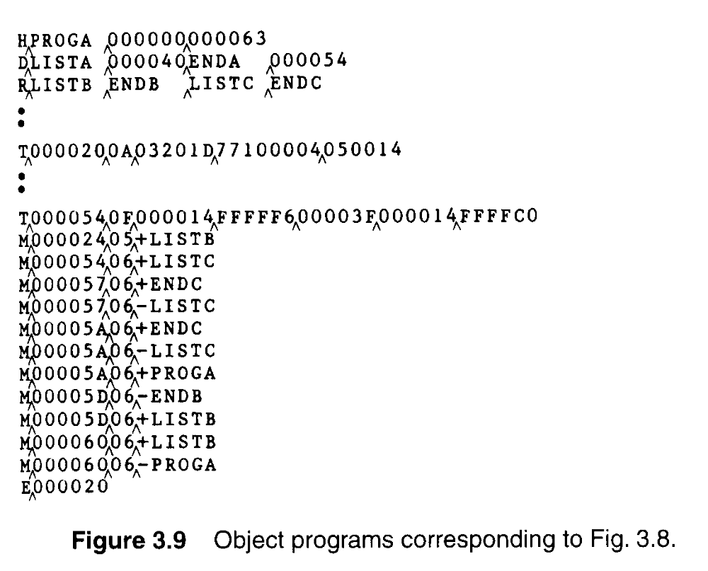
REF2
REF4
REF5
REF6
REF7
REF8

Slide 29
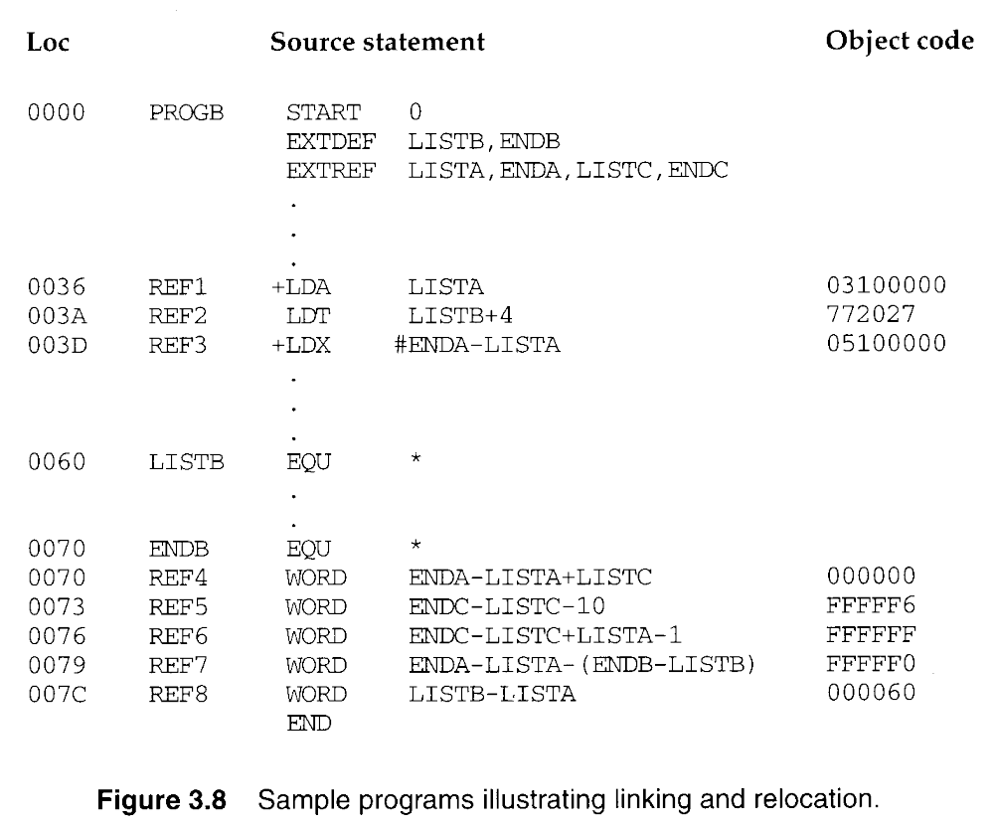

Slide 30
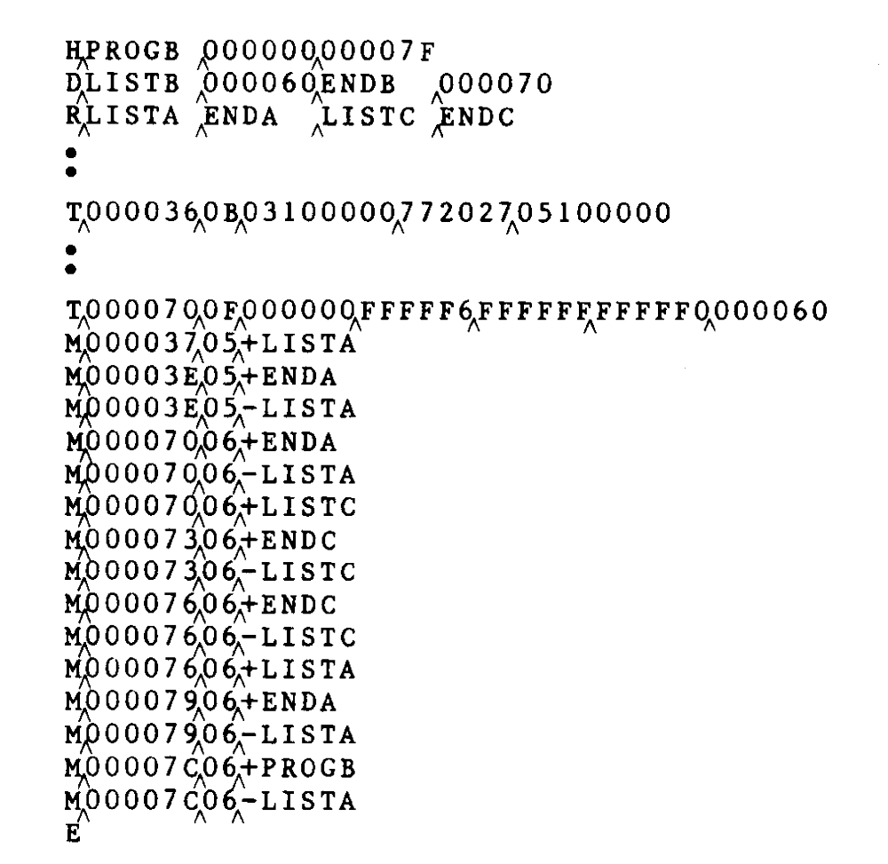
REF1
REF3
REF4
REF5
REF6
REF7
REF8

Slide 31
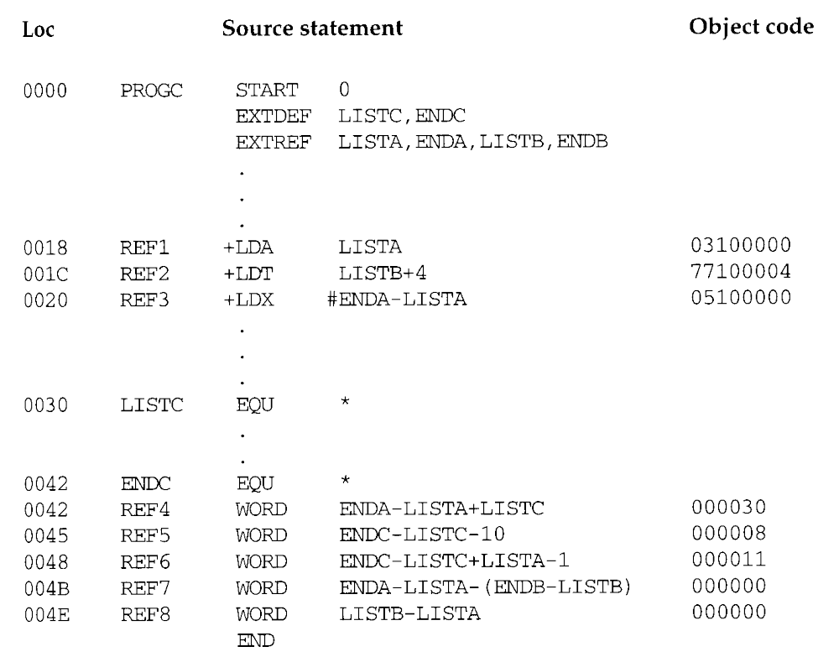

Slide 32
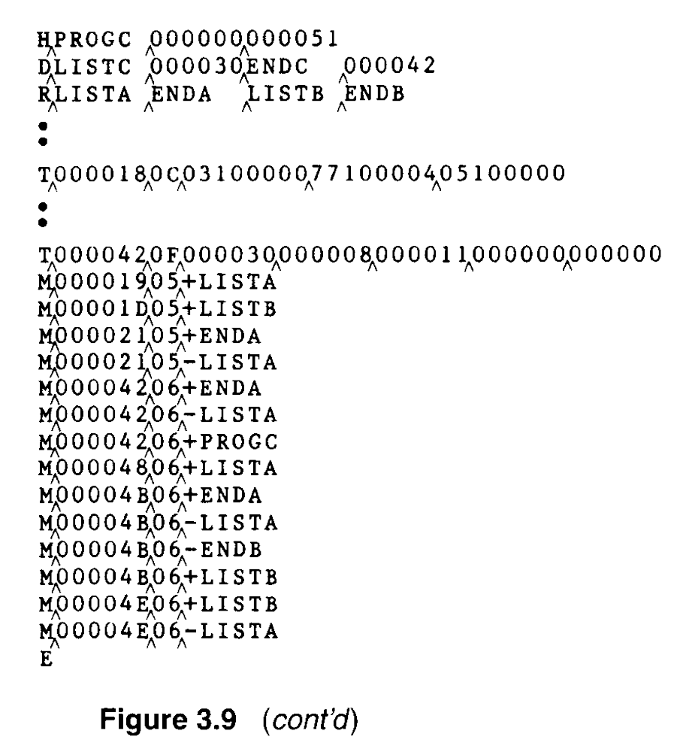
REF1
REF2
REF3
REF4
REF6
REF7
REF8

Slide 33
3.2.2 Program Linking
REF1,
  LDA LISTA 03201D 03100000
  In the PROGA, REF1 is simply a reference to a label.
  In the PROGB and PROGC, REF1 is a reference to an external symbols.
  Need to use extended format, Modification record.
REF2 and REF3.
  LDT LISTB+4 772027 77100004
  LDX #ENDA-LISTA 050014 05100000

Slide 34
3.2.2 Program Linking
REF4 through REF8,
  WORD ENDA-LISTA+LISTC 000014+000000
Figure 3.10(a) and 3.10(b)
  Shows these three programs as they might appear in memory after loading and linking.
  PROGA 004000, PROGB 004063, PROGC 0040E2.
  REF4 through REF8 in the same value.
  For the references that are instruction operands, the calculated values after loading do not always appear to be equal.
  Target address, REF1 4040.

Slide 35
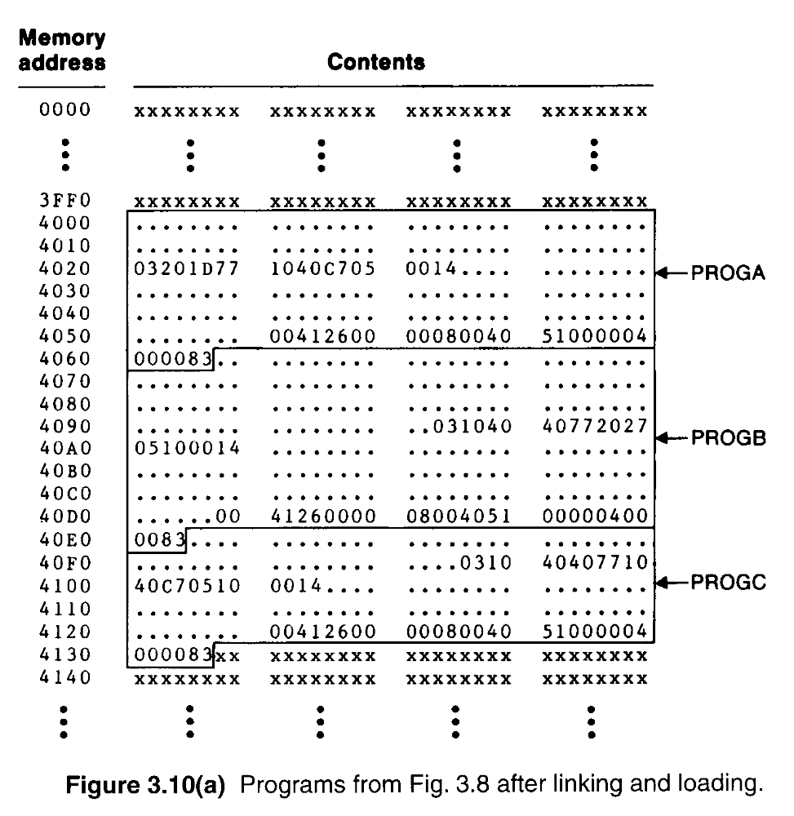

Slide 36
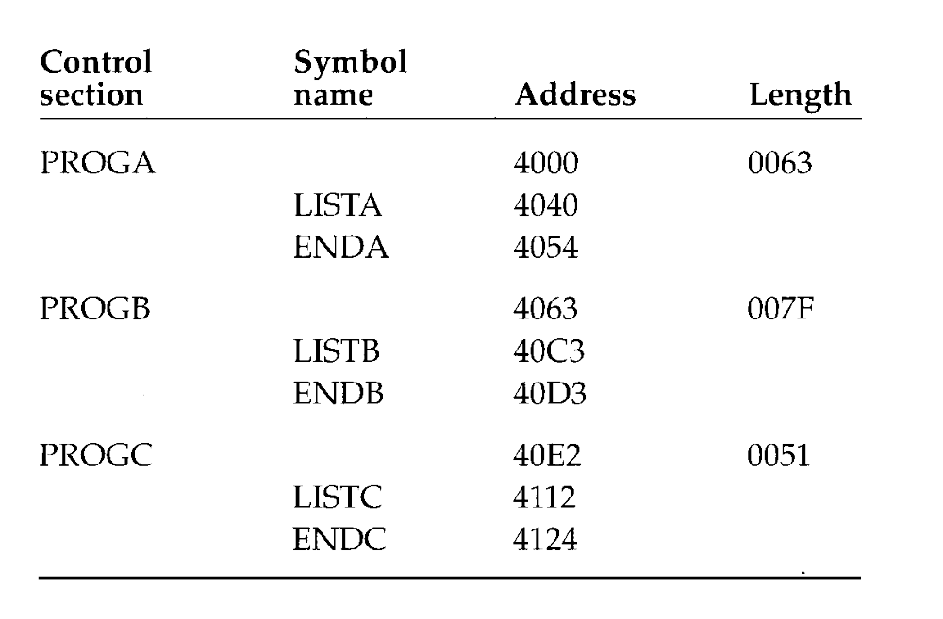
4000+0063=
4063+007F=

Slide 37
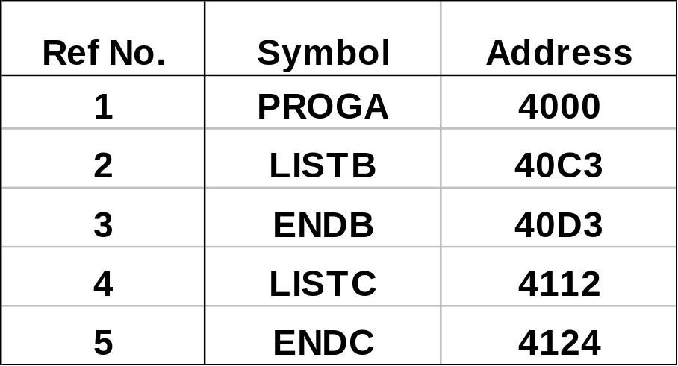

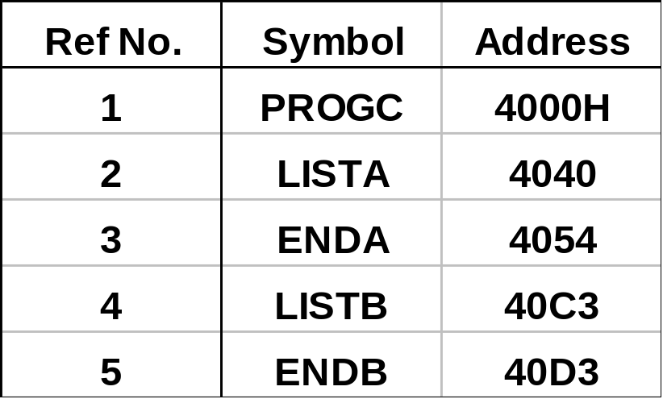

Slide 38
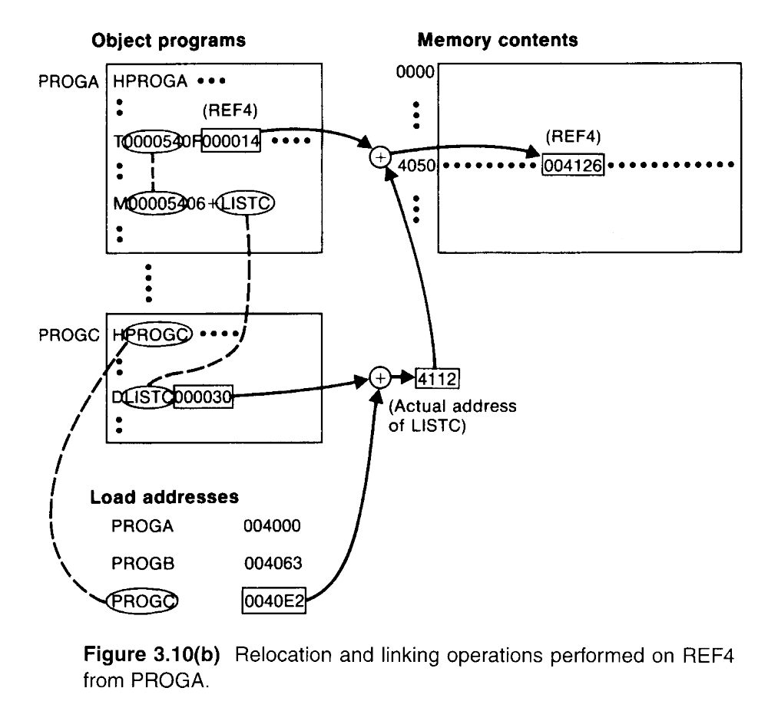

Slide 39
3.2.3 Algorithm and Data Structure for a Linking Loader
A linking loader usually makes two passes
  Pass 1 assigns addresses to all external symbols by creating ESTAB.
  Pass 2 performs the actual loading, relocation, and linking by using ESTAB.
  The main data structure is ESTAB (hashing table).

Slide 40
3.2.3 Algorithm and Data Structure for a Linking Loader
A linking loader usually makes two passes
  ESTAB is used to store the name and address of each external symbol in the set of control sections being loaded.
  Two variables PROGADDR and CSADDR.
  PROGADDR is the beginning address in memory where the linked program is to be loaded.
  CSADDR contains the starting address assigned to the control section currently being scanned by the loader.

Slide 41
3.2.3 Algorithm and Data Structure for a Linking Loader
The linking loader algorithm, Fig 3.11(a) & (b).
  In Pass 1, concerned only Header and Defined records.
  CSADDR+CSLTH = the next CSADDR.
  A load map is generated.
  In Pass 2, as each Text record is read, the object code is moved to the specified address (plus the current value of CSADDR).
  When a Modification record is encountered, the symbol whose value is to be used for modification is looked up in ESTAB.
  This value is then added to or subtracted from the indicated location in memory.

Slide 42
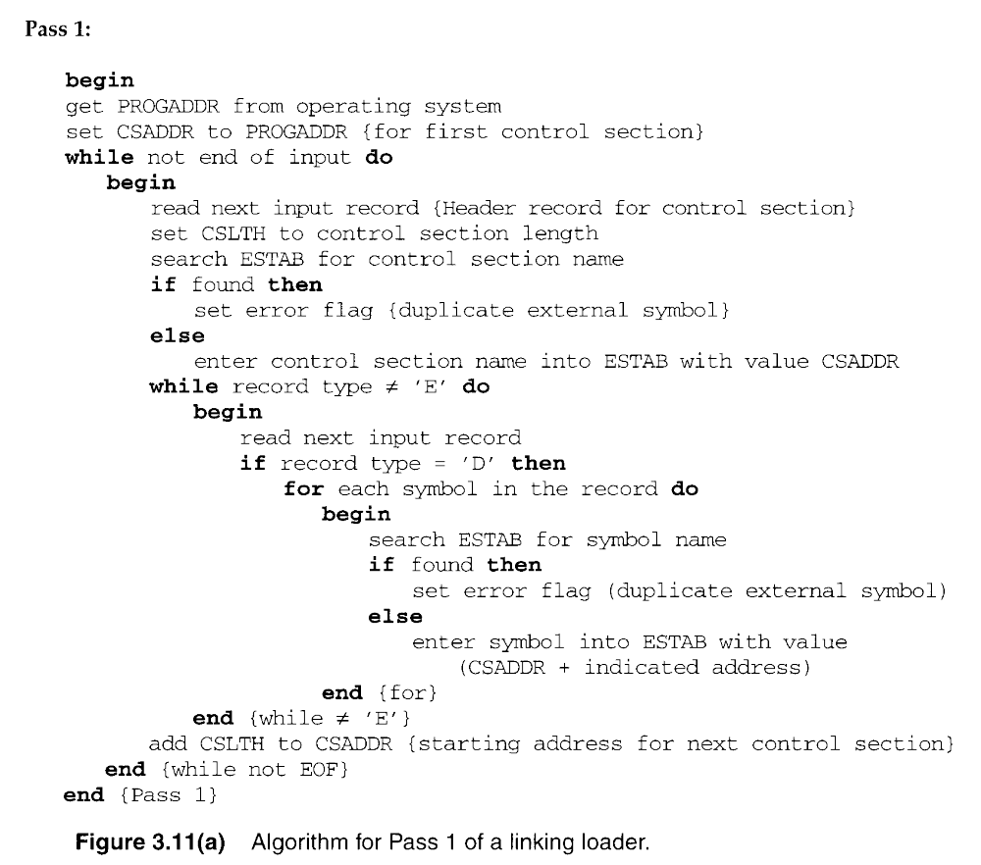

Slide 43
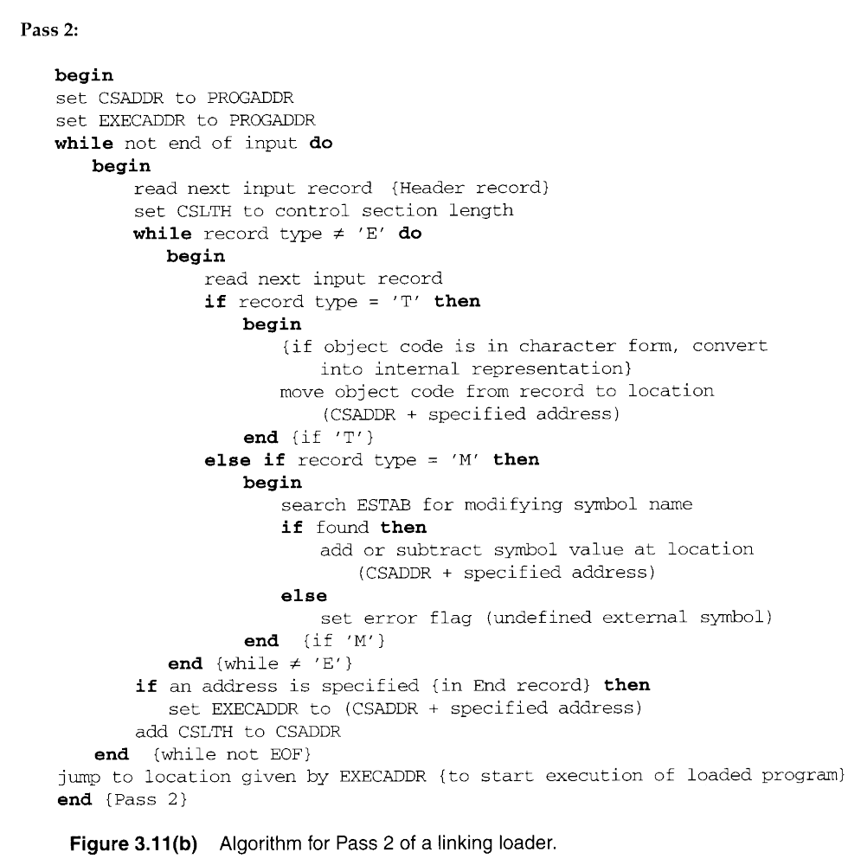

Slide 44
3.2.3 Algorithm and Data Structure for a Linking Loader
The algorithm can be made more efficient.
  A reference number, is used in Modification records.
  The number 01 to the control section name.
  Figure 3.12, the main advantage of this reference-number mechanism is that it avoids multiple searches of ESTAB for the same symbol during the loading of a control section.

Slide 45
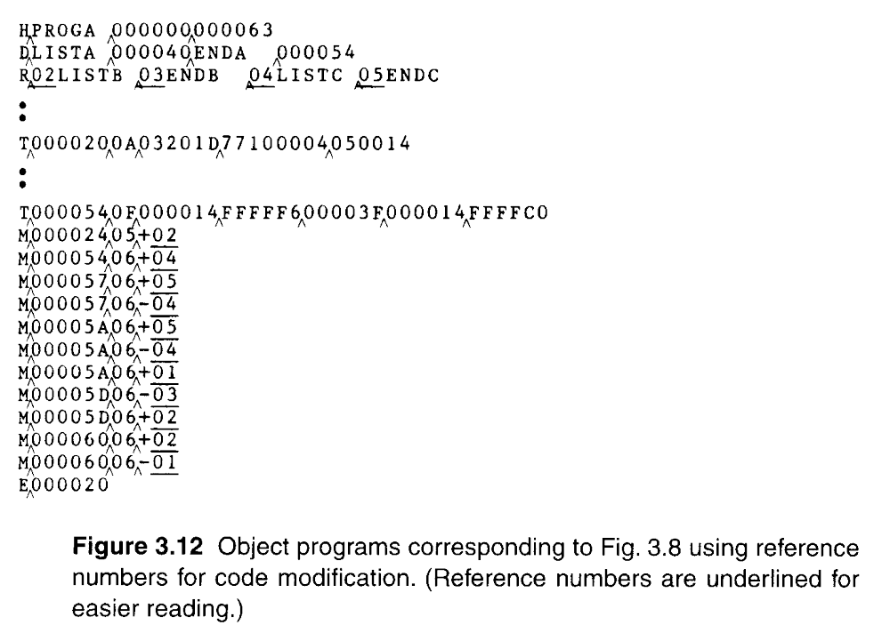

Slide 46
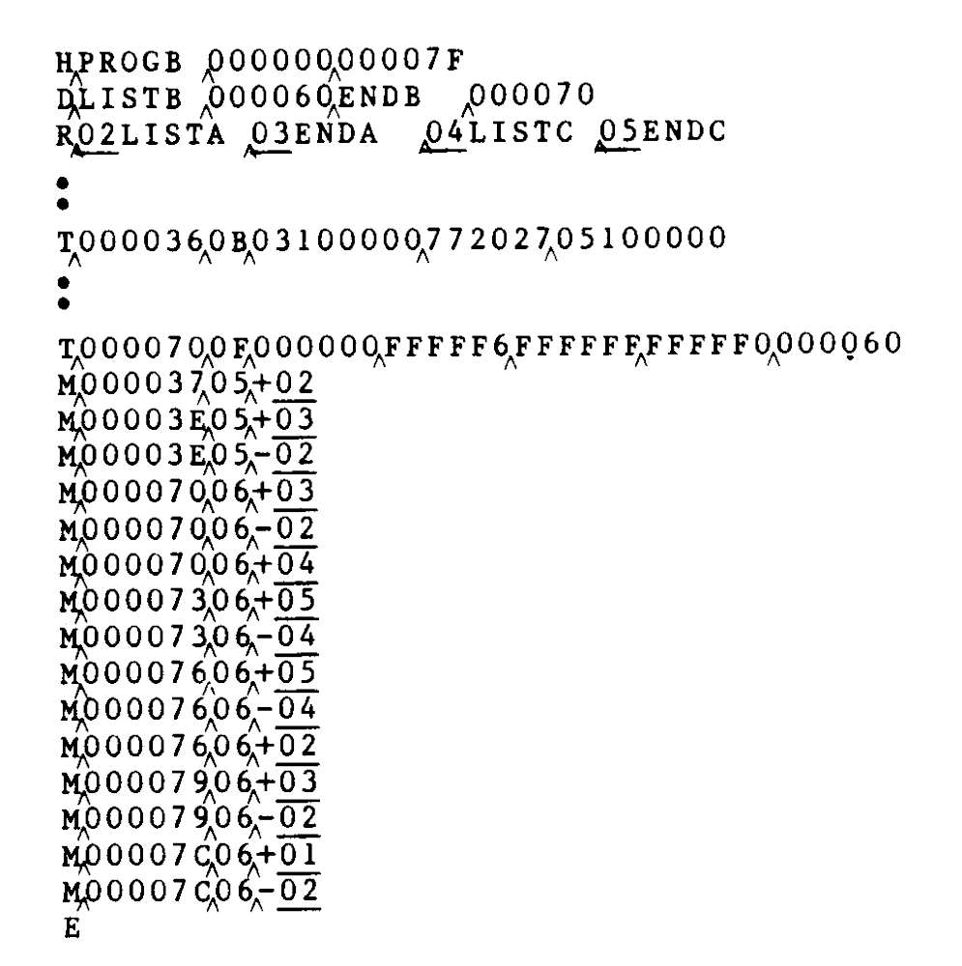

Slide 47
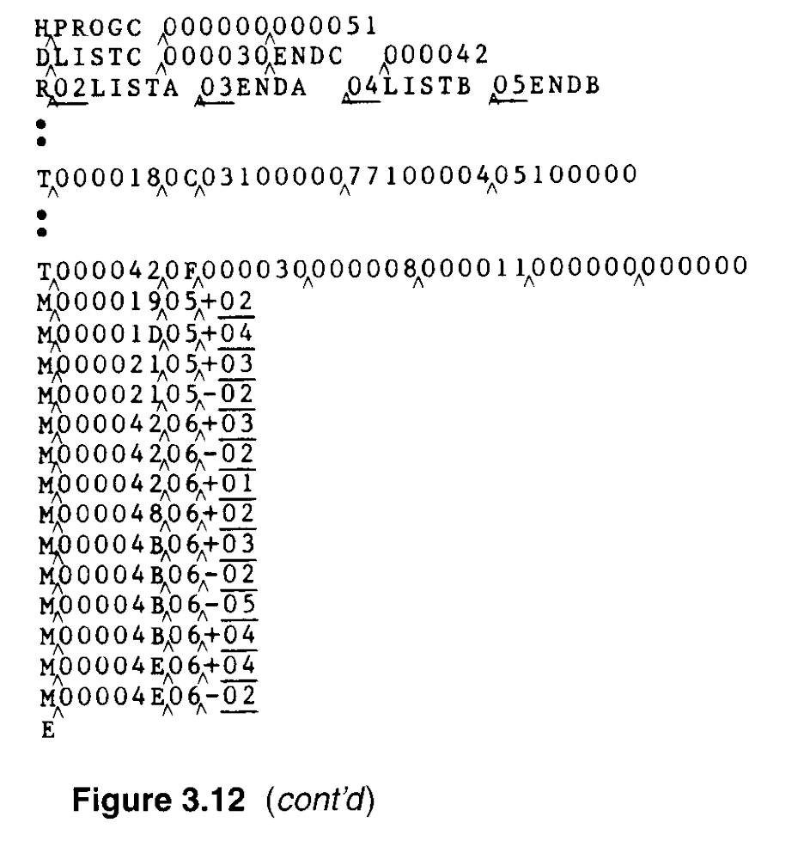

Slide 48
3.3 Machine-Independent Loader Features
3.3.1 Automatic Library Search
Many linking loaders
  Can automatically incorporate routines form a subprogram library into the program being loaded.
  A standard system library
  The subroutines called by the program begin loaded are automatically fetched from the library, linked with the main program, and loaded.

Slide 49
3.3.1 Automatic Library Search
Automatic library call
  At the end of Pass 1, the symbols in ESTAB that remain undefined represent unresolved external references.
  The loader searches the library

Slide 50
3.3.2 Loader Options
Many loaders allow the user to specify options that modify the standard processing.
  Special command
  Separate file
  INCLUDE program-name(library-name)
  DELETE csect-name
  CHANGE name1, name2
    INCLUDE READ(UTLIB)
    INCLUDE WRITE(UTLIB)
    DELETE RDREC, WRREC
    CHANGE RDREC, READ
    CHANGE WRREC, WRITE
    LIBRARY MYLIB
    NOCALL STDEV, PLOT, CORREL

Slide 51
3.4 Loader Design Options
3.4.1 Linkage Editors
Fig 3.13 shows the difference between linking loader and linkage editor.
  The source program is first assembled or compiled, producing an OP.
Linking loader
  A linking loader performs all linking and relocation operations, including automatic library search if specified, and loads the linked program directly into memory for execution.

Slide 52
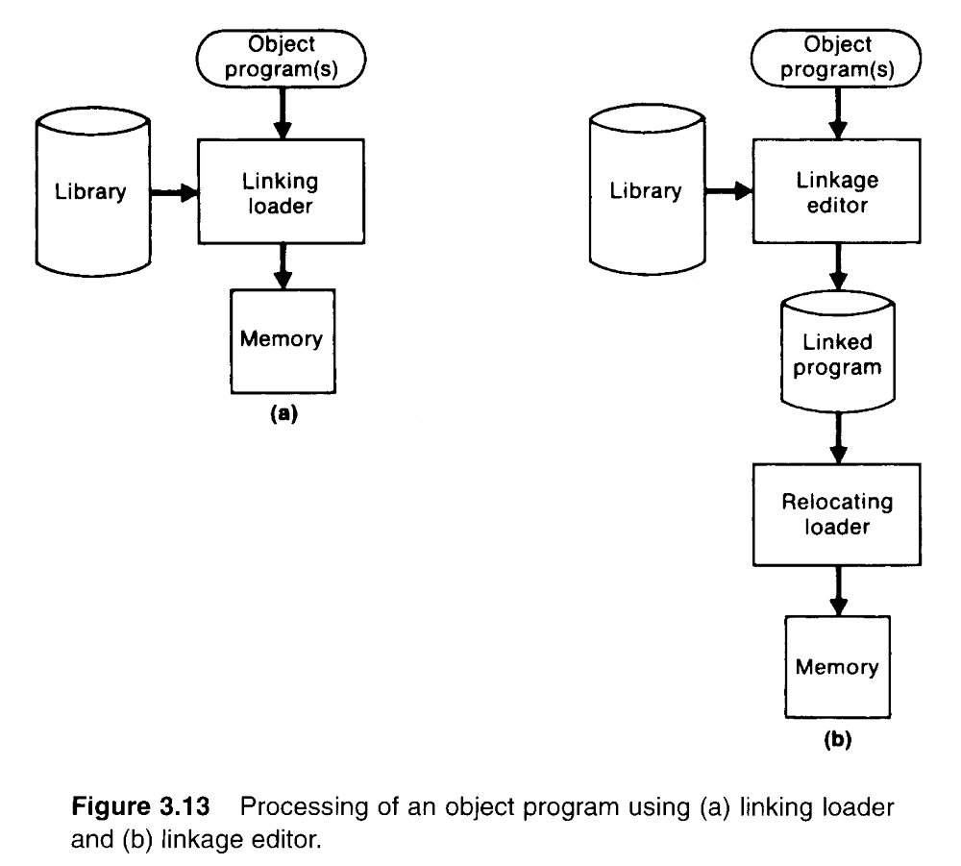
The essential difference between a linkage editor and a linking loader

Slide 53
3.4.1 Linkage Editors
Linkage editor
  A linkage editor produces a linked version of the program (load module or executable image), which is written to a file or library for later execution.
  When the user is ready to run the linked program, a simple relocating loader can be used to load the program into memory for execution.
  The only object code modification necessary is the addition of an actual load address to relative values within the program.
  The LE performs relocation of all control sections relative to the start of the linked program.

Slide 54
3.4.1 Linkage Editors
  All items that need to be modified at load time have values that are relative to the start of the linked program.
  If a program is to be executed many times without being reassembled, the use of a LE substantially reduces the overhead required.
  LE can perform many useful functions besides simply preparing an OP for execution.

Slide 55
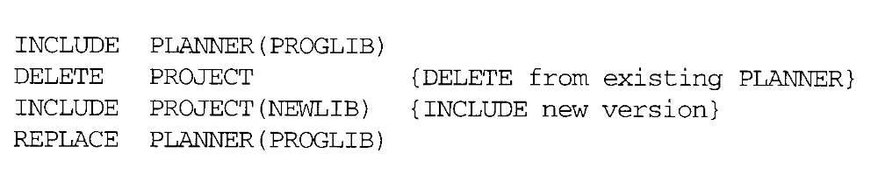
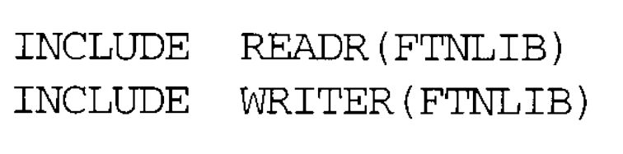
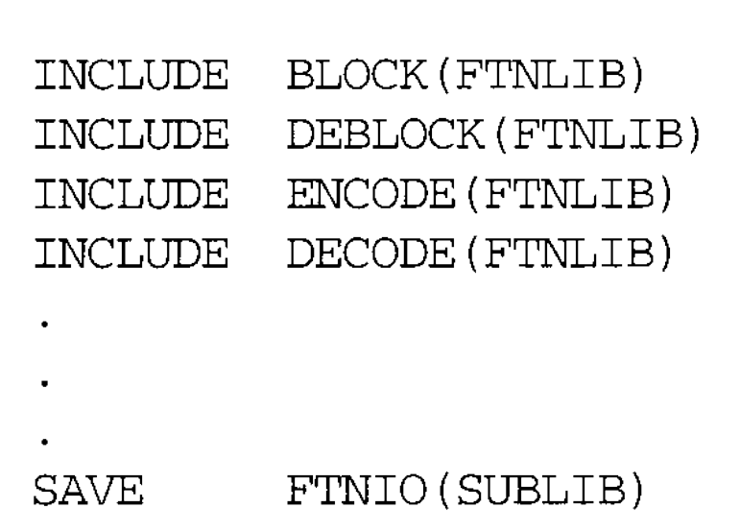

Slide 56
3.4.2 Dynamic Linking
Linking loaders perform these same (linking) operations during at load time.
Linkage editors perform linking operations before the linked program (exe) is load for execution.
Dynamic Linking postpones the linking function until execution time.

Slide 57
3.4.2 Dynamic Linking
Dynamic linking (dynamic loading, load on call)
  Postpones the linking function until execution time.
  A subroutine is loaded and linked to the rest the program when is first loaded.
  Dynamic linking is often used to allow several executing programs to share one copy of a subroutine or library.
    Run-time library (C language), dynamic link library
    A single copy of the routines in this library could be loaded into the memory of the computer.

Slide 58
3.4.2 Dynamic Linking
Dynamic linking provides the ability to load the routines only when (and if) they are needed.
  For example, that a program contains subroutines that correct or clearly diagnose error in the input data during execution.
  If such error are rare, the correction and diagnostic routines may not be used at all during most execution of the program.
  However, if the program were completely linked before execution, these subroutines need to be loaded and linked every time.

Slide 59
3.4.2 Dynamic Linking
Dynamic linking avoids the necessity of loading the entire library for each execution.
Fig. 3.14 illustrates a method in which routines that are to be dynamically loaded must be called via an operating system (OS) service request.

Slide 60
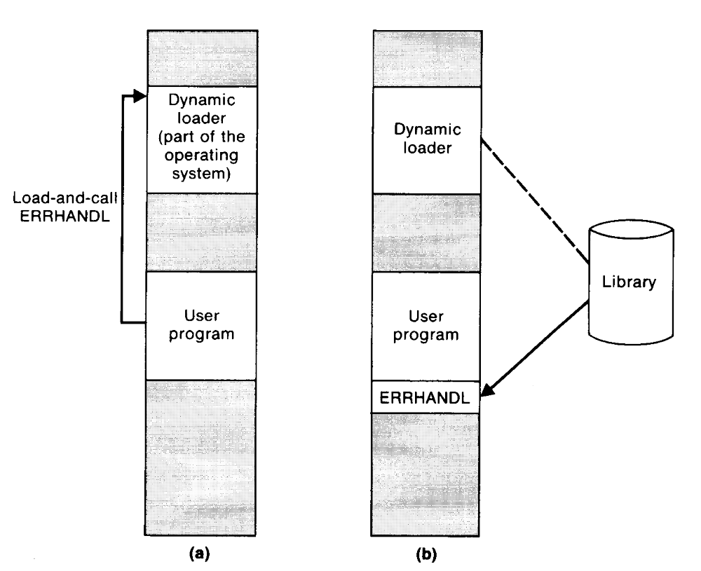

Slide 61
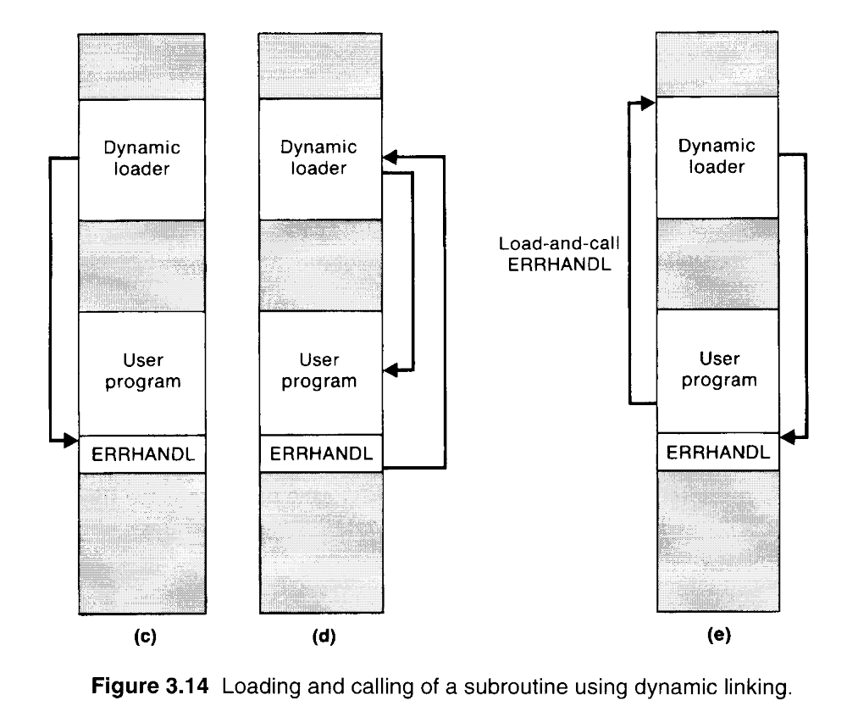

Slide 62
3.4.2 Dynamic Linking
The program makes a load-and-call service request to OS. The parameter argument (ERRHANDL) of this request is the symbolic name of the routine to be loaded.
OS examines its internal tables to determine whether or not the routine is already loaded. If necessary, the routine is loaded form the specified user or system libraries.
Control id then passed form OS to the routine being called.
When the called subroutine completes its processing, OS then returns control to the program that issued the request.
If a subroutine is still in memory, a second call to it may not require another load operation.

Slide 63
3.4.3 Bootstrap Loaders
An absolute loader program is permanently resident in a read-only memory (ROM)
  Hardware signal occurs
The program is executed directly in the ROM
The program is copied from ROM to main memory and executed there.

Slide 64
3.4.3 Bootstrap Loaders
Bootstrap and bootstrap loader
  Reads a fixed-length record form some device into memory at a fixed location.
  After the read operation is complete, control is automatically transferred to the address in memory.
  If the loading process requires more instructions than can be read in a single record, this first record causes the reading of others, and these in turn can cause the reading of more records.

