Slide 1
Chapter 4
Macro Processors
Source Code
(with macro)
Macro Processor
Expanded Code
Compiler or Assembler
obj

Slide 2
4.1 Basic Macro Processor Functions
4.1.1 Macro Definition and Expansion
Fig. 4.1 shows an example of a SIC/XE program using macro instructions.
  RDBUFF and WRBUFF
  MACRO and MEND
  RDBUFF is name
  Parameters (參數) of the macro instruction, each parameter begins with the character &.
  Macro invocation (引用) statement and the arguments (引數) to be used in expanding the macro.
Fig. 4.2 shows the output that would be generated.

Slide 3
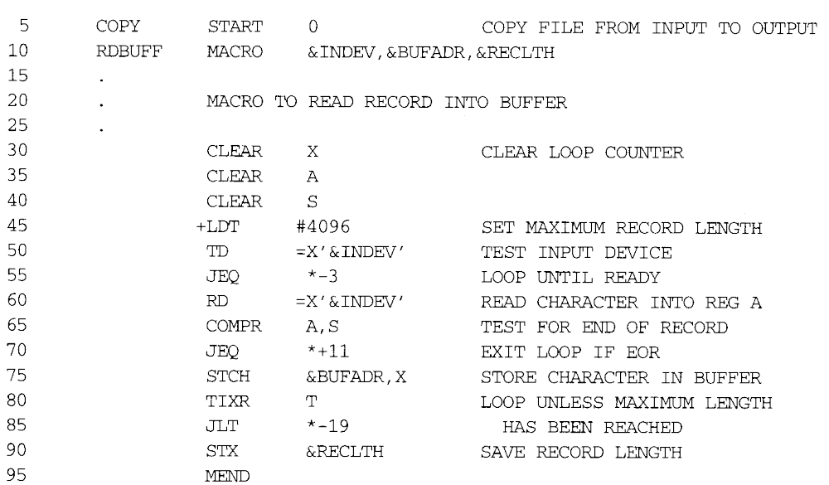

Slide 4
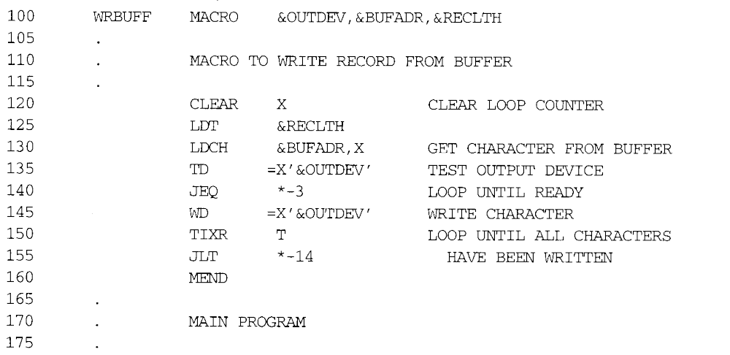

Slide 5
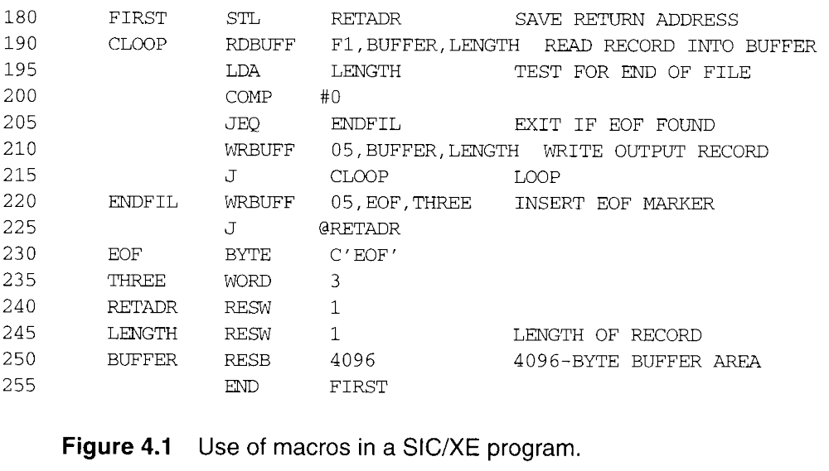

Slide 6
Macro invocation (引用) statement is changed to be comments
Label in Macro invocation (引用) statement will be listed in the first line of macro expanding statement.
MEND will not be expanded

Slide 7
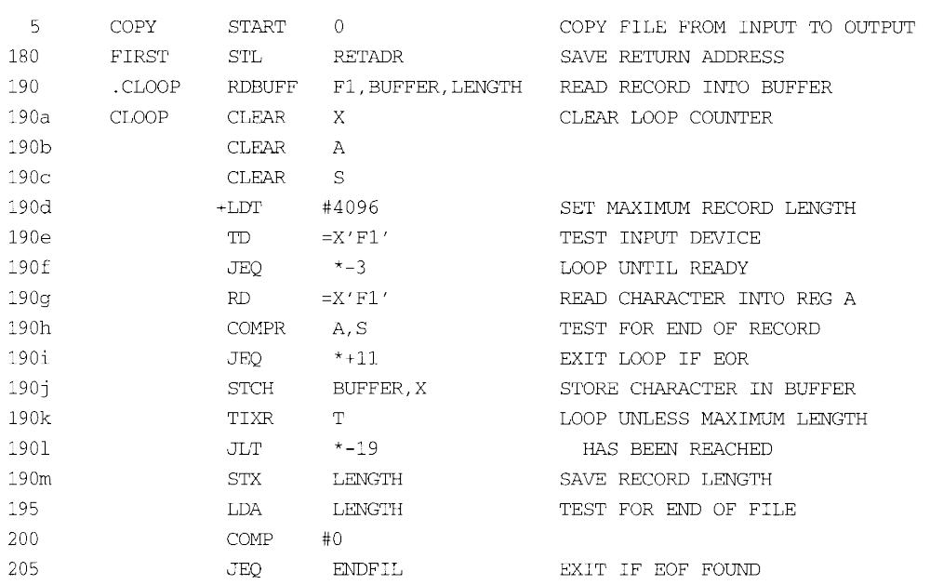

Slide 8
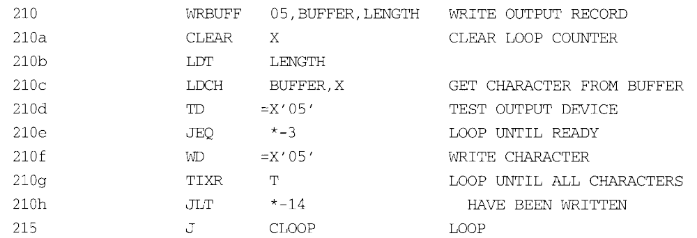

Slide 9
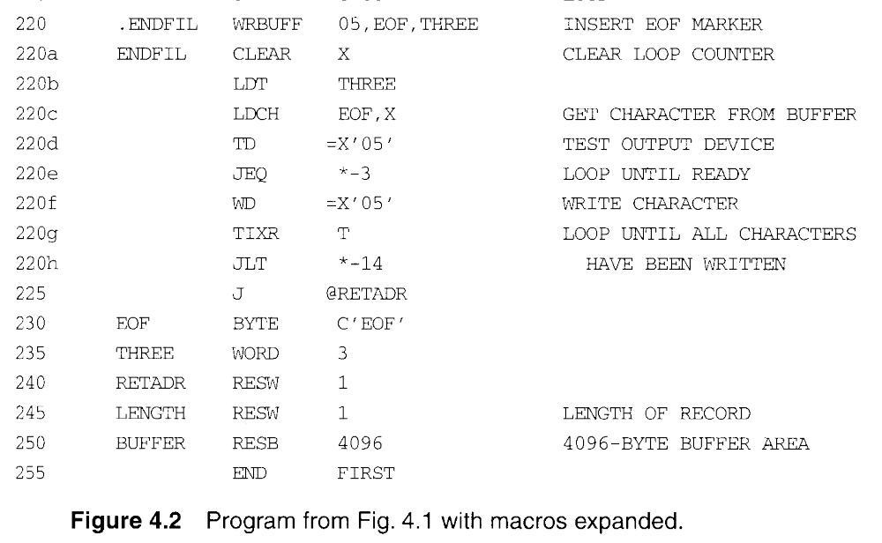

Slide 10
Source
STRG MACRO
STA DATA1
STB DATA2
STX DATA3
MEND
.
STRG
.
STRG
.
.
Expanded source
.
.
.
.STRG
STA DATA1
STB DATA2
STX DATA3
.STRG
STA DATA1
STB DATA2
STX DATA3
.
{
{

Slide 11
4.1.2 Macro Processor Algorithm and Data Structures
Two-pass macro processor
  All macro definitions are processed during the first pass.
  All macro invocation statements are expanded during the second pass.
  Two-pass macro processor would not allow the body of one macro instruction to contain definitions of other macros.
Such definitions of macros by other macros Fig. 4.3

Slide 12
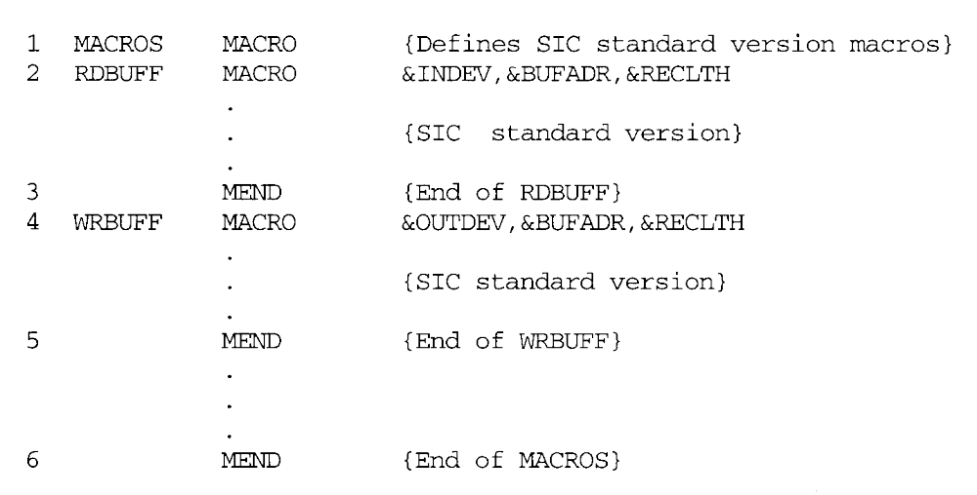

Slide 13
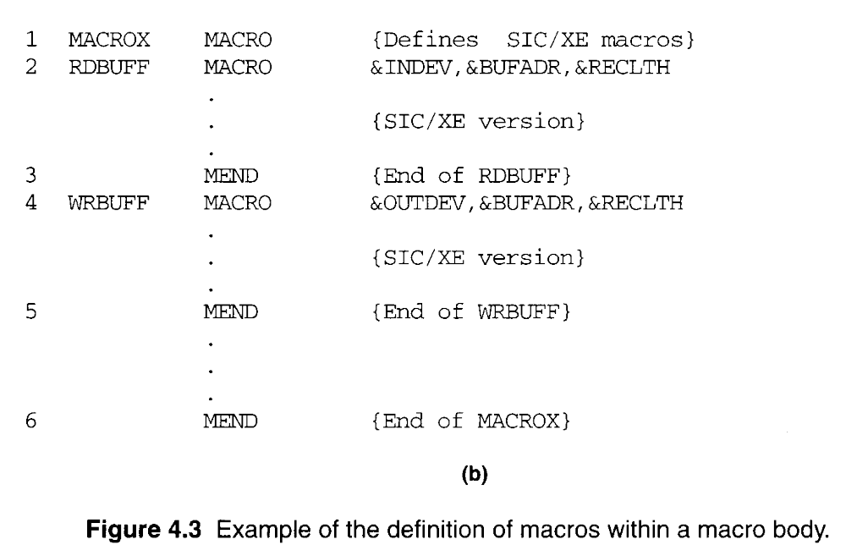

Slide 14
4.1.2 Macro Processor Algorithm and Data Structures
A one-pass macro processor that can alternate between macro definition and macro expansion.
  The definition of a macro must appear in the source program before any statements that invoke that macro.
  Inconvenience of the programmer.

Slide 15
4.1.2 Macro Processor Algorithm and Data Structures
  Macro definitions are stored in DEFTAB
  Comment lines are not entered the DEFTAB.
  The macro names are entered into NAMTAB, NAMTAB contains two pointers to the beginning and the end of the definition in DEFTAB
  &INDEV -> ?1
  The third data structure is an argument table ARGTAB, which is used during the expansion of macro invocations.
  The arguments are stored in ARGTAB according to their position in the argument list.

Slide 16
4.1.2 Macro Processor Algorithm and Data Structures
Fig. 4.4 shows positions of the contents of these tables during the processing.
  Parameter &INDEV -> Argument ?1
  Parameter &BUFADR -> Argument ?2
  When the ?n notation is recognized in a line form DEFTAB, a simple indexing operation supplies the proper argument form ARGTAB.

Slide 17
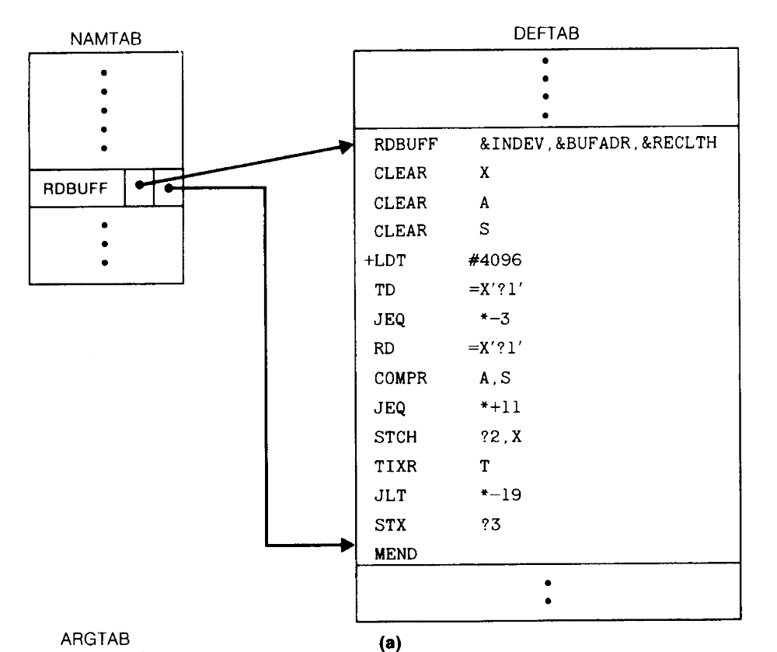
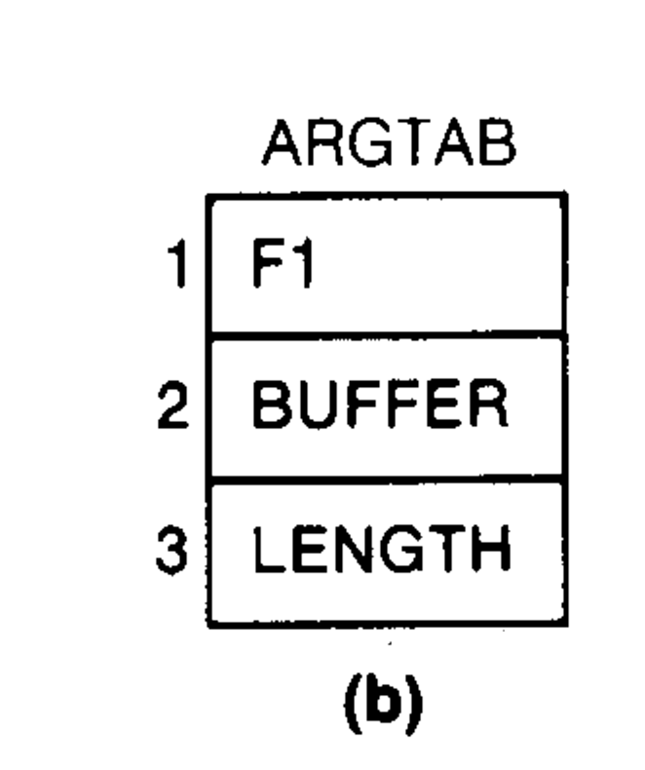

Slide 18
4.1.2 Macro Processor Algorithm and Data Structures
The macro processor algorithm itself is presented in Fig. 4.5.
  The procedure PROCESSING
  The procedure DEFINE
    Called when the beginning of a macro definition is recognized, makes the appropriate entries in DEFTAB and NAMTAB.
  The procedure EXPAND
    Called to set up the argument values in ARGTAB and expand a macro invocation statement.
  The procedure GETLINE
    Called at several points in the algorithm, gets the next line to be processed.
  EXPANDING is set to TRUE or FALSE.

Slide 19
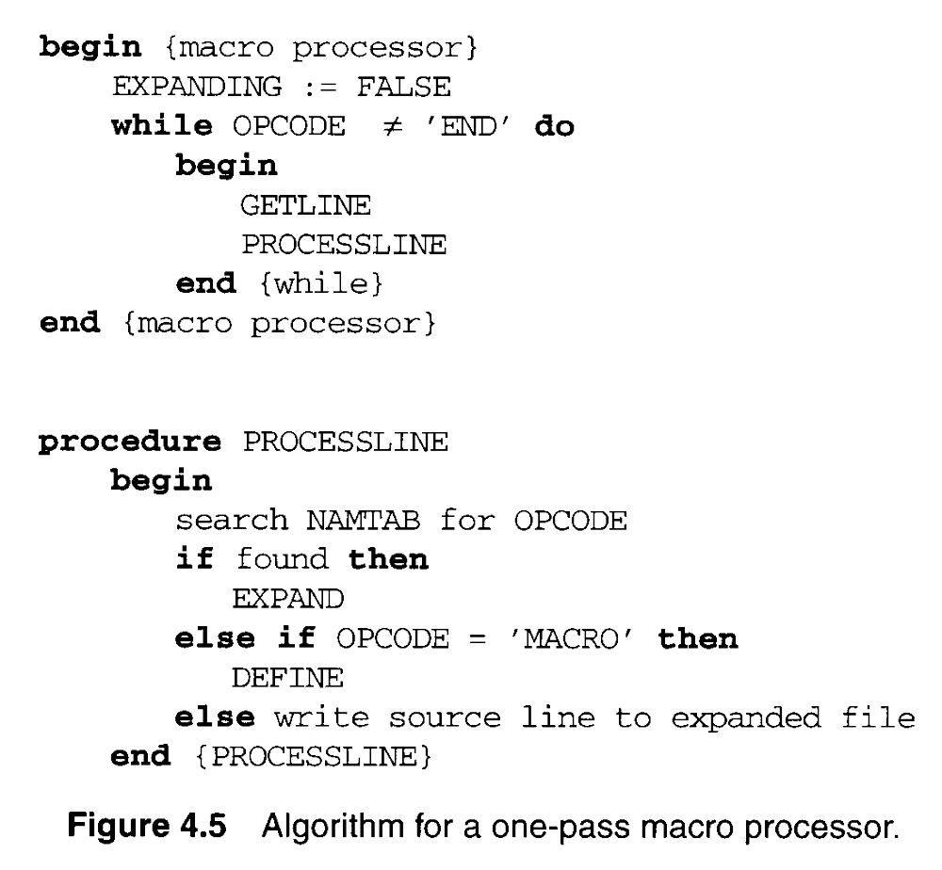

Slide 20
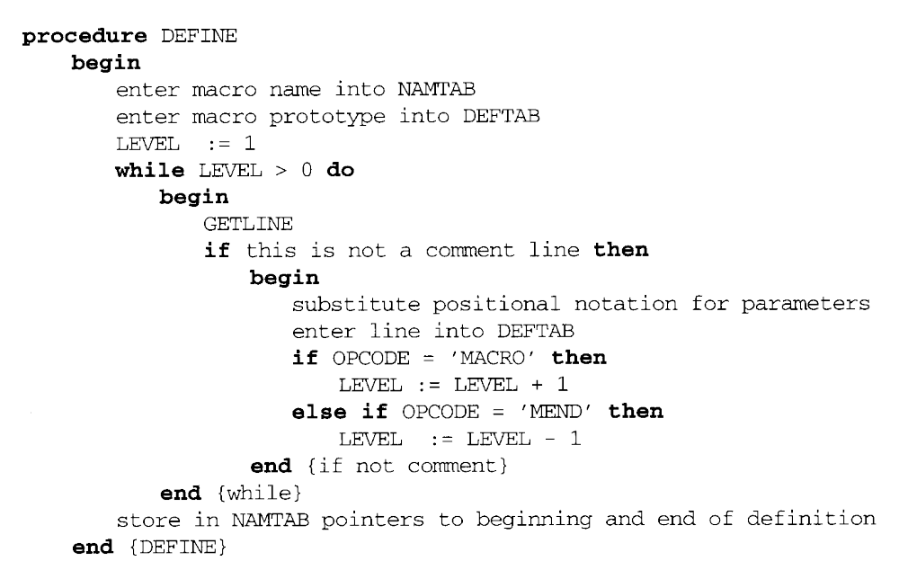

Slide 21
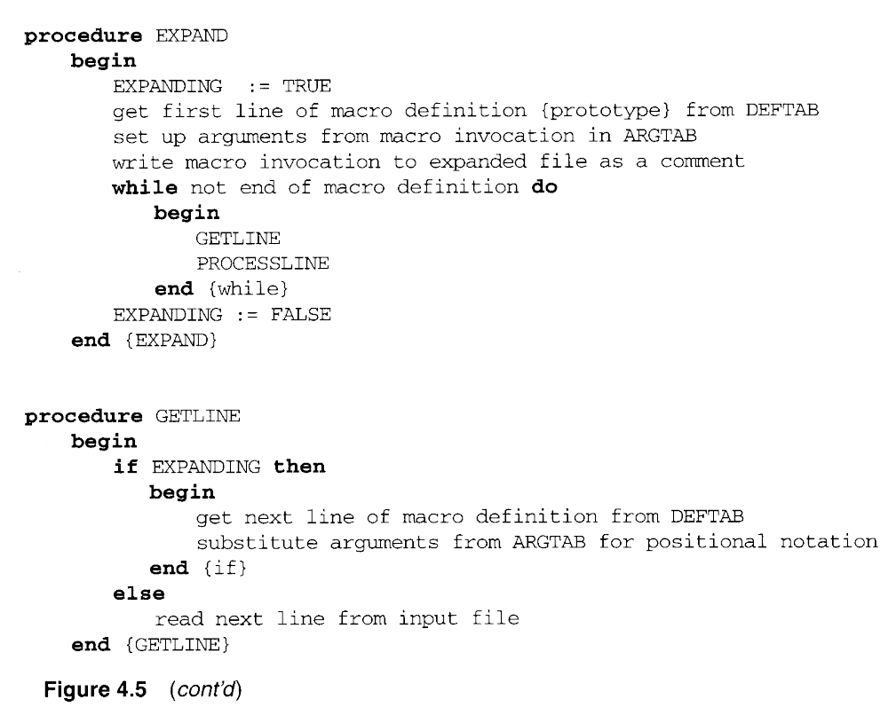

Slide 22
4.1.2 Macro Processor Algorithm and Data Structures
To solve the problem is Fig. 4.3, our DEFINE procedure maintains a counter named LEVEL.
  MACRO directive is read, the value of LEVEL is inc. by 1.
  MEND directive is read, the value of LEVEL is dec. by 1.

Slide 23
4.2 Machine-Independent Macro Processor Features
4.2.1 Concatenation of Macro Parameters
Most macro processors allow parameters to be concatenated with other character strings.
  A program contains one series of variables named by the symbols XA1, XA2, XA3, XAS, another series named by XB1, XB2, XB3, XBS, etc.
  The body of the macro definition might contain a statement like
    SUM Macro &ID
    LDA X&ID1
    LDA X&ID2
    LDA X&ID3
    LDA X&IDS

Slide 24
4.2.1 Concatenation of Macro Parameters
  The beginning of the macro parameter is identified by the starting symbol &; however, the end of the parameter is not marked.
  The problem is that the end of the parameter is not marked. Thus X&ID1 may mean “X” + ID + “1” or “X” + ID1.
  In which the parameter &ID is concatenated after the character string X and before the character string 1.
    SUM Macro &ID SUM Macro &ID
    LDA X&ID1 LDA X&ID->1
    MEND MEND

Slide 25
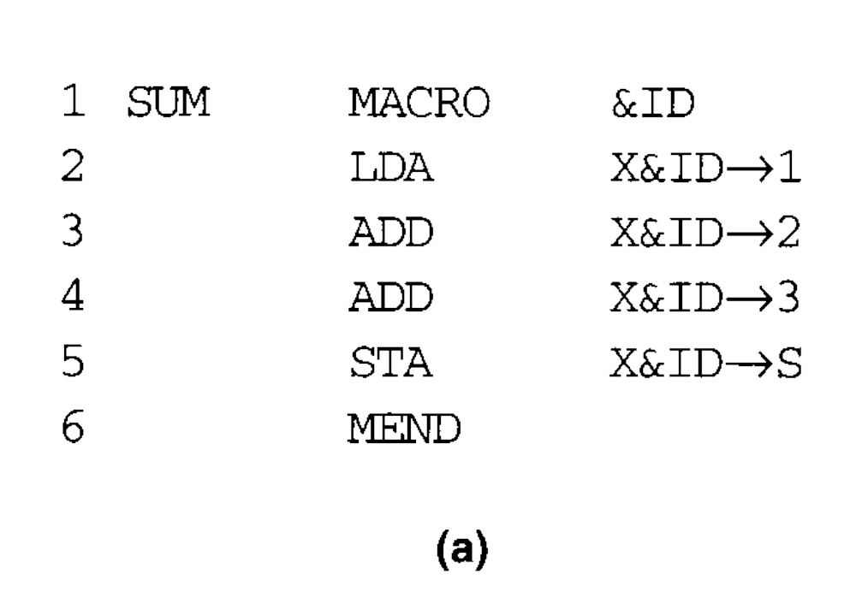
4.2.1 Concatenation of Macro Parameters
Most macro processors deal with this problem by providing a special concatenation operator (Fig. 4.6).
  In SIC or SIC/XE, -> is used

Slide 26
4.2.2 Generation of Unique Labels
As we discussed in Section 4.1, it is in general not possible for the body of a macro instruction to contain labels of usual kind.
  WRBUFF (line 135) is called twice.
  Fig. 4.7 illustrates one techniques for generating unique labels within a macro expansion.
  Labels used within the macro body begin with the special character $.
  Each symbol beginning with $ has been modified by replacing $ with $AA.

Slide 27
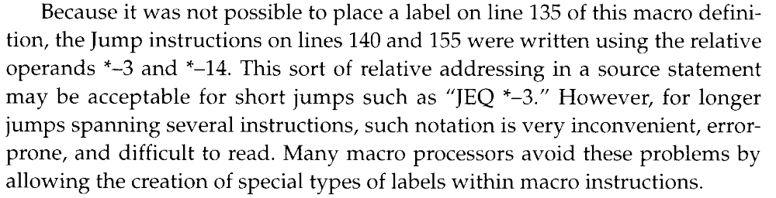
4.2.2 Generation of Unique Labels

Slide 28
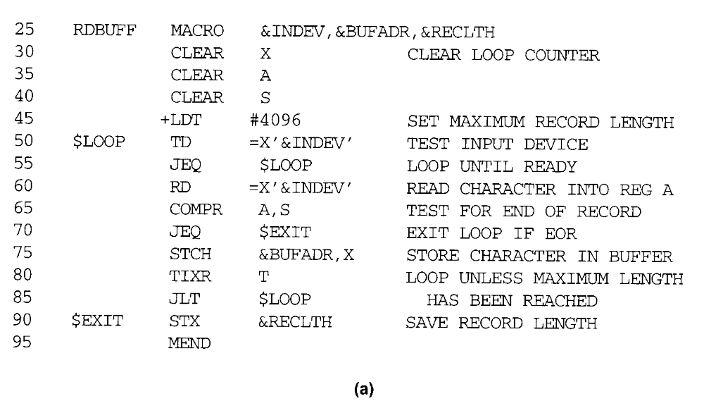
4.2.2 Generation of Unique Labels

Slide 29
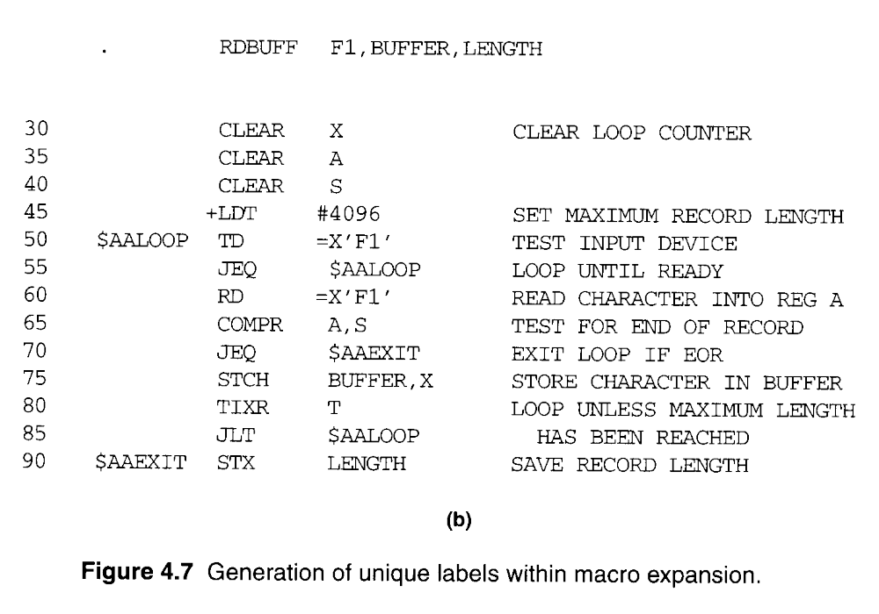

Slide 30
4.2.3 Conditional Macro Expansion
The use of one type of conditional macro expansion statement is illustrated in Fig. 4.8.
  The definition of RDBUFF has two additional parameters: &EOR and &MAXLTH.
  Macro processor directive SET
  This SET statement assigns the value 1 to &EORCK.
  The symbol &EORCK is a macro time variables, which can be used to store working values during the macro expansion.
  RDBUFF F3,BUF,RECL,04,2048
  RDBUFF 0E,BUFFER,LENGTH,,80
  RDBUFF F1,BUFF,RLENG,04

Slide 31
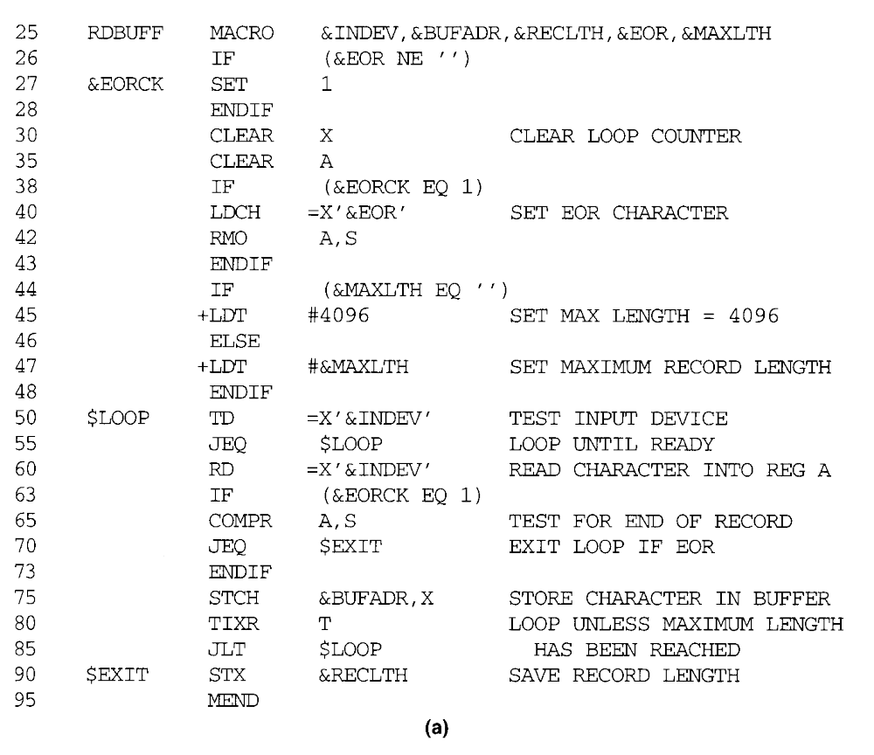
1
2
3
4

Slide 32
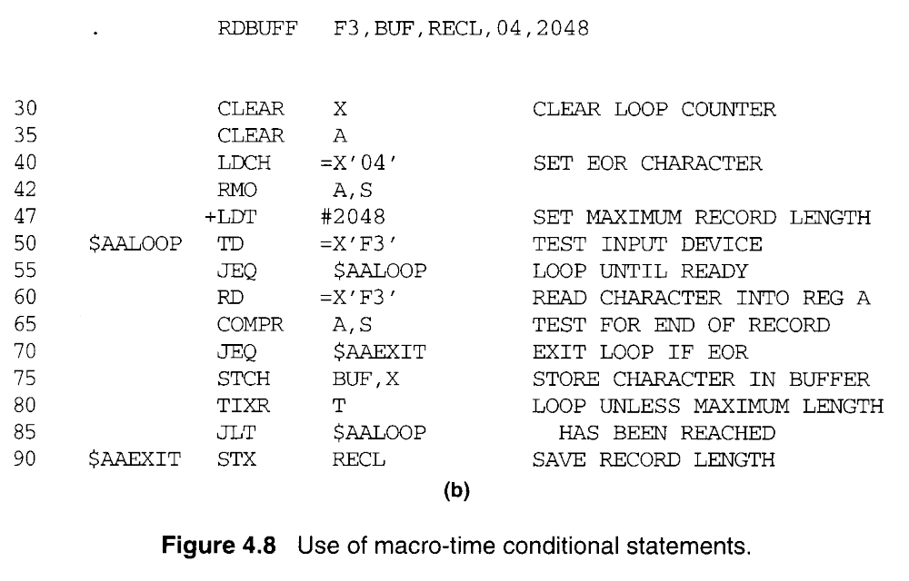
2
3
4

Slide 33
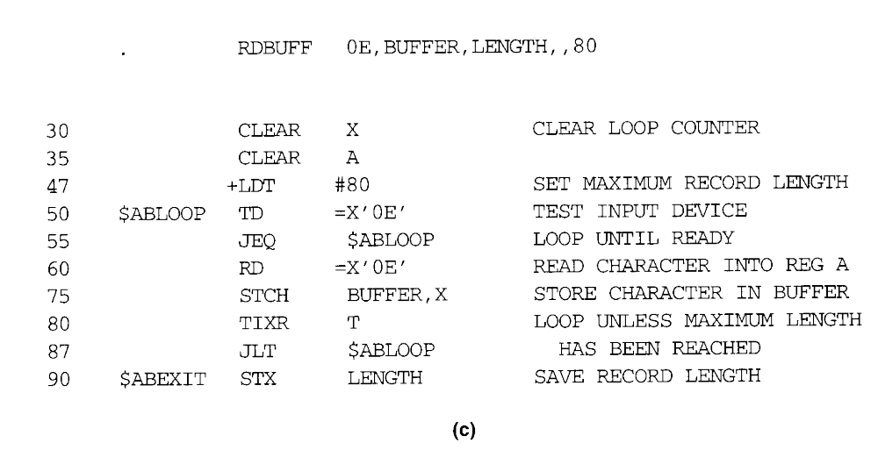
3

Slide 34
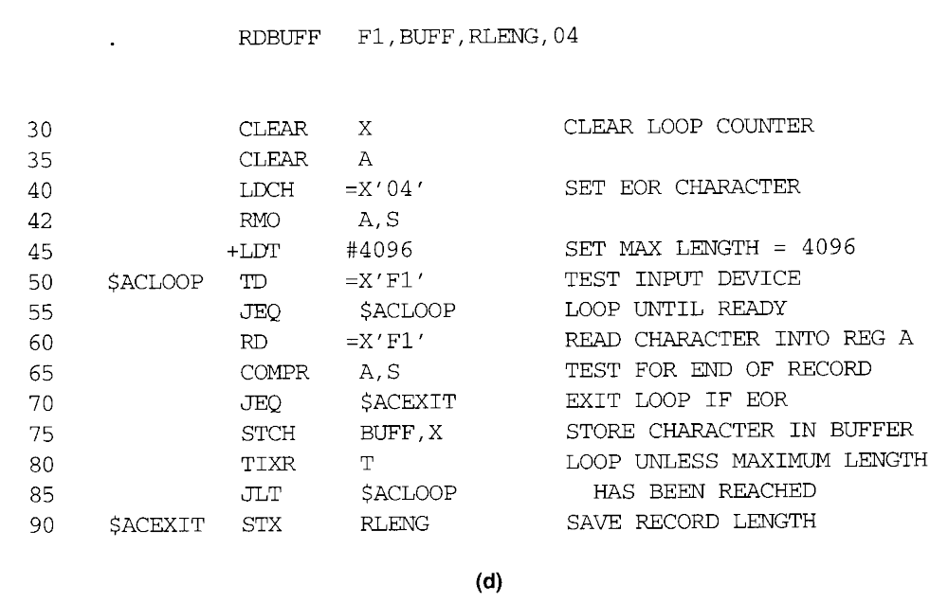
2
3
4

Slide 35
4.2.3 Conditional Macro Expansion
A different type of conditional macro expansion statement is illustrated in Fig. 4.9.
  There is a list (00, 03, 04) corresponding to &EOR.
  %NITEMS is a macro processor function that returns as its value the number of members in an argument list.
  %NITEMS(&EOR) is equal to 3.
  &CTR is used to count the number of times the lines following the WHILE statement have been generated.
  Thus on the first iteration the expression &EOR[&CTR] on line 65 has the value 00 = &EOR[1]; on the second iteration it has the value 03, and so on.
  How to implement nesting WHILE structures?

Slide 36
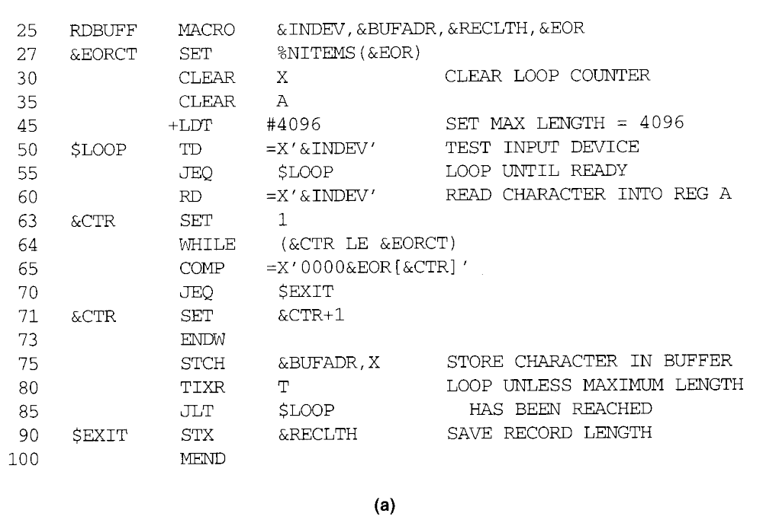

Slide 37
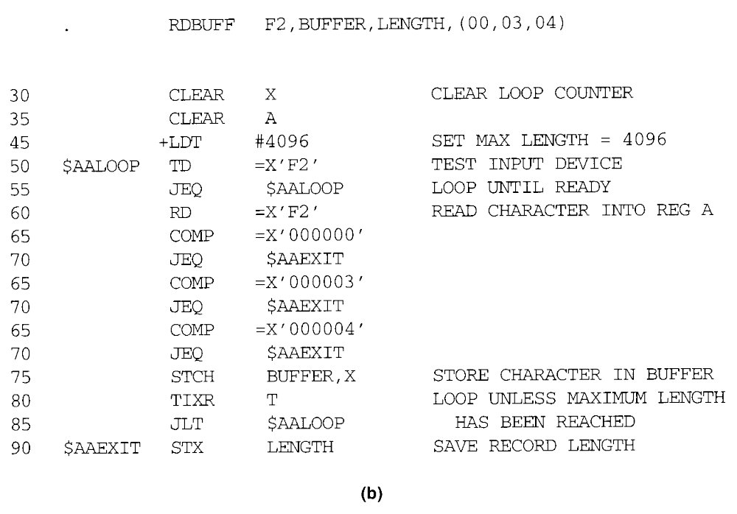

Slide 38
4.2.4 Keyword Macro Parameters
Positional parameters
  Parameters and arguments were associated with each other according to their positions in the macro prototype and the macro invocation statements.
  A certain macro instruction GENER has 10 possible parameters.
  GENER MACRO &1, &2, &type, …, &channel, &10
  GENER , , DIRECT, , , , , , 3

Slide 39
4.2.4 Keyword Macro Parameters
Keyword parameters
  Each argument value is written with a keyword that names the corresponding parameter.
  Arguments may appear in any order.
  GENER , , DIRECT, , , , , , 3 (positional)
  GENER TYPE=DIRECT, CHANNEL=3 (keyword)
  GENER CHANNEL=3, TYPE=DIRECT (keyword)
  parameter=argument
  Fig. 4.10 shows a version of the RDBUFF using keyword.

Slide 40
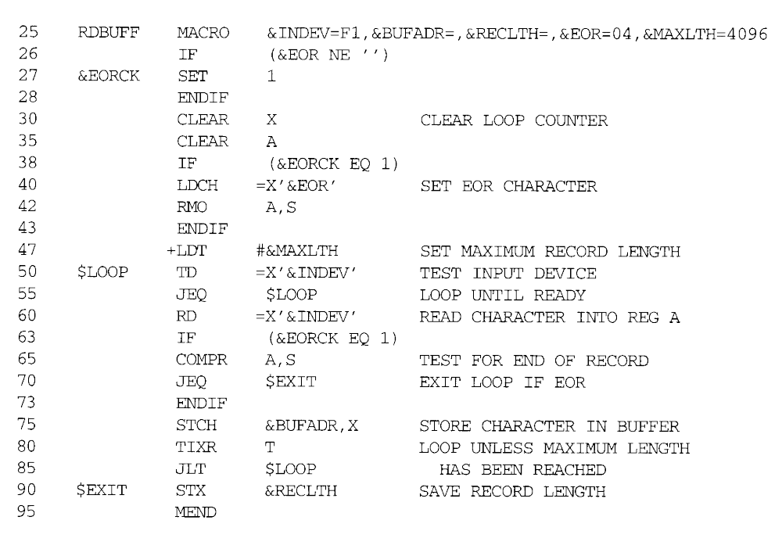
2
3

Slide 41
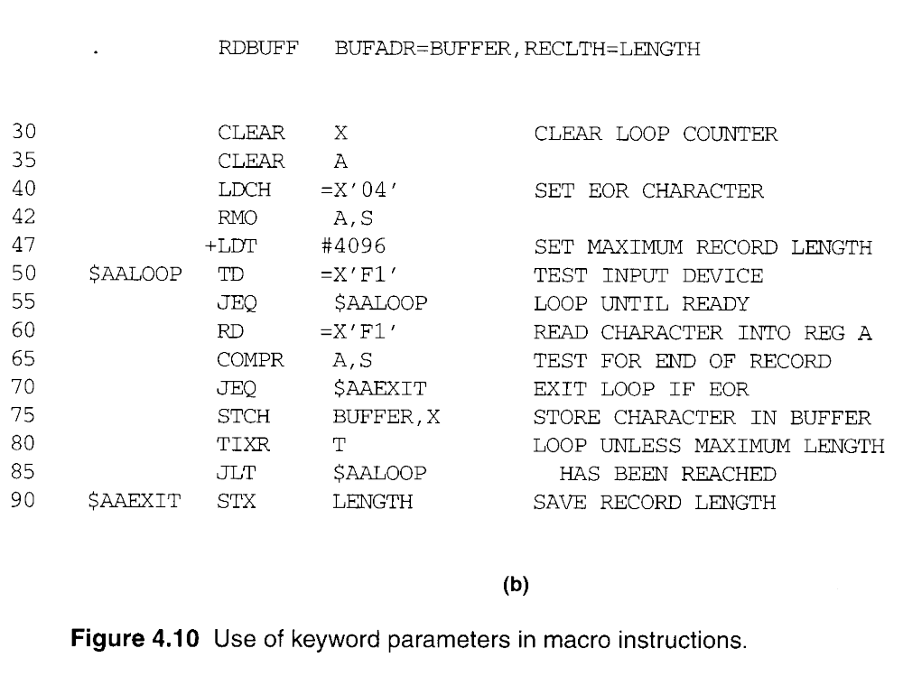
2
3

Slide 42
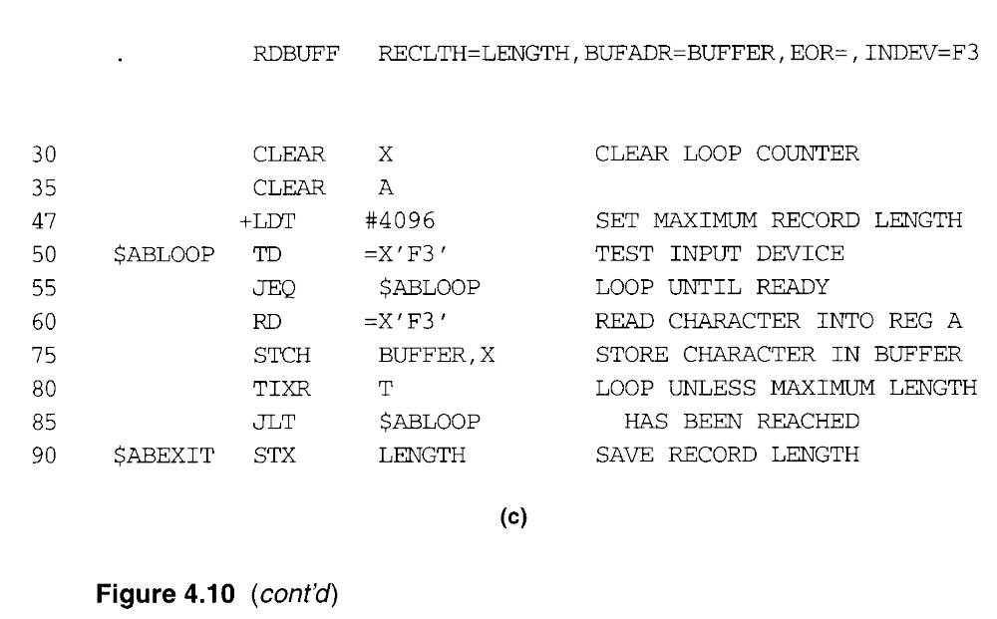

Slide 43
4.3 Macro Processor Design Options
4.3.1 Recursive Macro Expansion
In Fig. 4.3 we presented an example of the definition of one macro instruction by another.
Fig. 4.11(a) shows an example - Dealt with the invocation of one macro by another.
The purpose of RDCHAR Fig. 4.11(b) is to read one character from a specified device into register A, taking care of the necessary test-and-wait loop.

Slide 44
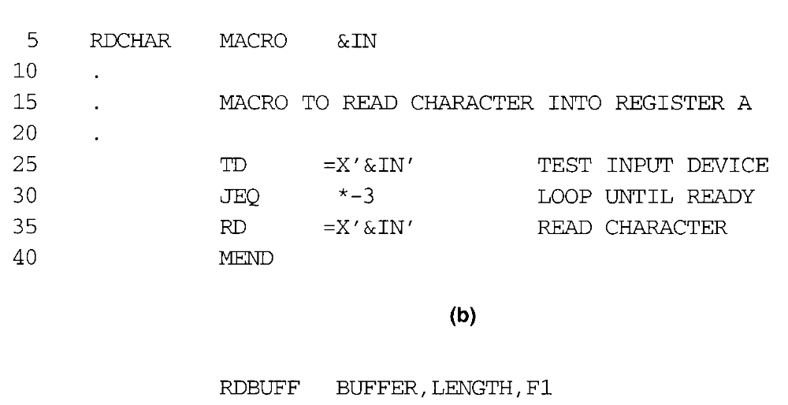

Slide 45
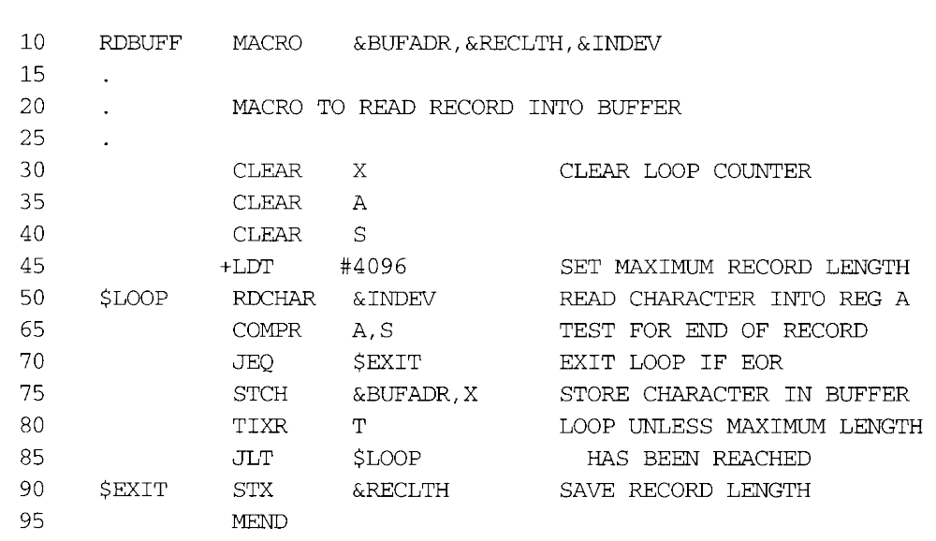

Slide 46
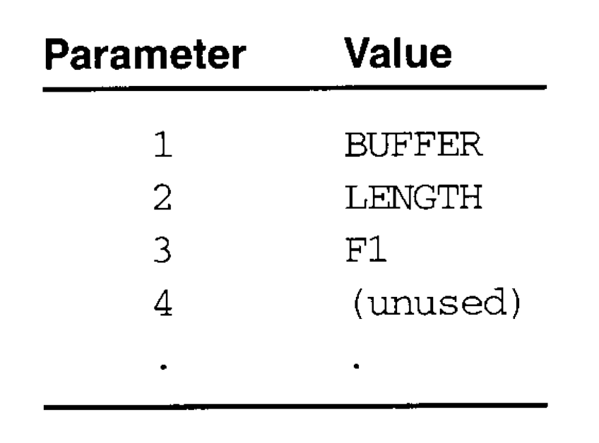
4.3.1 Recursive Macro Expansion
Fig. 4.11(c), applied to the macro invocation statement
RDBUFF BUFFER, LENGTH, F1
The procedure EXPAND would be called when the macro was recognized.
The arguments from the macro invocation would be entered into ARGTAB as follows:

Slide 47
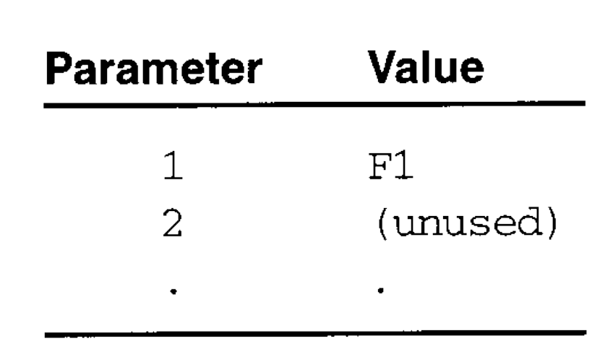
4.3.1 Recursive Macro Expansion
The Boolean variable EXPANDING would be set to TRUE, and expansion of the macro invocation statement would be begin.
The processing would proceed normally until line 50, which contains a statement invoking RDCHAR. At that point, PROCESSLINE would call EXPAND again.
This time, ARGTAB would look like

Slide 48
4.3.1 Recursive Macro Expansion
At the end of this expansion, however, a problem would appear. When the end of the definition of RDCHAR was recognized, EXPANDING would be set to FALSE.
Thus the macro processor would “forget” that it had been in middle of expanding a macro when it encountered the RDCHAR statement.
Use a Stack to save ARGTAB.
Use a counter to identify the expansion.

Slide 49
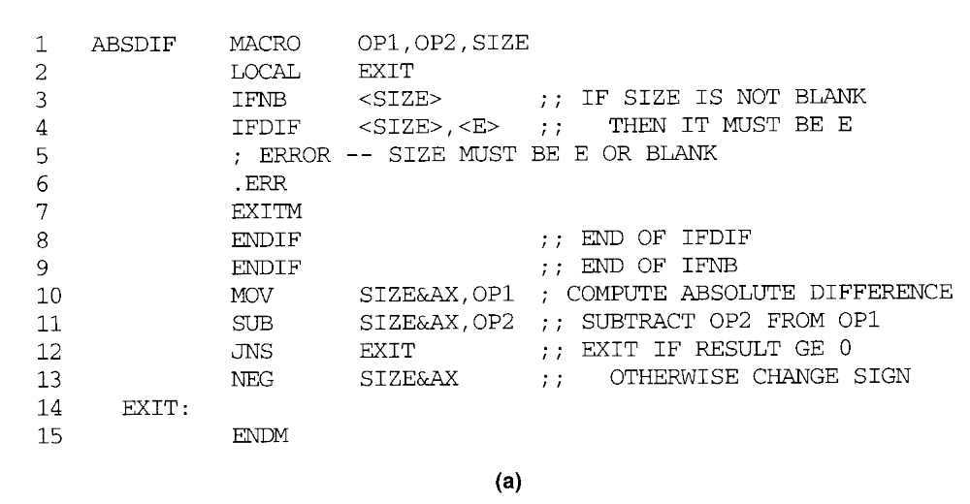
Pages 208-209, MASM

Slide 50
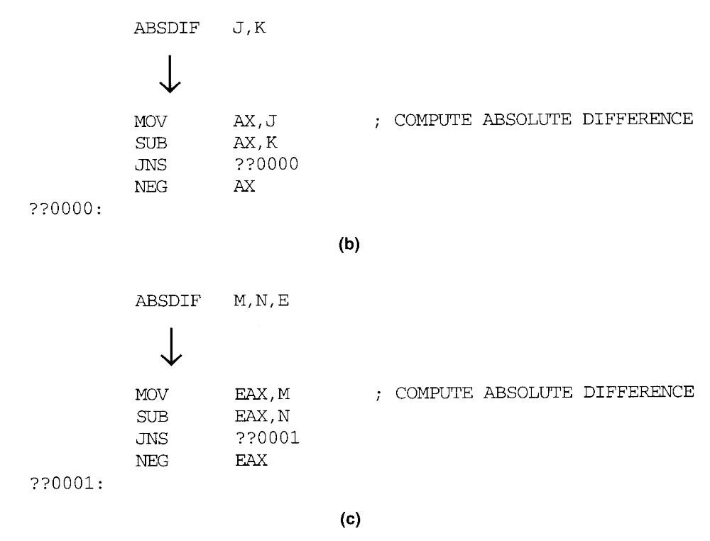

Slide 51
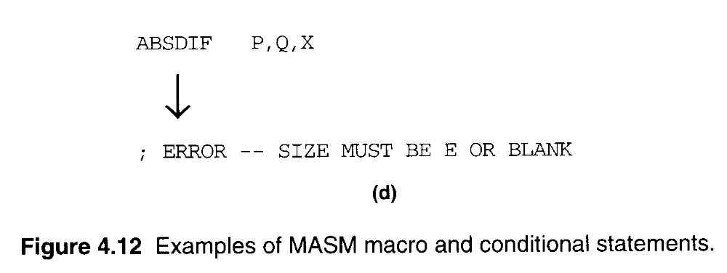

Slide 52
