Slide 1
11
Operator
Overloading;
String and Array
Objects

Slide 2
The whole difference between construction and creation is exactly this:
that a thing constructed can only be loved after it is constructed; but a thing created is loved before it exists.
  Gilbert Keith Chesterton
The die is cast.
  Julius Caesar
Our doctor would never really operate unless it was necessary. He was just that way. If he didn’t need the money, he wouldn’t lay a hand on you.
  Herb Shriner

Slide 3
OBJECTIVES
In this chapter you will learn:
What operator overloading is and how it makes programs more readable and programming more convenient.
To redefine (overload) operators to work with objects of user-defined classes.
The differences between overloading unary and binary operators.
To convert objects from one class to another class.
When to, and when not to, overload operators.
To create PhoneNumber, Array, String and Date classes that demonstrate operator overloading.
To use overloaded operators and other member functions of standard library class string.
To use keyword explicit to prevent the compiler from using single-argument constructors to perform implicit conversions.

Slide 4
11.1 Introduction
11.2 Fundamentals of Operator Overloading
11.3 Restrictions on Operator Overloading
11.4 Operator Functions as Class Members vs. Global Functions
11.5 Overloading Stream Insertion and Stream Extraction Operators
11.6 Overloading Unary Operators
11.7 Overloading Binary Operators
11.8 Case Study: Array Class
11.9 Converting between Types
11.10 Case Study: String Class
11.11 Overloading ++ and --
11.12 Case Study: A Date Class
11.13 Standard Library Class string
11.14 explicit Constructors
11.15 Wrap-Up

Slide 5
Software Engineering Observation 11.1
Operator overloading contributes to C++’s extensibility—one of the language’s most appealing attributes.

Slide 6
Good Programming Practice 11.1
Use operator overloading when it makes a program clearer than accomplishing the same operations with function calls.

Slide 7
Good Programming Practice 11.2
Overloaded operators should mimic the functionality of their built-in counterparts—for example, the + operator should be overloaded to perform addition, not subtraction. Avoid excessive or inconsistent use of operator overloading, as this can make a program cryptic and difficult to read.

Slide 8
Common Programming Error 11.1
Attempting to overload a nonoverloadable operator is a syntax error.

Slide 9
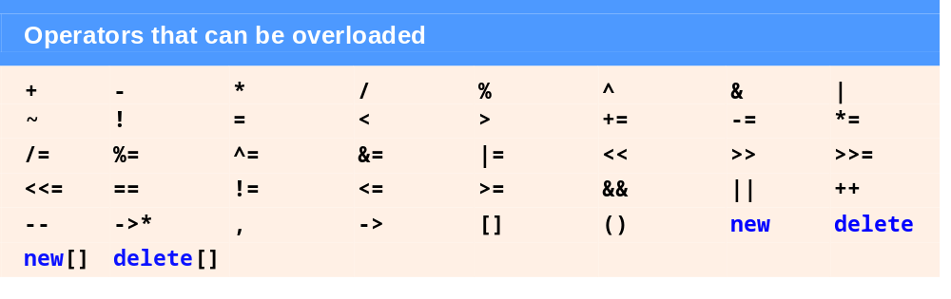
Fig. 11.1 | Operators that can be overloaded.

Slide 10

Fig. 11.2 | Operators that cannot be overloaded.

Slide 11
Common Programming Error 11.2
Attempting to change the “arity” of an operator via operator overloading is a compilation error.

Slide 12
Common Programming Error 11.3
Attempting to create new operators via operator overloading is a syntax error.

Slide 13
Software Engineering Observation 11.2
At least one argument of an operator function must be an object or reference of a user-defined type. This prevents programmers from changing how operators work on fundamental types.

Slide 14
Common Programming Error 11.4
Attempting to modify how an operator works with objects of fundamental types is a compilation error.

Slide 15
Common Programming Error 11.5
Assuming that overloading an operator such as + overloads related operators such as += or that overloading == overloads a related operator like != can lead to errors. Operators can be overloaded only explicitly; there is no implicit overloading.

Slide 16
Performance Tip 11.1
It is possible to overload an operator as a global, non-friend function, but such a function requiring access to a class’s private or protected data would need to use set or get functions provided in that class’s public interface. The overhead of calling these functions could cause poor performance, so these functions can be inlined to improve performance.

Slide 17
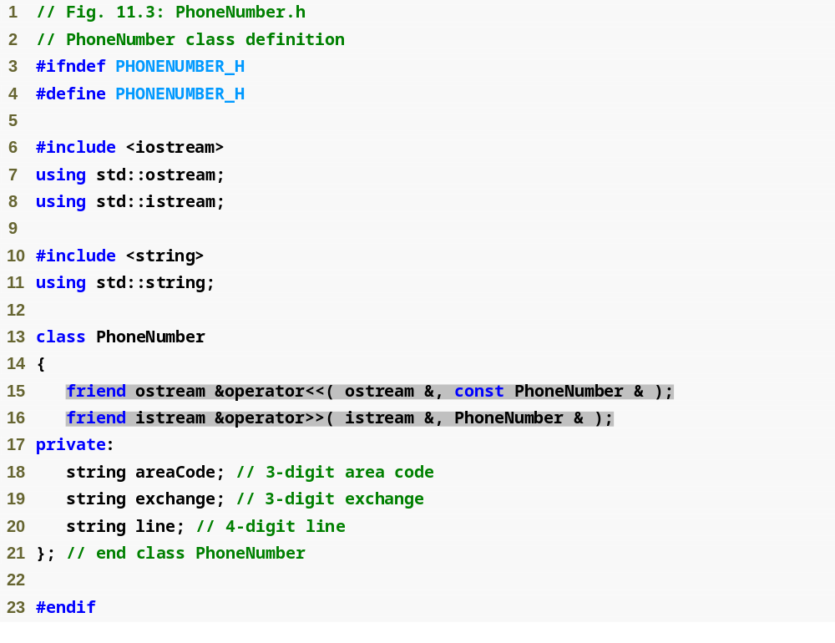
Outline
PhoneNumber.h
(1 of 1)

Slide 18
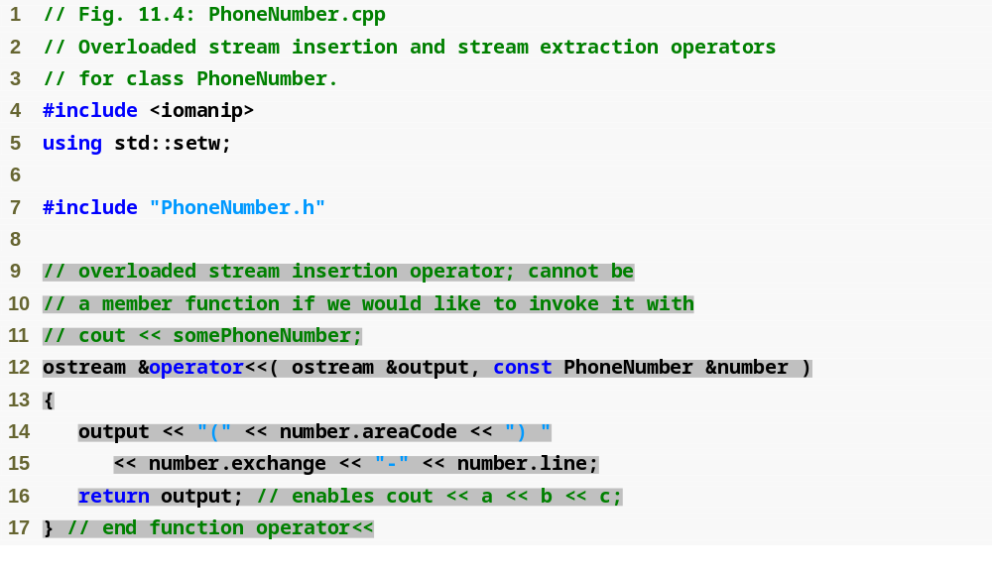
Outline
PhoneNumber.cpp
(1 of 2)

Slide 19
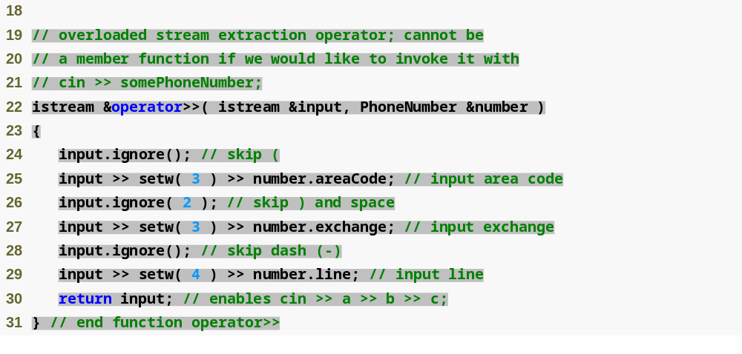
Outline
PhoneNumber.cpp
(2 of 2)

Slide 20
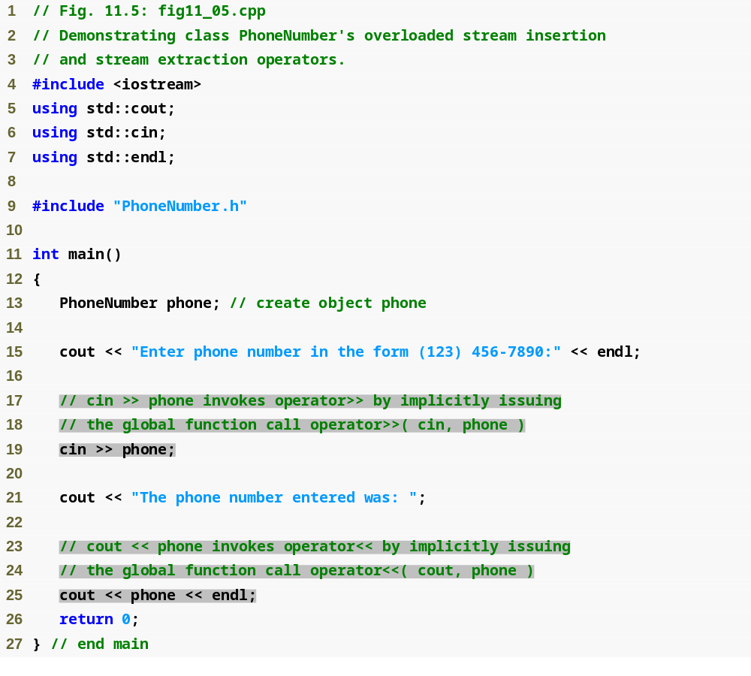
Outline
fig11_05.cpp
(1 of 2)

Slide 21

Outline
fig11_05.cpp
(2 of 2)

Slide 22
Error-Prevention Tip 11.1
Returning a reference from an overloaded << or >> operator function is typically successful because cout, cin and most stream objects are global, or at least long-lived. Returning a reference to an automatic variable or other temporary object is dangerous—creating “dangling references” to nonexisting objects.

Slide 23
Software Engineering Observation 11.3
New input/output capabilities for user-defined types are added to C++ without modifying C++’s standard input/output library classes. This is another example of the extensibility of the C++ programming language.

Slide 24
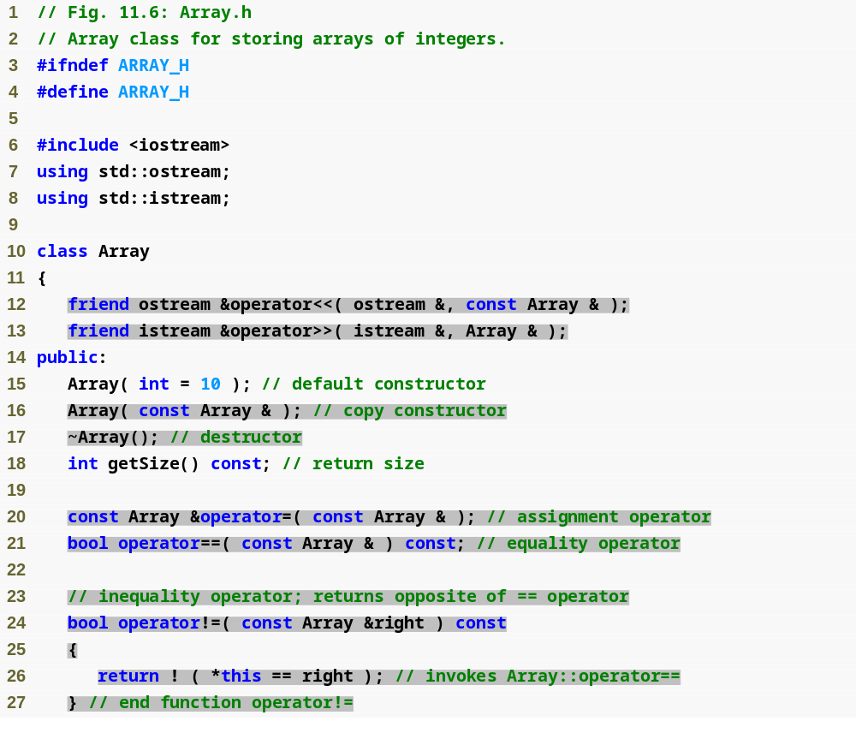
Outline
Array.h
(1 of 2)

Slide 25
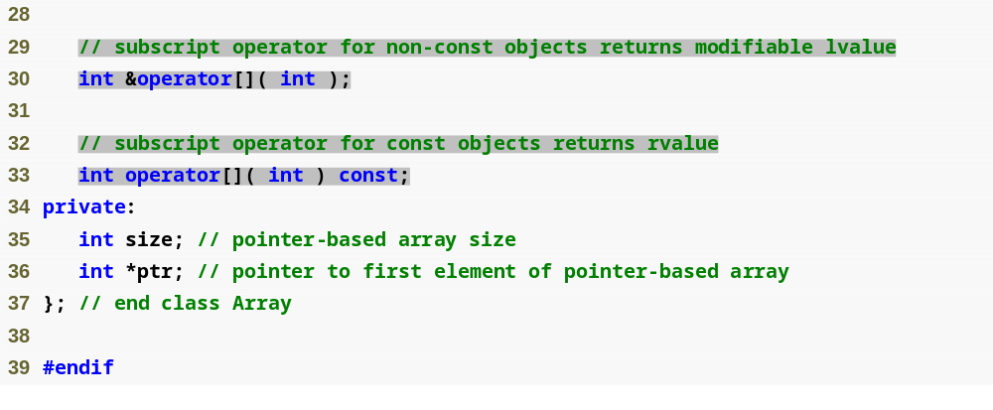
Outline
Array.h
(2 of 2)

Slide 26
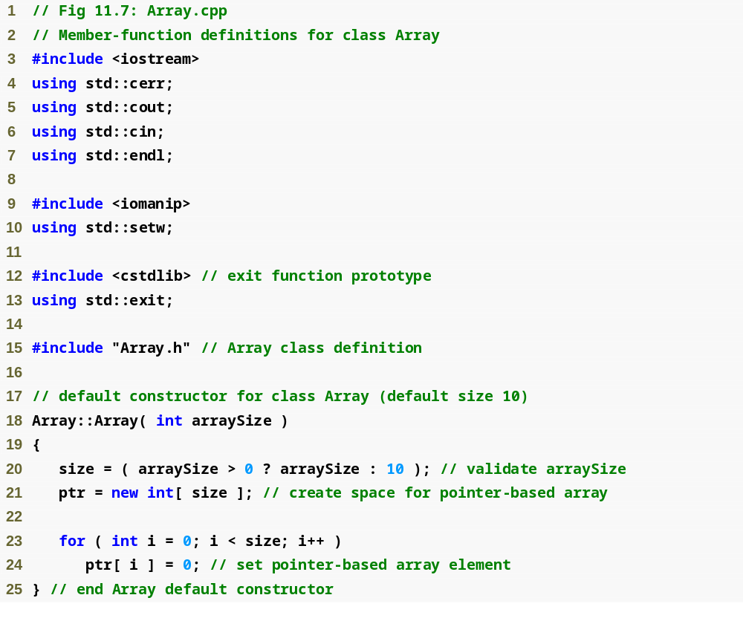
Outline
Array.cpp
(1 of 6)

Slide 27
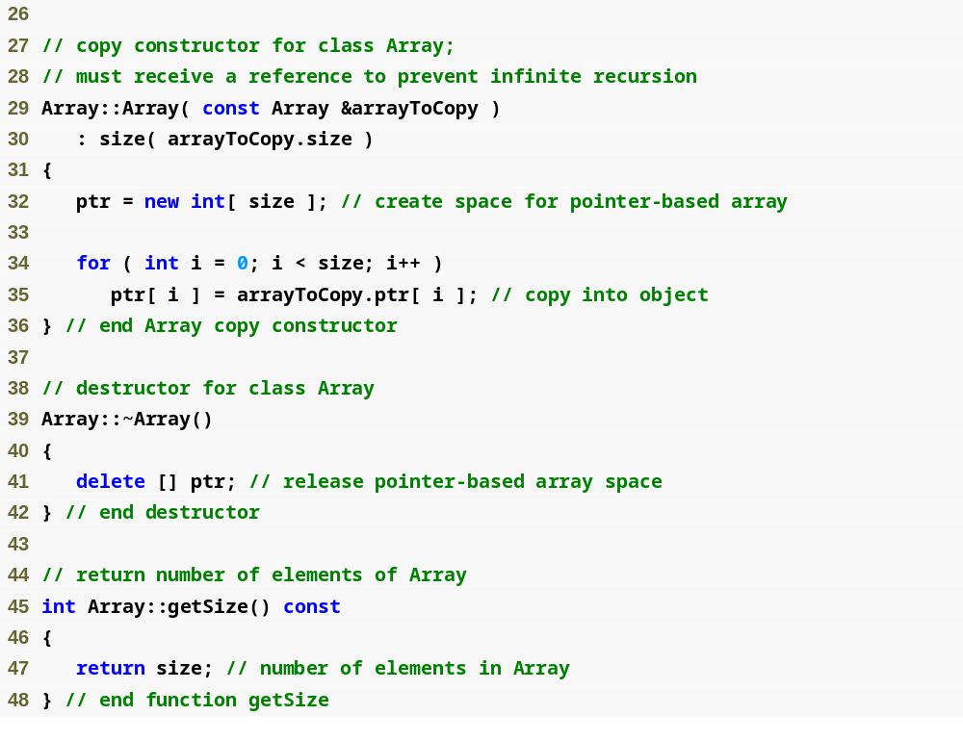
Outline
Array.cpp
(2 of 6)

Slide 28
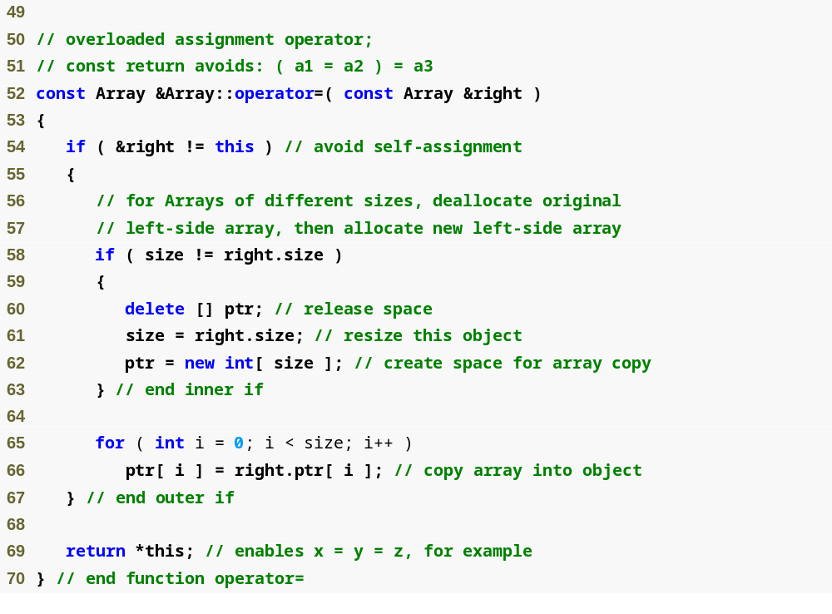
Outline
Array.cpp
(3 of 6)

Slide 29
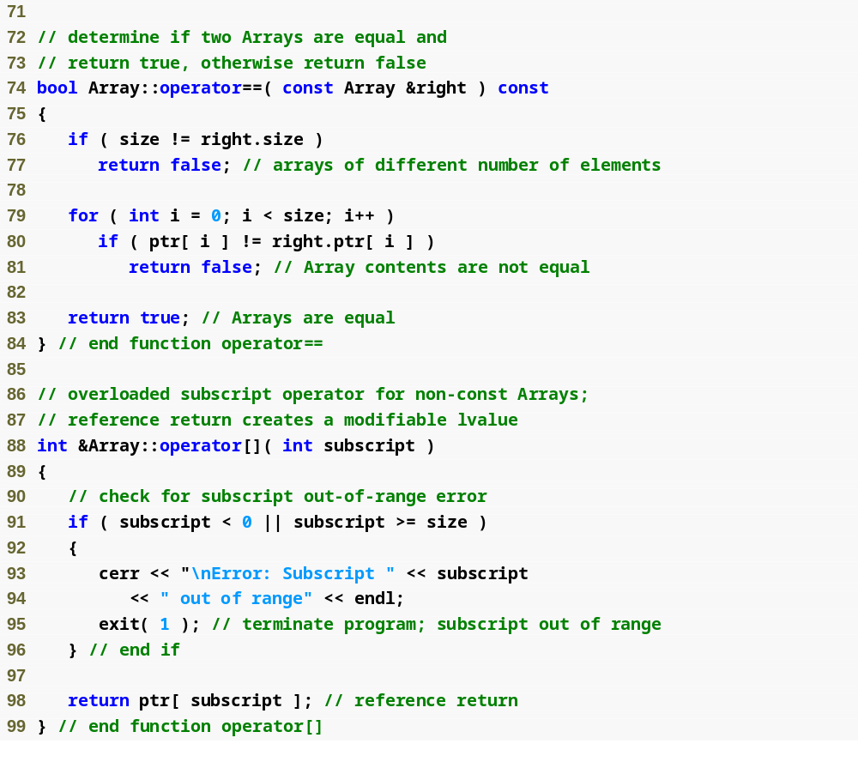
Outline
Array.cpp
(4 of 6)

Slide 30
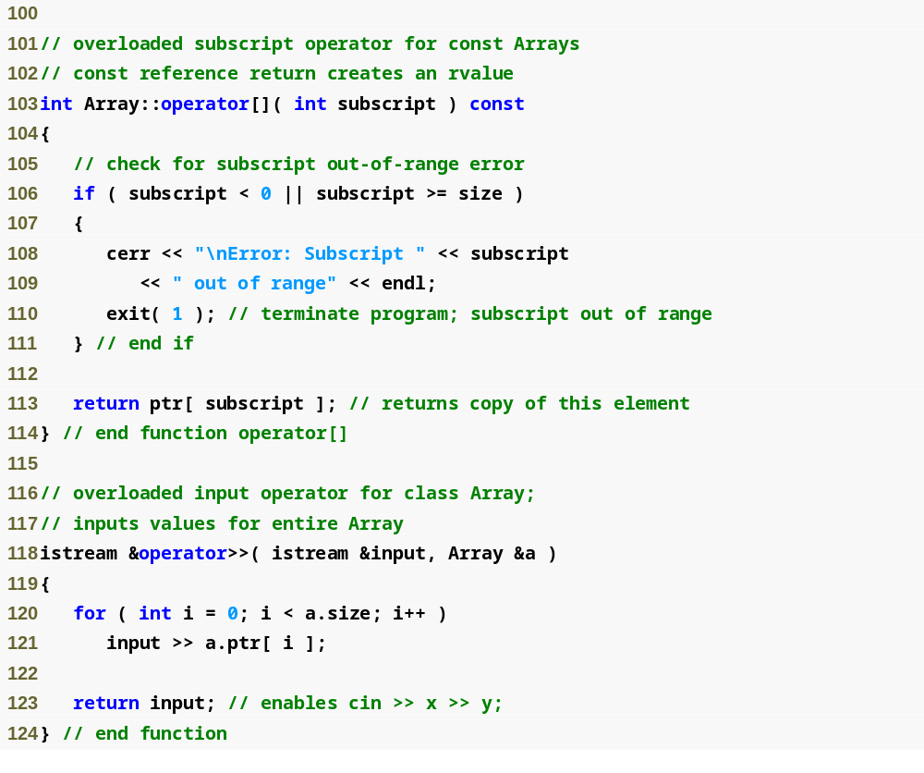
Outline
Array.cpp
(5 of 6)

Slide 31
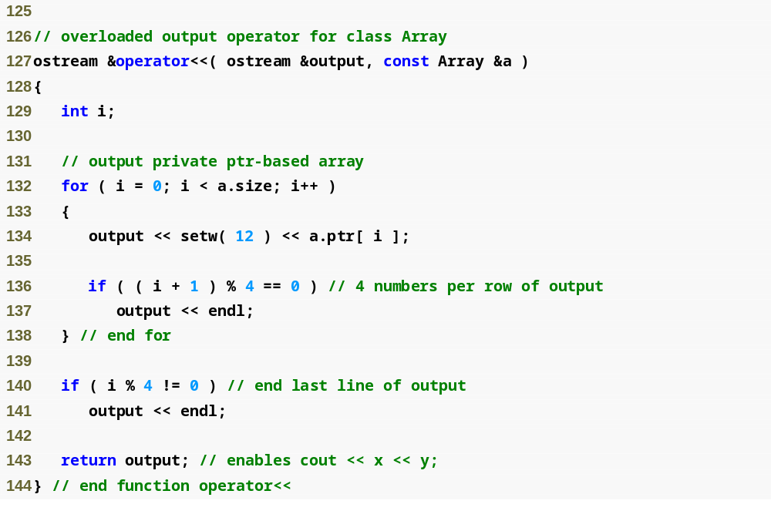
Outline
Array.cpp
(6 of 6)

Slide 32
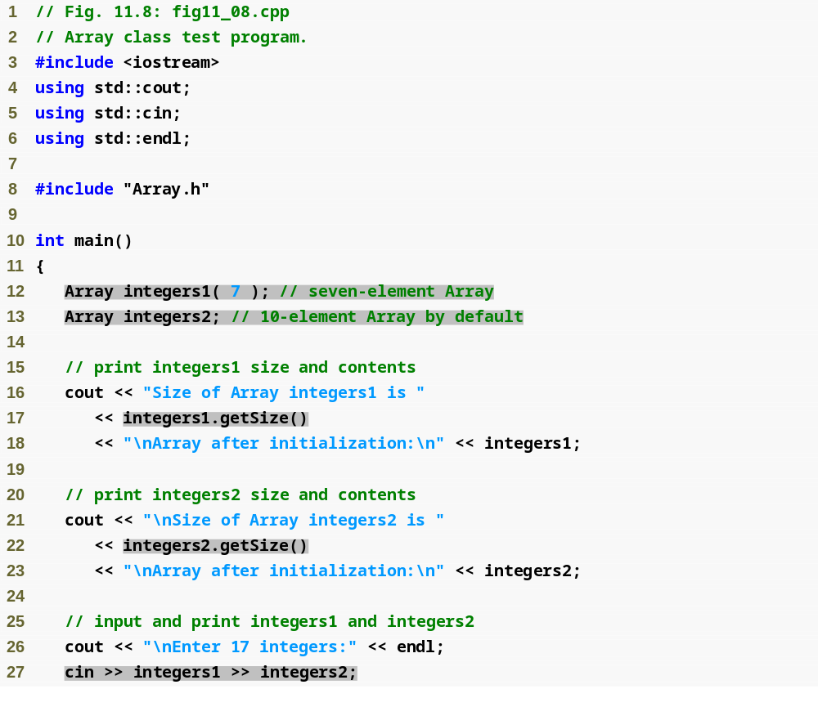
Outline
fig11_08.cpp
(1 of 5)

Slide 33
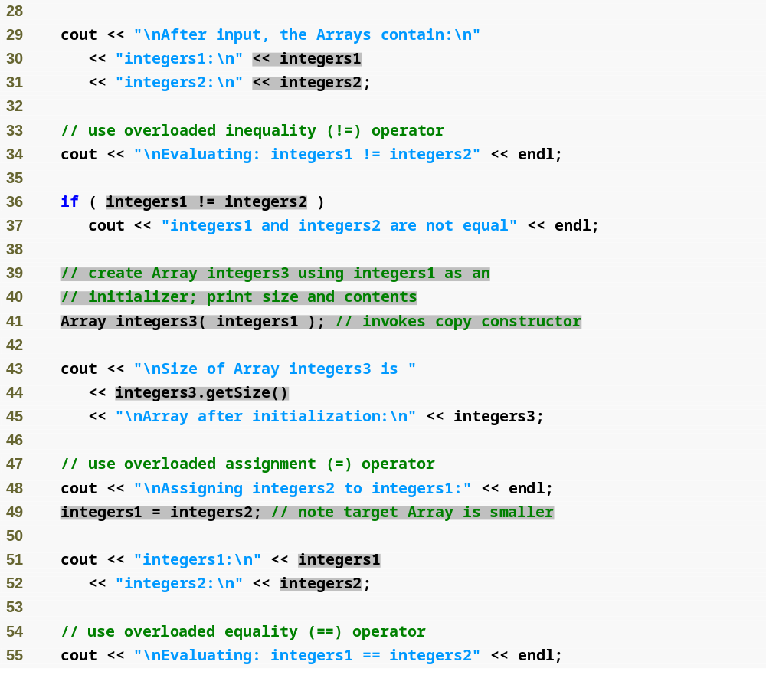
Outline
fig11_08.cpp
(2 of 5)

Slide 34
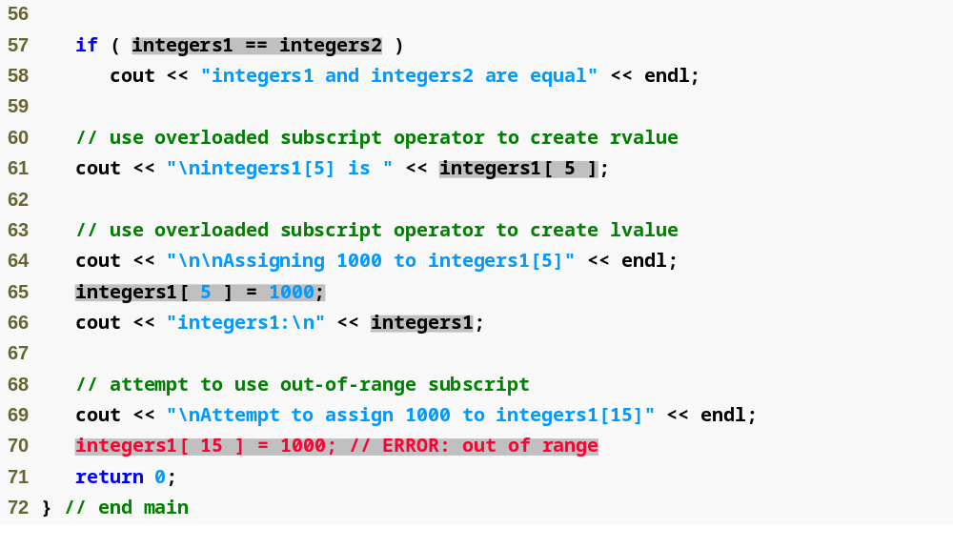
Outline
fig11_08.cpp
(3 of 5)

Slide 35
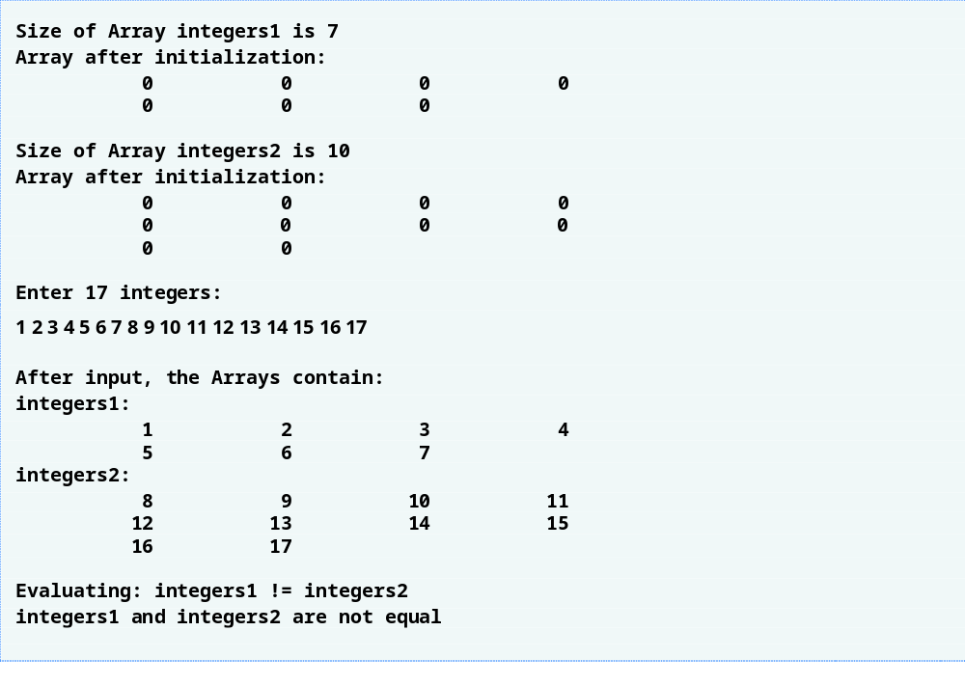
Outline
fig11_08.cpp
(4 of 5)

Slide 36
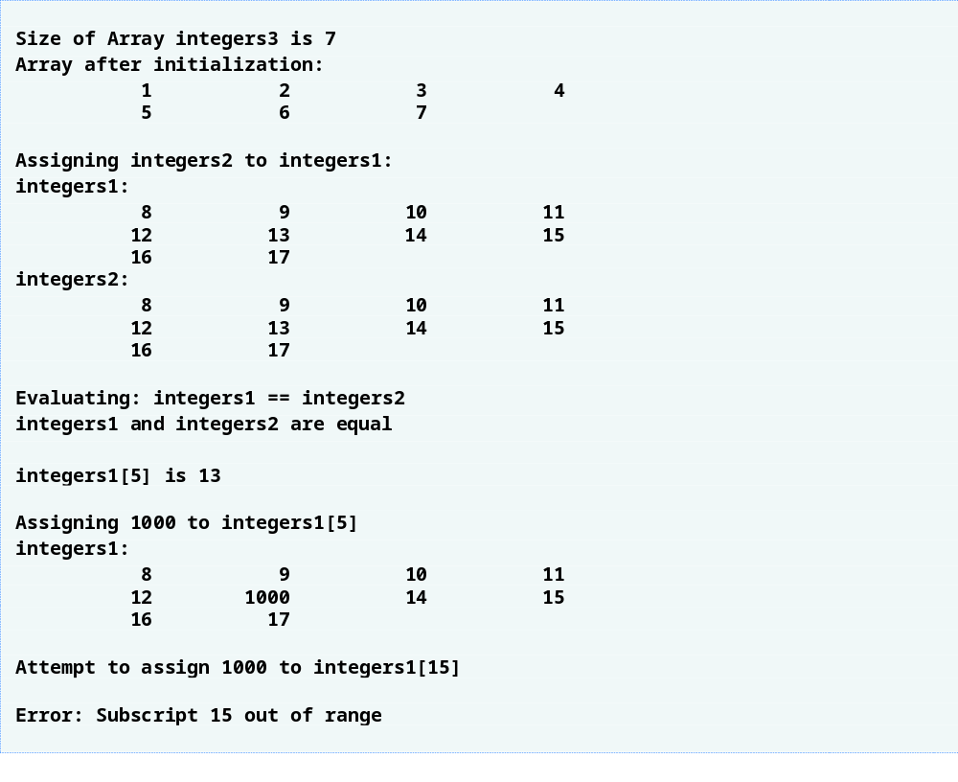
Outline
fig11_08.cpp
(5 of 5)

Slide 37
Software Engineering Observation 11.4
The argument to a copy constructor should be a const reference to allow a const object to be copied.

Slide 38
Common Programming Error 11.6
Note that a copy constructor must receive its argument by reference, not by value. Otherwise, the copy constructor call results in infinite recursion (a fatal logic error) because receiving an object by value requires the copy constructor to make a copy of the argument object. Recall that any time a copy of an object is required, the class’s copy constructor is called. If the copy constructor received its argument by value, the copy constructor would call itself recursively to make a copy of its argument!

Slide 39
Common Programming Error 11.7
If the copy constructor simply copied the pointer in the source object to the target object’s pointer, then both objects would point to the same dynamically allocated memory. The first destructor to execute would then delete the dynamically allocated memory, and the other object’s ptr would be undefined, a situation called a dangling pointer—this would likely result in a serious run-time error (such as early program termination) when the pointer was used.

Slide 40
Software Engineering Observation 11.5
A copy constructor, a destructor and an overloaded assignment operator are usually provided as a group for any class that uses dynamically allocated memory.

Slide 41
Common Programming Error 11.8
Not providing an overloaded assignment operator and a copy constructor for a class when objects of that class contain pointers to dynamically allocated memory is a logic error.

Slide 42
Software Engineering Observation 11.6
It is possible to prevent one object of a class from being assigned to another. This is done by declaring the assignment operator as a private member of the class.

Slide 43
Software Engineering Observation 11.7
It is possible to prevent class objects from being copied; to do this, simply make both the overloaded assignment operator and the copy constructor of that class private.

Slide 44
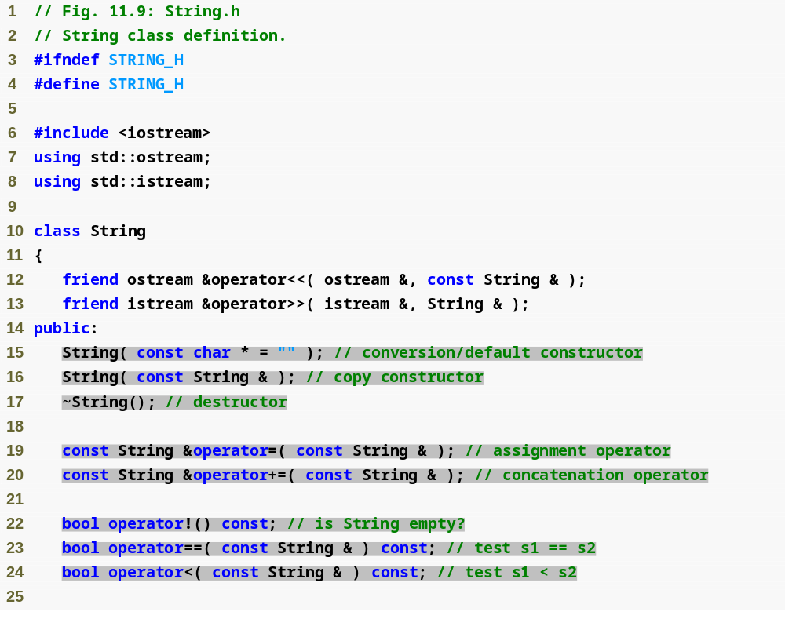
Outline
String.h
(1 of 3)

Slide 45
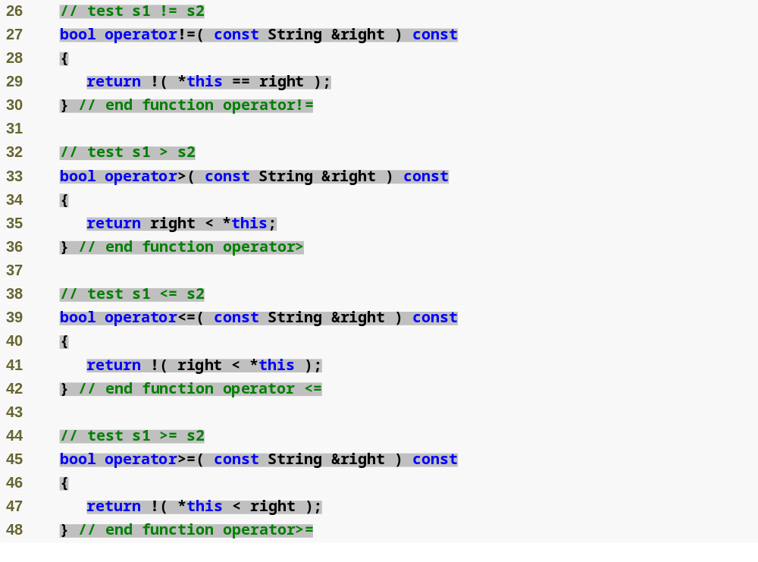
Outline
String.h
(2 of 3)

Slide 46
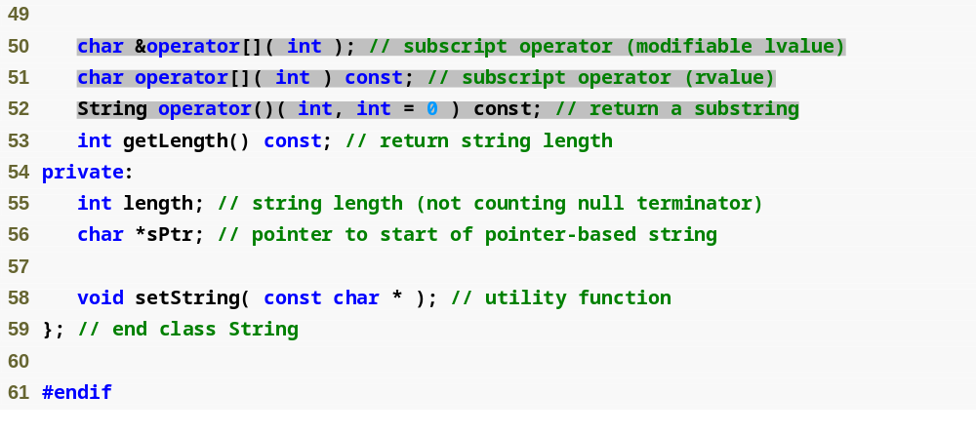
Outline
String.h
(3 of 3)

Slide 47
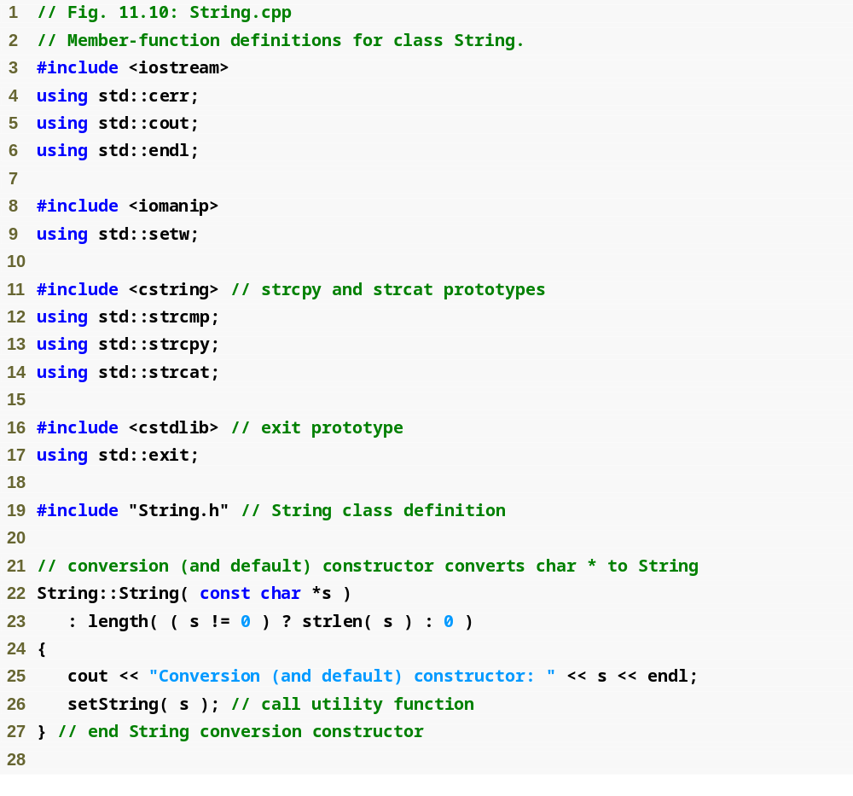
Outline
String.cpp
(1 of 7)

Slide 48
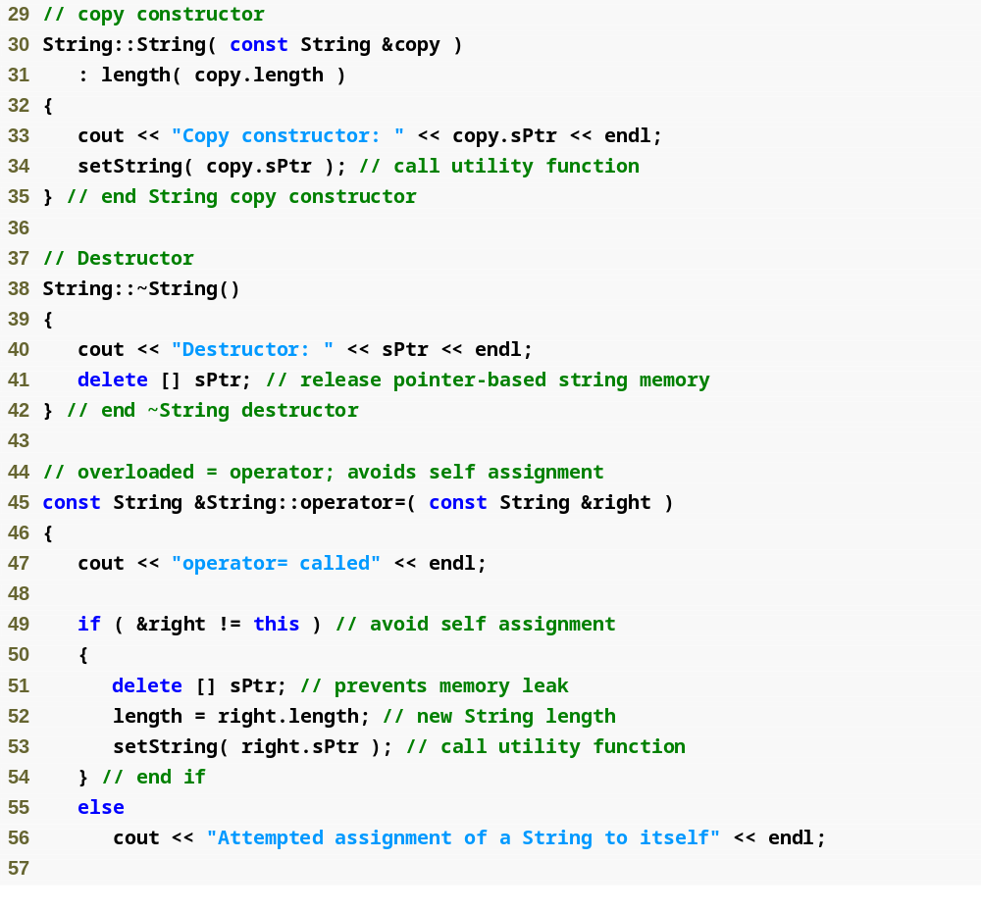
Outline
String.cpp
(2 of 7)

Slide 49
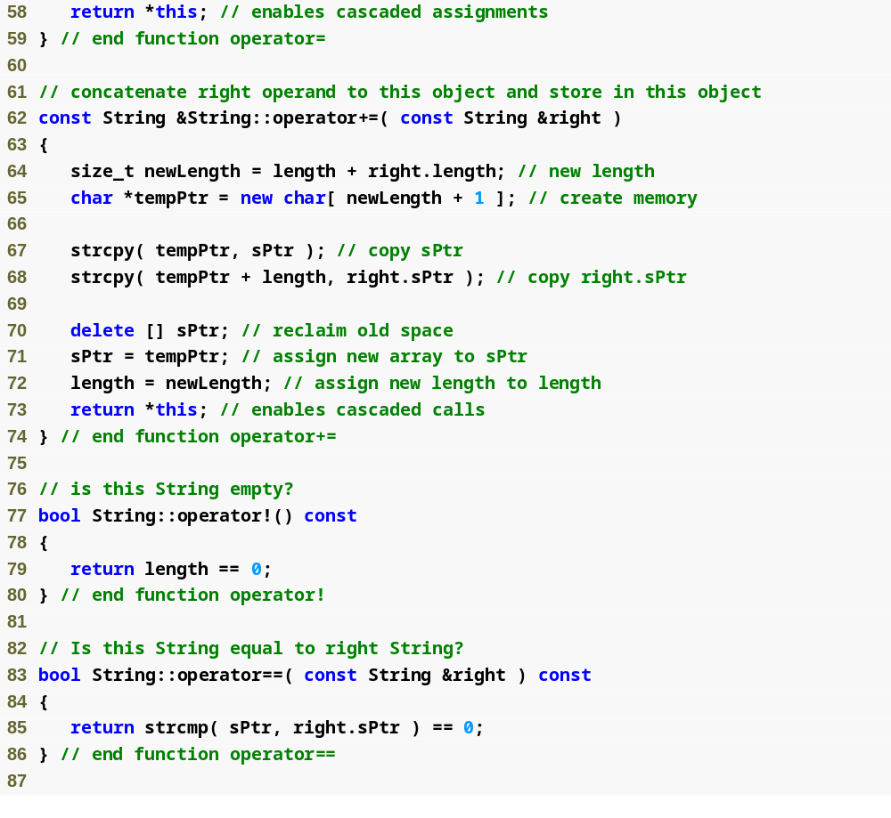
Outline
String.cpp
(3 of 7)

Slide 50
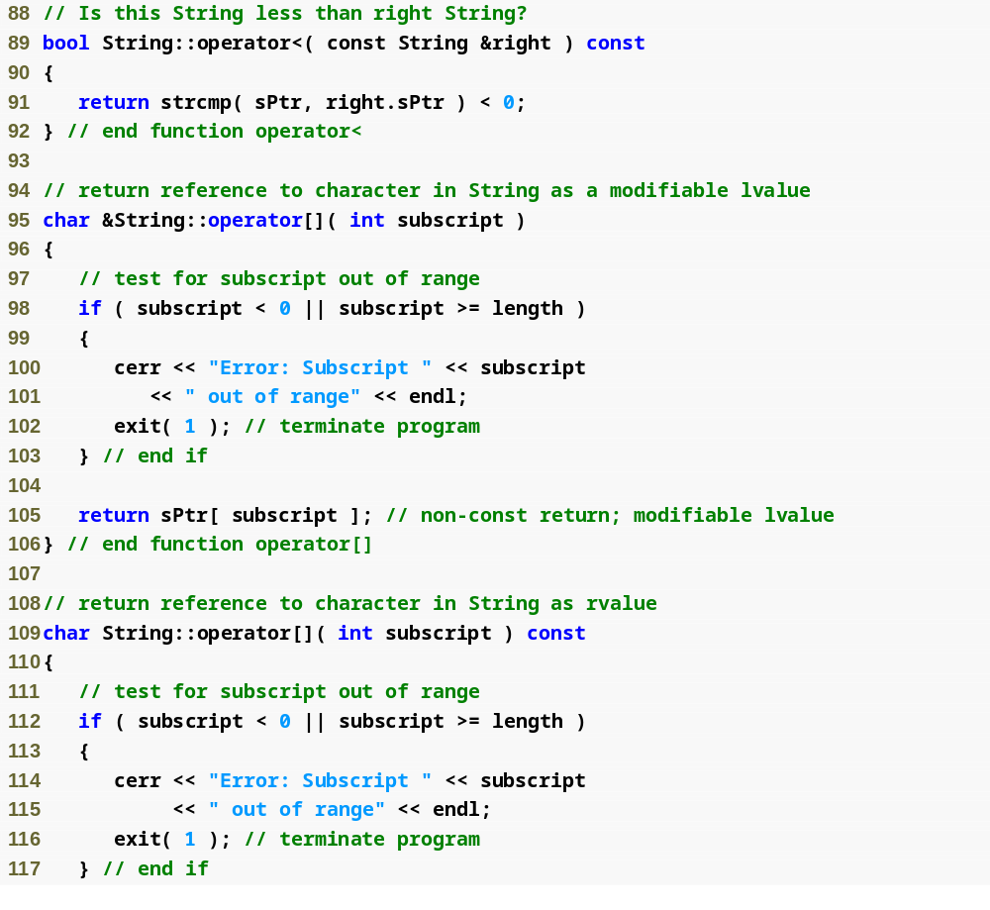
Outline
String.cpp
(4 of 7)

Slide 51
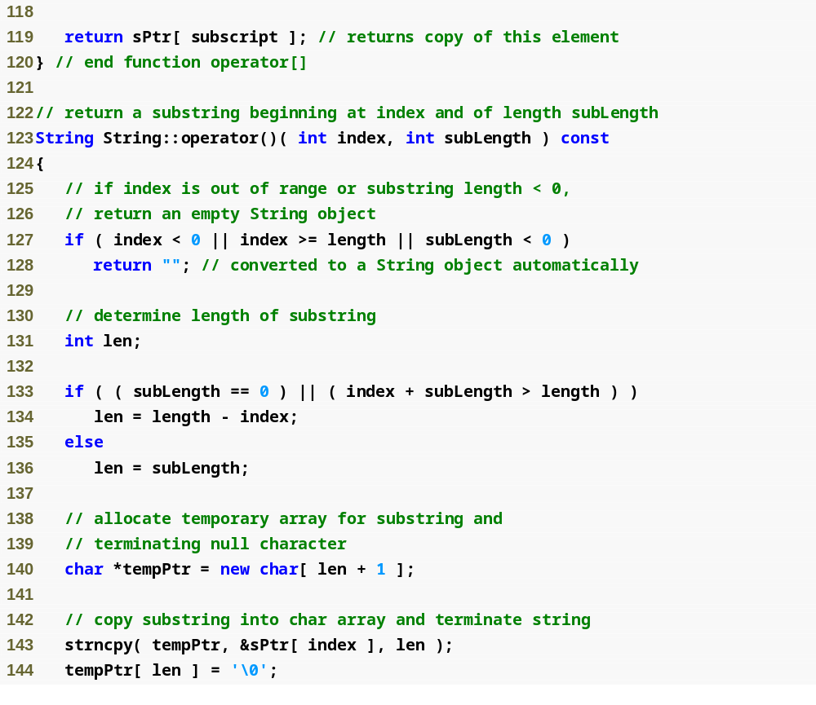
Outline
String.cpp
(5 of 7)

Slide 52
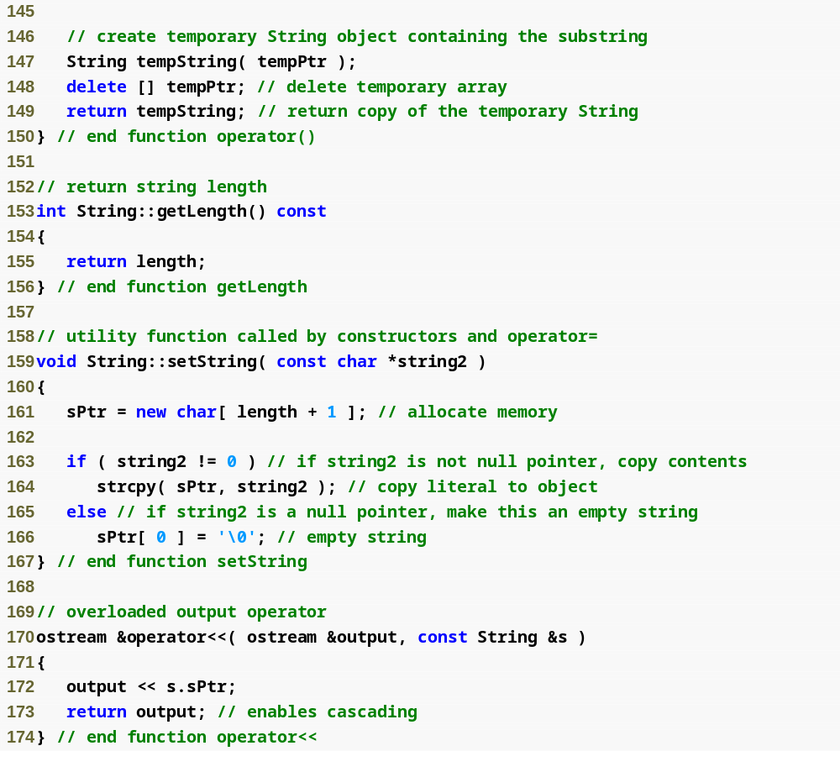
Outline
String.cpp
(6 of 7)

Slide 53
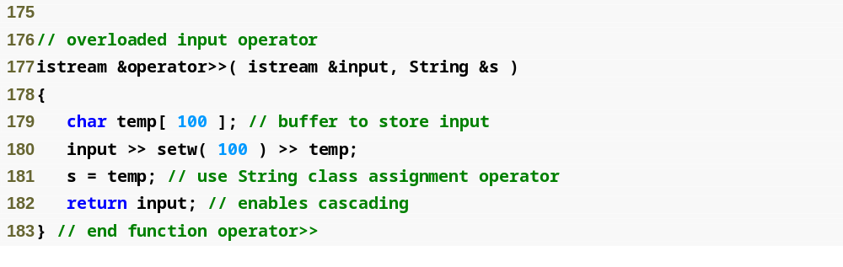
Outline
String.cpp
(7 of 7)

Slide 54
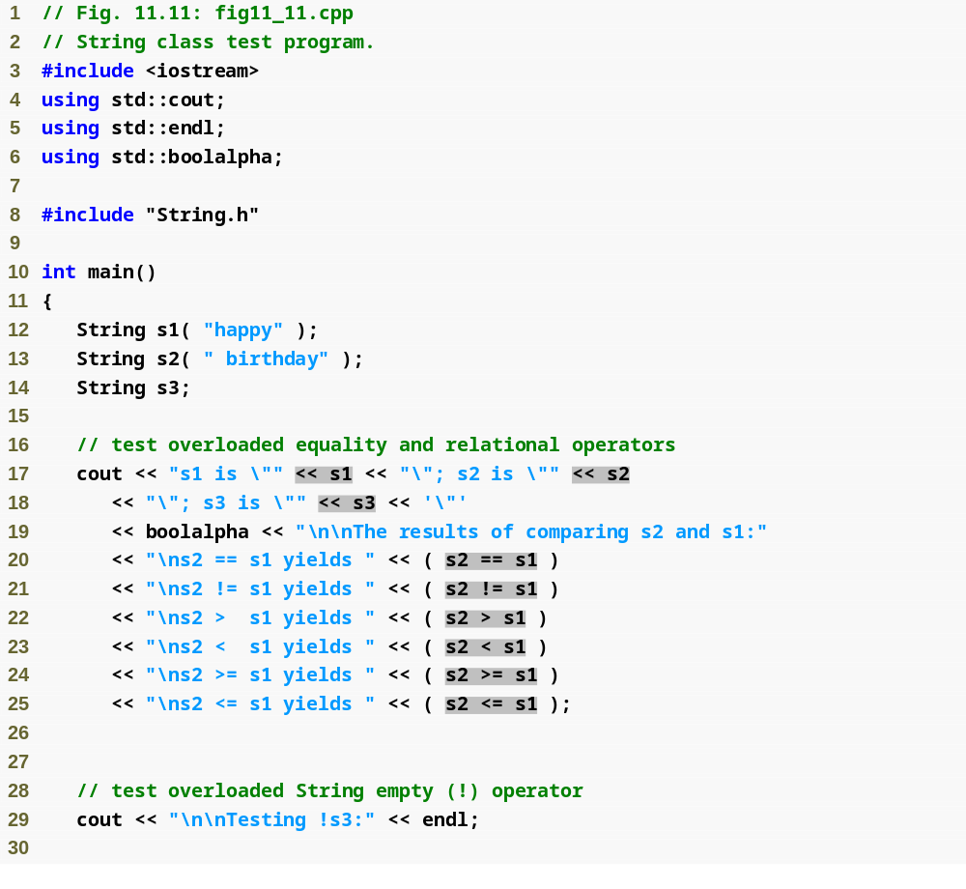
Outline
fig11_11.cpp
(1 of 5)

Slide 55
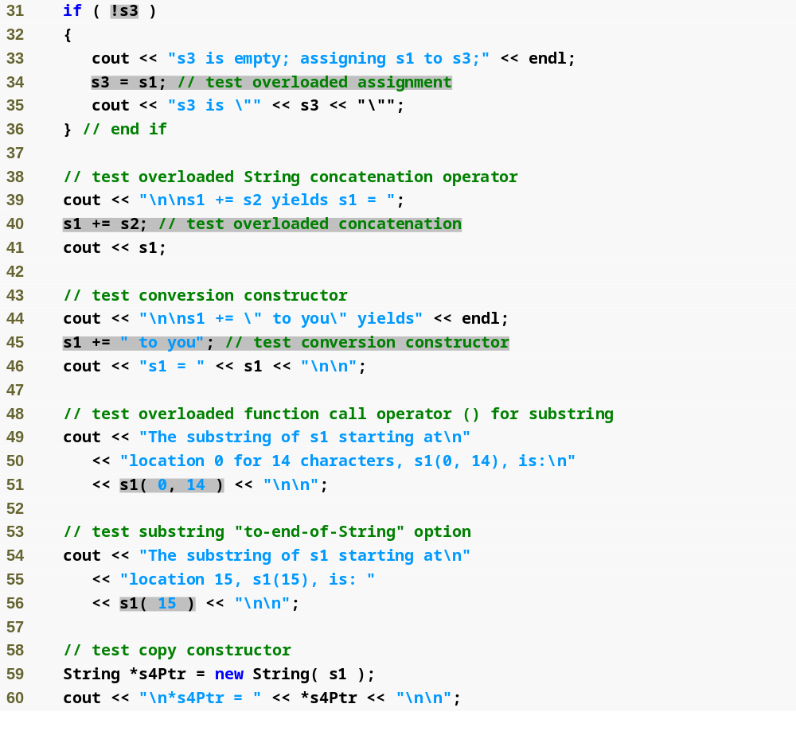
Outline
fig11_11.cpp
(2 of 5)

Slide 56
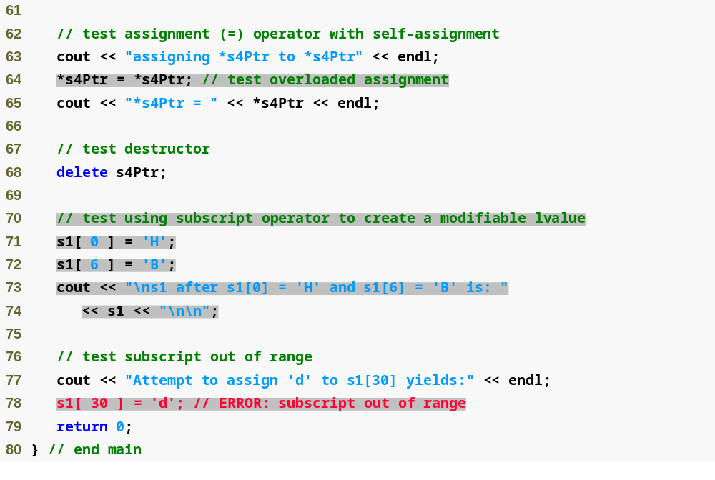
Outline
fig11_11.cpp
(3 of 5)

Slide 57
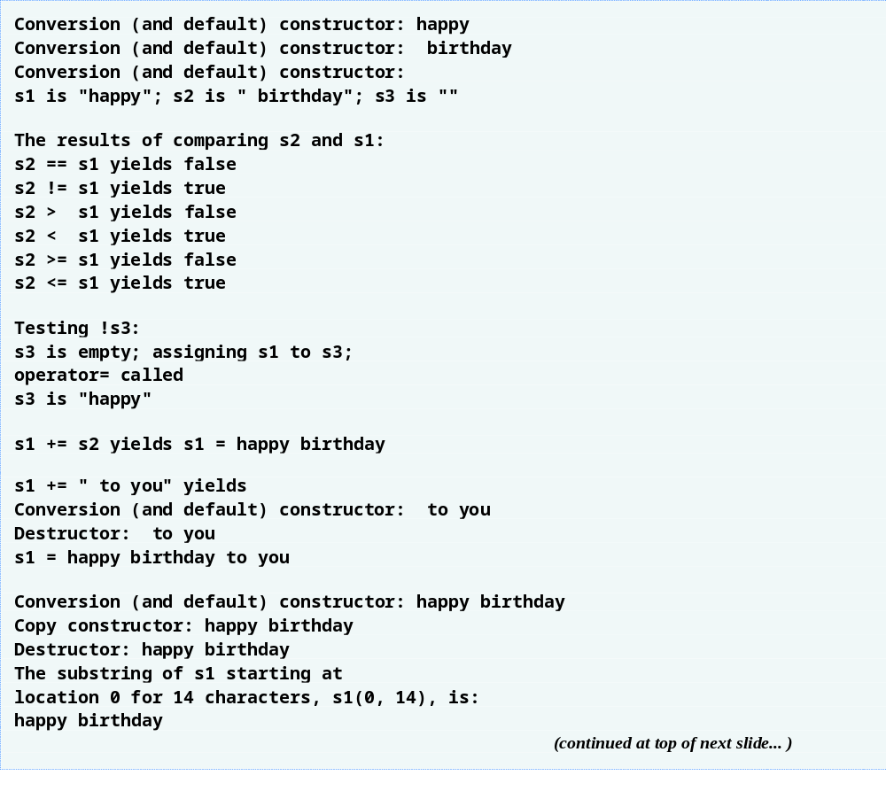
Outline
fig11_11.cpp
(4 of 5)

Slide 58
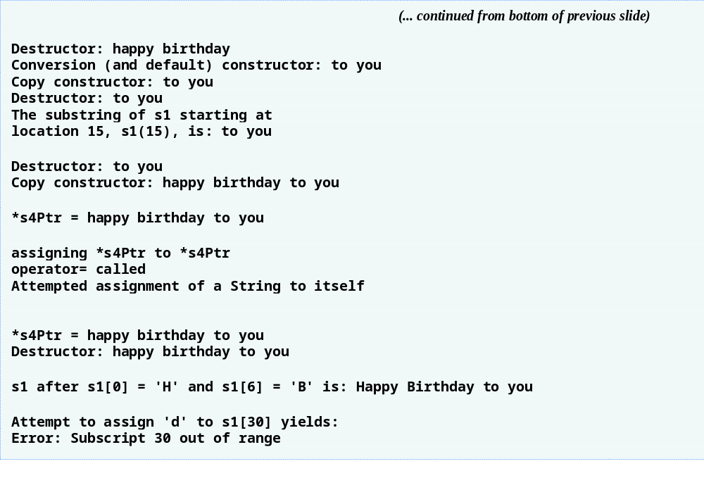
Outline
fig11_11.cpp
(5 of 5)

Slide 59
Software Engineering Observation 11.8
When a conversion constructor is used to perform an implicit conversion, C++ can apply only one implicit constructor call (i.e., a single user-defined conversion) to try to match the needs of another overloaded operator. The compiler will not match an overloaded operator’s needs by performing a series of implicit, user-defined conversions.

Slide 60
Performance Tip 11.2
Overloading the += concatenation operator with an additional version that takes a single argument of type const char * executes more efficiently than having only a version that takes a String argument. Without the const char * version of the += operator, a const char * argument would first be converted to a String object with class String’s conversion constructor, then the += operator that receives a String argument would be called to perform the concatenation.

Slide 61
Software Engineering Observation 11.9
Using implicit conversions with overloaded operators, rather than overloading operators for many different operand types, often requires less code, which makes a class easier to modify, maintain and debug.

Slide 62
Software Engineering Observation 11.10
By implementing member functions using previously defined member functions, the programmer reuses code to reduce the amount of code that must be written and maintained.

Slide 63
Error-Prevention Tip 11.2
Returning a non-const char reference from an overloaded subscript operator in a String class is dangerous. For example, the client could use this reference to insert a null ('\0') anywhere in the string.

Slide 64
Performance Tip 11.3
The extra object that is created by the postfix increment (or decrement) operator can result in a significant performance problem—especially when the operator is used in a loop. For this reason, you should use the postfix increment (or decrement) operator only when the logic of the program requires postincremnting (or postdecrementing).

Slide 65
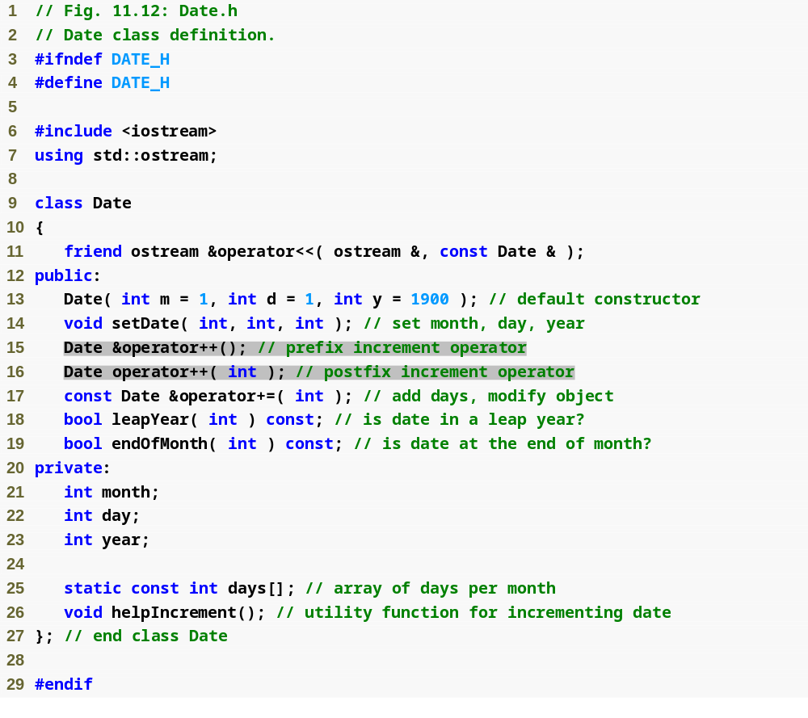
Outline
Date.h
(1 of 1)

Slide 66
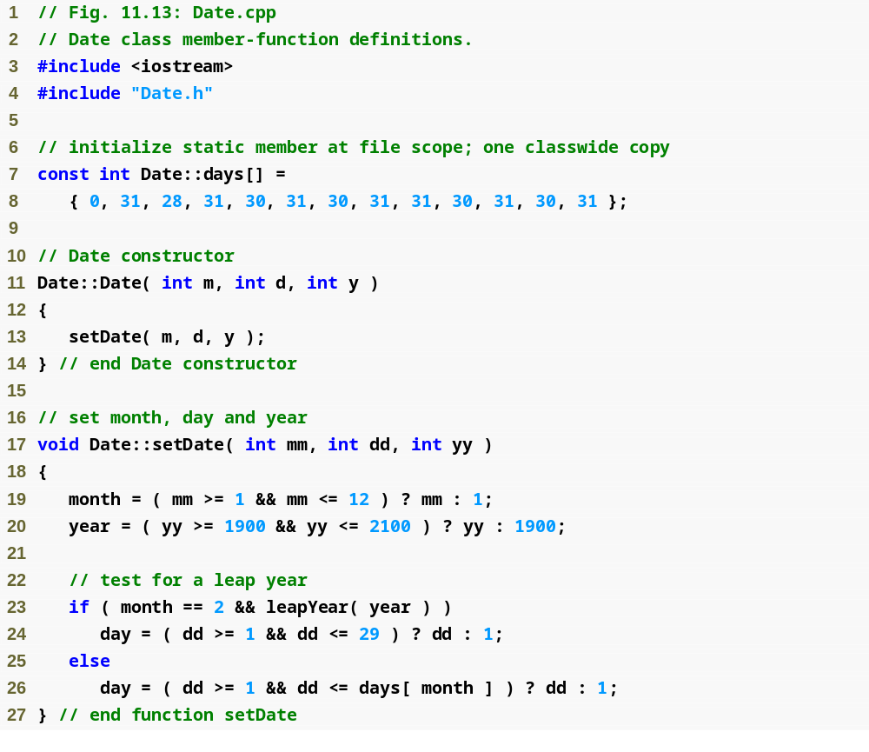
Outline
Date.cpp
(1 of 4)

Slide 67
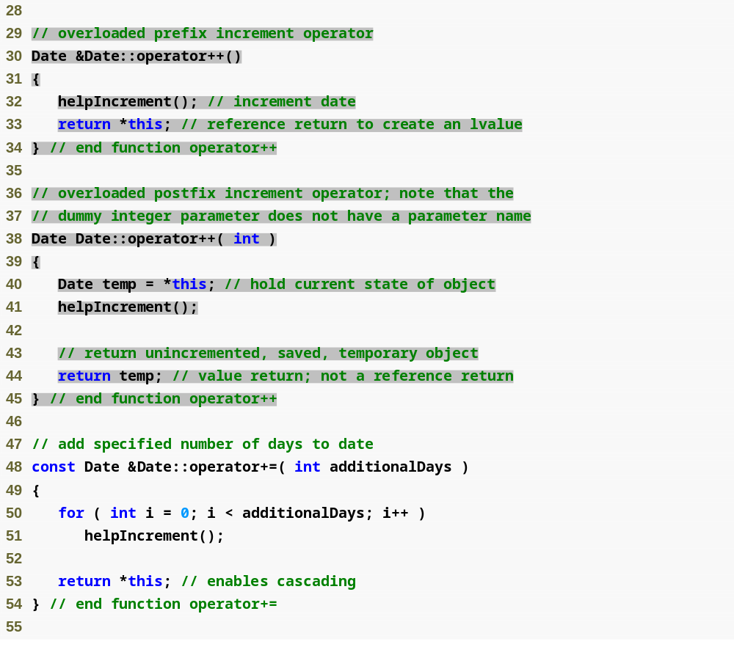
Outline
Date.cpp
(2 of 4)

Slide 68
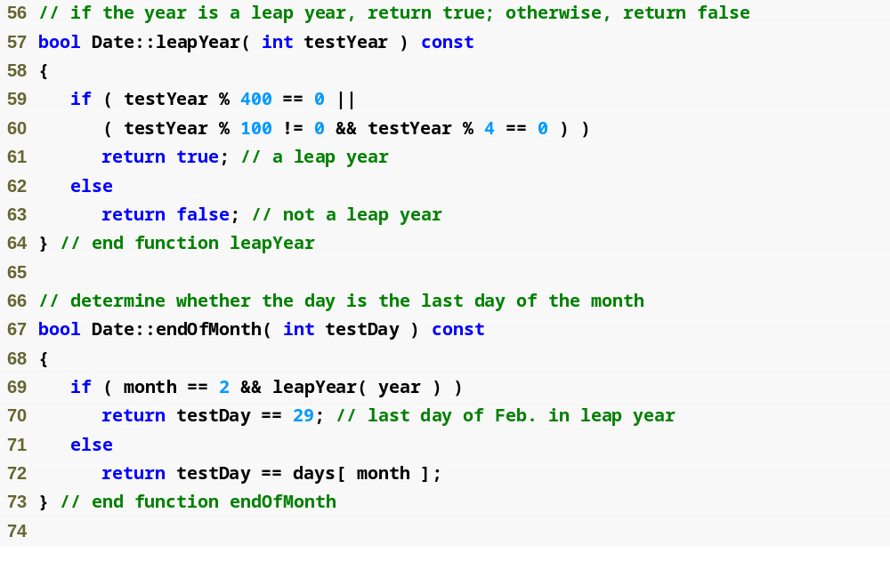
Outline
Date.cpp
(3 of 4)

Slide 69
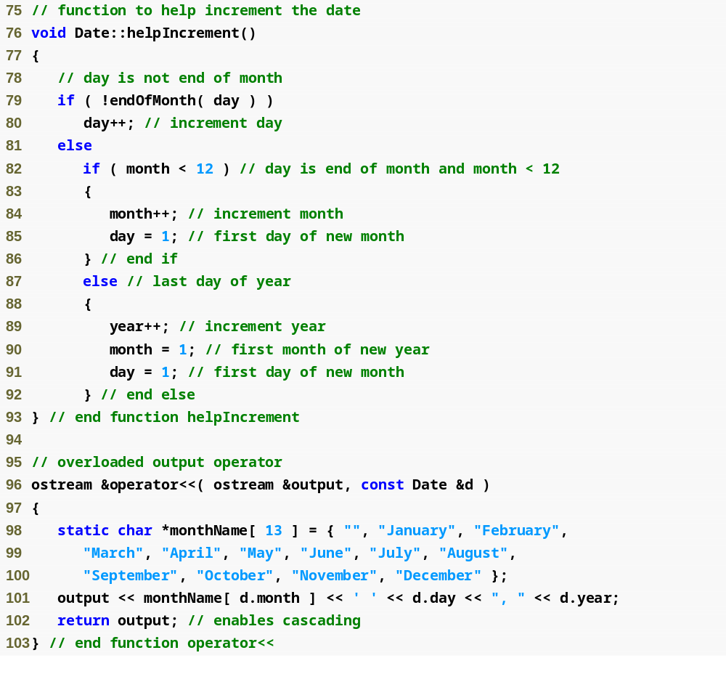
Outline
Date.cpp
(4 of 4)

Slide 70
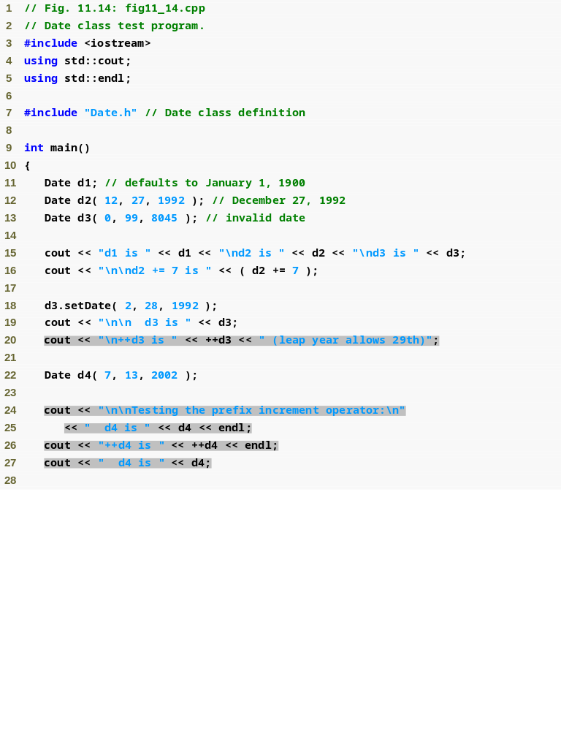
Outline
fig11_14.cpp
(1 of 2)

Slide 71
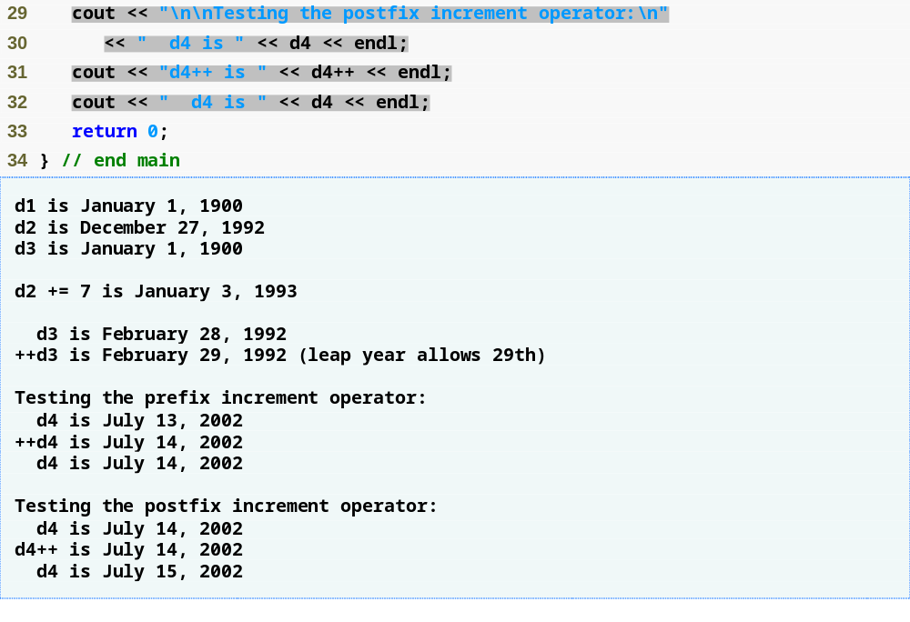
Outline
fig11_14.cpp
(2 of 2)

Slide 72
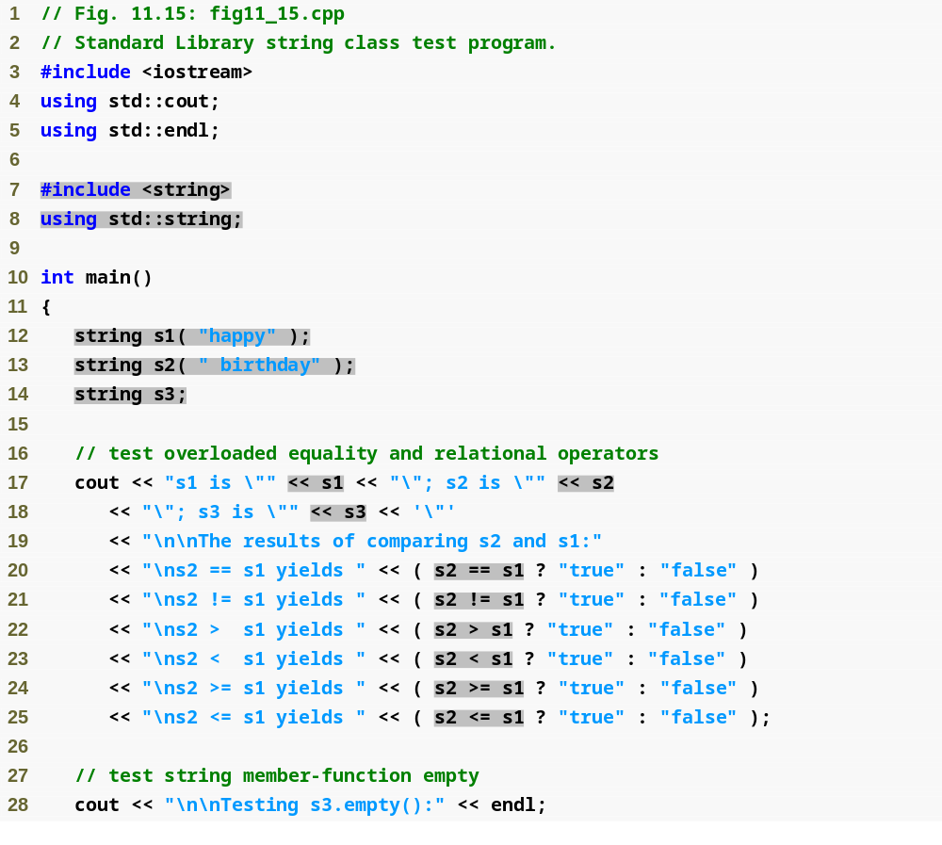
Outline
fig11_15.cpp
(1 of 4)

Slide 73
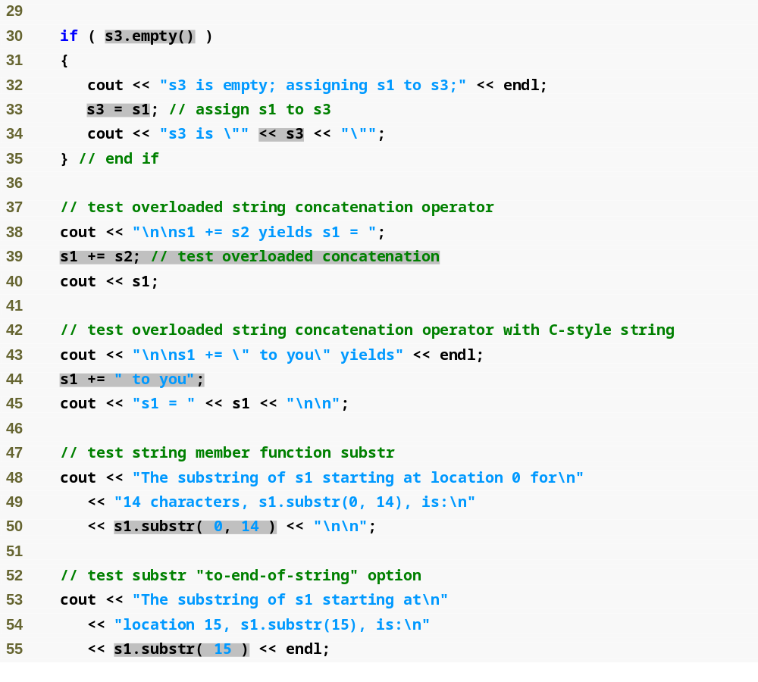
Outline
fig11_15.cpp
(2 of 4)

Slide 74
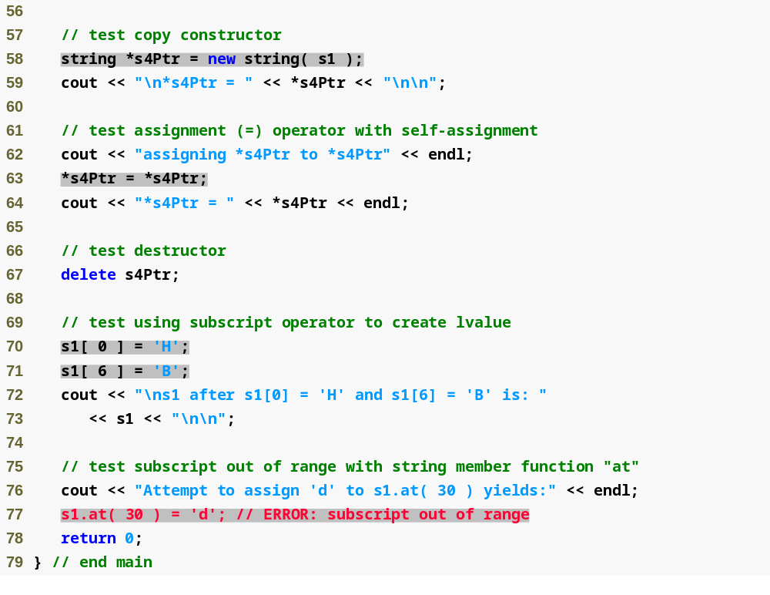
Outline
fig11_15.cpp
(3 of 4)

Slide 75
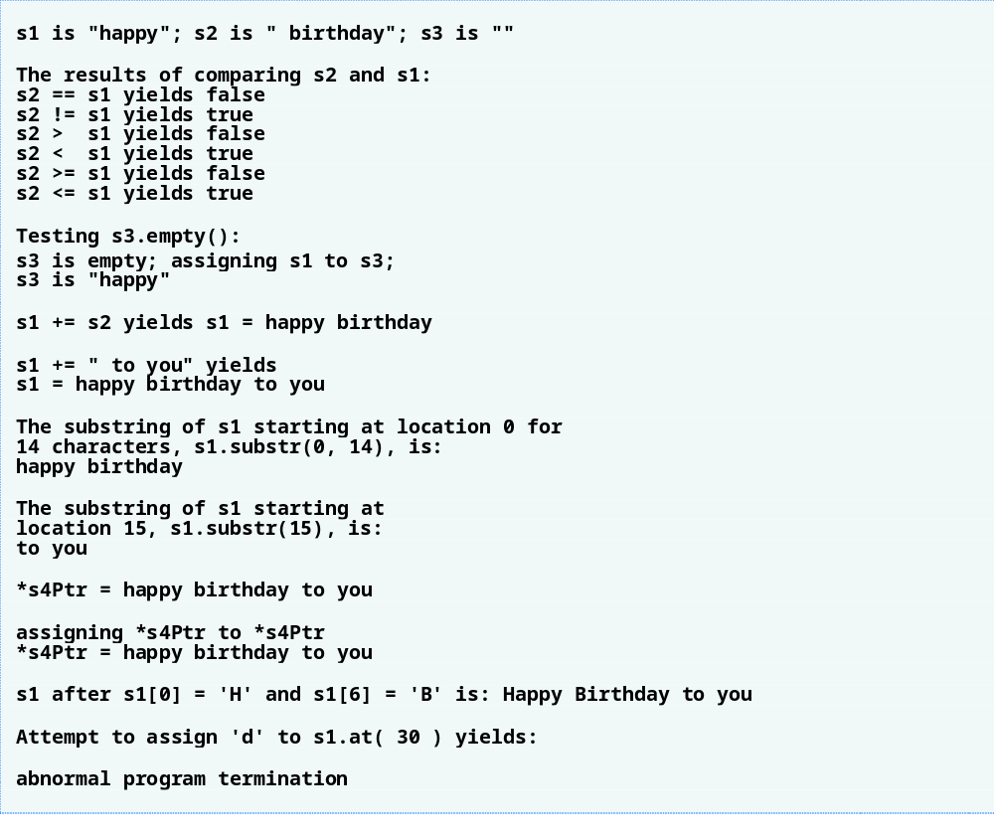
Outline
fig11_15.cpp
(4 of 4)

Slide 76
Common Programming Error 11.9
Unfortunately, the compiler might use implicit conversions in cases that you do not expect, resulting in ambiguous expressions that generate compilation errors or resulting in execution-time logic errors.

Slide 77
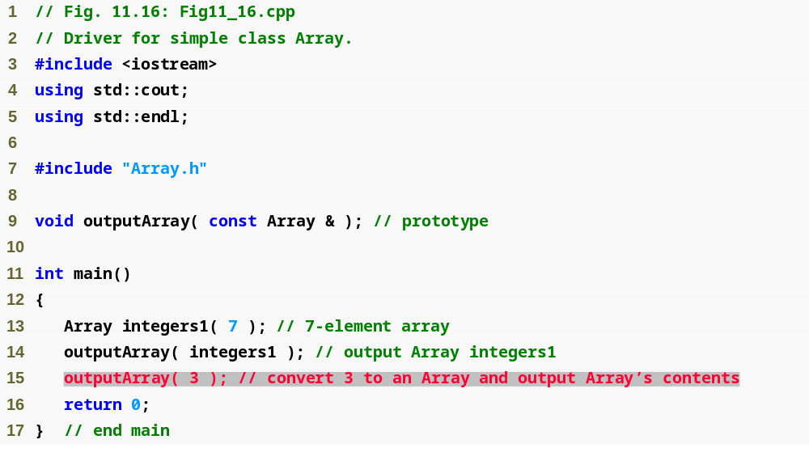
Outline
fig11_16.cpp
(1 of 2)

Slide 78
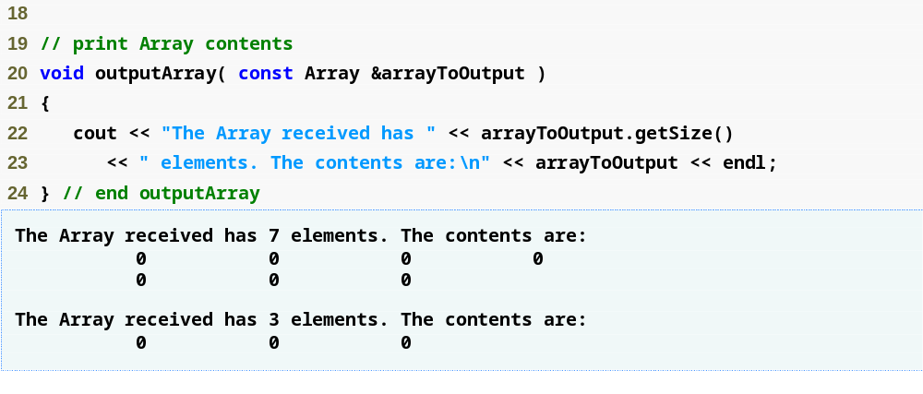
Outline
fig11_16.cpp
(2 of 2)

Slide 79
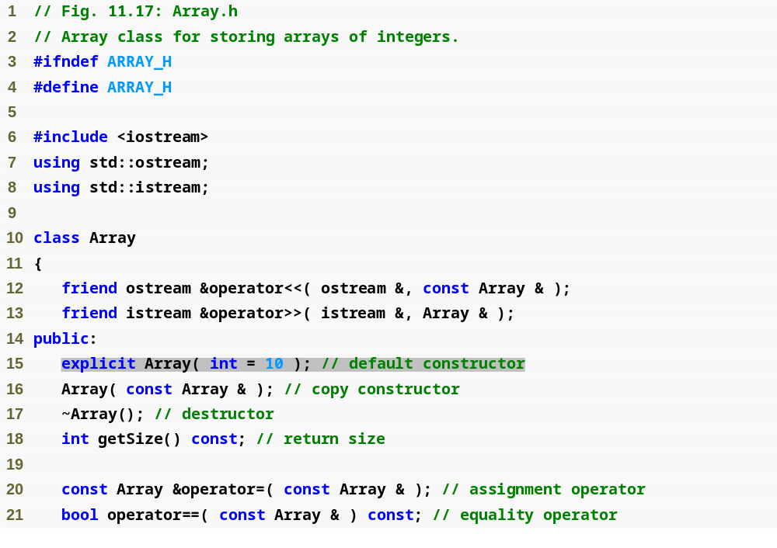
Outline
Array.h
(1 of 1)

Slide 80
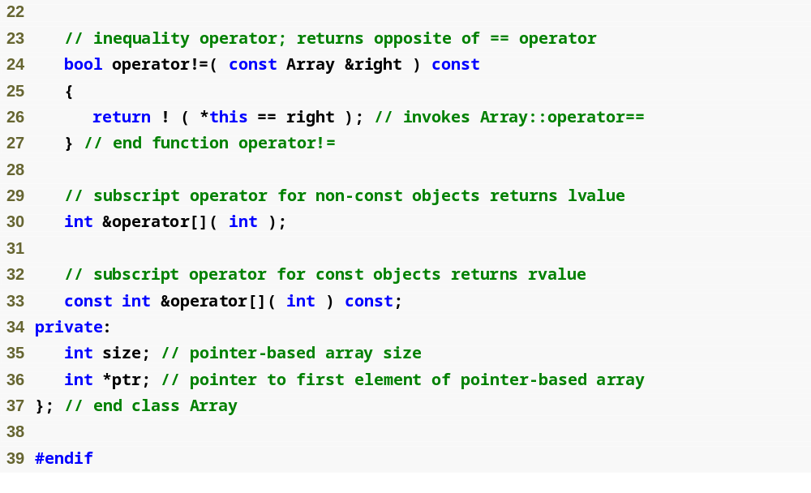
Outline
Array.h
(2 of 2)

Slide 81
Common Programming Error 11.10
Attempting to invoke an explicit constructor for an implicit conversion is a compilation error.

Slide 82
Common Programming Error 11.11
Using the explicit keyword on data members or member functions other than a single-argument constructor is a compilation error.

Slide 83
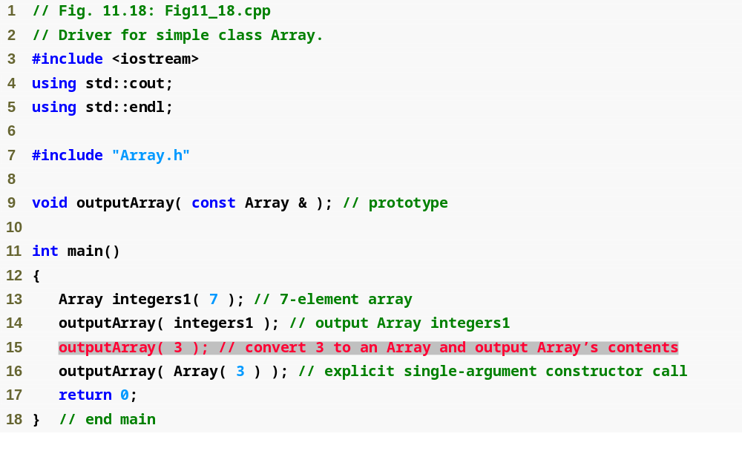
Outline
Fig11_18.cpp
(1 of 2)

Slide 84
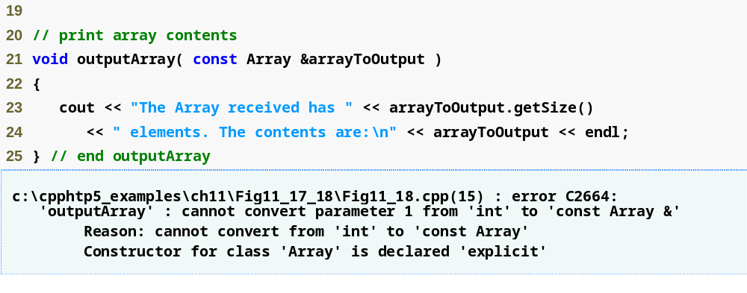
Outline
Fig11_18.cpp
(2 of 2)

Slide 85
Error-Prevention Tip 11.3
Use the explicit keyword on single-argument constructors that should not be used by the compiler to perform implicit conversions.

