Slide 1
8
Pointers and
Pointer-Based
Strings

Slide 2
Addresses are given to us to conceal our whereabouts.
  Saki (H. H. Munro)
By indirection find direction out.
  William Shakespeare
Many things, having full reference
To one consent, may work contrariously.
  William Shakespeare
You will find it a very good practice always to verify your references, sir!
  Dr. Routh

Slide 3
OBJECTIVES
In this chapter you will learn:
What pointers are.
The similarities and differences between pointers and references and when to use each.
To use pointers to pass arguments to functions by reference.
To use pointer-based C-style strings.
The close relationships among pointers, arrays and C-style strings.
To use pointers to functions.
To declare and use arrays of C-style strings.

Slide 4
8.1 Introduction
8.2 Pointer Variable Declarations and Initialization
8.3 Pointer Operators
8.4 Passing Arguments to Functions by Reference with Pointers
8.5 Using const with Pointers
8.6 Selection Sort Using Pass-by-Reference
8.7 sizeof Operators
8.7 Pointer Expressions and Pointer Arithmetic
8.9 Relationship Between Pointers and Arrays
8.10 Arrays of Pointers
8.11 Case Study: Card Shuffling and Dealing Simulation
8.12 Function Pointers
8.13 Introduction to Pointer-Based String Processing
8.13.1 Fundamentals of Characters and Pointer-Based Strings
8.13.2 String Manipulation Functions of the String-Handling Library
8.14 Wrap-Up

Slide 5
Common Programming Error 8.1
Assuming that the * used to declare a pointer distributes to all variable names in a declaration’s comma-separated list of variables can lead to errors. Each pointer must be declared with the * prefixed to the name (either with or without a space in between—the compiler ignores the space). Declaring only one variable per declaration helps avoid these types of errors and improves program readability.

Slide 6
Good Programming Practice 8.1
Although it is not a requirement, including the letters Ptr in pointer variable names makes it clear that these variables are pointers and that they must be handled appropriately.

Slide 7
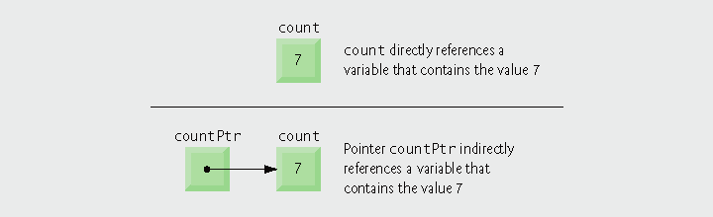
Fig. 8.1 | Directly and indirectly referencing a variable.

Slide 8
Error-Prevention Tip 8.1
Initialize pointers to prevent pointing to unknown or uninitialized areas of memory.

Slide 9

Fig. 8.2 | Graphical representation of a pointer pointing to a variable in memory.

Slide 10

Fig. 8.3 | Representation of y and yPtr in memory.

Slide 11
Common Programming Error 8.2
Dereferencing a pointer that has not been properly initialized or that has not been assigned to point to a specific location in memory could cause a fatal execution-time error, or it could accidentally modify important data and allow the program to run to completion, possibly with incorrect results.

Slide 12
Common Programming Error 8.3
An attempt to dereference a variable that is not a pointer is a compilation error.

Slide 13
Common Programming Error 8.4
Dereferencing a null pointer is normally a fatal execution-time error.

Slide 14
Portability Tip 8.1
The format in which a pointer is output is compiler dependent. Some systems output pointer values as hexadecimal integers, while others use decimal integers.

Slide 15
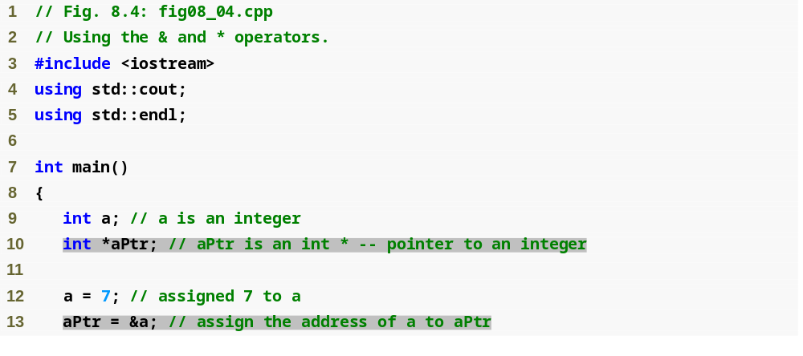
Outline
fig08_04.cpp
(1 of 2)

Slide 16
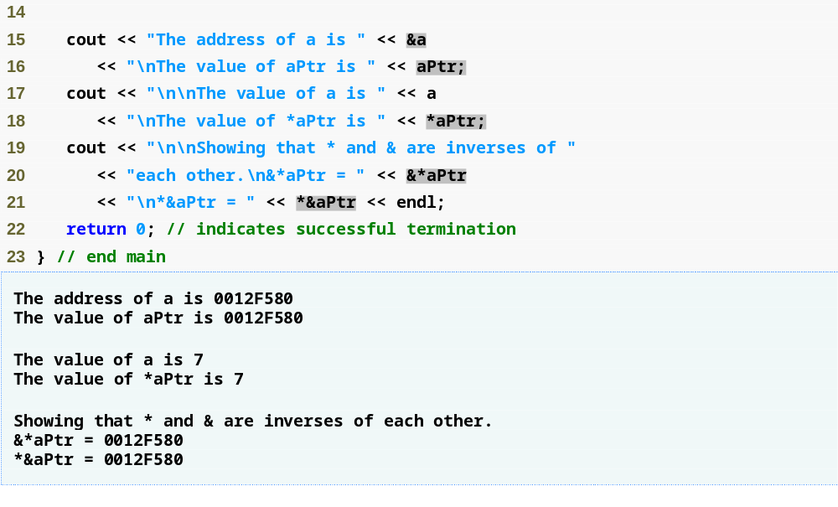
Outline
fig08_04.cpp
(2 of 2)

Slide 17
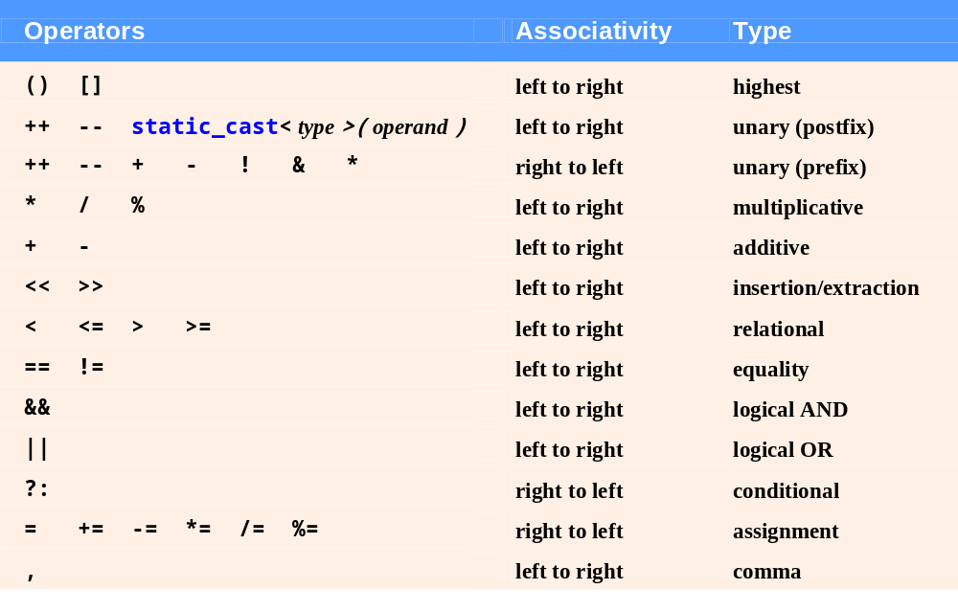
Fig. 8.5 | Operator precedence and associativity.

Slide 18
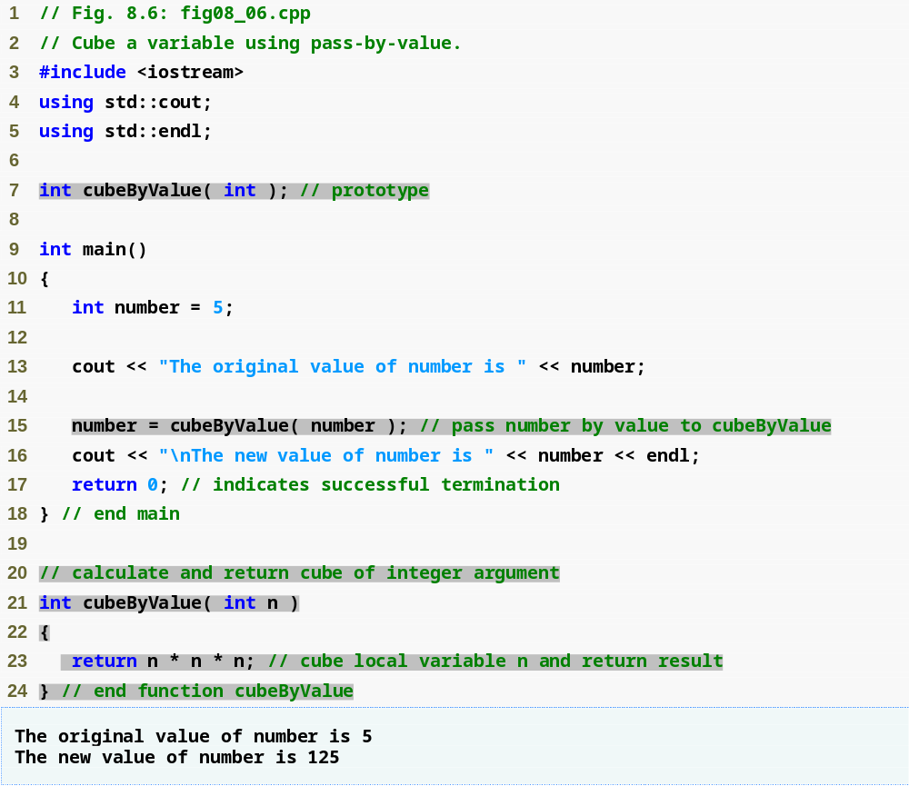
Outline
fig08_06.cpp
(1 of 1)

Slide 19
Common Programming Error 8.5
Not dereferencing a pointer when it is necessary to do so to obtain the value to which the pointer points is an error.

Slide 20
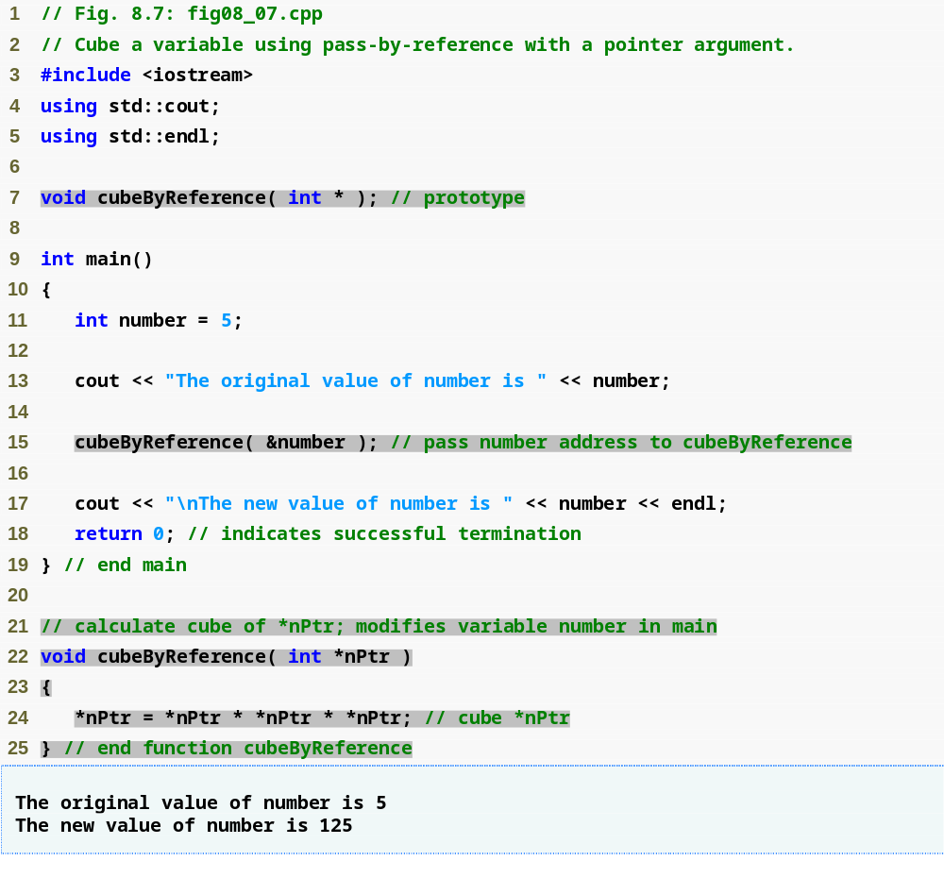
Outline
fig08_07.cpp
(1 of 1)

Slide 21
Software Engineering Observation 8.1
Use pass-by-value to pass arguments to a function unless the caller explicitly requires that the called function directly modify the value of the argument variable in the caller. This is another example of the principle of least privilege.

Slide 22
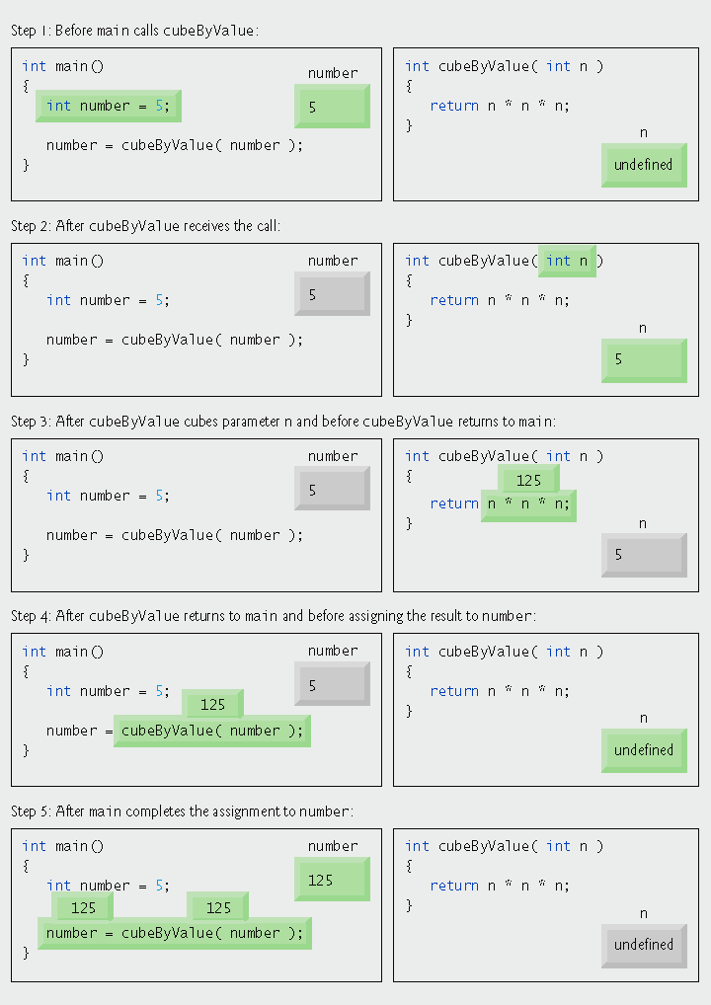
Fig. 8.8 | Pass-by-value analysis of the program of Fig. 8.6.

Slide 23
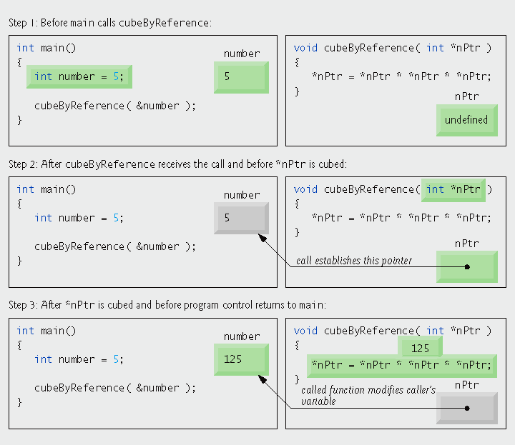
Fig. 8.9 | Pass-by-reference analysis (with a pointer argument) of the program of Fig. 8.7.

Slide 24
Portability Tip 8.2
Although const is well defined in ANSI C and C++, some compilers do not enforce it properly. So a good rule is, “Know your compiler.”

Slide 25
Software Engineering Observation 8.2
If a value does not (or should not) change in the body of a function to which it is passed, the parameter should be declared const to ensure that it is not accidentally modified.

Slide 26
Error-Prevention Tip 8.2
Before using a function, check its function prototype to determine the parameters that it can modify.

Slide 27
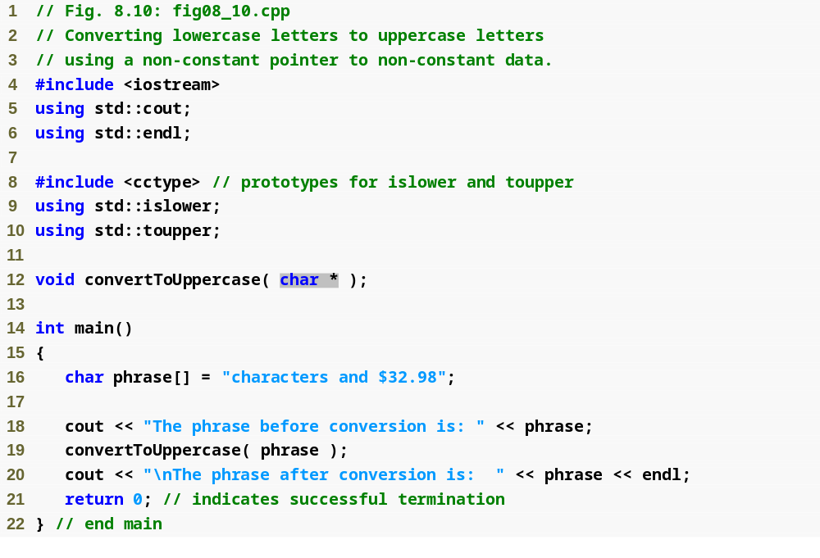
Outline
fig08_10.cpp
(1 of 2)

Slide 28
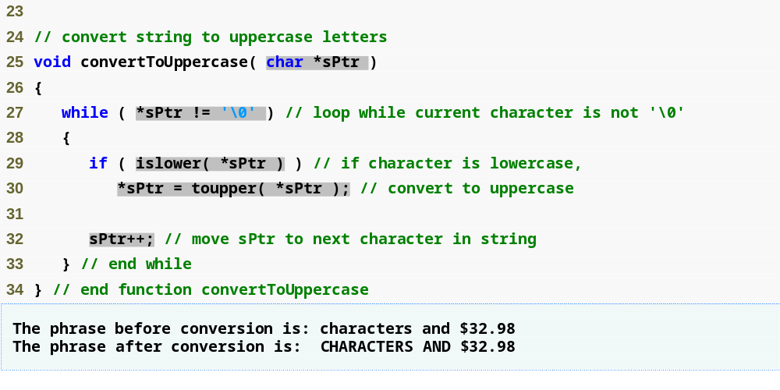
Outline
fig08_10.cpp
(2 of 2)

Slide 29
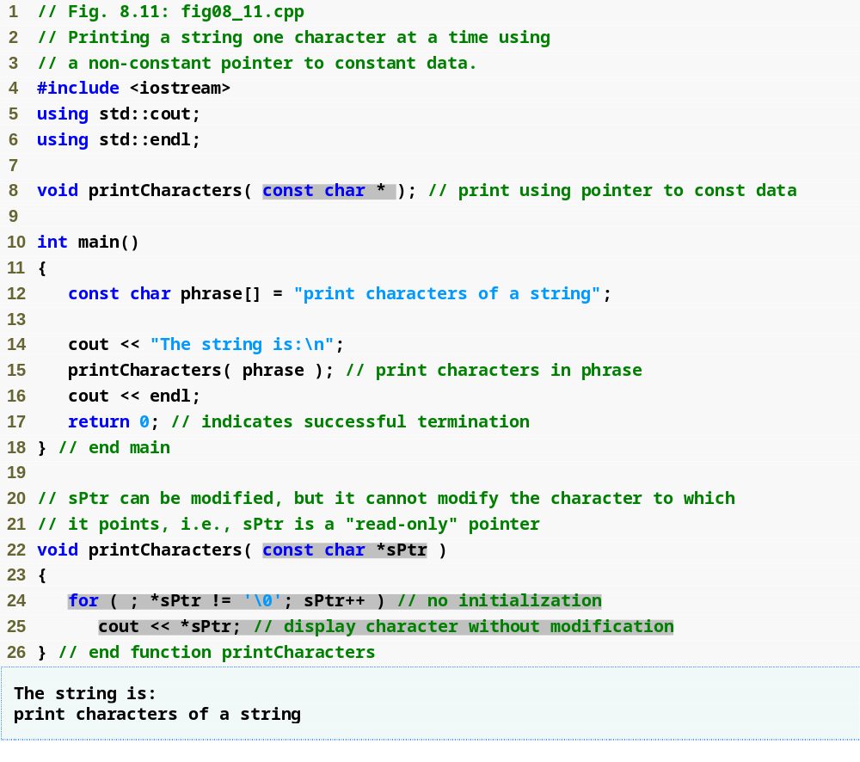
Outline
fig08_11.cpp
(1 of 1)

Slide 30
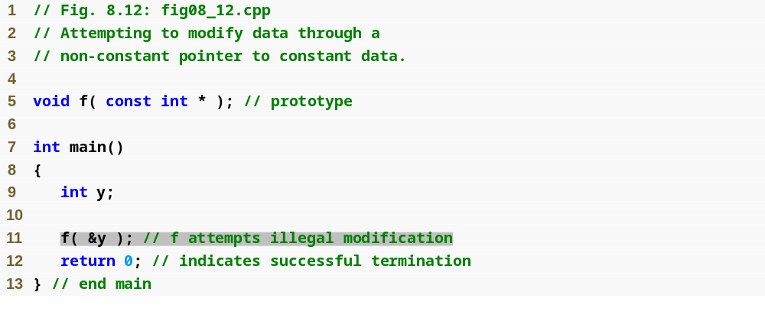
Outline
fig08_12.cpp
(1 of 2)

Slide 31
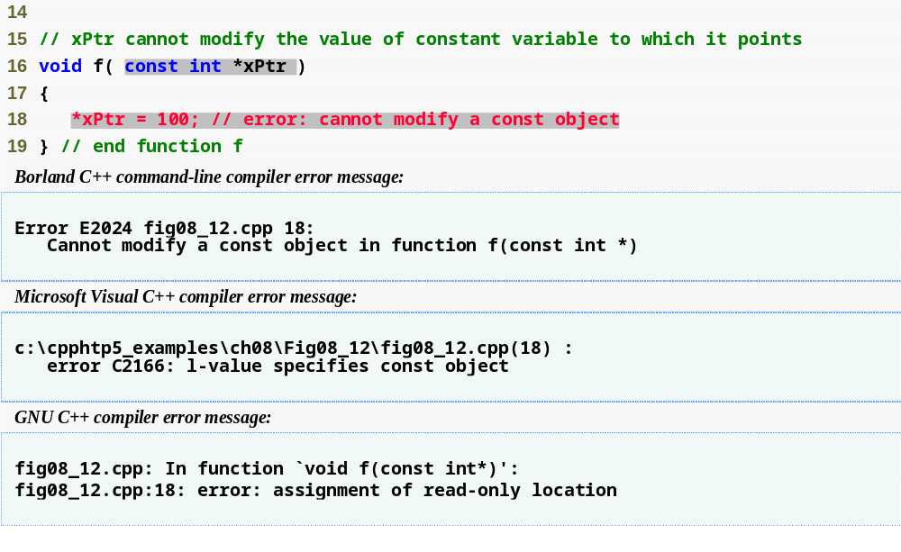
Outline
fig08_12.cpp
(2 of 2)

Slide 32
Performance Tip 8.1
If they do not need to be modified by the called function, pass large objects using pointers to constant data or references to constant data, to obtain the performance benefits of pass-by-reference.

Slide 33
Software Engineering Observation 8.3
Pass large objects using pointers to constant data, or references to constant data, to obtain the security of pass-by-value.

Slide 34
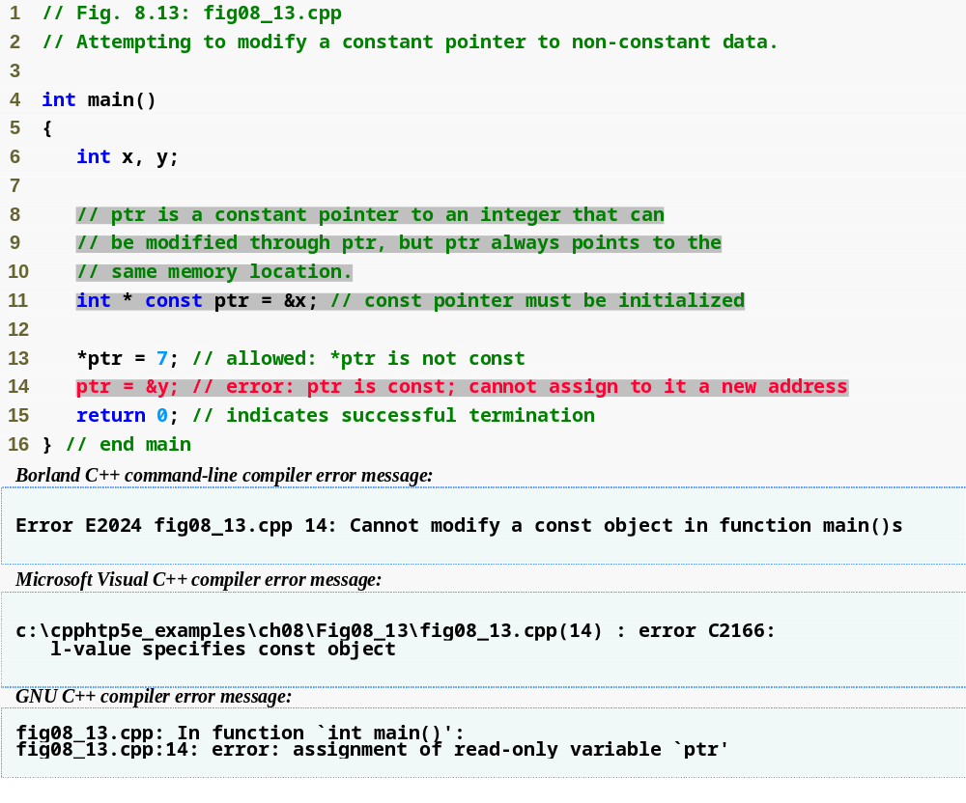
Outline
fig08_13.cpp
(1 of 1)

Slide 35
Common Programming Error 8.6
Not initializing a pointer that is declared const is a compilation error.

Slide 36
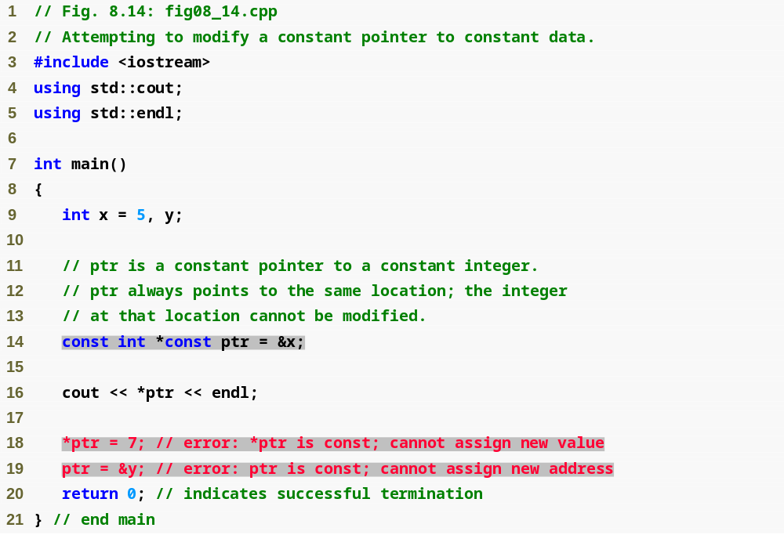
Outline
fig08_14.cpp
(1 of 2)

Slide 37
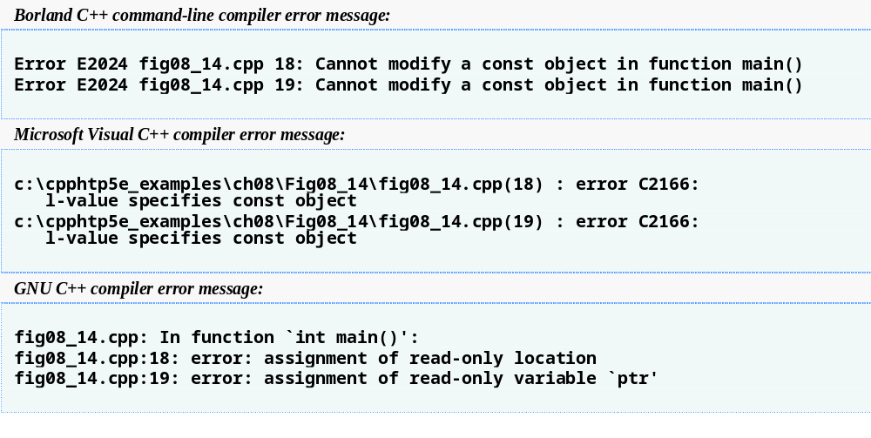
Outline
fig08_14.cpp
(2 of 2)

Slide 38
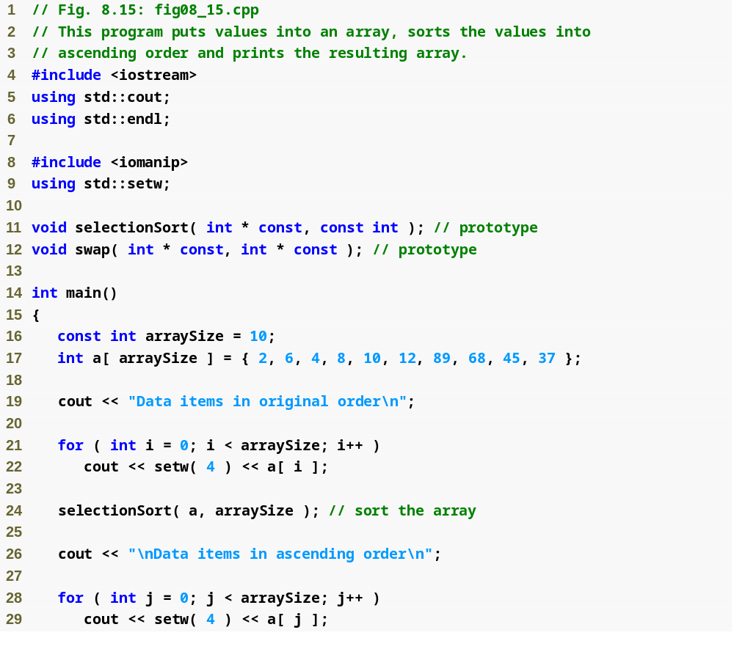
Outline
fig08_15.cpp
(1 of 3)

Slide 39
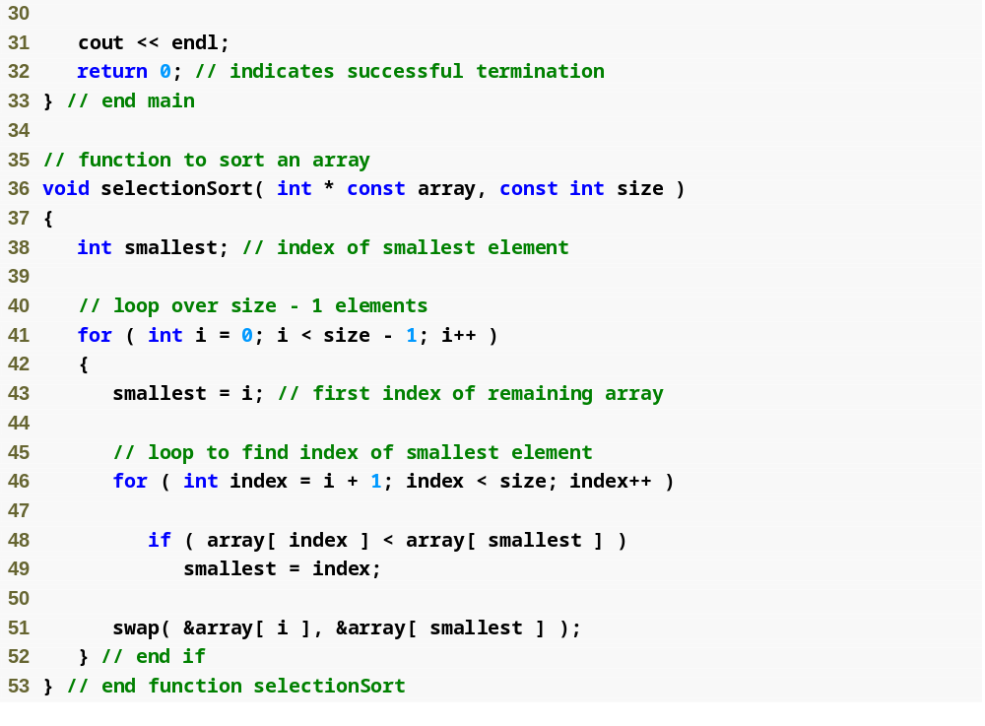
Outline
fig08_15.cpp
(2 of 3)

Slide 40
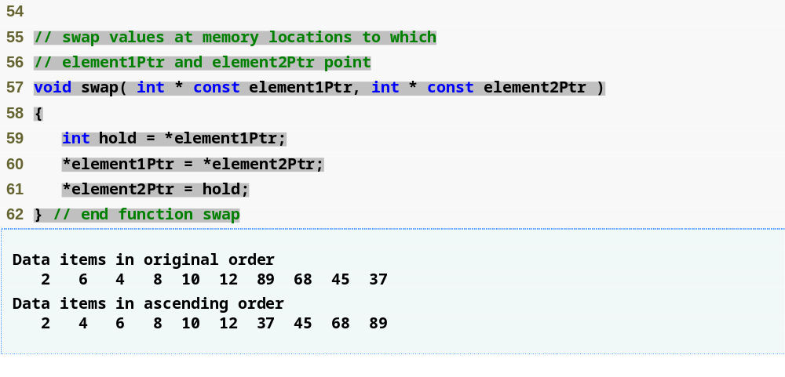
Outline
fig08_15.cpp
(3 of 3)

Slide 41
Software Engineering Observation 8.4
When passing an array to a function, also pass the size of the array (rather than building into the function knowledge of the array size). This makes the function more reusable.

Slide 42
Common Programming Error 8.7
Using the size of operator in a function to find the size in bytes of an array parameter results in the size in bytes of a pointer, not the size in bytes of the array.

Slide 43
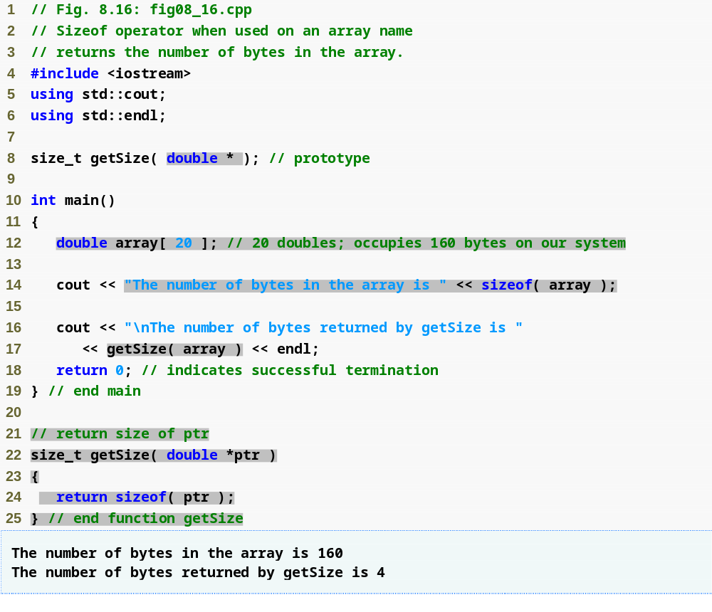
Outline
fig08_16.cpp
(1 of 1)

Slide 44
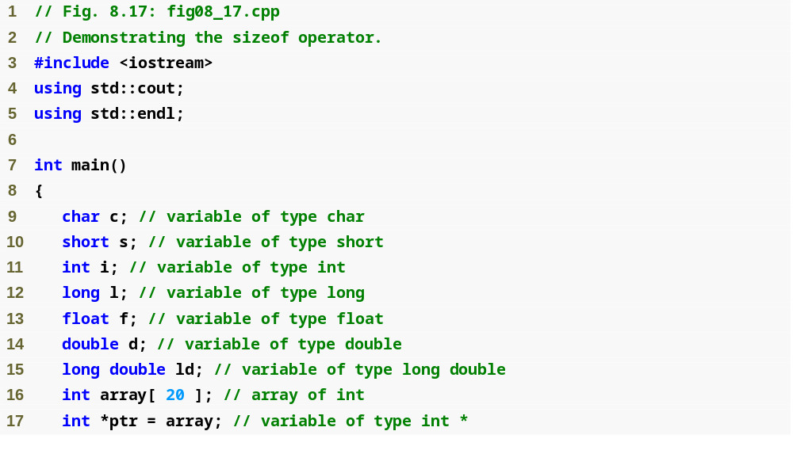
Outline
fig08_17.cpp
(1 of 2)

Slide 45
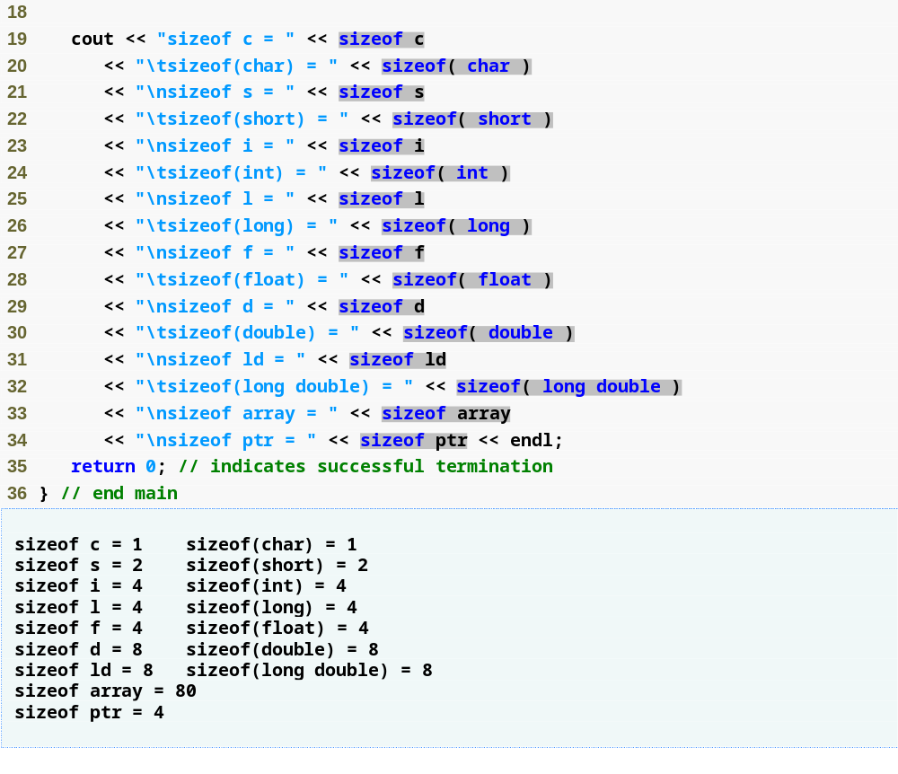
Outline
fig08_17.cpp
(2 of 2)

Slide 46
Portability Tip 8.3
The number of bytes used to store a particular data type may vary between systems. When writing programs that depend on data type sizes, and that will run on several computer systems, use sizeof to determine the number of bytes used to store the data types.

Slide 47
Common Programming Error 8.8
Omitting the parentheses in a sizeof operation when the operand is a type name is a compilation error.

Slide 48
Performance Tip 8.2
Because sizeof is a compile-time unary operator, not an execution-time operator, using sizeof does not negatively impact execution performance.

Slide 49
Error-Prevention Tip 8.3
To avoid errors associated with omitting the parentheses around the operand of operator sizeof, many programmers include parentheses around every sizeof operand.

Slide 50
Portability Tip 8.4
Most computers today have two-byte or four-byte integers. Some of the newer machines use eight-byte integers. Because the results of pointer arithmetic depend on the size of the objects a pointer points to, pointer arithmetic is machine dependent.

Slide 51
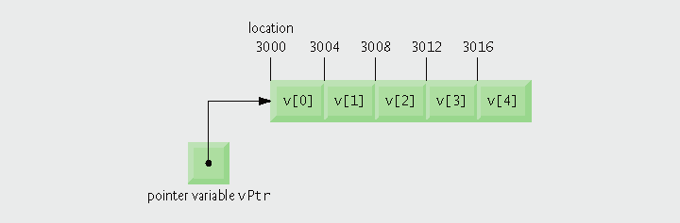
Fig. 8.18 | Array v and a pointer variable vPtr that points to v.

Slide 52
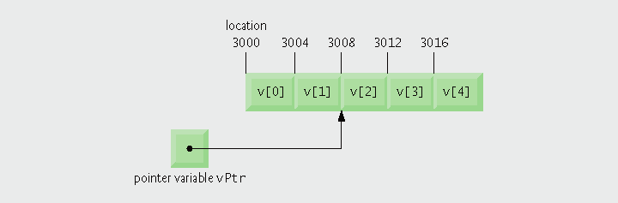
Fig. 8.19 | Pointer vPtr after pointer arithmetic.

Slide 53
Common Programming Error 8.9
Using pointer arithmetic on a pointer that does not refer to an array of values is a logic error.

Slide 54
Common Programming Error 8.10
Subtracting or comparing two pointers that do not refer to elements of the same array is a logic error.

Slide 55
Common Programming Error 8.11
Using pointer arithmetic to increment or decrement a pointer such that the pointer refers to an element past the end of the array or before the beginning of the array is normally a logic error.

Slide 56
Software Engineering Observation 8.5
Nonconstant pointer arguments can be passed to constant pointer parameters. This is helpful when the body of a program uses a nonconstant pointer to access data, but does not want that data to be modified by a function called in the body of the program.

Slide 57
Common Programming Error 8.12
Assigning a pointer of one type to a pointer of another (other than void *) without casting the first pointer to the type of the second pointer is a compilation error.

Slide 58
Common Programming Error 8.13
All operations on a void * pointer are compilation errors, except comparing void * pointers with other pointers, casting void * pointers to valid pointer types and assigning addresses to void * pointers.

Slide 59
Common Programming Error 8.14
Although array names are pointers to the beginning of the array and pointers can be modified in arithmetic expressions, array names cannot be modified in arithmetic expressions, because array names are constant pointers.

Slide 60
Good Programming Practice 8.2
For clarity, use array notation instead of pointer notation when manipulating arrays.

Slide 61
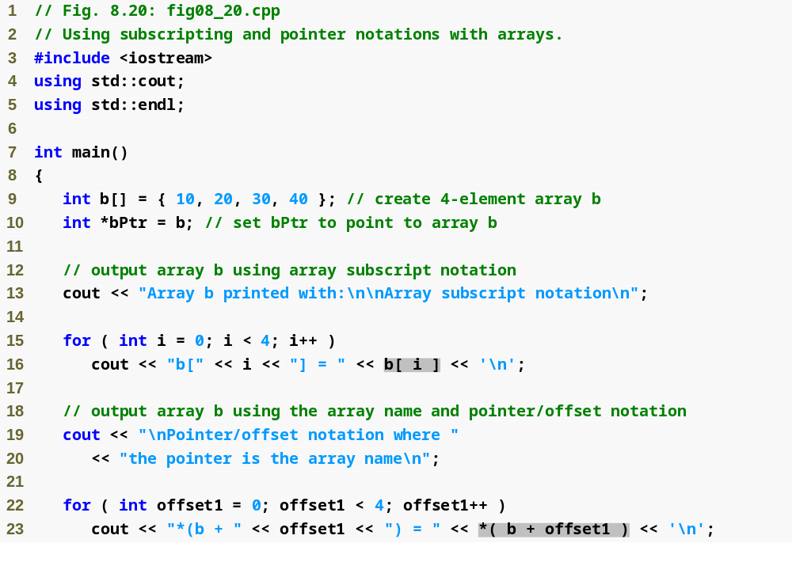
Outline
fig08_20.cpp
(1 of 3)

Slide 62
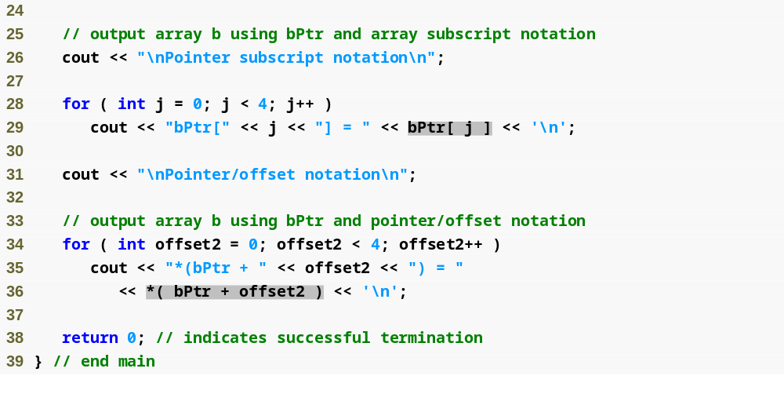
Outline
fig08_20.cpp
(2 of 3)

Slide 63
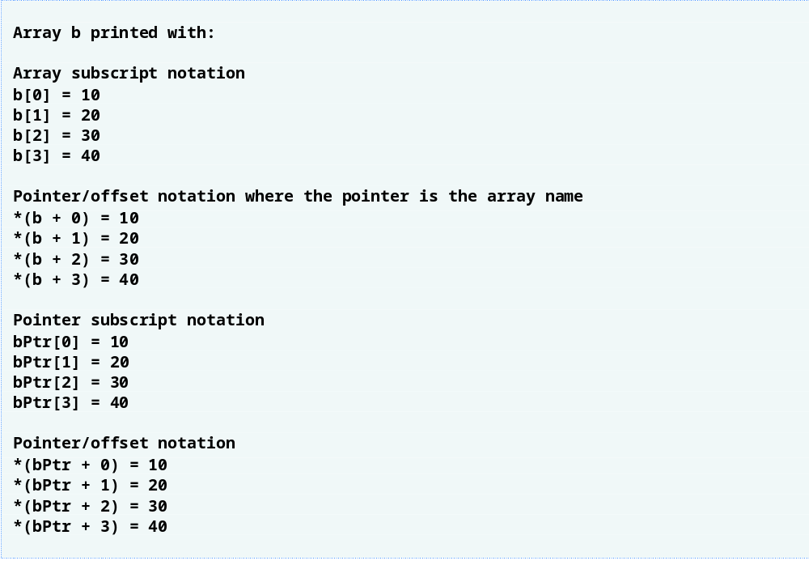
Outline
fig08_20.cpp
(3 of 3)

Slide 64
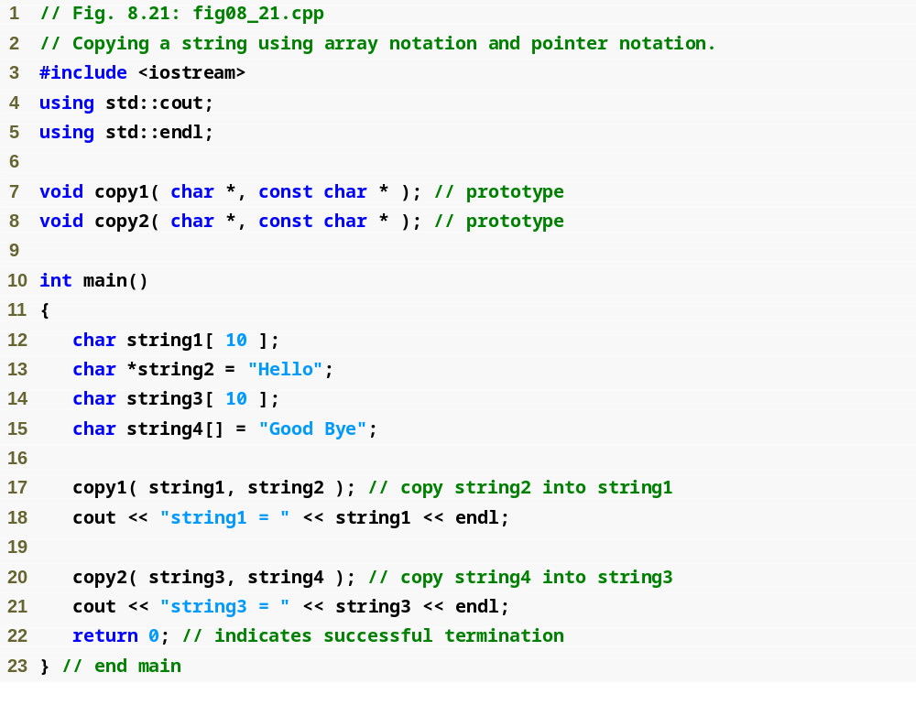
Outline
fig08_21.cpp
(1 of 2)

Slide 65
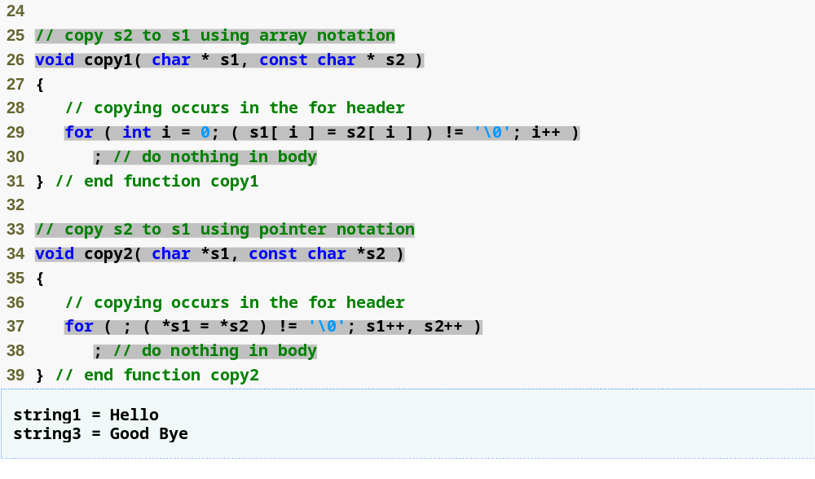
Outline
fig08_21.cpp
(2 of 2)

Slide 66
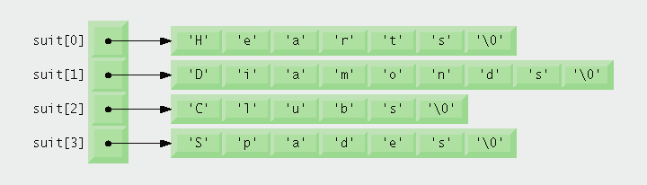
Fig. 8.22 | Graphical representation of the suit array.

Slide 67
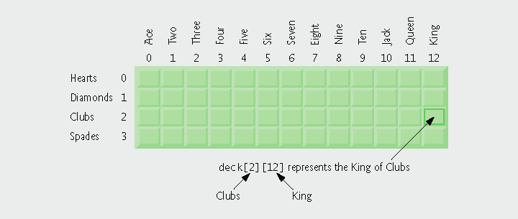
Fig. 8.23 | Two-dimensional array representation of a deck of cards.

Slide 68
Performance Tip 8.3
Sometimes algorithms that emerge in a “natural” way can contain subtle performance problems such as indefinite postponement. Seek algorithms that avoid indefinite postponement.

Slide 69
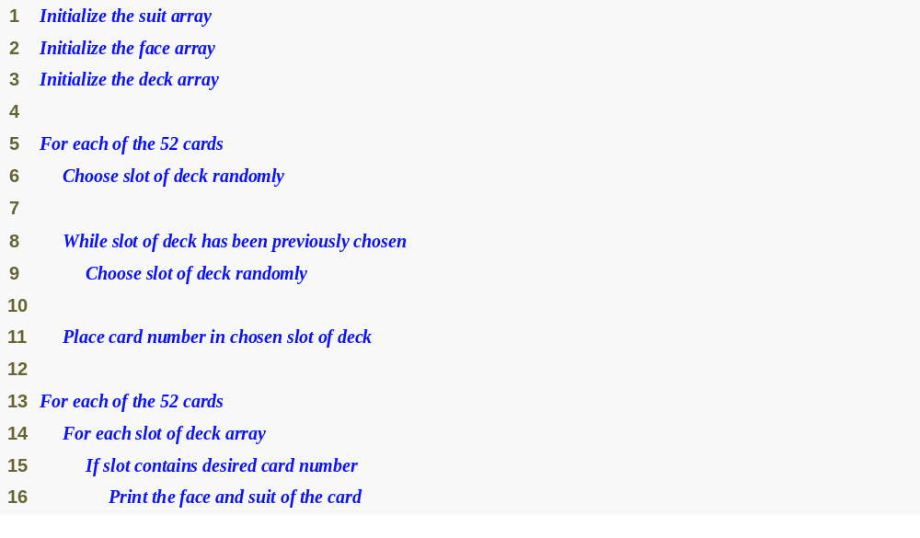
Outline
fig08_24.cpp
(1 of 1)

Slide 70
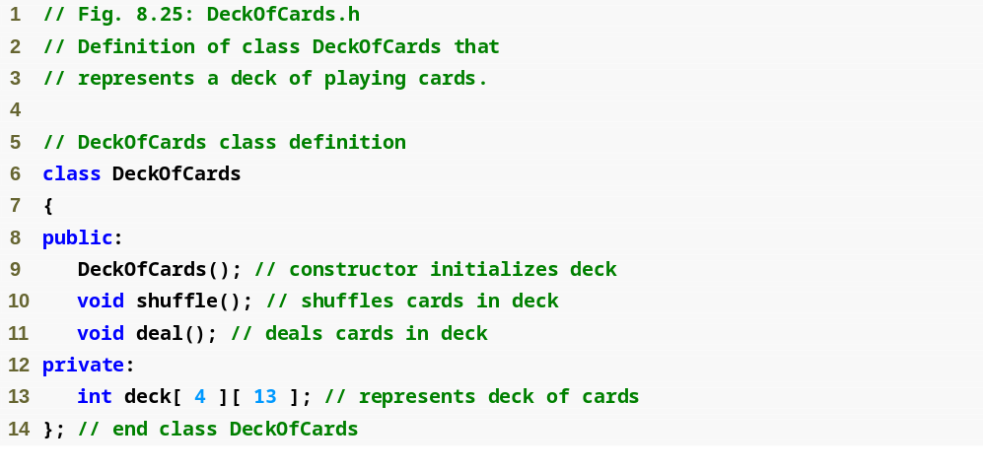
Outline
fig08_25.cpp
(1 of 1)

Slide 71
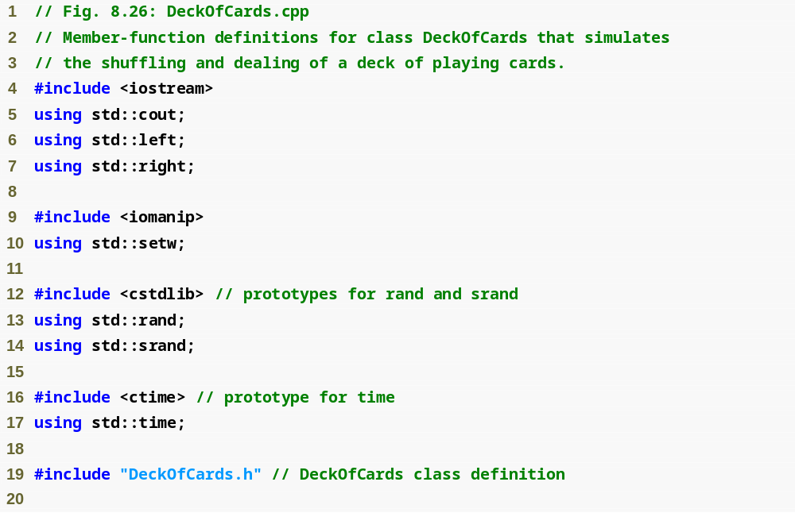
Outline
fig08_26.cpp
(1 of 4)

Slide 72
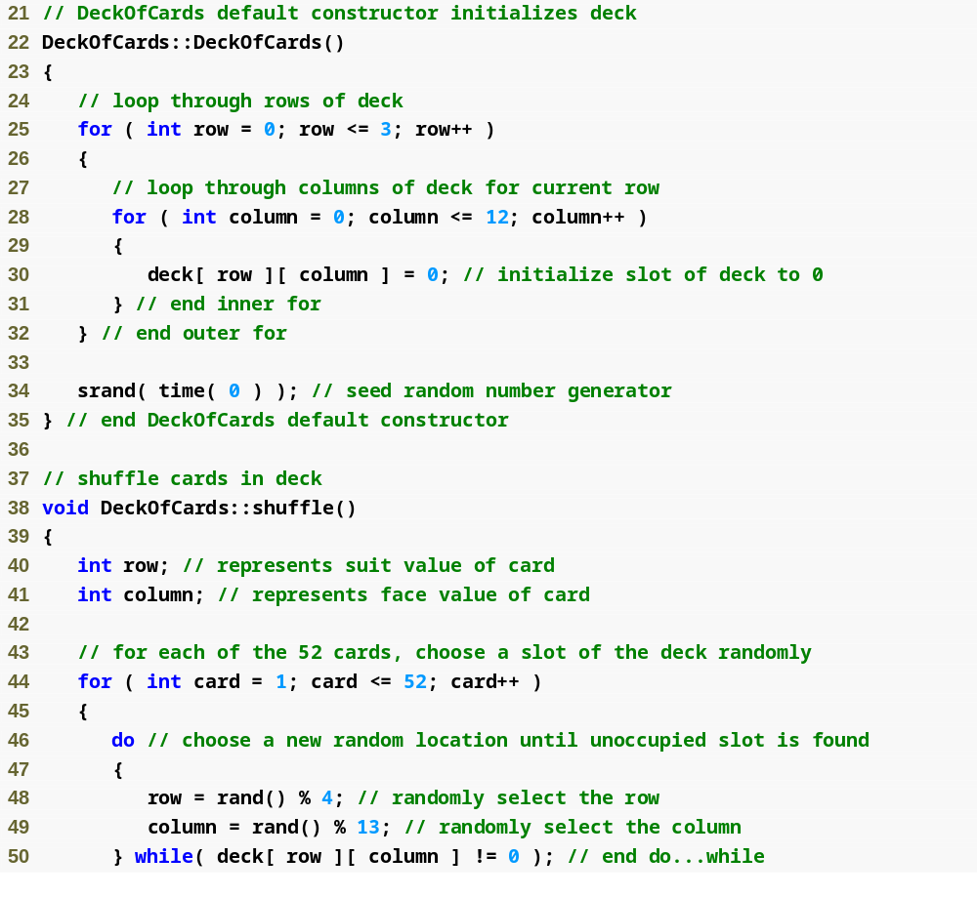
Outline
fig08_26.cpp
(2 of 4)

Slide 73
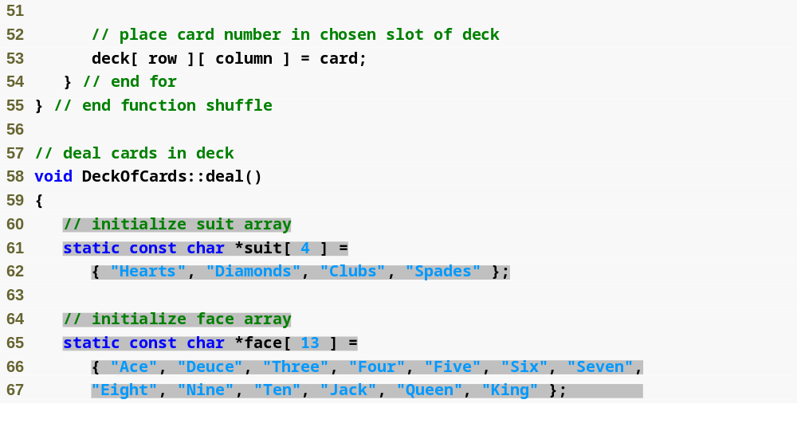
Outline
fig08_26.cpp
(3 of 4)

Slide 74
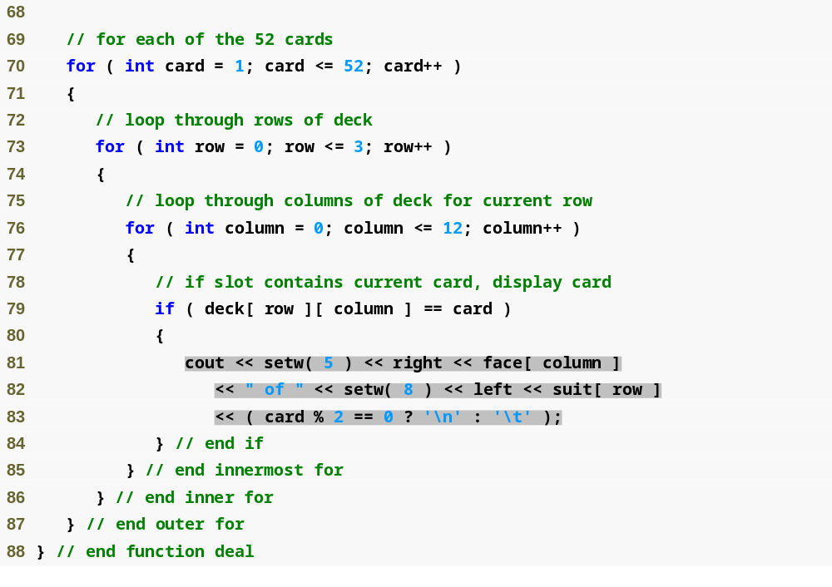
Outline
fig08_26.cpp
(4 of 4)

Slide 75
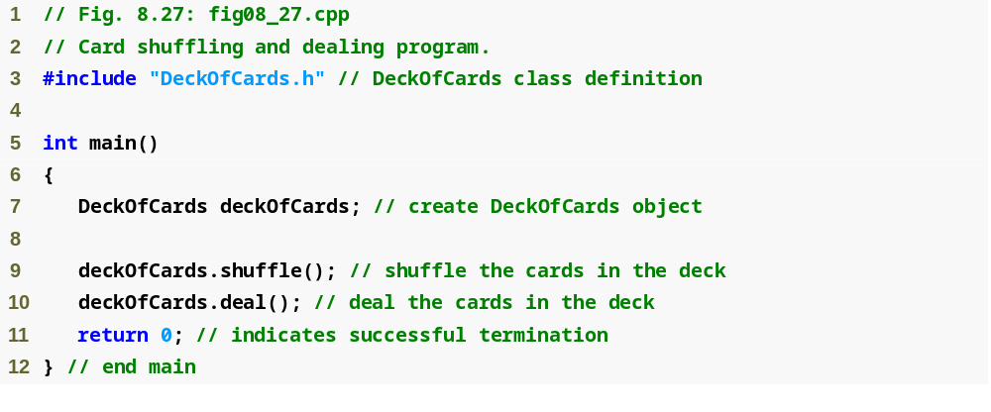
Outline
fig08_27.cpp
(1 of 2)

Slide 76
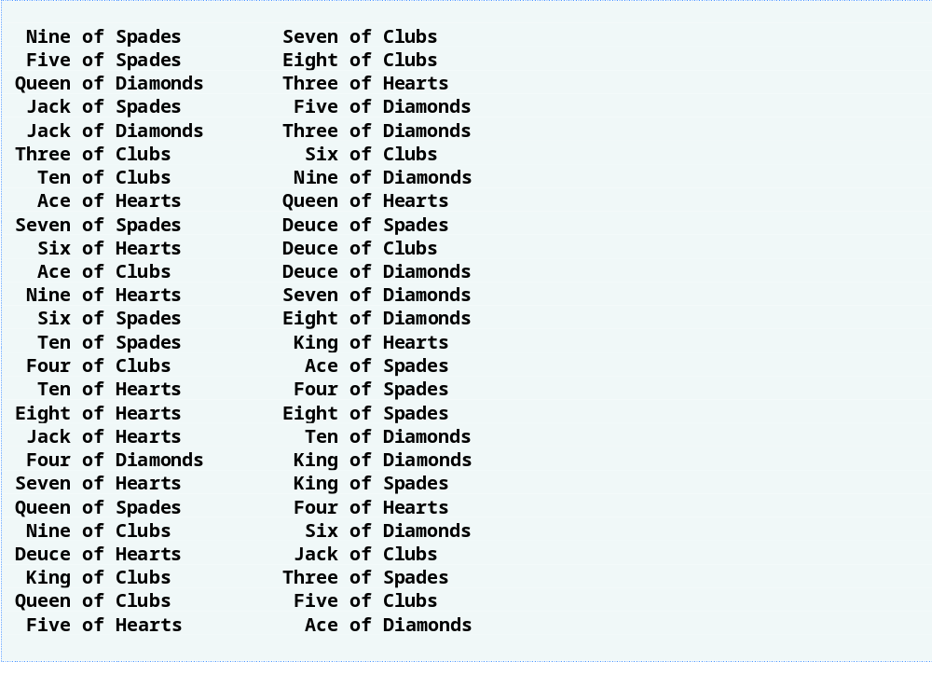
Outline
fig08_27.cpp
(2 of 2)

Slide 77
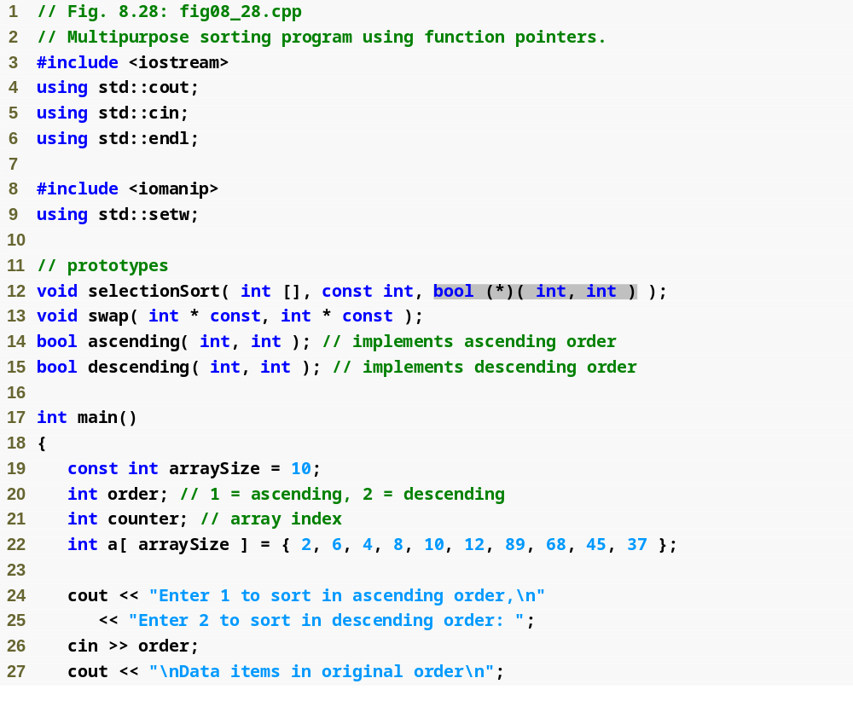
Outline
fig08_28.cpp
(1 of 4)

Slide 78
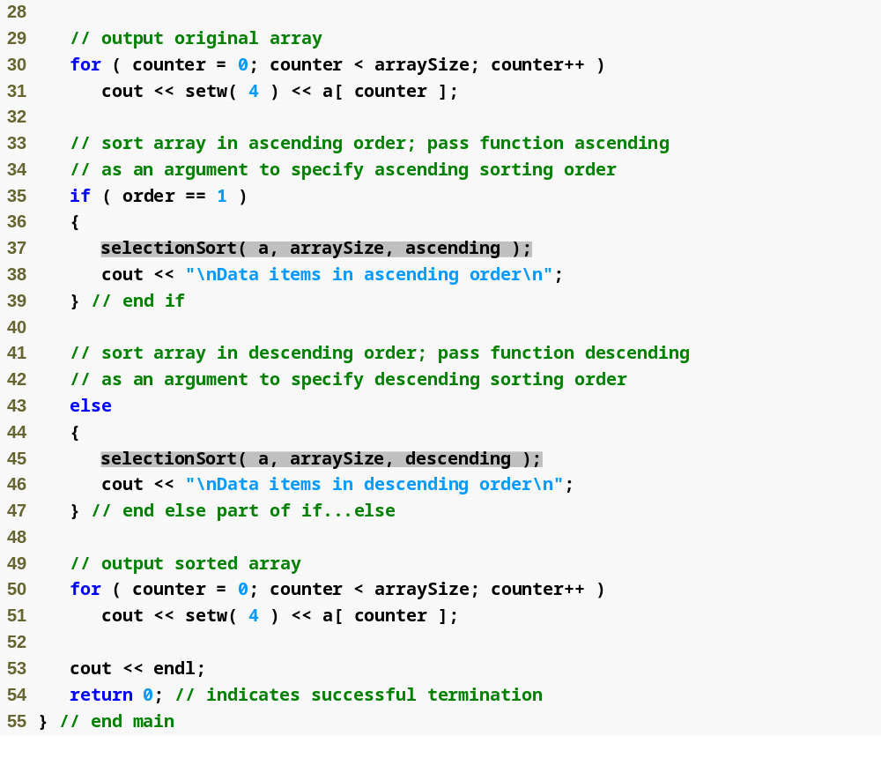
Outline
fig08_28.cpp
(2 of 4)

Slide 79
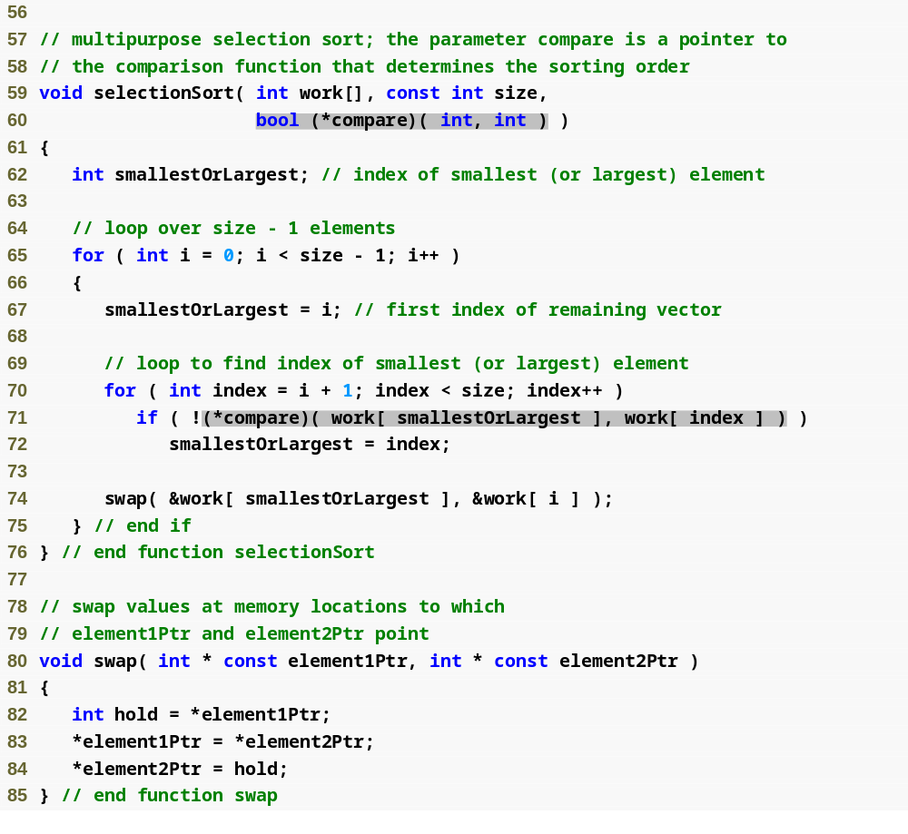
Outline
fig08_28.cpp
(3 of 4)

Slide 80
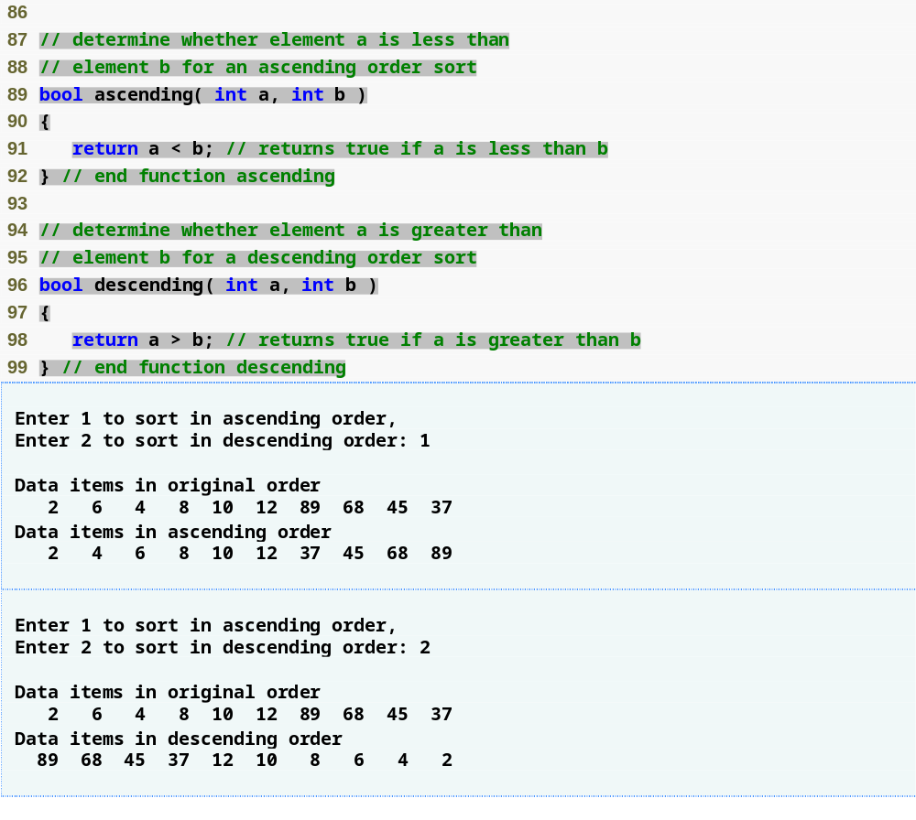
Outline
fig08_28.cpp
(4 of 4)

Slide 81
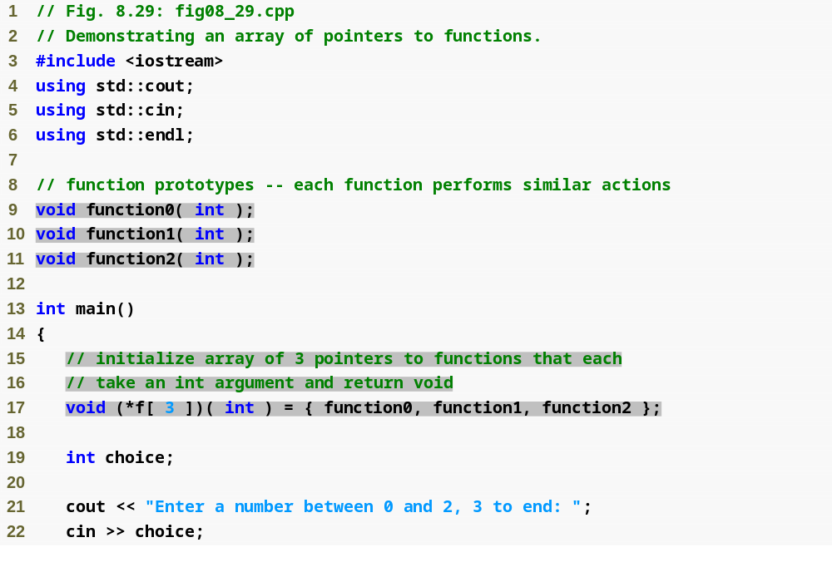
Outline
fig08_29.cpp
(1 of 3)

Slide 82
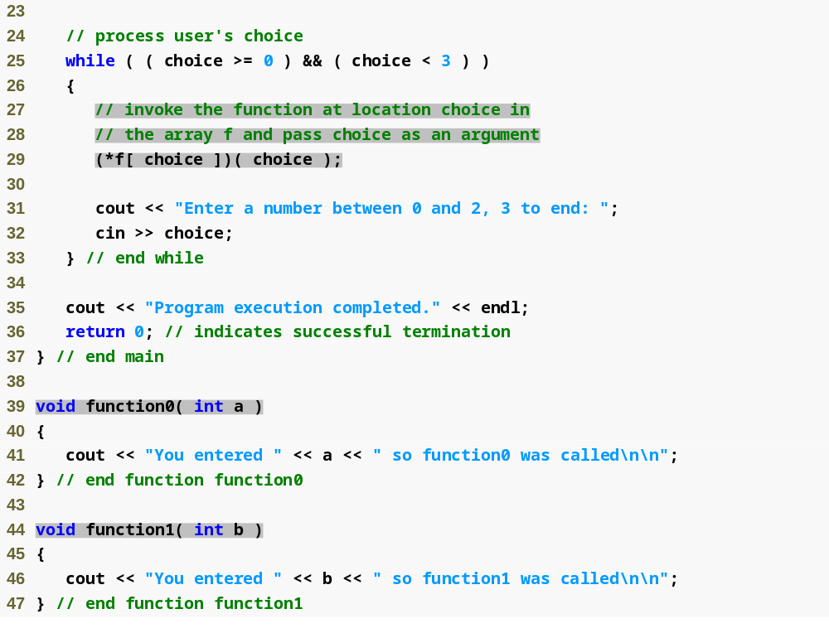
Outline
fig08_29.cpp
(2 of 3)

Slide 83
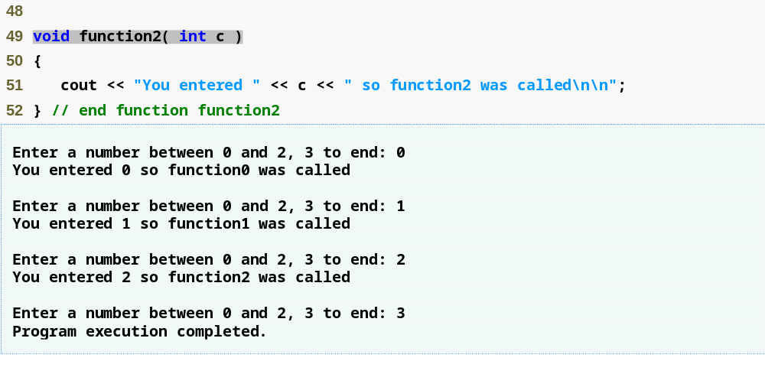
Outline
fig08_29.cpp
(3 of 3)

Slide 84
Common Programming Error 8.15
Not allocating sufficient space in a character array to store the null character that terminates a string is an error.

Slide 85
Common Programming Error 8.16
Creating or using a C-style string that does not contain a terminating null character can lead to logic errors.

Slide 86
Error-Prevention Tip 8.4
When storing a string of characters in a character array, be sure that the array is large enough to hold the largest string that will be stored. C++ allows strings of any length to be stored. If a string is longer than the character array in which it is to be stored, characters beyond the end of the array will overwrite data in memory following the array, leading to logic errors.

Slide 87
Common Programming Error 8.17
Processing a single character as a char * string can lead to a fatal runtime error. A char * string is a pointer—probably a respectably large integer. However, a character is a small integer (ASCII values range 0–255). On many systems, dereferencing a char value causes an error, because low memory addresses are reserved for special purposes such as operating system interrupt handlers—so “memory access violations” occur.

Slide 88
Common Programming Error 8.18
Passing a string as an argument to a function when a character is expected is a compilation error.

Slide 89
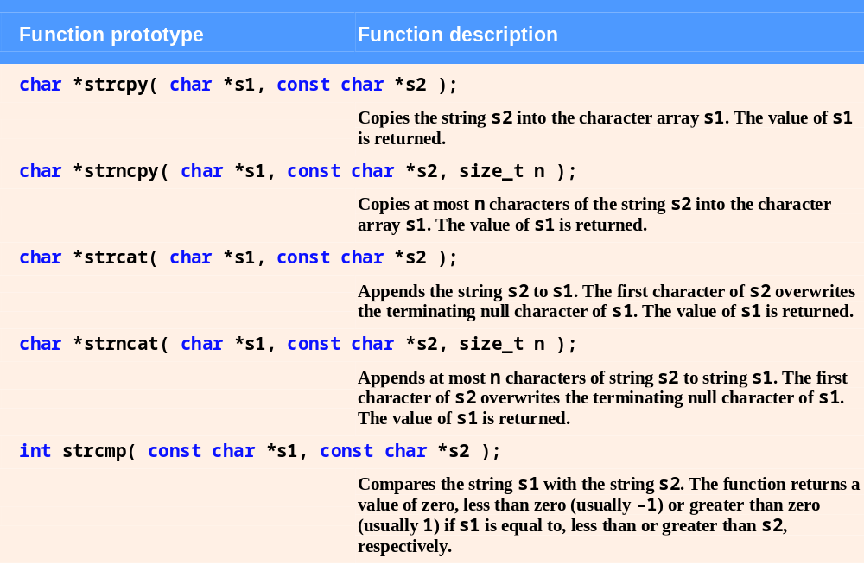
Fig. 8.30 | String-manipulation functions of the string-handling library. (Part 1 of 2)

Slide 90
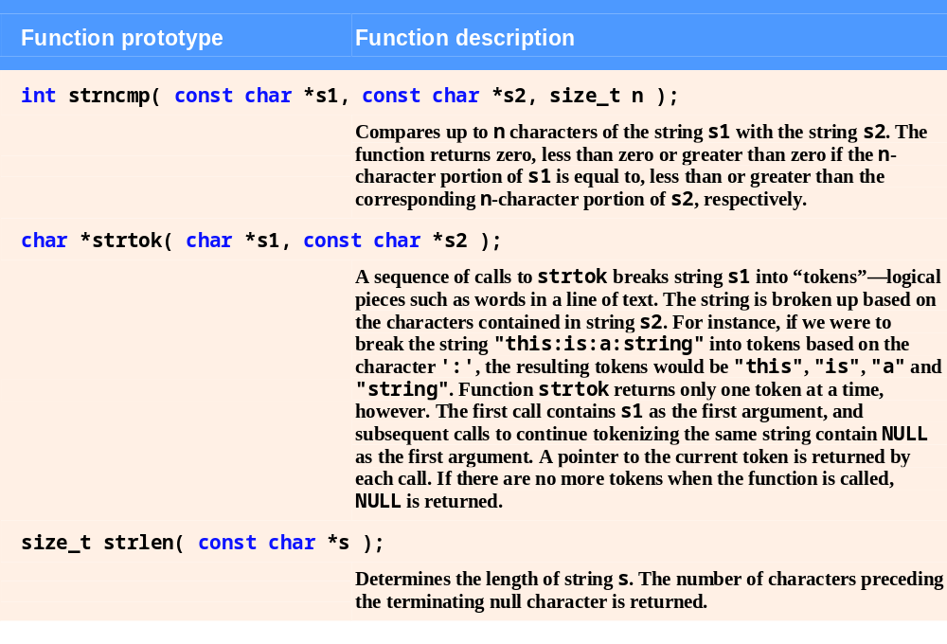
Fig. 8.30 | String-manipulation functions of the string-handling library. (Part 2 of 2)

Slide 91
Common Programming Error 8.19
Forgetting to include the <cstring> header file when using functions from the string-handling library causes compilation errors.

Slide 92
Common Programming Error 8.20
When using strncpy, the terminating null character of the second argument (a char * string) will not be copied if the number of characters specified by strncpy’s third argument is not greater than the second argument’s length. In that case, a fatal error may occur if the programmer does not manually terminate the resulting char * string with a null character.

Slide 93
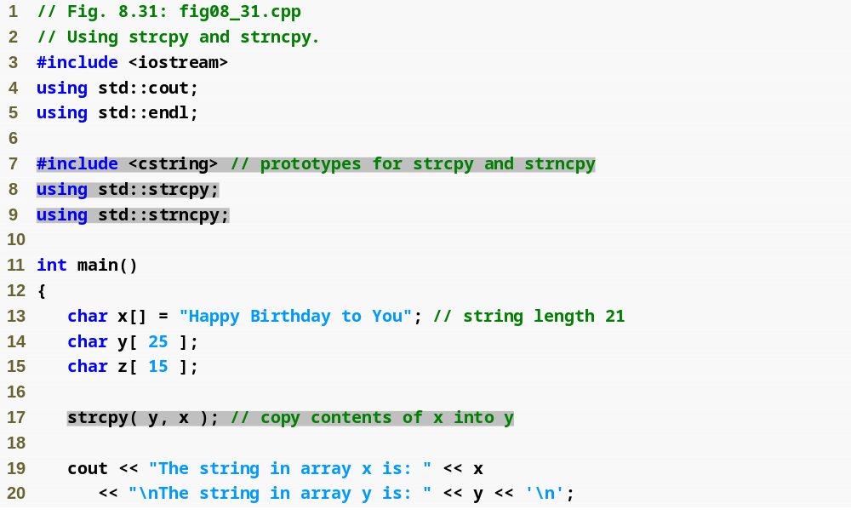
Outline
fig08_31.cpp
(1 of 2)

Slide 94
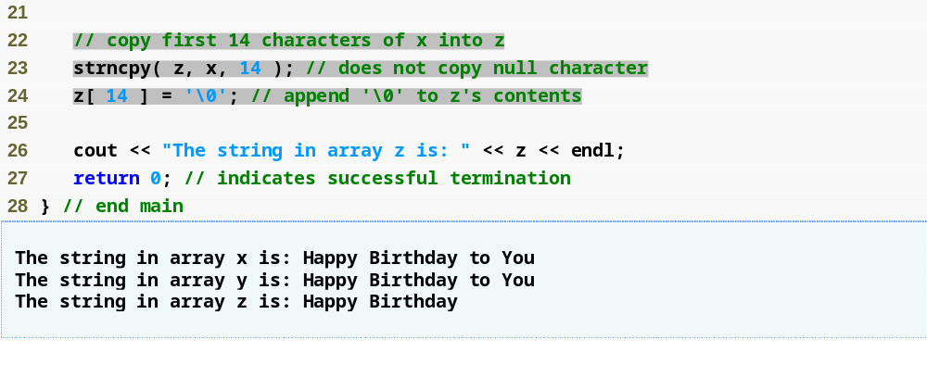
Outline
fig08_31.cpp
(2 of 2)

Slide 95

Outline
fig08_32.cpp
(1 of 2)

Slide 96

Outline
fig08_32.cpp
(2 of 2)

Slide 97
Common Programming Error 8.21
Assuming that strcmp and strncmp return one (a true value) when their arguments are equal is a logic error. Both functions return zero (C++'s false value) for equality. Therefore, when testing two strings for equality, the result of the strcmp or strncmp function should be compared with zero to determine whether the strings are equal.

Slide 98

Outline
fig08_33.cpp
(1 of 2)

Slide 99

Outline
fig08_33.cpp
(2 of 2)

Slide 100
Portability Tip 8.5
The internal numeric codes used to represent characters may be different on different computers, because these computers may use different character sets.

Slide 101
Portability Tip 8.6
Do not explicitly test for ASCII codes, as in if ( rating == 65 ); rather, use the corresponding character constant, as in if ( rating == 'A' ).

Slide 102

Outline
fig08_34.cpp
(1 of 2)

Slide 103

Outline
fig08_34.cpp
(2 of 2)

Slide 104
Common Programming Error 8.22
Not realizing that strtok modifies the string being tokenized and then attempting to use that string as if it were the original unmodified string is a logic error.

Slide 105

Outline
fig08_35.cpp
(1 of 1)

