Slide 1
9
Classes:
A Deeper Look,
Part 1

Slide 2
My object all sublime I shall achieve in time.
  W. S. Gilbert
Is it a world to hide virtues in?
  William Shakespeare
Don’t be “consistent,” but be simply true.
  Oliver Wendell Holmes, Jr.
This above all: to thine own self be true.
  William Shakespeare

Slide 3
OBJECTIVES
In this chapter you will learn:
How to use a preprocessor wrapper to prevent multiple definition errors caused by including more than one copy of a header file in a source-code file.
To understand class scope and accessing class members via the name of an object, a reference to an object or a pointer to an object.
To define constructors with default arguments.
How destructors are used to perform "termination housekeeping" on an object before it is destroyed.
When constructors and destructors are called and the order in which they are called.
The logic errors that may occur when a public member function of a class returns a reference to private data.
To assign the data members of one object to those of another object by default memberwise assignment.

Slide 4
9.1 Introduction
9.2 Time Class Case Study
9.3 Class Scope and Accessing Class Members
9.4 Separating Interface from Implementation
9.5 Access Functions and Utility Functions
9.6 Time Class Case Study: Constructors with Default Arguments
9.7 Destructors
9.8 When Constructors and Destructors Are Called
9.9 Time Class Case Study: A Subtle Trap—Returning a Reference to a private Data Member
9.10 Default Memberwise Assignment
9.11 Software Reusability
9.12 (Optional) Software Engineering Case Study: Starting to Program the Classes of the ATM System
9.13 Wrap-Up

Slide 5
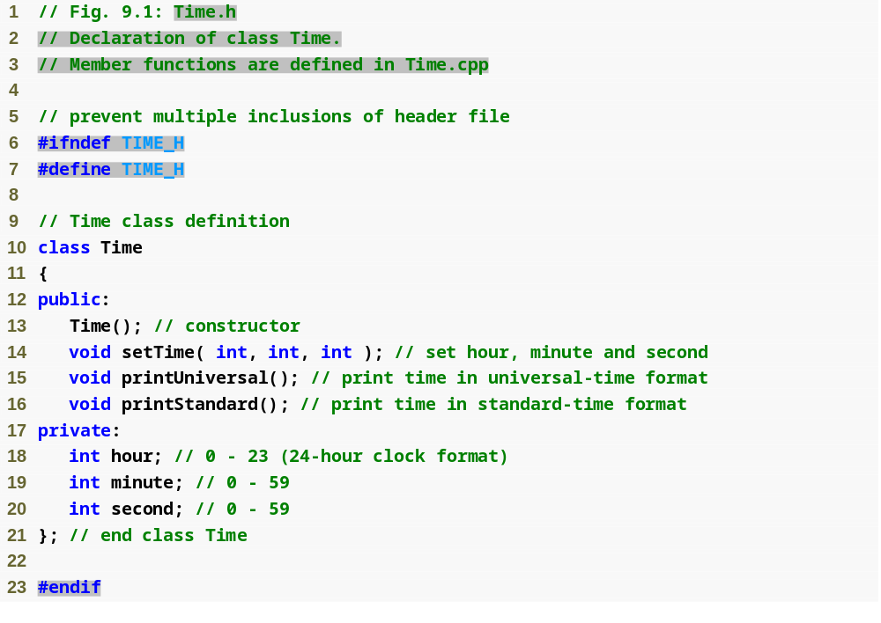
Outline
Time.h
(1 of 1)

Slide 6
Good Programming Practice 9.1
For clarity and readability, use each access specifier only once in a class definition. Place public members first, where they are easy to locate.

Slide 7
Software Engineering Observation 9.1
Each element of a class should have private visibility unless it can be proven that the element needs public visibility. This is another example of the principle of least privilege.

Slide 8
Error-Prevention Tip 9.1
Use #ifndef, #define and #endif preprocessor directives to form a preprocessor wrapper that prevents header files from being included more than once in a program.

Slide 9
Good Programming Practice 9.2
Use the name of the header file in upper case with the period replaced by an underscore in the #ifndef and #define preprocessor directives of a header file.

Slide 10
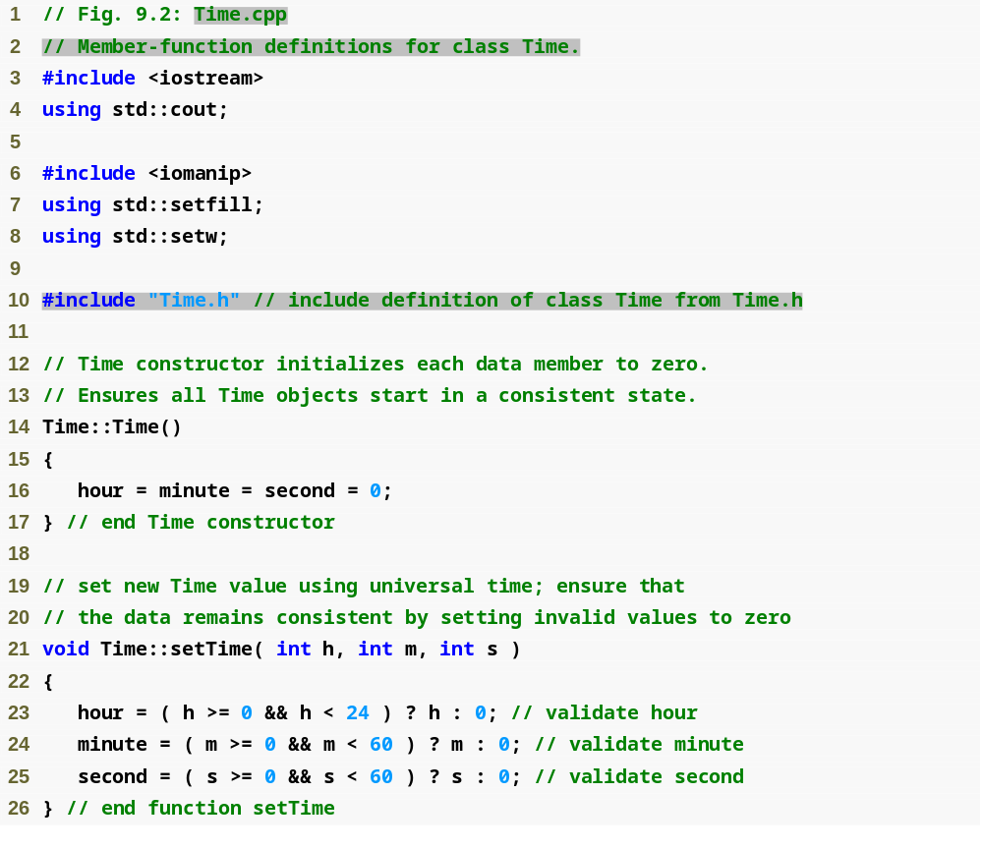
Outline
Time.cpp
(1 of 2)

Slide 11
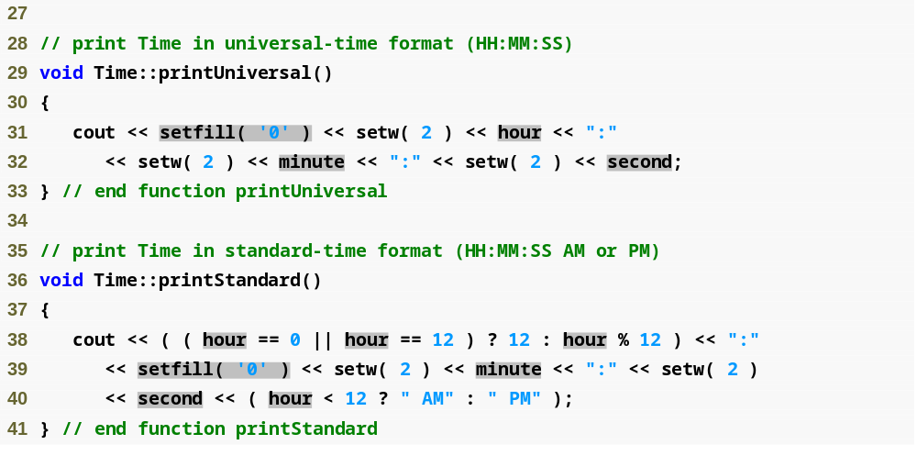
Outline
Time.cpp
(2 of 2)

Slide 12
Common Programming Error 9.1
Attempting to initialize a non-static data member of a class explicitly in the class definition is a syntax error.

Slide 13
Error-Prevention Tip 9.2
Each sticky setting (such as a fill character or floating-point precision) should be restored to its previous setting when it is no longer needed. Failure to do so may result in incorrectly formatted output later in a program. Chapter 15, Stream Input/Output, discusses how to reset the fill character and precision.

Slide 14
Performance Tip 9.1
Defining a member function inside the class definition inlines the member function (if the compiler chooses to do so). This can improve performance.

Slide 15
Software Engineering Observation 9.2
Defining a small member function inside the class definition does not promote the best software engineering, because clients of the class will be able to see the implementation of the function, and the client code must be recompiled if the function definition changes.

Slide 16
Software Engineering Observation 9.3
Only the simplest and most stable member functions (i.e., whose implementations are unlikely to change) should be defined in the class header.

Slide 17
Software Engineering Observation 9.4
Using an object-oriented programming approach can often simplify function calls by reducing the number of parameters to be passed. This benefit of object-oriented programming derives from the fact that encapsulating data members and member functions within an object gives the member functions the right to access the data members.

Slide 18
Software Engineering Observation 9.5
Member functions are usually shorter than functions in non-object-oriented programs, because the data stored in data members have ideally been validated by a constructor or by member functions that store new data. Because the data is already in the object, the member-function calls often have no arguments or at least have fewer arguments than typical function calls in non-object-oriented languages. Thus, the calls are shorter, the function definitions are shorter and the function prototypes are shorter. This facilitates many aspects of program development.

Slide 19
Error-Prevention Tip 9.3
The fact that member function calls generally take either no arguments or substantially fewer arguments than conventional function calls in non-object-oriented languages reduces the likelihood of passing the wrong arguments, the wrong types of arguments or the wrong number of arguments.

Slide 20
Performance Tip 9.2
Objects contain only data, so objects are much smaller than if they also contained member functions. Applying operator sizeof to a class name or to an object of that class will report only the size of the class’s data members. The compiler creates one copy (only) of the member functions separate from all objects of the class. All objects of the class share this one copy. Each object, of course, needs its own copy of the class’s data, because the data can vary among the objects. The function code is nonmodifiable (also called reentrant code or pure procedure) and, hence, can be shared among all objects of one class.

Slide 21
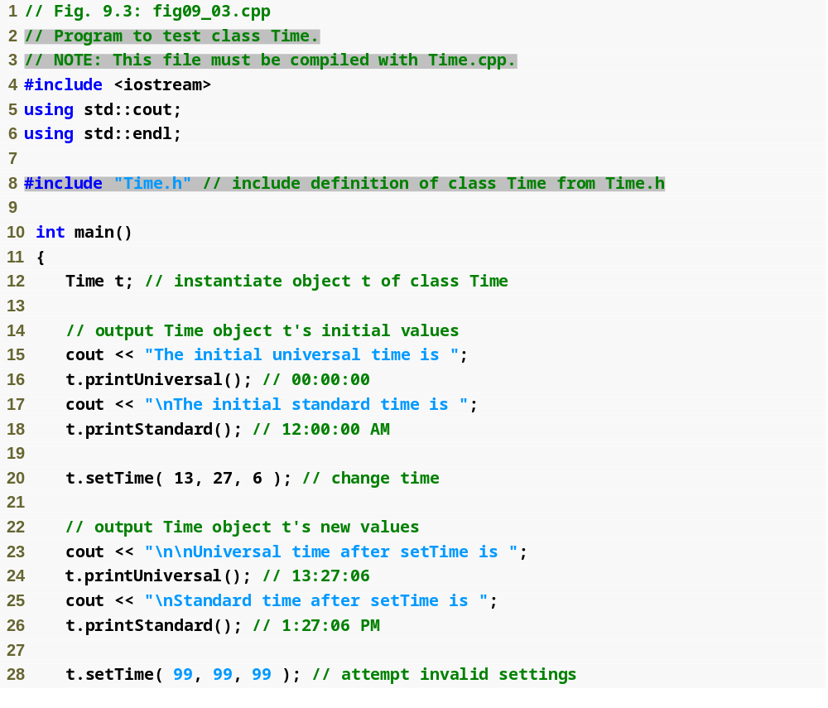
Outline
fig09_03.cpp
(1 of 2)

Slide 22
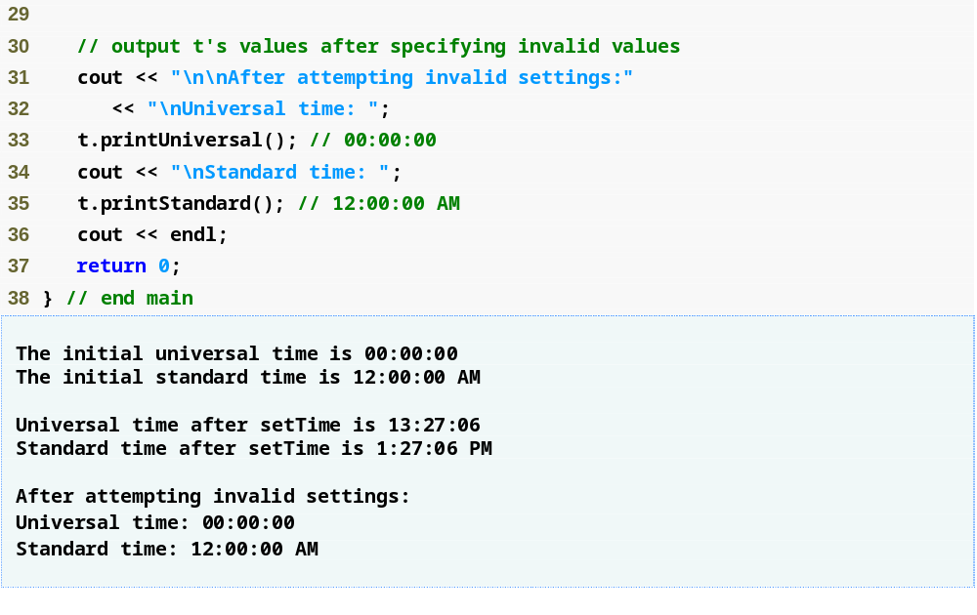
Outline
fig09_03.cpp
(2 of 2)

Slide 23
Software Engineering Observation 9.6
Clients of a class do not need access to the class’s source code in order to use the class. The clients do, however, need to be able to link to the class’s object code (i.e., the compiled version of the class). This encourages independent software vendors (ISVs) to provide class libraries for sale or license. The ISVs provide in their products only the header files and the object modules. No proprietary information is revealed—as would be the case if source code were provided. The C++ user community benefits by having more ISV-produced class libraries available.

Slide 24
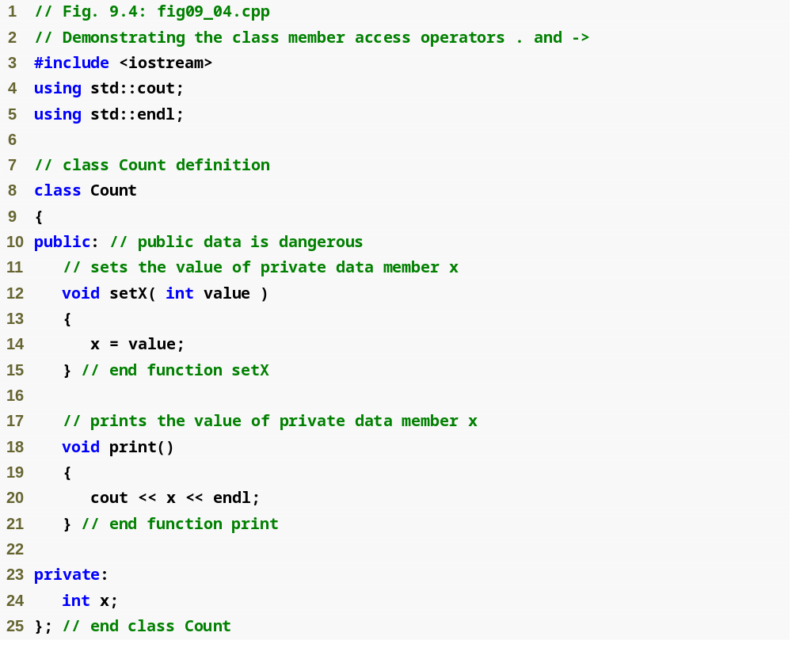
Outline
fig09_04.cpp
(1 of 2)

Slide 25
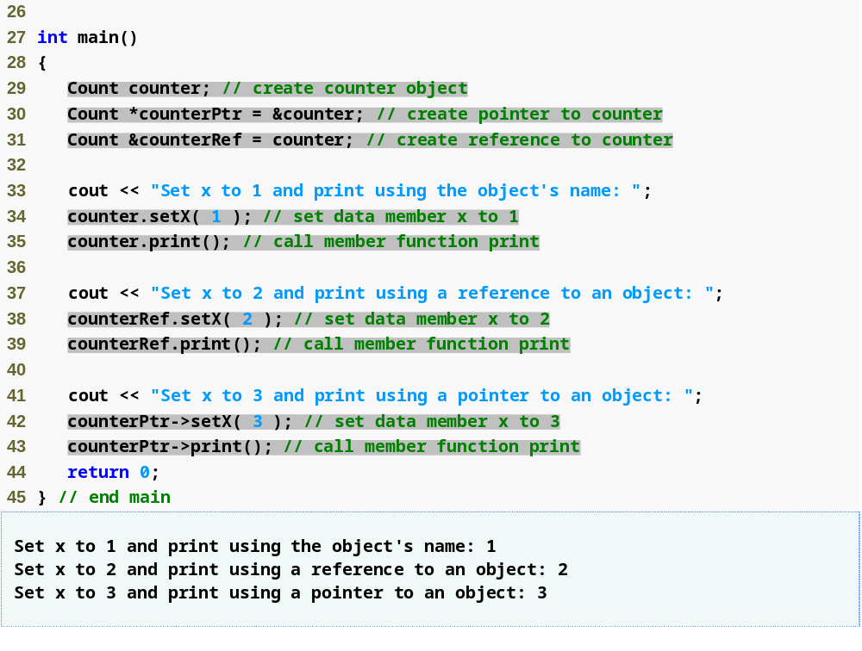
Outline
fig09_04.cpp
(2 of 2)

Slide 26
Software Engineering Observation 9.7
Information important to the interface to a class should be included in the header file. Information that will be used only internally in the class and will not be needed by clients of the class should be included in the unpublished source file. This is yet another example of the principle of least privilege.

Slide 27
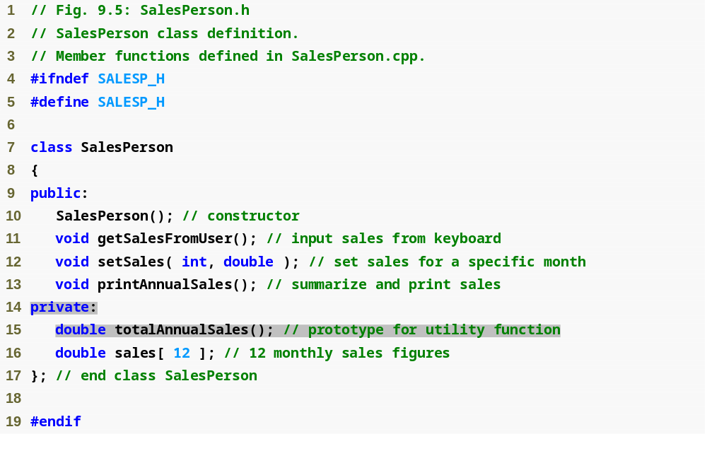
Outline
SalesPerson.h
(1 of 1)

Slide 28
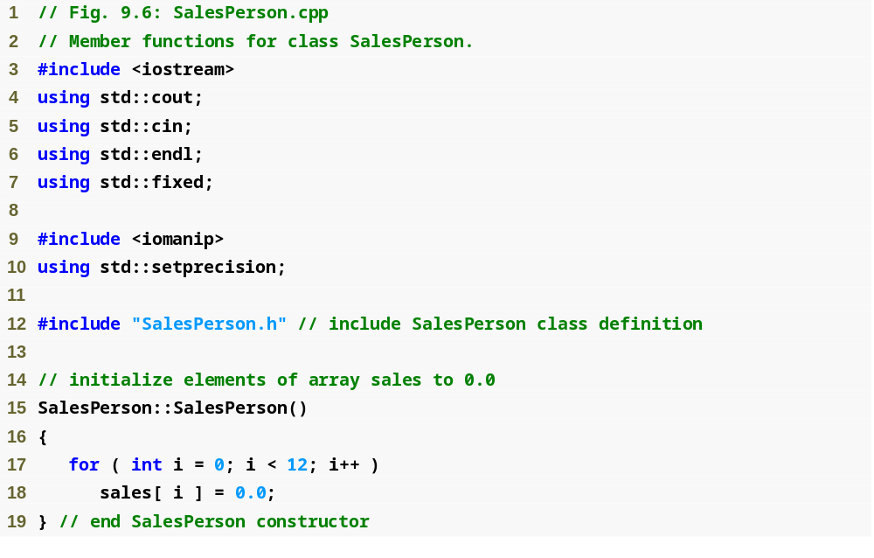
Outline
SalesPerson.cpp
(1 of 3)

Slide 29
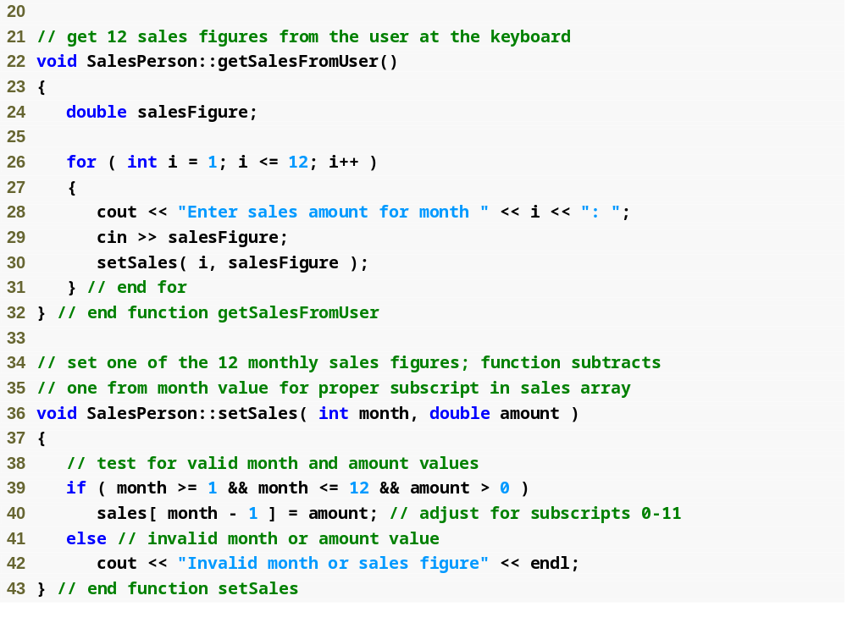
Outline
SalesPerson.cpp
(2 of 3)

Slide 30
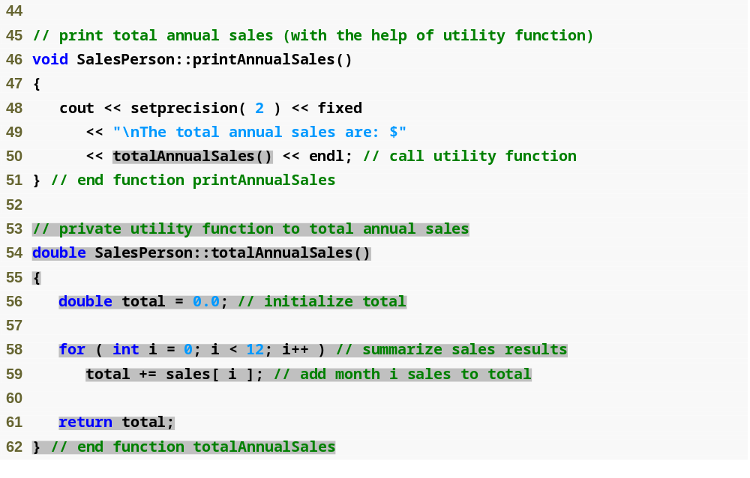
Outline
SalesPerson.cpp
(3 of 3)

Slide 31
Software Engineering Observation 9.8
A phenomenon of object-oriented programming is that once a class is defined, creating and manipulating objects of that class often involve issuing only a simple sequence of member-function calls—few, if any, control statements are needed. By contrast, it is common to have control statements in the implementation of a class’s member functions.

Slide 32
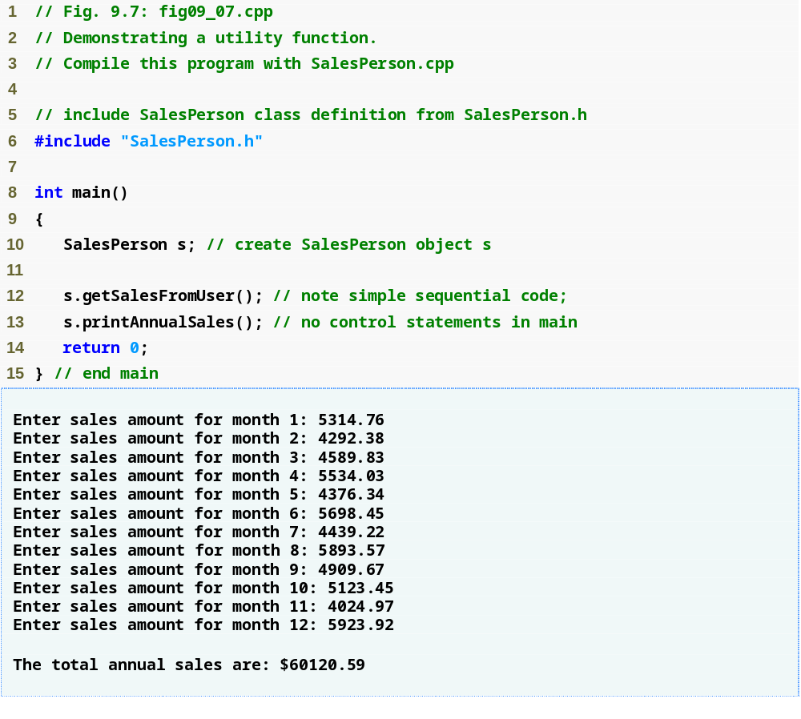
Outline
fig09_07.cpp
(1 of 1)

Slide 33
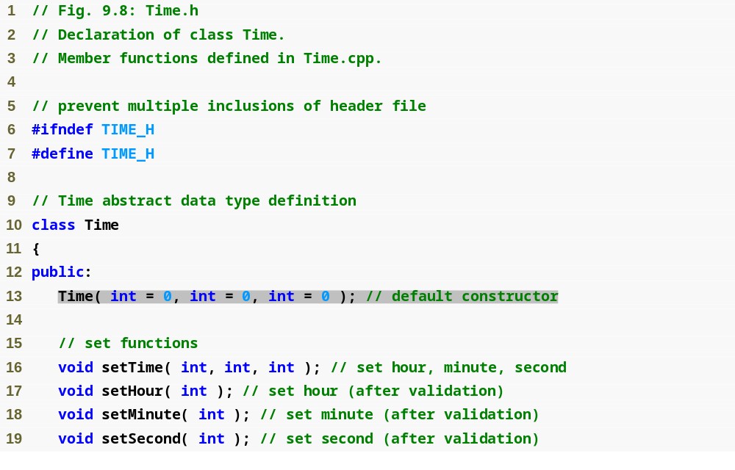
Outline
Time.h
(1 of 2)

Slide 34
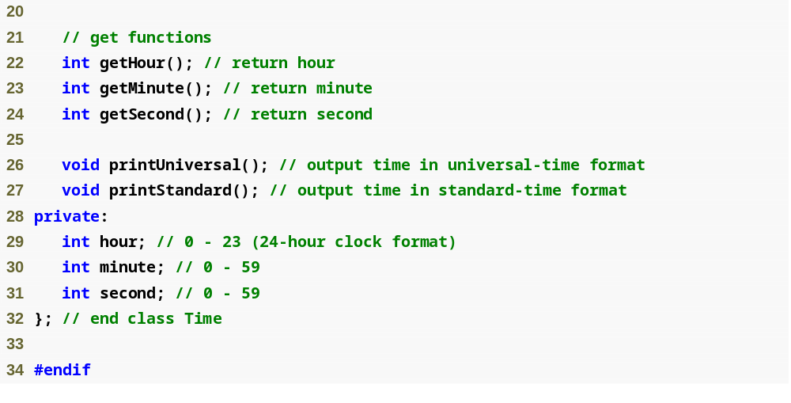
Outline
Time.h
(2 of 2)

Slide 35
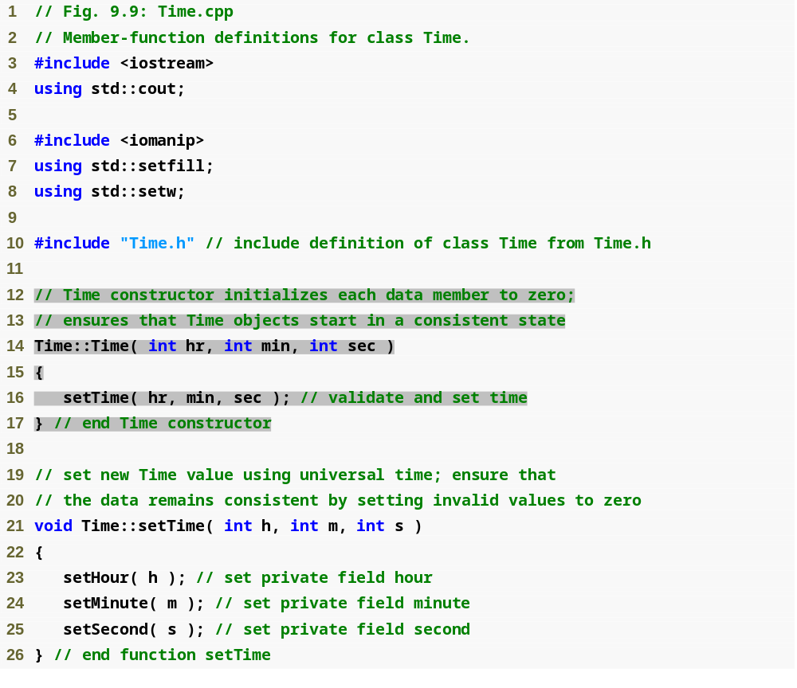
Outline
Time.cpp
(1 of 3)

Slide 36
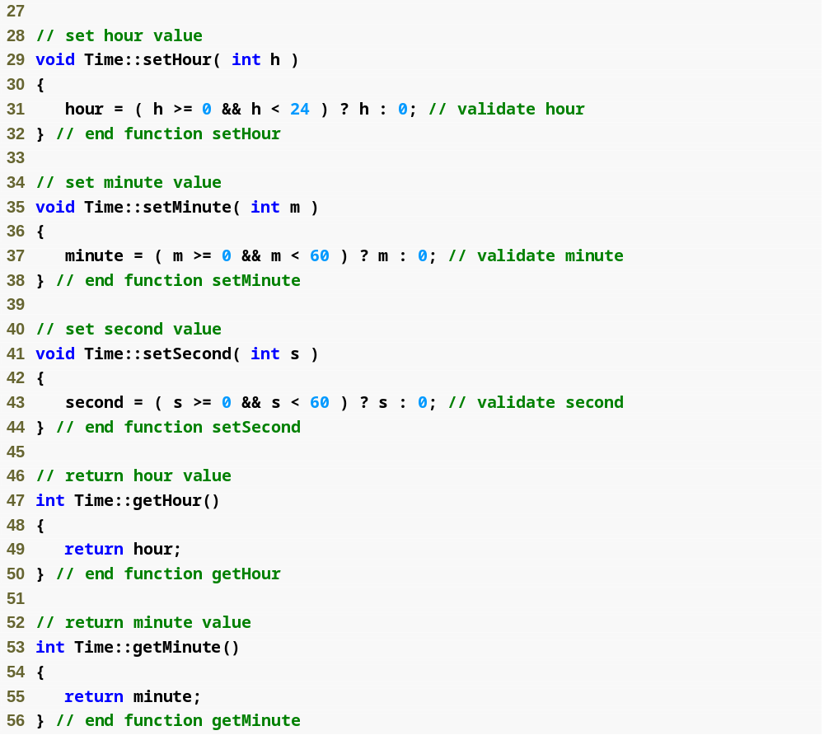
Outline
Time.cpp
(2 of 3)

Slide 37
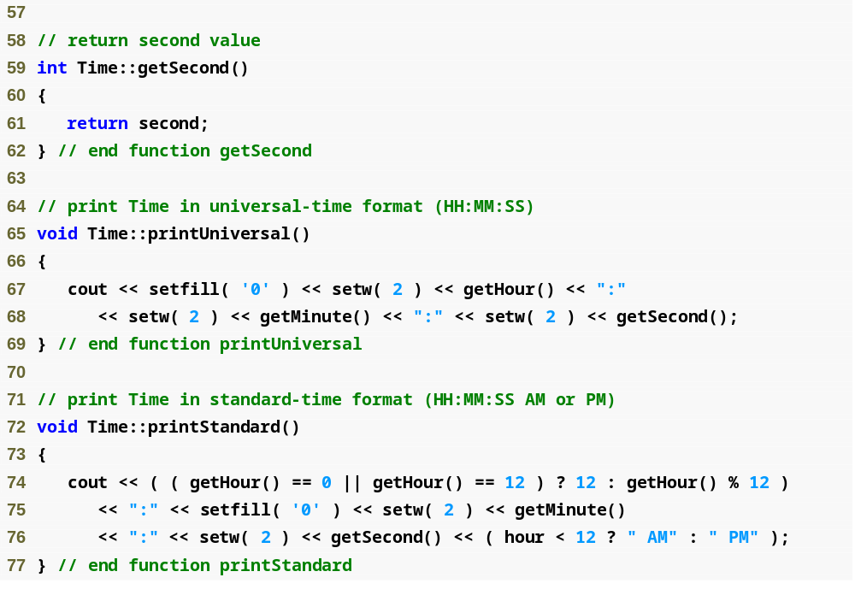
Outline
Time.cpp
(3 of 3)

Slide 38
Software Engineering Observation 9.9
If a member function of a class already provides all or part of the functionality required by a constructor (or other member function) of the class, call that member function from the constructor (or other member function). This simplifies the maintenance of the code and reduces the likelihood of an error if the implementation of the code is modified. As a general rule: Avoid repeating code.

Slide 39
Software Engineering Observation 9.10
Any change to the default argument values of a function requires the client code to be recompiled (to ensure that the program still functions correctly).

Slide 40
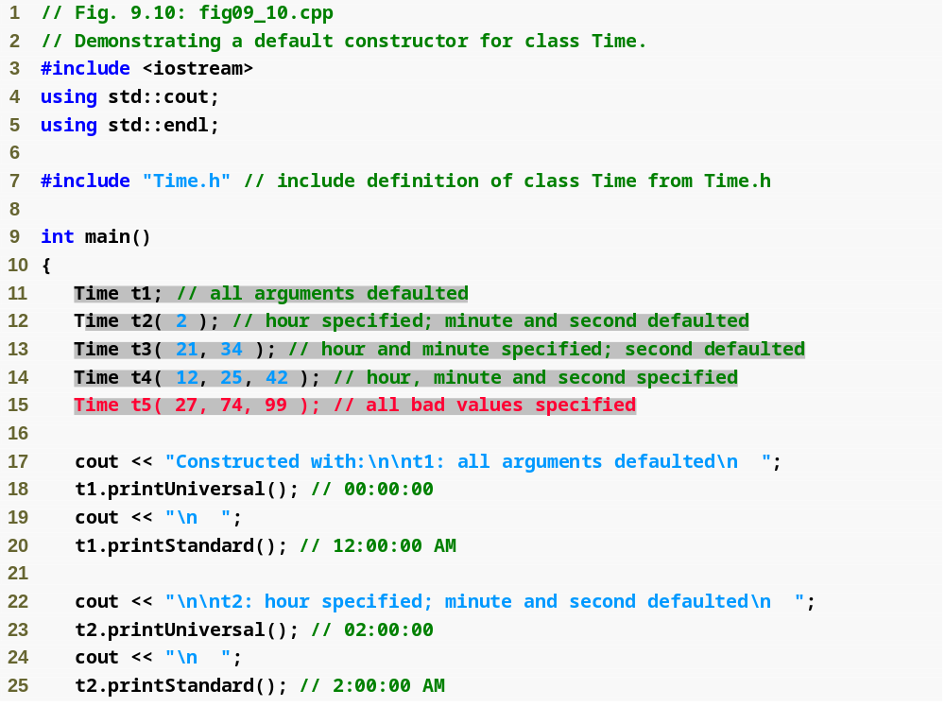
Outline
fig09_10.cpp
(1 of 3)

Slide 41
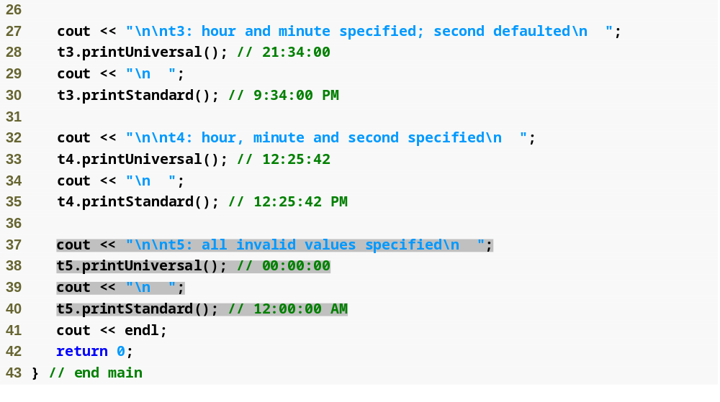
Outline
fig09_10.cpp
(2 of 3)

Slide 42
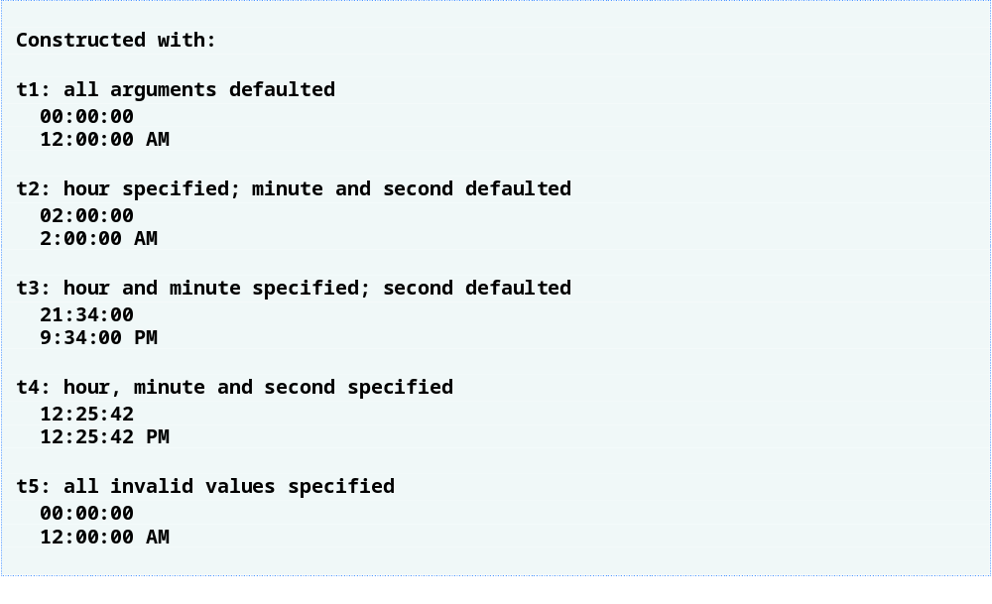
Outline
fig09_10.cpp
(3 of 3)

Slide 43
Common Programming Error 9.2
A constructor can call other member functions of the class, such as set or get functions, but because the constructor is initializing the object, the data members may not yet be in a consistent state. Using data members before they have been properly initialized can cause logic errors.

Slide 44
Common Programming Error 9.3
It is a syntax error to attempt to pass arguments to a destructor, to specify a return type for a destructor (even void cannot be specified), to return values from a destructor or to overload a destructor.

Slide 45
Software Engineering Observation 9.11
As we will see in the remainder of the book, constructors and destructors have much greater prominence in C++ and object-oriented programming than is possible to convey after only our brief introduction here.

Slide 46
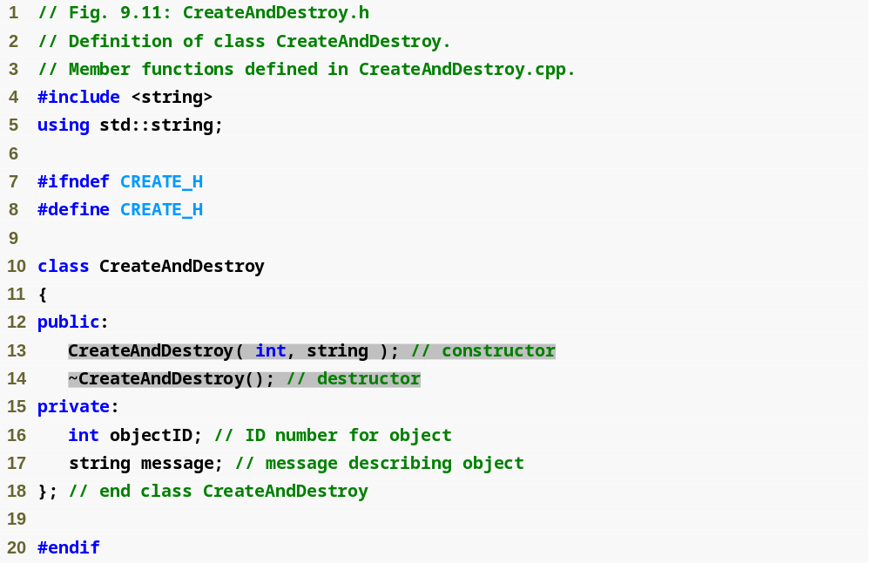
Outline
CreateAndDestroy.h
(1 of 1)

Slide 47
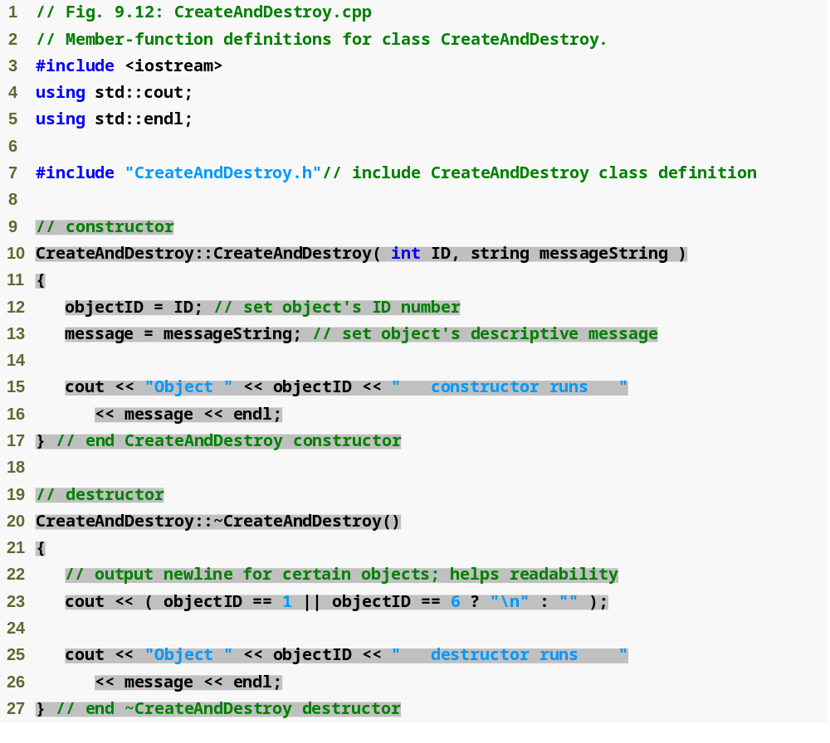
Outline
CreateAndDestroy.cpp
(1 of 1)

Slide 48
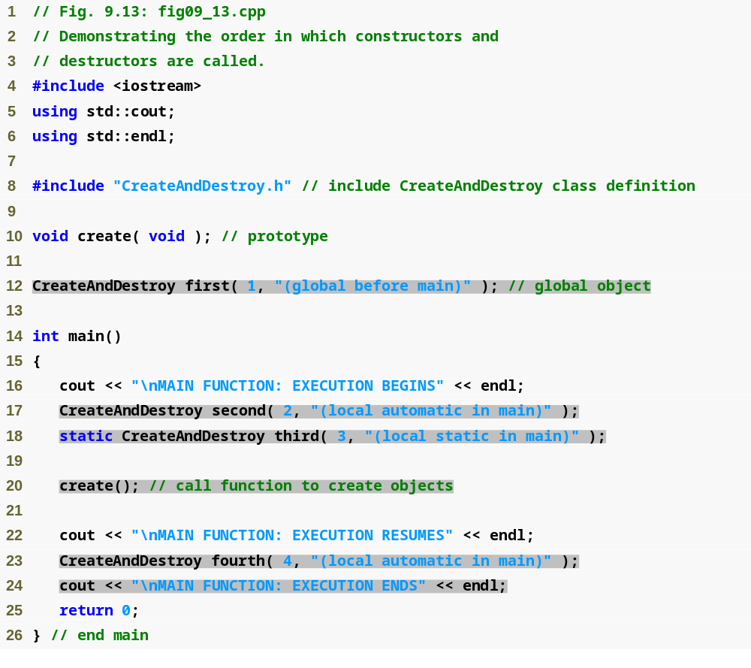
Outline
Fig09_13.cpp
(1 of 3)

Slide 49
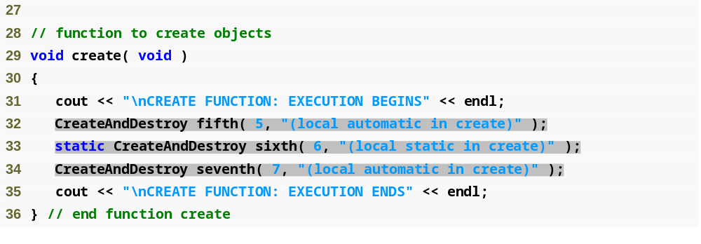
Outline
Fig09_13.cpp
(2 of 3)

Slide 50
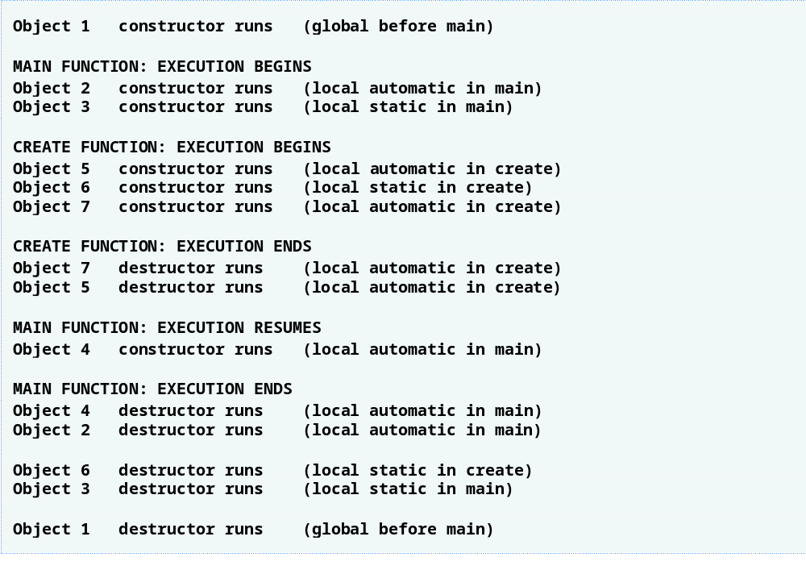
Outline
Fig09_13.cpp
(3 of 3)

Slide 51
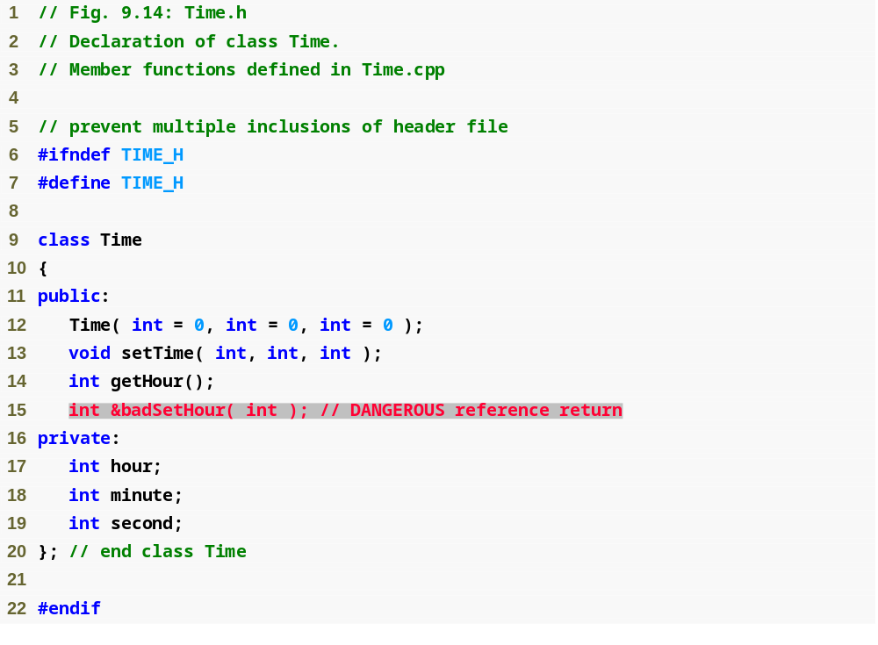
Outline
Time.h
(1 of 1)

Slide 52
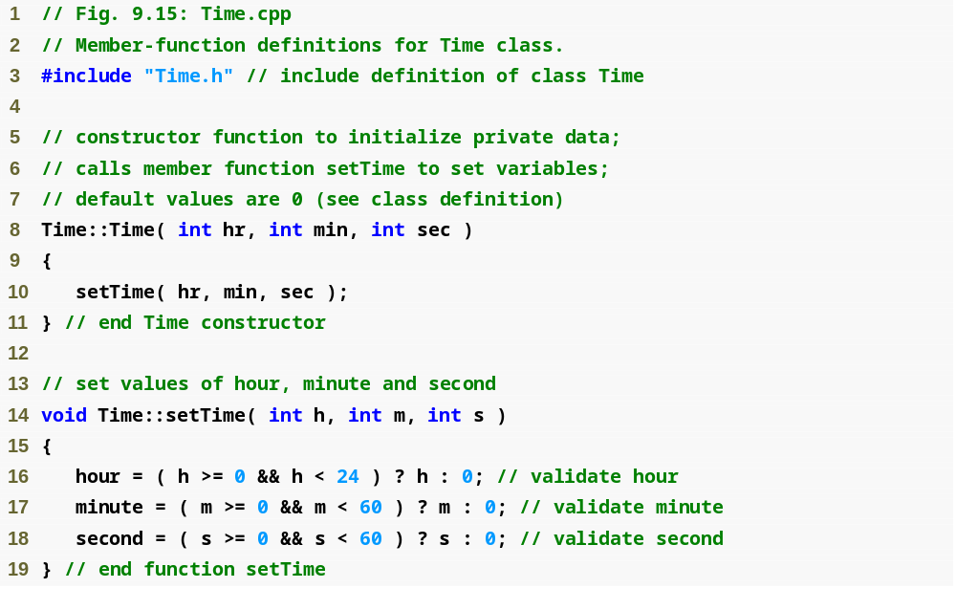
Outline
Time.cpp
(1 of 2)

Slide 53
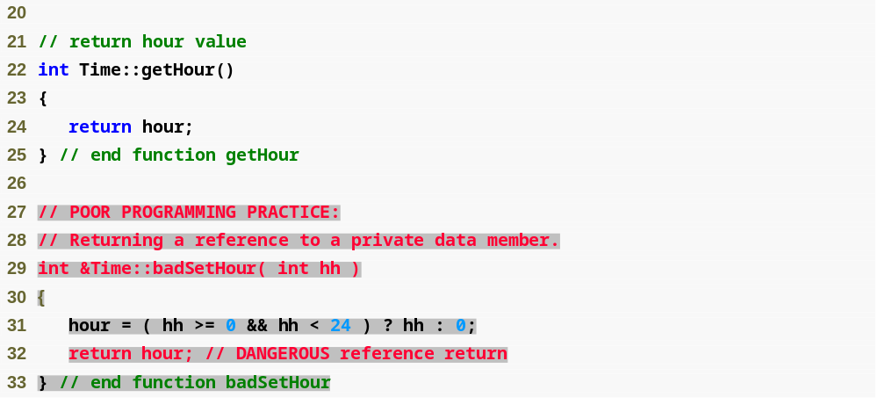
Outline
Time.cpp
(2 of 2)

Slide 54
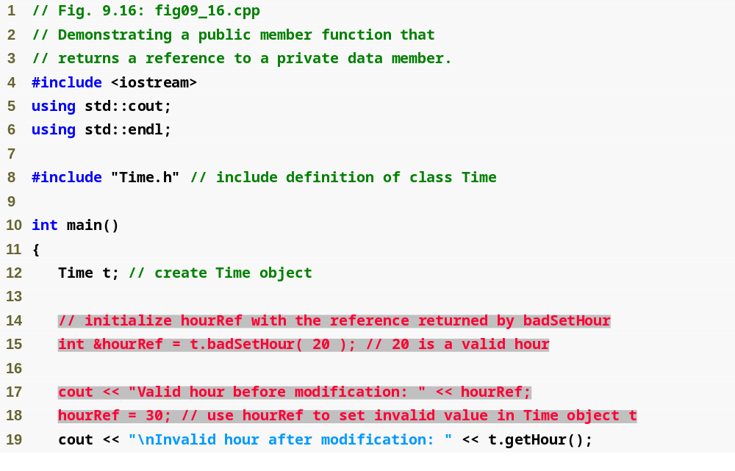
Outline
Fig09_16.cpp
(1 of 2)

Slide 55
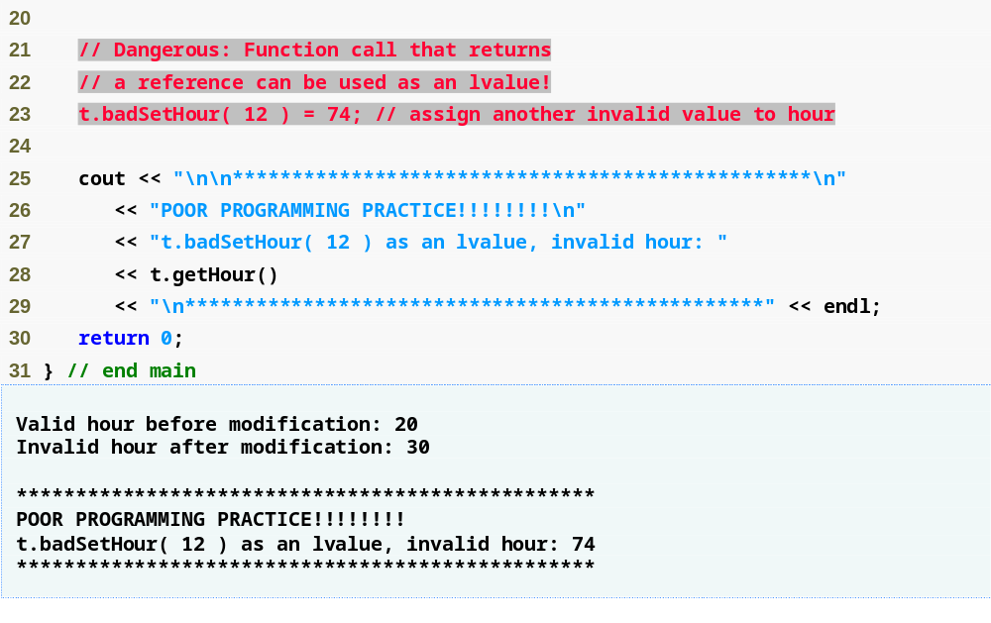
Outline
Fig09_16.cpp
(2 of 2)

Slide 56
Error-Prevention Tip 9.4
Returning a reference or a pointer to a private data member breaks the encapsulation of the class and makes the client code dependent on the representation of the class’s data. So, returning pointers or references to private data is a dangerous practice that should be avoided.

Slide 57
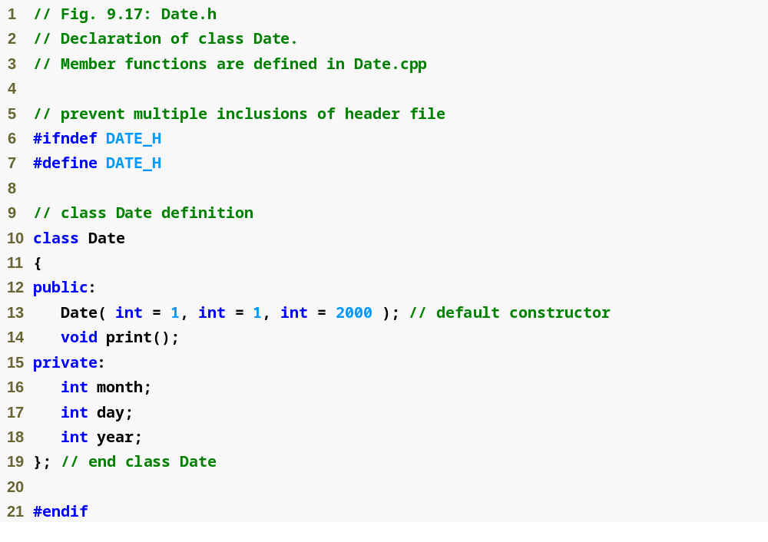
Outline
Date.h
(1 of 1)

Slide 58
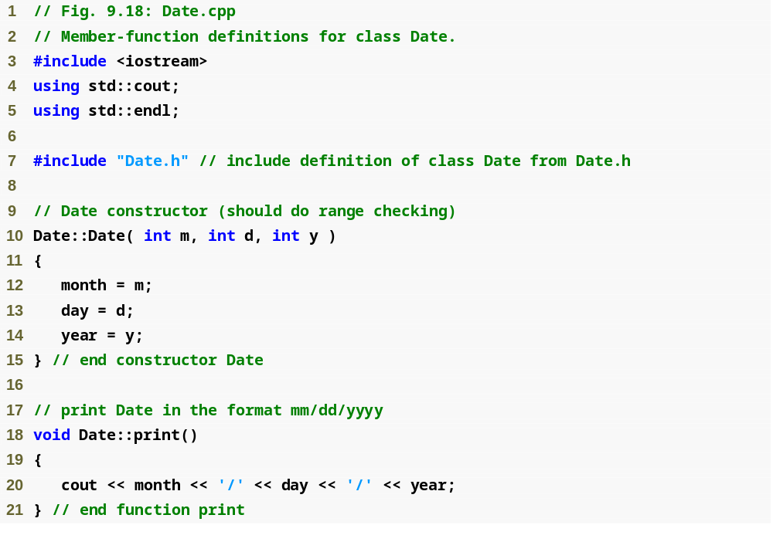
Outline
Date.cpp
(1 of 1)

Slide 59
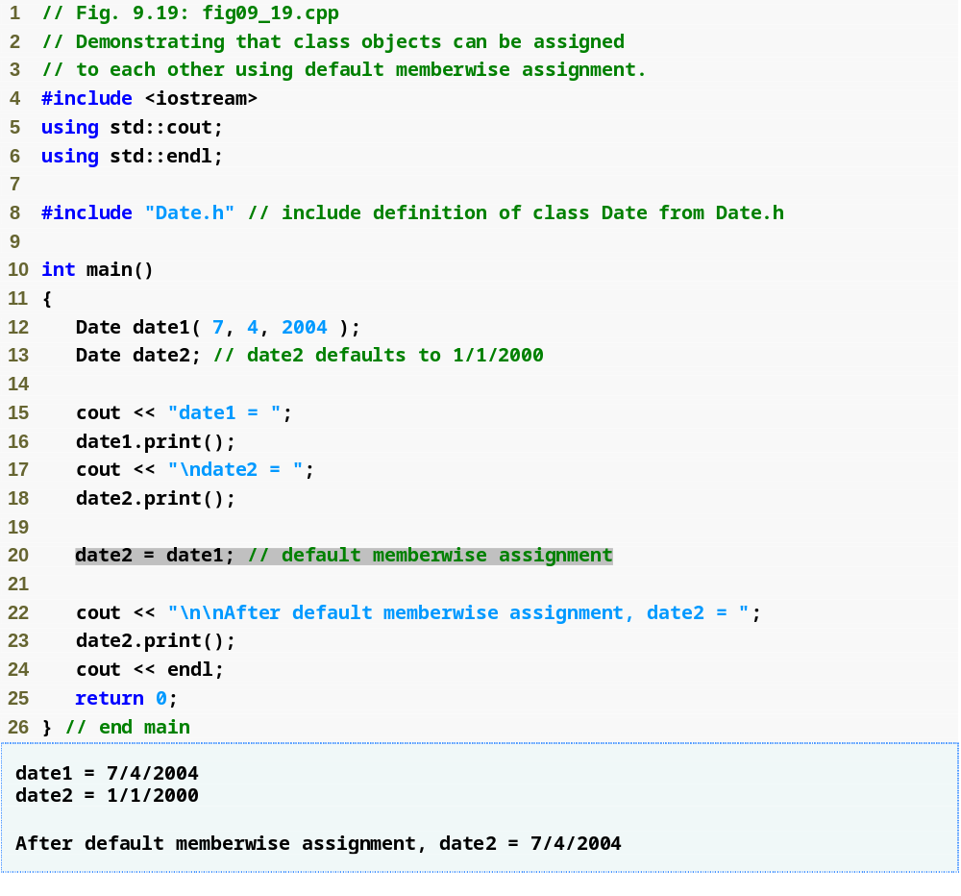
Outline
fig09_19.cpp
(1 of 1)

Slide 60
Performance Tip 9.3
Passing an object by value is good from a security standpoint, because the called function has no access to the original object in the caller, but pass-by-value can degrade performance when making a copy of a large object. An object can be passed by reference by passing either a pointer or a reference to the object. Pass-by-reference offers good performance but is weaker from a security standpoint, because the called function is given access to the original object. Pass-by-const-reference is a safe, good-performing alternative (this can be implemented with a const reference parameter or with a pointer-to-const-data parameter).

Slide 61
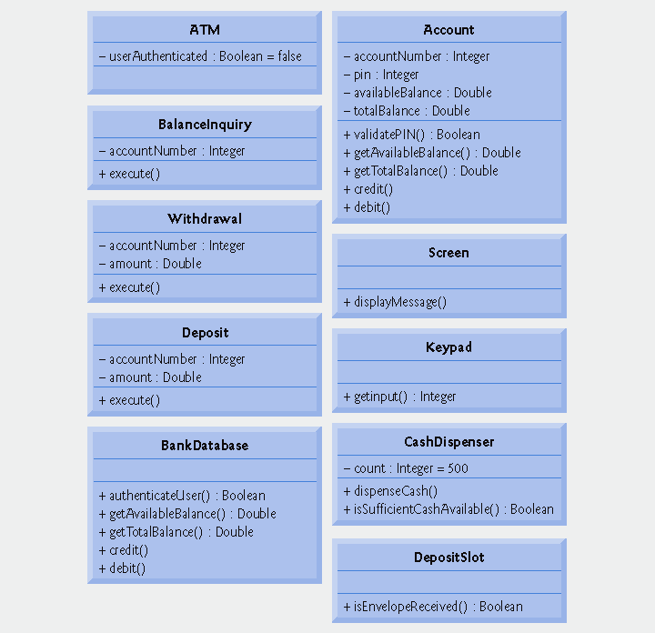
Fig. 9.20 | Class diagram with visibility markers.

Slide 62
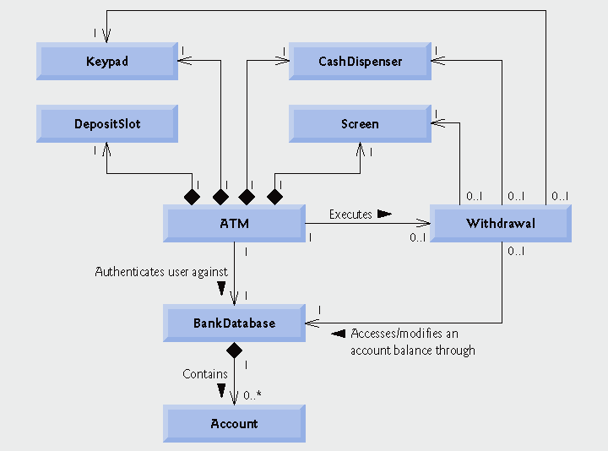
Fig. 9.21 | Class diagram with navigability arrows.

Slide 63
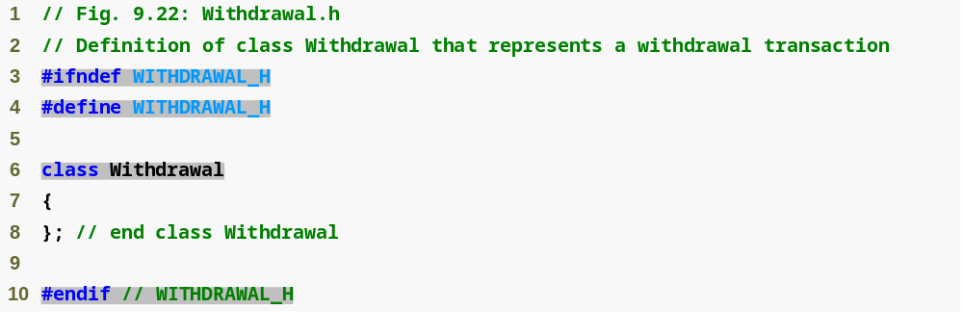
Outline
fig09_22.cpp
(1 of 1)

Slide 64
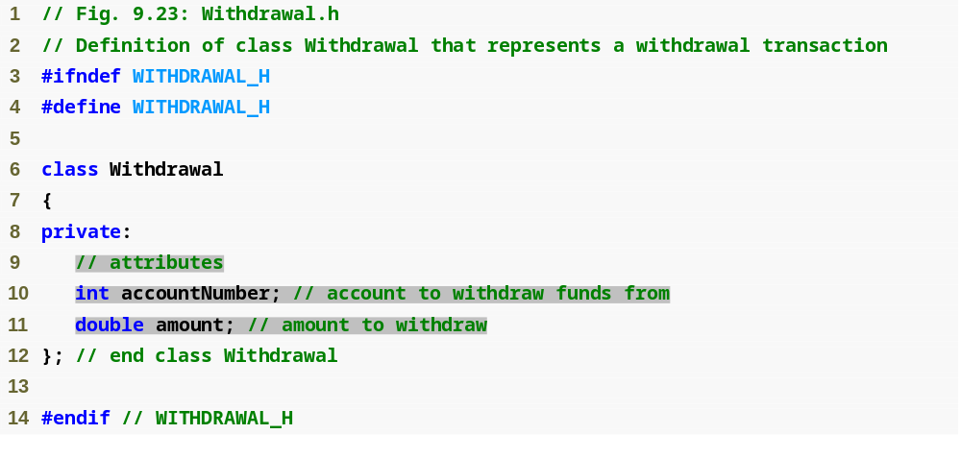
Outline
Withdrawal.h
(1 of 1)

Slide 65
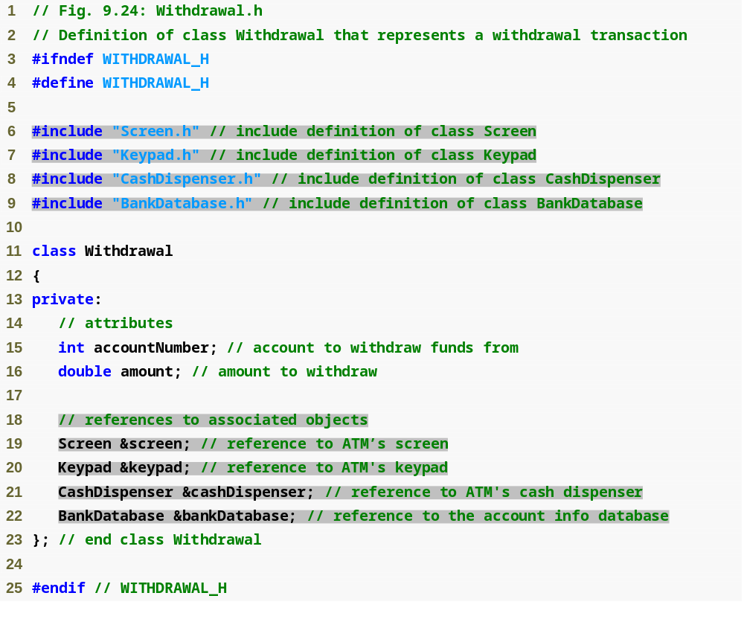
Outline
Withdrawal.h
(1 of 1)

Slide 66
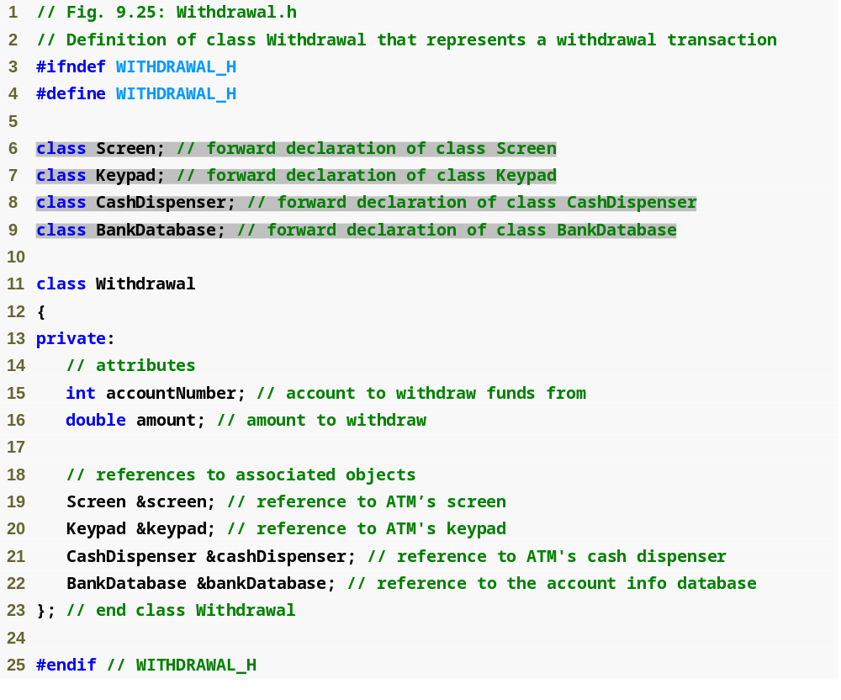
Outline
Withdrawal.h
(1 of 1)

Slide 67
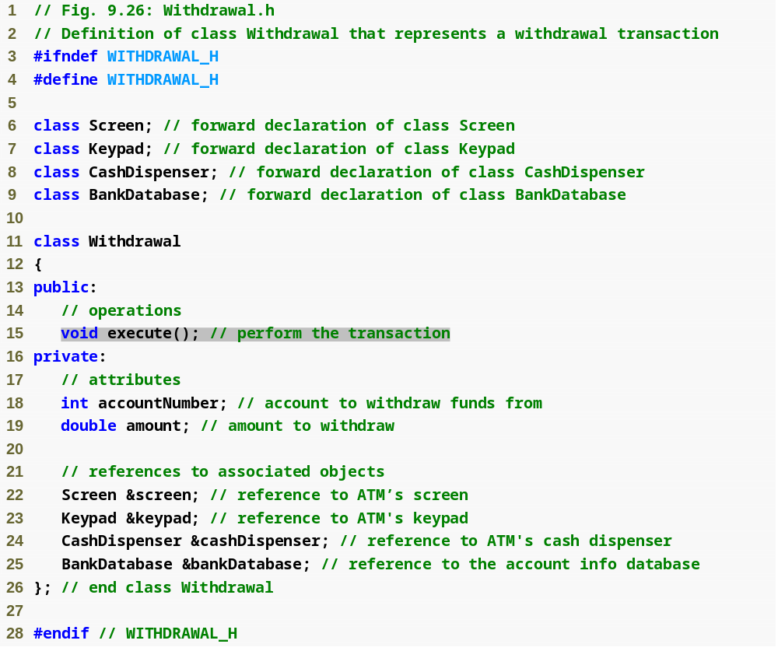
Outline
Withdrawal.h
(1 of 1)

Slide 68
Software Engineering Observation 9.12
Several UML modeling tools can convert UML-based designs into C++ code, considerably speeding the implementation process. For more information on these “automatic” code generators, refer to the Internet and Web resources listed at the end of Section 2.8.

Slide 69
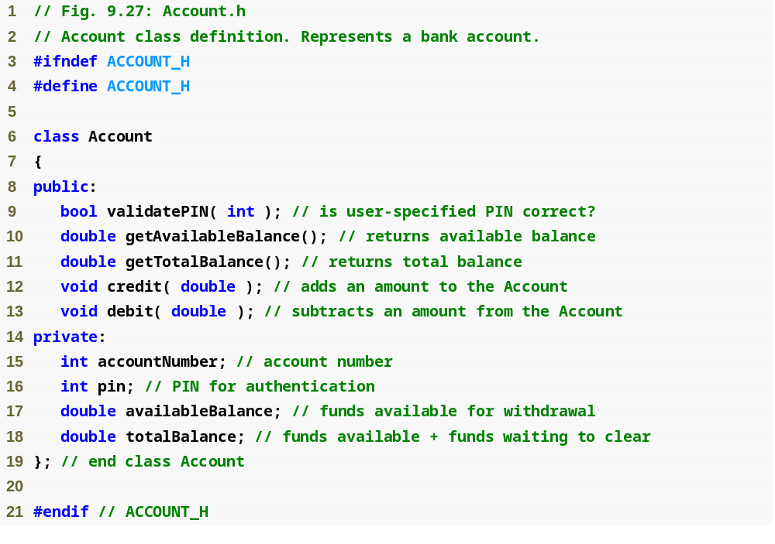
Outline
Account.h
(1 of 1)

