Slide 1
10
Classes: A Deeper Look, Part 2

Slide 2
But what, to serve our private ends, Forbids the cheating of our friends?
  Charles Churchill
Instead of this absurd division into sexes they ought to class people as static and dynamic.
  Evelyn Waugh
Have no friends not equal to yourself.
  Confucius

Slide 3
OBJECTIVES
In this chapter you will learn:
To specify const (constant) objects and const member functions.
To create objects composed of other objects.
To use friend functions and friend classes.
To use the this pointer.
To create and destroy objects dynamically with operators new and delete, respectively.
To use static data members and member functions.
The concept of a container class.
The notion of iterator classes that walk through the elements of container classes.
To use proxy classes to hide implementation details from a class's clients.

Slide 4
10.1 Introduction
10.2 const (Constant) Objects and const Member Functions
10.3 Composition: Objects as Members of Classes
10.4 friend Functions and friend Classes
10.5 Using the this Pointer
10.6 Dynamic Memory Management with Operators new and delete
10.7 static Class Members
10.8 Data Abstraction and Information Hiding
10.8.1 Example: Array Abstract Data Type
10.8.2 Example: String Abstract Data Type
10.8.3 Example: Queue Abstract Data Type
10.9 Container Classes and Iterators
10.10 Proxy Classes
10.11 Wrap-Up

Slide 5
Software Engineering Observation 10.1
Declaring an object as const helps enforce the principle of least privilege. Attempts to modify the object are caught at compile time rather than causing execution-time errors. Using const properly is crucial to proper class design, program design and coding.

Slide 6
Performance Tip 10.1
Declaring variables and objects const can improve performance—today’s sophisticated optimizing compilers can perform certain optimizations on constants that cannot be performed on variables.

Slide 7
Common Programming Error 10.1
Defining as const a member function that modifies a data member of an object is a compilation error.

Slide 8
Common Programming Error 10.2
Defining as const a member function that calls a non-const member function of the class on the same instance of the class is a compilation error.

Slide 9
Common Programming Error 10.3
Invoking a non-const member function on a const object is a compilation error.

Slide 10
Software Engineering Observation 10.2
A const member function can be overloaded with a non-const version. The compiler chooses which overloaded member function to use based on the object on which the function is invoked. If the object is const, the compiler uses the const version. If the object is not const, the compiler uses the non-const version.

Slide 11
Common Programming Error 10.4
Attempting to declare a constructor or destructor const is a compilation error.

Slide 12
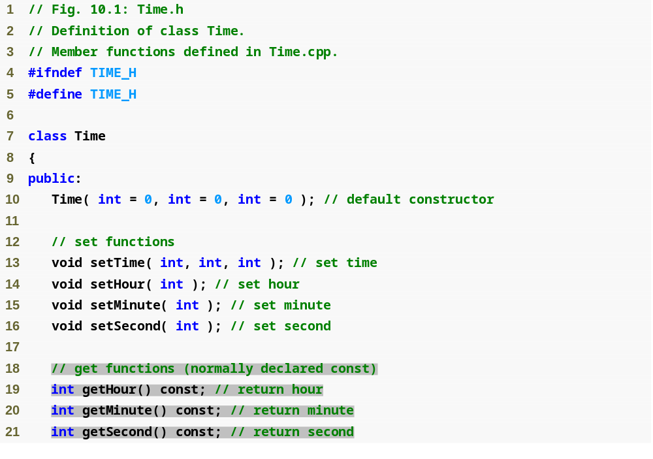
Outline
Time.h
(1 of 2)

Slide 13
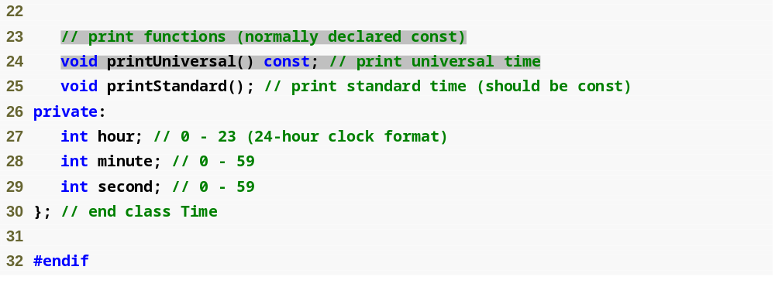
Outline
Time.h
(2 of 2)

Slide 14
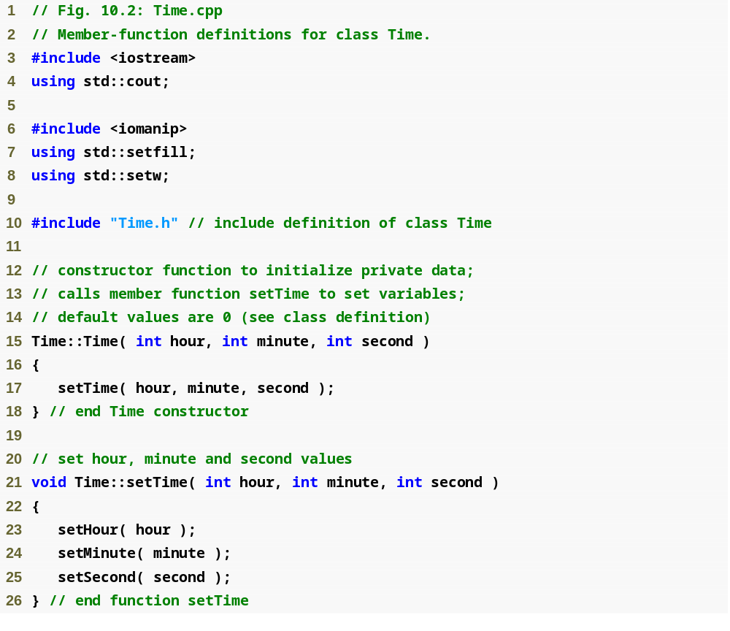
Outline
Time.cpp
(1 of 3)

Slide 15
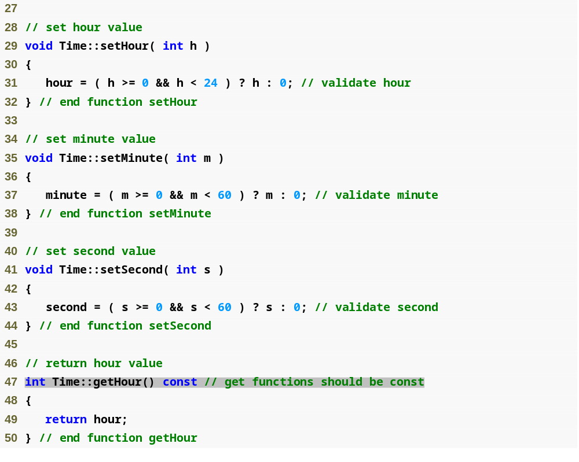
Outline
Time.cpp
(2 of 3)

Slide 16
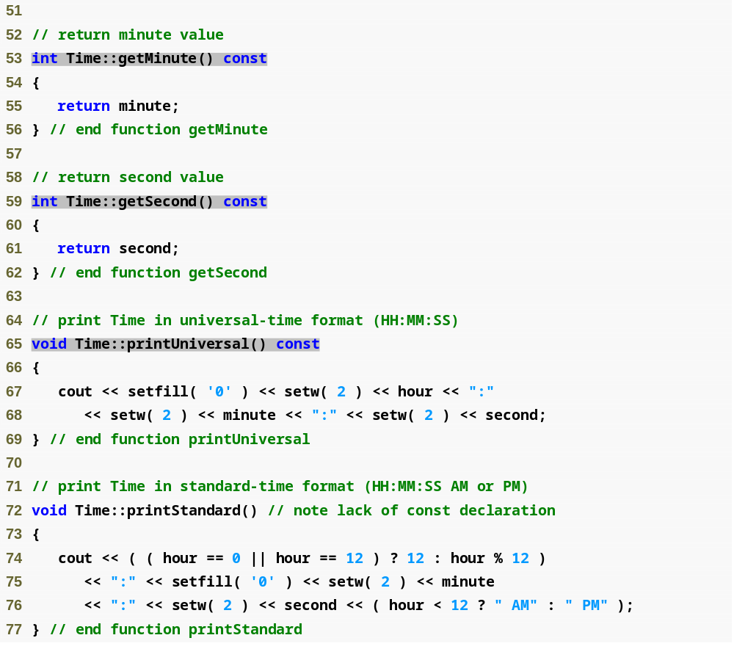
Outline
Time.cpp
(3 of 3)

Slide 17
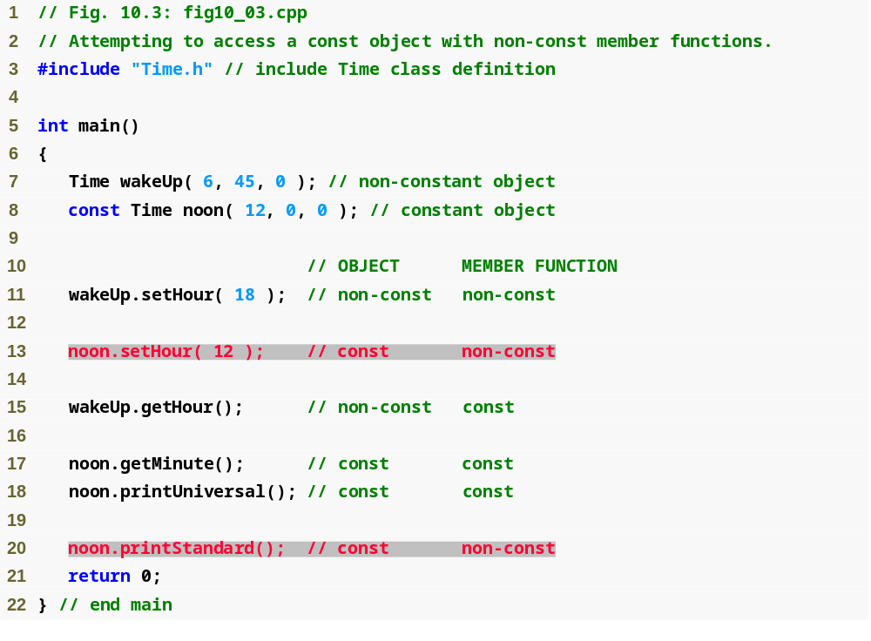
Outline
fig10_03.cpp
(1 of 2)

Slide 18
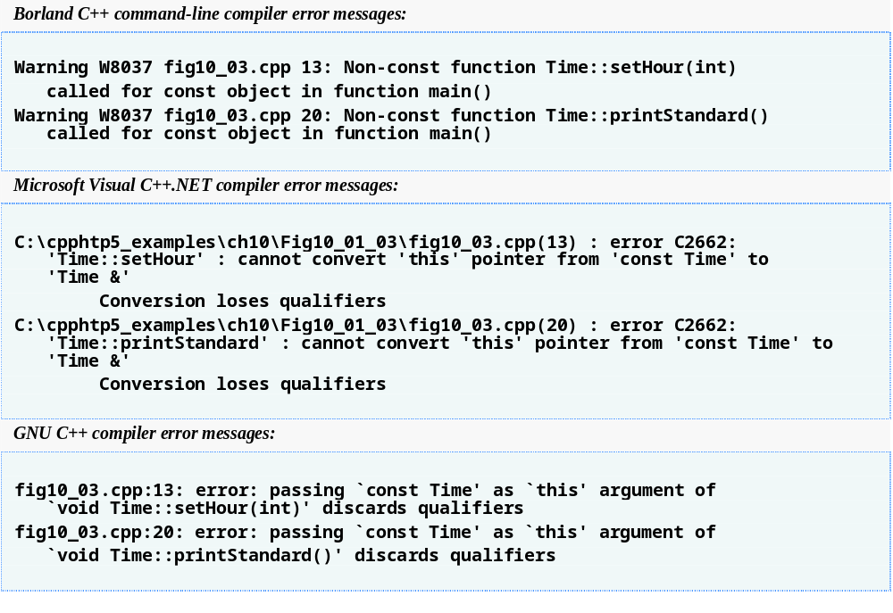
Outline
fig10_03.cpp
(2 of 2)

Slide 19
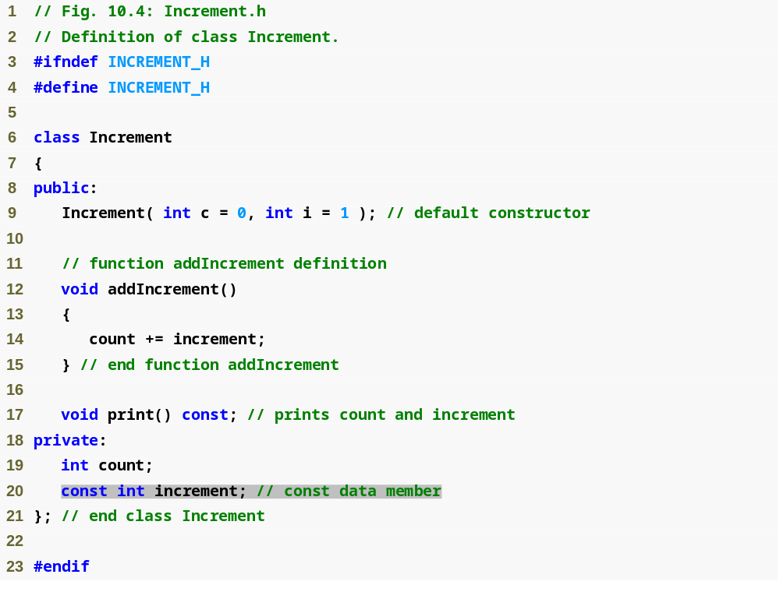
Outline
Increment.h
(1 of 1)

Slide 20
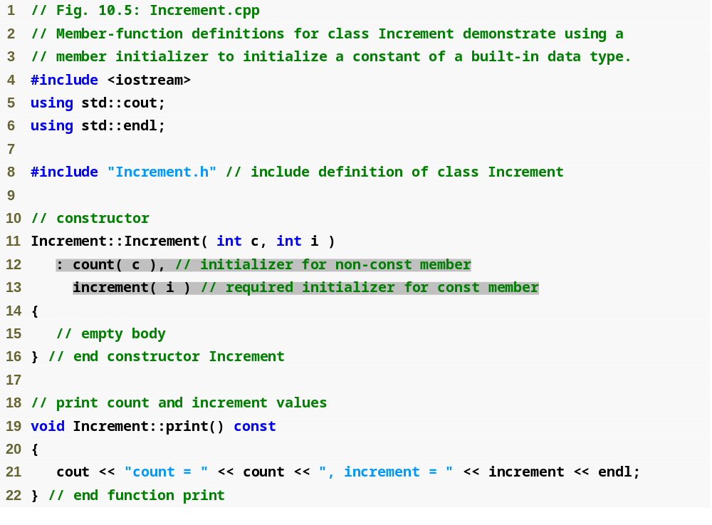
Outline
Increment.cpp
(1 of 1)

Slide 21
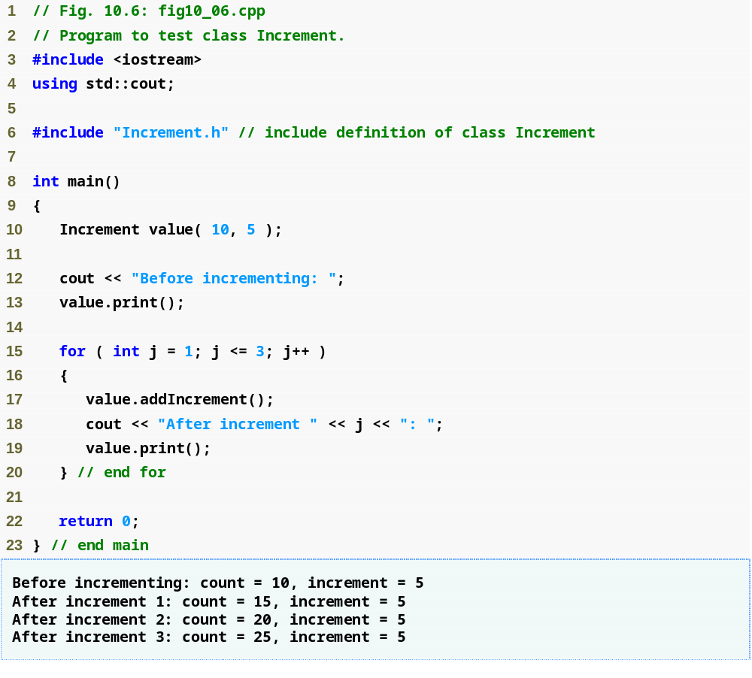
Outline
fig10_06.cpp
(1 of 1)

Slide 22
Software Engineering Observation 10.3
A const object cannot be modified by assignment, so it must be initialized. When a data member of a class is declared const, a member initializer must be used to provide the constructor with the initial value of the data member for an object of the class. The same is true for references.

Slide 23
Common Programming Error 10.5
Not providing a member initializer for a const data member is a compilation error.

Slide 24
Software Engineering Observation 10.4
Constant data members (const objects and const variables) and data members declared as references must be initialized with member initializer syntax; assignments for these types of data in the constructor body are not allowed.

Slide 25
Error-Prevention Tip 10.1
Declare as const all of a class’s member functions that do not modify the object in which they operate. Occasionally this may seem inappropriate, because you will have no intention of creating const objects of that class or accessing objects of that class through const references or pointers to const. Declaring such member functions const does offer a benefit, though. If the member function is inadvertently written to modify the object, the compiler will issue an error message.

Slide 26
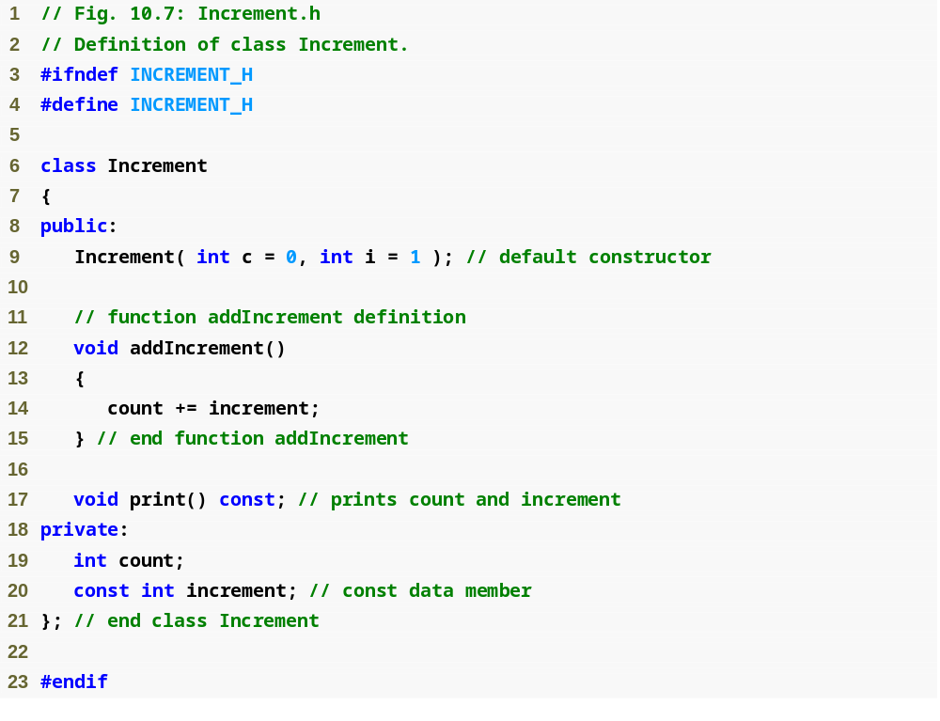
Outline
Increment.h
(1 of 1)

Slide 27
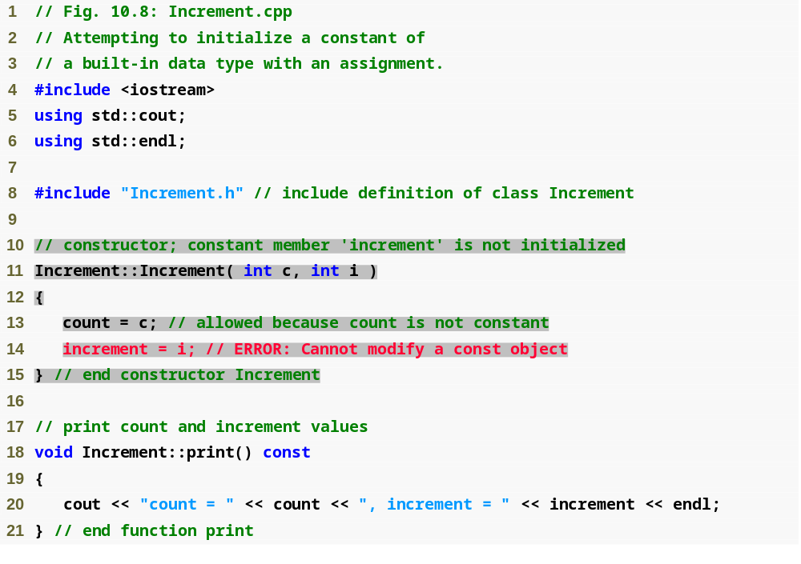
Outline
Increment.cpp
(1 of 1)

Slide 28
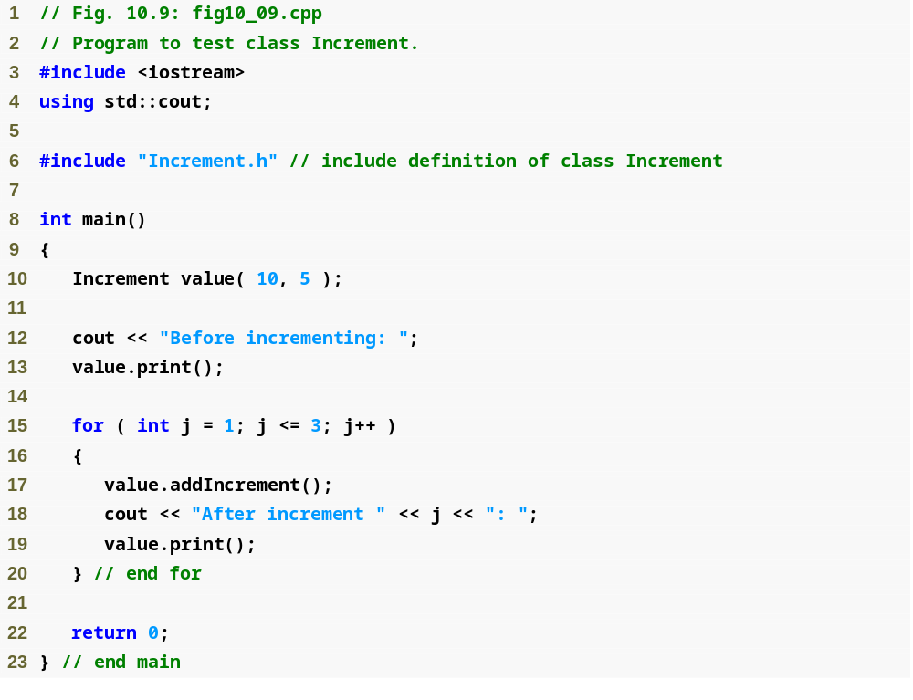
Outline
fig10_09.cpp
(1 of 2)

Slide 29
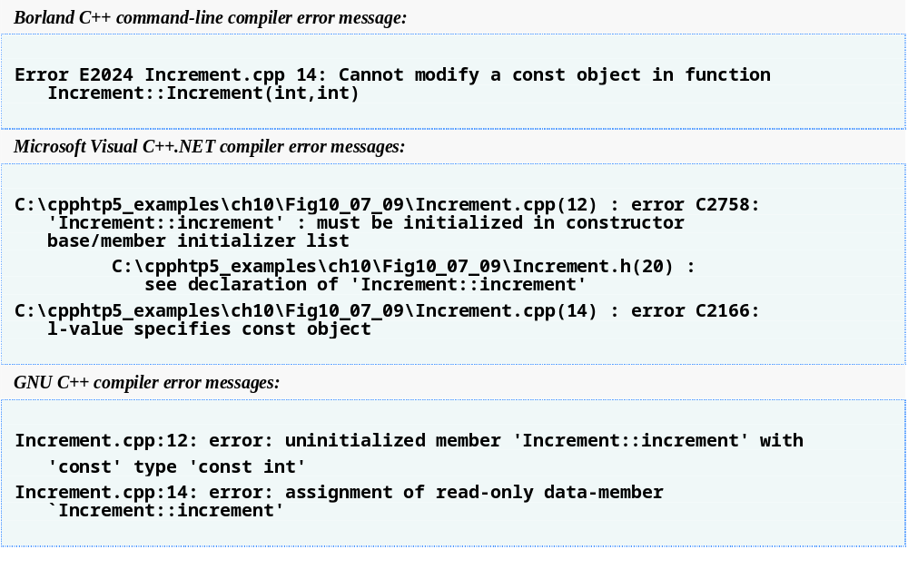
Outline
fig10_09.cpp
(2 of 2)

Slide 30
Software Engineering Observation 10.5
A common form of software reusability is composition, in which a class has objects of other classes as members.

Slide 31
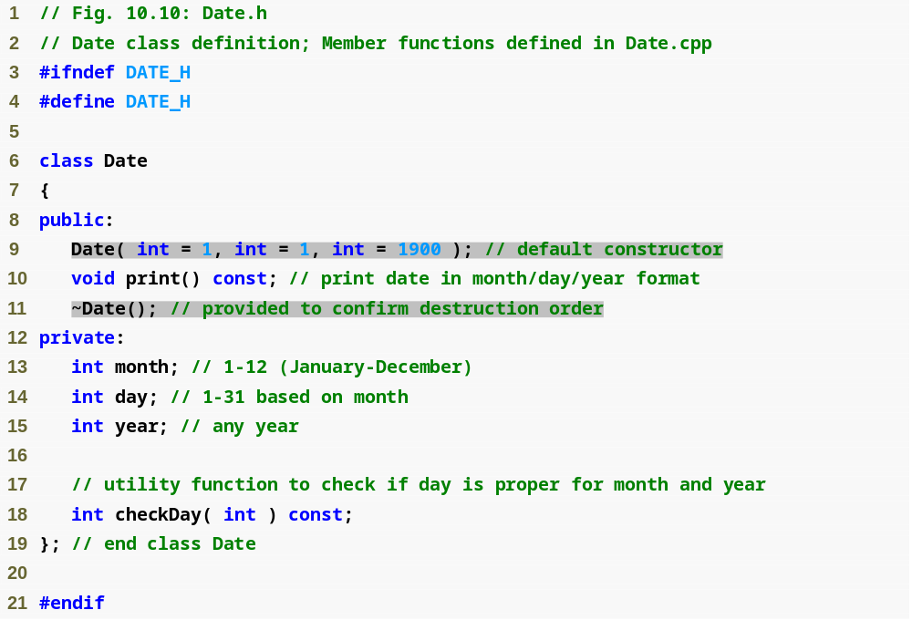
Outline
Date.h
(1 of 1)

Slide 32
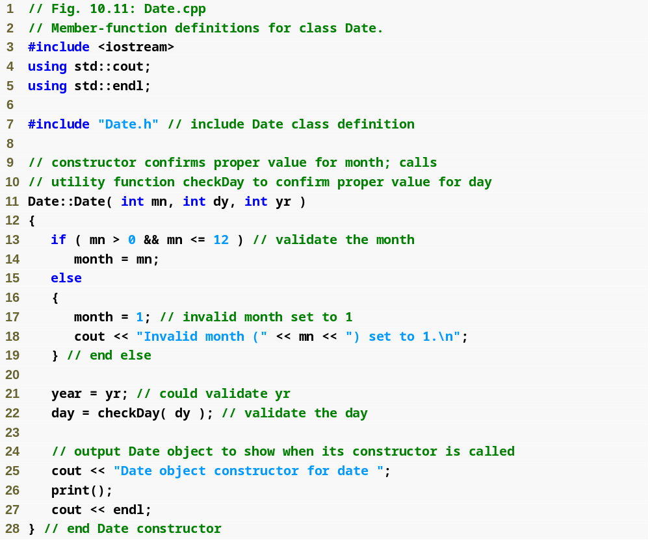
Outline
Date.cpp
(1 of 3)

Slide 33
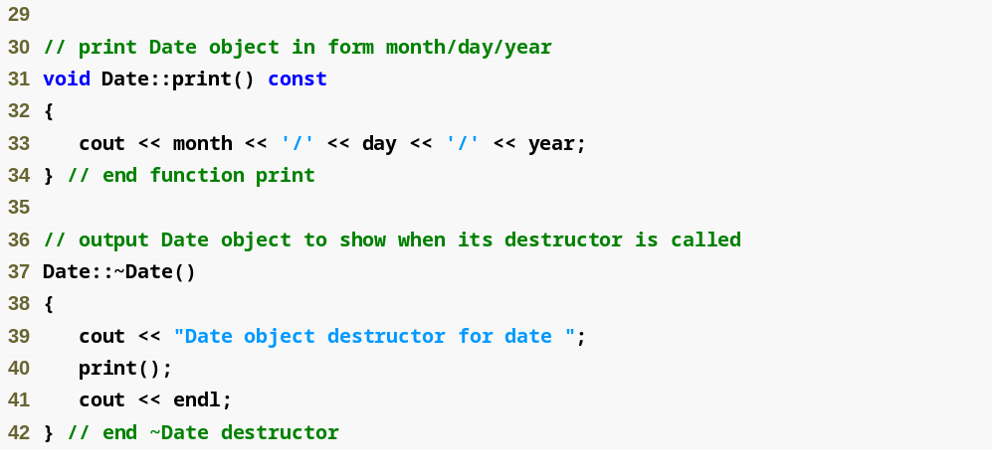
Outline
Date.cpp
(2 of 3)

Slide 34
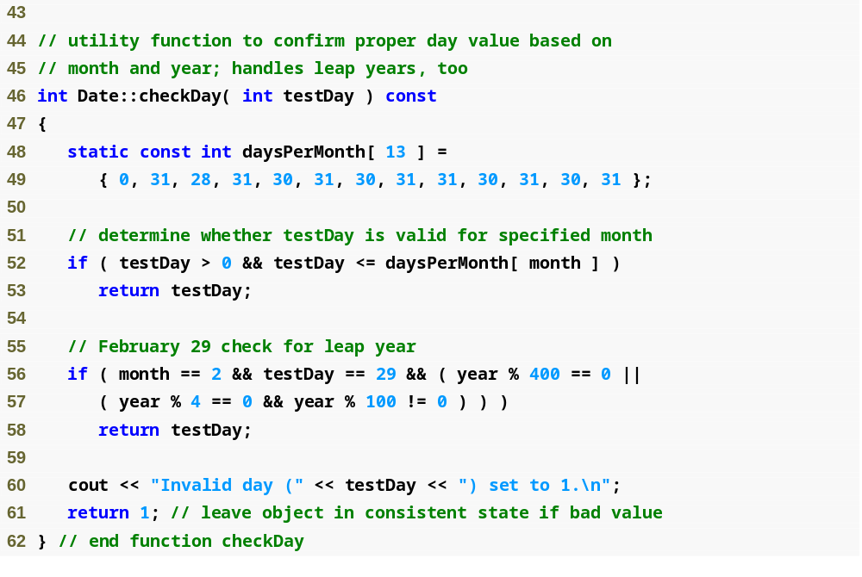
Outline
Date.cpp
(3 of 3)

Slide 35
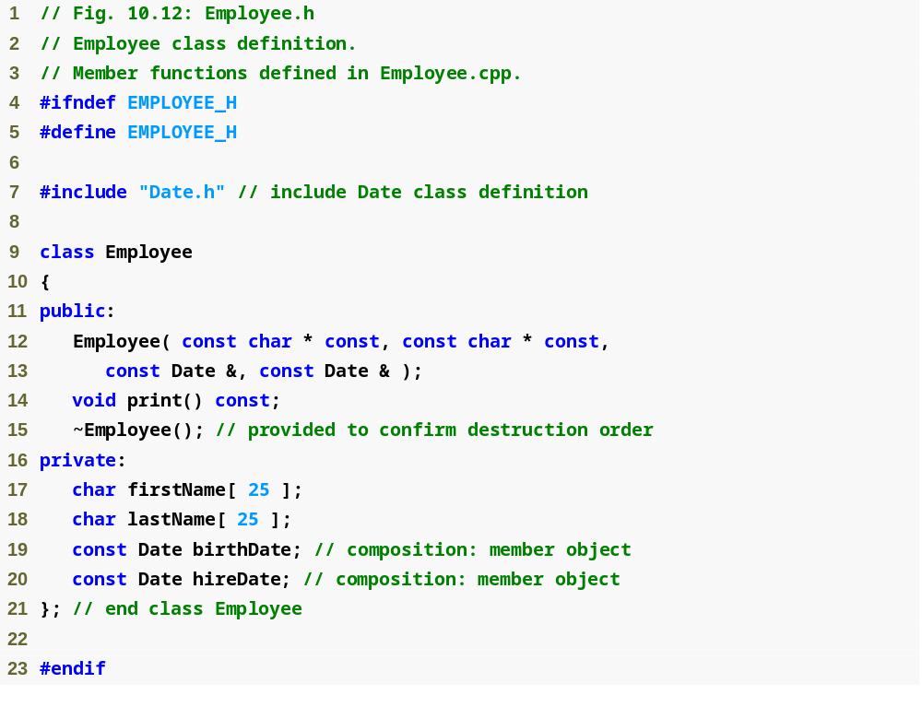
Outline
Employee.h
(1 of 1)

Slide 36
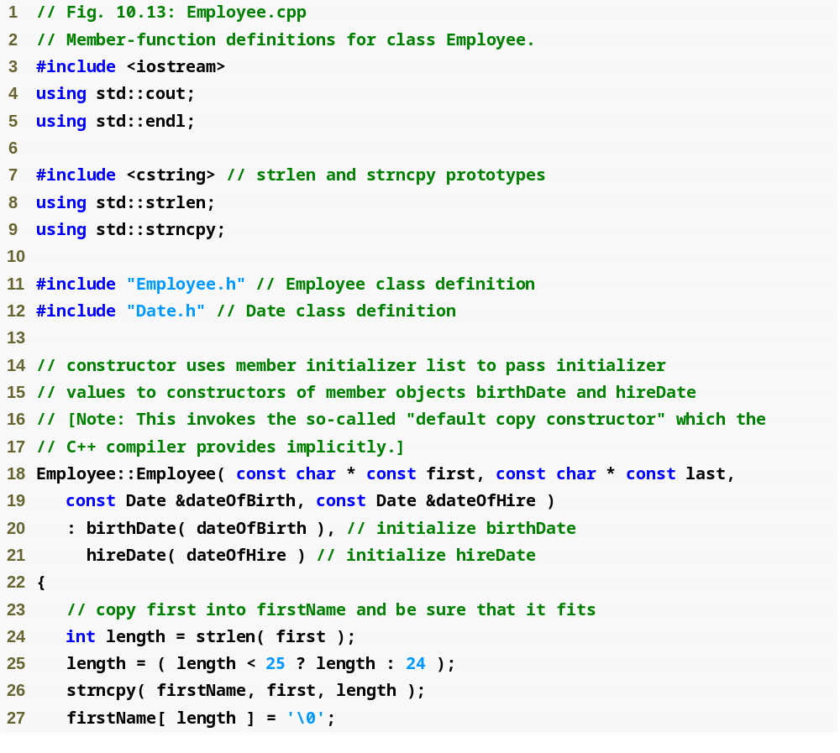
Outline
Employee.cpp
(1 of 2)

Slide 37
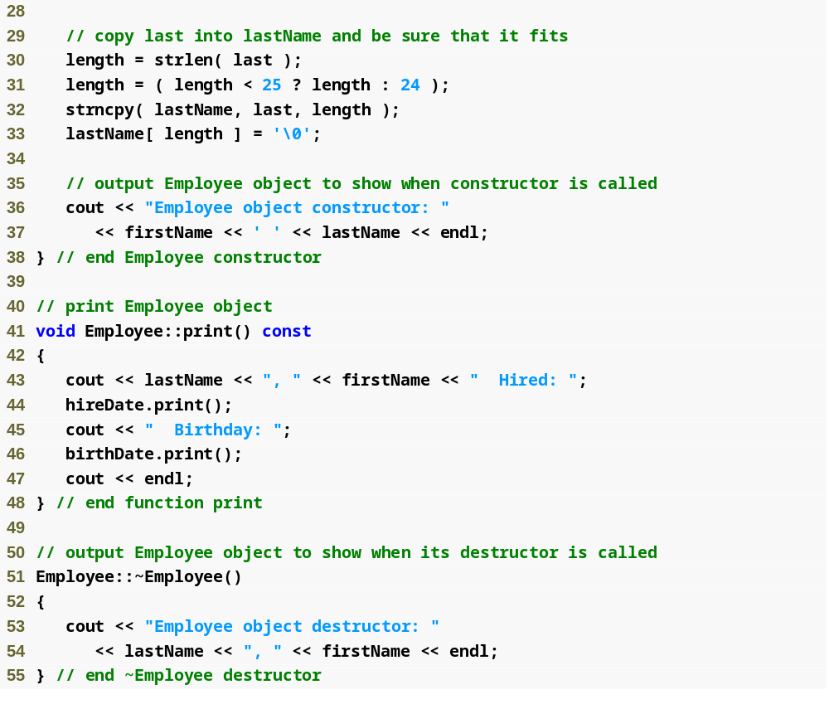
Outline
Employee.cpp
(2 of 2)

Slide 38
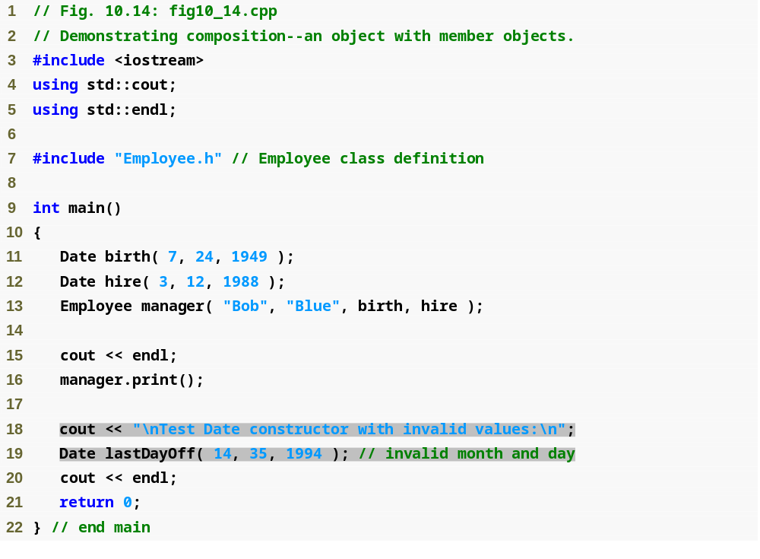
Outline
fig10_14.cpp
(1 of 2)

Slide 39
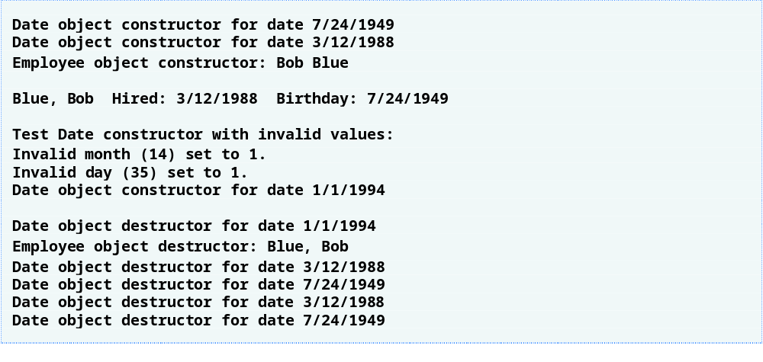
Outline
fig10_14.cpp
(2 of 2)

Slide 40
Common Programming Error 10.6
A compilation error occurs if a member object is not initialized with a member initializer and the member object’s class does not provide a default constructor (i.e., the member object’s class defines one or more constructors, but none is a default constructor).

Slide 41
Performance Tip 10.2
Initialize member objects explicitly through member initializers. This eliminates the overhead of “doubly initializing” member objects—once when the member object’s default constructor is called and again when set functions are called in the constructor body (or later) to initialize the member object.

Slide 42
Software Engineering Observation 10.6
If a class member is an object of another class, making that member object public does not violate the encapsulation and hiding of that member object’s private members. However, it does violate the encapsulation and hiding of the containing class’s implementation, so member objects of class types should still be private, like all other data members.

Slide 43
Software Engineering Observation 10.7
Even though the prototypes for friend functions appear in the class definition, friends are not member functions.

Slide 44
Software Engineering Observation 10.8
Member access notions of private, protected and public are not relevant to friend declarations, so friend declarations can be placed anywhere in a class definition.

Slide 45
Good Programming Practice 10.1
Place all friendship declarations first inside the class definition’s body and do not precede them with any access specifier.

Slide 46
Software Engineering Observation 10.9
Some people in the OOP community feel that “friendship” corrupts information hiding and weakens the value of the object-oriented design approach. In this text, we identify several examples of the responsible use of friendship.

Slide 47
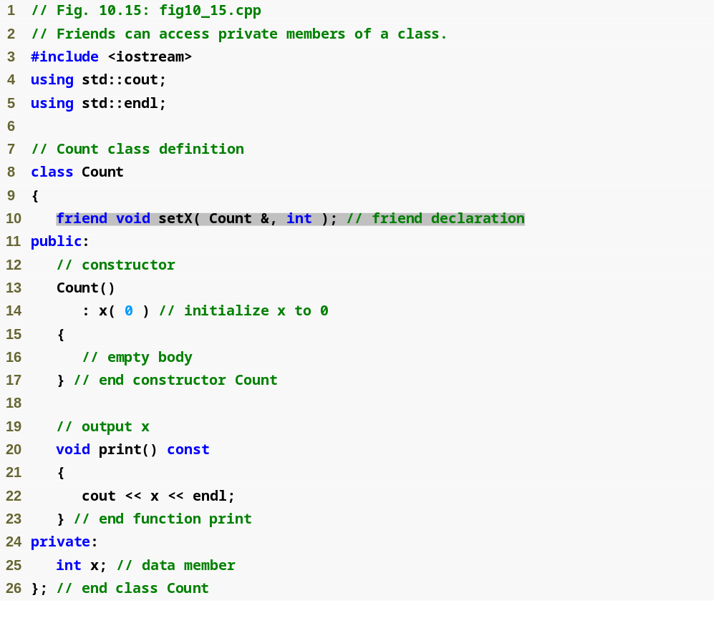
Outline
fig10_15.cpp
(1 of 2)

Slide 48
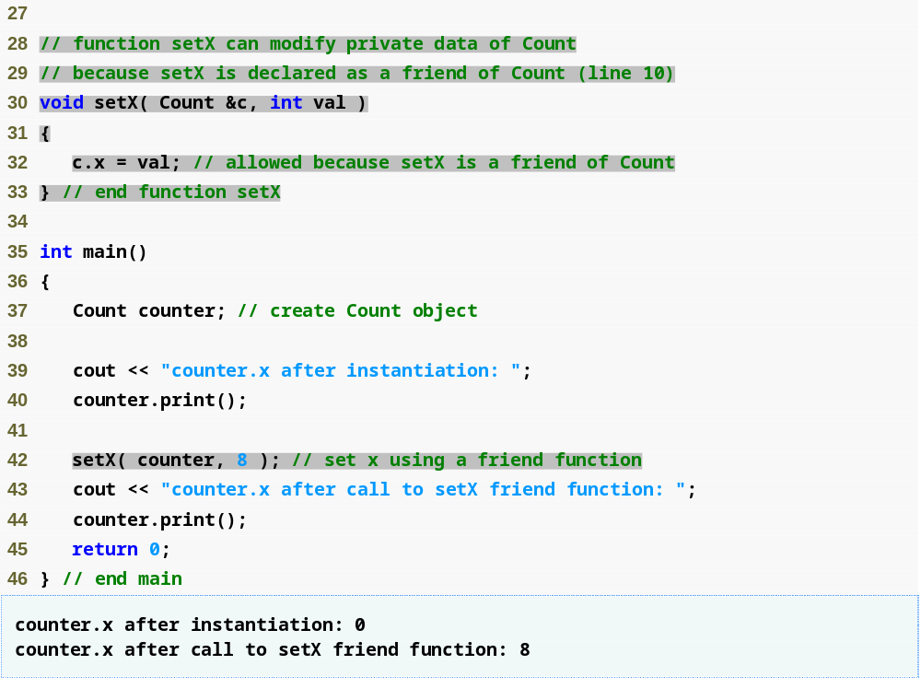
Outline
fig10_15.cpp
(2 of 2)

Slide 49
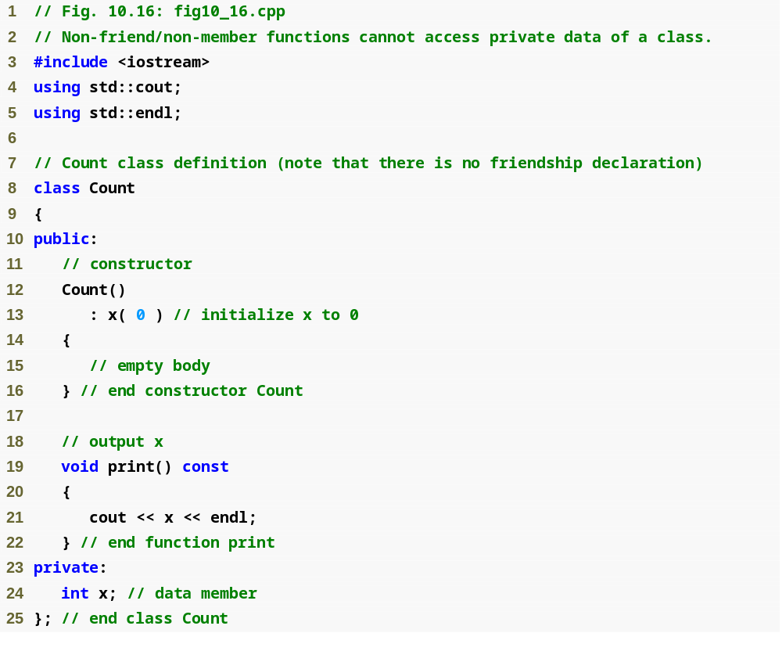
Outline
fig10_16.cpp
(1 of 3)

Slide 50
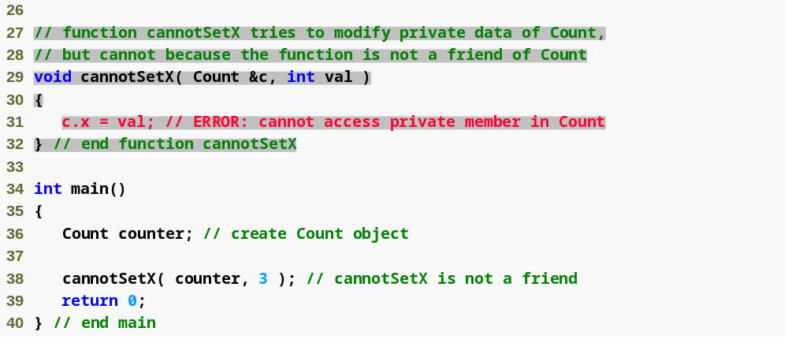
Outline
fig10_16.cpp
(2 of 3)

Slide 51
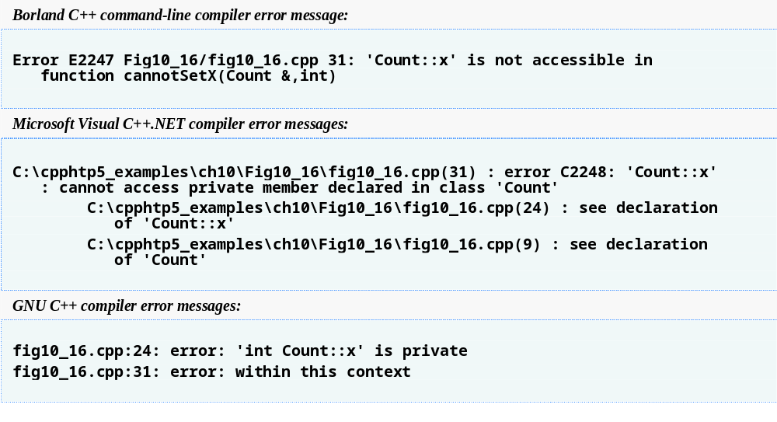
Outline
fig10_16.cpp
(3 of 3)

Slide 52
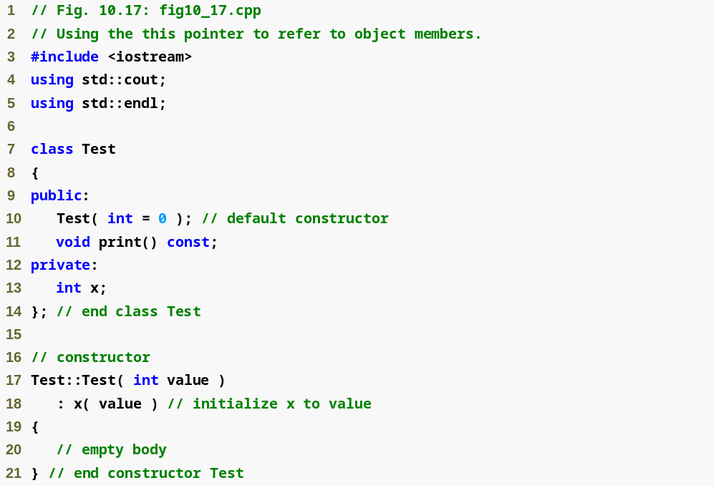
Outline
fig10_17.cpp
(1 of 2)

Slide 53
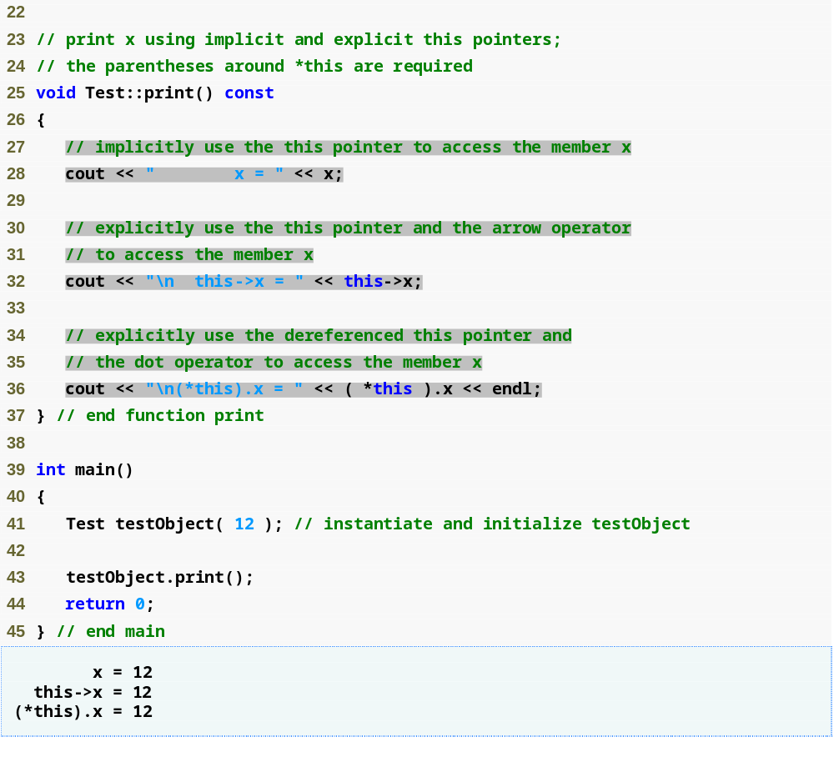
Outline
fig10_17.cpp
(2 of 2)

Slide 54
Common Programming Error 10.7
Attempting to use the member selection operator (.) with a pointer to an object is a compilation error—the dot member selection operator may be used only with an lvalue such as an object’s name, a reference to an object or a dereferenced pointer to an object.

Slide 55
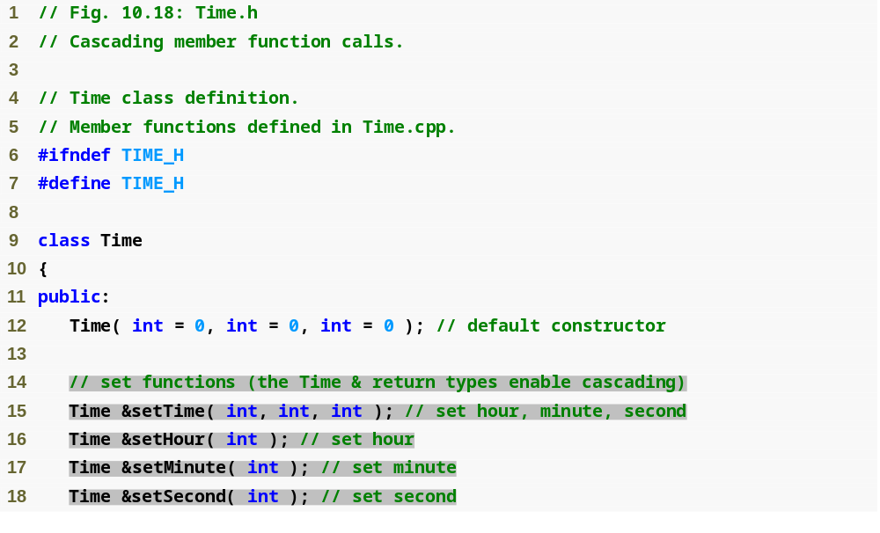
Outline
Time.h
(1 of 2)

Slide 56
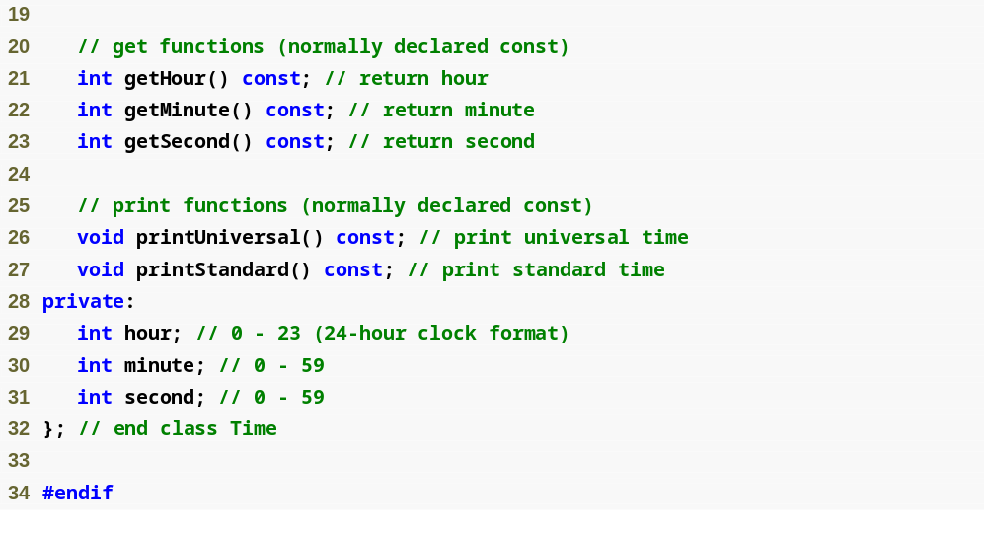
Outline
Time.h
(2 of 2)

Slide 57
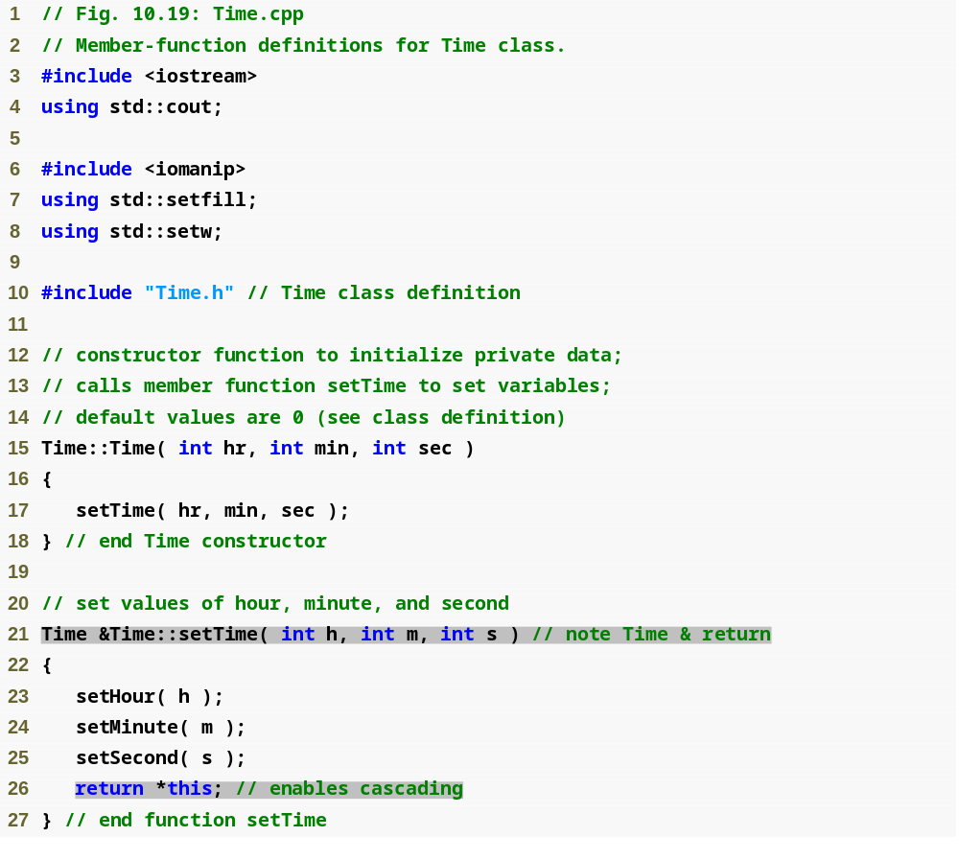
Outline
Time.cpp
(1 of 3)

Slide 58
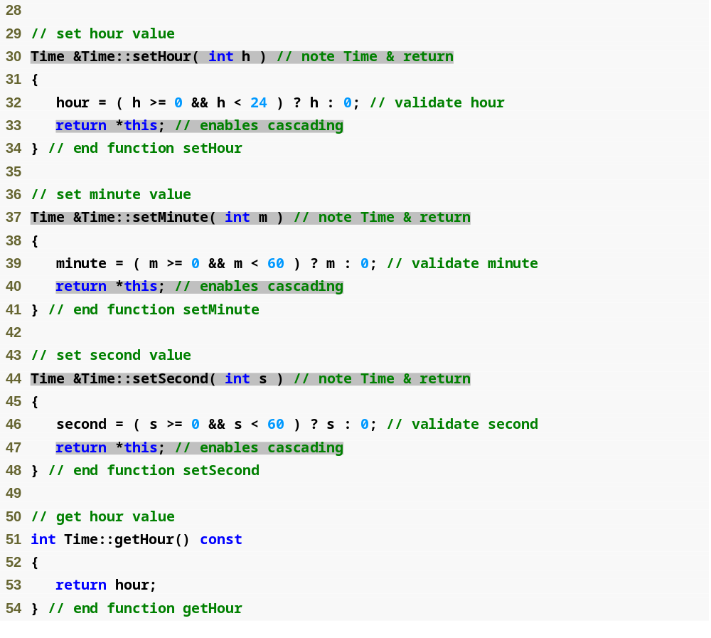
Outline
Time.cpp
(2 of 3)

Slide 59
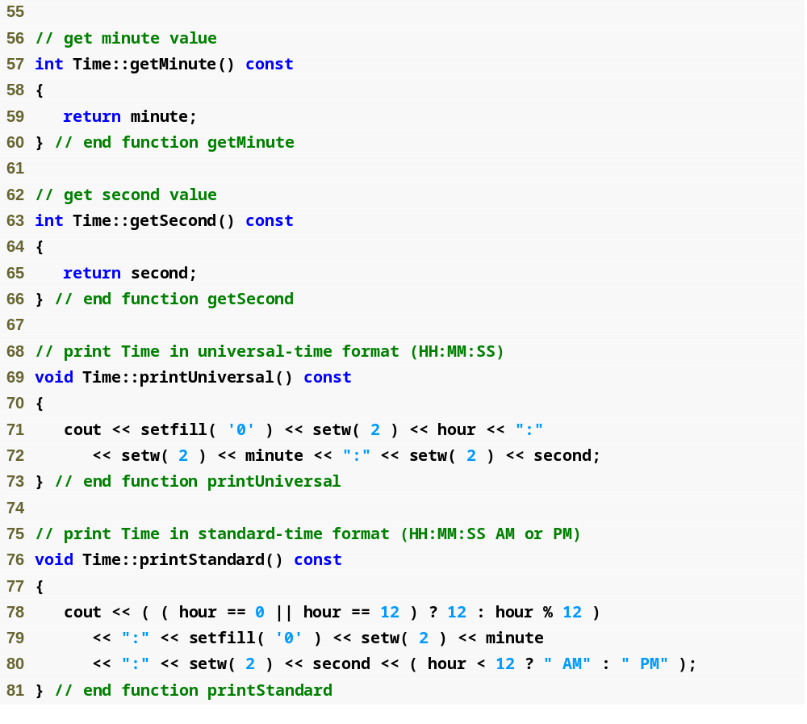
Outline
Time.cpp
(3 of 3)

Slide 60
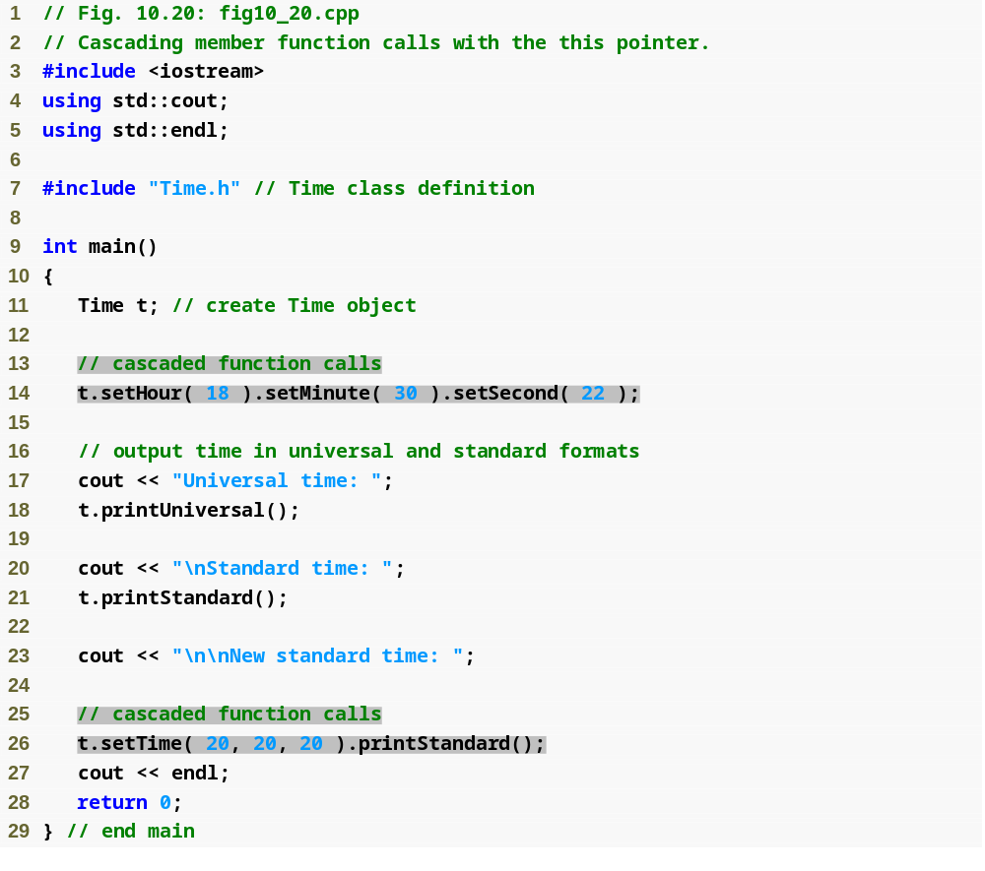
Outline
fig10_20.cpp
(1 of 2)

Slide 61
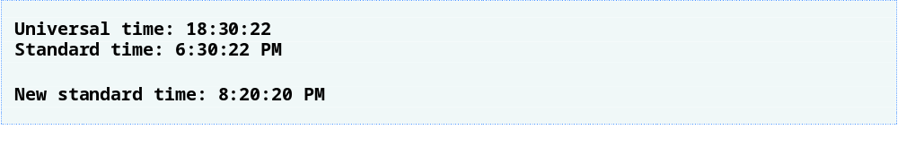
Outline
fig10_20.cpp
(2 of 2)

Slide 62
Common Programming Error 10.8
Not releasing dynamically allocated memory when it is no longer needed can cause the system to run out of memory prematurely. This is sometimes called a “memory leak.”

Slide 63
Common Programming Error 10.9
Using delete instead of delete [] for arrays of objects can lead to runtime logic errors. To ensure that every object in the array receives a destructor call, always delete memory allocated as an array with operator delete []. Similarly, always delete memory allocated as an individual element with operator delete.

Slide 64
Performance Tip 10.3
Use static data members to save storage when a single copy of the data for all objects of a class will suffice.

Slide 65
Software Engineering Observation 10.10
A class’s static data members and static member functions exist and can be used even if no objects of that class have been instantiated.

Slide 66
Common Programming Error 10.10
It is a compilation error to include keyword static in the definition of a static data members at file scope.

Slide 67
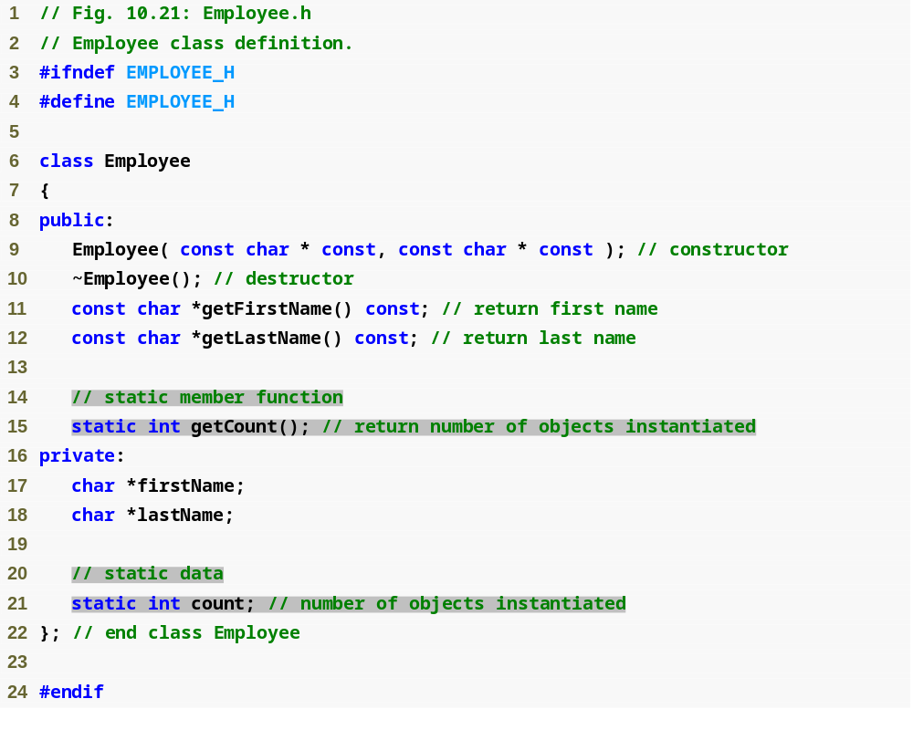
Outline
fig10_21.cpp
(1 of 1)

Slide 68
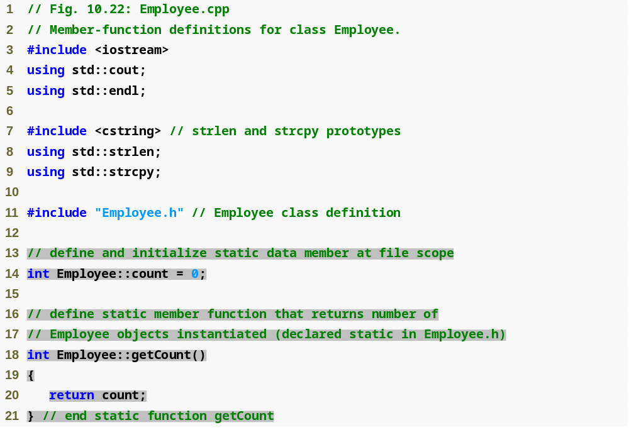
Outline
Employee.cpp
(1 of 3)

Slide 69
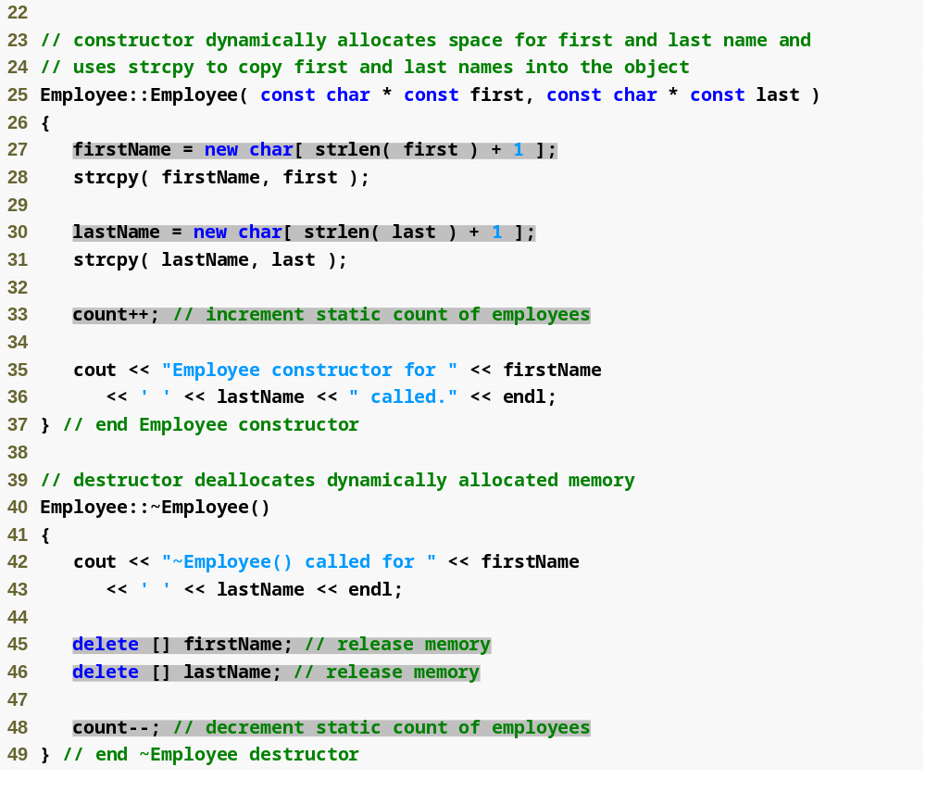
Outline
Employee.cpp
(2 of 3)

Slide 70
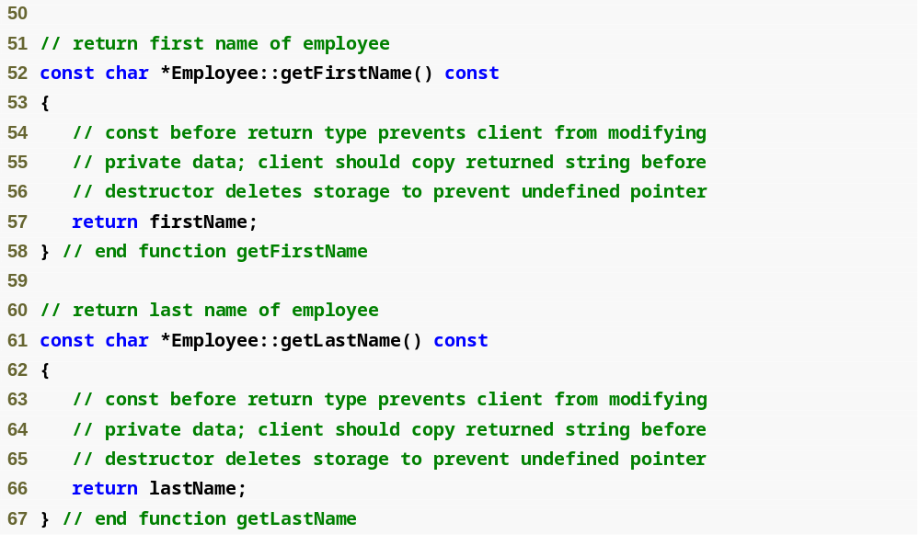
Outline
Employee.cpp
(3 of 3)

Slide 71
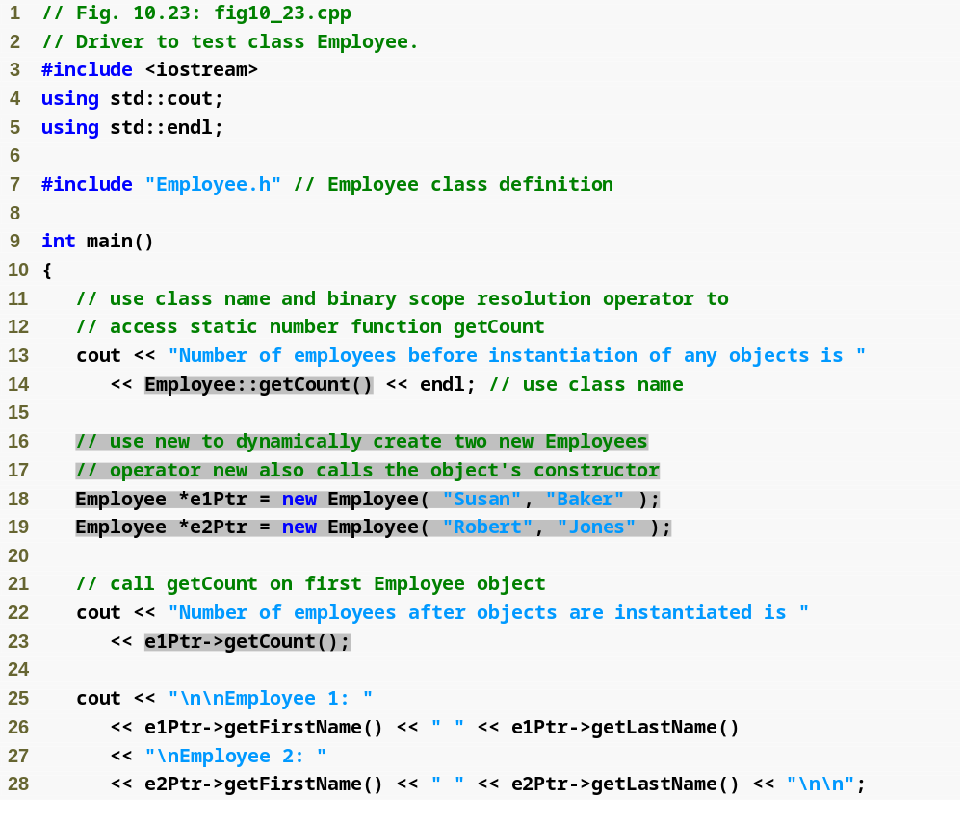
Outline
fig10_23.cpp
(1 of 2)

Slide 72
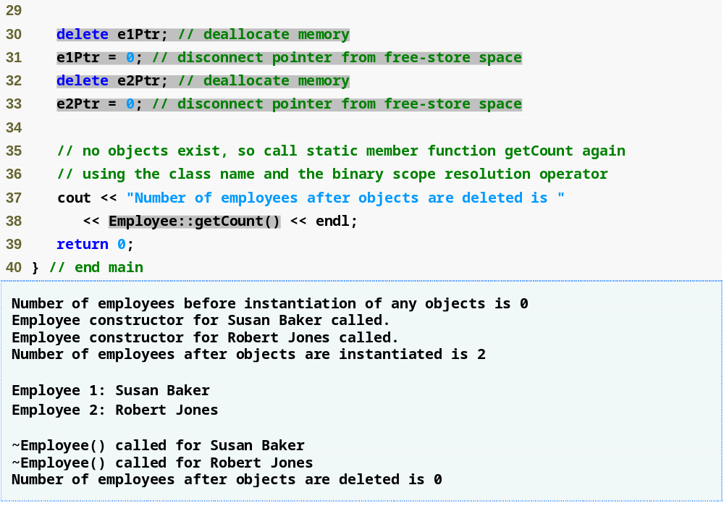
Outline
fig10_23.cpp
(2 of 2)

Slide 73
Software Engineering Observation 10.11
Some organizations specify in their software engineering standards that all calls to static member functions be made using the class name and not an object handle.

Slide 74
Common Programming Error 10.11
Using the this pointer in a static member function is a compilation error.

Slide 75
Common Programming Error 10.12
Declaring a static member function const is a compilation error. The const qualifier indicates that a function cannot modify the contents of the object in which it operates, but static member functions exist and operate independently of any objects of the class.

Slide 76
Error-Prevention Tip 10.2
After deleting dynamically allocated memory, set the pointer that referred to that memory to 0. This disconnects the pointer from the previously allocated space on the free store. This space in memory could still contain information, despite having been deleted. By setting the pointer to 0, the program loses any access to that free-store space, which, in fact, could have already been reallocated for a different purpose. If you didn't set the pointer to 0, your code could inadvertently access this new information, causing extremely subtle, nonrepeatable logic errors.

Slide 77
Software Engineering Observation 10.12
The programmer is able to create new types through the class mechanism. These new types can be designed to be used as conveniently as the built-in types. Thus, C++ is an extensible language. Although the language is easy to extend with these new types, the base language itself cannot be changed.

Slide 78
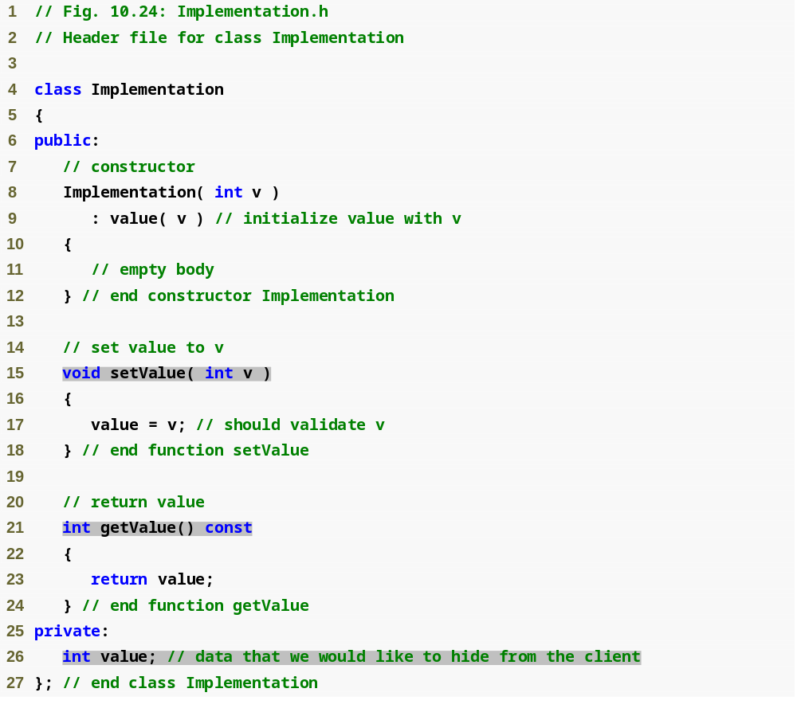
Outline
Implementation.h
(1 of 1)

Slide 79
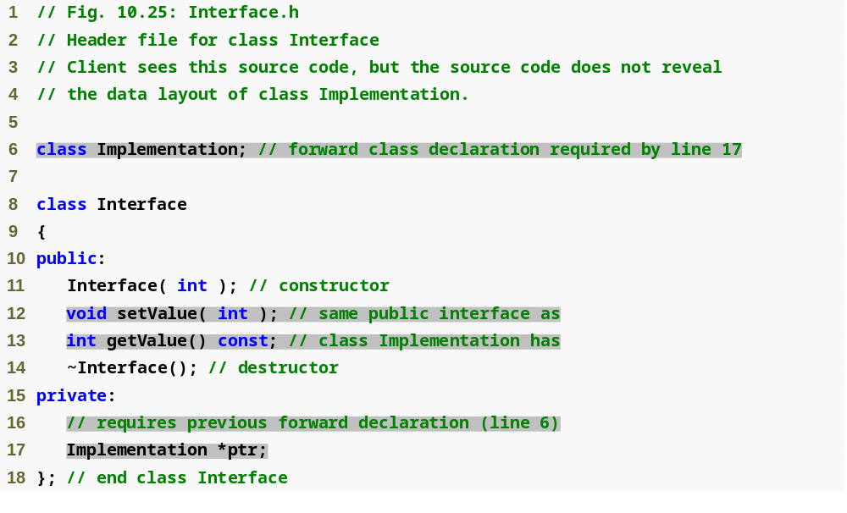
Outline
Interface.h
(1 of 1)

Slide 80
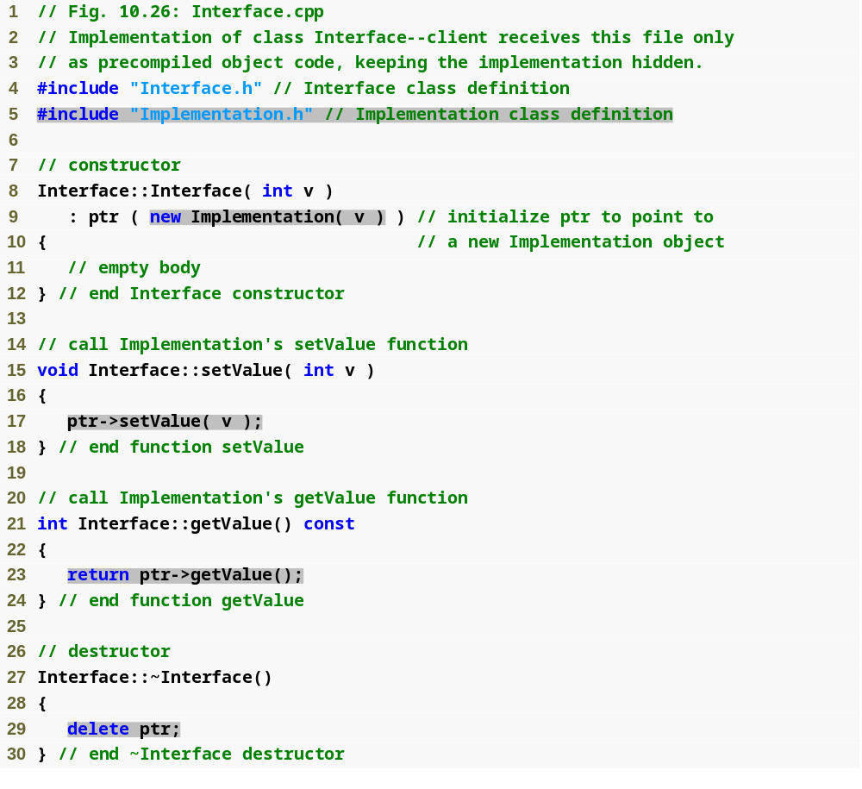
Outline
Interface.cpp
(1 of 1)

Slide 81
Software Engineering Observation 10.13
A proxy class insulates client code from implementation changes.

Slide 82
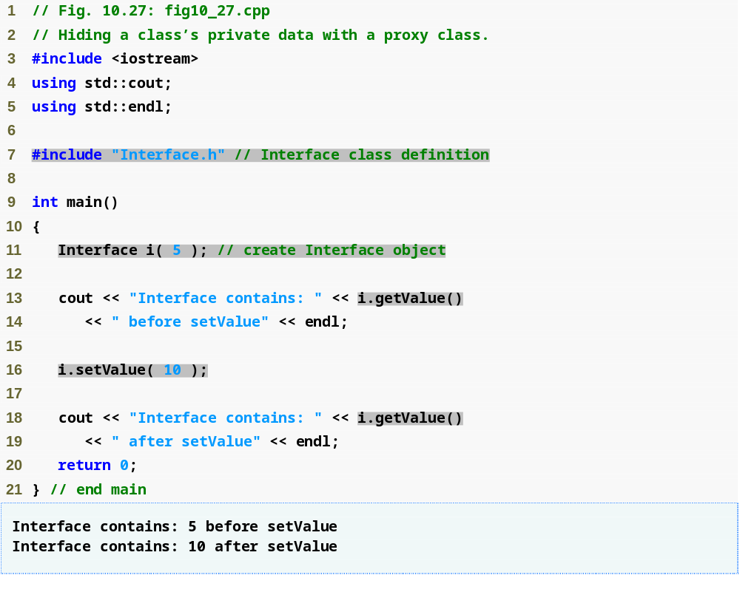
Outline
fig10_27.cpp
(1 of 1)

