Slide 1
12
Object-Oriented
Programming:
Inheritance

Slide 2
Say not you know another entirely, till you have divided an inheritance with him.
  Johann Kasper Lavater
This method is to define as the number of a class the class of all classes similar to the given class.
  Bertrand Russell
Good as it is to inherit a library, it is better to collect one.
  Augustine Birrell
Save base authority from others’ books.
  William Shakespeare

Slide 3
OBJECTIVES
In this chapter you will learn:
To create classes by inheriting from existing classes.
How inheritance promotes software reuse.
The notions of base classes and derived classes and the relationships between them.
The protected member access specifier.
The use of constructors and destructors in inheritance hierarchies.
The differences between public, protected and private inheritance.
The use of inheritance to customize existing software.

Slide 4
12.1 Introduction
12.2 Base Classes and Derived Classes
12.3 protected Members
12.4 Relationship between Base Classes and Derived Classes
12.4.1 Creating and Using a CommissionEmployee Class
12.4.2 Creating a BasePlusCommissionEmployee Class Without Using Inheritance
12.4.3 Creating a CommissionEmployee-BasePlusCommissionEmployee Inheritance Hierarchy
12.4.4 CommissionEmployee-BasePlusCommissionEmployee Inheritance Hierarchy Using protected Data
12.4.5 CommissionEmployee-BasePlusCommissionEmployee Inheritance Hierarchy Using private Data
12.5 Constructors and Destructors in Derived Classes
12.6 public, protected and private Inheritance
12.7 Software Engineering with Inheritance
12.8 Wrap-Up

Slide 5
Software Engineering Observation 12.1
Member functions of a derived class cannot directly access private members of the base class.

Slide 6
Software Engineering Observation 12.2
If a derived class could access its base class’s private members, classes that inherit from that derived class could access that data as well. This would propagate access to what should be private data, and the benefits of information hiding would be lost.

Slide 7
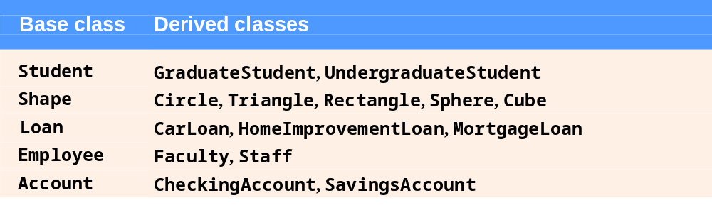
Fig. 12.1 | Inheritance examples.

Slide 8
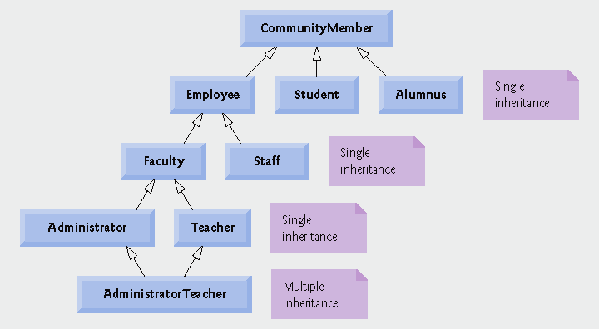
Fig. 12.2 | Inheritance hierarchy for university CommunityMembers.

Slide 9
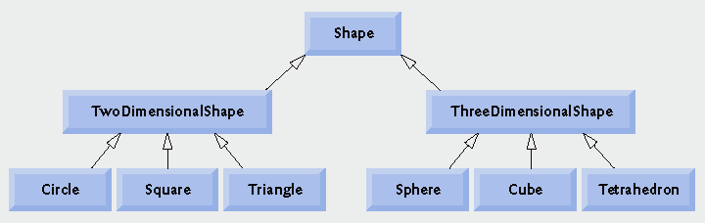
Fig. 12.3 | Inheritance hierarchy for Shapes.

Slide 10
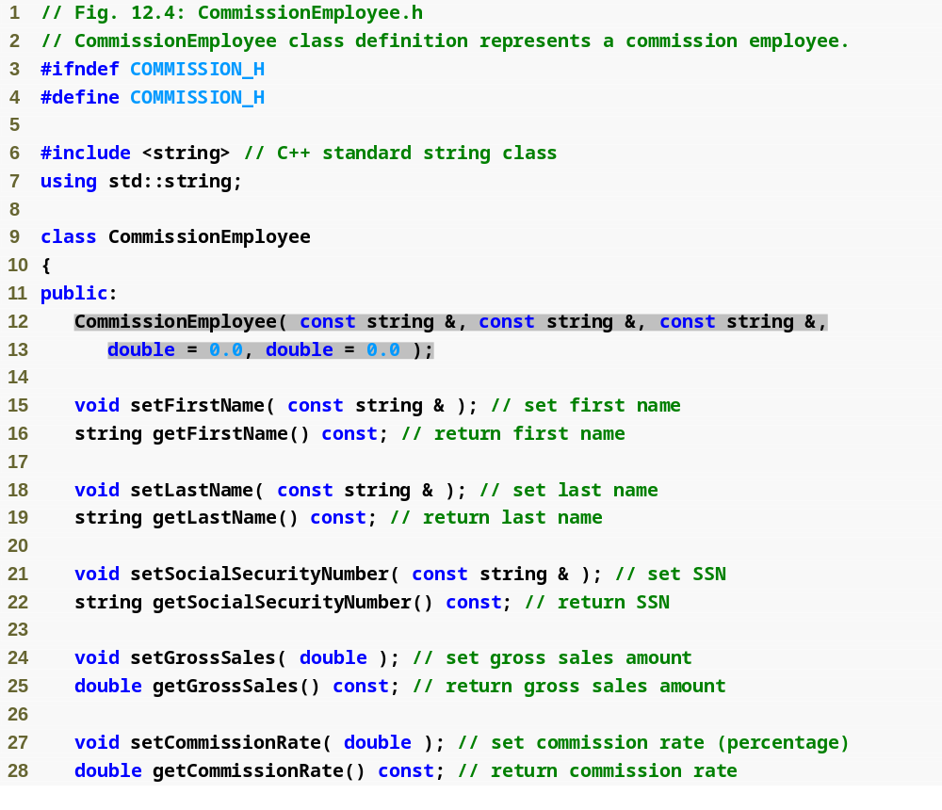
Outline
Commission
Employee.h
(1 of 2)

Slide 11
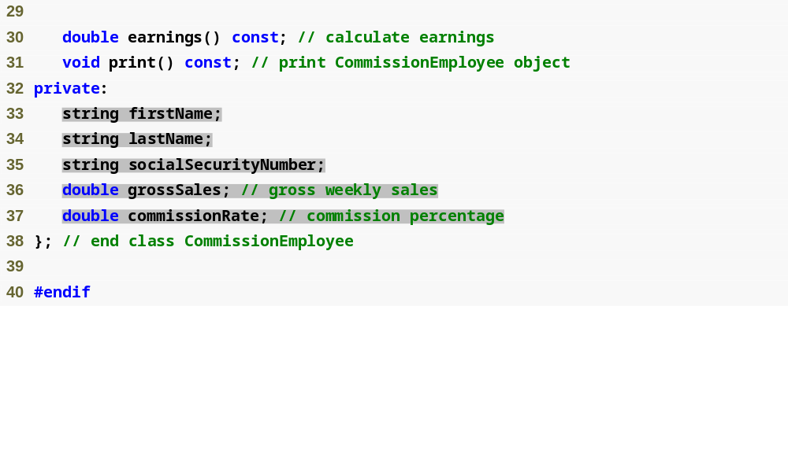
Outline
Commission
Employee.h
(2 of 2)

Slide 12
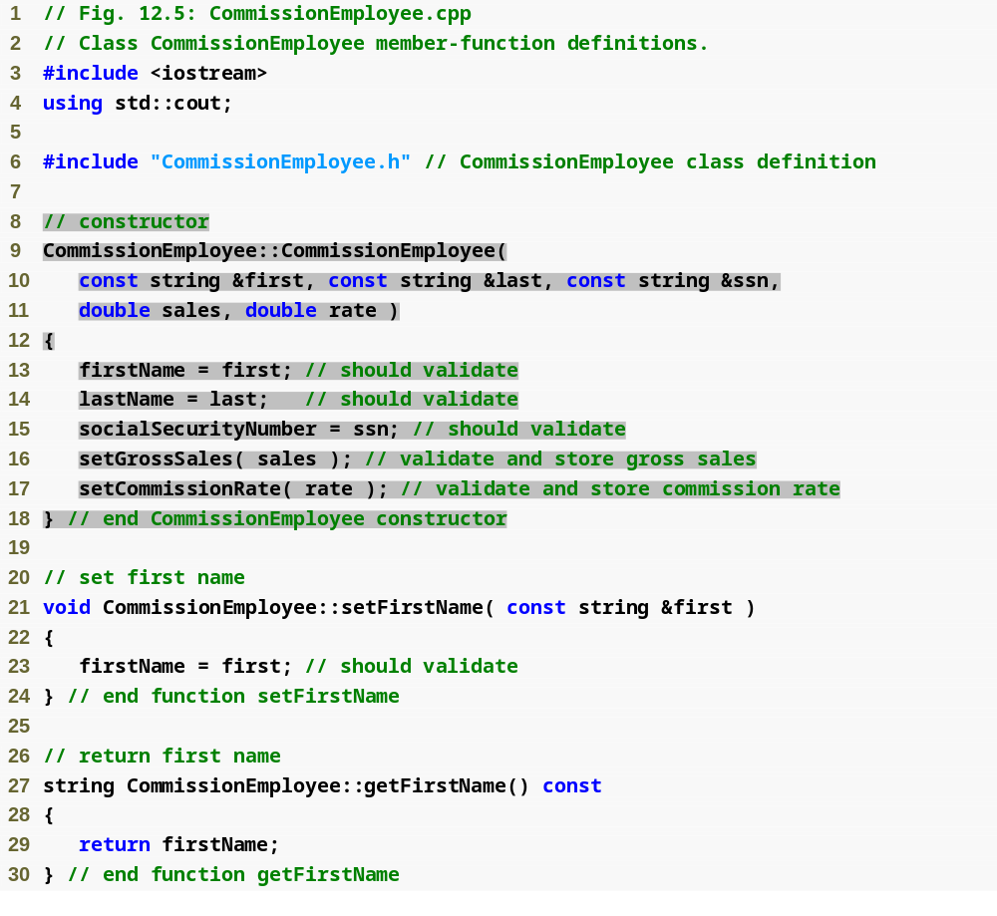
Outline
Commission
Employee.cpp
(1 of 4)

Slide 13
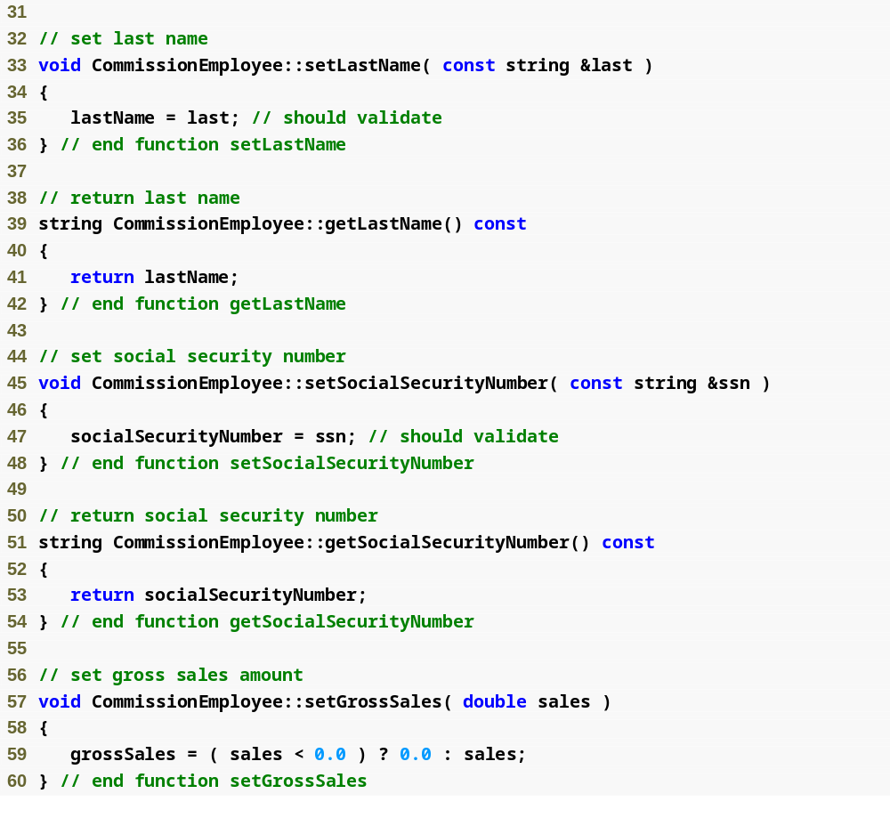
Outline
Commission
Employee.cpp
(2 of 4)

Slide 14
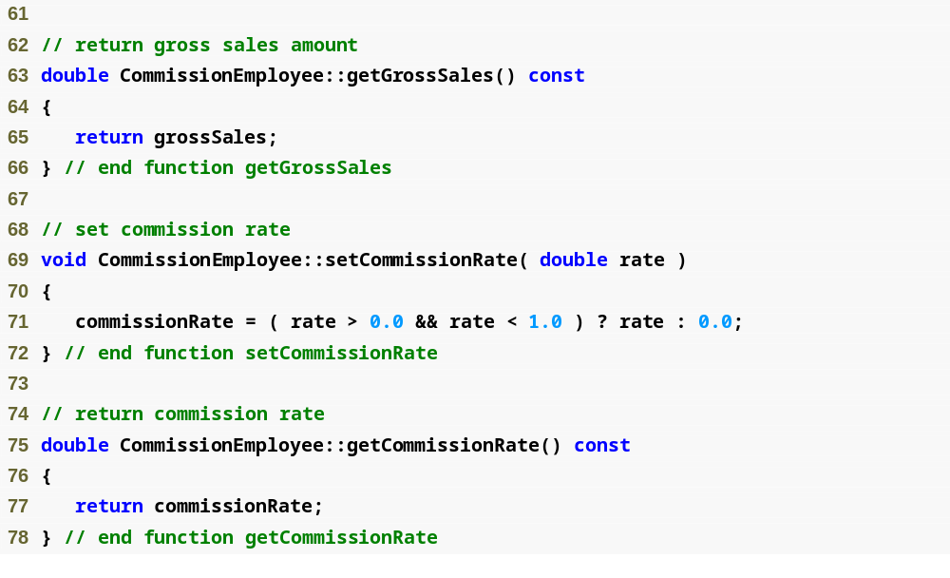
Outline
Commission
Employee.cpp
(3 of 4)

Slide 15
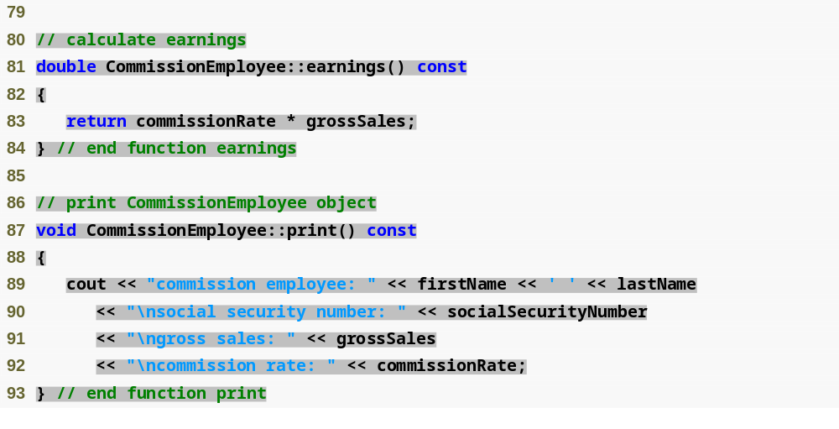
Outline
Commission
Employee.cpp
(4 of 4)

Slide 16
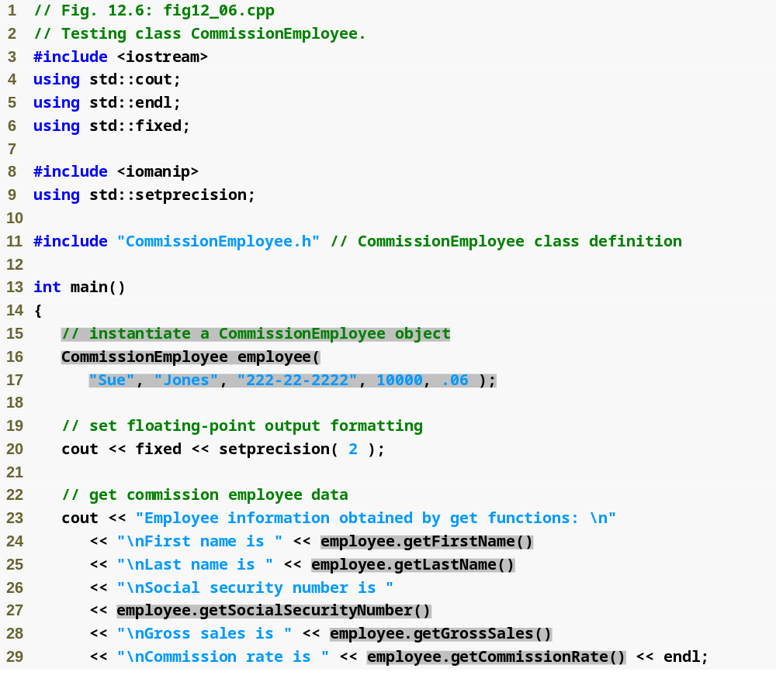
Outline
fig12_06.cpp
(1 of 2)

Slide 17
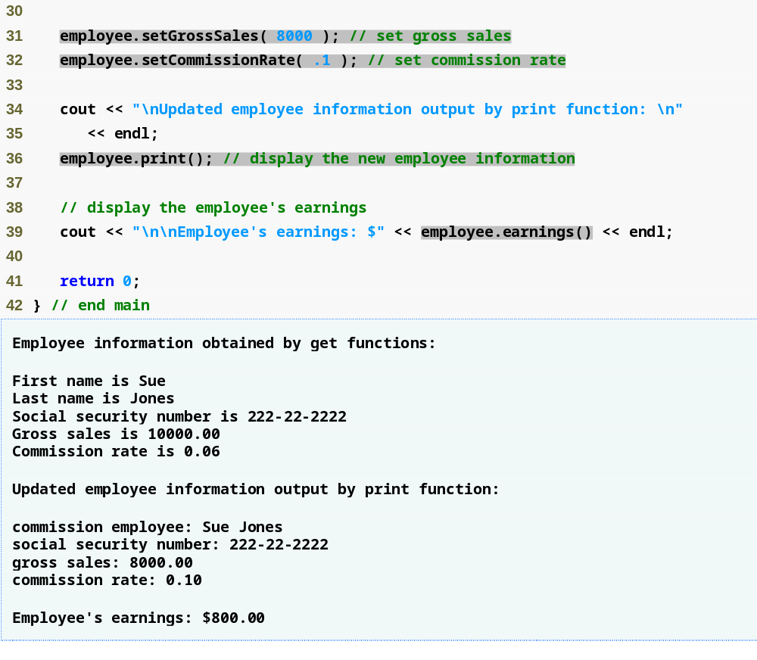
Outline
fig12_06.cpp
(2 of 2)

Slide 18
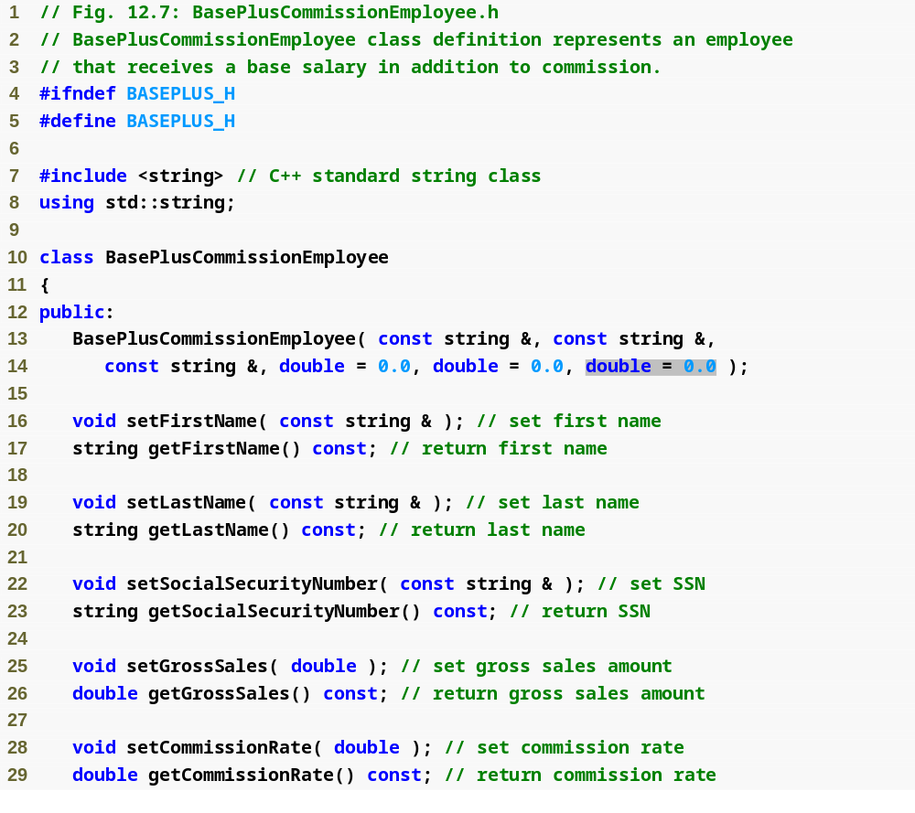
Outline
BasePlus
Commission
Employee.h
(1 of 2)

Slide 19
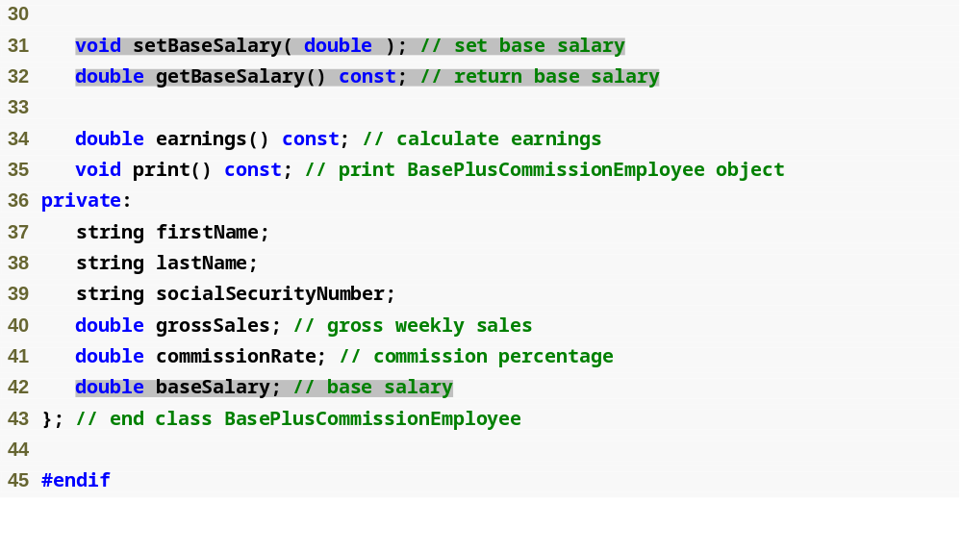
Outline
BasePlus
Commission
Employee.h
(2 of 2)

Slide 20
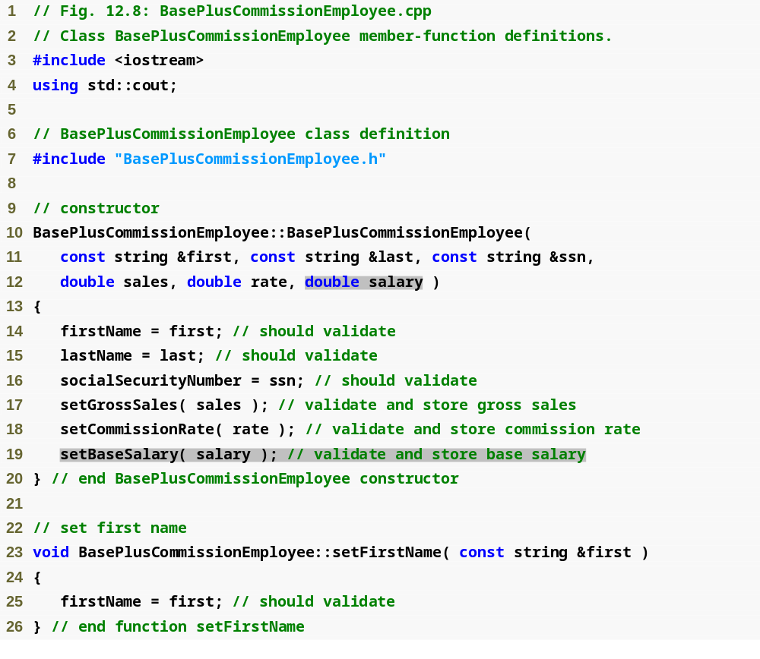
Outline
BasePlus
Commission
Employee.cpp
(1 of 4)

Slide 21
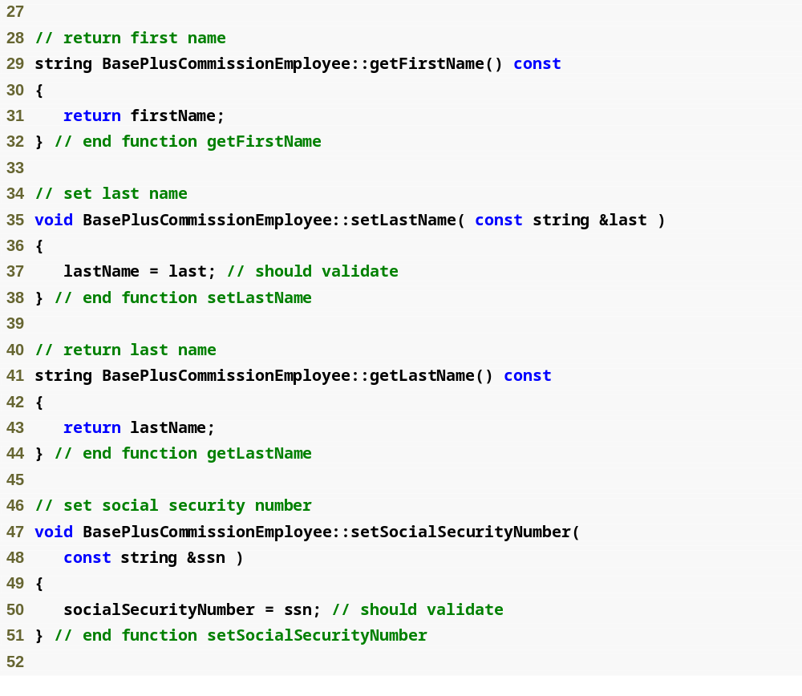
Outline
BasePlus
Commission
Employee.cpp
(2 of 4)

Slide 22
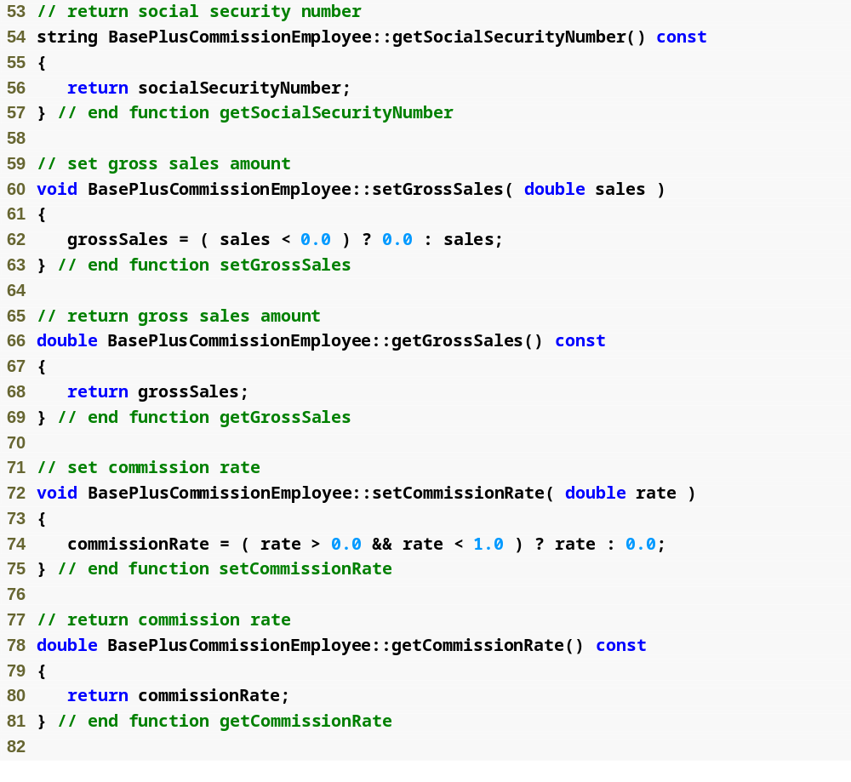
Outline
BasePlus
Commission
Employee.cpp
(3 of 4)

Slide 23
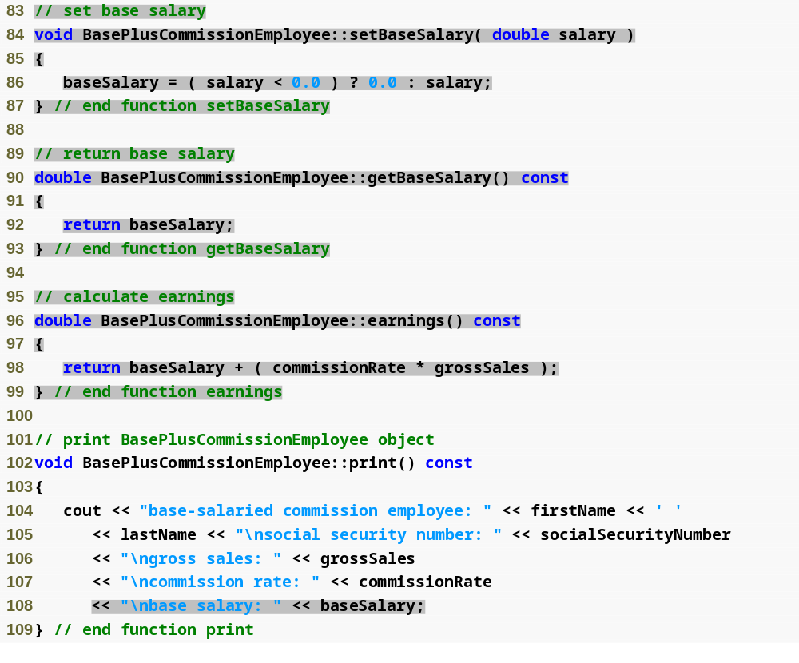
Outline
BasePlus
Commission
Employee.cpp
(4 of 4)

Slide 24
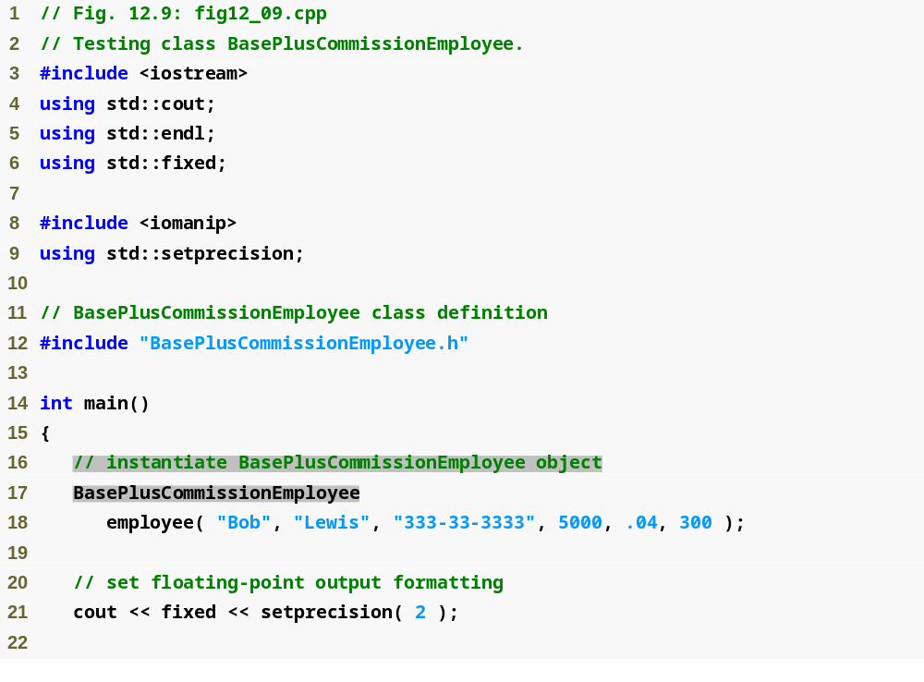
Outline
fig12_09.cpp
(1 of 3)

Slide 25
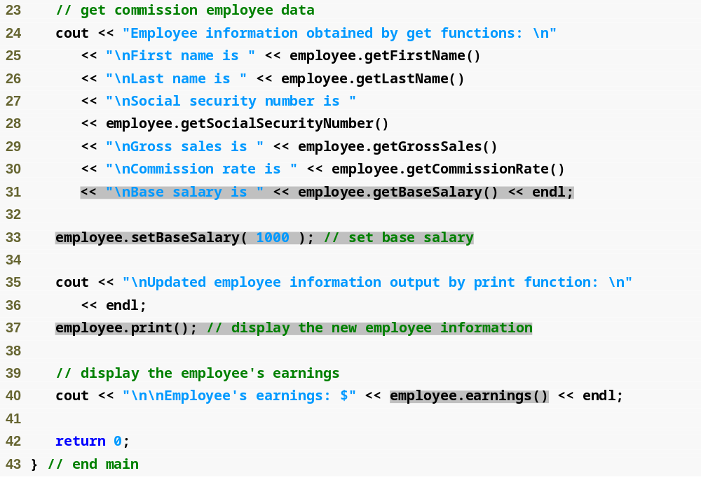
Outline
fig12_09.cpp
(2 of 3)

Slide 26
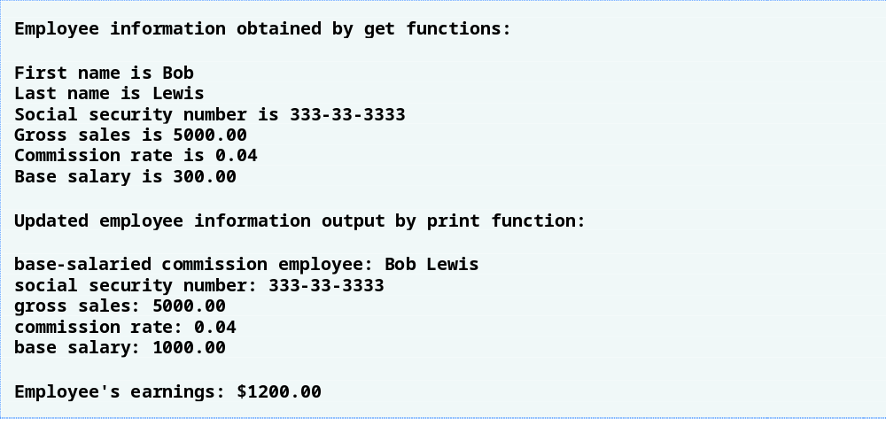
Outline
fig12_09.cpp
(3 of 3)

Slide 27
Software Engineering Observation 12.3
Copying and pasting code from one class to another can spread errors across multiple source code files. To avoid duplicating code (and possibly errors), use inheritance, rather than the “copy-and-paste” approach, in situations where you want one class to “absorb” the data members and member functions of another class.

Slide 28
Software Engineering Observation 12.4
With inheritance, the common data members and member functions of all the classes in the hierarchy are declared in a base class. When changes are required for these common features, software developers need to make the changes only in the base class—derived classes then inherit the changes. Without inheritance, changes would need to be made to all the source code files that contain a copy of the code in question.

Slide 29
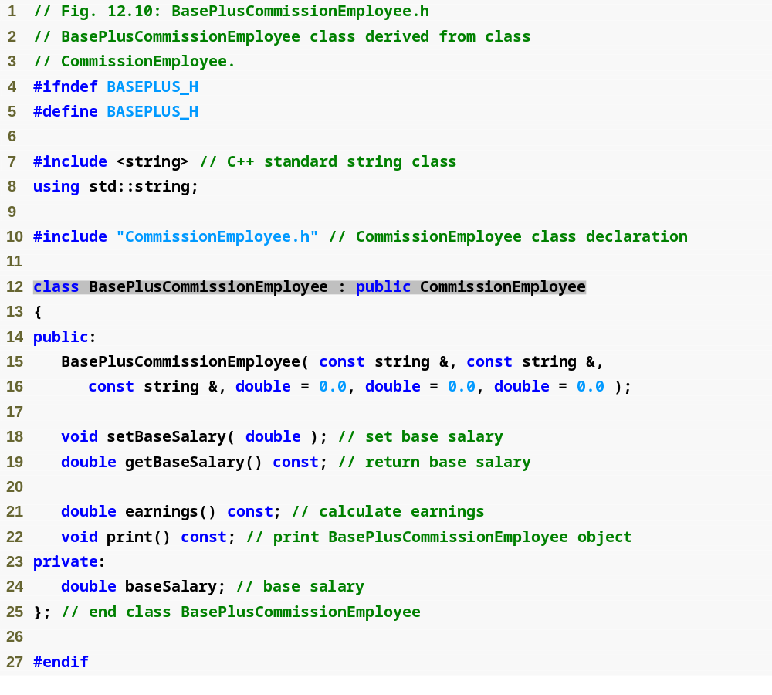
Outline
BasePlus
Commission
Employee.h
(1 of 1)

Slide 30
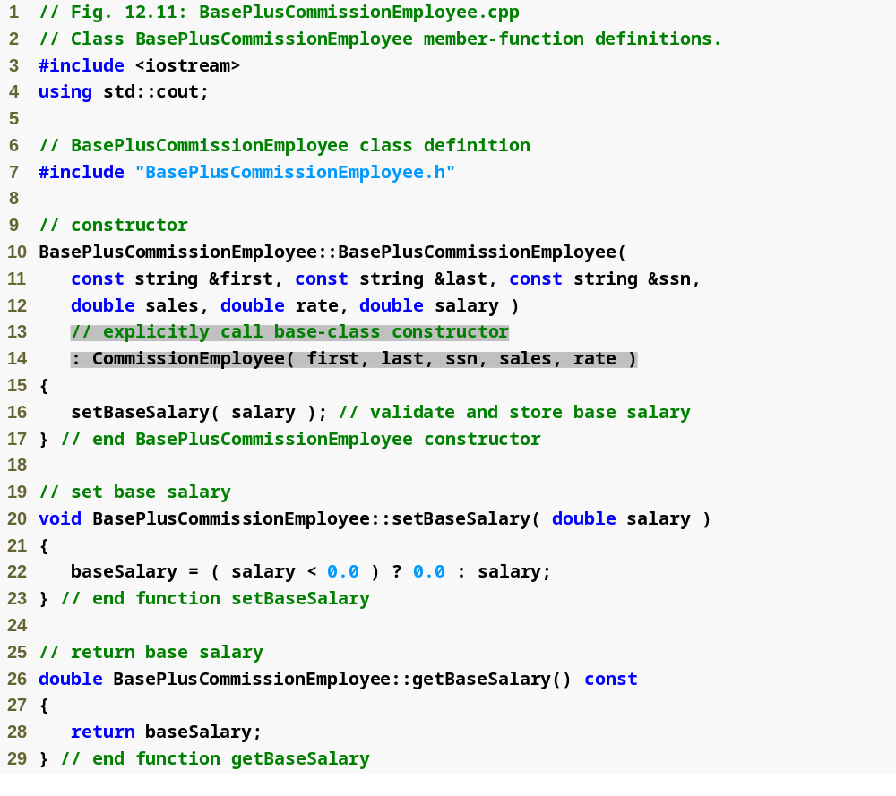
Outline
BasePlus
Commission
Employee.cpp
(1 of 4)

Slide 31
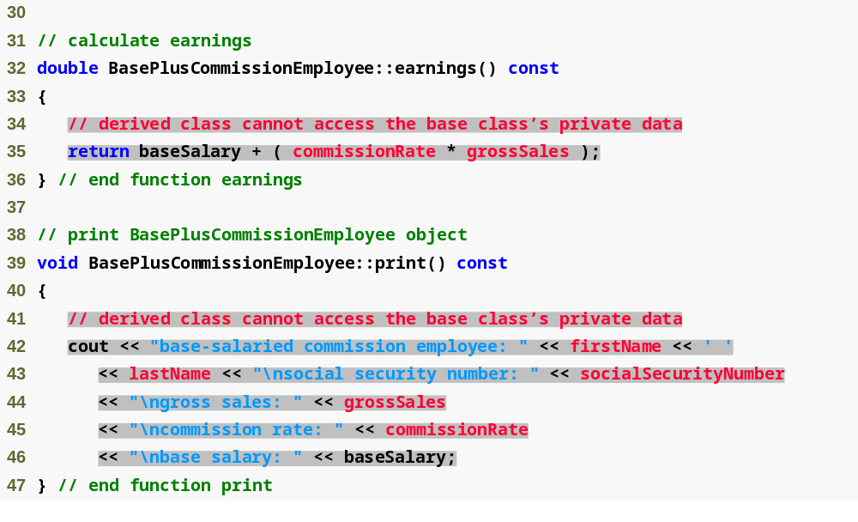
Outline
BasePlus
Commission
Employee.cpp
(2 of 4)

Slide 32
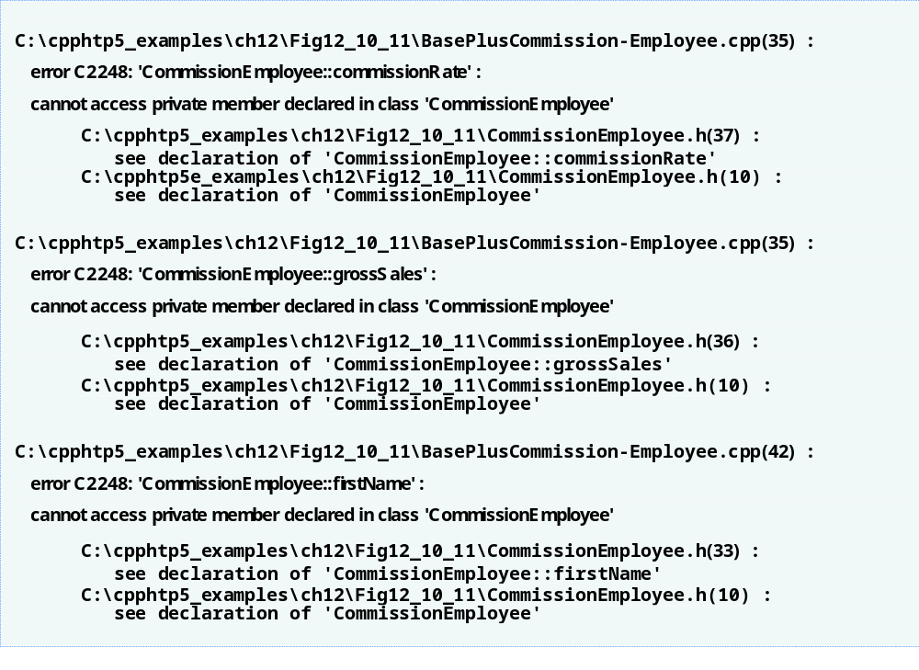
Outline
BasePlus
Commission
Employee.cpp
(3 of 4)

Slide 33
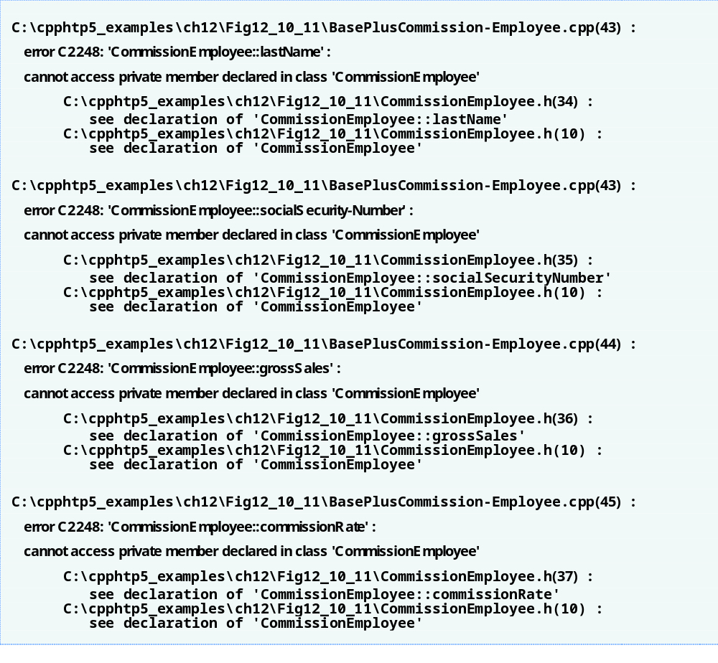
Outline
BasePlus
Commission
Employee.cpp
(4 of 4)

Slide 34
Common Programming Error 12.1
A compilation error occurs if a derived-class constructor calls one of its base-class constructors with arguments that are inconsistent with the number and types of parameters specified in one of the base-class constructor definitions.

Slide 35
Performance Tip 12.1
In a derived-class constructor, initializing member objects and invoking base-class constructors explicitly in the member initializer list prevents duplicate initialization in which a default constructor is called, then data members are modified again in the derived-class constructor’s body.

Slide 36
Good Programming Practice 12.1
Declare public members first, protected members second and private members last.

Slide 37
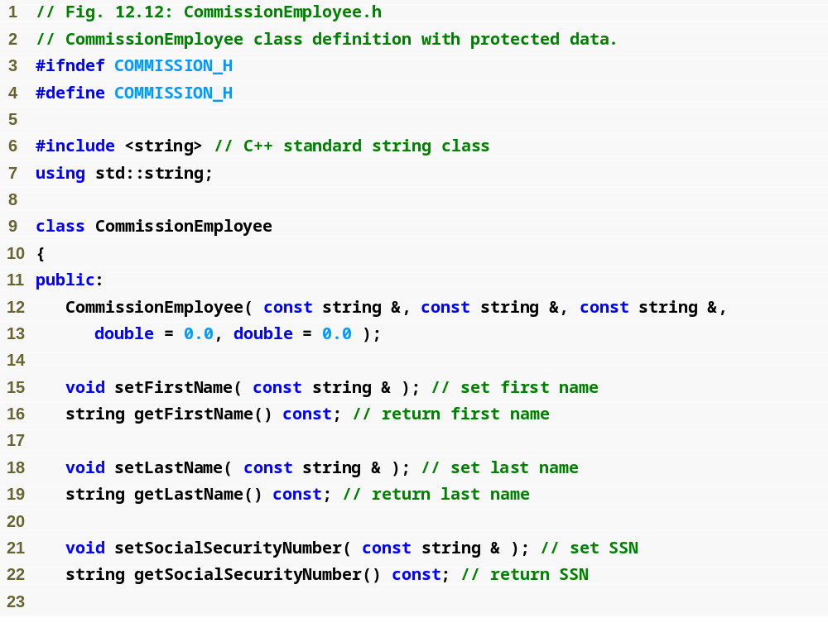
Outline
Commission
Employee.h
(1 of 2)

Slide 38
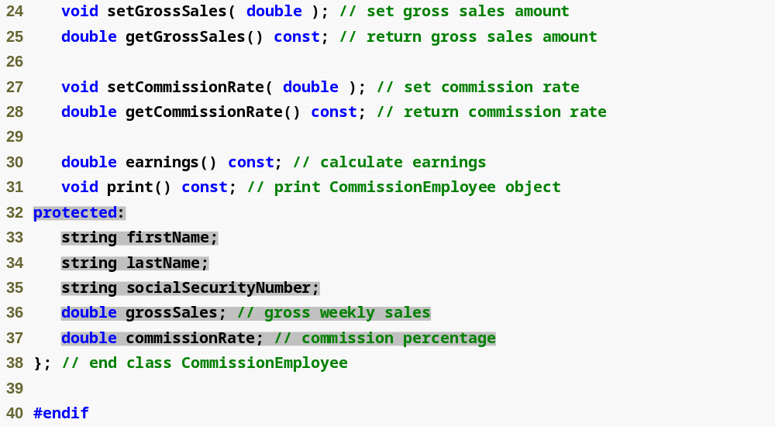
Outline
Commission
Employee.h
(2 of 2)

Slide 39
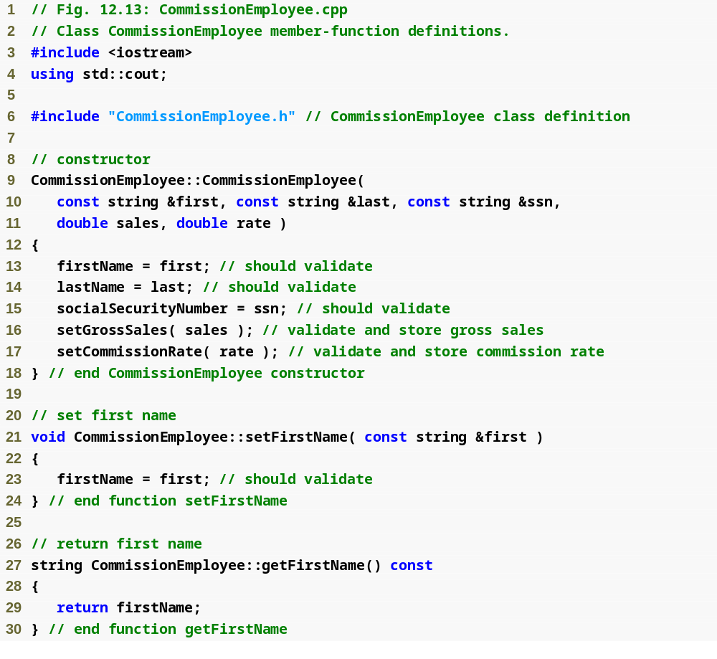
Outline
Commission
Employee.cpp
(1 of 4)

Slide 40
Outline
Commission
Employee.cpp
(2 of 4)

Slide 41
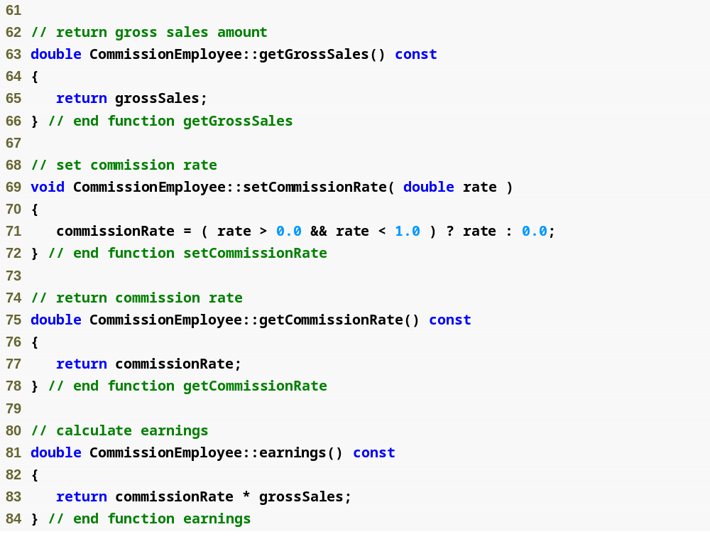
Outline
Commission
Employee.cpp
(3 of 4)

Slide 42
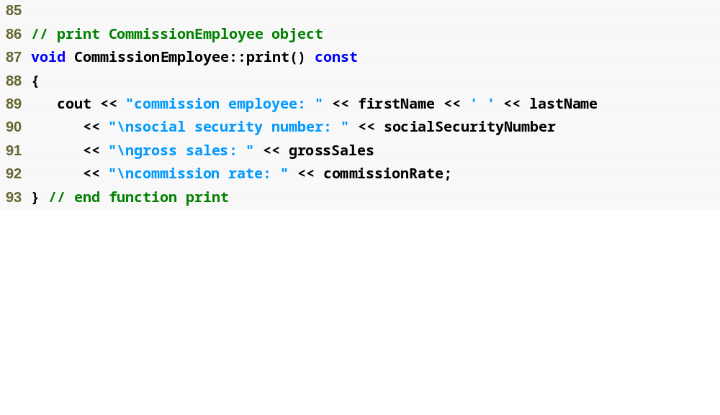
Outline
Commission
Employee.cpp
(4 of 4)

Slide 43

Outline
BasePlus
Commission
Employee.h
(1 of 1)

Slide 44

Outline
BasePlus
Commission
Employee.cpp
(1 of 2)

Slide 45
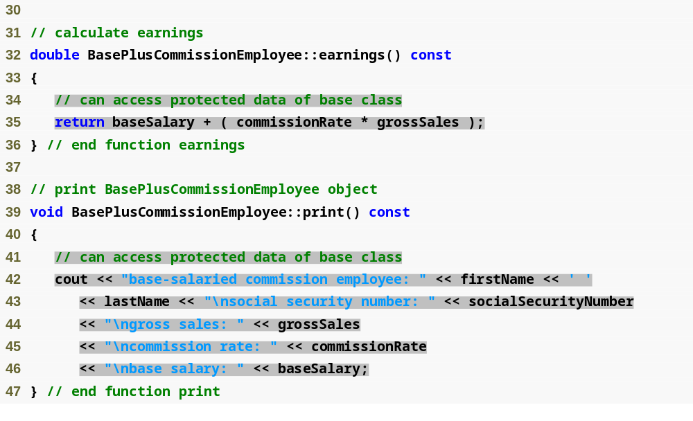
Outline
BasePlus
Commission
Employee.cpp
(2 of 2)

Slide 46

Outline
Fig12_16.cpp
(1 of 3)

Slide 47

Outline
Fig12_16.cpp
(2 of 3)

Slide 48
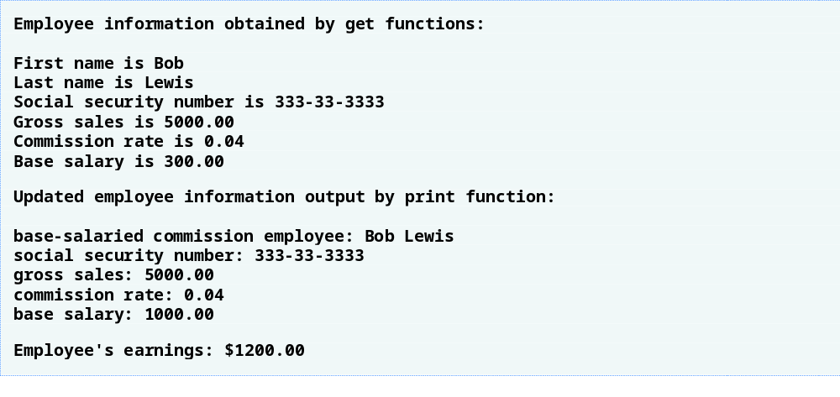
Outline
Fig12_16.cpp
(3 of 3)

Slide 49
Software Engineering Observation 12.5
It is appropriate to use the protected access specifier when a base class should provide a service (i.e., a member function) only to its derived classes (and friends), not to other clients.

Slide 50
Software Engineering Observation 12.6
Declaring base-class data members private (as opposed to declaring them protected) enables programmers to change the base-class implementation without having to change derived-class implementations.

Slide 51
Error-Prevention Tip 12.1
When possible, avoid including protected data members in a base class. Rather, include non-private member functions that access private data members, ensuring that the object maintains a consistent state.

Slide 52
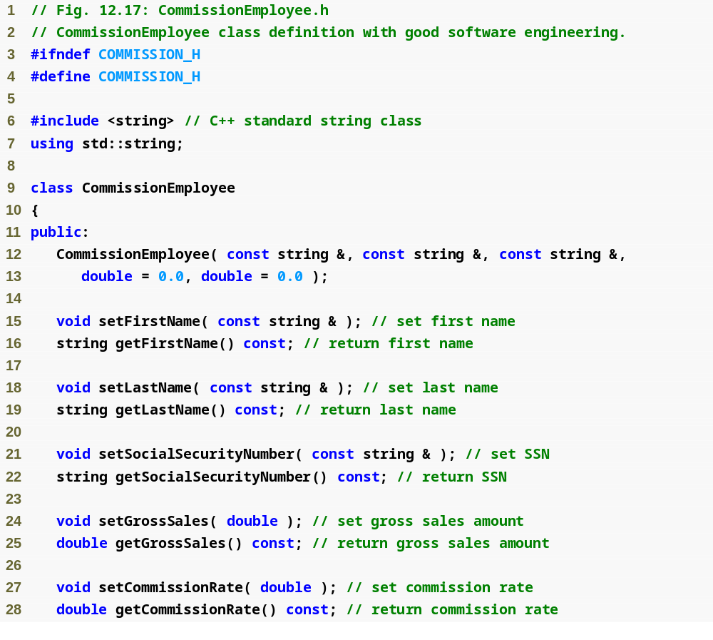
Outline
Commission
Employee.h
(1 of 2)

Slide 53
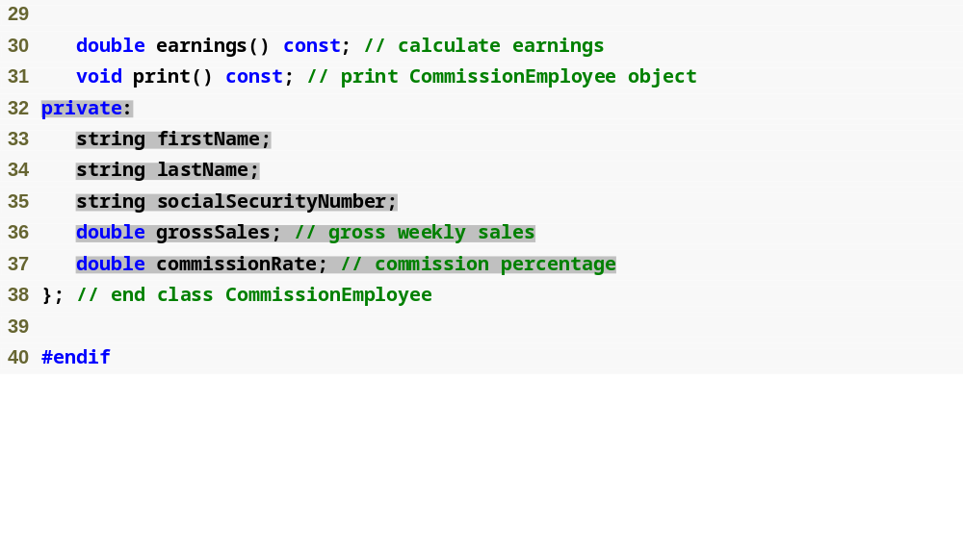
Outline
Commission
Employee.h
(2 of 2)

Slide 54
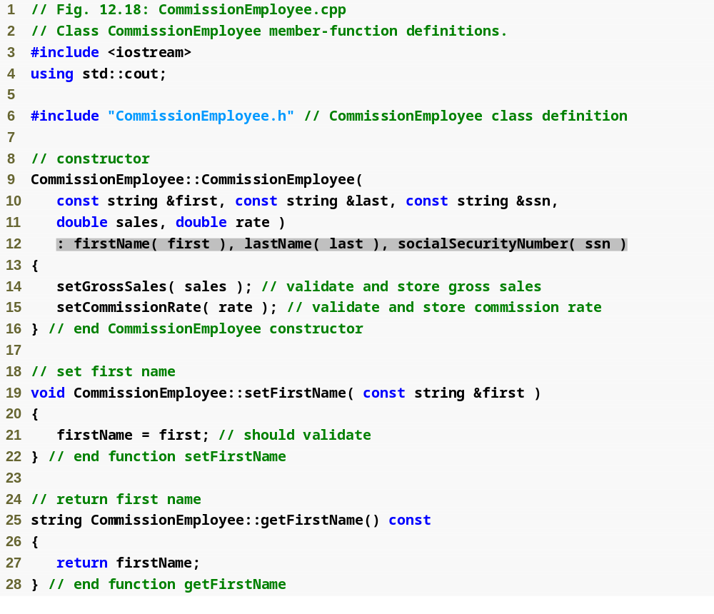
Outline
Commission
Employee.cpp
(1 of 4)

Slide 55
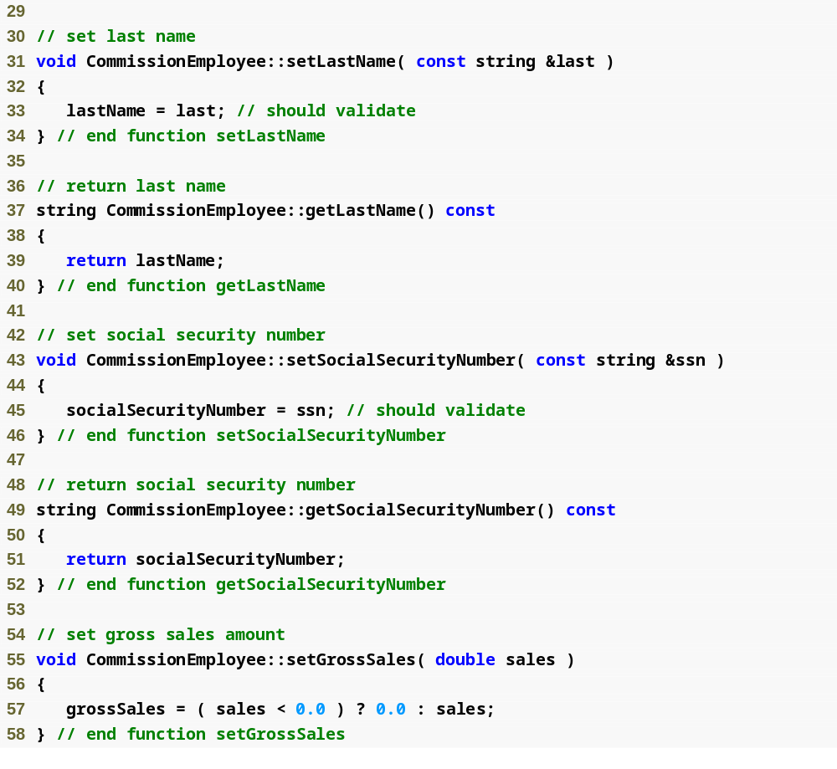
Outline
Commission
Employee.cpp
(2 of 4)

Slide 56
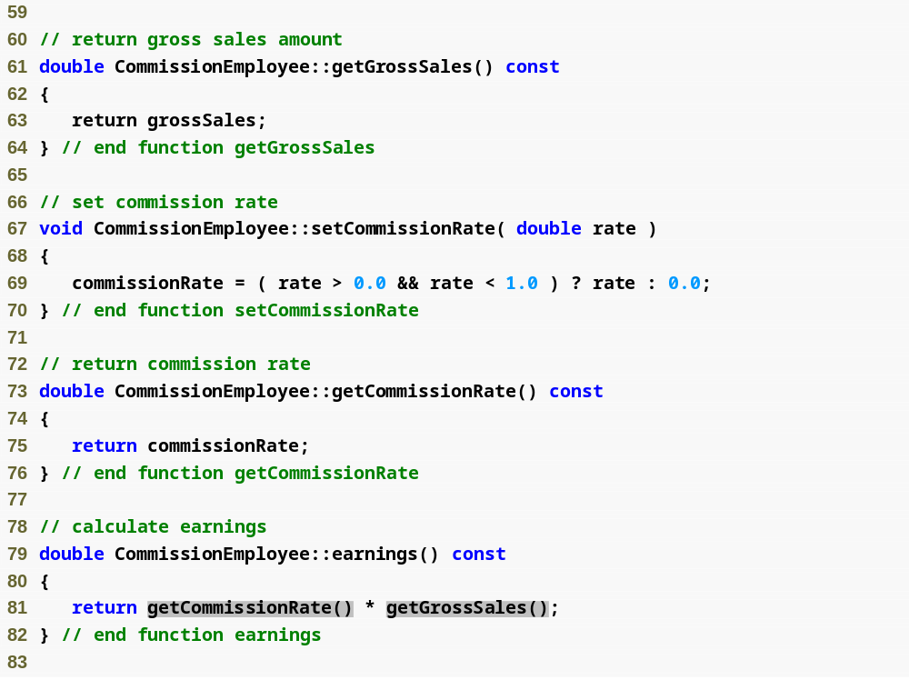
Outline
Commission
Employee.cpp
(3 of 4)

Slide 57
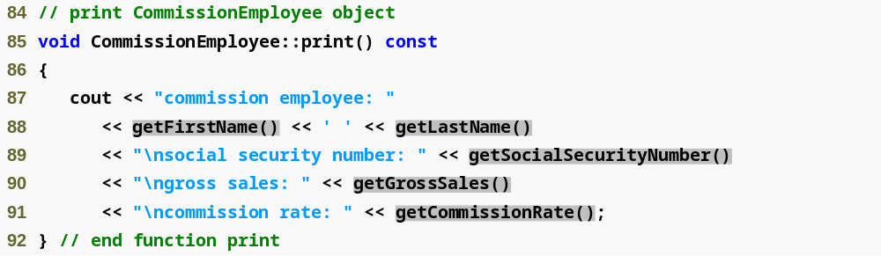
Outline
Commission
Employee.cpp
(4 of 4)

Slide 58
Performance Tip 12.2
Using a member function to access a data member’s value can be slightly slower than accessing the data directly. However, today’s optimizing compilers are carefully designed to perform many optimizations implicitly (such as inlining set and get member-function calls). As a result, programmers should write code that adheres to proper software engineering principles, and leave optimization issues to the compiler. A good rule is, “Do not second-guess the compiler.”

Slide 59

Outline
BasePlus
Commission
Employee.h
(1 of 1)

Slide 60
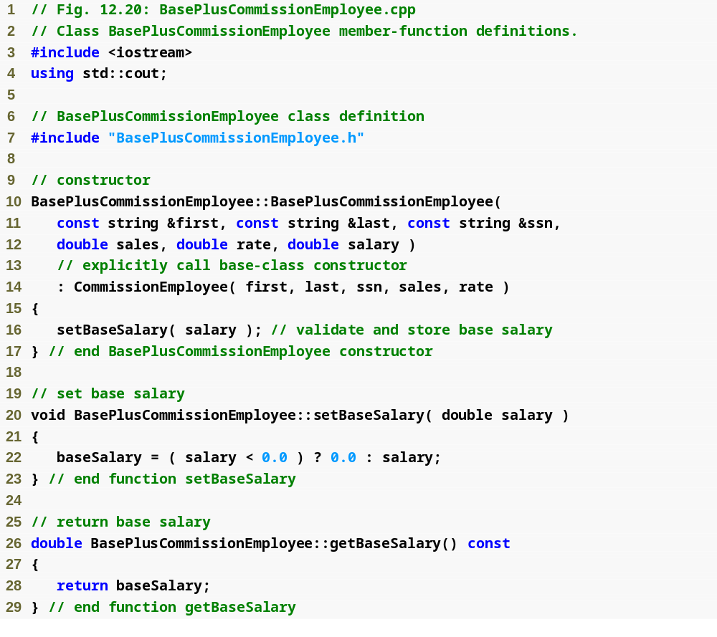
Outline
BasePlus
Commission
Employee.cpp
(1 of 2)

Slide 61
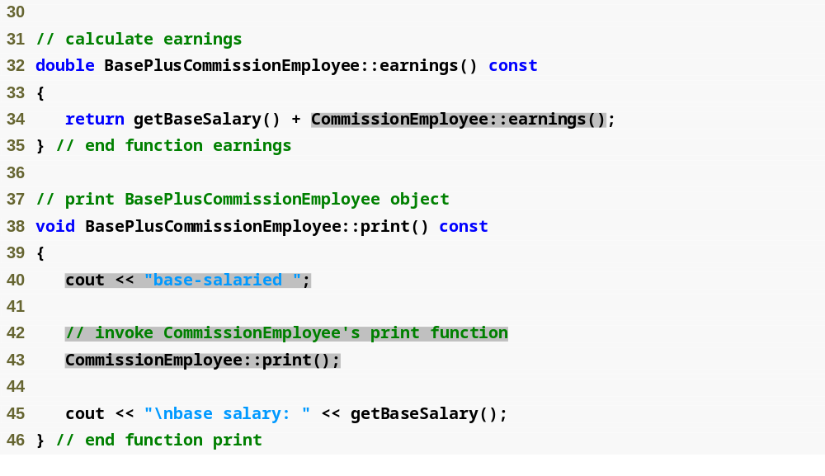
Outline
BasePlus
Commission
Employee.cpp
(2 of 2)

Slide 62
Common Programming Error 12.2
When a base-class member function is redefined in a derived class, the derived-class version often calls the base-class version to do additional work. Failure to use the :: operator prefixed with the name of the base class when referencing the base class’s member function causes infinite recursion, because the derived-class member function would then call itself.

Slide 63
Common Programming Error 12.3
Including a base-class member function with a different signature in the derived class hides the base-class version of the function. Attempts to call the base-class version through the public interface of a derived-class object result in compilation errors.

Slide 64
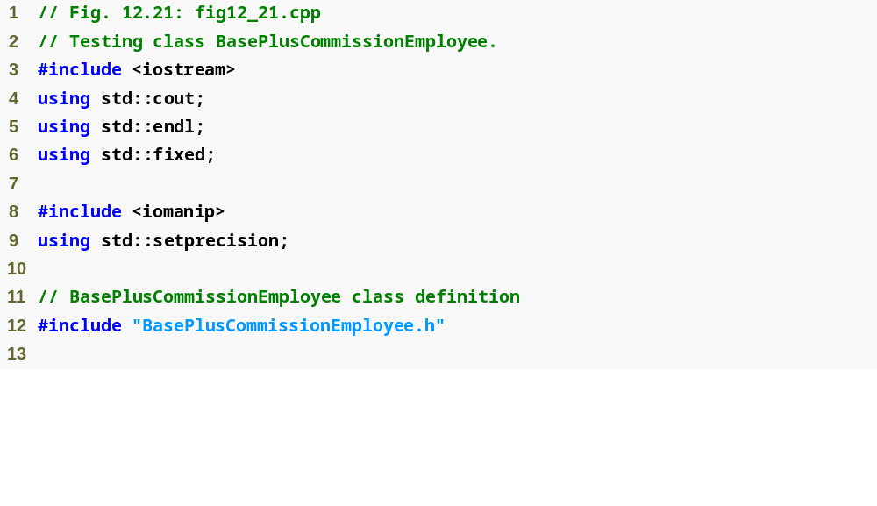
Outline
fig12_21.cpp
(1 of 3)

Slide 65
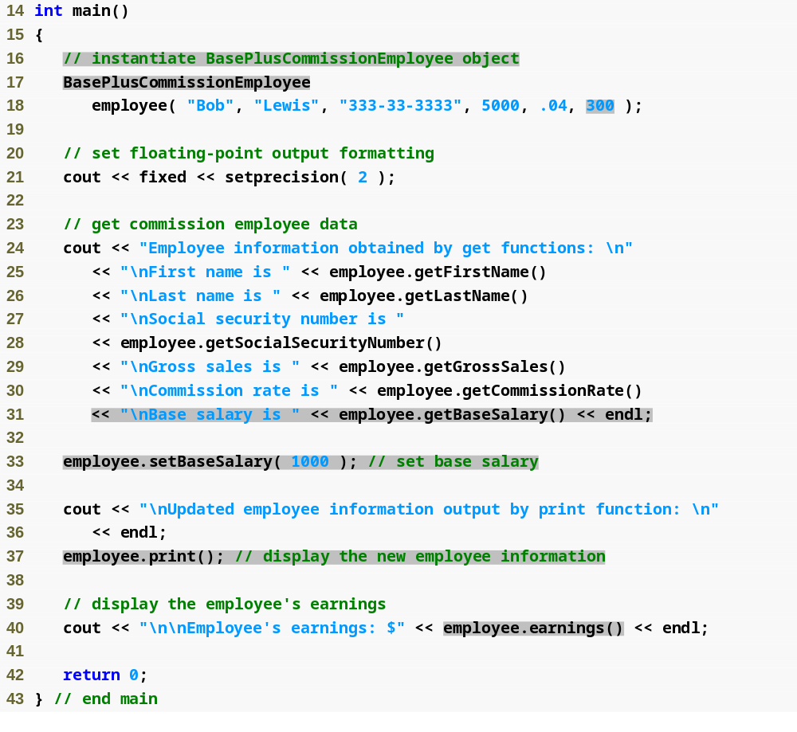
Outline
fig12_21.cpp
(2 of 3)

Slide 66
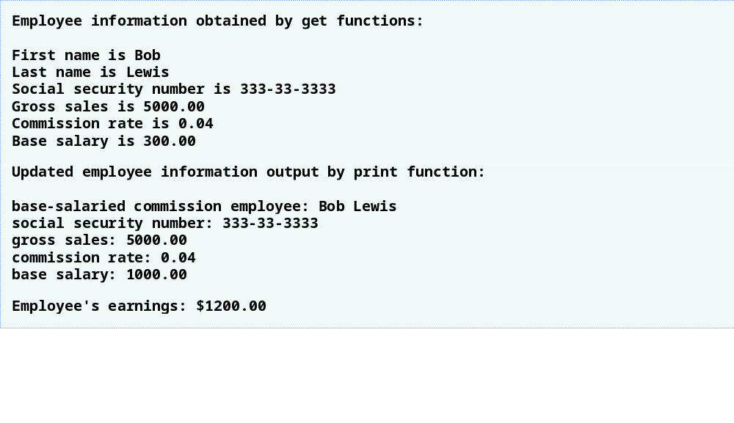
Outline
fig12_21.cpp
(3 of 3)

Slide 67
Software Engineering Observation 12.7
When a program creates a derived-class object, the derived-class constructor immediately calls the base-class constructor, the base-class constructor’s body executes, then the derived class’s member initializers execute and finally the derived-class constructor’s body executes. This process cascades up the hierarchy if the hierarchy contains more than two levels.

Slide 68
Software Engineering Observation 12.8
Suppose that we create an object of a derived class where both the base class and the derived class contain objects of other classes. When an object of that derived class is created, first the constructors for the base class’s member objects execute, then the base-class constructor executes, then the constructors for the derived class’s member objects execute, then the derived class’s constructor executes. Destructors for derived-class objects are called in the reverse of the order in which their corresponding constructors are called.

Slide 69
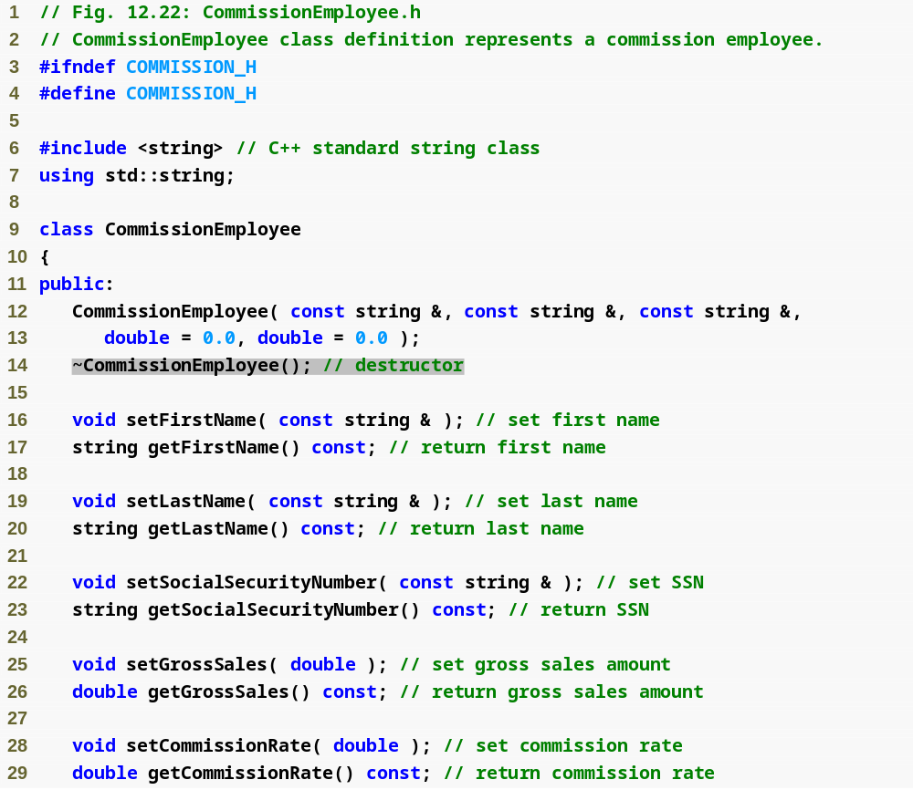
Outline
Commission
Employee.h
(1 of 2)

Slide 70
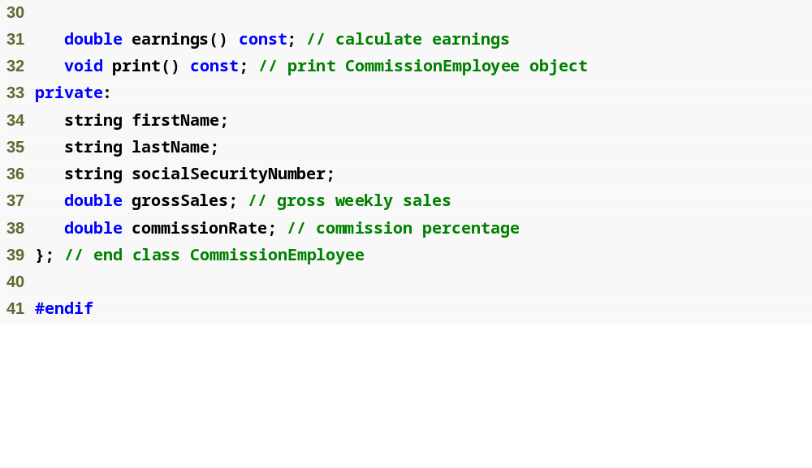
Outline
Commission
Employee.h
(2 of 2)

Slide 71
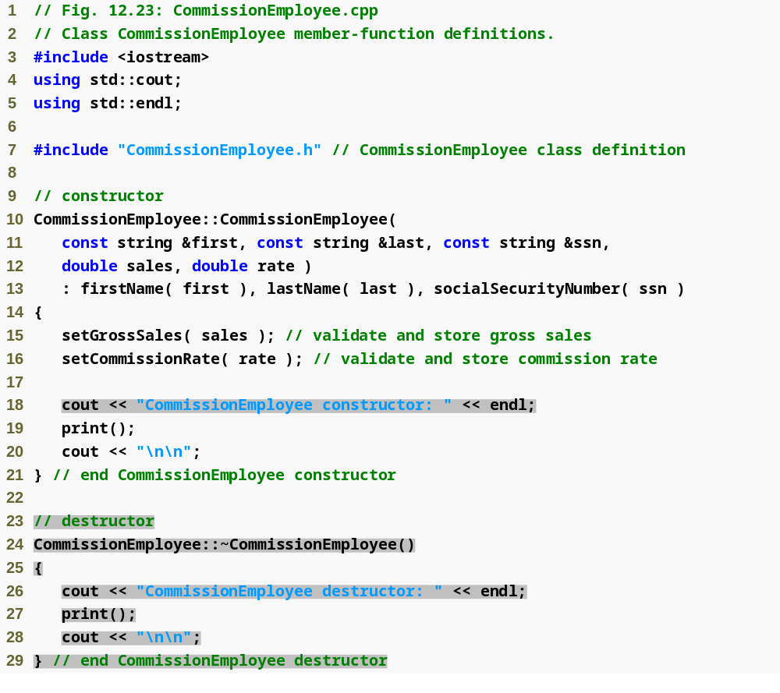
Outline
Commission
Employee.cpp
(1 of 4)

Slide 72
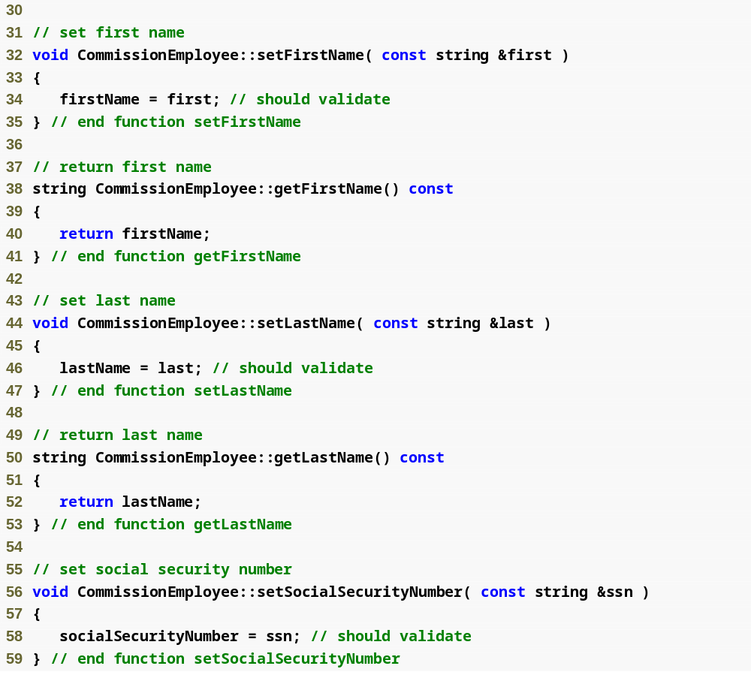
Outline
Commission
Employee.cpp
(2 of 4)

Slide 73
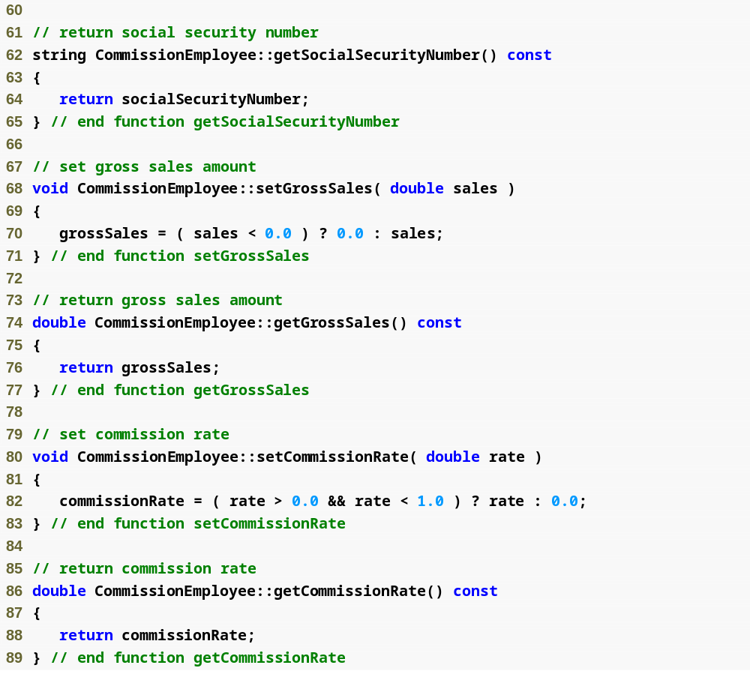
Outline
Commission
Employee.cpp
(3 of 4)

Slide 74
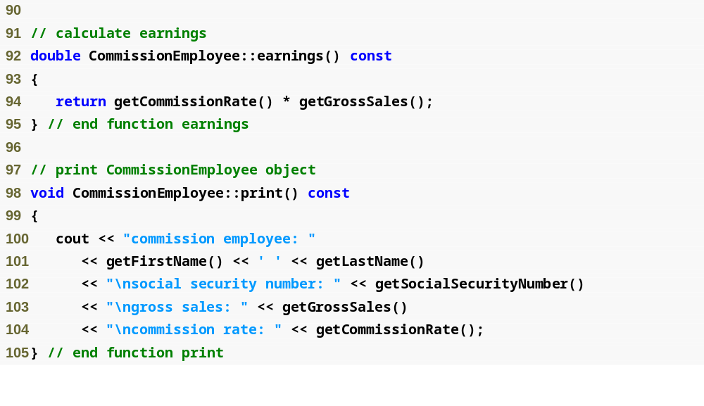
Outline
Commission
Employee.cpp
(4 of 4)

Slide 75
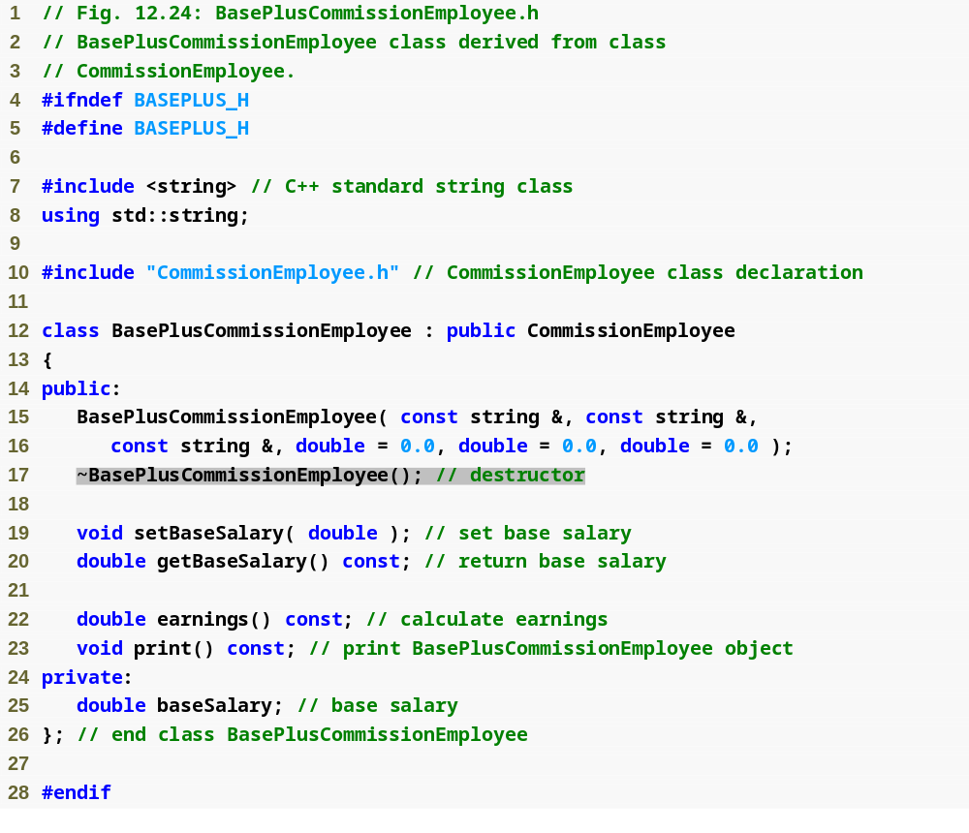
Outline
BasePlus
Commission
Employee.h
(1 of 1)

Slide 76

Outline
BasePlus
Commission
Employee.cpp
(1 of 2)

Slide 77

Outline
BasePlus
Commission
Employee.cpp
(2 of 2)

Slide 78

Outline
fig12_26.cpp
(1 of 4)

Slide 79

Outline
fig12_26.cpp
(2 of 4)

Slide 80

Outline
fig12_26.cpp
(3 of 4)

Slide 81

Outline
fig12_26.cpp
(4 of 4)

Slide 82

Fig. 12.27 | Summary of base-class member accessibility in a derived class.

Slide 83
Software Engineering Observation 12.9
At the design stage in an object-oriented system, the designer often determines that certain classes are closely related. The designer should “factor out” common attributes and behaviors and place these in a base class, then use inheritance to form derived classes, endowing them with capabilities beyond those inherited from the base class.

Slide 84
Software Engineering Observation 12.10
The creation of a derived class does not affect its base class’s source code. Inheritance preserves the integrity of a base class.

Slide 85
Software Engineering Observation 12.11
Just as designers of non-object-oriented systems should avoid proliferation of functions, designers of object-oriented systems should avoid proliferation of classes. Proliferation of classes creates management problems and can hinder software reusability, because it becomes difficult for a client to locate the most appropriate class of a huge class library. The alternative is to create fewer classes that provide more substantial functionality, but such classes might provide too much functionality.

Slide 86
Performance Tip 12.3
If classes produced through inheritance are larger than they need to be (i.e., contain too much functionality), memory and processing resources might be wasted. Inherit from the class whose functionality is “closest” to what is needed.

