Slide 1
13
Object-Oriented
Programming:
Polymorphism

Slide 2
One Ring to rule them all, One Ring to find them,
One Ring to bring them all and in the darkness bind them.
  John Ronald Reuel Tolkien
The silence often of pure innocence
Persuades when speaking fails.
  William Shakespeare
General propositions do not decide concrete cases.
  Oliver Wendell Holmes
A philosopher of imposing stature doesn’t think in a vacuum. Even his most abstract ideas are, to some extent, conditioned by what is or is not known in the time when he lives.
  Alfred North Whitehead

Slide 3
OBJECTIVES
In this chapter you will learn:
What polymorphism is, how it makes programming more convenient, and how it makes systems more extensible and maintainable.
To declare and use virtual functions to effect polymorphism.
The distinction between abstract and concrete classes.
To declare pure virtual functions to create abstract classes.
How to use run-time type information (RTTI) with downcasting, dynamic_cast, typeid and type_info.
How C++ implements virtual functions and dynamic binding "under the hood."
How to use virtual destructors to ensure that all appropriate destructors run on an object.

Slide 4
13.1 Introduction
13.2 Polymorphism Examples
13.3 Relationships Among Objects in an Inheritance Hierarchy
13.3.1 Invoking Base-Class Functions from Derived- Class Objects
13.3.2 Aiming Derived-Class Pointers at Base-Class Objects
13.3.3 Derived-Class Member-Function Calls via Base- Class Pointers
13.3.4 Virtual Functions
13.3.5 Summary of the Allowed Assignments Between Base-Class and Derived-Class Objects and Pointers
13.4 Type Fields and switch Statements
13.5 Abstract Classes and Pure virtual Functions

Slide 5
13.6 Case Study: Payroll System Using Polymorphism
13.6.1 Creating Abstract Base Class Employee
13.6.2 Creating Concrete Derived Class SalariedEmployee
13.6.3 Creating Concrete Derived Class HourlyEmployee
13.6.4 Creating Concrete Derived Class CommissionEmployee
13.6.5 Creating Indirect Concrete Derived Class BasePlusCommissionEmployee
13.6.6 Demonstrating Polymorphic Processing
13.7 (Optional) Polymorphism, Virtual Functions and Dynamic Binding "Under the Hood"
13.8 Case Study: Payroll System Using Polymorphism and Run-Time Type Information with Downcasting, dynamic_cast, typeid and type_info
13.9 Virtual Destructors
13.10 (Optional) Software Engineering Case Study: Incorporating Inheritance into the ATM System
13.11 Wrap-Up

Slide 6
Software Engineering Observation 13.1
With virtual functions and polymorphism, you can deal in generalities and let the execution-time environment concern itself with the specifics. You can direct a variety of objects to behave in manners appropriate to those objects without even knowing their types (as long as those objects belong to the same inheritance hierarchy and are being accessed off a common base-class pointer).

Slide 7
Software Engineering Observation 13.2
Polymorphism promotes extensibility: Software written to invoke polymorphic behavior is written independently of the types of the objects to which messages are sent. Thus, new types of objects that can respond to existing messages can be incorporated into such a system without modifying the base system. Only client code that instantiates new objects must be modified to accommodate new types.

Slide 8
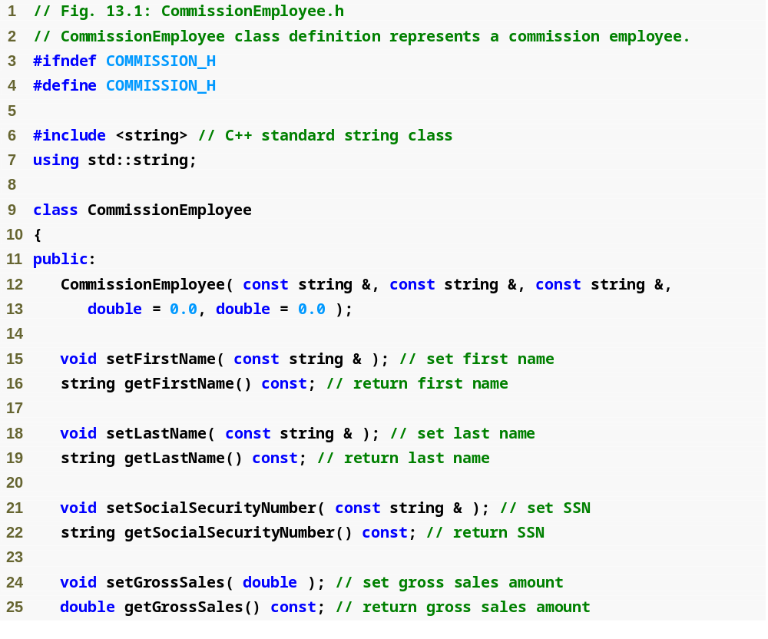
Outline
Commission
Employee.h
(1 of 2)

Slide 9
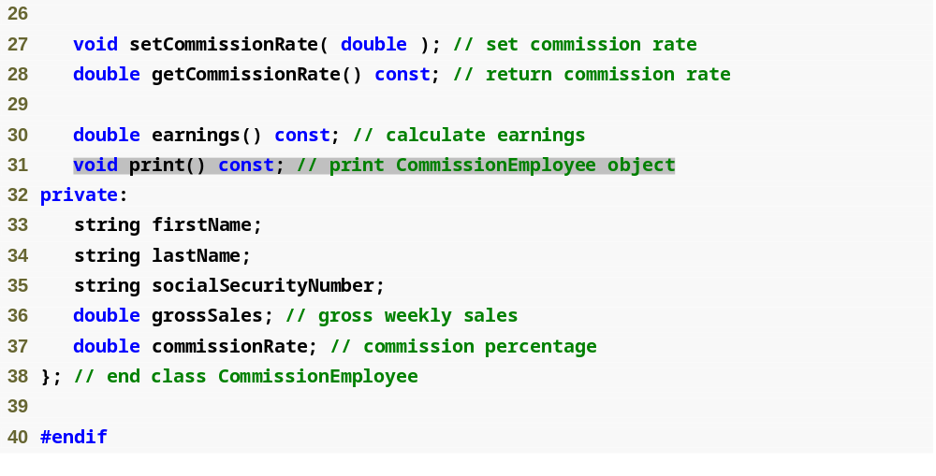
Outline
Commission
Employee.h
(2 of 2)

Slide 10
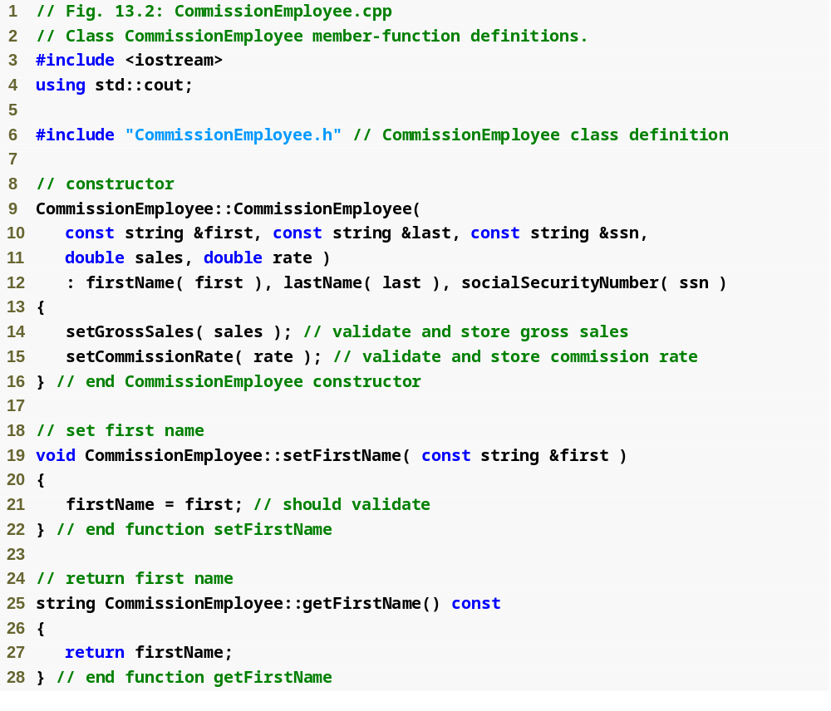
Outline
Commission
Employee.cpp
(1 of 4)

Slide 11
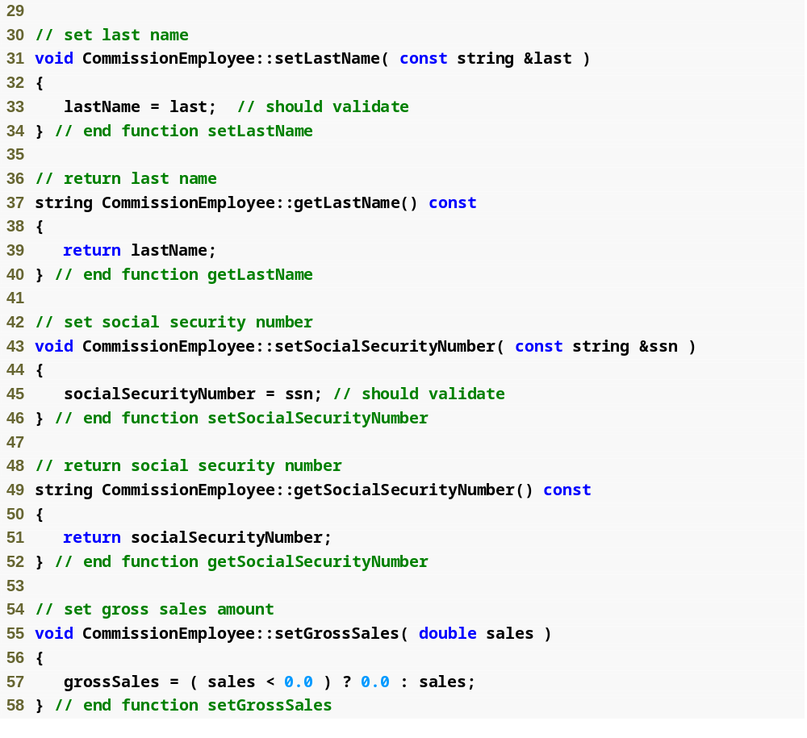
Outline
Commission
Employee.cpp
(2 of 4)

Slide 12
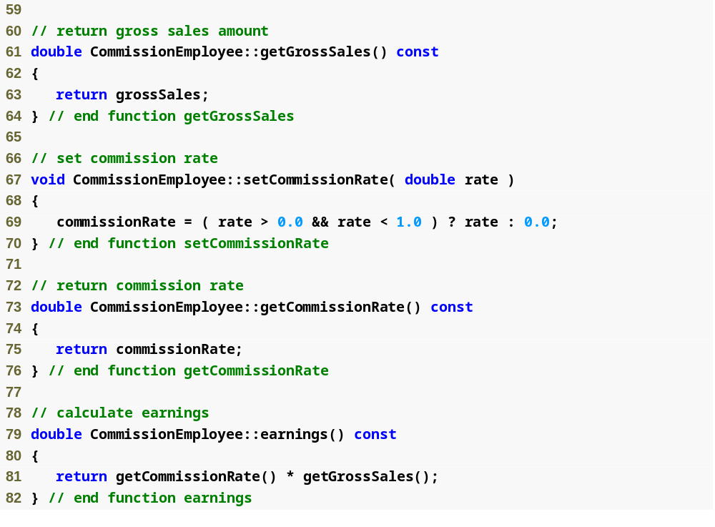
Outline
Commission
Employee.cpp
(3 of 4)

Slide 13
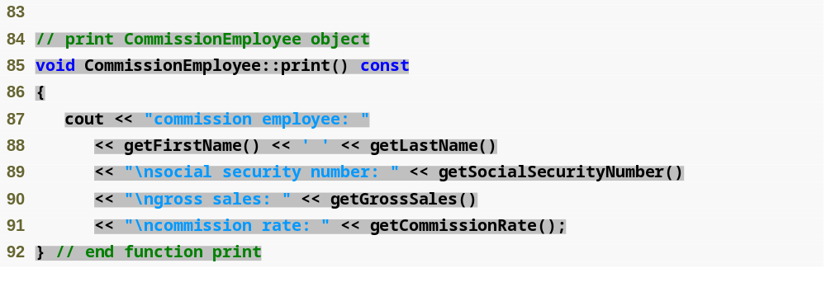
Outline
Commission
Employee.cpp
(4 of 4)

Slide 14
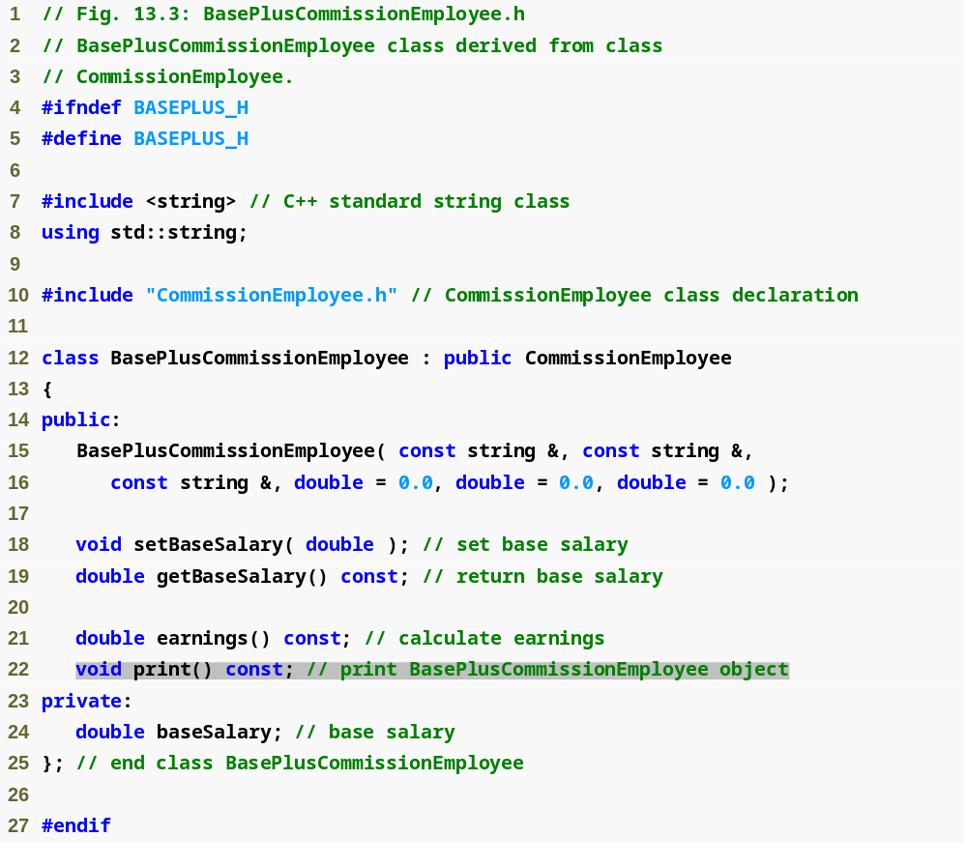
Outline
BasePlus
Commission
Employee.h
(1 of 1)

Slide 15
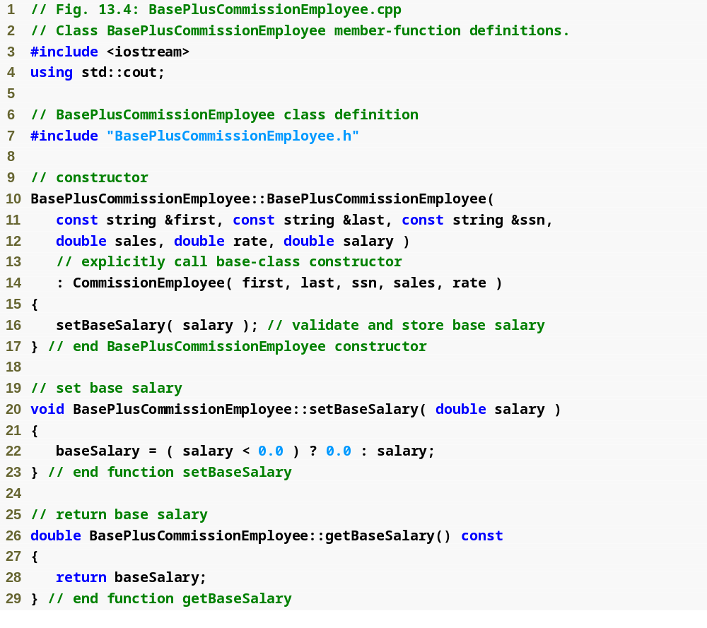
Outline
BasePlus
Commission
Employee.cpp
(1 of 2)

Slide 16
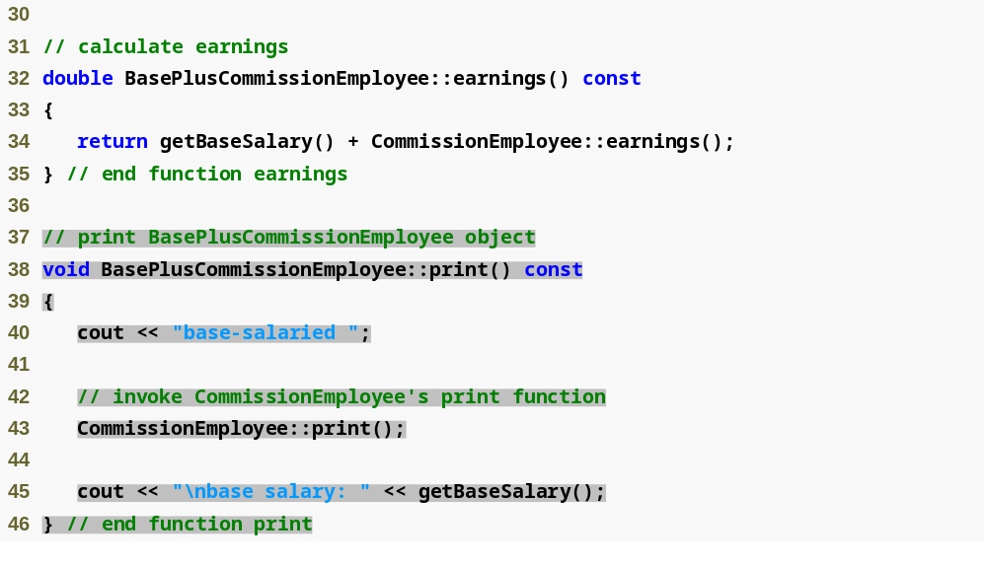
Outline
BasePlus
Commission
Employee.cpp
(2 of 2)

Slide 17
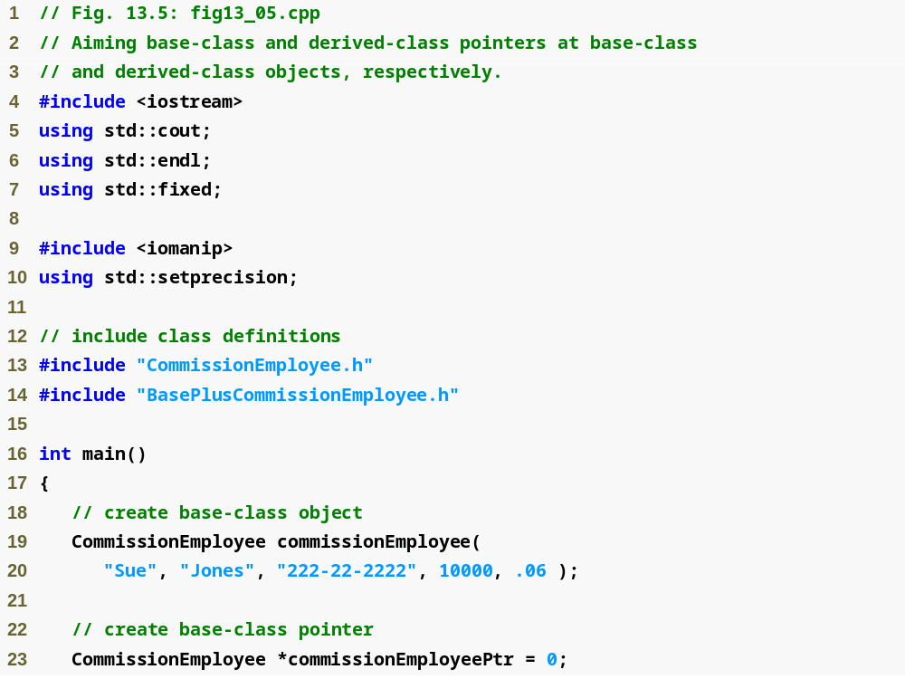
Outline
fig13_05.cpp
(1 of 5)

Slide 18
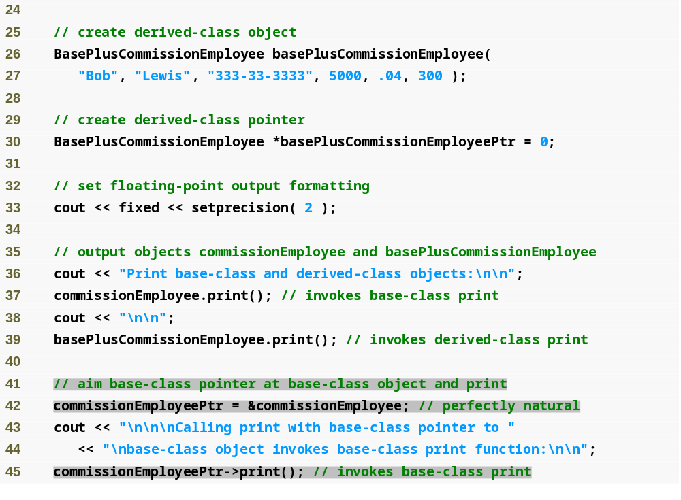
Outline
fig13_05.cpp
(2 of 5)

Slide 19
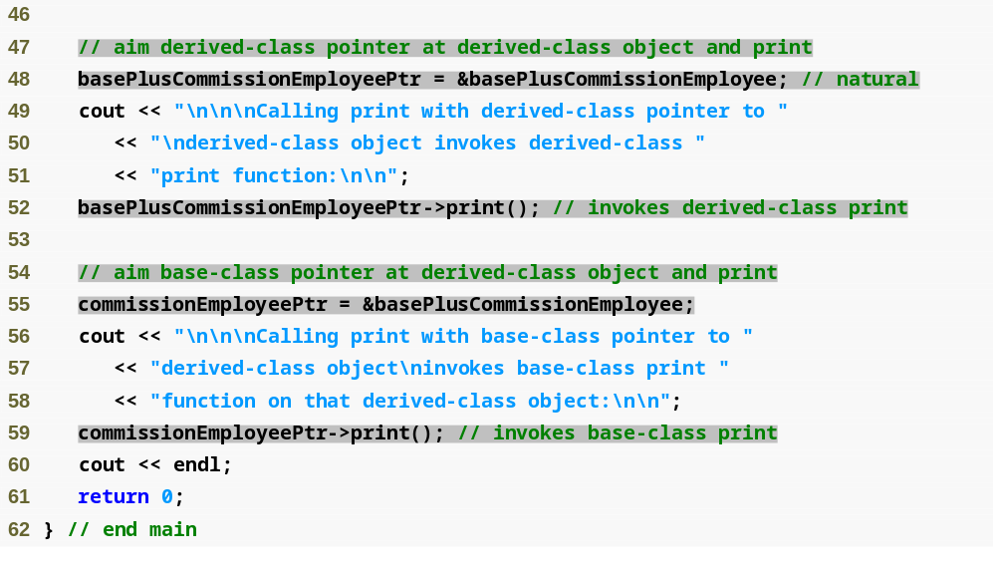
Outline
fig13_05.cpp
(3 of 5)

Slide 20
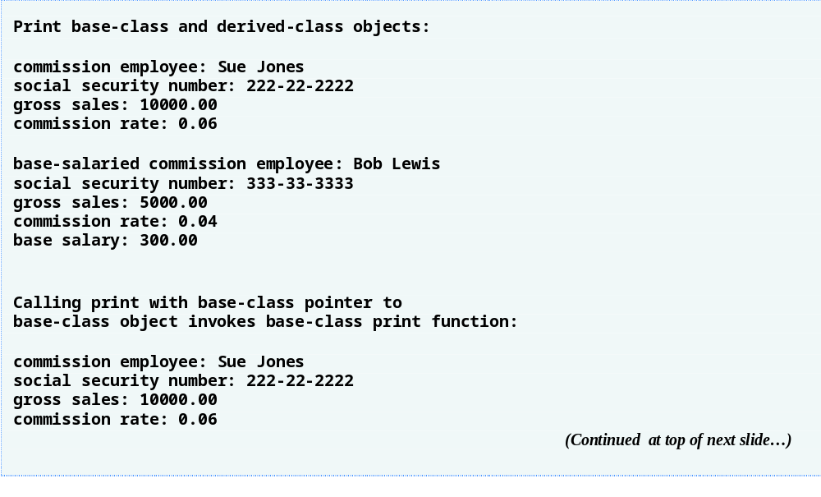
Outline
fig13_05.cpp
(4 of 5)

Slide 21
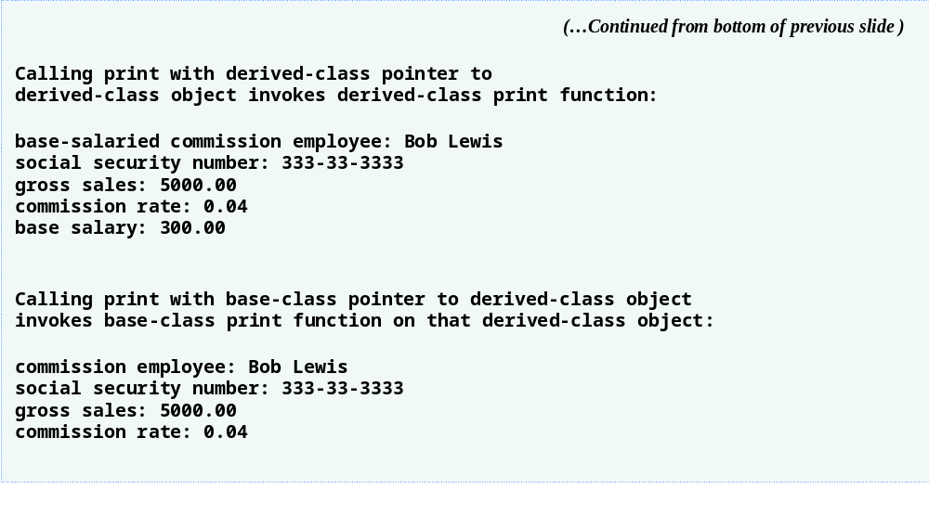
Outline
fig13_05.cpp
(5 of 5)

Slide 22
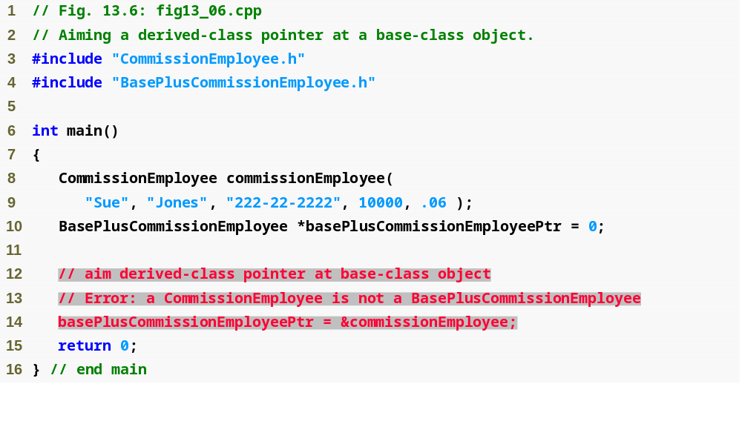
Outline
fig13_06.cpp
(1 of 2)

Slide 23
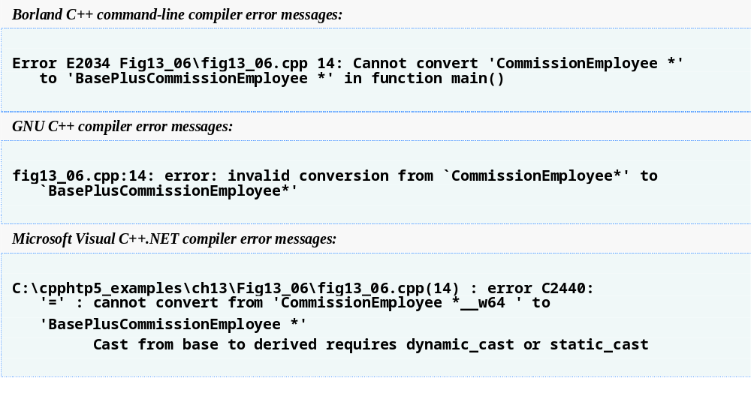
Outline
fig13_06.cpp
(2 of 2)

Slide 24
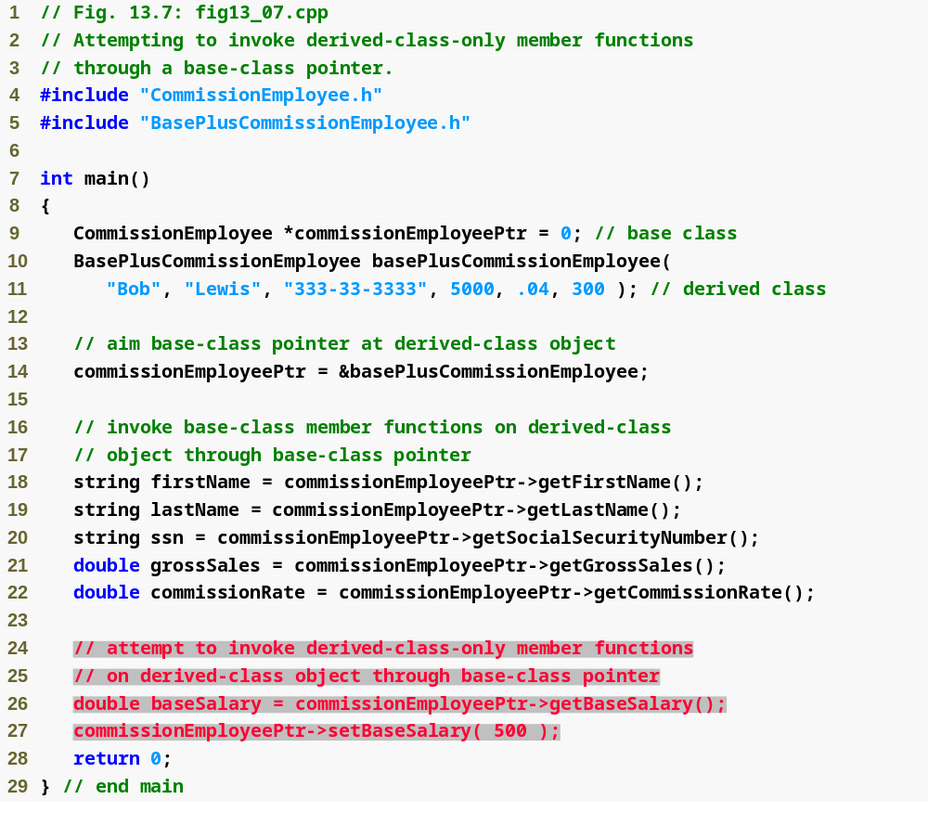
Outline
fig13_07.cpp
(1 of 2)

Slide 25
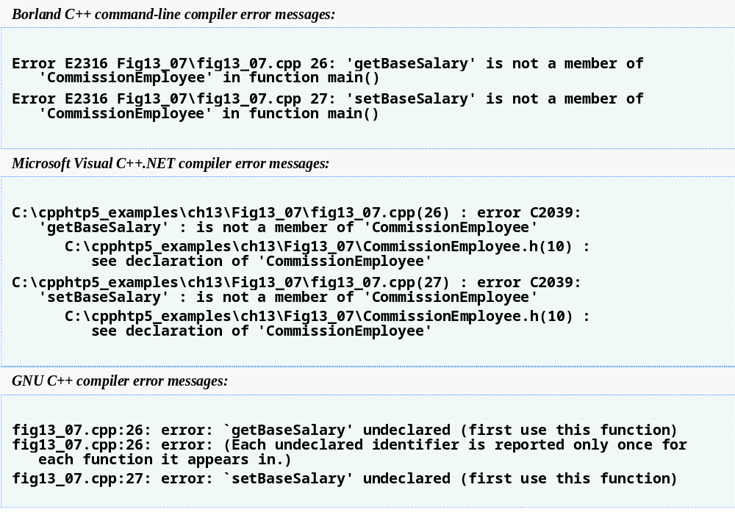
Outline
fig13_07.cpp
(2 of 2)

Slide 26
Software Engineering Observation 13.3
If the address of a derived-class object has been assigned to a pointer of one of its direct or indirect base classes, it is acceptable to cast that base-class pointer back to a pointer of the derived-class type. In fact, this must be done to send that derived-class object messages that do not appear in the base class.

Slide 27
Software Engineering Observation 13.4
Once a function is declared virtual, it remains virtual all the way down the inheritance hierarchy from that point, even if that function is not explicitly declared virtual when a class overrides it.

Slide 28
Good Programming Practice 13.1
Even though certain functions are implicitly virtual because of a declaration made higher in the class hierarchy, explicitly declare these functions virtual at every level of the hierarchy to promote program clarity.

Slide 29
Error-Prevention Tip 13.1
When a programmer browses a class hierarchy to locate a class to reuse, it is possible that a function in that class will exhibit virtual function behavior even though it is not explicitly declared virtual. This happens when the class inherits a virtual function from its base class, and it can lead to subtle logic errors. Such errors can be avoided by explicitly declaring all virtual functions virtual throughout the inheritance hierarchy.

Slide 30
Software Engineering Observation 13.5
When a derived class chooses not to override a virtual function from its base class, the derived class simply inherits its base class’s virtual function implementation.

Slide 31
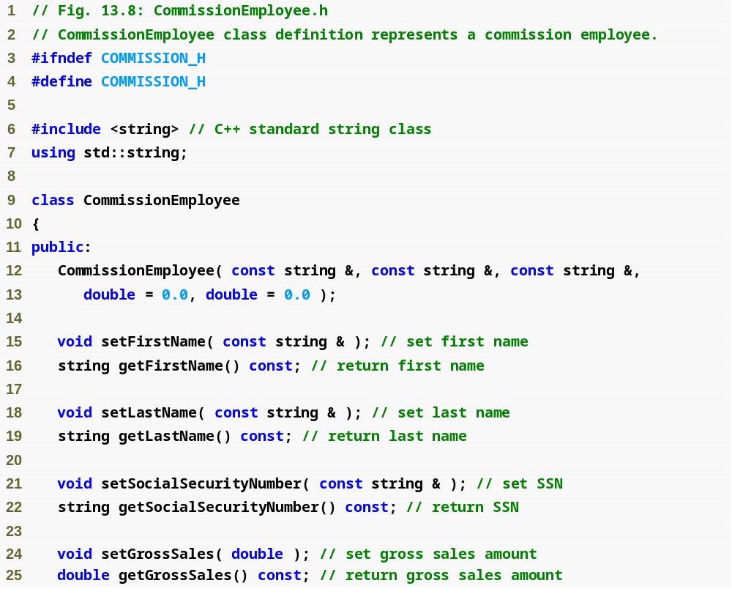
Outline
Commission
Employee.h
(1 of 2)

Slide 32
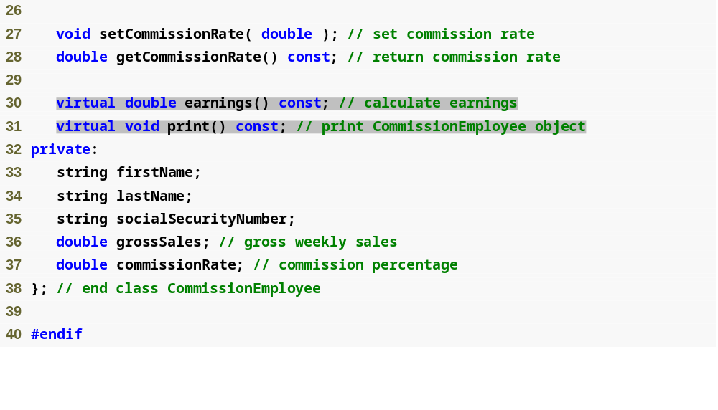
Outline
Commission
Employee.h
(2 of 2)

Slide 33
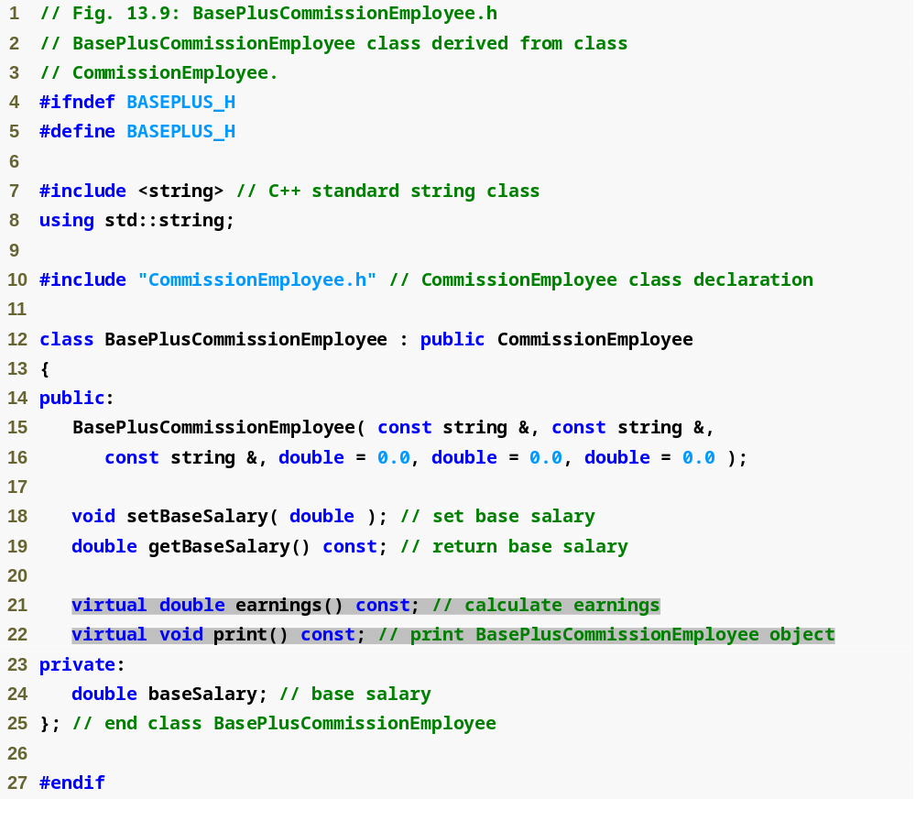
Outline
BasePlus
Commission
Employee.h
(1 of 1)

Slide 34
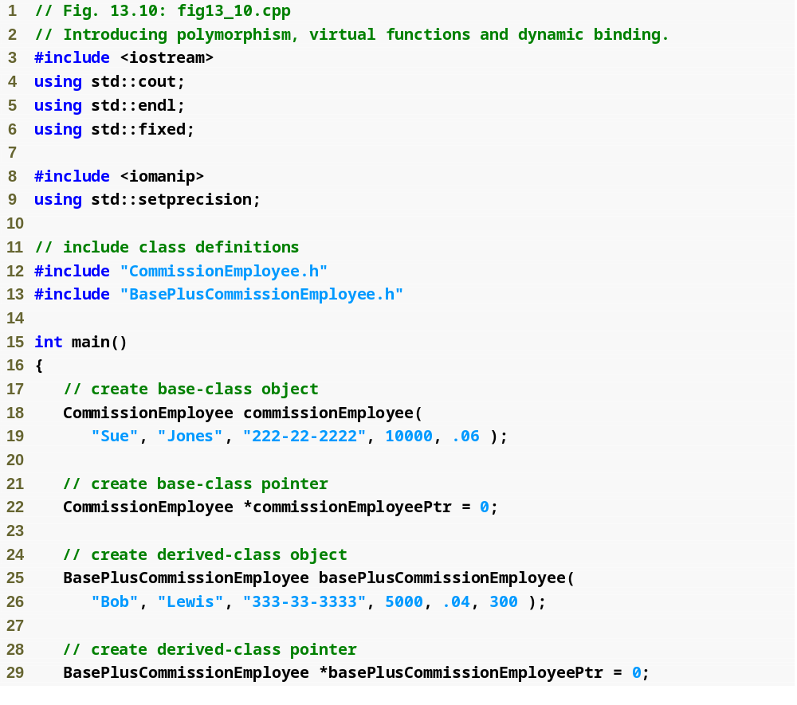
Outline
fig13_10.cpp
(1 of 5)

Slide 35
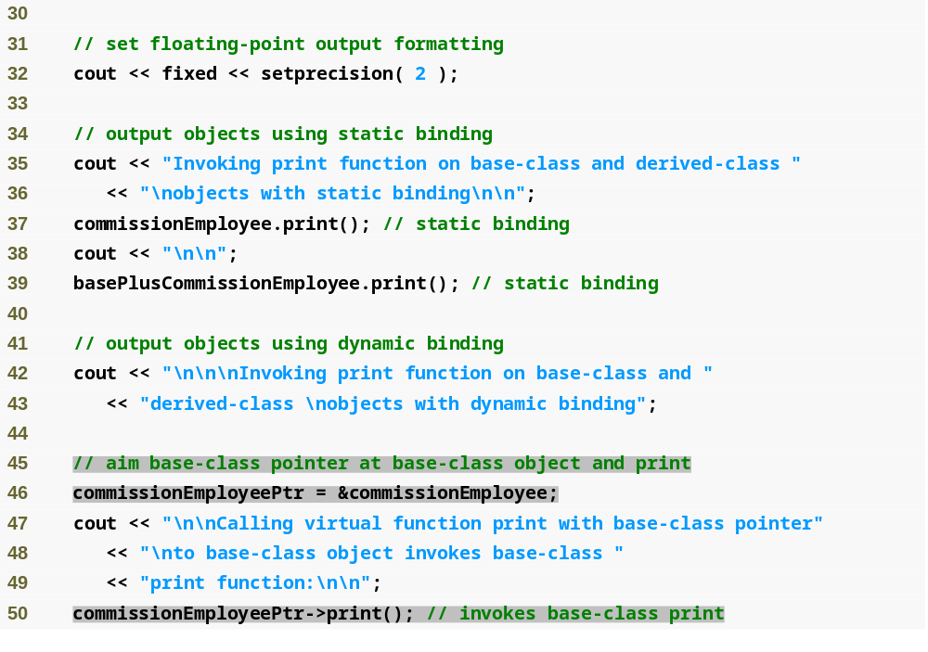
Outline
fig13_10.cpp
(2 of 5)

Slide 36
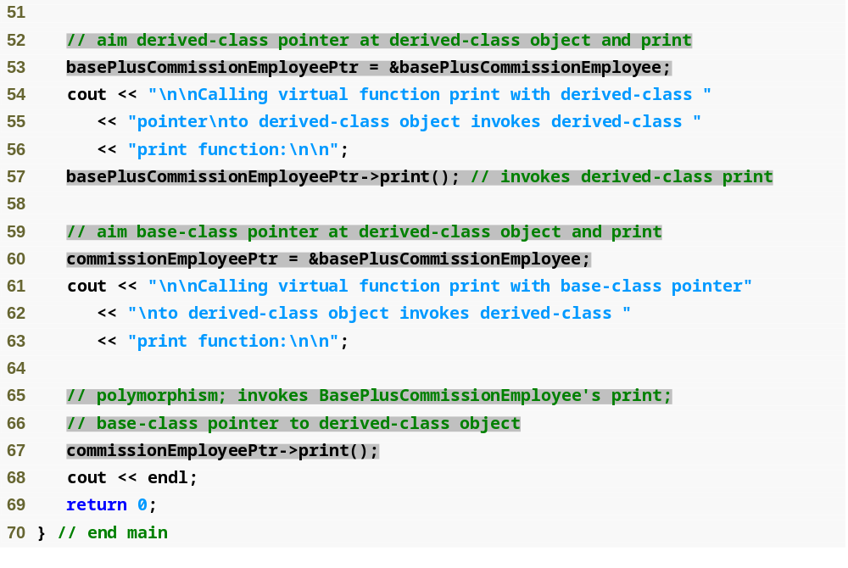
Outline
fig13_10.cpp
(3 of 5)

Slide 37
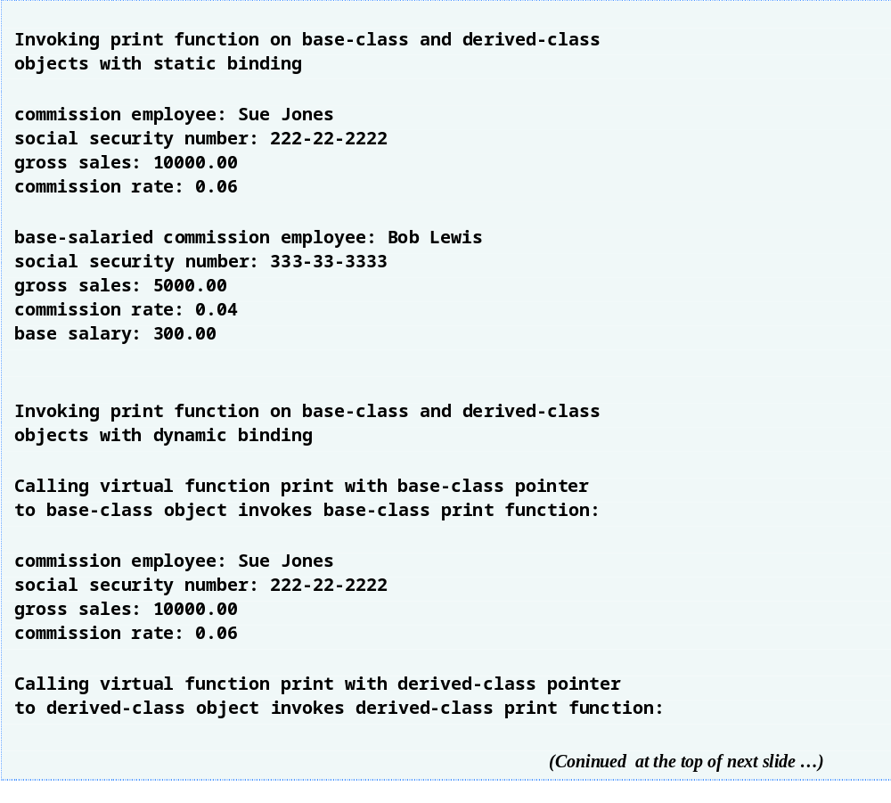
Outline
fig13_10.cpp
(4 of 5)

Slide 38
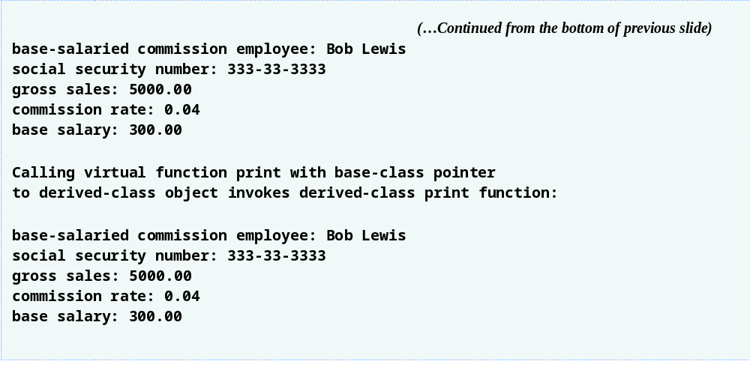
Outline
fig13_10.cpp
(5 of 5)

Slide 39
Common Programming Error 13.1
After aiming a base-class pointer at a derived-class object, attempting to reference derived-class-only members with the base-class pointer is a compilation error.

Slide 40
Common Programming Error 13.2
Treating a base-class object as a derived-class object can cause errors.

Slide 41
Software Engineering Observation 13.6
Polymorphic programming can eliminate the need for unnecessary switch logic. By using the C++ polymorphism mechanism to perform the equivalent logic, programmers can avoid the kinds of errors typically associated with switch logic.

Slide 42
Software Engineering Observation 13.7
An interesting consequence of using polymorphism is that programs take on a simplified appearance. They contain less branching logic and more simple, sequential code. This simplification facilitates testing, debugging and program maintenance.

Slide 43
Software Engineering Observation 13.8
An abstract class defines a common public interface for the various classes in a class hierarchy. An abstract class contains one or more pure virtual functions that concrete derived classes must override.

Slide 44
Common Programming Error 13.3
Attempting to instantiate an object of an abstract class causes a compilation error.

Slide 45
Common Programming Error 13.4
Failure to override a pure virtual function in a derived class, then attempting to instantiate objects of that class, is a compilation error.

Slide 46
Software Engineering Observation 13.9
An abstract class has at least one pure virtual function. An abstract class also can have data members and concrete functions (including constructors and destructors), which are subject to the normal rules of inheritance by derived classes.

Slide 47
Software Engineering Observation 13.10
A derived class can inherit interface or implementation from a base class. Hierarchies designed for implementation inheritance tend to have their functionality high in the hierarchy—each new derived class inherits one or more member functions that were defined in a base class, and the derived class uses the base-class definitions. Hierarchies designed for interface inheritance tend to have their functionality lower in the hierarchy—a base class specifies one or more functions that should be defined for each class in the hierarchy (i.e., they have the same prototype), but the individual derived classes provide their own implementations of the function(s).

Slide 48
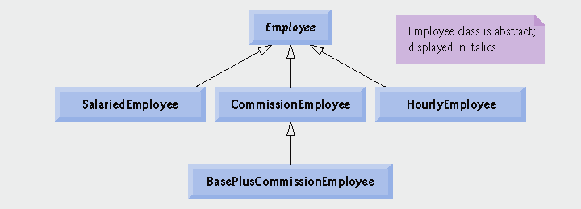
Fig.13.11 | Employee hierarchy UML class diagram.

Slide 49
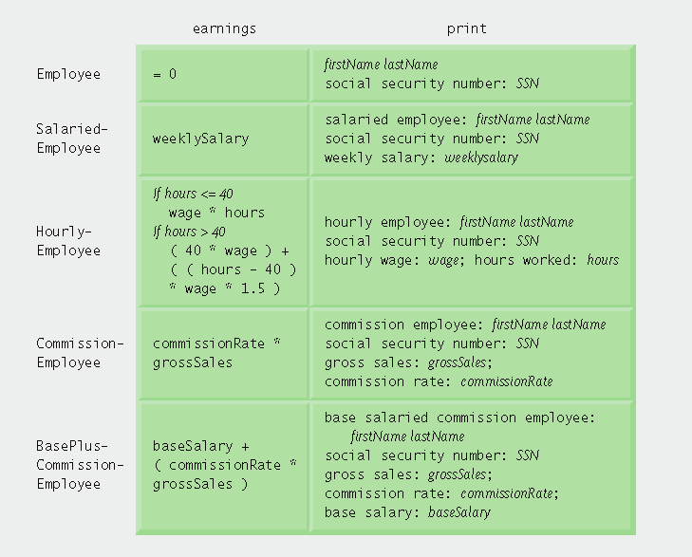
Fig.13.12 | Polymorphic interface for the Employee hierarchy classes.

Slide 50
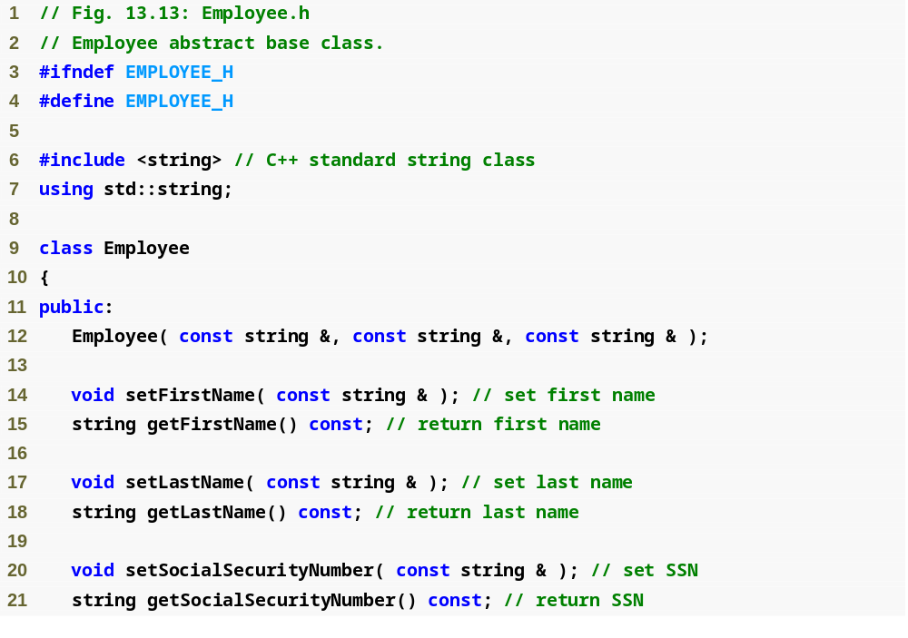
Outline
Employee.h
(1 of 2)

Slide 51
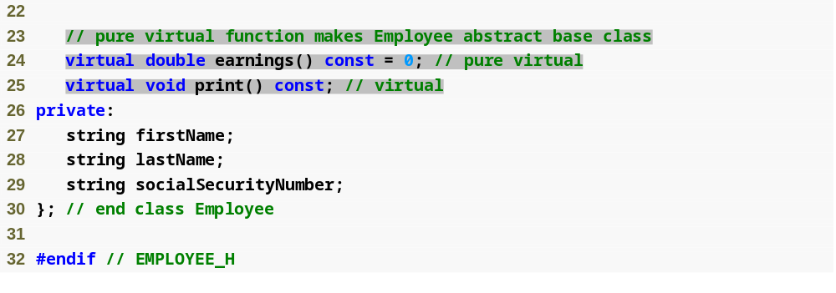
Outline
Employee.h
(2 of 2)

Slide 52
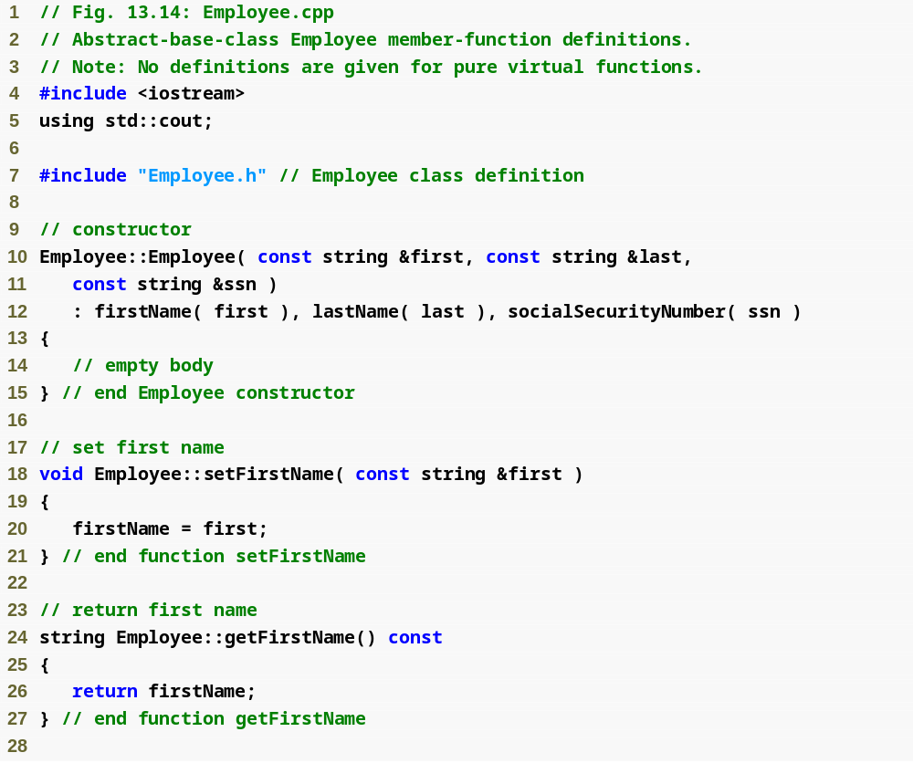
Outline
Employee.cpp
(1 of 2)

Slide 53
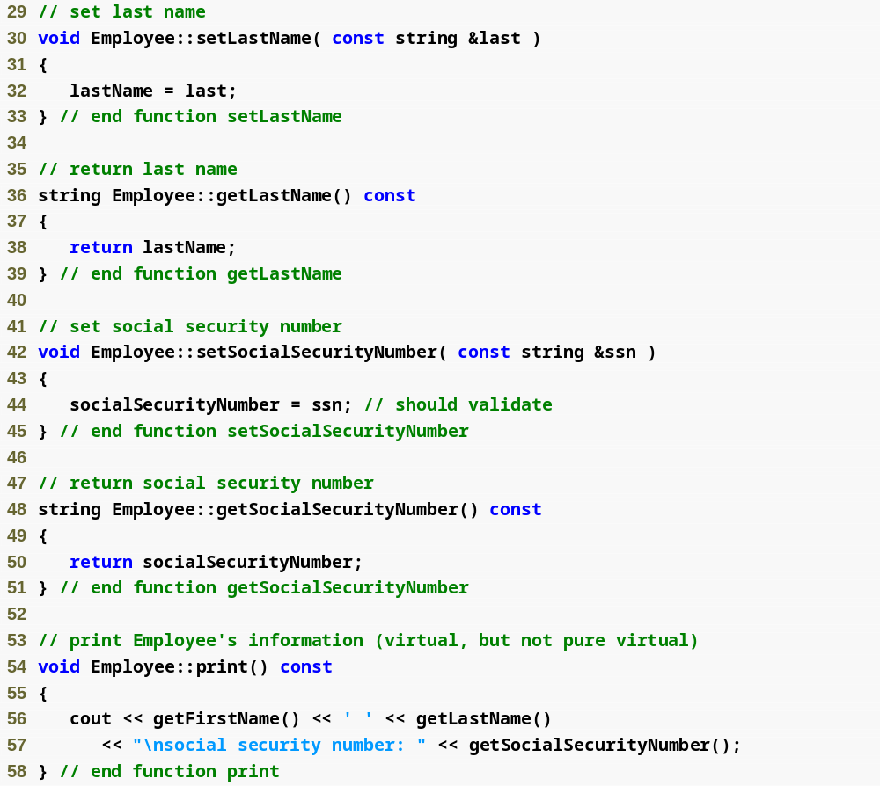
Outline
Employee.cpp
(2 of 2)

Slide 54
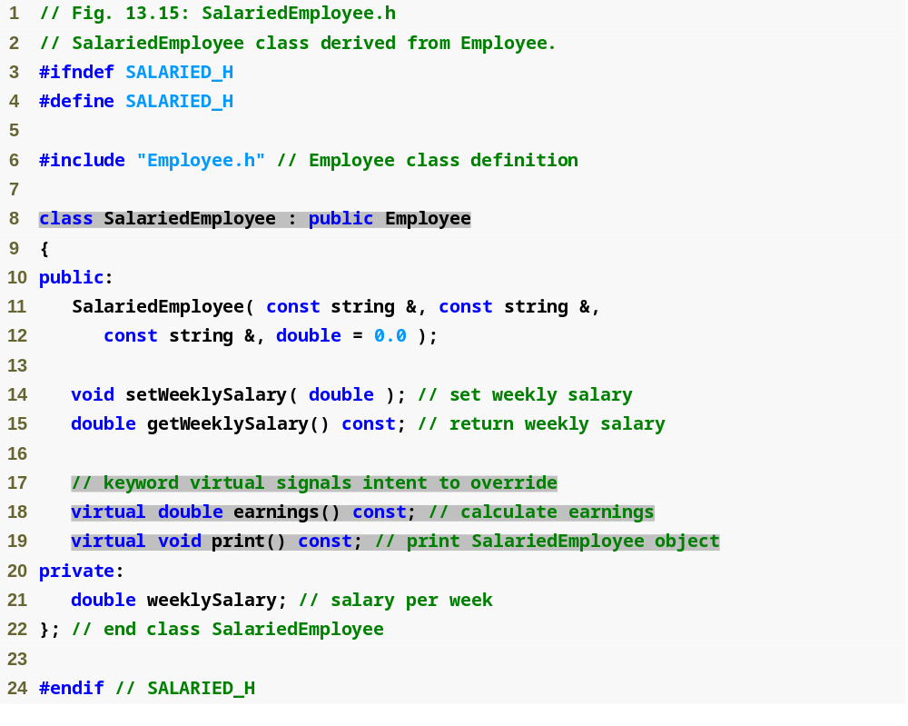
Outline
Salaried
Employee.h
(1 of 1)

Slide 55
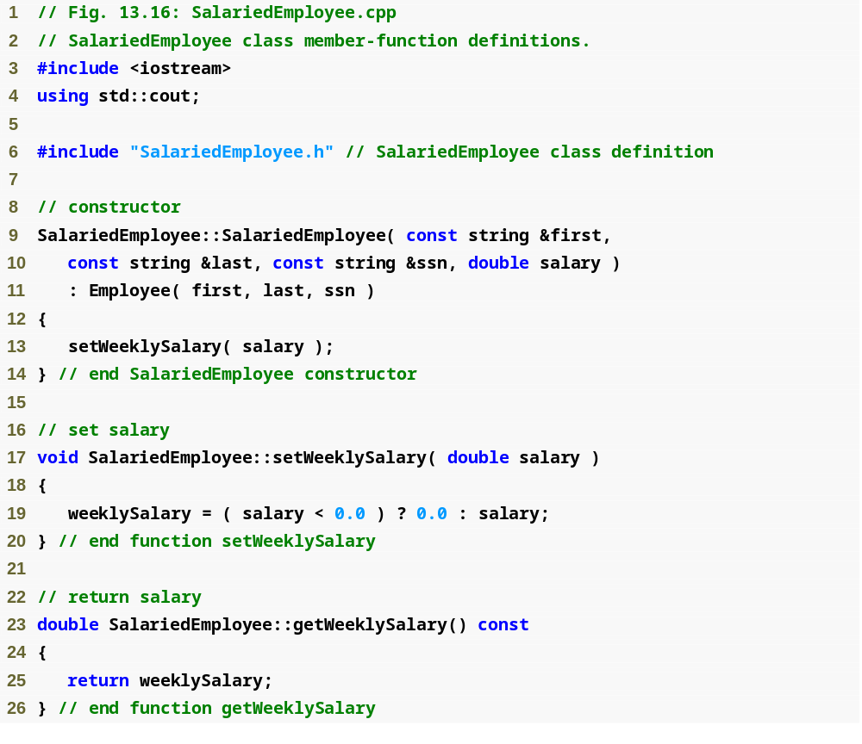
Outline
Salaried
Employee.cpp
(1 of 2)

Slide 56
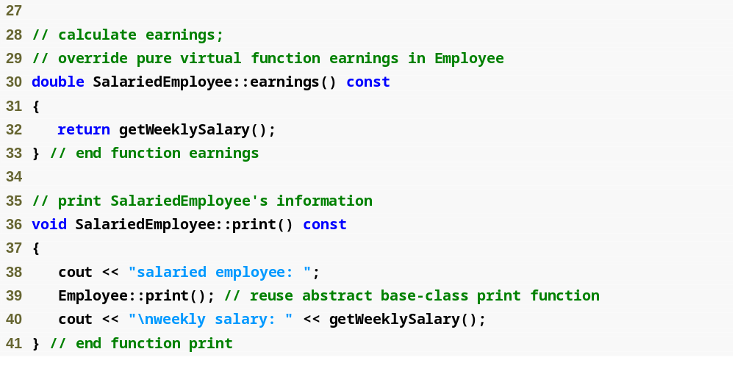
Outline
Salaried
Employee.cpp
(1 of 2)

Slide 57
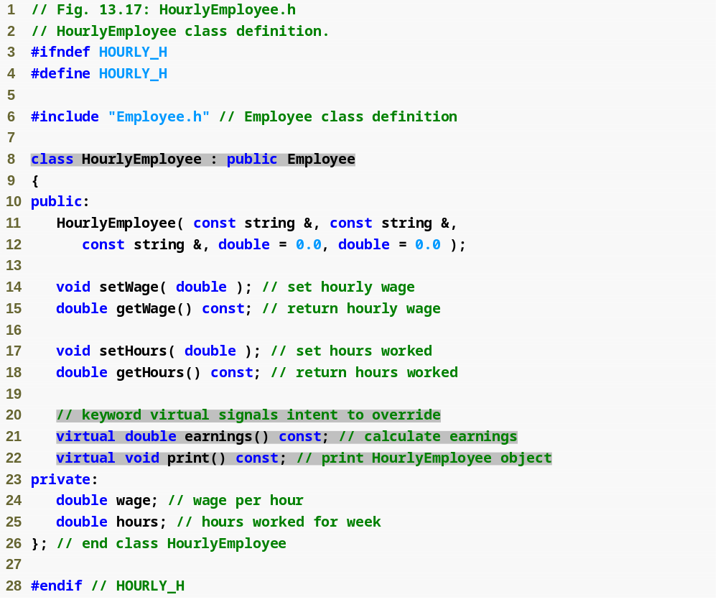
Outline
Hourly
Employee.h
(1 of 1)

Slide 58
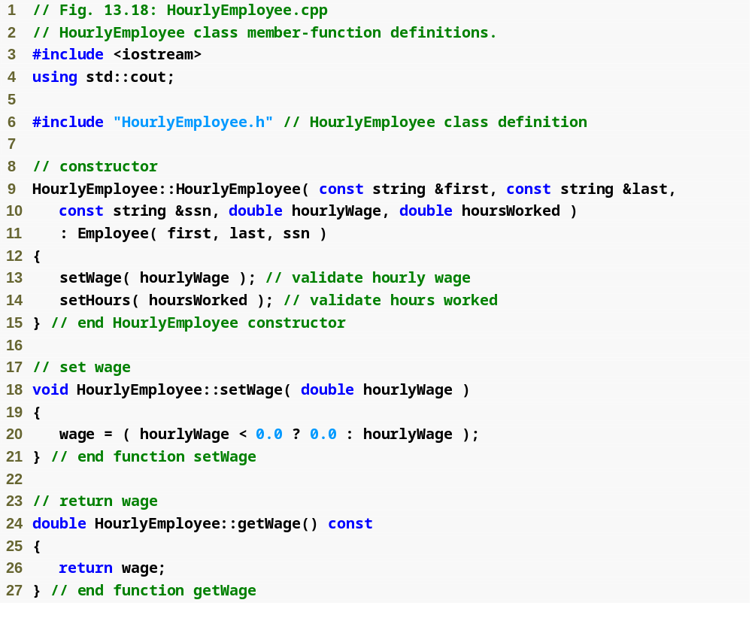
Outline
Hourly
Employee.cpp
(1 of 2)

Slide 59
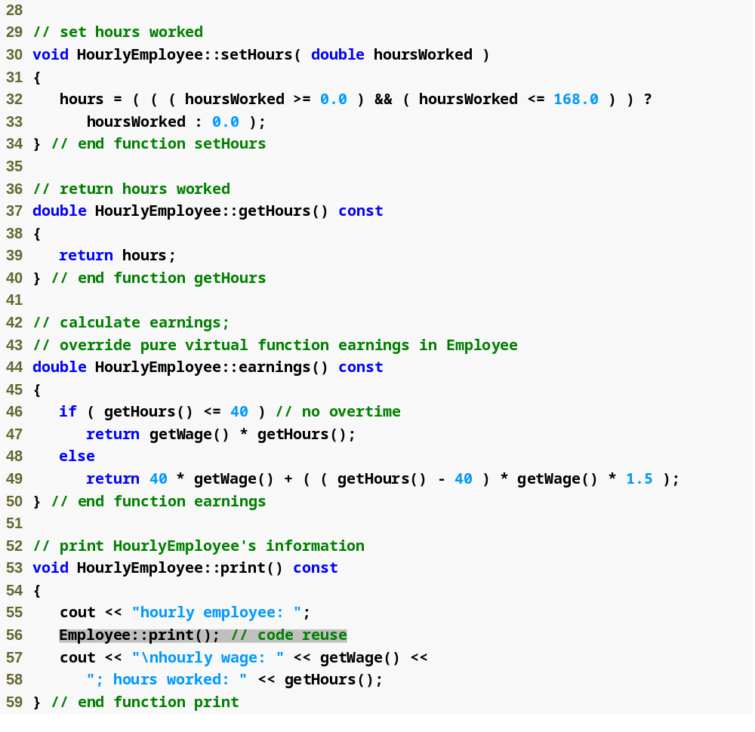
Outline
Hourly
Employee.cpp
(2 of 2)

Slide 60
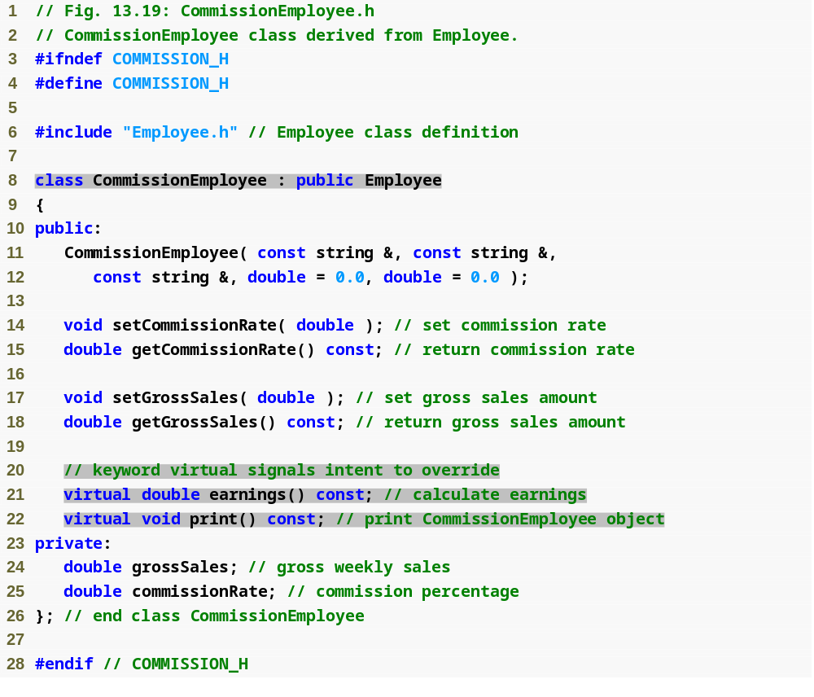
Outline
Commission
Employee.h
(1 of 1)

Slide 61
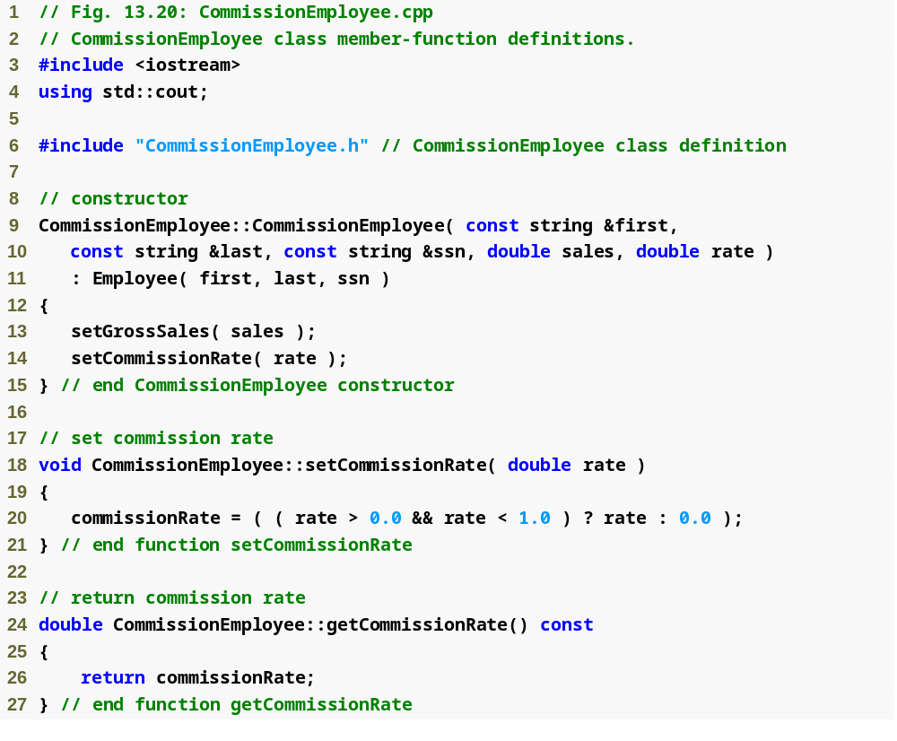
Outline
Commission
Employee.cpp
(1 of 2)

Slide 62
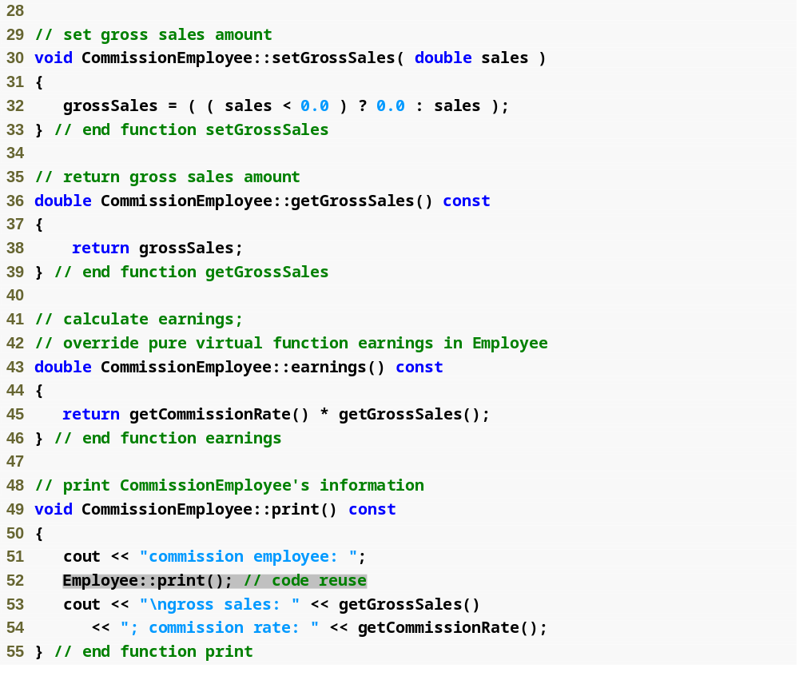
Outline
Commission
Employee.cpp
(2 of 2)

Slide 63
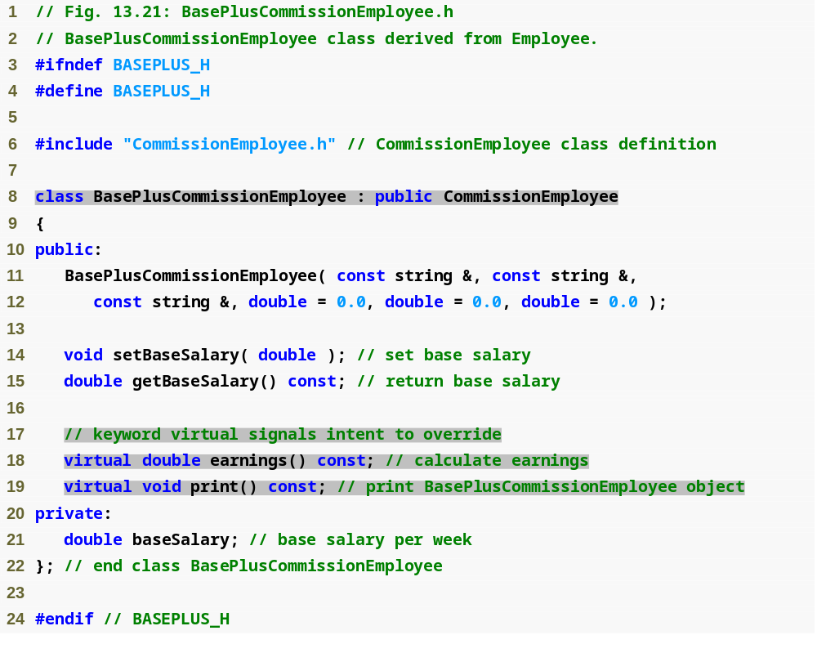
Outline
BasePlus
Commission
Employee.h
(1 of 1)

Slide 64
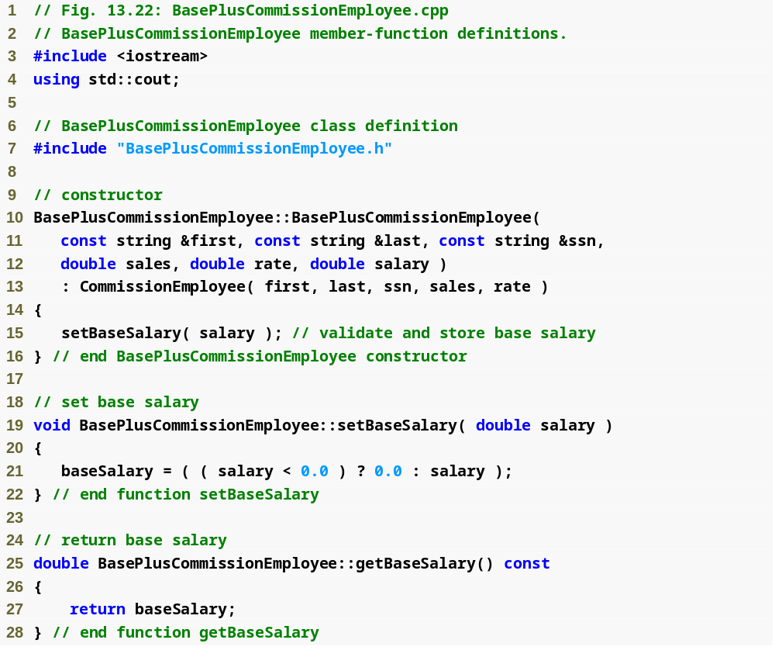
Outline
BasePlus
Commission
Employee.cpp
(1 of 2)

Slide 65
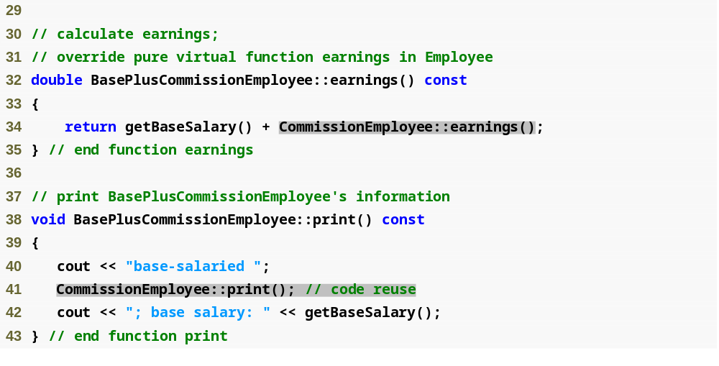
Outline
BasePlus
Commission
Employee.cpp
(1 of 2)

Slide 66
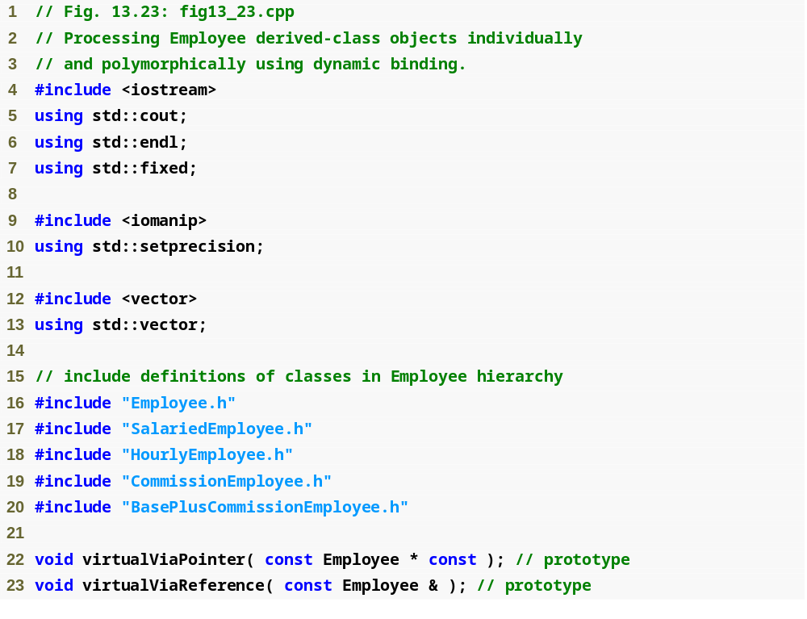
Outline
fig13_23.cpp
(1 of 7)

Slide 67
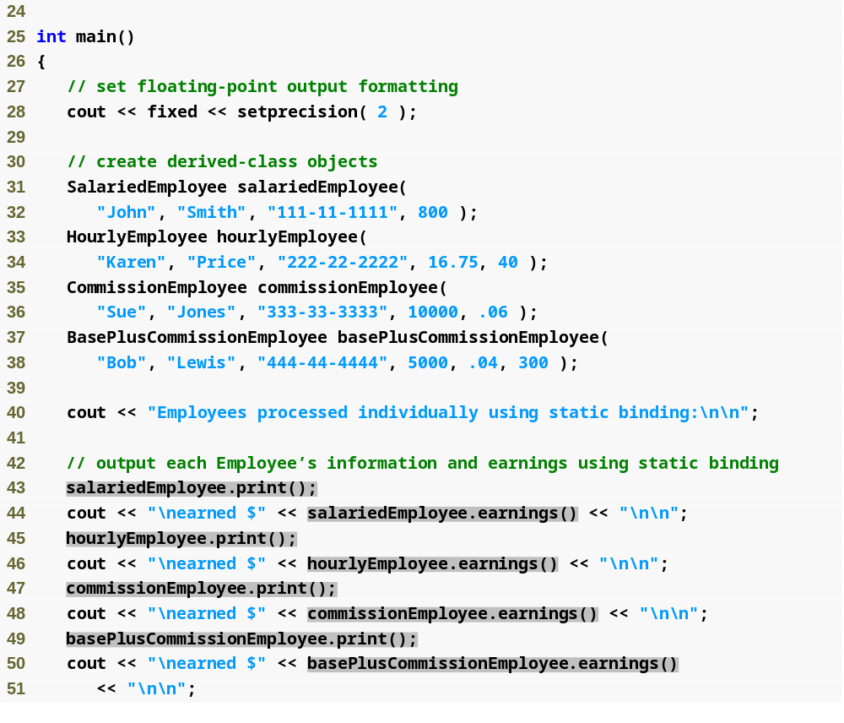
Outline
fig13_23.cpp
(2 of 7)

Slide 68
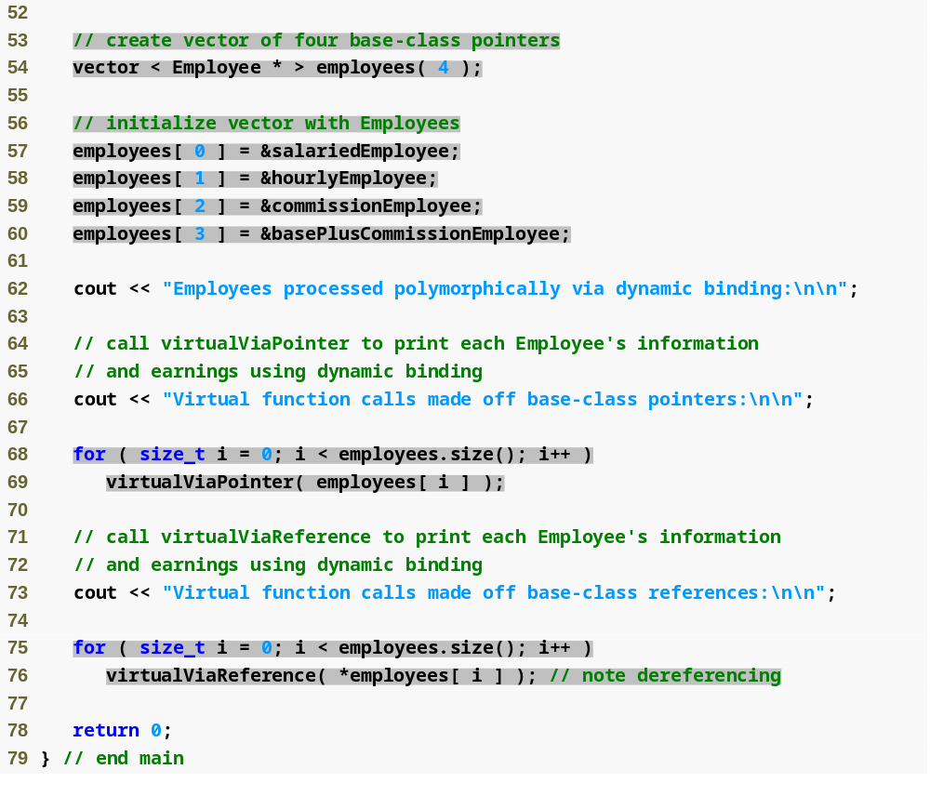
Outline
fig13_23.cpp
(3 of 7)

Slide 69
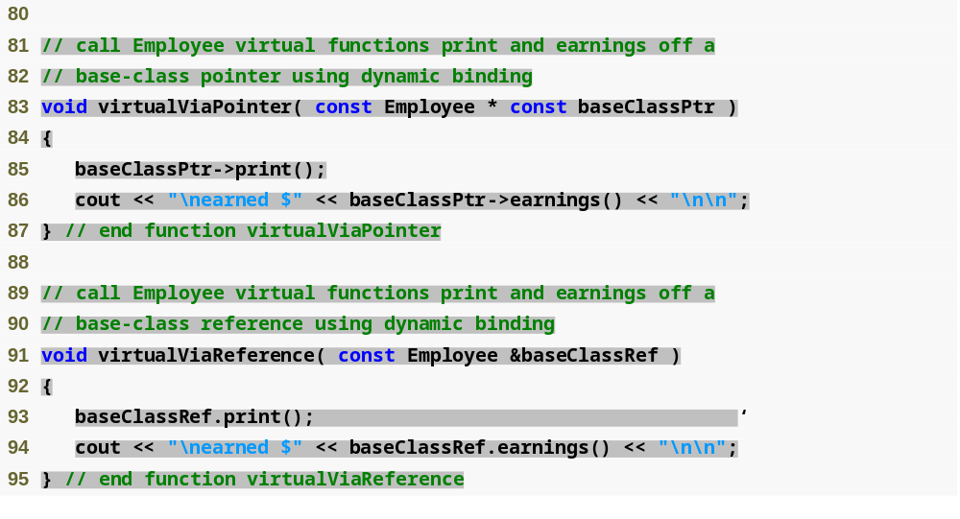
Outline
fig13_23.cpp
(4 of 7)

Slide 70
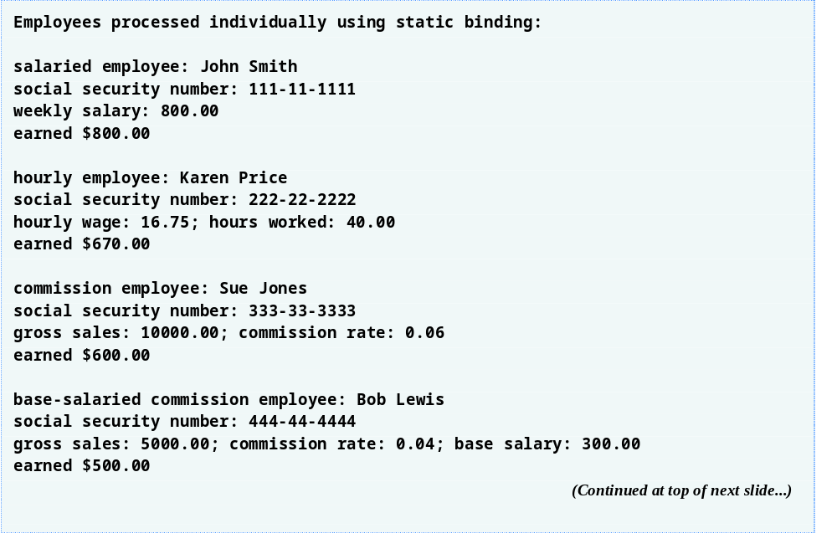
Outline
fig13_23.cpp
(5 of 7)

Slide 71
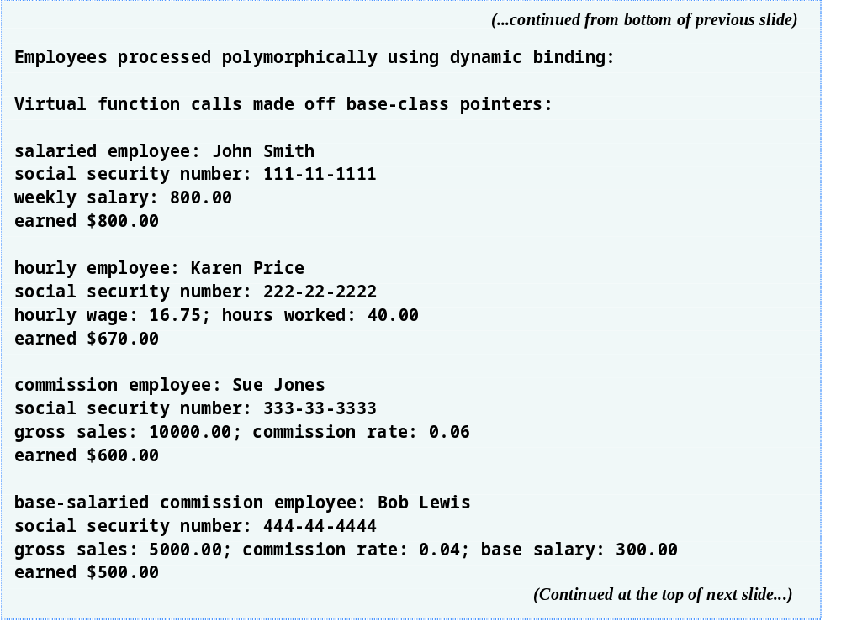
Outline
fig13_10.cpp
(6 of 7)

Slide 72

Outline
fig13_10.cpp
(7 of 7)

Slide 73

Fig.13.24 | How virtual function calls work.

Slide 74
Performance Tip 13.1
Polymorphism, as typically implemented with virtual functions and dynamic binding in C++, is efficient. Programmers may use these capabilities with nominal impact on performance.

Slide 75
Performance Tip 13.2
Virtual functions and dynamic binding enable polymorphic programming as an alternative to switch logic programming. Optimizing compilers normally generate polymorphic code that runs as efficiently as hand-coded switch-based logic. The overhead of polymorphism is acceptable for most applications. But in some situations—real-time applications with stringent performance requirements, for example—the overhead of polymorphism may be too high.

Slide 76
Software Engineering Observation 13.11
Dynamic binding enables independent software vendors (ISVs) to distribute software without revealing proprietary secrets. Software distributions can consist of only header files and object files—no source code needs to be revealed. Software developers can then use inheritance to derive new classes from those provided by the ISVs. Other software that worked with the classes the ISVs provided will still work with the derived classes and will use the overridden virtual functions provided in these classes (via dynamic binding).

Slide 77

Outline
fig13_25.cpp
(1 of 4)

Slide 78

Outline
fig13_25.cpp
(2 of 4)

Slide 79

Outline
fig13_25.cpp
(3 of 4)

Slide 80

Outline
fig13_25.cpp
(4 of 4)

Slide 81
Good Programming Practice 13.2
If a class has virtual functions, provide a virtual destructor, even if one is not required for the class. Classes derived from this class may contain destructors that must be called properly.

Slide 82
Common Programming Error 13.5
Constructors cannot be virtual. Declaring a constructor virtual is a compilation error.

Slide 83

Fig.13.26 | Attributes and operations of classes BalanceInquiry, Withdrawal and Deposit.

Slide 84

Fig.13.27 | Class diagram modeling generalization relationship between base class Transaction and derived classes BalanceInquiry, Withdrawal and Deposit.

Slide 85

Fig.13.28 | Class diagram of the ATM system (incorporating inheritance). Note that abstract class name Transaction appears in italics.

Slide 86

Fig.13.29 | Class diagram after incorporating inheritance into the system.

Slide 87
Software Engineering Observation 13.12
A complete class diagram shows all the associations among classes and all the attributes and operations for each class. When the number of class attributes, operations and associations is substantial (as in Fig. 13.28 and Fig. 13.29), a good practice that promotes readability is to divide this information between two class diagrams—one focusing on associations and the other on attributes and operations. However, when examining classes modeled in this fashion, it is crucial to consider both class diagrams to get a complete view of the classes. For example, one must refer to Fig. 13.28 to observe the inheritance relationship between Transaction and its derived classes that is omitted from Fig. 13.29.

Slide 88

Outline
Withdrawal.h
(1 of 1)

Slide 89

Outline
Withdrawal.h
(1 of 1)

Slide 90

Outline
Transaction.h
(1 of 1)

