Slide 1
14
Templates

Slide 2
Behind that outside pattern
the dim shapes get clearer every day.
It is always the same shape, only very numerous.
  Charlotte Perkins Gilman
Every man of genius sees the world at a different angle from his fellows.
  Havelock Ellis
...our special individuality, as distinguished from our generic humanity.
  Oliver Wendell Holmes, Sr

Slide 3
OBJECTIVES
In this chapter you will learn:
To use function templates to conveniently create a group of related (overloaded) functions.
To distinguish between function templates and function-template specializations.
To use class templates to create a group of related types.
To distinguish between class templates and class-template specializations.
To overload function templates.
To understand the relationships among templates, friends, inheritance and static members.

Slide 4
14.1 Introduction
14.2 Function Templates
14.3 Overloading Function Templates
14.4 Class Templates
14.5 Nontype Parameters and Default Types for Class Templates
14.6 Notes on Templates and Inheritance
14.7 Notes on Templates and Friends
14.8 Notes on Templates and static Members
14.9 Wrap-Up

Slide 5
Software Engineering Observation 14.1
Most C++ compilers require the complete definition of a template to appear in the client source-code file that uses the template. For this reason and for reusability, templates are often defined in header files, which are then #included into the appropriate client source-code files. For class templates, this means that the member functions are also defined in the header file.

Slide 6
Error-Prevention Tip 14.1
Function templates, like macros, enable software reuse. Unlike macros, function templates help eliminate many types of errors through the scrutiny of full C++ type checking.

Slide 7
Common Programming Error 14.1
Not placing keyword class or keyword typename before each type template parameter of a function template is a syntax error.

Slide 8
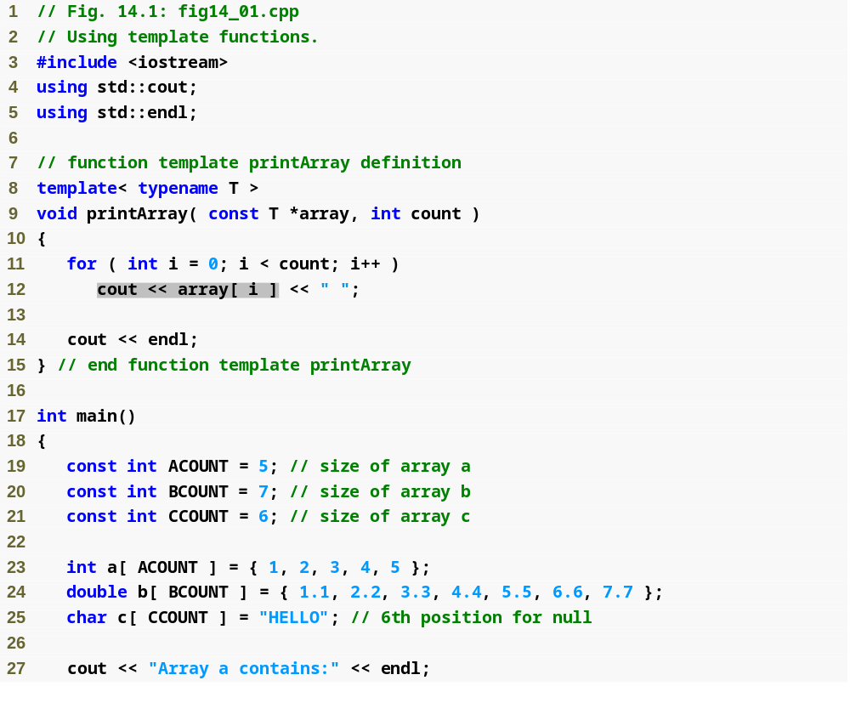
Outline
fig14_01.cpp
(1 of 2)

Slide 9
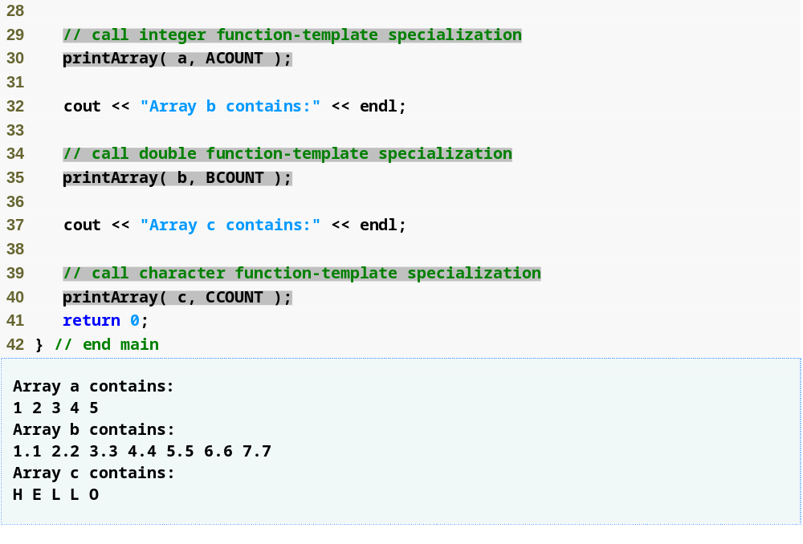
Outline
fig14_01.cpp
(2 of 2)

Slide 10
Common Programming Error 14.2
If a template is invoked with a user-defined type, and if that template uses functions or operators (e.g., ==, +, <=) with objects of that class type, then those functions and operators must be overloaded for the user-defined type. Forgetting to overload such operators causes compilation errors.

Slide 11
Performance Tip 14.1
Although templates offer software-reusability benefits, remember that multiple function-template specializations and class-template specializations are instantiated in a program (at compile time), despite the fact that the template is written only once. These copies can consume considerable memory. This is not normally an issue, though, because the code generated by the template is the same size as the code the programmer would have written to produce the separate overloaded functions.

Slide 12
Common Programming Error 14.3
If no matching function definition can be found for a particular function call, or if there are multiple matches, the compiler generates an error.

Slide 13
Software Engineering Observation 14.2
Class templates encourage software reusability by enabling type-specific versions of generic classes to be instantiated.

Slide 14
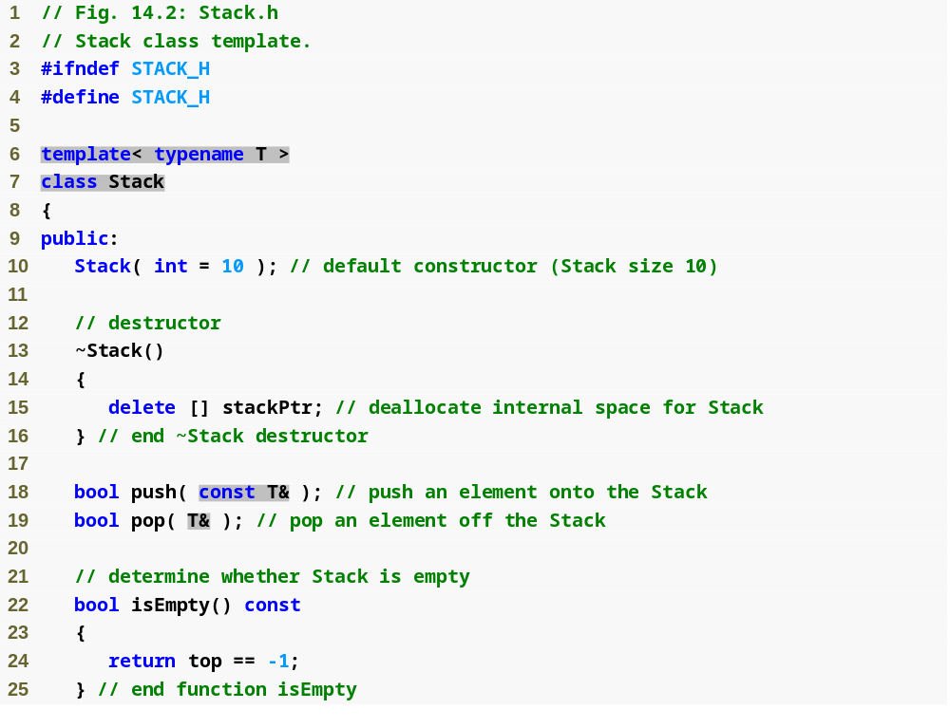
Outline
Stack.h
(1 of 3)

Slide 15
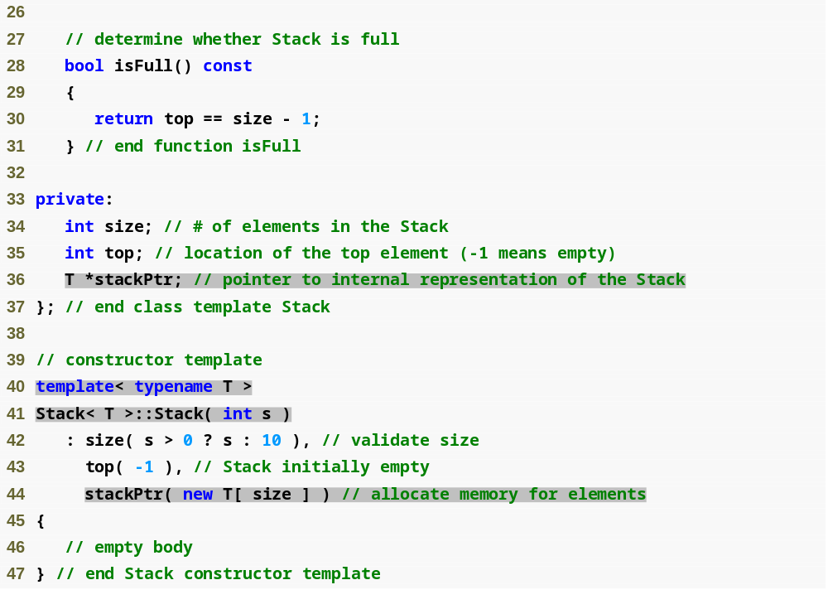
Outline
Stack.h
(2 of 3)

Slide 16
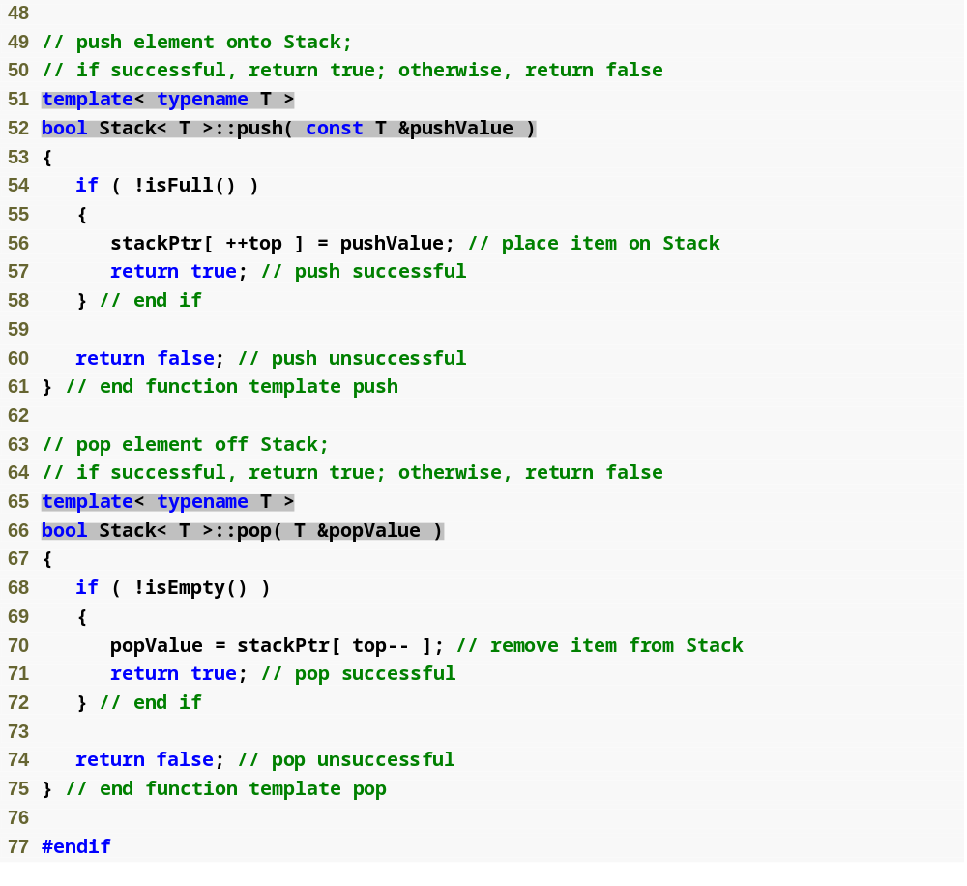
Outline
Stack.h
(3 of 3)

Slide 17
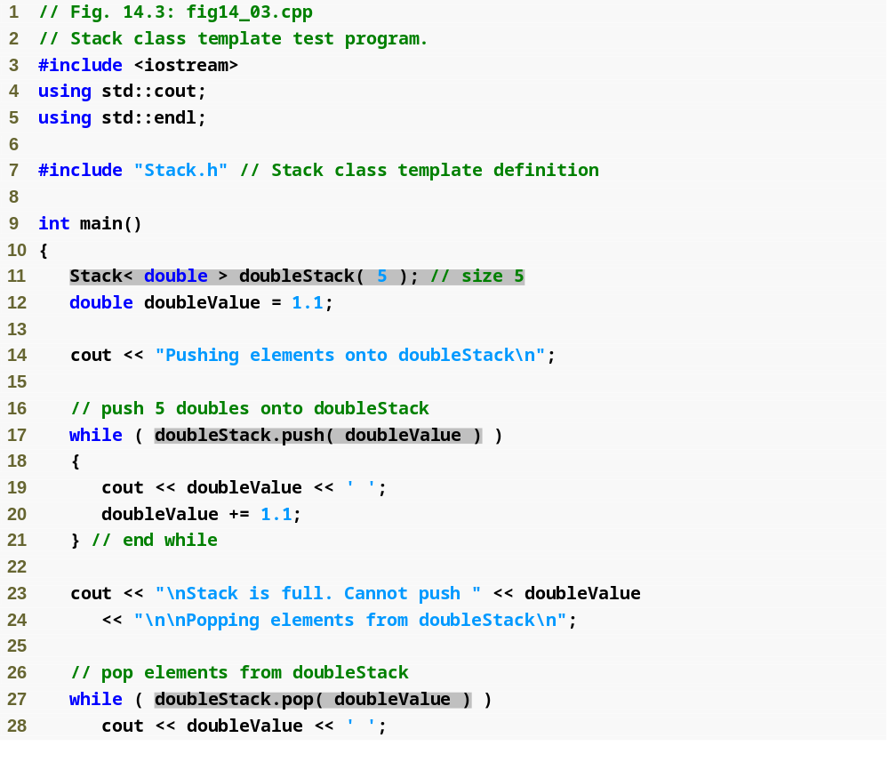
Outline
fig14_03.cpp
(1 of 3)

Slide 18
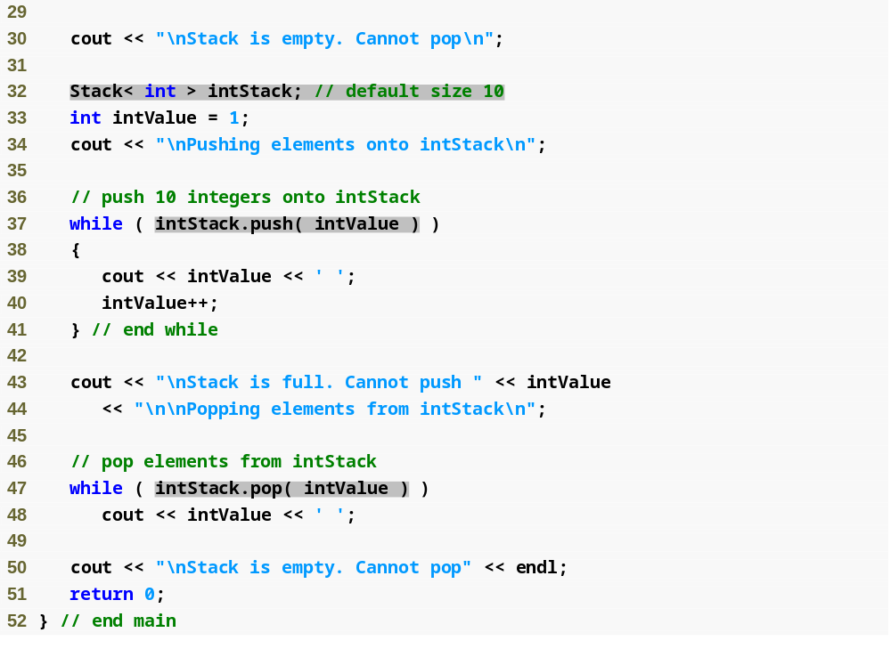
Outline
fig14_03.cpp
(2 of 3)

Slide 19
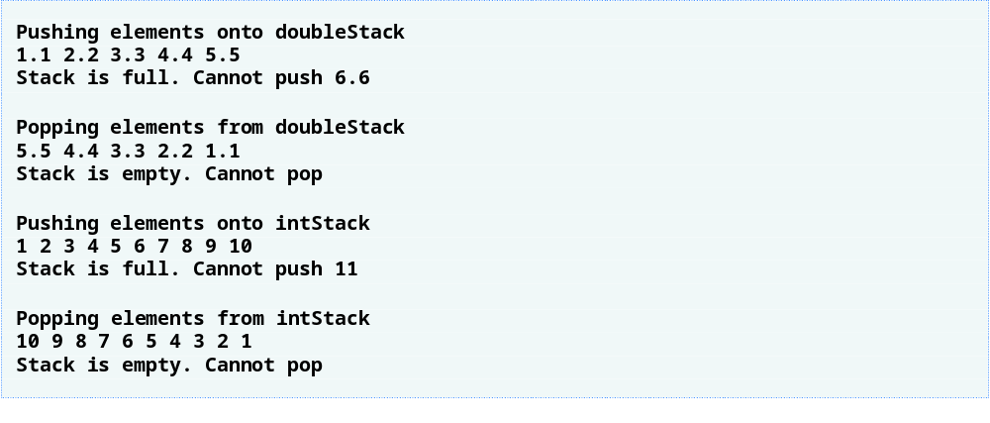
Outline
fig14_03.cpp
(3 of 3)

Slide 20
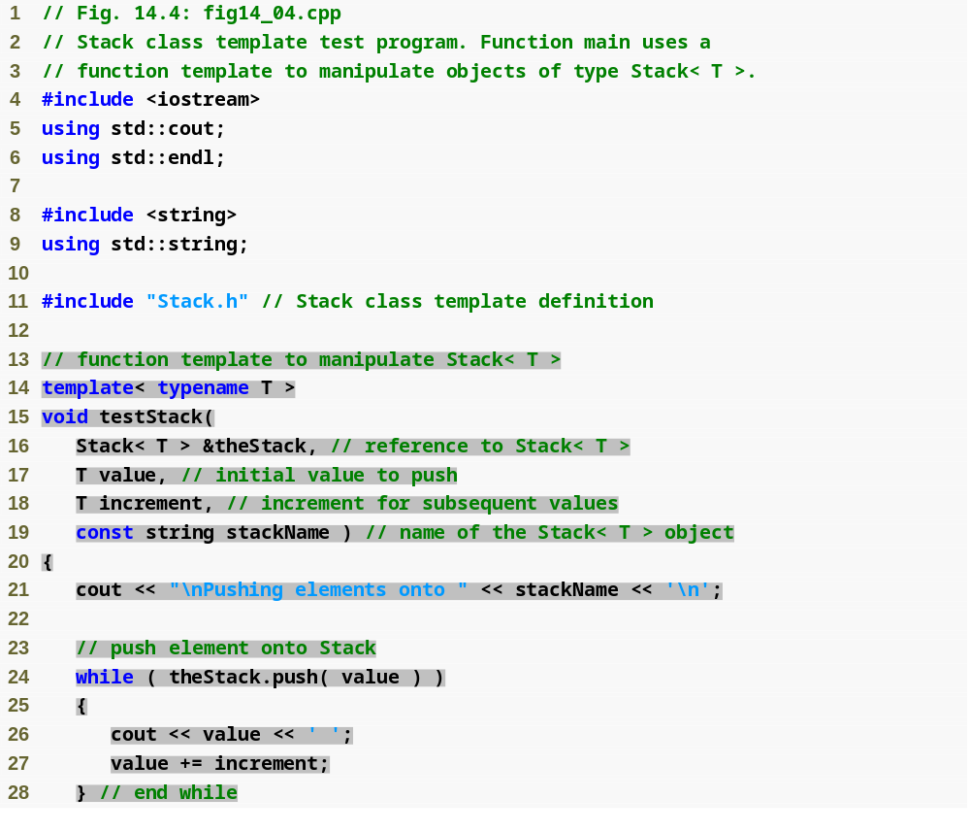
Outline
fig14_04.cpp
(1 of 3)

Slide 21
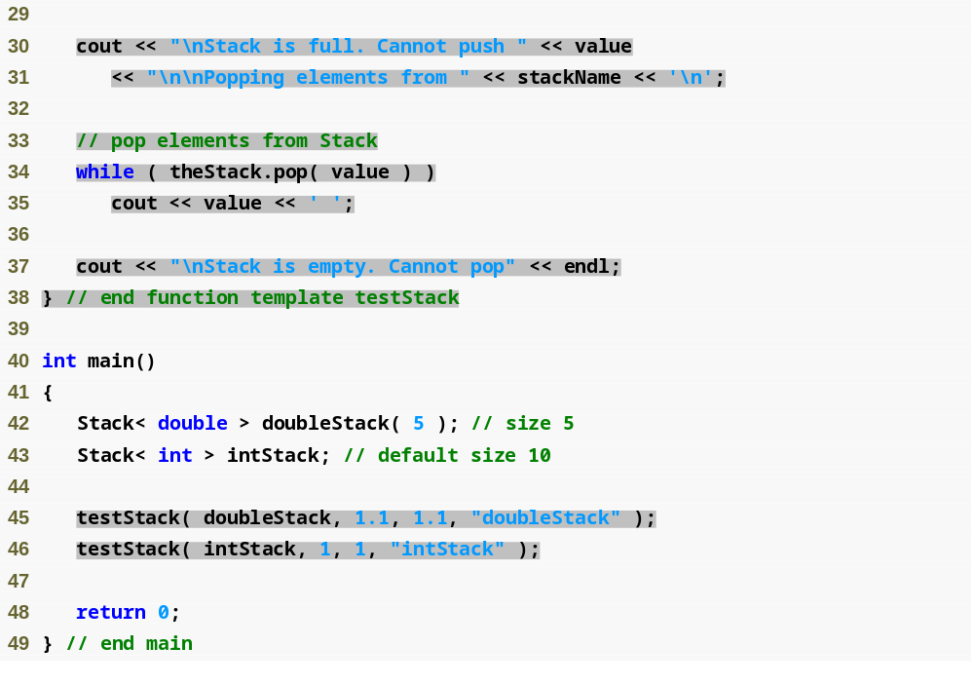
Outline
fig14_04.cpp
(2 of 3)

Slide 22

Outline
fig14_04.cpp
(3 of 3)

Slide 23
Performance Tip 14.2
When appropriate, specify the size of a container class (such as an array class or a stack class) at compile time (possibly through a nontype template parameter). This eliminates the execution-time overhead of using new to create the space dynamically.

Slide 24
Software Engineering Observation 14.3
Specifying the size of a container at compile time avoids the potentially fatal execution-time error if new is unable to obtain the needed memory.

