Slide 1
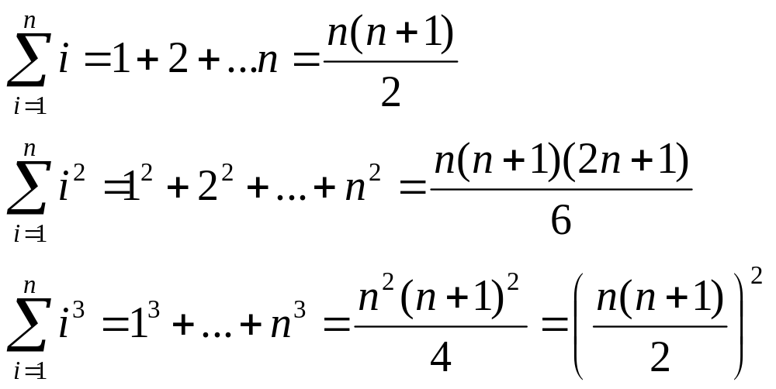

Slide 2
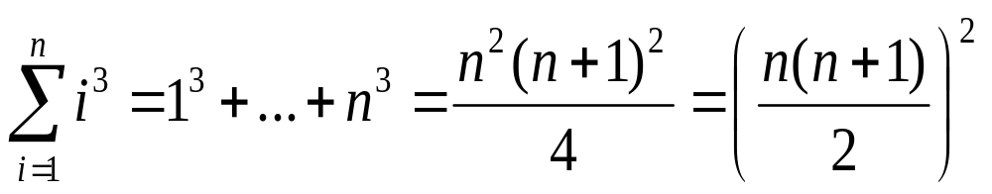
Induction base: n=1, 顯而易見成立, 等於1
Induction inference

Slide 3
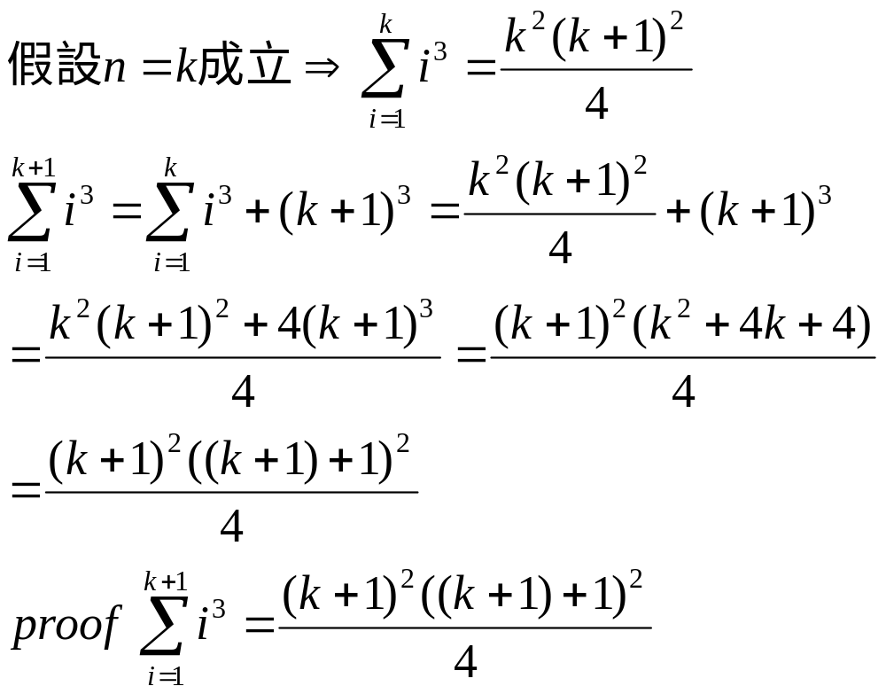

Slide 4
S(n)=3a+8b, n>=14
Induction base: n=14 S(14)= 3+3+8成立
Induction inference:
假設n=k, k=3a, k>=15
n=k+1= 3a+1=3(a-5)+15+1=3(a-5)+2*8
k=3a+8b
k+1=3a+8b+1=3a+8(b-1)+8+1=3(a+3)+8(b-1)

Slide 5
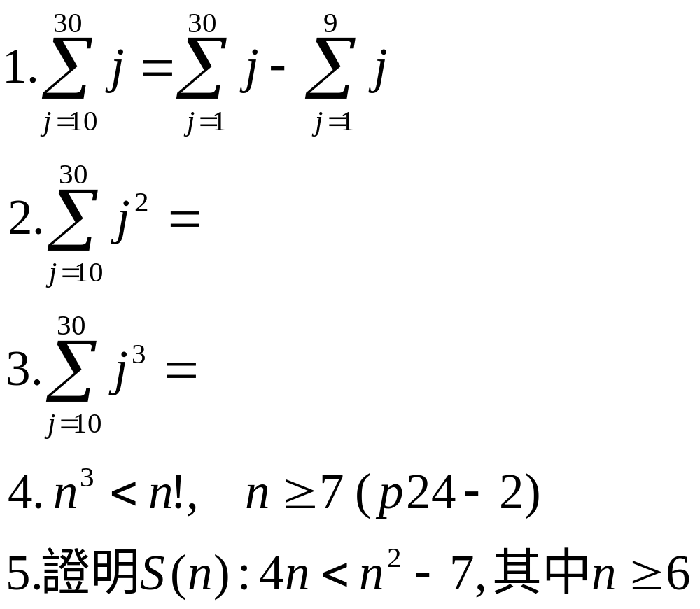

Slide 6
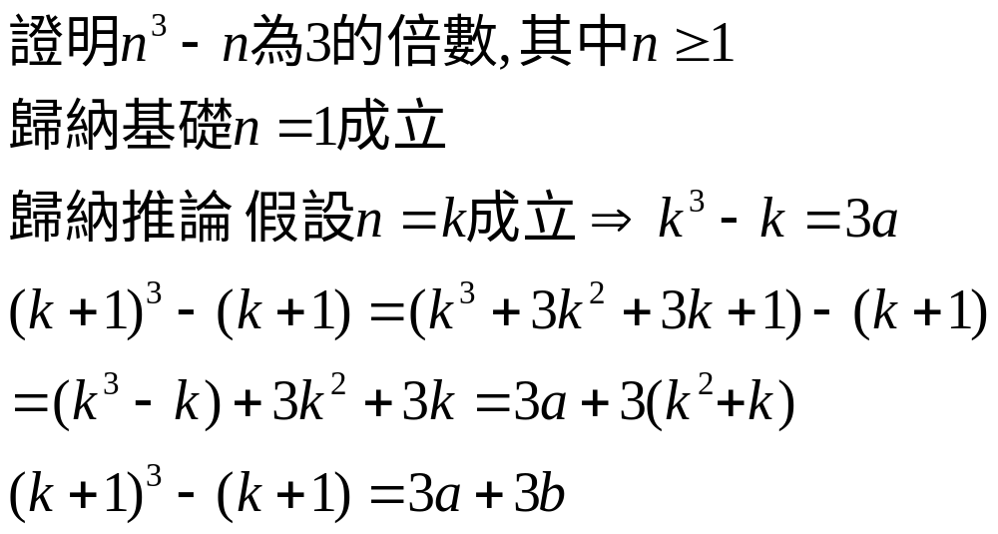

Slide 7
