Slide 1

CHILDSAFE
A safety app with privacy in mind
Wenkai Fan, Bingwu Peng, Hui Wan, Zeyu Liu, Yuan Feng, Cheng Zhang, Zihui Zheng, Jianwei Du
Notes:
HI EVERYONE. I am Wenkai from duke university. Today I want to talk about my current work of adding duke version LBT and heavy jet analysis to JETSCAPE.

Slide 2
OUTLINE
Project Description & Requirements
UI Design
Architecture
Development & Testing
Maintenance & Evolution
Challenges & Skills learnt
Demonstration

Slide 3
PART ONE
Requirements
Real-time location tracking of a lost child while avoiding domestic abuse.
Parent:
Child:
Police:
Bind/Unbind with children
Send “Lost Child” request
Send “Found Child” request
Call 911 when sending “Lost Child” request / user desires
Bind/Unbind with parents
Upload location data only to cloud when child is lost
Claim self as “in danger”
Monitor all lost child status
Show lost child location history on the map

Slide 4
PART ONE
Requirements
Functional Requirements:
Only email verified accounts can log in. An account can only log into one device at a time.
One parent can bind with more than one child. One child can bind with more than one parent.
Lost/Found child status are synchronized among parents.
Children’s end send location information to the cloud without any notification. Location service runs every 15 minutes even the app is closed/device in doze mode/device restarts.
Parent end receive notification when a child is lost (child/other parent claim this child as lost).

Slide 5
PART ONE
Requirements
Functional Requirements:
Non-functional Requirements:
Users can update their name and photo.
All data is synced/updated in real-time.
Parent and Child end will stay logged in.
Police end have additional verification.
Dark mode
Multilanguage support
Landscape/portrait mode
Font size change

Slide 6
PART ONE
Requirements
Non-functional Requirements (Privacy):
Only a single device is allowed to be logged in at a time.
No GPS data ever sent to the parents.
Past child GPS data will be handled to avoid data leakage.
Child binding request does not display child’s photo.
Police account will be automatically logged out once the app is closed.

Slide 7

PART TWO
UI Design
Material design language
Logo design
Consistent color scheme
Consistent UI components
(material card, material button, snack bar…)
https://material.io
CHILDSAFE

Slide 8
PART THREE
Architecture
Model View Presenter (MVP)
Model
Activities/
fire events
Fragments/
manipulates
Presenter
Model/
updates
Worker/
pass call to
View
Util/
res/
layout/
interact
drawble/
User
values/
The Model View Presenter (MVP) pattern
…

Slide 9
PART FOUR
Development & Testing
Tested on:
Xiaomi MIX 3 (Android 9.0)
Google Pixel 2 (Android 9.0)
Nexus 5X (Android 8.0)
Tested against:
invalid inputs at various places
no network/no GPS data
null/empty data from server
navigate back/forth from home screen/fragments/other apps
UI component functioning (click, long click, swipe, animation)
different color mode/text size/phone orientation/language
Over 100+ commits. Around 20 bug fix commits.

Slide 10
PART FIVE
Maintenance & Evolution
Features to be implemented: Police end role verification and responsibility allocation.
Database data encryption/past data handling.
Database migration.
Documentation update.
Use MVVM/RxJava/Dagger, migrate to Kotlin.
Stress test, Server load balancing.

Slide 11
PART SIX
Challenges & Skills learnt
Android API deprecation/library bug.
Learn Java and Android development in a short time.
Team member schedule conflict.
Data merge conflict caused by Firebase local backup.

Slide 12
PART SIX
Challenges & Skills learnt
Agile software development.
Java, Android, NoSQL Firebase.
Communication, collaboration.
Risk and challenges management.
Software testing and maintaining.

Slide 13
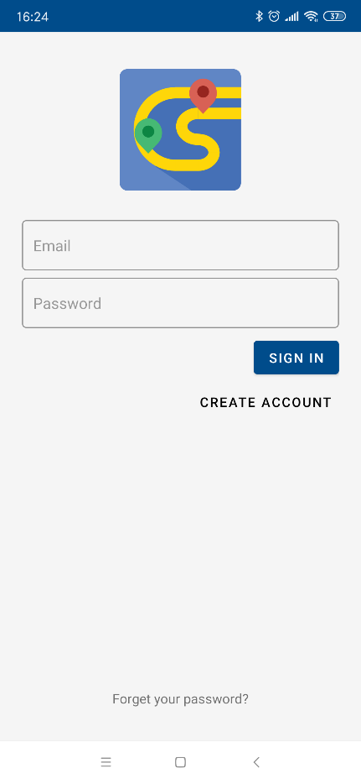
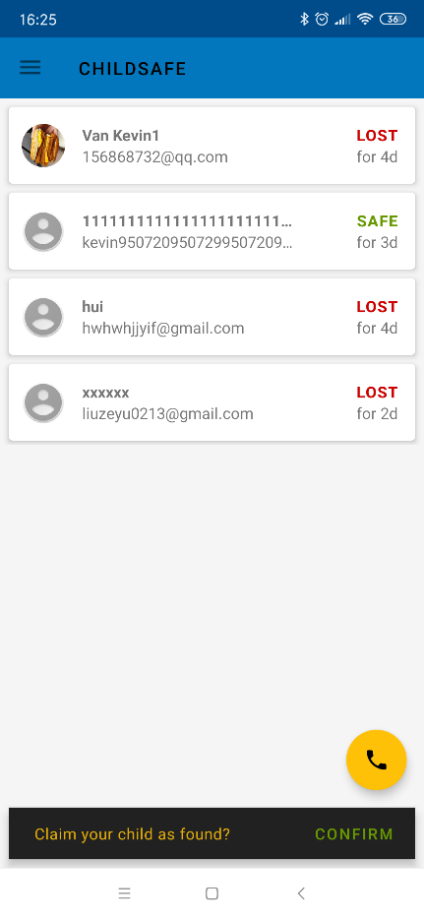
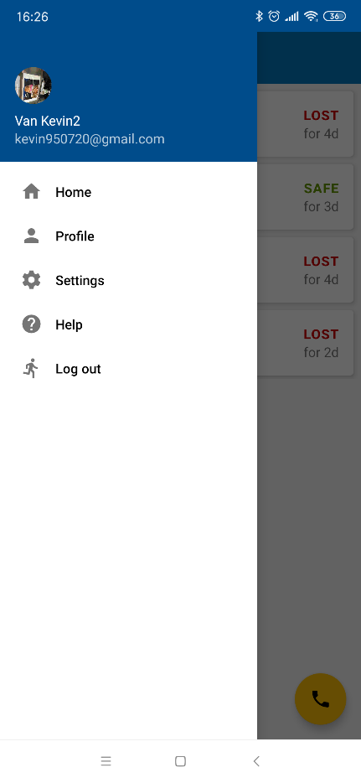
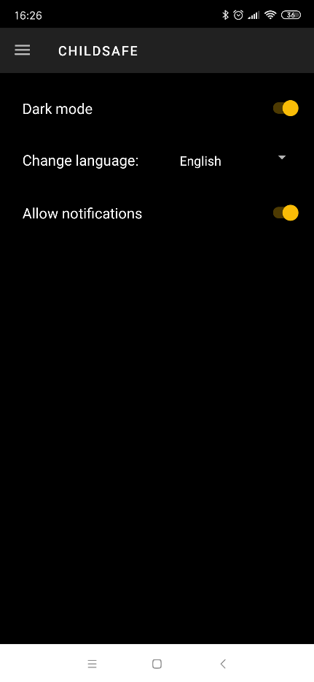
PART SEVEN
Demonstration

Slide 14
THANK YOU
Wenkai Fan, Bingwu Peng, Hui Wan, Zeyu Liu, Yuan Feng, Cheng Zhang, Zihui Zheng, Jianwei Du

Slide 15
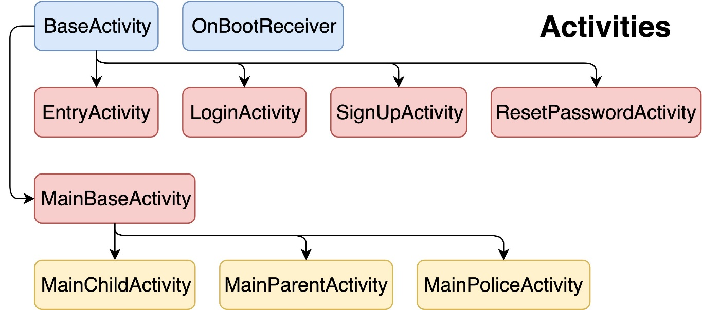
PART THREE
Architecture
: extend
Model View Presenter (MVP)
: communicate with

Slide 16
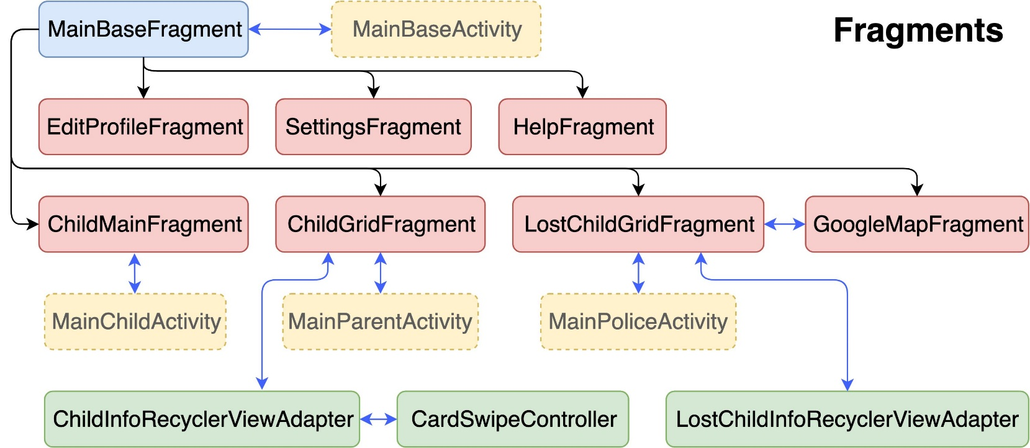
PART THREE
Architecture
: extend
Model View Presenter (MVP)
: communicate with

Slide 17
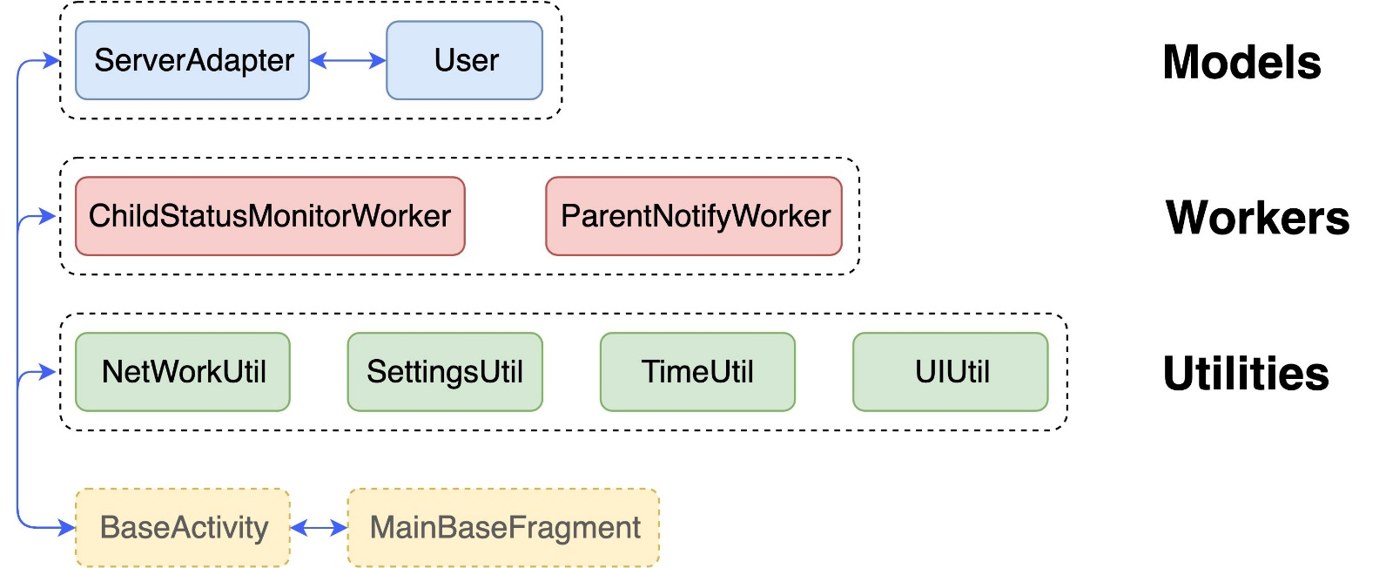
PART THREE
Architecture
: extend
Model View Presenter (MVP)
: communicate with

Slide 18
PART THREE
Architecture
View
Presenter
Model
User clicked the dark mode button
SettingsFragment make calls to SettingsUtil
SettingsUtil update the relevant stored value
View is updated
SettingsFragment trigger new event

Slide 19
PART THREE
Architecture
View
Presenter
Model
User clicked the save profile button
ProfileFragment calls ServerAdapter
ServerAdapter upload data to the server
View is updated
Any activity/fragment with a event listener get an update

Slide 20
PART FOUR
Development & Testing
Id | duration | Depen- dency | Owner | Task name | Task progress
T1 | 1 |  | Wenkai/Yuan | Create and link database | ✔
T2 | 1 |  | Cheng/Zihui | Set up environment and development tools | ✔
T3 | 2 | T1 | Binwu/Jianwei | Design database structure | ✔
T4 | 4 | T2,T3 | Wenkai/Zihui | Implement sign up module | ✔
T5 | 4 | T4 | Hui/Cheng | Implement log in/log out module | ✔
T6 | 4 | T5 | Jianwei/Binwu | Implement user binding module | ✔
T7 | 2 | T5 | Cheng/Yuan | Implement user profile editing and auto-update | ✔
T8 | 5 | T6 | Wenkai/Zihui | implement launching lost child/found child event function | ✔
T9 | 2 | T8 | Hui | Implement calling 911 functionality | ✔
T10 | 4 | T8 | Zeyu/Binwu | Implement location tracking and data uploading module | ✔
T11 | 2 | T10 | Jianwei | System test | ✔

Slide 21
PART FOUR
Development & Testing
Id | duration | Depen- dency | Owner | Task name | Task progress
T12 | 1 | T4 | Wenkai/Yuan | Only allow account to log into one device at a time | ✔
T13 | 1 | T6 | Wenkai/Zihui | Notifications on parent end | ✔
T14 | 2 | T6 | Binwu/Jianwei | Forbid child status update when offline | ✔
T15 | 2 | T3 | Wenkai/Zihui | Multi-language support | ✔
T16 | 2 | T3 | Hui/Cheng | Dark mode | ✔
T17 | 4 | T6 | Zeyu/Jianwei | Unlink child | ✔
T18 | 2 | T5 | Cheng/Yuan | Reset password | ✔
T19 | 4 | T11 | Wenkai/Zihui | create and authenticate police accounts | ✔
T20 | 6 | T19 | Hui/Wenkai | implement location monitoring module for police | ✔
T21 | 4 | T20 | Binwu/Yuan | write user manual and FAQs | ✔
T22 | 3 | T21 | Jianwei | System test | ✔

