Slide 1
Medicore
Kevin Wang, Khalil Manpuri, Amar Sheth

Slide 2
Function
Provides a way to search for potential diseases based on symptoms you have
Allows easy access to nearby doctors who specialize in treating a particular disease
Allows users to provide as well as see ratings and reviews for doctors that they have visited

Slide 3
Challenges
Coordinating code with one person not having consistent access to a Mac
Figuring out how to effectively use Firebase
Putting together the structure of the app

Slide 4
Target Audience
New parents who have inexperience with professional care for newborns
College students who need a quick/easy fix for certain symptoms they may experience
People moving to a new location seeking the best medical treatment possible.

Slide 5
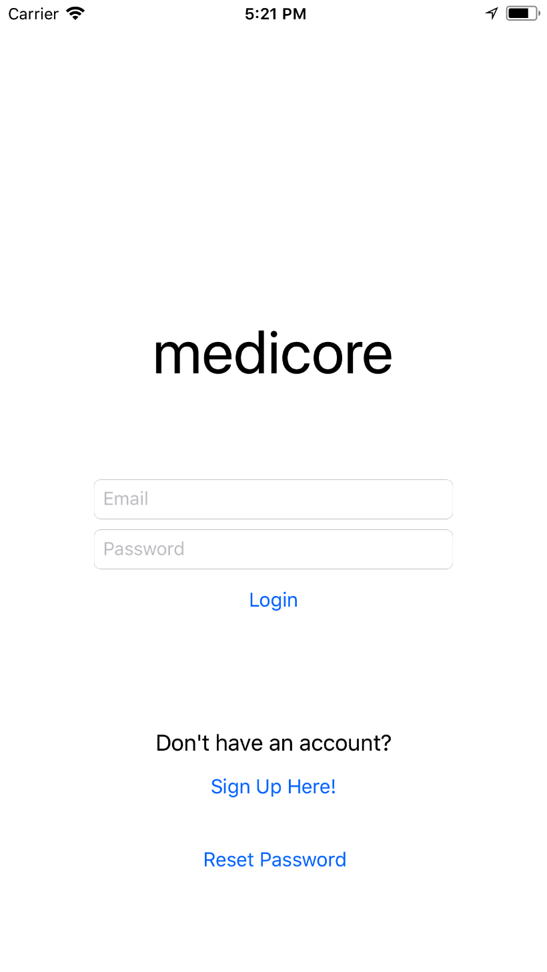
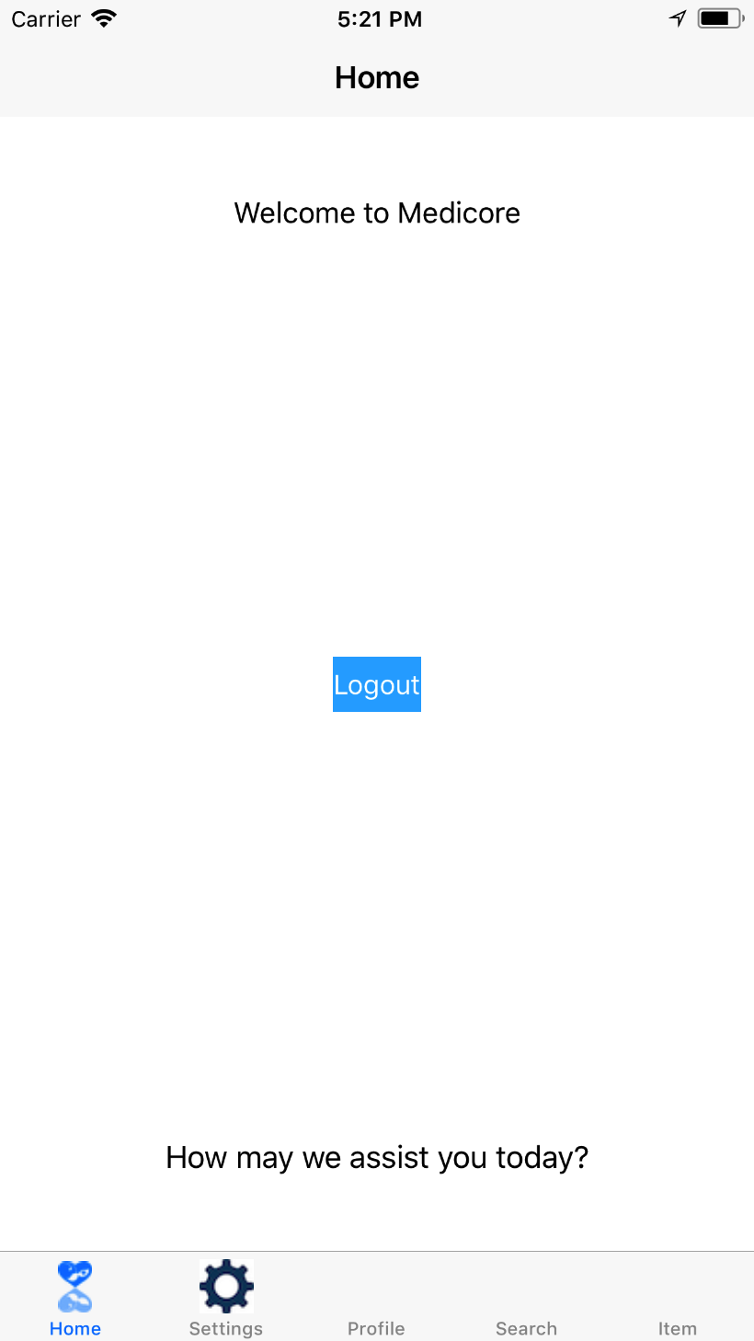
Login

Slide 6
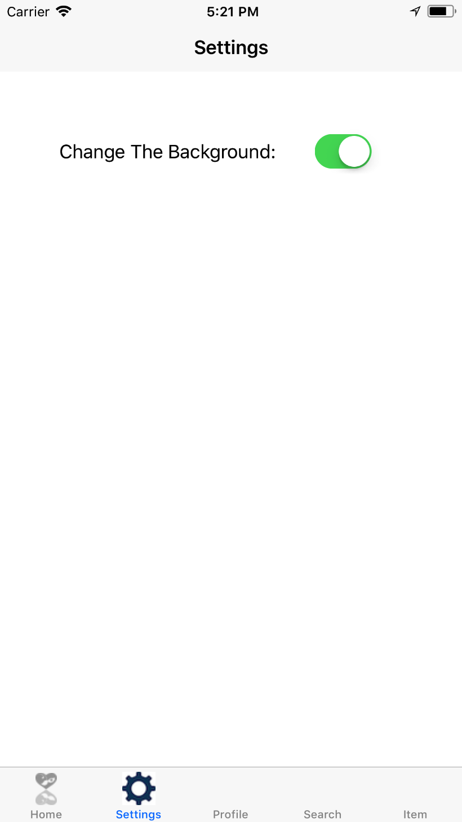
Settings
Eventually potential to change more than just background
Change medical search settings

Slide 7
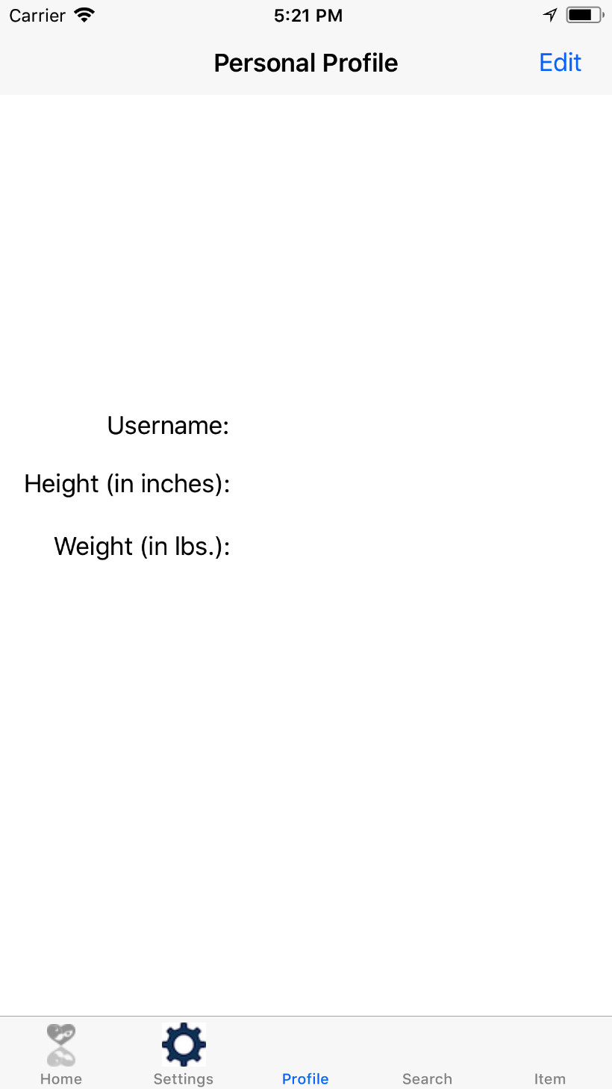
Profile
Displays basic user information
Displays brief summary of past medical conditions

Slide 8
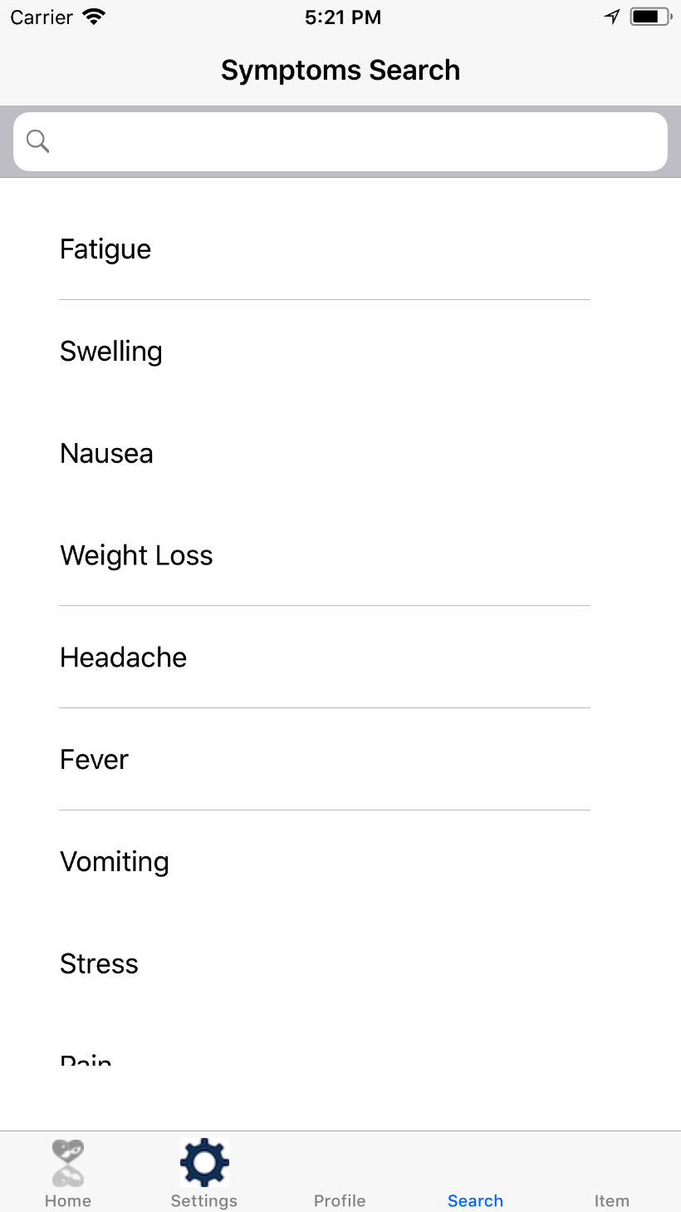
Searches
Allows search for symptoms and translates into a search for potential diseases
Also allows for searches based on known doctors

Slide 9
Descriptions
Shows details on diseases such as descriptions and potential cures
Gives more detailed information about doctors

Slide 10
Contribtuions
Kevin
App logic
Navigation and search
Khalil
Backend / Firebase
Login
Amar
UI/UX
App design

Slide 11
Any Questions?

Slide 12
Demo

