Slide 1
AWS Lambda – Container Image Support
Using container tooling in
serverless workflows
Kevin Wang
Notes:
Hello everyone, my name is Kevin Wang, and I’m a Solution Architect here at AWS. Today, I’ll be discussing a new feature, AWS Lambda Container Image Support, and how customers can now use container tooling such as the Docker CLI with our serverless offerings. You can now package and deploy Lambda functions as container images of up to 10 GB in size. This way, you can also easily build and deploy larger workloads that rely on sizable dependencies, such as machine learning or data intensive workloads. Just like functions packaged as ZIP archives, functions deployed as container images benefit from the same operational simplicity, automatic scaling, high availability, and native integrations with many services.

Slide 2
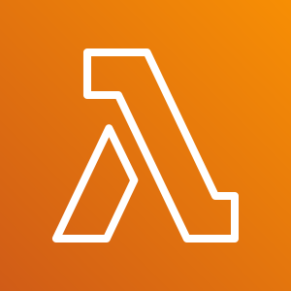
No Servers to manage
Continuous Scaling
Cost optimized with millisecond metering
Consistent performance at any scale
AWS Lambda
Notes:
Before we dive into container image support, let’s do a a quick overview of its underlying components. First, we’ll take a look at AWS Lambda. The service provides an event-driven, serverless computing platform
No servers to manage:
AWS Lambda automatically runs your code without requiring you to provision or manage infrastructure. Just write the code and upload it to Lambda either as a ZIP file or container image.
Continuous Scaling:
AWS Lambda automatically scales your application by running code in response to each event. Your code runs in parallel and processes each trigger individually, scaling precisely with the size of the workload, from a few requests per day, to hundreds of thousands per second.
Cost opt:
With AWS Lambda, you only pay for the compute time you consume, so you’re never paying for over-provisioned infrastructure. You are charged for every millisecond your code executes and the number of times your code is triggered.
Consistent performance at any scale:
With AWS Lambda, you can optimize your code execution time by choosing the right memory size for your function. You can also keep your functions initialized and hyper-ready to respond within double digit milliseconds by enabling Provisioned Concurrency.

Slide 3


Amazon Elastic Container Registry
Amazon Elastic Container Service
Notes:
On the other side of the coin are containers.
Containers are an easy and portable way to run and deploy applications, and often a first step in a one’s modernization journey. Operations teams who are already running containers, on-premises or in the cloud, would benefit from migrating them to AWS Managed Services like Amazon Elastic Kubernetes Service (Amazon EKS) or Amazon Elastic Container Service (Amazon ECS) with AWS Fargate to reduce operational burden and gain the benefits of scalability, reliability, security and availability.
AWS also does the heavy lifting for your customers (ex. infrastructure provisioning and container orchestration), resulting in simplified operations and reduced management overhead
ECR: fully managed container registry that makes it easy to store, manage, share, and deploy your container images and artifacts anywhere
ECS: is a fully managed container orchestration service.

Slide 4
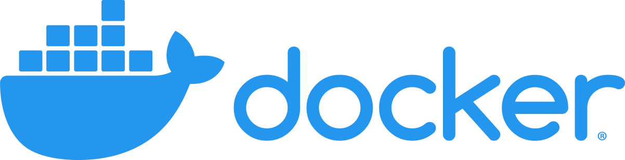
Run code without managing or provisioning servers
Develop, ship, and run applications with containers
Notes:
Build applications to run on lambda using container tooling you’re familiar with
functions deployed as container images benefit from the same operational simplicity, automatic scaling, high availability, and native integrations with many services.
base images for all the supported Lambda runtimes (Python, Node.js, Java, .NET, Go, Ruby) so that you can easily add your code and dependencies. You can deploy your own arbitrary base images to Lambda, for example images based on Alpine or Debian Linux.
There are no additional costs to use this feature. You pay for the ECR repository and the usual Lambda pricing.
You can use container image support in AWS Lambda with the console, AWS Command Line Interface (CLI), AWS SDKs, AWS Serverless Application Model (SAM), AWS Cloud Development Kit (CDK), AWS Toolkits for Visual Studio, VS Code,
Easier dependency management and app building
Use a consistent set of tools
Deploy large applications w/ AWS provided or 3rd party images

Slide 5

Developer Experience
docker push
CreateFunction
Local Development
Container
Elastic Container Registry
Container
AWS Lambda
Notes:
Develop locally. Push to ECR, and execute a createfunction using the container image.
Runtime hooks: New is Lambda Runtime Interface Clients, Runtime API for all supported runtimes. These implementations are available via native package managers, so that you can easily pick them up in your images, and are being shared with the community using an open source license (for custom base images). You can use internal extensions to modify the runtime proces
Local Testing: Lambda Runtime Interface Emulator, enables you to perform local testing of the container image and check that it will run when deployed to Lambda, included in all AWS provided base images

Slide 6
Demo

Slide 7
Q&A
Kevin Wang

