Slide 1
ANOVA of Socio-Economic Status Between Continents
Kevin Wang

Slide 2
Data Collection/Cleaning
Dataset obtained from: Global Socio-Economic & Environmental Indicators (kaggle.com)
Region codes based on World Bank definitions were included in the dataset, but with many missing values and no easy way to get all the World Bank regions, I instead mapped each of the 195 countries to their continent using the package “pycountry-convert.”
I only focused on the latest 2021 data, but my analysis could be extended to all years in the dataset.

Slide 3
Main Topic of Interest
Are there significant differences in socio-economic status defined by indicators: (CO2 production, gross national income (GNI) by capita, life expectancy, and Human Development Index (HDI) between continents?

Slide 4
Define the Four Socio-Economic Indicators
1. CO2 production per capita
2. GNI per capita is GDP plus net income from abroad.
3. Life expectancy is the average age of death.
4. HDI is a composite index of life expectancy, education, and per capita income.
a. Main indicator - Project would be too long if we ran ANOVAs for all 4 variables.

Slide 5

Univariate Analysis
The average co2_prod_2021 value is 4.16, but the middle value of the distribution is 2.5. This suggests that the distribution is skewed to the right, with a few very high values. The standard deviation is 5.35, which is relatively large. Similarly, gnipc_2021 is also skewed to the right with a mean of 20136.4 and a median of 12306.3 with a relatively large standard deviation of 21756.1.
Le_2021 and hdi_2021 are more evenly distributed with similar means and medians.

Slide 6
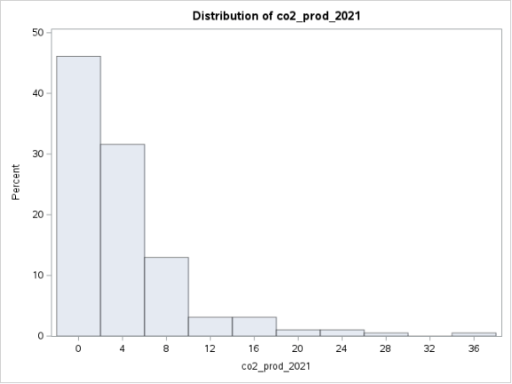
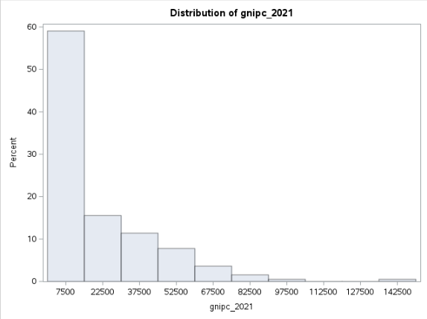
Histograms

Slide 7
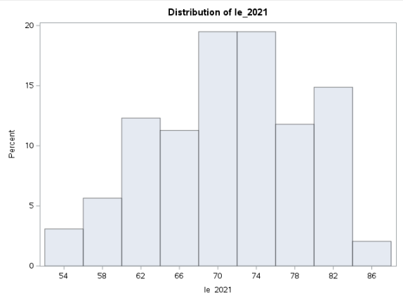
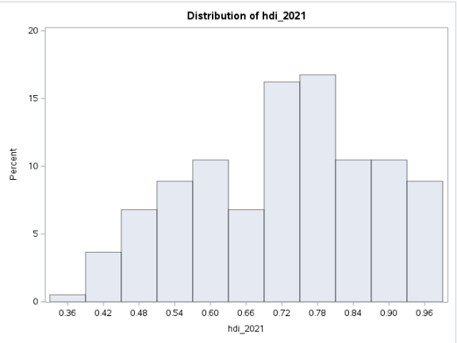
Histograms

Slide 8
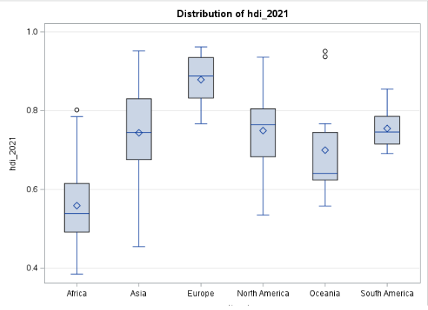
Distribution of HDI by Continent
Africa has the lowest average HDI whereas Europe has the highest.

Slide 9
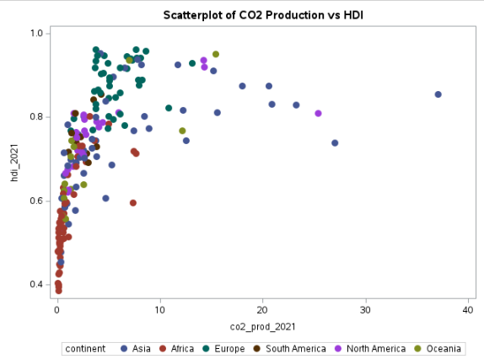
CO2 Production vs HDI
The continent with the lowest average HDI, Africa, also has the lowest average CO2 production.
Europe has a very high HDI but overall low CO2 production.
There are a few points (mainly countries from Asia) with high HDI and very high CO2 production. Overall, there appears to be correlation between the 3 other indicators and HDI.

Slide 10
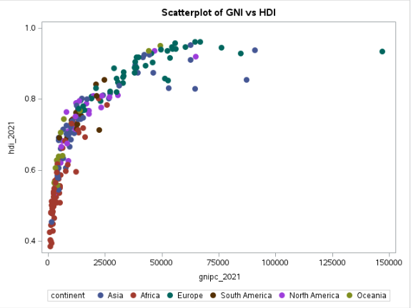
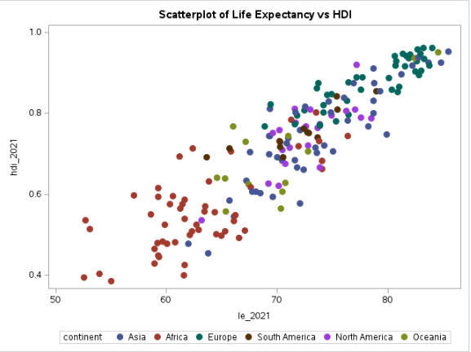
GNI and Life Expectancy vs HDI

Slide 11
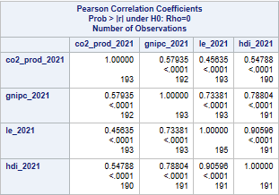
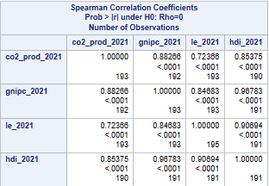
Correlation
HDI is highly correlated with GNI and life expectancy using the Pearson method. HDI is highly correlated with all three other indicators using the Spearman method. As a composite indicator, and given the high correlations with other indicators, we feel confident that HDI is the best indicator to use for our analysis.

Slide 12
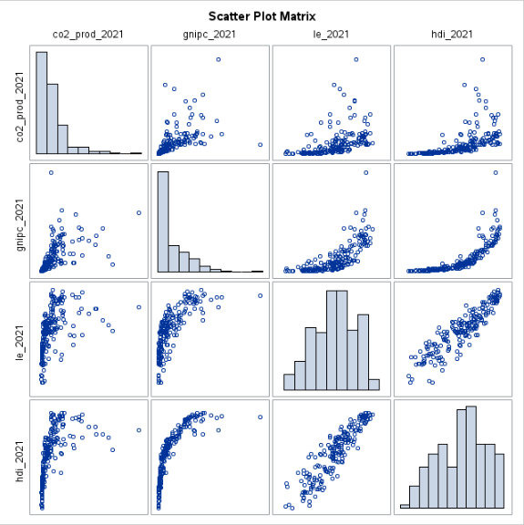
Scatterplot Matrix
Spearman correlation is less sensitive to outliers compared to Pearson.

Slide 13
Assumptions for ANOVA
Dependent variable is continuous and independent variable is categorical.
HDI is a continuous numeric variable. Independent variable (continent) is categorical.
Data is randomly sampled, and the samples are independent.
Samples are independent as each observation is a different country. Data was likely obtained from census data and may not strictly fulfill random sampling.
Data within each group is normally distributed.
For n>30, ANOVA should be robust even if group is not normal!
Homogeneity of Variance

Slide 14
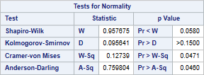
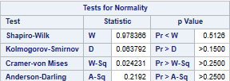
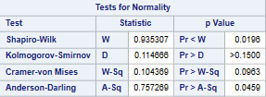
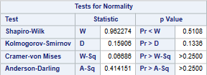
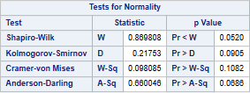
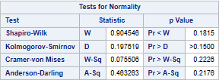
Normally Distributed - HDI?
Africa N=53
Asia N=48
Europe N=42
North America N=23
Oceania N=13
South America N=12

Slide 15
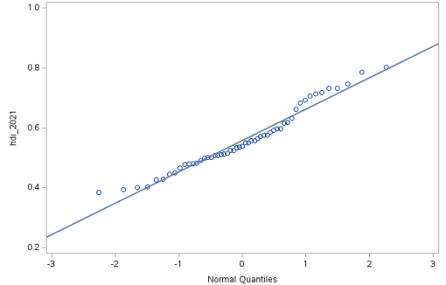
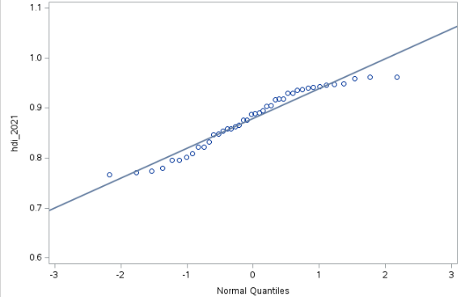
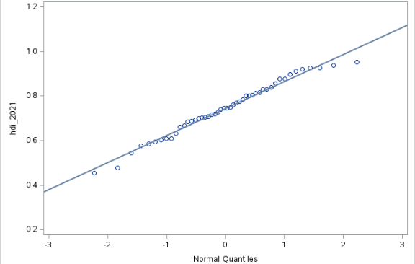
QQ Plots
Africa
Europe
Asia

Slide 16
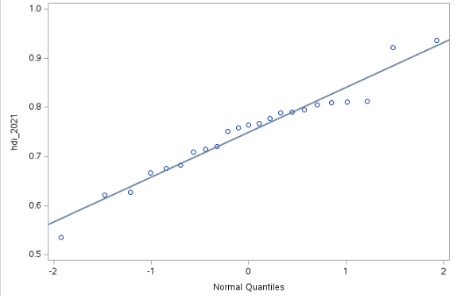
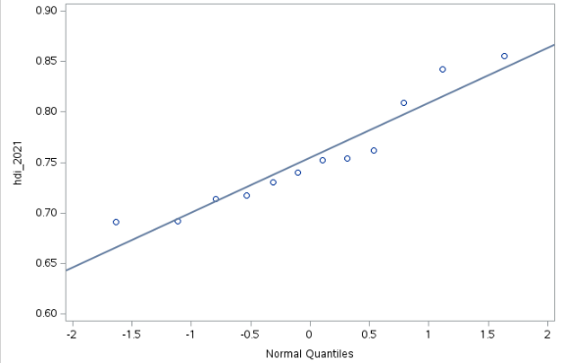
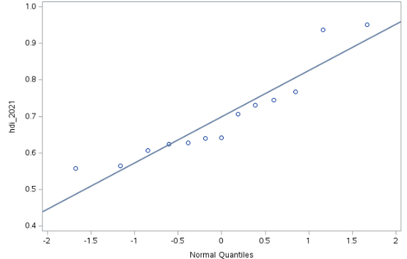
QQ Plots
North America
South America
Oceania

Slide 17

Homogeneity of Variance
H0: All group variances are equal.
H1: At least one group variance is different.
We reject the null at alpha=5% and conclude that at least one group variance is different. In this case, Welch’s ANOVA test produces a more robust F statistic.

Slide 18


ANOVA with Welch Adjustment
H0: No difference in means between continents
H1: At least one continent has different mean HDI.
Welch’s ANOVA computes an F-stat of 69.3 and a corresponding p-value of <0.0001. Note Welch’s ANOVA produced a higher F-stat than regular one-way ANOVA, meaning our results are even more statistically significant.

Slide 19
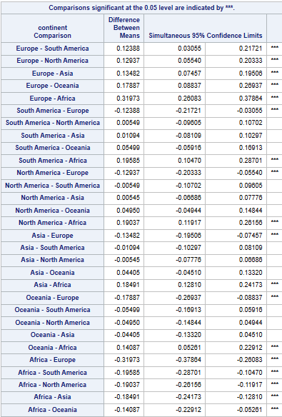
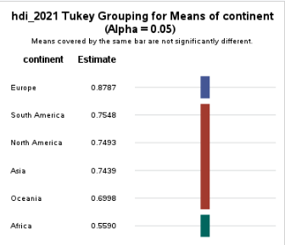
Continent Comparisons
Which continents have significantly different HDI?
Europe vs all 5 other continents
Africa vs all 5 other continents

Slide 20
Conclusion
Africa is the least socio-economically developed continent (not including Antarctica) according to HDI.
Europe is the most socio-economically developed continent.
No difference in socio-economic status of the other 4 continents (NA, SA, Asia, Oceania).

