Slide 1
Teaching Styles
Kevin Wang

Slide 2
Topic Background
I have data of math scores from 3 different teachers for grade 8 students. Ms. Wesson uses the traditional method, adhering to a top-down approach in which knowledge originates from the teacher and is passed to the students. It is believed that behavioral issues can be mitigated through structure and order, resulting in more effective, direct instruction.
On the other hand, Ms. Ruger and Ms. Smith use the standards-based method, where students play an active role in building their knowledge. Standards-based teaching adheres to a set of defined standards but encourages students to develop, explore, conjecture, and test their knowledge. It is believed that students learn deeper math and are better problem-solvers.
Is there a difference in the mean math scores of grade 8 students between the two teaching methods?

Slide 3
Main Project Topic
Primary topic: compare the mean math scores of grade 8 students based on two teaching methods. I ran two independent samples Z-Test with 216 total observations.
Population of interest: Grade 8 Students in the United States
Secondary topics: comparison of mean math scores based on gender, paid/free lunch, and ethnicity. Ethnicity has four levels, so we conduct a one-way ANOVA with post-hoc Tukey instead.

Slide 4
Data Collection
The data was obtained from Kaggle with no information about how the dataset was collected. I only know that the dataset contains information for grade 8 math students in the same junior high school.
One concern here is that inference to the population of interest, grade 8 students in the United States, is difficult as the dataset is from a single school.

Slide 5
Assumptions for Two Sample Z-Test
You have a random sample from the population of interest.
The dataset fails this assumption as the sample is taken from a single school. To meet this requirement, the sample would need to contain observations for grade 8 students randomly picked from across the US.
The population standard deviation is known.
The population standard deviation is unknown, so I use the sample standard deviation.
The samples are independent of each other.
True, every observation is a different student.
The data from each sample are continuous and approximately normally distributed.
Math scores are continuous and not discrete.

Slide 6

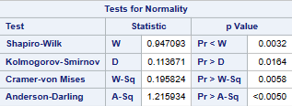
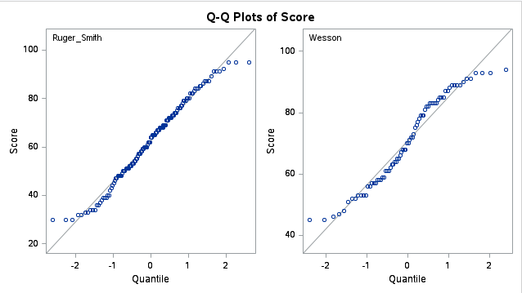
Standards-Based
Traditional

Slide 7
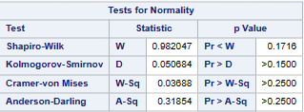
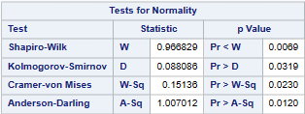
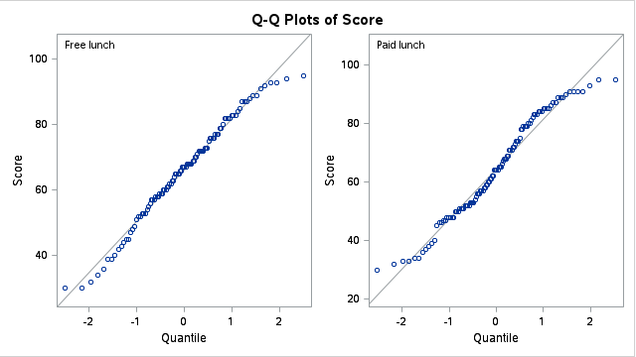
Free Lunch
Paid Lunch

Slide 8
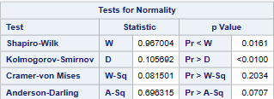
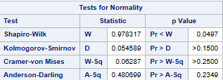
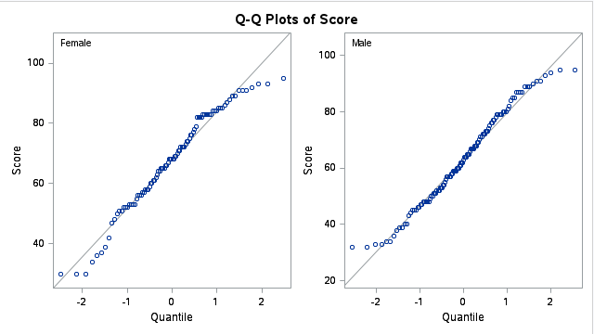
Female
Male

Slide 9
Failed Normality Tests?
Groups that failed normality tests: traditional (wesson), paid lunch, and female. Although the normality tests show half the groups are not normal, our hypothesis tests should be robust even if this assumption is violated as our sample size is large.
By the Central Limit Theorem, means of samples from a population approach normality even if the population is not normal. All groups contain > 30 observations, and so non-normality should not be a problem.

Slide 10
Exploring the Data:
Univariate Distributions

Slide 11
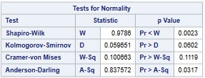
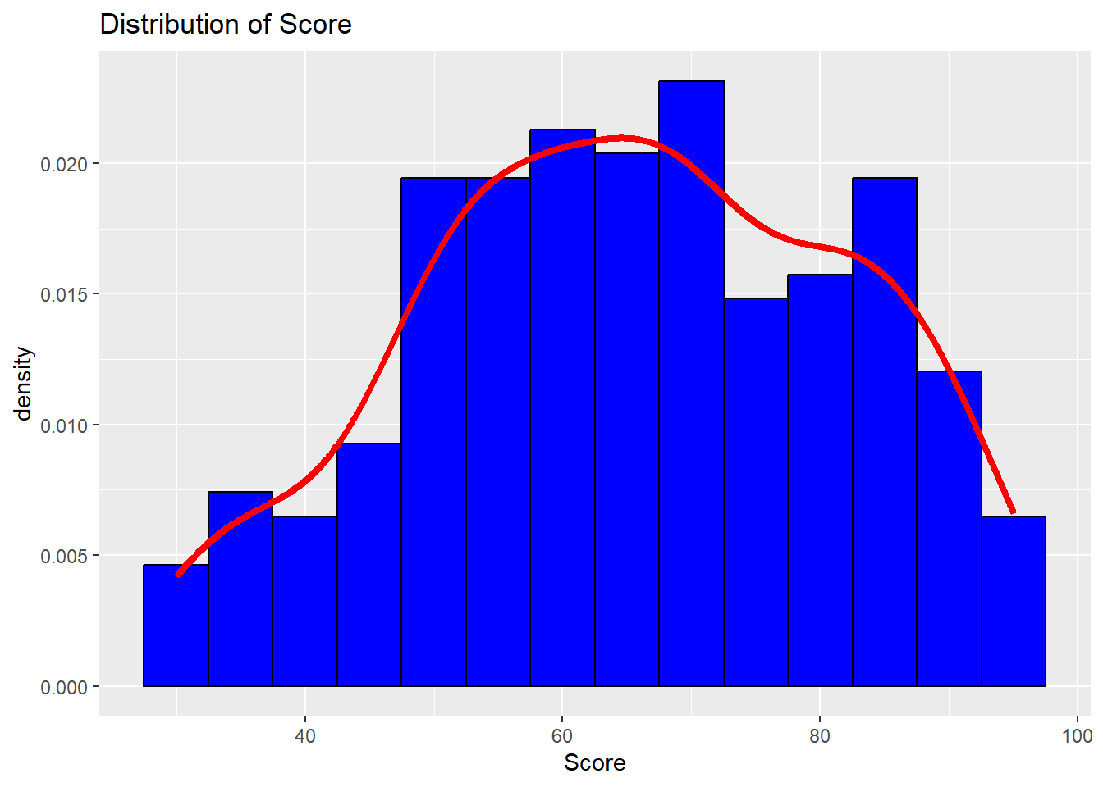
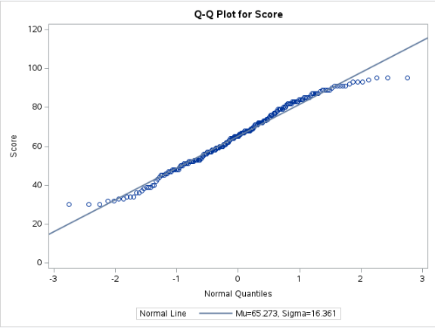
Score appears to be “approximately” normally distributed

Slide 12
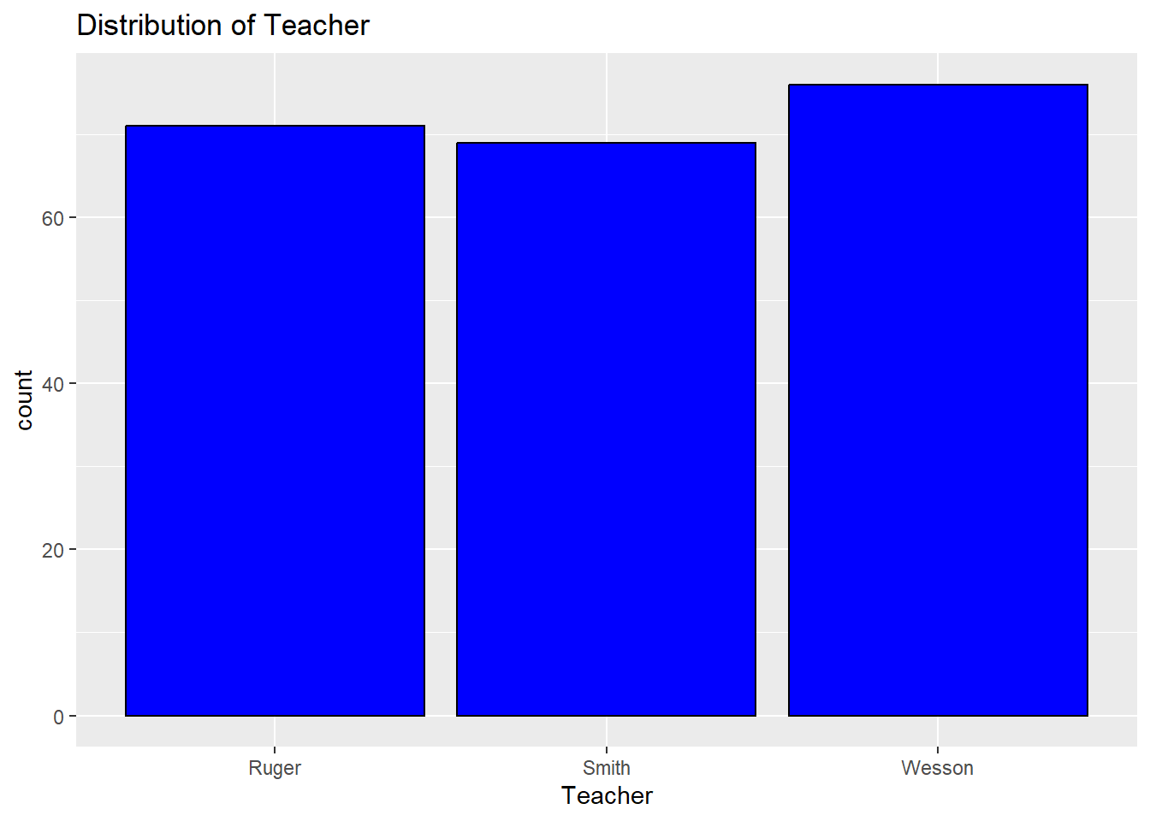
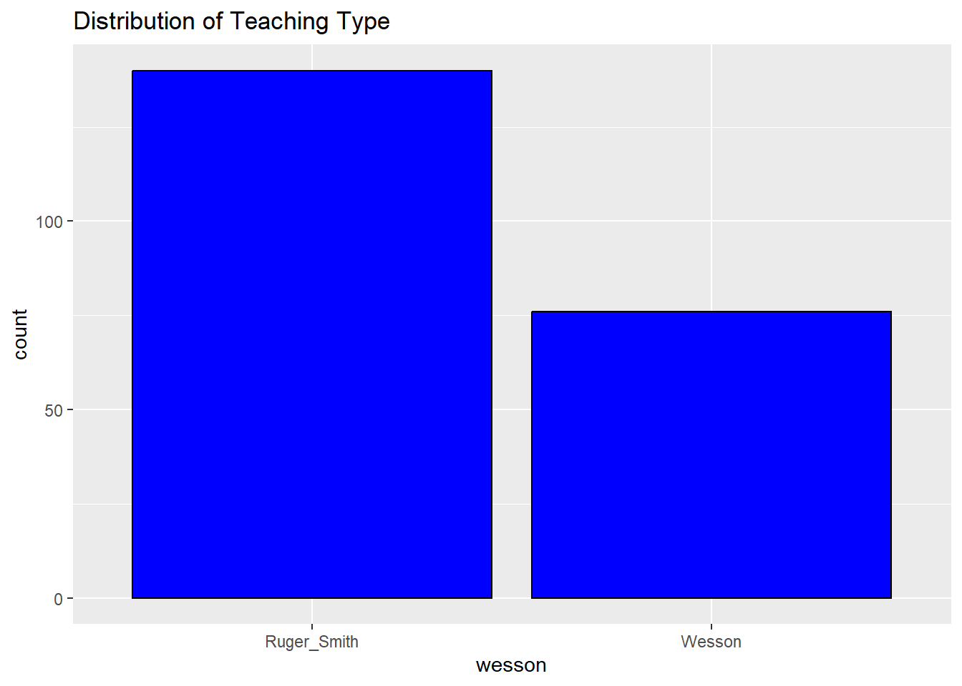
The three teachers each have about the same number of students, but more are taught with the standards-based method (Ruger and Smith) than the traditional method (Wesson).

Slide 13
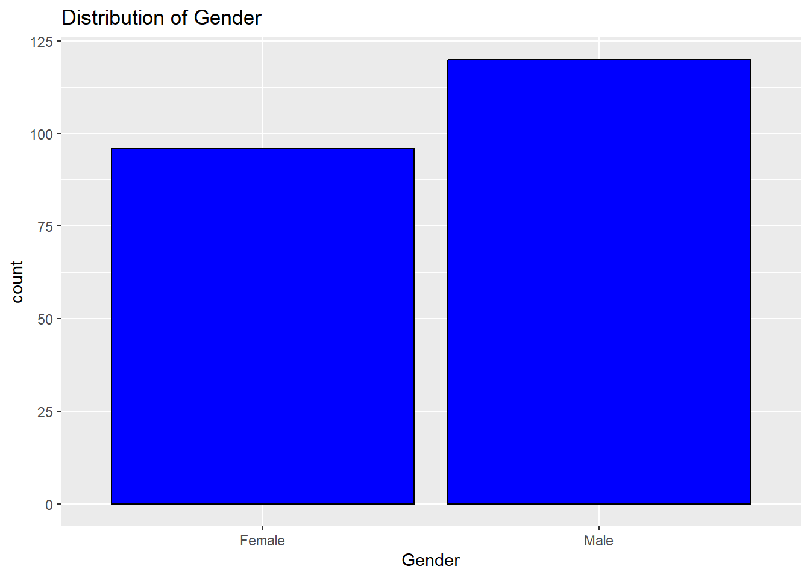
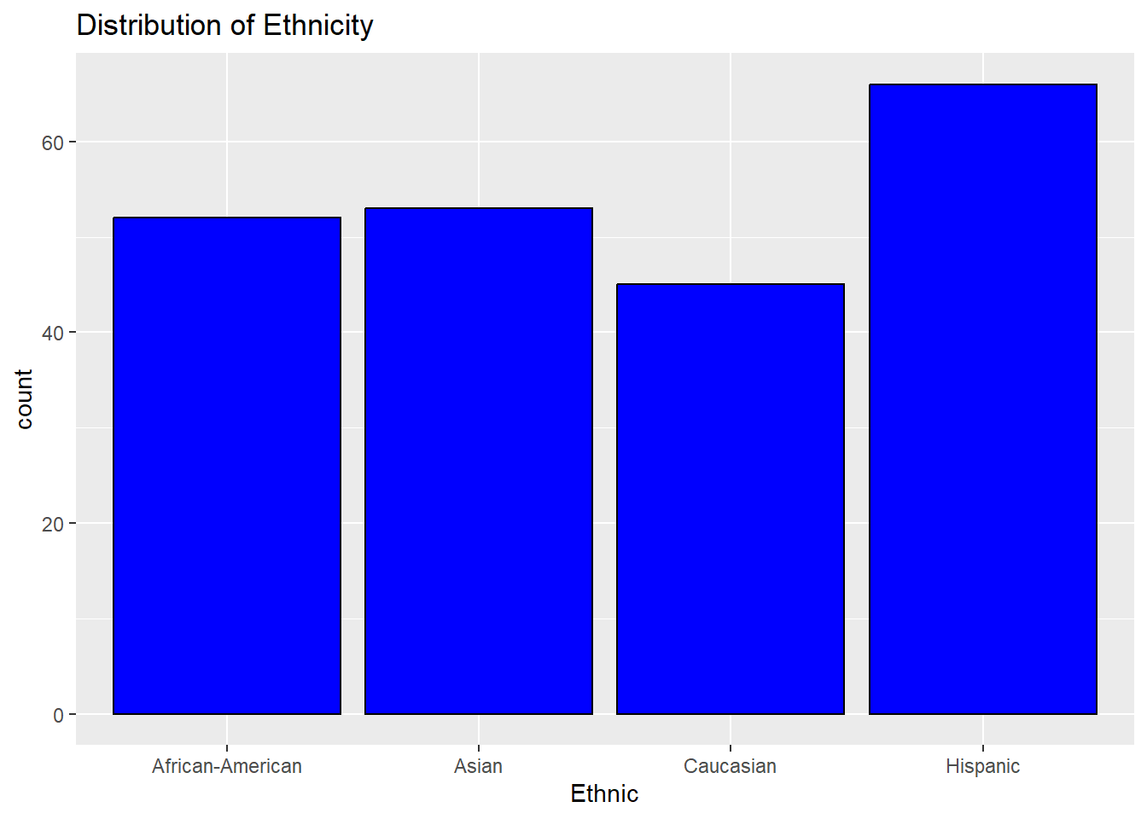
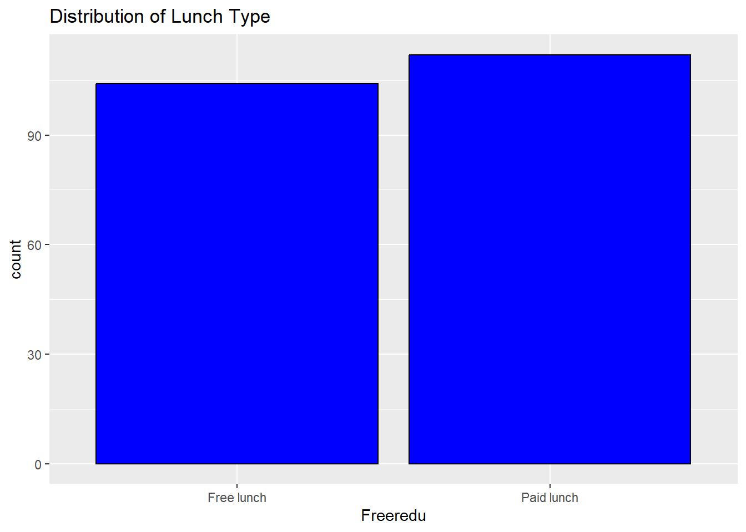
Demographic Factors

Slide 14
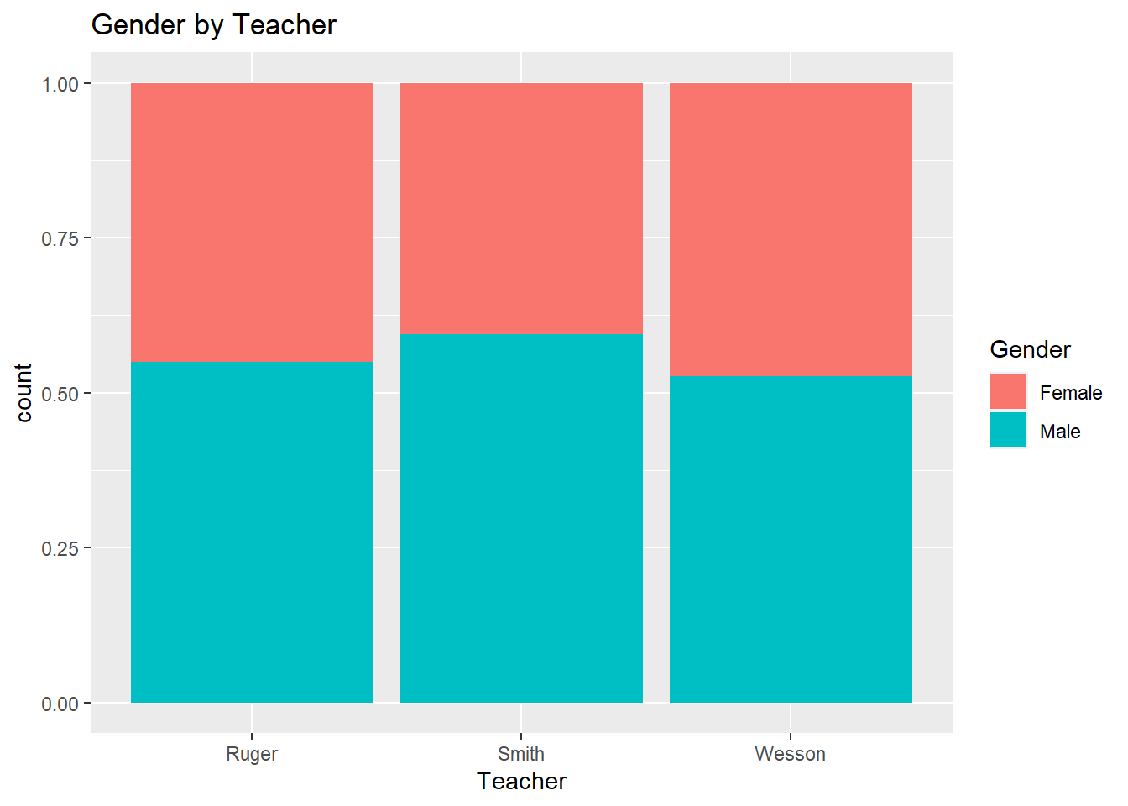
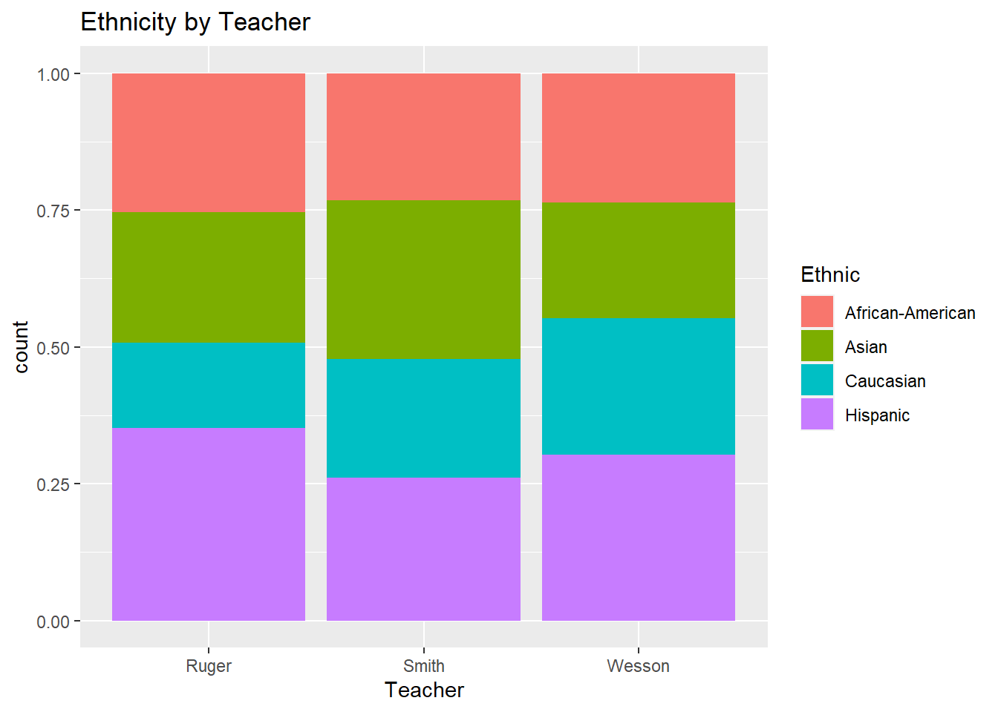
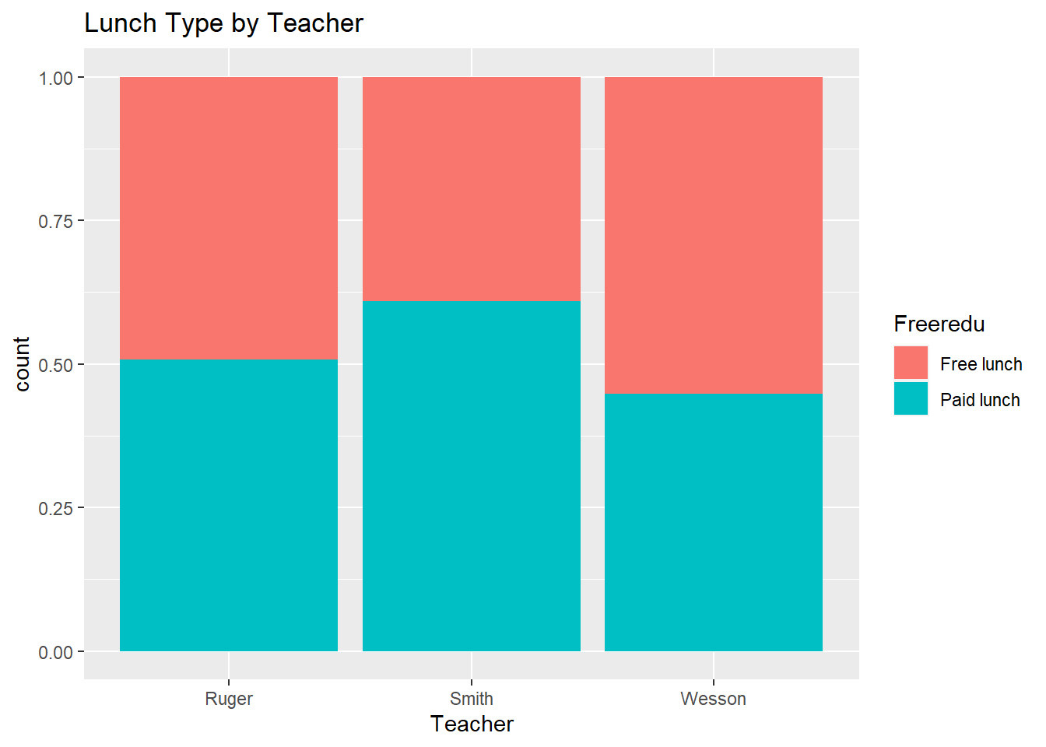
BiVariate Distributions by Teacher

Slide 15
Exploring the Data:
Distributions of Score by Group

Slide 16
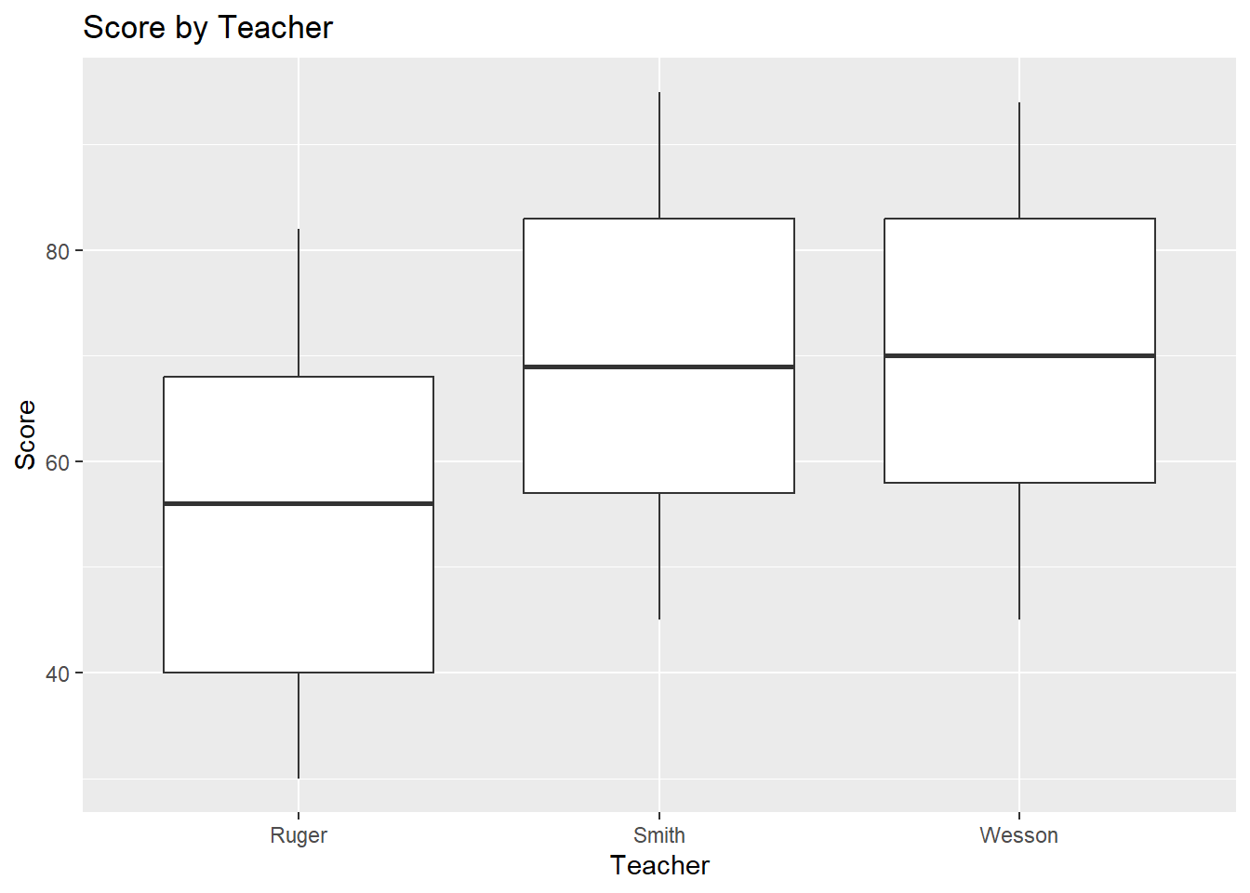
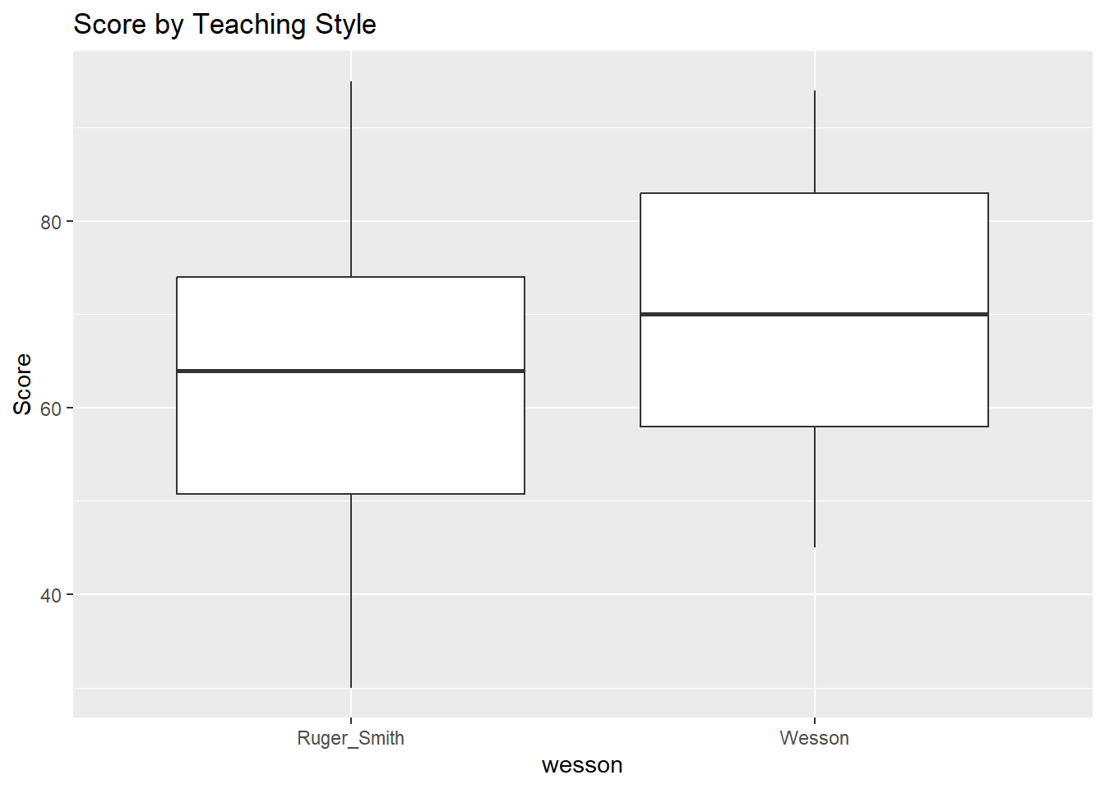
Score By Teacher & Teaching Style

Slide 17
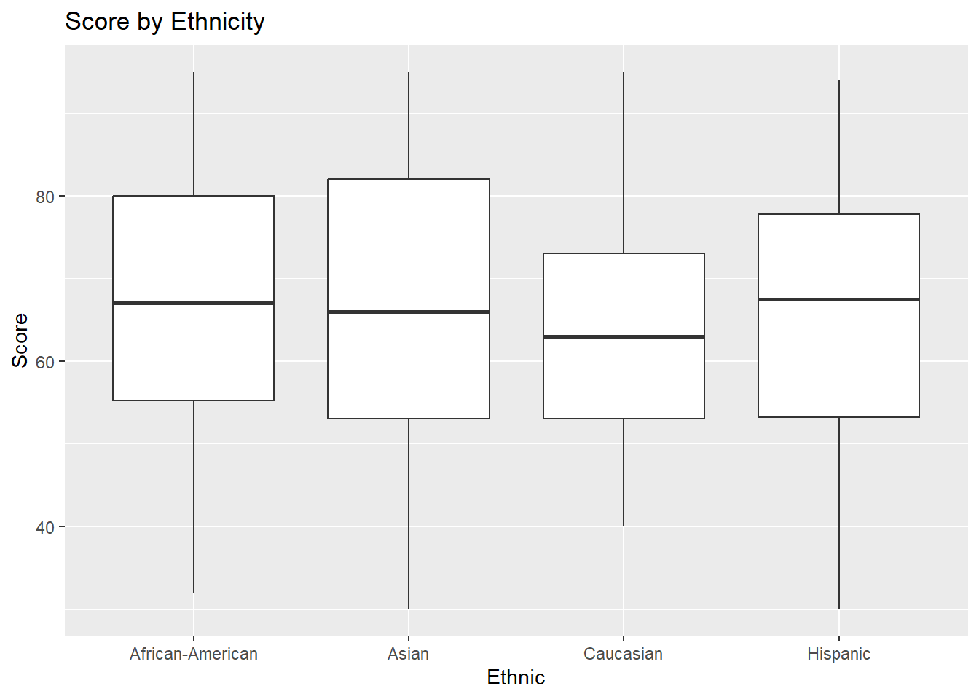
Score By Ethnicity

Slide 18
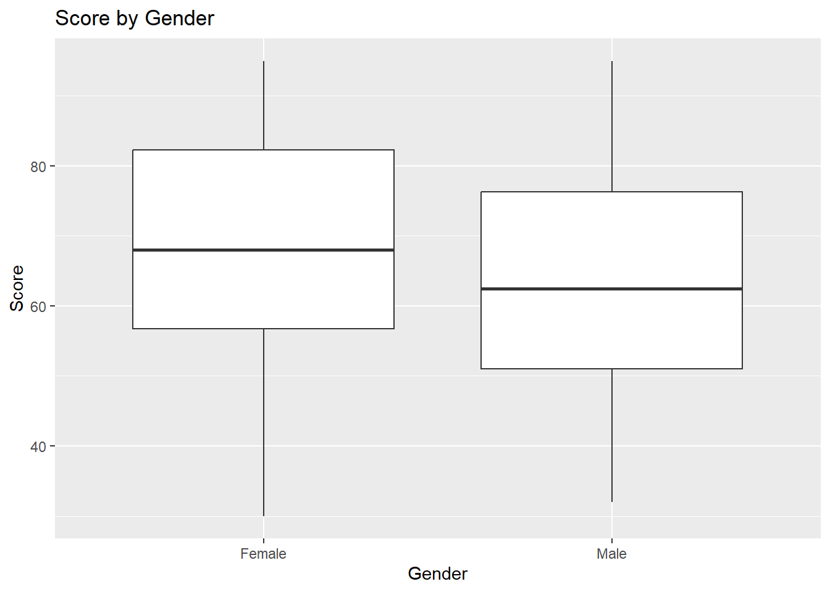
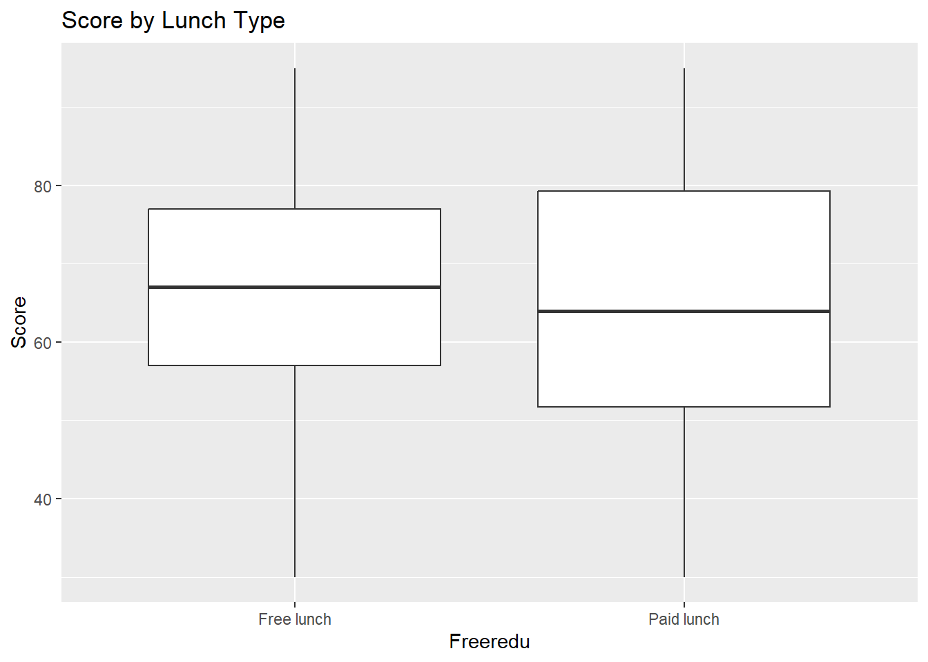
Score By Gender and Lunch Type

Slide 19
Hypothesis Testing

Slide 20

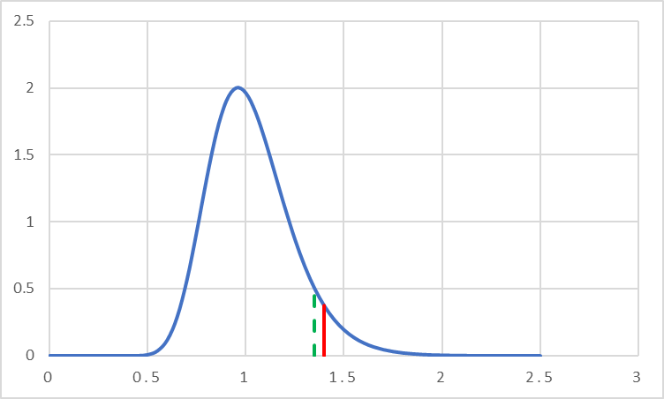
Traditional or Standards-Based Teaching?
Part 1: Test for Equal Variances
F-Test
H0: Variance Ruger_Smith = Variance Watson
H1: Variance Ruger_Smith ≠ Variance Watson
Hypothesis tests are more robust given equal variances even if dataset is unbalanced.
Test Statistic: 1.35
Critical Value: 1.4
Fail to reject H0; we can assume equal variances

Slide 21

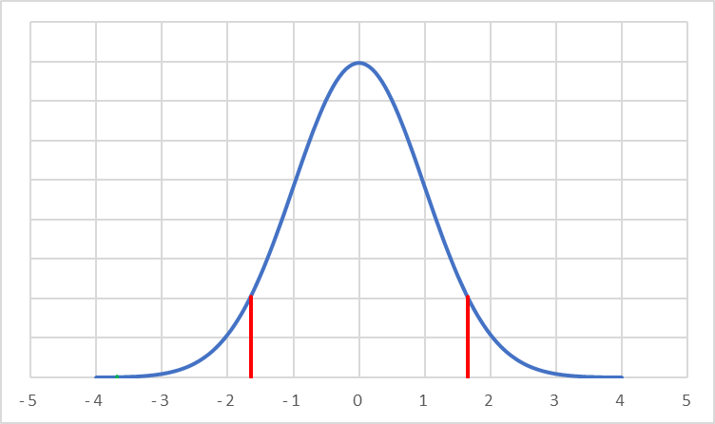
Traditional or Standards-Based Teaching?
Part 2: Test for Equality of Means
T statistic and P-value
H0: Mean Score Ruger_Smith = Mean Score Wesson
H1: Mean Score Ruger_Smith ≠ Mean Score Wesson
Test Statistic: -3.68
Rejection Region: > 1.65 or < -1.65
Reject H0; There is a significant difference as shown by low p-value.

Slide 22
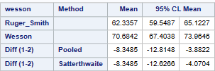
Traditional or Standards-Based Teaching?
Part 3: Confidence Interval for Difference b/w means
H0: Mean Score Ruger_Smith - Mean Score Wesson = 0
H1: Mean Score Ruger_Smith ≠ Mean Score Wesson
Traditional teaching method is better on average by 8.35 points!
Mean Score Ruger_Smith - Mean Score Wesson
is in [-12.81,-3.88].
Zero is not in CI, therefore Mean_Wesson is greater than Mean_Ruger_Smith.
Confidence Interval

Slide 23


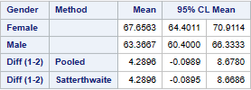
Females vs Males
F-Test
T statistic and P-value
Confidence Interval
H0: Mean Score Female = Mean Score Male
H1: Mean Score Female ≠ Mean Score Male
Using alpha = 0.05, I fail to reject the null and conclude females and males have same mean score.
However, if I used alpha = 0.10, then I would conclude that grade 8 females are better than males at math!

Slide 24


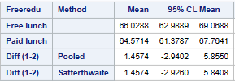
Free vs Paid Lunch
F-Test
T statistic and P-value
Confidence Interval
H0: Mean Score Free = Mean Score Paid
H1: Mean Score Free ≠ Mean Score Paid
There is no difference in math scores for students with free vs paid lunches.

Slide 25
One-Way ANOVA

Slide 26

Assumptions for ANOVA
Dependent variable (score) is continuous and independent variable (ethnicity) is categorical.
Data is randomly sampled and the samples are independent.
Same logic as previous
Data within each group is normally distributed.
CLT, each ethnicity group n > 30
Homogeneity of Variance
Fail to reject the null and conclude variances are equal.

Slide 27
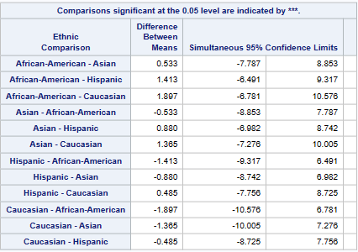

ANOVA Results
Confidence Interval
F statistic and P-value
H0: All group means are equal
H1: At least 1 group mean is different
No difference in math scores between ethnicities!

Slide 28
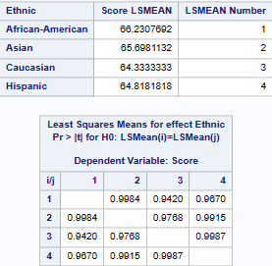
ANOVA P-Values
Confidence Interval
P-Values confirm no two groups are different.

Slide 29
Conclusion
Traditional teaching method is better on average by 8.35 points.
No difference between genders using alpha = 0.05. Under alpha = 0.10, female 8th graders score on average 4.29 points higher than males!
No difference in math scores between free and paid lunches.
Finally, ANOVA shows no difference in math scores between any of the four ethnicities.

