Slide 1

MIT Indoor Scenes
Kevin Wang

Slide 2
Overview
Data Source from MIT containing over 15,000 images of indoor locations. There are 67 total categories in the original dataset and I will use 61 of those.
Objective: Perform image classification on 61 target classes.
Build and evaluate the following models using both TensorFlow and PyTorch.
CNN model with data augmentation and dropout
Pre-trained model using transfer learning
Finally, I will recommend the best model based on test data evaluation.

Slide 3
Preprocessing Data Steps
1. Loaded data and confirmed there are 61 classes of indoor images.
2. Checked if there are any bad images in the data, confirming 0 bad paths.
3. Viewed one image from each class in its original format.
4. Created training, validation, and test data. All three were used in TensorFlow, but I only used training and test in PyTorch.

Slide 4
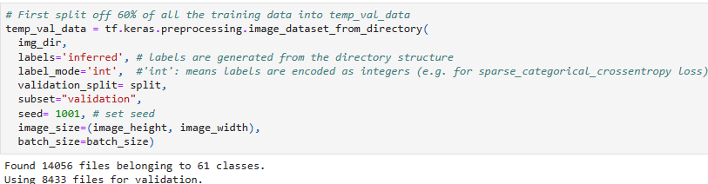
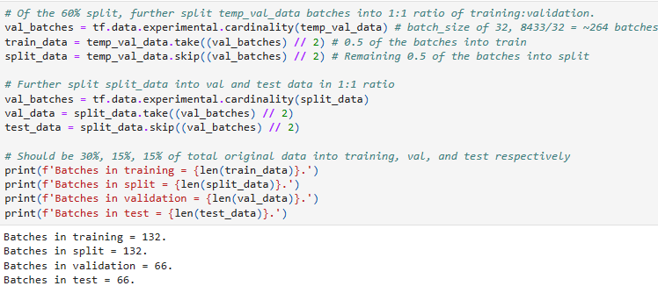
TensorFlow Data Creation

Slide 5
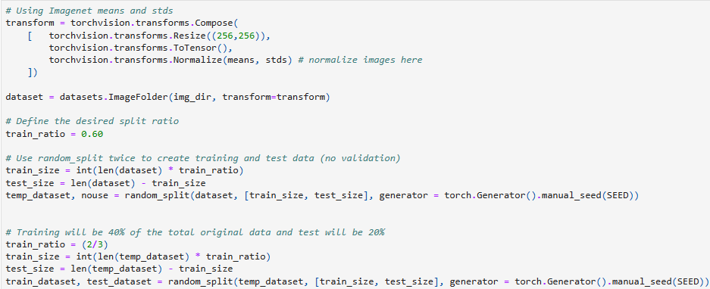
PyTorch Data Creation and Normalization

Slide 6
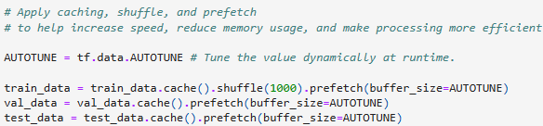
TensorFlow Configure/Normalize Data

Slide 7
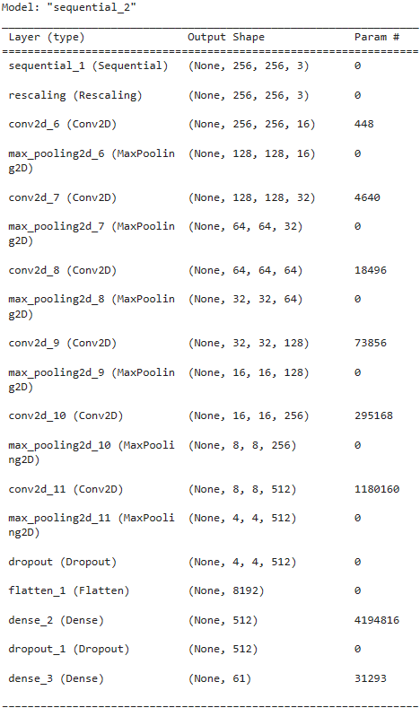
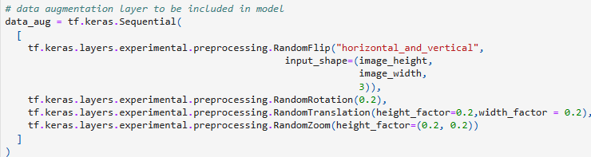
TensorFlow Model 1 Summary and Training
Includes the above data_aug layer as well as a dropout layer as seen in the model summary.
Highest training accuracy was 0.2562 and highest validation accuracy was 0.2377.

Slide 8
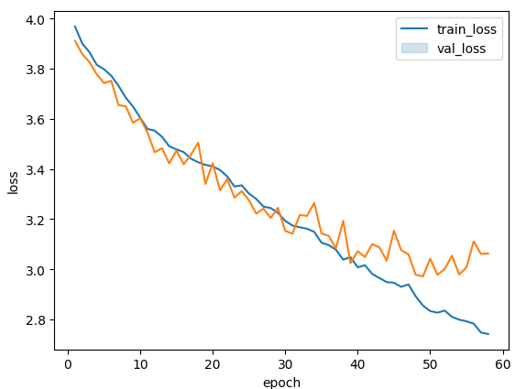
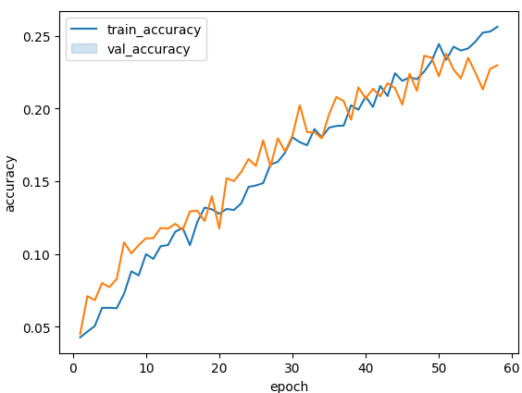
TensorFlow Training/Validation Graphs

Slide 9
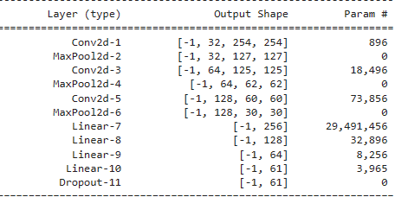
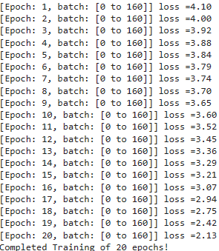
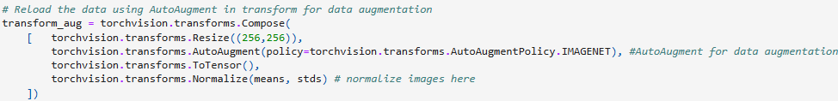
PyTorch Model 1 Summary and Training
Model summary on the left and used AutoAugment for data augmentation as seen on the bottom.

Slide 10
Evaluate TF/PyTorch Model 1
TensorFlow Model 2 yielded an overall accuracy of 0.25 and weighted average f1-score of 0.22. The inclusion of data augmentation and dropouts into the second model seems to address any overfitting issues. The validation curves show both training and validation moving generally 1 to 1 with each other, and as soon as there was a divergence, early_stopping stopped the training. Overall, I would say the model is okay given there are 61 total classes so we do not expect a high accuracy like we would for a binary classification.
PyTorch Model 1 performed slightly better with an overall accuracy of 29% and f1-score of 0.29 on the test data. The models could also have trained on more epochs given loss was still decreasing at the end of training but stopped due to GPU limitations on Colab. Overall, I would say this is also an okay model but could have trained on more epochs.

Slide 11
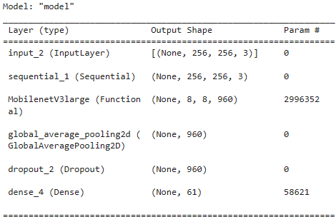
TensorFlow Model 2 Summary and Training
Model 2 used transfer learning from MobileNetV3Large_model.
Highest training accuracy was 0.6579 and highest validation accuracy was 0.6198

Slide 12
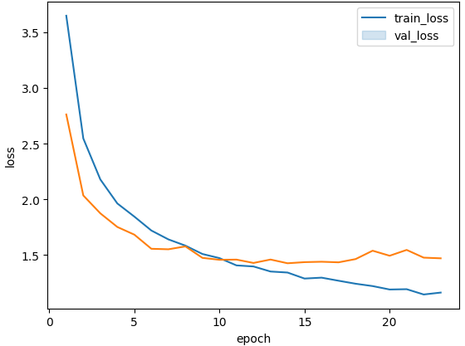
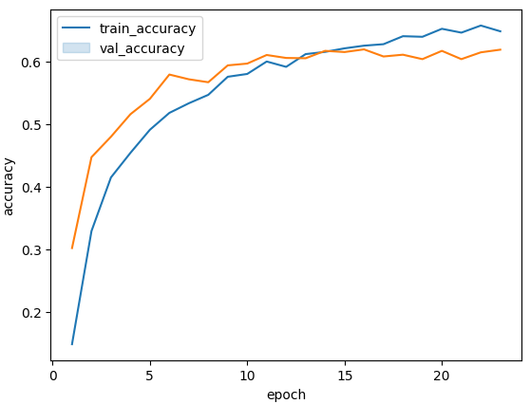
TensorFlow Training/Validation Graphs

Slide 13
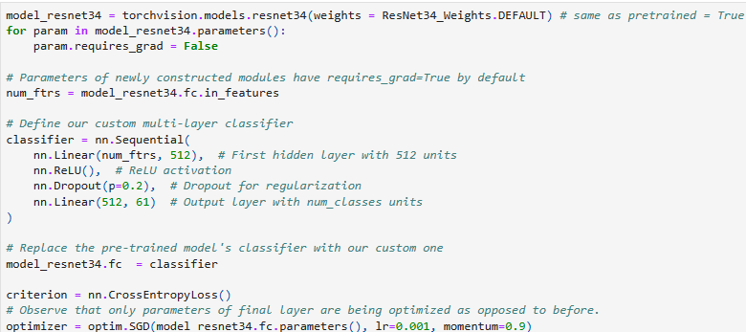
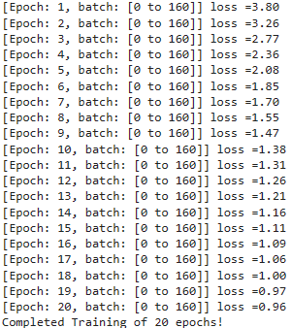
PyTorch Model 2 Summary and Training
Model 2 used transfer learning from the ResNet34 pretrained model.

Slide 14
Evaluate TF/PyTorch Model 2
TensorFlow model 2 on the test data yielded an overall accuracy of 64% and weighted f1-score of 0.62, by far the highest I have seen from any model. Model 2 was also quicker to train. All these factors demonstrate the usefulness of a pre-trained model and transfer learning. The best TF model was the pre-trained MobileNetV3Large model.
PyTorch model 2 yielded an overall accuracy of 64% and f1-score of 0.63, which is almost the same as TF model 2. While the loss was still decreasing at the end of training, epochs 19 to 20 resulted in a decrease in loss of only 0.01, compared to model 1 where the loss was still decreasing by 0.29. Overall, the pre-trained model for both TF/PyTorch produced the best scores in accuracy and f-1 on the test data and is my recommended model.

