Slide 1

MIT Indoor Scenes
Kevin Wang

Slide 2
Overview
Data Source from MIT containing over 15,000 images of indoor locations. There are 67 total categories in the original dataset and I will use 61 of those.
Objective: Perform image classification on 61 target classes.
Build and evaluate the following three models using both TensorFlow and PyTorch.
Baseline CNN model
CNN model with data augmentation and dropout
Pre-trained model using transfer learning
Finally, I will recommend the best model based on test data evaluation.

Slide 3
Preprocessing Data Steps
1. Loaded data and confirmed there are 61 classes of indoor images.
2. Checked if there are any bad images in the data, confirming 0 bad paths.
3. Viewed one image from each class in its original format.
4. Created training, validation, and test data. All three were used in TensorFlow, but I only used training and test in PyTorch.

Slide 4
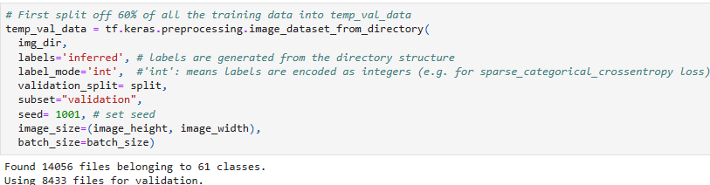
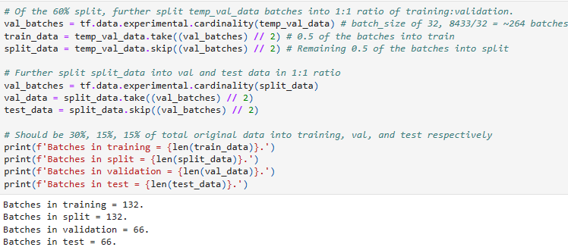
TensorFlow Data Creation

Slide 5
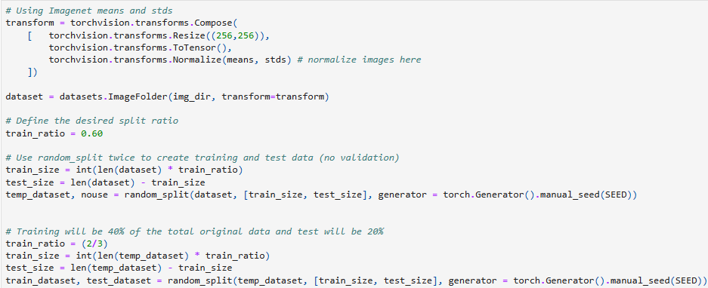
PyTorch Data Creation and Normalization

Slide 6
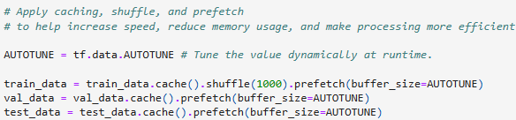
TensorFlow Configure/Normalize Data

Slide 7
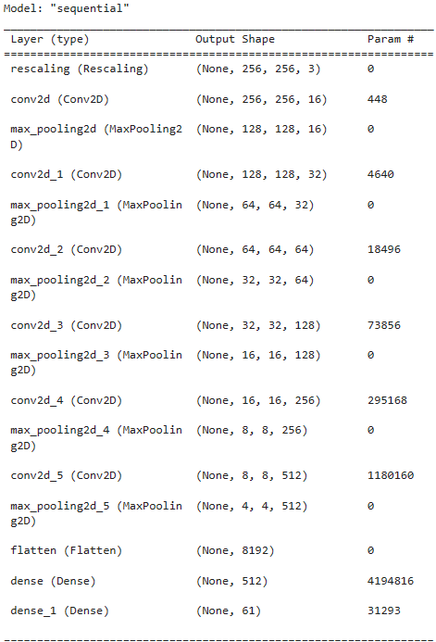
TensorFlow Model 1 Summary and Training
Each TensorFlow model was trained using 100 epochs and patience = 7.
Optimizer = Adam
Loss = SpareCategoricalCrossentropy
Metric = accuracy
Highest training accuracy was 0.9891 and highest validation accuracy was 0.2391.

Slide 8
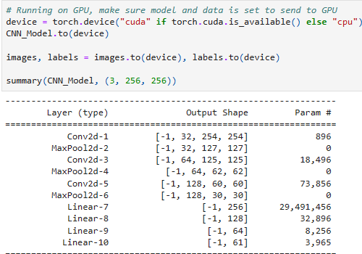
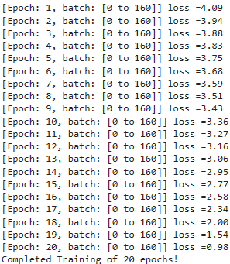

PyTorch Model 1 Summary and Training
Used the same criterion and optimizer for all PyTorch models. Attempted to rerun the PyTorch notebook with 40 epochs instead of 20 but ran out of GPU time on Colab.

Slide 9
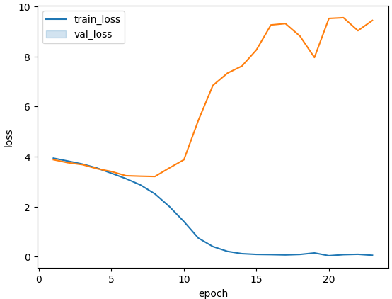
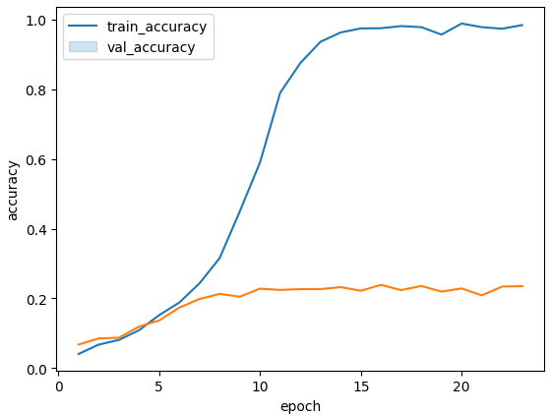
TensorFlow Training/Validation Graphs

Slide 10
Evaluate Baseline TF/PyTorch Models
Model 1 using TensorFlow yielded an overall accuracy 18% and weighted F1-score of also 0.18 on the test data. It is clear from the validation graphs that the model is severely overfit. Both loss and accuracy curves diverge very significantly as training accuracy reached 98.9% whereas validation accuracy only reached 23.9%. I tested changing the learning rate in the Adam optimizer from 0.001 to (0.0001 and 0.005), but both yielded similar results (model still overfit). This is most likely due to the lack of Dropout in the model architecture, which would directly address the overfitting issue.
Model 1 using PyTorch achieved an overall accuracy of 14% and weighted F1-score of 0.13 on the test data. Overall, this model is not good as it performed even worse than model 1 using TensorFlow. Again, running such few epochs resulted in a lower accuracy given the loss function was still decreasing at the end of training.

Slide 11
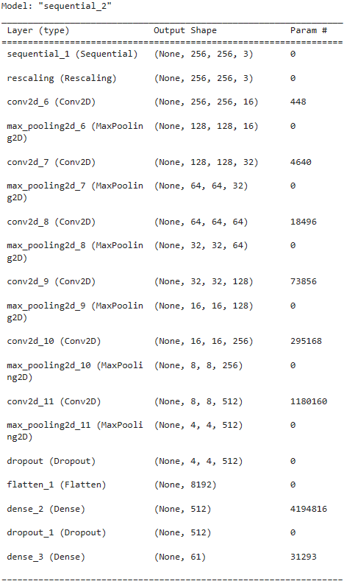
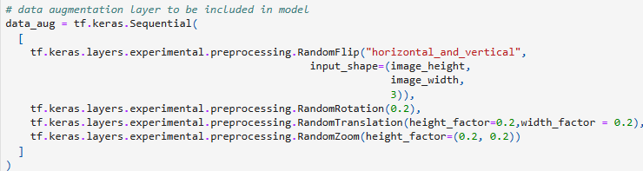
TensorFlow Model 2 Summary and Training
The above data_aug layer as well as a dropout layer as seen in the model summary was added to model 2.
Highest training accuracy was 0.2562 and highest validation accuracy was 0.2377.

Slide 12
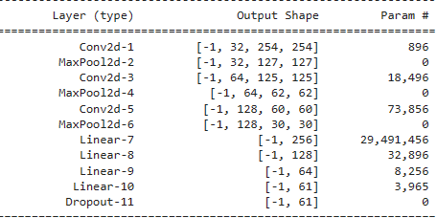
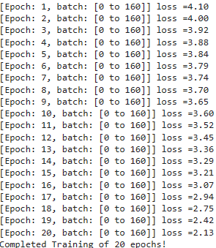
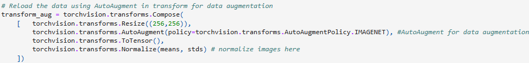
PyTorch Model 2 Summary and Training
Added dropouts into the CNNNet class and used AutoAugment for data augmentation.

Slide 13
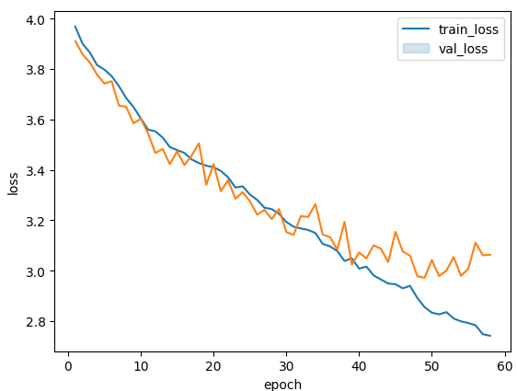
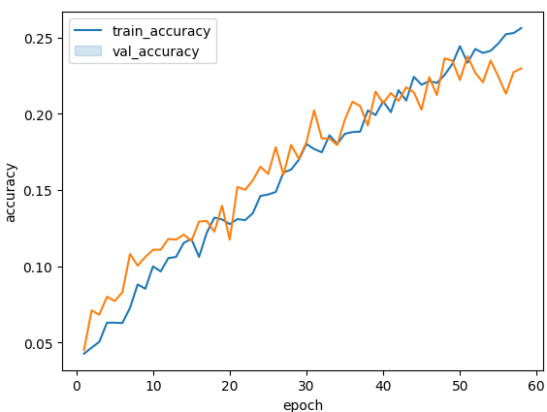
TensorFlow Training/Validation Graphs

Slide 14
Evaluate TF/PyTorch Model 2
TensorFlow Model 2 yielded an overall accuracy of 0.25 and weighted average f1-score of 0.22, which is a significant improvement over the first baseline model. The inclusion of data augmentation and dropouts into the second model fixed the overfitting seen in the first model. The validation curves show both training and validation moving generally 1 to 1 with each other, and as soon as there was a divergence, early_stopping stopped the training. Overall, I would say the second model is okay given there are 61 total classes so we do not expect a high accuracy like we would for a binary classification.
PyTorch Model 2 performed significally better than model 1 with an overall accuracy of 29% and f1-score of 0.29 on the test data. Like model 1, model 2 could also have trained on more epochs given loss was still decreasing at the end of training. Compared to the TF model 2, my PyTorch model performed better. Overall, I would say this is an okay model but could have trained on more epochs.

Slide 15
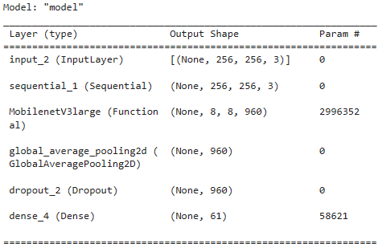
TensorFlow Model 3 Summary and Training
Model 3 used transfer learning from MobileNetV3Large_model.
Highest training accuracy was 0.6579 and highest validation accuracy was 0.6198

Slide 16
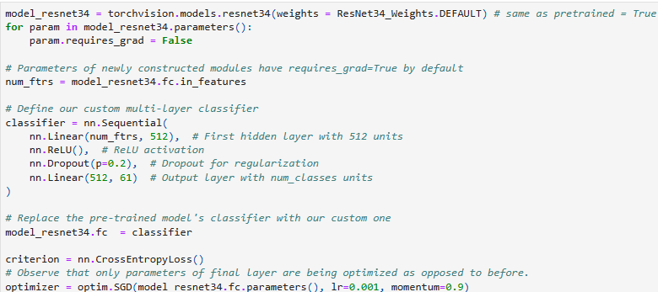
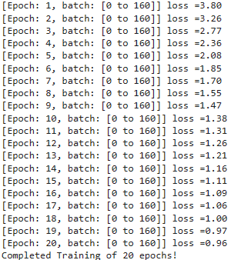
PyTorch Model 3 Summary and Training
Model 3 used transfer learning from the ResNet34 pretrained model.

Slide 17
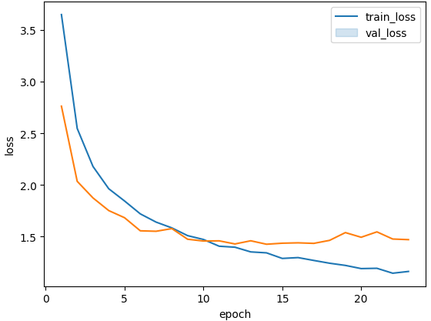
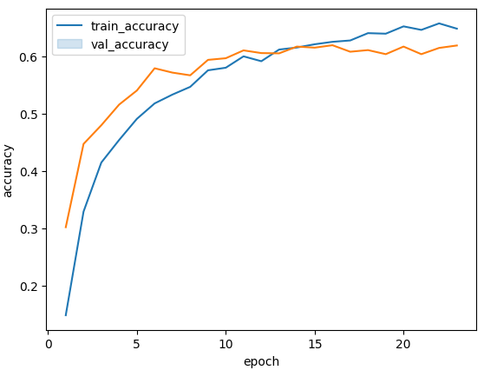
TensorFlow Training/Validation Graphs

Slide 18
Evaluate TF/PyTorch Model 3
TensorFlow model 3 on the test data yielded an overall accuracy of 64% and weighted f1-score of 0.62, by far the highest I have seen from any model. Model 3 was also the quickest to train. All these factors demonstrate the usefulness of a pre-trained model and transfer learning. The best TF model was the pre-trained MobileNetV3Large model.
PyTorch model 3 yielded an overall accuracy of 64% and f1-score of 0.63, which is almost the same as TF model 3. While the loss was still decreasing at the end of training, epochs 19 to 20 resulted in a decrease in loss of only 0.01, compared to models 1 and 2 where the loss was still decreasing by 0.56 and 0.29, respectively. Overall, the pre-trained model produces the best scores in accuracy and f-1 on the test data and is my recommended model.

