Slide 1

Forecasting Fare for Taxi Rides in Chicago 2016
Kevin Wang

Slide 2
Overview
Data Source from Kaggle is taxi trip data for 2016 in the city of Chicago.
Forecast taxi fare using seconds and miles for each trip.
Evaluate and tune the following models using RMSE and R².
Linear Regression
Decision Tree
Random Forest
Gradient Boosted Tree
Finally, I use K-means clustering to recommend an optimal number of clusters and plot them.

Slide 3

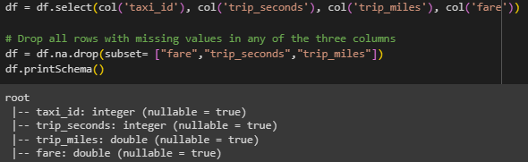
Process Dataset
Out of an original 22 columns, I keep only 4 for analysis, drop missing values, and filter out observations where seconds and miles = 0 and fare > 0.
Original dataset: 19,866,157 observations
Filter if seconds and miles = 0 and fare > 0

Slide 4
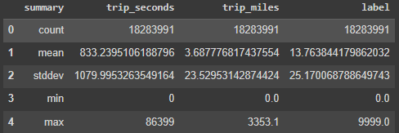
Process Dataset
Next, I use VectorAssembler to output a features column consisting of trip_seconds and trip_miles. I also rename the fare column as label so I will not have to specify columns later.
Dropped 3,551 rows from missing values.
Dropped 1,578,615 (8%) rows from filter.
Note the extremely large ranges and standard deviations.
Did not standardize data as tree-based models do not require it (based on order of data).
LinearRegression() has base parameter: standardization: bool = True.

Slide 5
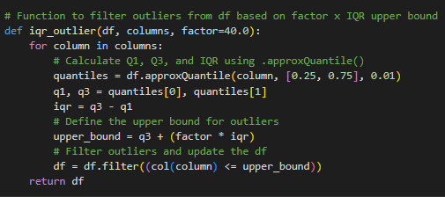
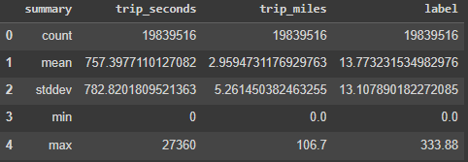
Outliers
Dropped 22,970 rows, or 0.126% of the observations.
Note the much more reasonable ranges and standard deviations.
Ran models on original dataset and obtained poor metrics.
Also ran models without previous conditional filter, but with iqr_outlier.
Finally, ran models with everything and obtained the best metrics.

Slide 6
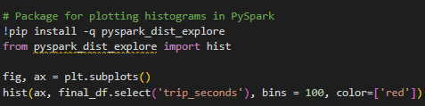
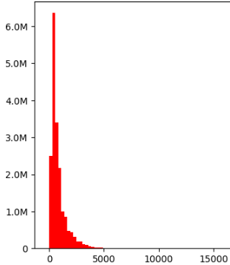
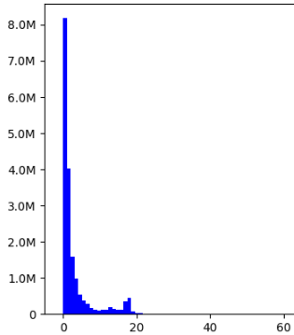
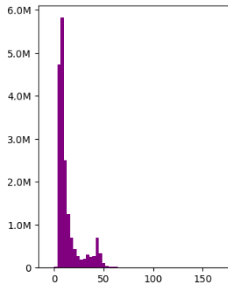
Histograms
Seconds, bin size: 274.2
Miles, bin size: 1.03
Fare, bin size: 3.24

Slide 7

Linear Regression
The parameters: elasticNetParam and regParam can be set to support Lasso (L1), Ridge (L2), and Elastic Net regularization (L1 + L2).
ElasticNetParam is set between 0 (Ridge L2) and 1 (Lasso L1). RegParam controls the amount of regularization applied to the model.
L1 (Lasso) regularization adds a penalty term to the loss function proportional to the absolute value of the coefficients. L1 effectively drives some coefficients to 0, making it more useful for datasets with irrelevant or redundant features.
L2 (Ridge) regularization adds a penalty term to the loss function proportional to the squared values of the coefficients. L2 regularization is useful for reducing the impact of multicollinearity and provides robustness against noise.

Slide 8


LR Results
No Filter w/iqr_outlier OLS model – RMSE: 8.03, R²: 0.62
Filtered OLS model – RMSE: 5.64, R²: 0.80
Correlations of training set
Seconds vs Miles: 0.61
Fare vs Seconds: 0.83
Fare vs Miles: 0.77

Slide 9
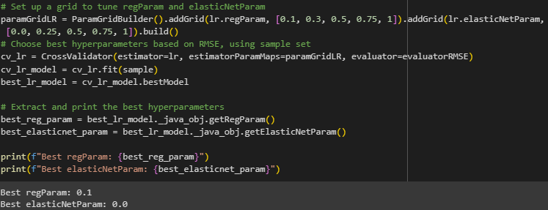
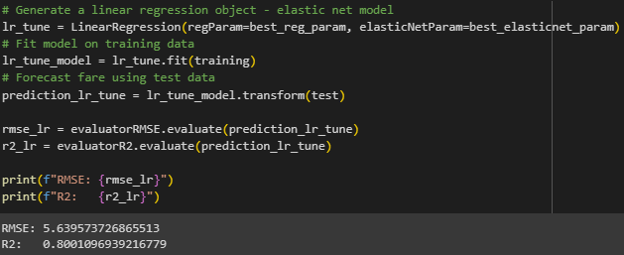
LR Tuning
With tuning, I obtain essentially the same RMSE and R².
Best elasticNetParam of 0.0 may suggest multicollinearity, but metrics were essentially the same as OLS model.

Slide 10
Decision Tree
Decision trees are useful because they are easy to understand, used for classification or regression, do not require a linear relationship, and have almost no hyperparameters to tune.
No Filter w/iqr_outlier DT model - RMSE: 6.63, R²: 0.74
Filtered DT model – RMSE: 4.25, R²: 0.89
To view the DT, I followed steps from: visualizing-decisiontree-dtree-model-pyspark to turn the output of .toDebugString into a json, which I then copy and pasted into an online tree diagram generator: https://vanya.jp.net/vtree/

Slide 11
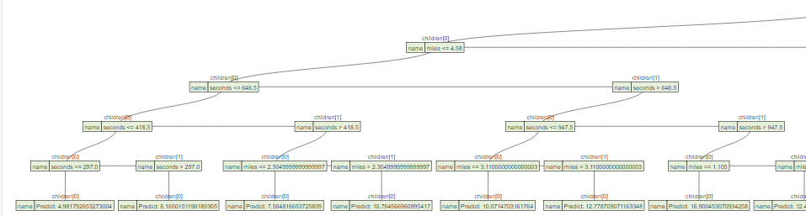
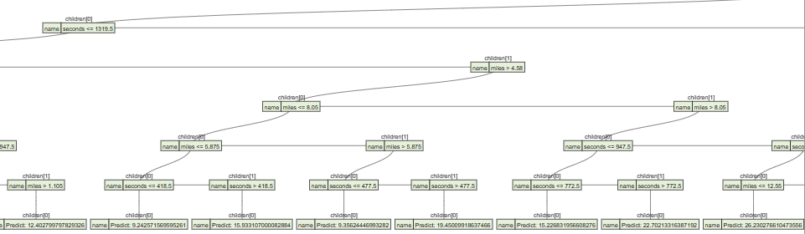

Slide 12
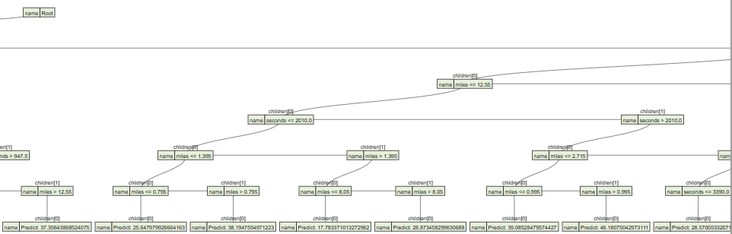
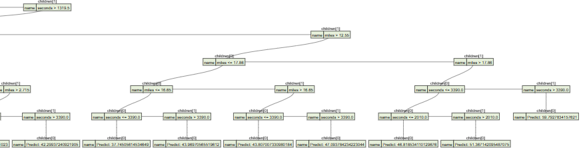

Slide 13

Random Forest w/ Tuning
Random forest algorithms combine ensemble learning methods with bootstrapping.
Ensemble learning is the process of averaging results from multiple models and bootstrapping is the process of randomly sampling subsets of a dataset over several iterations.
No filter w/iqr_outlier RF model – RMSE: 6.68, R²: 0.74
Filtered RF model – RMSE: 4.39, R²: 0.88
Final tuned RF model – RMSE: 3.77, R²: 0.91
maxBins = Max number of bins for discretizing continuous features.
maxDepth = Longest path between root and leaf node.

Slide 14

Gradient Boosted Tree
Boosting works by improving on the mistakes of the previous tree via the next tree. The trees are connected in series and each tree minimizes the error (residuals) of the previous tree.
No filter GBT model – RMSE: 6.29, R²: 0.77
Filtered GBT model – RMSE: 3.88, R²: 0.91
GBTRegressor uses stepSize to control the learning rate of the algorithm.
Tuned GBT model – RMSE: 3.77, R²: 0.91
No numTrees parameter

Slide 15
K-means
K-means clustering differs from the previous 4 models because it is an unsupervised machine learning algorithm. The algorithm works by:
Randomly initialize K centroids (mean clusters)
Categorize each data point to its closest centroid, updating the centroid's location as the average of all points in the cluster.
Iterate until all data points have been assigned and all centroid locations have been updated.
The silhouette coefficient contrasts the average distance to points in the same cluster with points in other clusters. A high silhouette coefficient equates to a better clustering.

Slide 16
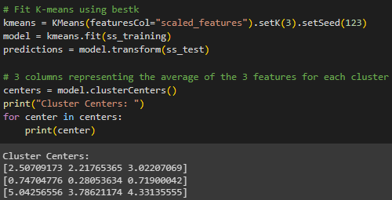

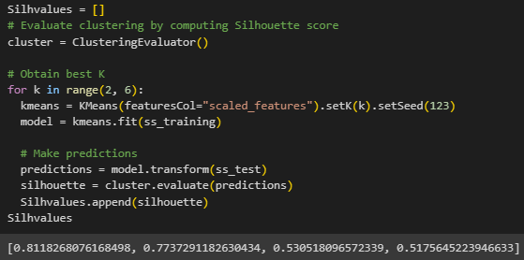
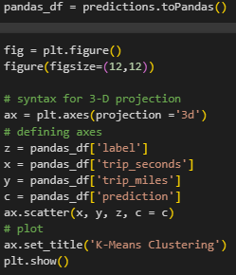


K-means
Dropped features column and made new features vector with label.
Standardized features using StandardScaler.
Use 10% random sample of scaled data
Used K=3

Slide 17
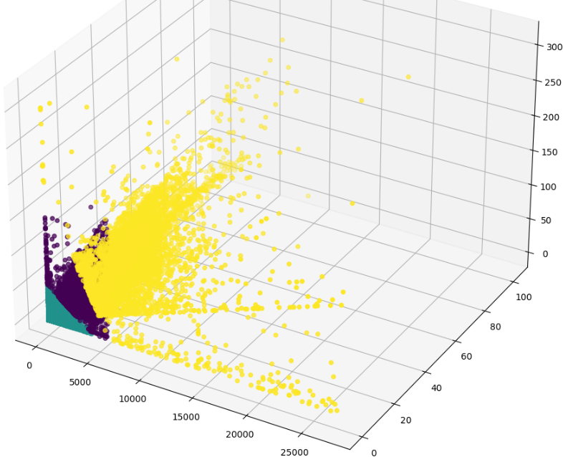

Slide 18
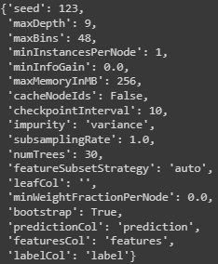
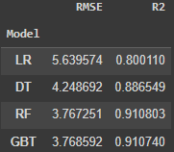
Best Model
From the results, the tuned RF model has the lowest RMSE and highest R².
Essentially the same as GBT model and only marginally better than DT.

Slide 19
Further Topics to Consider
Investigate outliers and filtered observations
Consider other features like longitude/latitude as well as pickup/dropoff community areas
Include more hyperparameters for tuning
Compare tuning with other methods such as TrainValidationSplit, which is faster but less reliable
Use libraries outside of pyspark.ml such as sklearn

