Slide 1
E-Commerce with Augmented Reality(AR)
Chenggang Xu

Slide 2
Abstract
The e-commerce industry has been growing at an explosive pace over the past few years
In current e-commerce the purchase behavior can't give the shopper an in-store experience
Augmented reality (AR) technology makes it possible for the digital realm and the real world to combine in a seamless environment. It will create more meaningful, memorable shopping experiences.
This research aims at the adoption of AR technologies in E-Commerce, by developing an APP, and outlining possible future directions in the online shopping field.
Chenggang Xu
50155315

Slide 3
Introduction
Several studies have mentioned to the augmented reality technologies applied in the E-Commerce.
Augmented Reality (AR) is one of the emerging technologies which has increasingly gained attention over last few years(Kumar, 2016).
While AR has been successfully implemented in the gaming industry (Christian et al., 2014), E-commerce is one such industry for which AR holds huge potential.
We need to explore the key factors that influence the adoption of AR technology by the e-commerce industry.
The purpose of this study is to develop an E-Commerce APP with Augmented Reality
Chenggang Xu
50155315

Slide 4
Literature Review
User experience and expectations in E-Commerce
User experience takes a broad perspective on the user’s interaction with a product and it's important to a success service(Desmet et al., 2007).
If the product falls short of expectations, the user is likely to be dissatisﬁed(Oliver, 1977).
User experience and expectations inﬂuence the user’s perceptions of the product’s capabilities and quality, as well as direct the user’s attention in interaction situations.
Concept of Augmented Reality
The general approach of AR is to combine real and computer-generated digital information into the user’s view of the physical real world in such a way that they appear as one environment (Hollerer et al., 2004).
Chenggang Xu
50155315

Slide 5
System Analysis & Design
System description
The systems consists of a front-end mobile app and a back-end server.
The back-end server contains databases, customer profiles and business logic API, from which information in the databases is filtered and returned to the front-end APP.
Smart phones are used to implement this front-end device with a camera. The APP provides the customers a see-through view of the real world environment to combine the digital entity for the item with some additional information through the camera. And then the customers can complete the shopping process interactively with the back-end server.
Chenggang Xu
50155315

Slide 6
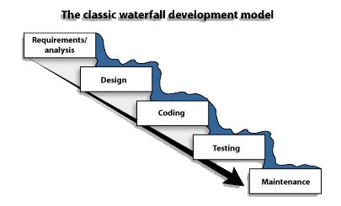
System Analysis & Design
Approach/Methodology-waterfall
Chenggang Xu
50155315

Slide 7
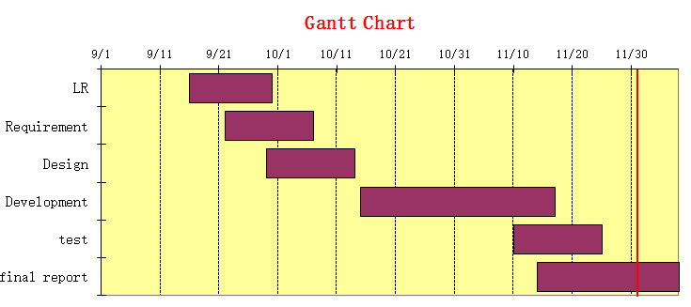
System Analysis & Design
Approach/Methodology
Chenggang Xu
50155315

Slide 8
System Analysis & Design
E-Commerce with AR
Back-end
Catelog Management
product Management
Front-end
List the catelog
Order Management
Webservice API
List the product
Item in the camera
Order the product
Sign in/Sign up
Functional requirement
Chenggang Xu
50155315

Slide 9
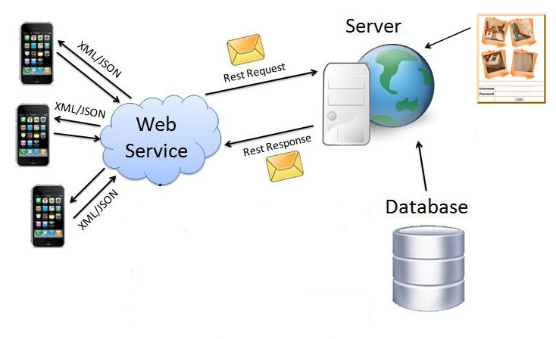
System Analysis & Design
System architecture
Chenggang Xu
50155315

Slide 10
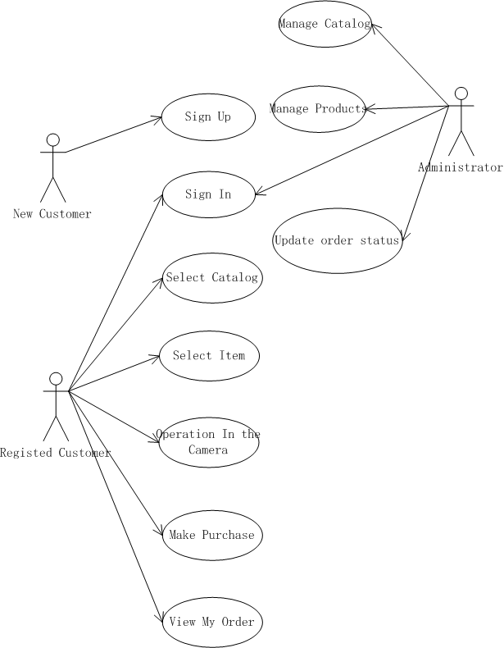
System Analysis & Design
Use Case Diagram
Chenggang Xu
50155315

Slide 11
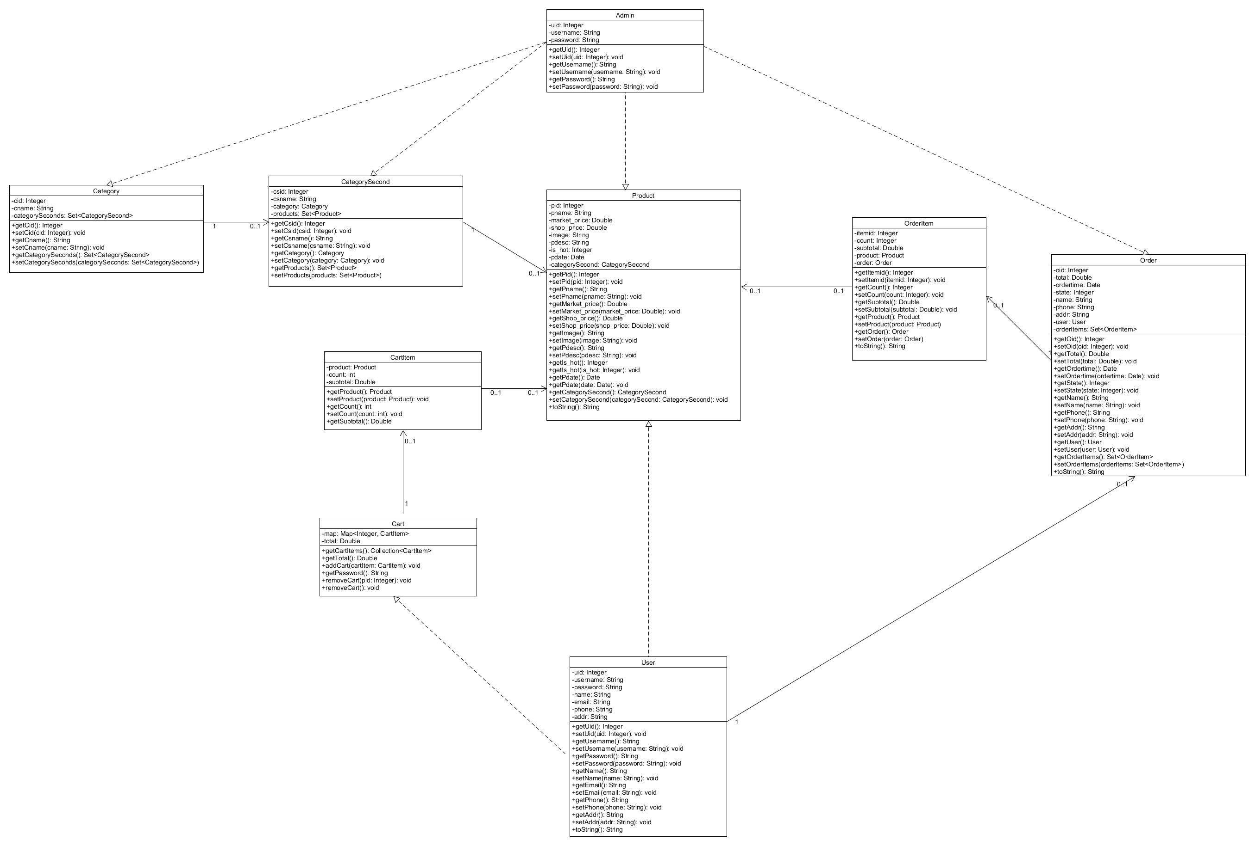
Class Diagram
Chenggang Xu
50155315

Slide 12
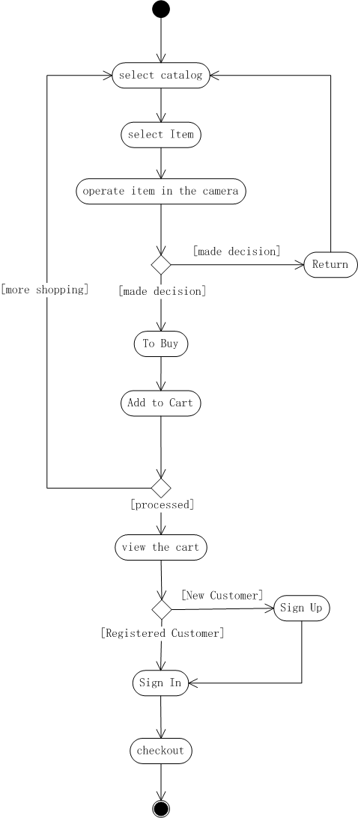
activity Diagram
Chenggang Xu
50155315

Slide 13
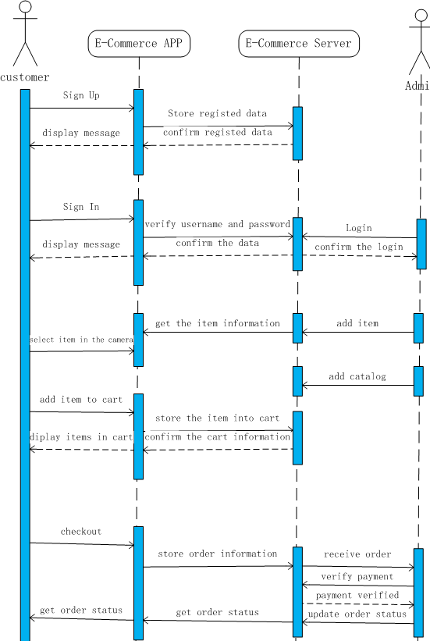
sequence diagram
Chenggang Xu
50155315

Slide 14
Results/Experiments/Discussion
The AR will be applied in more catalogs of E-Commerce in the future to create more meaningful, memorable shopping experiences for customers.
It should be easy to use in the E-Commerce with AR for retailer and customer.
Chenggang Xu
50155315

Slide 15
Significance of Study
The study will extend the current e-commerce mode to improve the customer experience for online shopping .
The study will help e-commerce company retain customers, increase impulsive buying among consumers, reduce the cost and increase the profit margin.
Chenggang Xu
50155315

Slide 16
Scope of Study
In this study, the users can position the item which is demonstrated in the 2D scene through the live camera.
In the camera view, Users can manually move, zoom in/out and rotate the item to fit the real world environment.
Chenggang Xu
50155315

Slide 17
Future Works
In the future study, the items will be are demonstrated in the 3D scene
The items can automatically fit the real world environment by adding some object recognition technologies.
Chenggang Xu
50155315

Slide 18
Conclusion
This study gives the introduction of augmented reality techniques for E-Commerce in different aspects, including user experience, the concept and framework of AR and the related research on AR applications.
It was compared with the original online shopping without AR technologies. The AR embedded E-Commerce will help customers to increase the effectiveness and satisfaction of performing online shopping.
It will be useful for the firms to strategize for AR adoption to gain sustainable competitive advantage.
Chenggang Xu
50155315

Slide 19
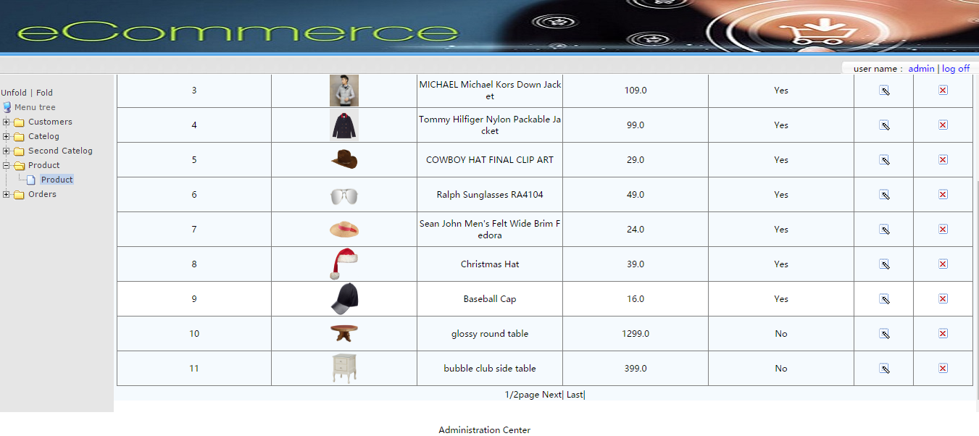
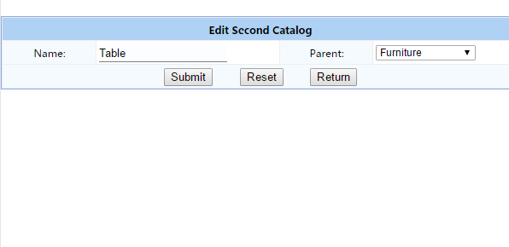
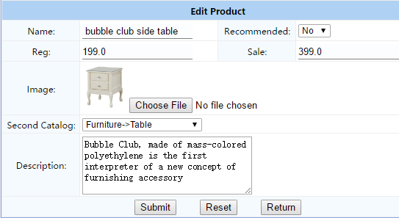
Snapshot
Chenggang Xu
50155315

Slide 20

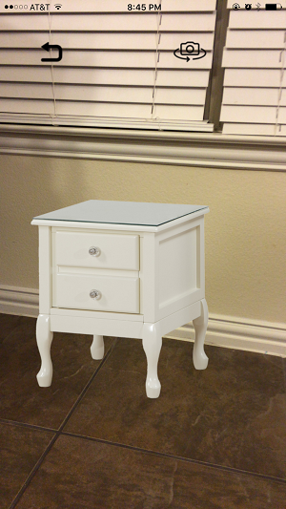

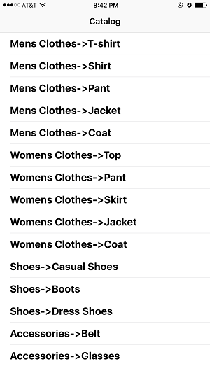
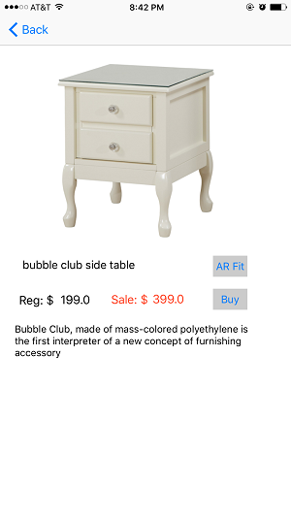
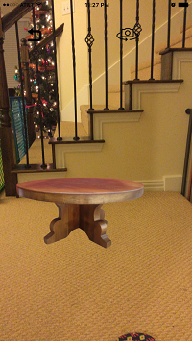
Snapshot
Chenggang Xu
50155315

Slide 21
References
Arhippainen, L. (2009) Studying user experience: issues and problems of mobile service—Case Adamos: user experience (im)possible to catch? Dissertation, University of Oulu.
Christian Travis, Levine Sam, Scheinerman Matt (2014), Implementing Augmented Reality into the Gaming Industry on a Desktop Display Interface, Virtual Reality Applications Center and Human Computer Interaction at Iowa State University.
Desmet, P & Hekkert, P. (2007) Framework of product experience. Int J Des 1(1):57–66
Halal, W. E. (2015). Business strategy for the technology revolution: Competing at the edge of creative destruction. Journal of the Knowledge Economy, 6(1), 31-47.
Hollerer,T. & Feiner, S. (2004) Mobile augmented reality. In: Karimi H, Hammad A (eds) Telegeoinformatics: location-based computing and services. Taylor & Francis Books, London
Hsu, C. & Shiau, H.C. (2013) "The Visual Web User Interface Design in Augmented Reality Technology." International Journal of Advanced Computer Science and Applications 4(2): 116-121.
Huang, T., & Tseng, C. (2015). USING AUGMENTED REALITY TO REINFORCE VIVID MEMORIES AND PRODUCE A DIGITAL INTERACTIVE EXPERIENCE. Journal of Electronic Commerce Research, 16(4), 307-328.
Chenggang Xu
50155315

Slide 22
References
Kuikkaniemi, K., Turpeinen, M., Salovaara, A., Saari, T. & Vuorenmaa, J. (2006) Toolkit for user-created augmented reality games. In: Proceedings of MUM 2006, Stanford, California, Article No.: 6
Kumar, K., Chandra, S., Bharati, S., & Manava, S.(2016). FACTORS INFLUENCING ADOPTION OF AUGMENTED REALITY TECHNOLOGY FOR E-COMMERCE. PACIS 2016 Proceedings, 342.
M. Kang, J. Y. (2014). Augmented reality and motion capture apparel e-shopping values and usage intention. International Journal of Clothing Science and Technology, 26(6), 486-499.
Milgram,P. & Kishino F. (1994) A taxonomy of mixed reality visual displays. IEICE Trans Inf Syst E77-D(12):1321–1329
O'Brien, H. L., 2010. The influence of hedonic and utilitarian motivations on user engagement: the case of online shopping experiences. Interacting with computers, pp. 344-352.
Oliver, RL. (1977) Effect of expectation and disconﬁrmation on postexposure product evaluations—an alternative interpretation. J Appl Psychol 62(4):480
Olsson, T., Lagerstam, E., Kärkkäinen, T. & Väänänen-Vainio-Mattila, K. (2013) "Expected User Experience of Mobile Augmented Reality Services: a User Study in the Context of Shopping Centres." Personal and Ubiquitous Computing Journal 17(2): 287-304
Chenggang Xu
50155315

Slide 23
References
Rohs, M., Schleicher, R., Scho ¨ning, J., Essl, G., Naumann, A. & Kruger, A. (2009) Impact of item density on the utility of visual context in magic lens interactions. Pers Ubiquit Comput 13(8):633–646
Shah, J., & Agrawal, B. (2015) Prototype Algorithm Design for Web Based Service Oriented Architecture Mobile Augmented Reality System. In Communication Systems and Network Technologies (CSNT), 2015 Fifth International Conference on (pp. 1085-1088). IEEE.
Statista, (2016). E-Commerce - Statistics & Market Data | Statista. [online] Available at: http://www.statista.com/markets/413/e-commerce/ [Accessed 25 Feb. 2016].
Tseng-Lung, H., & Feng, H. L. (2014). Formation of augmented-reality interactive technology's persuasive effects from the perspective of experiential value.Internet Research, 24(1), 82-109
Tullis, T. & Albert, W. (2013) "Measuring the User Experience: Collecting, Analyzing, and Presenting Usability Metrics."
Ware, C. & Balakrishnan, R. (1994) Reaching for objects in VR displays: Lag and frame rate. ACM Trans Comp-Hum Interact 1(4):331–356
Wellner, P., Mackay, W. & Gold, R. (1993) Back to the real world. Comm ACM 36(7):24–26
Chenggang Xu
50155315

