Slide 1

CS110: Discussion about Spark
Yijun Yuan
May 30th , 2018

Slide 2
00
Schedule
Big Data Problem and possible solutions
Basic Spark Core
Working with RDDs
Spark Cluster and Parallel programming(in lab)
From
https://www.realdbamagic.com/intro-to-apache-spark-2016-slides/

Slide 3
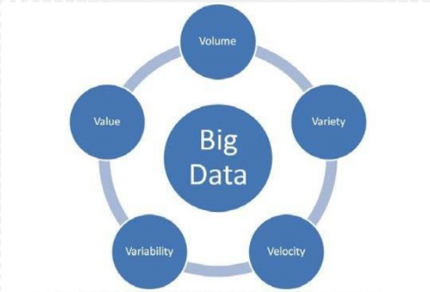
01
Big Data Problem and possible Solutions
The Big data Challenge:

Slide 4
01
Big Data Problem and possible Solutions
Older Solution: Giant server with lots of resources
Data needs to be copied to the server in real time.
Scale-out Solution: Multiple machine for single task
More machine and better infrastructure and framework
storage,
Network,
etc.

Slide 5
01
Big Data Problem and possible Solutions
Distributed System Challenges:
How to distributed the work?
How to ensure coherence?
How to deal with faults?

Slide 6
01
Big Data Problem and possible Solutions
Big Data Solution:
Hadoop (HDFS + MapReduce)
Spark(On memory resource on Clusters)

Slide 7
01
Big Data Problem and possible Solutions
MapReduce:
Map: Take a large problem and divides into sub problems and run same function on all subsystems
Reduce: Combine the output from all sub-problems.
Example:
Radix sort
words count
gradient descent

Slide 8
01
Big Data Problem and possible Solutions
Spark Advantages:
1. high level abstract: focus on what not how
2. Cluster computing
a. Managed by single master node
b. Distributed to worker nodes
c. Scalable and fault tolerant
3. Distributed Storage
a. Data is distributed when store
b. Replication for efficiency and fault tolerance
4. High performance by in-memory utilization and cashing

Slide 9
01
Big Data Problem and possible Solutions
Spark and Hadoop are built to co-exist:
Spark can use other storage systems(S3, local disks, NFS), but works
best with HDFS
It use Hadoop Input and output formats

Slide 10
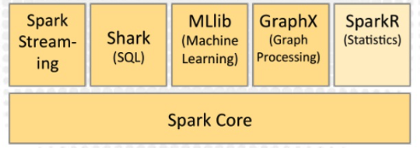
01
Big Data Problem and possible Solutions
Extension of spark

Slide 11
01
Big Data Problem and possible Solutions
Spark Use Cases:
Combination of massive data, intensive computing and iterative algorithm
e.g. Index building, graph creation, pattern recognition and ML.
Reason:
Distributed storage
Distributed computing
In-memory processing and pipelining

Slide 12
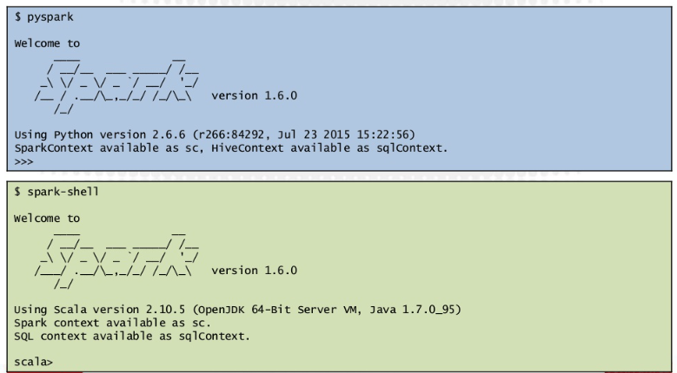
02
Basic Spark Core
Spark shell

Slide 13
02
Basic Spark Core
Spark Context：
Configuration of the file system
RDD: Resilient Distributed Datasets

Slide 14
02
Basic Spark Core
RDD: Resilient Distributed Datasets
Operations:
Actions
- return values(count, take, collect)
- Calculations
Transformations
- define new RDD(map, filter)
- setup things
- RDD is immutable
- Piped
functional programming:
RDD take function as parameters

Slide 15
03
Work with RDD
RDD creation
RDDs basics
Sampling
Set operation
Aggregations
Key/value pairs
We run example in python notebook step by step!!!
API doc: https://spark.apache.org/docs/2.2.0/api/python/index.html
pyspark tutorial: https://github.com/jadianes/spark-py-notebooks

Slide 16
03
RDD creation
textRead
parallelize

Slide 17
03
RDDs bacics
map
filter
collect
count
take

Slide 18
03
Sampling
sample
takeSample

Slide 19
03
Set operation
subtract
distinct
cartesian

Slide 20
03
Aggregations
reduce
aggregate

Slide 21
03
Key value pairs
reduceByKey
counteByKey
combineByKey

Slide 22

THANKS!

