Slide 1
CycleGAN + Machine Translation + Pretrained Transformer + Semi-supervised
Transformer
Generator
A->B
Is it a good A sentences?
Is it a good B sentences?
Discriminator
A
A sentences
B sentences
Discriminator
B
Transformer encoder
Transformer encoder
Generator
B->A
Transformer
Discriminator make sure the sentences are fluent and high-quality sentences in that domain
Consistency loss (A->B->A) make sure the information are remained in the translated sentences.
Generator try to fool the discriminator, Discriminator try to discriminate the generated sentences from the real sentences.

Slide 2
Baseline: 2016 dual learning (https://arxiv.org/abs/1611.00179)
Which use RL and consistency loss

Slide 3
Example
Input for each iteration are:
Unrelated Chinese (monolingual)+English (monolingual) sentences pair
start
Do you have time?
Generator
A->B
Sentence Quality: low
你有时间吗
Discriminator
B
Consistency loss
你有空吗 is a better sentence for the discriminator,
It will motivate the generator to generate 你有空吗
Do you have time?
Generator
B->A

Slide 4
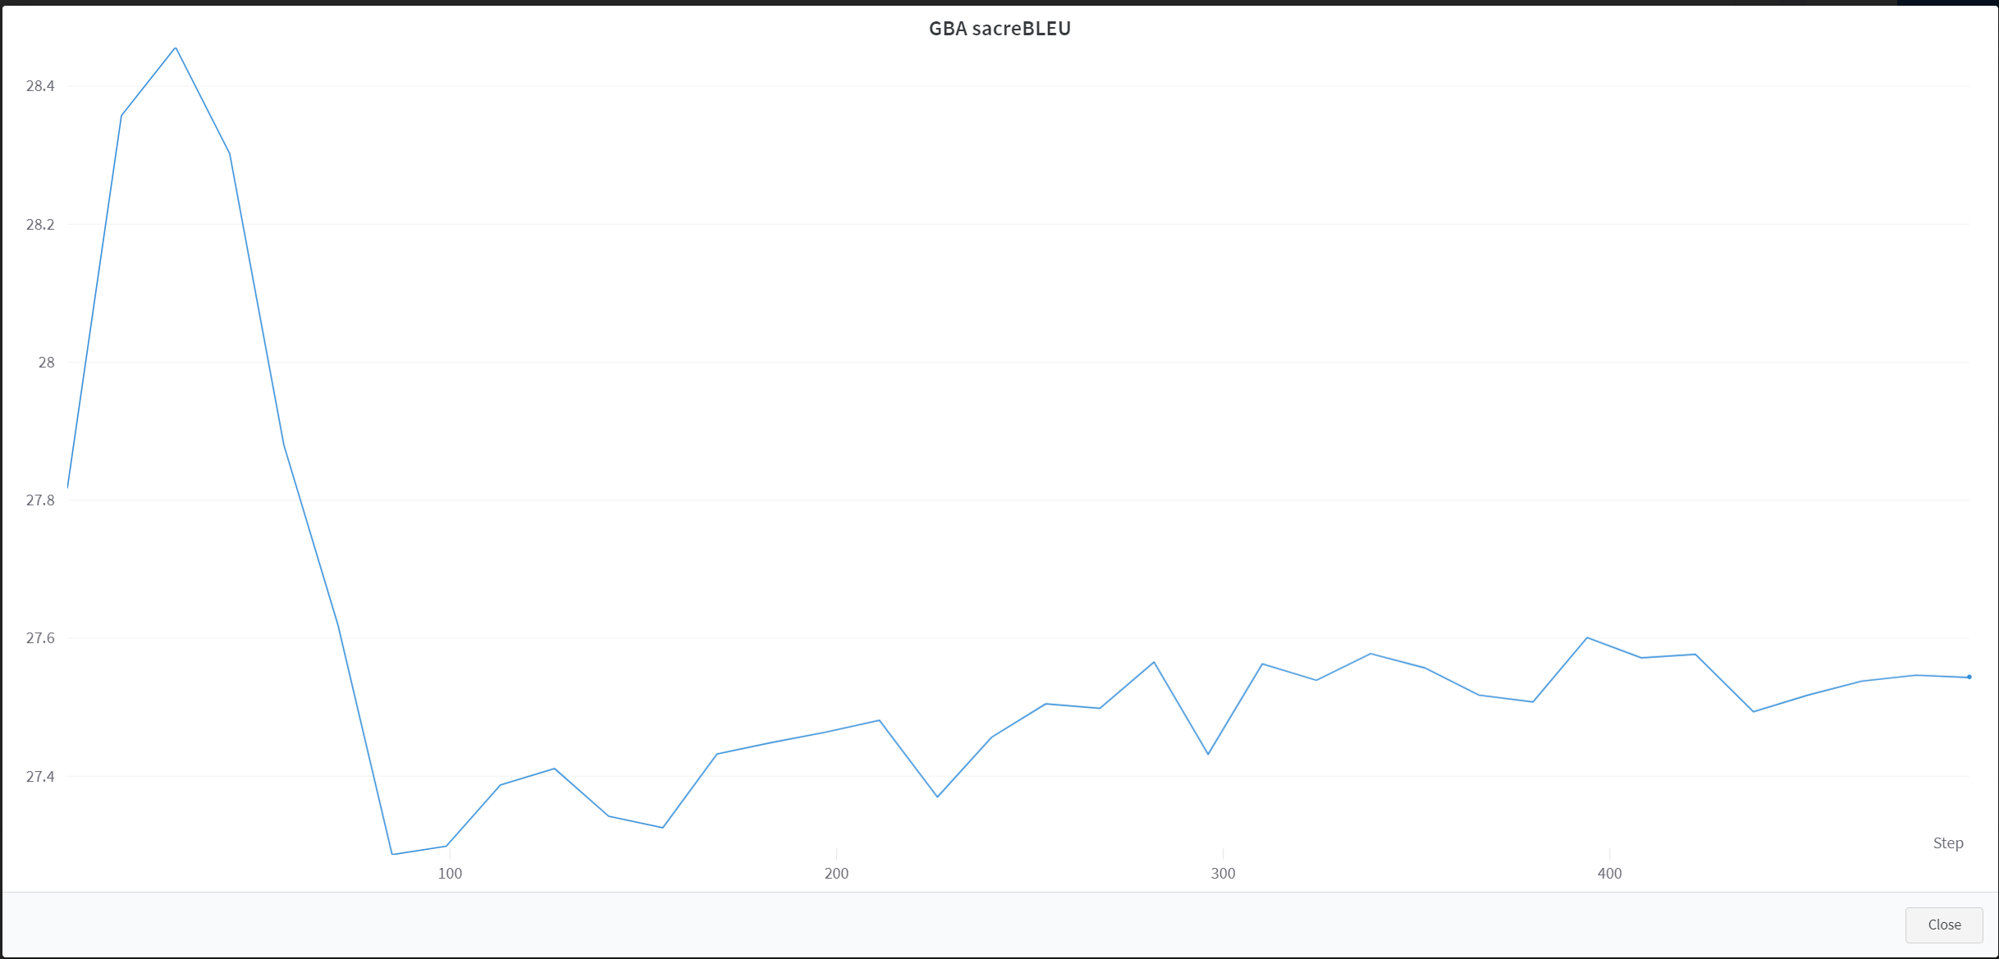
Works well only for the first 30k data wmt16-en-de
https://github.com/KevinZhoutianyi/cycleMT

