Slide 1

WALL easy street Trading algorithm
Use signals and machine learning for profitable trading
April 2022

Slide 2
Team: Group 2
Kevin Gross
Ann Howell
Neil Mendelow
Angela Richter

Slide 3
Goal & Key Questions
Create an algorithmic trading model that can correctly predict buying or selling entries/ exits from the S&P 500 with 60% accuracy
What technical indicators create the most consistent profit trading?
How can machine learning improve the models and which model is best?
Can a model trained and tested on equities data be re-used for crypto data?
This type of analysis leverages machine learning models and thinking to automate a FinTech solution. The ability to predict and quickly respond to market changes could result in significant profit through buy and sell signals without the bias of human decision making.

Slide 4
Analysis Steps
Technical Indicators
Create baseline performance and generate trading signals using technical indicators
Machine Learning
Try to optimize technical indicators data using machine learning algorithms
Test with crypto
Apply a model trained on SPY data to cryptocurrency trading
Try to optimize with a neural network model
MACD, RSI, Stochastic Double Cross, custom
Train-test the algorithm with 4 indicators
Back-tested
Data: Hourly SPY data pulled via API from Yahoo Finance to cover previous 252 trading days
Libraries: Python libraries include Scikit-Learn, Tensor Flow Keras

Slide 5
Algorithmic Trading with Technical Indicators
Trying to find a set if rules to tell the system when to buy or sell an asset and execute a trading strategy
MACD (moving average convergence/divergence ): a trading indicator that shows the relationship between two moving averages of a security's price; identify when bullish or bearish momentum is high in order to identify entry and exit points for trades
RSI (Relative Strength Index): charts the current and historical strength or weakness of a stock or market based on the closing prices of a recent trading period; measures the magnitude of recent price changes to analyze overbought or oversold conditions
Stochastic Double Cross: has two lines – an indicator line and a signal line; used to identify oversold nd overbought conditions and spot divergences between the price and indicator; often paired with the MACD
Custom Indicator: Combined Stochastic and MACD

Slide 6
Results for Technical Indicators *Based on data pulled on 4/13/2022
 | MACD | RSI | Stochastic | Custom (MACD/ Stochastic) | MACD Alt Signal | Custom MACD*/Stoch) | S&P 500
Value Counts | 1606 hold 68 buy 68 sell | 1745 hold 8 buy 8 sell | 1327 hold 207 buy 207 sell | 1486 hold 128 buy 128 sell | 1349 hold 197 buy 196 sell | 1486 hold 128 buy 128 sell | n/a
Win/Loss Rate | (26/42) 38.24% | (5/3) 62.50% | (88/121) 42.10% | (60/68) 46.88% | (81/115) 41.33% | (71/109) 39.44% | n/a
Profit | $2,223 | $2,388 | $4,049 | $4,260 | $7,759 | $7,189
Return | 2.23% | 2.38% | 4.05% | 4.28% | 7.76% | 7.19% | 7.33%
Volatility | 4.33% | 5.86% | 3.26% | 3.28% | 4.37% | 3.98% | 1.53%
Sharpe Ratio | .5357 | .4327 | .5138 | .4924 | 1.75 | .676 | .479

Slide 7
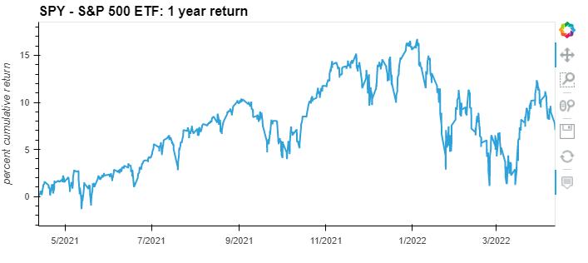
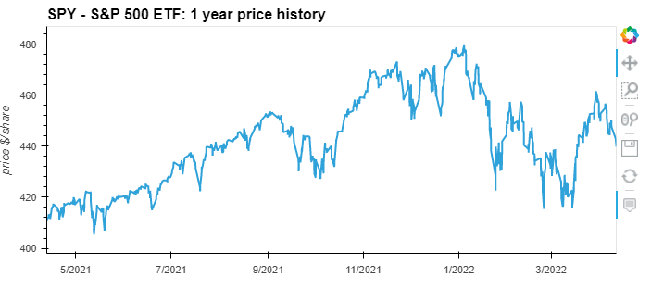
SPY Market Overview

Slide 8
Technical Indicator Graphs – MACD 1

Slide 9
Technical Indicator Graphs – MACD 2

Slide 10
Technical Indicator Graphs – MACD 2

Slide 11
Technical Indicator Graphs - RSI

Slide 12
Technical Indicator Graphs – RSI 2

Slide 13
Technical Indicator Graphs - RSI

Slide 14
Technical Indicator Graphs - Stochastic

Slide 15
Technical Indicator Graphs - custom

Slide 16
Machine Learning Models

Slide 17
Machine Learning Results – confusion and classification matrices

Slide 18
Neural Network Analysis
We applied a neural network to detect complex relationships within the data
Input layer included xxx; hidden layer included x neurons, the output layer was XX
Activation functions used:
Evaluation metrics: model predictive accuracy for classification model and mean squared error (MSE) for regression models https://www.tensorflow.org/api_docs/python/tf/keras/metrics
Epochs:

Slide 19
Cryptocurrency Test
X

Slide 20
Conclusions and Next Steps
Based on these results, we determined:
X
To continue to improve this analysis, we propose:
X

