Slide 1


PORTFOLIO SUITABILITY APP
2
+
2
+
ATTRACT CLIENTS
WITH A FREE REPORT

Slide 2

PORTFOLIO SUITABILITY APP
2
+
ATTRACT CLIENTS WITH A FREE REPORT
You can attract new clients by giving them something for free according to the marketing rule of reciprocity. This app allows you to offer a free report to potential clients that suggests a portfolio of ETFs based on their risk tolerance and investing goals. That report starts a conversation that enables you to show how you can customize a portfolio for them and how it would compare to common benchmarks like the S&P 500.

Slide 3
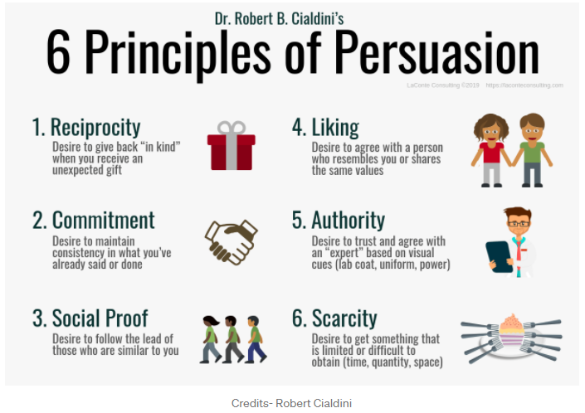
RECIPROCITY
Reciprocity shows that giving someone something causes people to want to give back.
One study showed that a small gift left with a restaurant check led to 21% increase in tips.
This gift of this free report should encourage potential clients to sign up for financial advising.
The Rule of Reciprocity: To owe or not to owe
By Akalya Srikumar(UG 22), Edited by Nitya Deep(UG 23) On Medium.com
https://medium.com/the-nudgelet/the-rule-of-reciprocity-to-owe-or-not-to-owe-80747cd87735

Slide 4

FEATURES
As a financial advisor, use this app to attract new clients by offering them something of value and creating reciprocity
The app provides simple ETF investment recommendations that you can build on to create a more customized portfolio once the client signs on with you
The app:
Collects data from the potential client
Translates data into a risk score
Uses the client information and risk score to recommend a portfolio of ETFs
Generates graphs to show how the recommended portfolio compares to portfolios with other levels of risk and benchmarks like the S&P500
Outputs a pdf of the graphical results that can be shared with the potential client
The app is answering these three questions:
1. Which criteria are important in determining portfolio suitability?
2. Which ETFs are best suited for each type of investor?
3. How are these different types of portfolios likely to perform compared to benchmarks?

Slide 5
INPUT CLIENT information
You or the potential client would enter the following information into the app:
What is your name?
What is your phone number?
What is your email address?
What’s your annual income?
How many years of investing experience do you have?
What is the amount you want to start investing?
What are your annual expenses?
Is your source of income stable?
What is your level of risk? (Low, Moderate, High, Speculative)
What type of investment strategy do you want? (Income, Growth, Value, Income/ Growth, Income/ Value, Growth/ Value, Income/Growth/ Value)
How long do you plan to invest the money in years?

Slide 6
Risk SCORES
ALLOCATION
Our risk scores are established through five risk statements. The first four statements defines the user’s financial situation in order to correctly establish a criteria for investing.
The last statement obtains the users goal for investing, based upon the three financial metrics, income, a blended growth and value strategy, or a mixture of all.
Our ETF portfolios and risk scores were selected using RBCs strategic asset allocation as a guideline, which will be shown in the next slide. Each portfolio is based upon the user’s investment strategy and risk assessment.

Slide 7
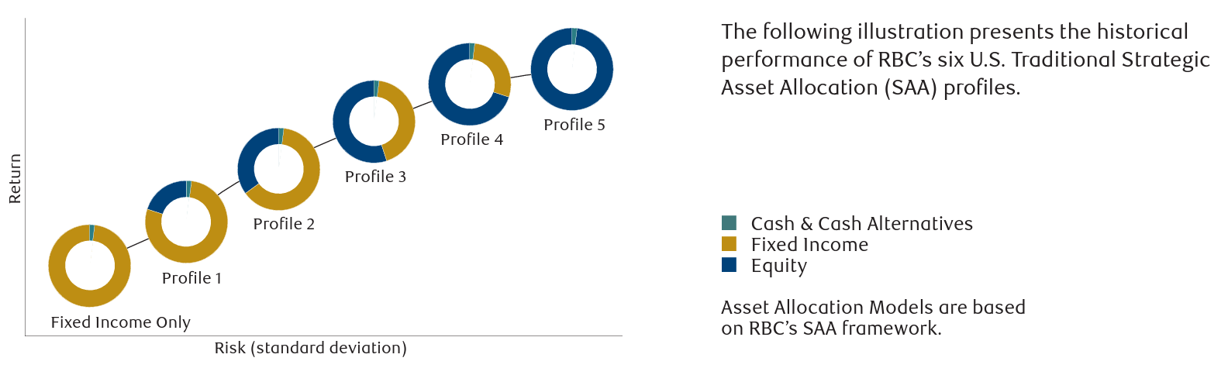
Portfolio construction
The app uses a simplified version of 6 profiles from RBC Wealth Management in their RBC Strategic Asset Allocation model

Slide 8
Portfolio construction
The six profiles have been simplified and applied to ETF holdings based on the following percentages.
Asset Class | Profile 0 Fixed Income | Profile 1 | Profile 2 | Profile 3 | Profile 4 | Profile 5 Speculative
Cash & Cash Alternatives | 2% | 2% | 2% | 2% | 2% | 2%
Fixed Income | 98% | 78% | 58% | 38% | 18% | NA
Equity: Large Cap | NA | 12% | 18% | 24% | 32% | 38%
Equity: Mid Cap | NA | NA | 6% | 9% | 10% | 13%
Equity: Small Cap | NA | NA | NA | 3% | 6% | 7%
Equity: Intl | NA | 8% | 16% | 20% | 26% | 33%
Equity: Emerging Mkts | NA | NA | NA | 4% | 6% | 7%
ETFs | AGG, VCIT, HYG, BNDX | AGG, VCIT, HYG, BNDX, SPGP, VXUS | AGG, VCIT, HYG, BNDX, EMB, SPGP, IJH, VB, VXUS, VWO | AGG, VCIT, HYG, BNDX, EMB, SPGP, IJH, VB, VXUS, VWO | AGG, VCIT, HYG, BNDX, EMB, SPGP, IJH, VB, VXUS, VWO | SPGP, IJH, VB, VXUS, VWO

Slide 9
ETF BOND Selection
We selected five bonds for our fixed income ETFs:
Government Fixed Income | Corporate Investment Grade Fixed Income | Corporate High Yield Fixed Income | International Fixed Income | Emerging Markets Fixed Income
AGG | VCIT | HYG | BNDX | EMB

Slide 10
ETF Fixed Income Holding
AGG | Percent | VCIT | Percent | HYG | Percent | BNDX | Percent | EMB | Percent
AAA | 68.92% | AAA | 1.64% | AAA | .28% | AAA | 21.62% | AAA | 0.09%
AA | 2.92% | AA | 4.90% | BBB | .61% | AA | 26.57% | AA | 7.97%
A | 11.16% | A | 38.77% | BB | 56.53% | A | 29.96% | A | 13.67%
BBB | 15.38% | BBB | 54.45% | B | 31.27% | BBB | 19.51% | BBB | 33.79%
Other | 1.63% | Below B/Other | .24% | Below B/Other | 11.31% | Below B/Other | 2.34% | BB | 16.92%
 |  |  |  |  |  |  |  | Below B, B, Other | 27.57%

Slide 11
ETF Equity Selection
The selection for our equity ETFs were based upon the requirements seen below as well as having a blended strategy of growth and value.
U.S Large Cap Equity | U.S Mid Cap Equity | U.S Small Cap Equity | International Equity | Emerging Markets Equity
SPGP | IJH | VB | VXUS | VWO

Slide 12
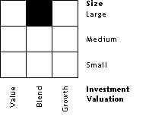
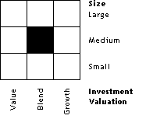
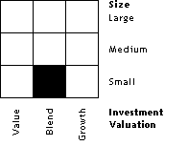
ETF Equity Investment Strategy
.
SPGP
IJH
VB
VXUS
VWO

Slide 13
Analysis
The app calculates the following financial metrics that can be configured on the backend to be included in the potential client report.
Daily returns
Cumulative returns
Percent of holdings
45 Day volatility
Monte Carlo simulation

Slide 14
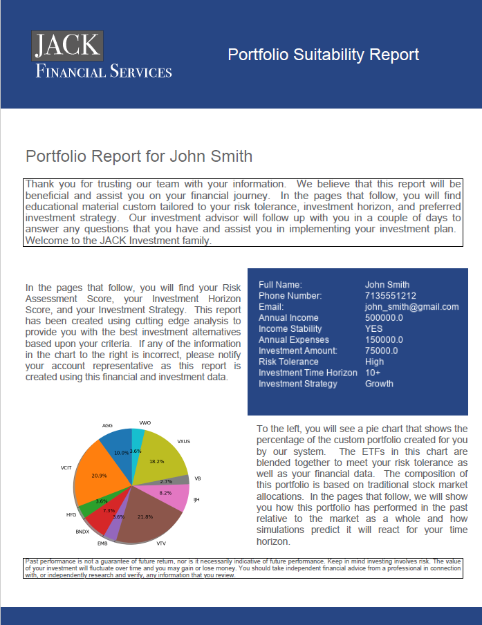
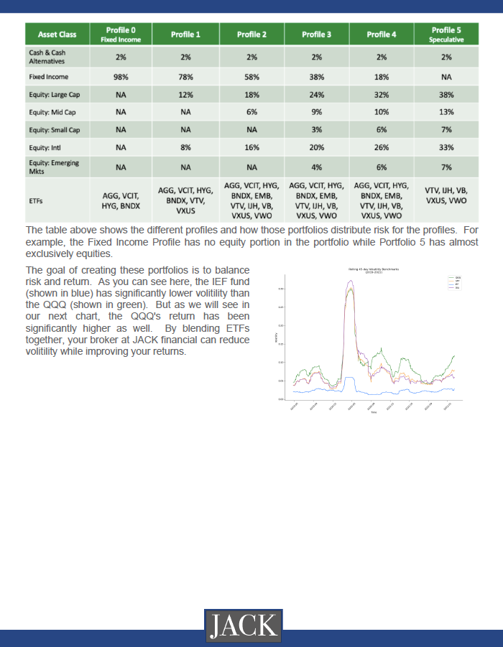
Portfolio Suitability Report PDF
This is a sample report with basic graphs displayed.
Other graphs can be configured on the backend.

Slide 15
Technical details
Technical details:
Built using Python
ETF data pulled via an API from Alpaca (an Alpaca account and .env file are required)
Monte Carlo Simulation generated using MCSimulation from MCForecast
PDF generated using FPDP
Requires program like Visual Studio Code to allow pdf generation

Slide 16
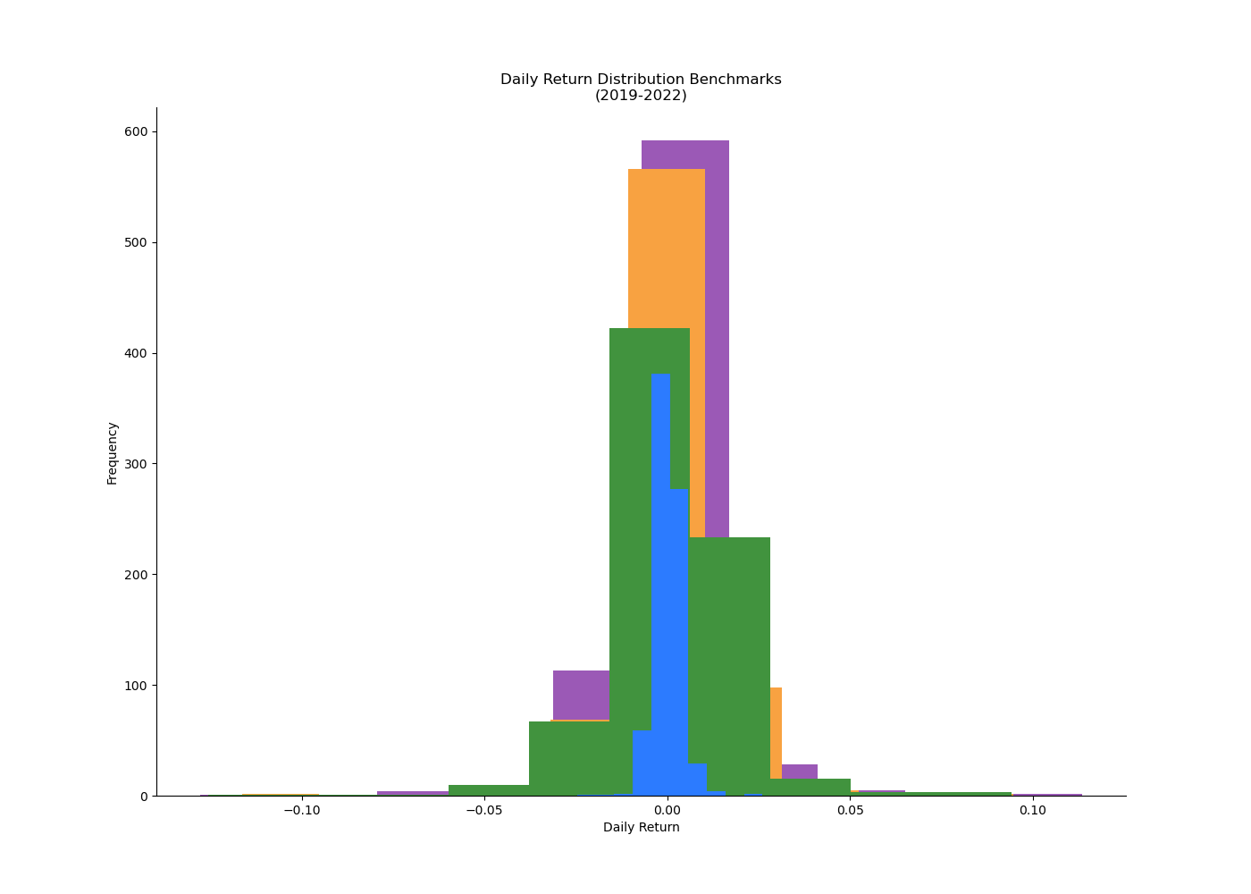
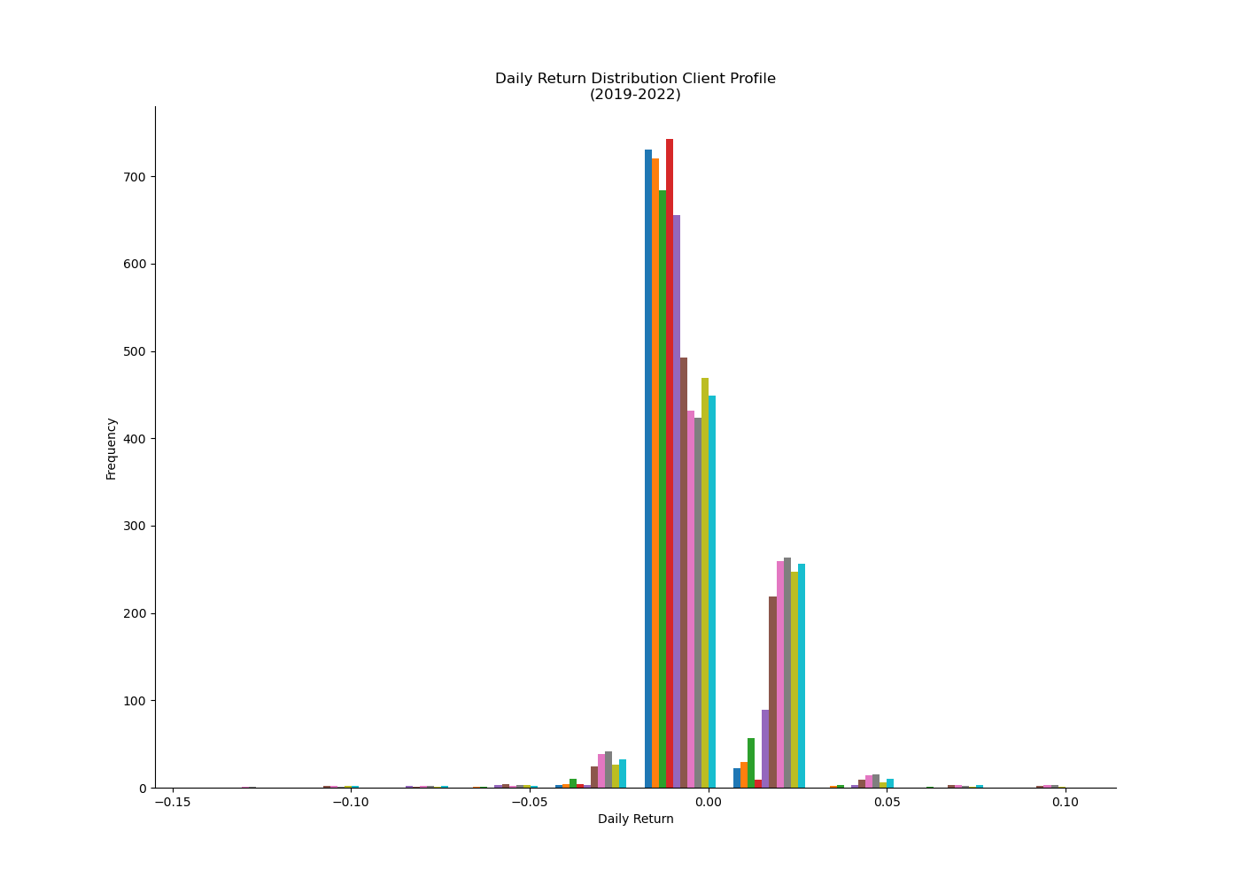
ANALYSIS EXAMPLE: DAILY Returns

Slide 17
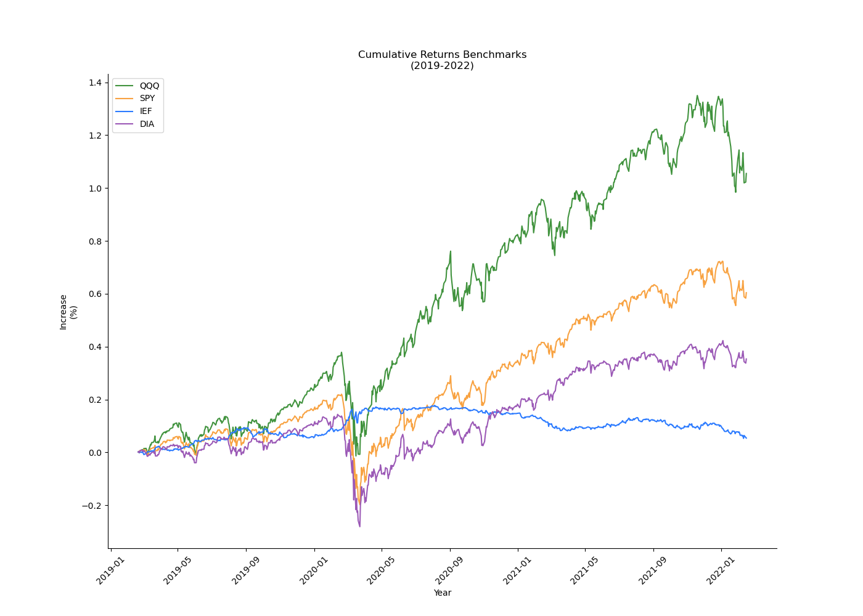
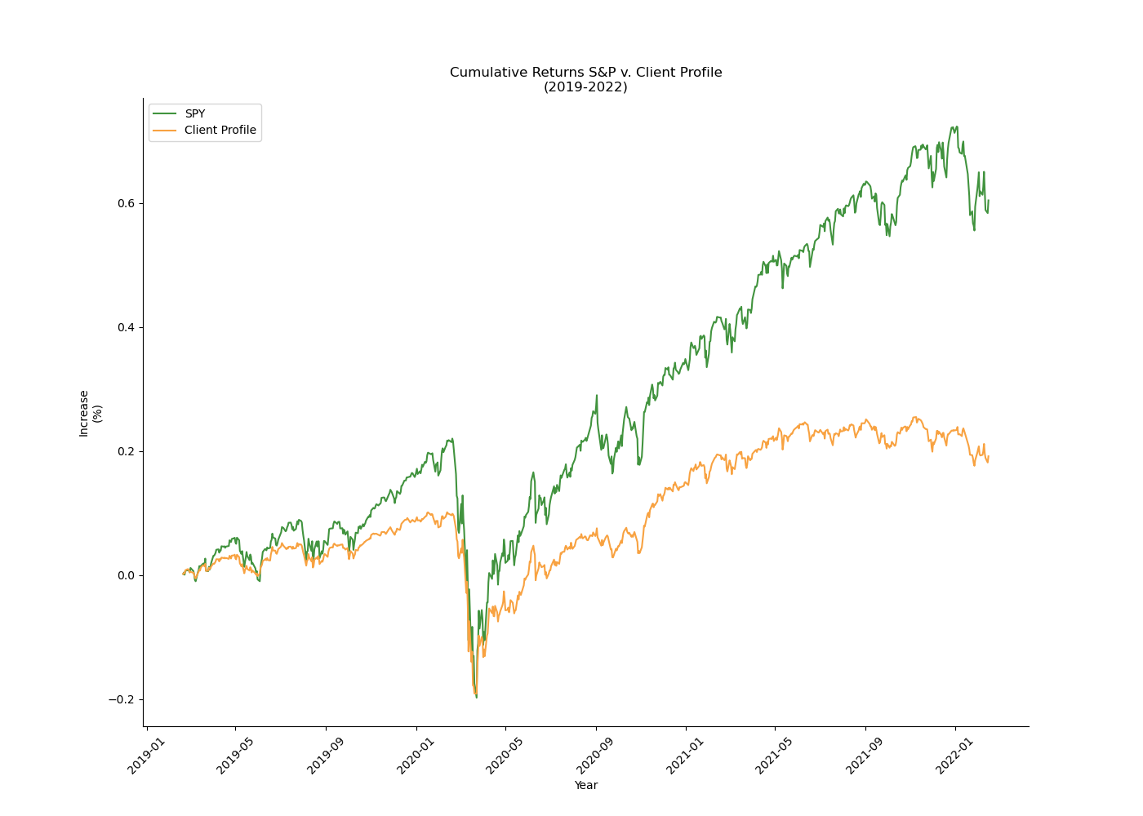
ANALYSIS EXAMPLE: Cumulative Returns

Slide 18
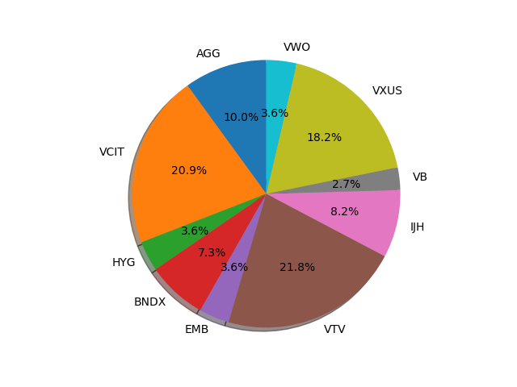
ANALYSIS EXAMPLE: Percent of holdings

Slide 19
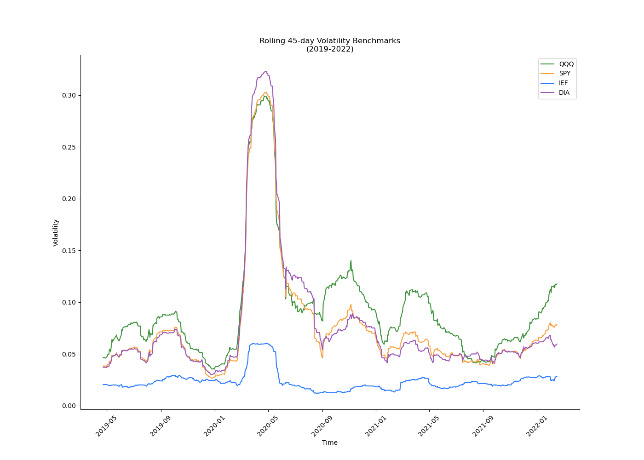
ANALYSIS EXAMPLE: 45 DAY VOLATILITY

Slide 20
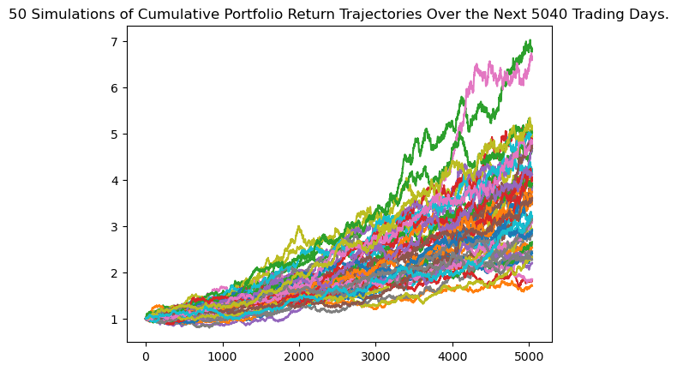
ANALYSIS EXAMPLE: Monte carlo simulation

Slide 21

Presentation – 10 minutes
Intro – Ann – slides 1-3
Features- Charles – slides 4-5
Portfolio construction – Jacob - slides 6-8
Analysis overview & pdf overview – Charles - slides 9-10
Technical Details & Review of graphs – Kevin – slides 11-16

