Slide 1
Graduation Thesis Outline
Weekly Report
Update data to cloud
Presenter: Chu Thanh Tùng
August, 2021

Slide 2
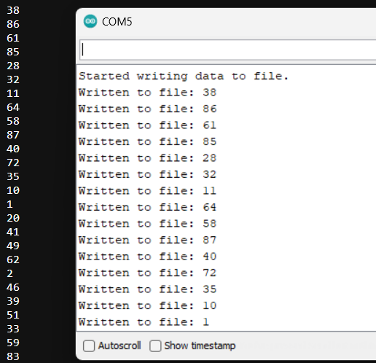
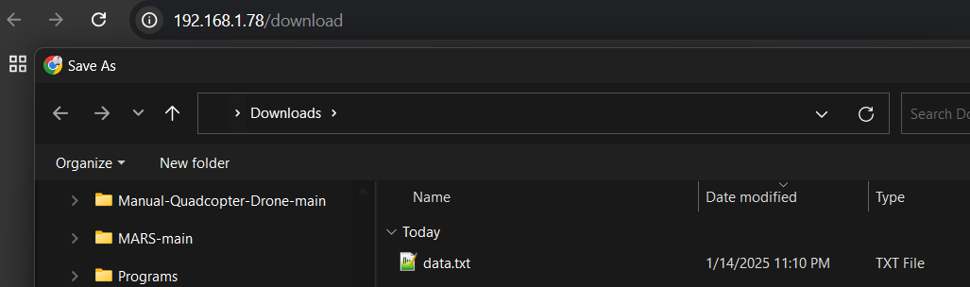
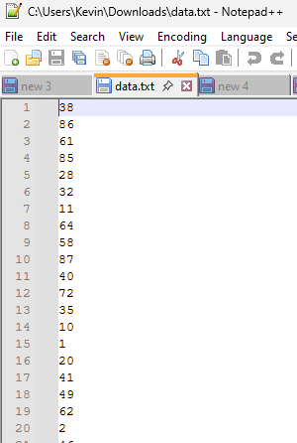
1. Store data in the local
Requestment: Data collect from sensor will be store in the local before upload to cloud.
Solution: Using library LittleFS to store data in .txt file. (can use an additional SD card if needed for backup.)
Result: Can observe what files are being recorded and can download data to the computer when connected to the same wifi and access IP address.
Conclusion: Data is saved in real time so there will be no data loss, meeting the storage condition with a maximum frequency of 20Hz.

Slide 3

2. Display real-time data (Visualize)
Requestment: Display real-time data for observers if needed
Solution: Using Firebase cloud. This platform supports real-time data tracking. Besides, it also supports application development so that users can observe on their phones.
Result: Can observe what files are being recorded and can download data to the computer when connected to the same wifi and have the same IP address.

Slide 4
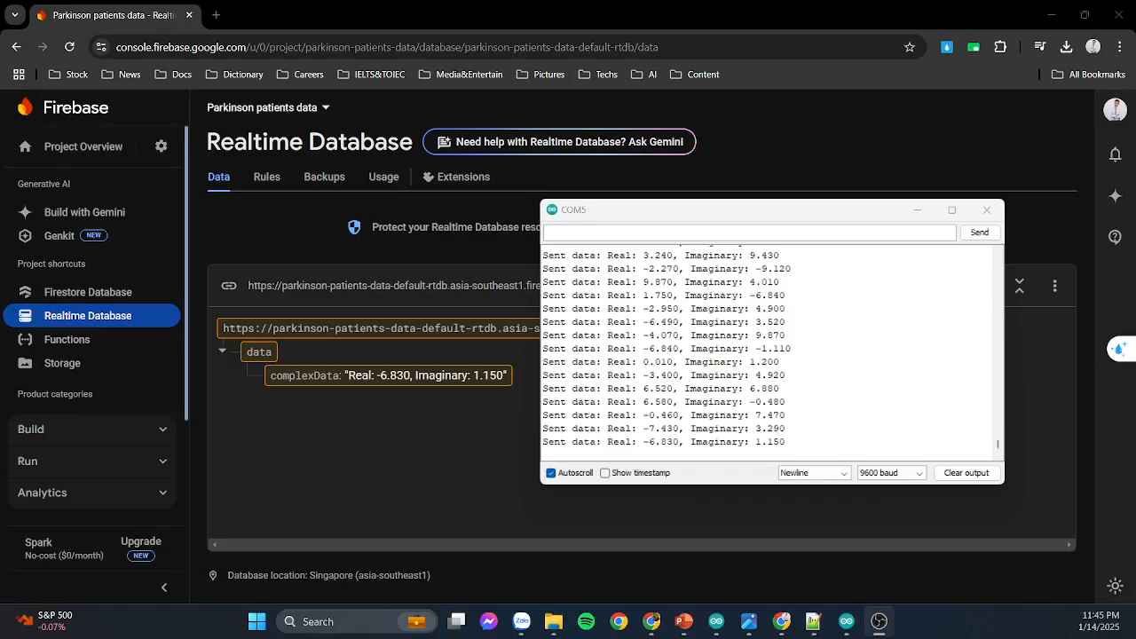
2. Display real-time data
Result:

Slide 5
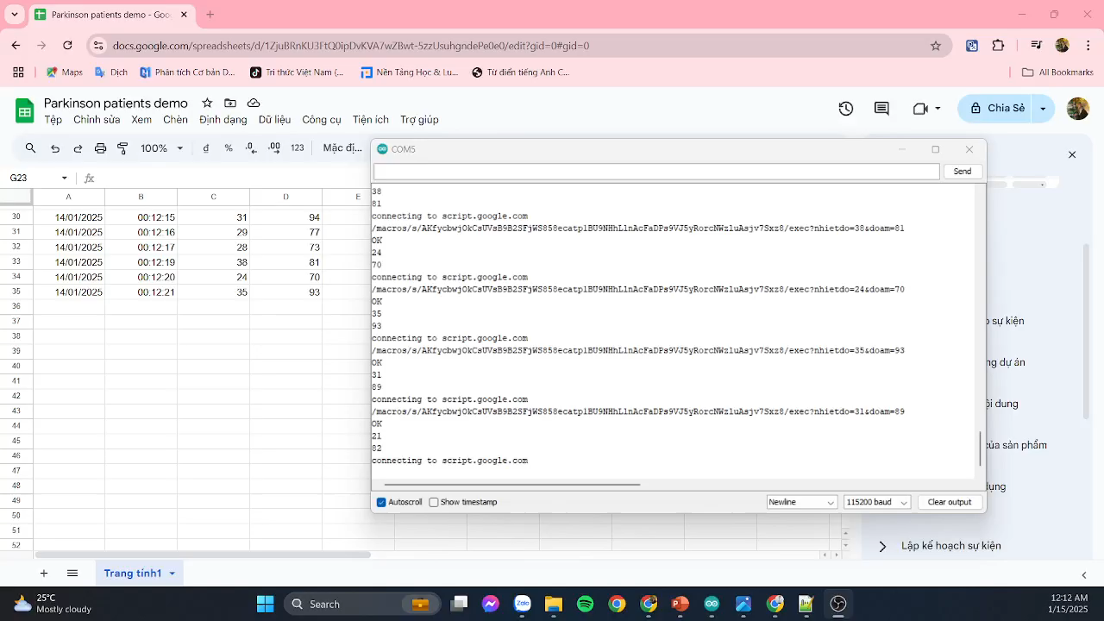
3. Store and Manage Data
Requestment: Store and Manage Data for training modern.
Solution: Save patient data to each excel sheet and save it on the Driver for management.
Result:

