Slide 1
eSun-TBN Prediction

Slide 2
預測商品說明
信用卡(CC)：預測顧客是否申辦信用卡，不論後續是否核卡成功
信託類產品(WM)：預測顧客是否以單筆/定期定額的方式，進行信託類產品(包括基金、債券、股票、ETF…)的申購/轉換【註：申購定期定額基金只會顯示最早申購及轉換的時點，若後面月份只是持續扣款則不會出現在TBN_WM_TXN資料表當中】
信貸(LN)：預測顧客是否進件，不論後續是否申貸成功
外匯(FX)：預測顧客是否以台幣購買外幣

Slide 3
金融商品交易預測：Dataset
https://tbrain.trendmicro.com.tw/Competitions/Details/5
Dataset files:
TBN_CUST_BEHAVIOR.csv
TBN_CIF.csv
TBN_CC_APPLY.csv
TBN_FX_TXN.csv
TBN_LN_APPLY.csv
TBN_RECENT_DT.csv
TBN_WM_TXN.csv

Slide 4
金融商品交易預測：Dataset
Prediction files:
TBN_Y_ZERO.csv
訓練資料集時間為 9447+1 (9448) ~ 9447+120 (9567) 之間，共120日之間產品交易/申請資訊．
本次比賽是請參賽者預測在9447+121 (9568) ~ 9447+150 (9597) 時間區間內（共30日），顧客在四個產品線CC_IND, FX_IND, LN_IND, WM_IND是否會進行交易，若預測顧客該時間內於任一產品線交易一次以上，該產品線的預測值為1，否則為0．例如: 顧客序號12345，預測信用卡核卡1次，外匯交易2次，沒有信貸申請，信託交易3次，該筆預測資料應為: 12345,1,1,0,1 ．
TBN_Y_ZERO.csv則是提供給參賽者做為上傳範例資料檔使用，內部預設值是全部為0．

Slide 5
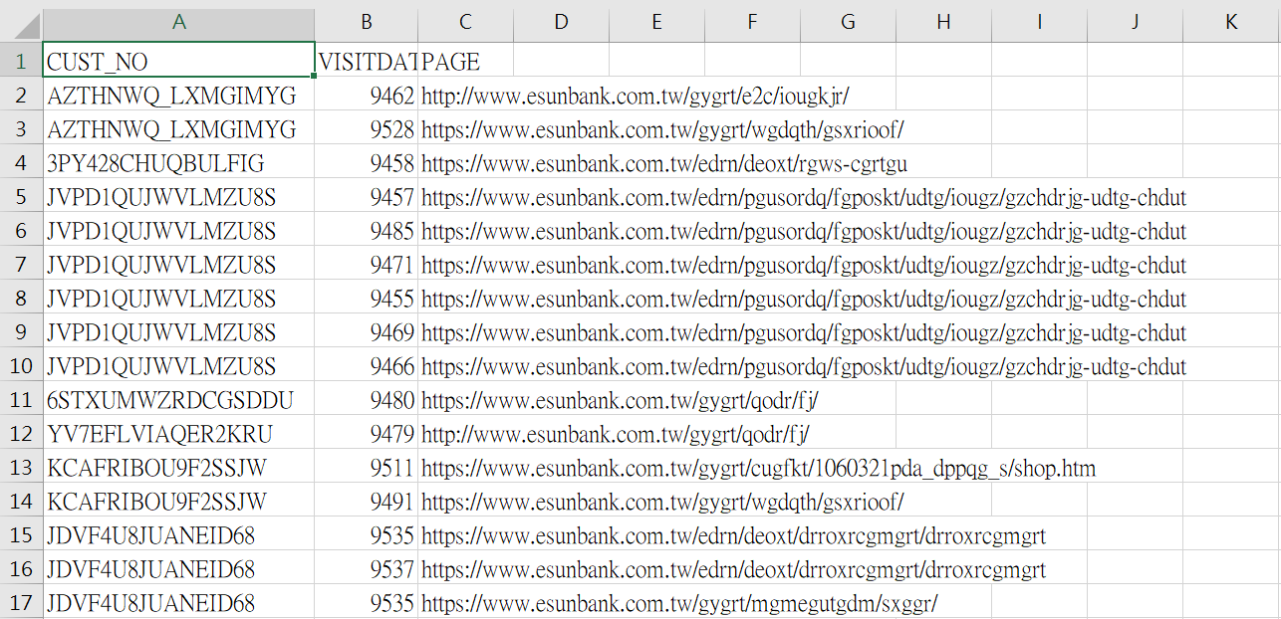
Dataset：TBN_CUST_BEHAVIOR.csv
資料表名稱 | 筆數 | 欄位 | 說明
TBN_CUST_BEHAVIOR (顧客網頁瀏覽行為) | 2,209,864筆 | CUST_NO | 顧客代碼
 |  | VISITDATE | 瀏覽日期
 |  | PAGE | 瀏覽網址(經過特殊處理)

Slide 6
Dataset：TBN_CUST_BEHAVIOR.csv
資料表名稱 | 筆數 | 欄位 | 說明
TBN_CUST_BEHAVIOR (顧客網頁瀏覽行為) | 2,209,864筆 | CUST_NO | 顧客代碼
 |  | VISITDATE | 瀏覽日期
 |  | PAGE | 瀏覽網址(經過特殊處理)
VISITDATE
同一客戶取最大值（最接近）
PAGE
OneHotEncoding(使用merge處理同一客戶可能瀏覽很多網頁)

Slide 7
Dataset：TBN_CIF.csv
TBN_CUST_BEHAVIOR.csv
TBN_CIF (顧客基本屬性資料，僅提供顧客目前最新狀態) | 187,679筆 | CUST_NO | 顧客代碼
 |  | AGE | 年齡 (年齡會分成四個級距)
 |  | CHILDREN_CNT | 子女數
 |  | CUST_START_DT | 顧客與本行最早往來日
 |  | EDU_CODE | 教育程度代碼 (如:大學、碩士)
 |  | GENDER_CODE | 性別代碼
 |  | INCOME_RANGE_CODE | 年收入級距代碼
 |  | WORK_MTHS | 工作月數 (工作月數會分成5個級距)

Slide 8
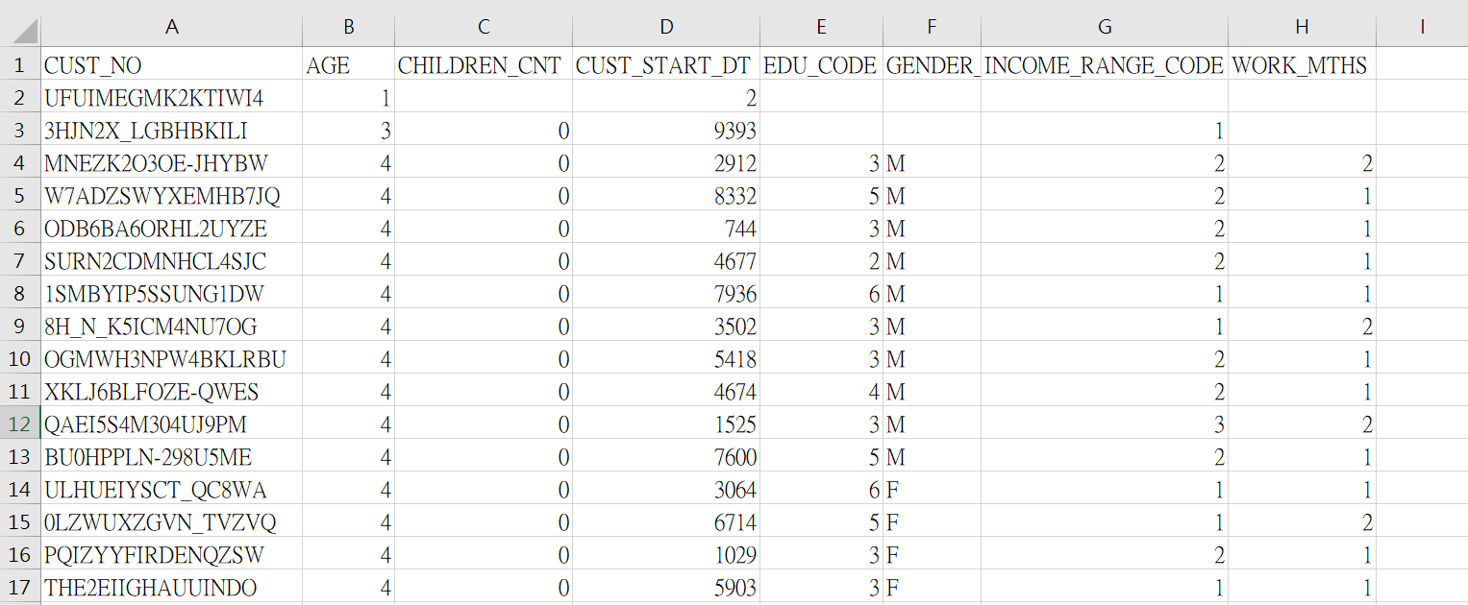
Dataset：TBN_CIF.csv

Slide 9
Dataset：TBN_CIF.csv
AGE
用數值
CHILDREN_CNT
使用數值(空缺處填0)
CUST_START_DT
使用數值
EDU_CODE
使用數值(空缺處填0)
GENDER_CODE
OneHotEncoding(空缺處填’N’)
INCOME_RANGE_CODE
使用數值(空缺處填0)
WORK_MTHS
使用數值(空缺處填0)

Slide 10
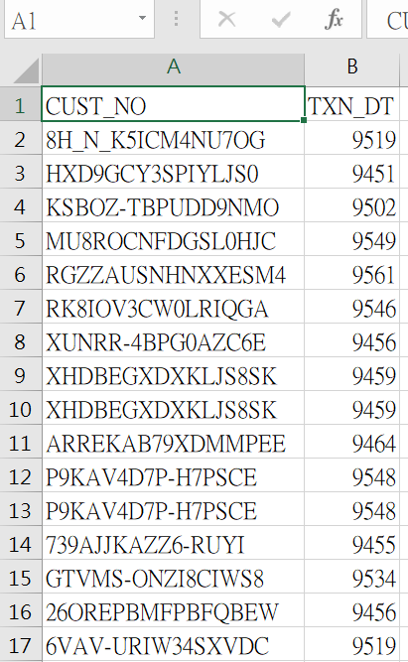
Dataset：TBN_CC_APPLY.csv
TBN_CC_APPLY (顧客信用卡核卡資料) | 54,393筆 | CUST_NO | 顧客代碼
 |  | TXN_DT | 申請信用卡日期

Slide 11
Dataset：TBN_CC_APPLY.csv
TBN_CC_APPLY (顧客信用卡核卡資料) | 54,393筆 | CUST_NO | 顧客代碼
 |  | TXN_DT | 申請信用卡日期
TXN_DT → TXN_Num1
使用數值計算次數

Slide 12
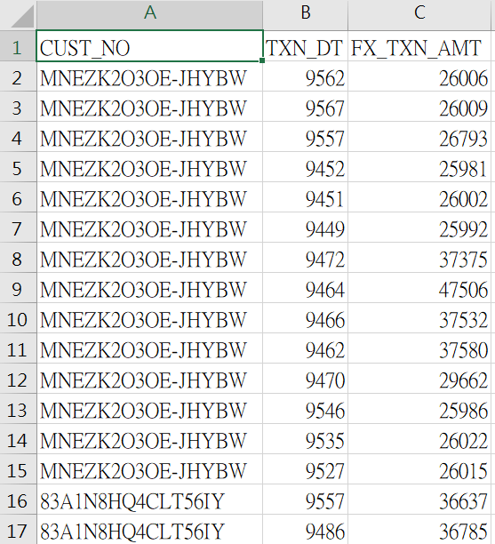
Dataset：TBN_FX_TXN.csv
TBN_FX_TXN (顧客外匯交易資料) | 507,185筆 | CUST_NO | 顧客代碼
 |  | TXN_DT | 交易日期
 |  | FX_TXN_AMT | 交易金額

Slide 13
Dataset：TBN_FX_TXN.csv
TBN_FX_TXN (顧客外匯交易資料) | 507,185筆 | CUST_NO | 顧客代碼
 |  | TXN_DT | 交易日期
 |  | FX_TXN_AMT | 交易金額
TXN_DT → TXN_Num2
使用數值計算次數
FX_TXN_AMT
使用數值(取個人平均值)

Slide 14
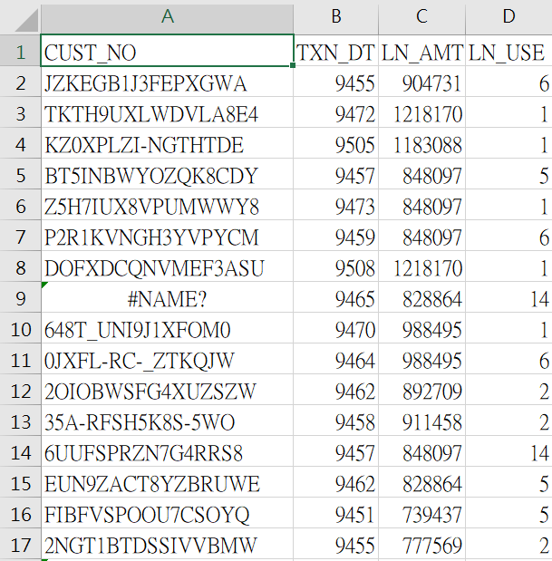
Dataset：TBN_LN_APPLY.csv
TBN_LN_APPLY (顧客信貸申請資料) | 6,741筆 | CUST_NO | 顧客代碼
 |  | TXN_DT | 申貸日期
 |  | LN_AMT | 申貸金額
 |  | LN_USE | 申貸用途代碼 (如:結婚、公司周轉金)

Slide 15
Dataset：TBN_LN_APPLY.csv
TBN_LN_APPLY (顧客信貸申請資料) | 6,741筆 | CUST_NO | 顧客代碼
 |  | TXN_DT | 申貸日期
 |  | LN_AMT | 申貸金額
 |  | LN_USE | 申貸用途代碼 (如:結婚、公司周轉金)
TXN_DT
使用數值取最大值
LN_AMT
使用數值(空缺處填0)，取最大值
LN_USE
OneHotEncoding(空缺處填0), 複選

Slide 16
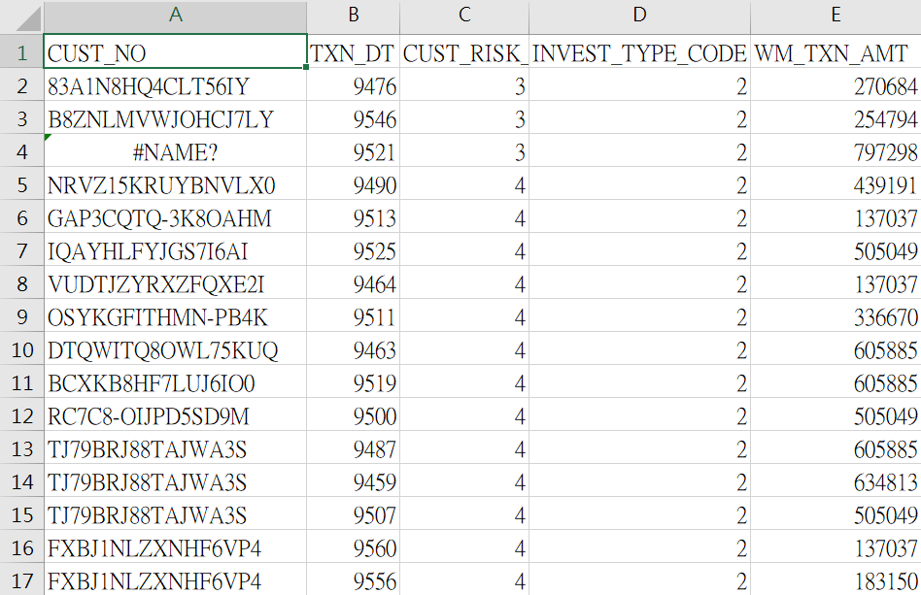
Dataset：TBN_WM_TXN.csv
TBN_WM_TXN (顧客信託類產品交易資料) | 36,763筆 | CUST_NO | 顧客代碼
 |  | TXN_DT | 交易日期
 |  | CUST_RISK_CODE | 顧客風險屬性 (顧客能夠承受的風險程度，數值大小與程度無關)
 |  | INVEST_TYPE_CODE | 信託性質 (如:單筆交易、定期定額)
 |  | WM_TXN_AMT | 交易金額

Slide 17
Dataset：TBN_WM_TXN.csv
TBN_WM_TXN (顧客信託類產品交易資料) | 36,763筆 | CUST_NO | 顧客代碼
 |  | TXN_DT | 交易日期
 |  | CUST_RISK_CODE | 顧客風險屬性 (顧客能夠承受的風險程度，數值大小與程度無關)
 |  | INVEST_TYPE_CODE | 信託性質 (如:單筆交易、定期定額)
 |  | WM_TXN_AMT | 交易金額
TXN_DT → TXN_Num3
使用數值計算次數
CUST_RISK_CODE
OneHotEncoding
INVEST_TYPE_CODE
OneHotEncoding
WM_TXN_AMT
使用數值(取個人平均值)

Slide 18
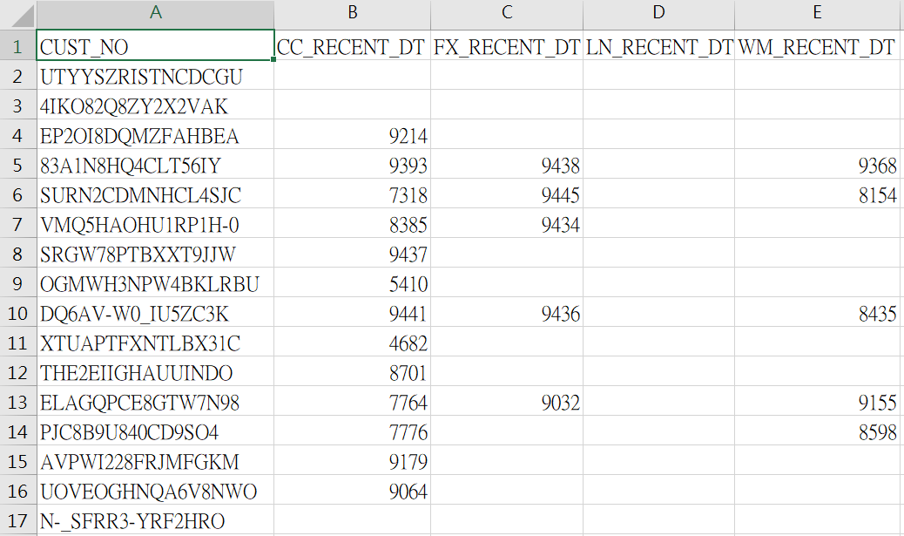
TrainData：TBN_RECENT_DT.csv
TBN_RECENT_DT (顧客最近一次交易時間)此檔保留顧客於9448前的最後交易日，此資訊可用上述資料集更新 | 195,000筆 | CC_RECENT_DT | 最近一次申請信用卡時間
 |  | LN_ RECENT_DT | 最近一次申貸時間
 |  | WM_ RECENT_DT | 最近一次信託類產品交易時間
 |  | FX_ RECENT_DT | 最近一次外匯交易時間

Slide 19
TrainData：TBN_RECENT_DT.csv
TBN_RECENT_DT (顧客最近一次交易時間)此檔保留顧客於9448前的最後交易日，此資訊可用上述資料集更新 | 195,000筆 | CC_RECENT_DT | 最近一次申請信用卡時間
 |  | LN_ RECENT_DT | 最近一次申貸時間
 |  | WM_ RECENT_DT | 最近一次信託類產品交易時間
 |  | FX_ RECENT_DT | 最近一次外匯交易時間
CC_RECENT_DT
使用數值(空缺處填0)
LN_RECENT_DT
使用數值(空缺處填0)
WM_RECENT_DT
使用數值(空缺處填0)
FX_RECENT_DT
使用數值(空缺處填0)

Slide 20
Data manipulation
# delete column
df = all_df.drop(['name'], axis=1)
# find the numbers of null entries in the columns
print(df.isnull().sum())
# compute the mean value of a column
age_mean = df['age'].mean()
fare_mean = df['fare'].mean()
# fill the null entries with mean value
df['age'] = df['age'].fillna(age_mean)
df['fare'] = df['fare'].fillna(fare_mean)

Slide 21
Data manipulation
# transfer text entries to binary
df['sex'] = df['sex'].map({'female':0, 'male':1}).astype(int)
# transfer classes into onehot encoding
onehot_df = pd.get_dummies(data=df, columns=['embarked'])
# transfer dataframe to array
ndarray = onehot_df.values

Slide 22
Data manipulation
# get labels and features
Label = ndarray[:,0]
Features = ndarray[:, 1:]
# normalize
from sklearn import preprocessing
minmax_scale = preprocessing.MinMaxScaler(feature_range=(0,1))
scaledFeatures = minmax_scale.fit_transform(Features)
# partition data array into train set and test set
from sklearn.model_selection import train_test_split
trainingData,testingData,trainingLabel,testingLabel = train_test_split(normalizedFeatures,label,test_size=0.2,random_state = 1, stratify = label)

Slide 23
Combine data sets
Import library & Set file path
Data manipulation for each dataset
Data combination of all datasets

Slide 24
Import library & Set file path
import numpy as np
import pandas as pd
import codecs
orderFilePath = ".\\dataset\\order.csv"
groupFilePath = ".\\dataset\\group.csv"
airlineFilePath = ".\\dataset\\airline.csv"
day_scheduleFilePath = ".\\dataset\\day_schedule.csv"
trainingFilePath = ".\\dataset\\training-set.csv"
testingFilePath = ".\\dataset\\testing-set.csv"

Slide 25
Data manipulation for order.csv
# Read data frame from order.csv
order_df = pd.read_csv(orderFilePath)
# Transfer ‘source_1’, ‘source_2’, ‘unit’ classes into one-hot encoding
order_df = pd.get_dummies(data=order_df,columns=['source_1','source_2','unit'])

Slide 26
Data manipulation for order.csv
# Transfer date to date time format
def date_format(x):
y = '20'+x[-2:]
m = x[-6:-3]
d = x[:-7]
return pd.to_datetime(y + '-‘ + m + '-‘ + d)

Slide 27
Data manipulation for order.csv
# Get ‘begin_date’ in group.csv
begin_dates = {}
for index , row in pd.read_csv(groupFilePath)[['group_id','begin_date']].iterrows():
begin_dates.update({row[0]:row[1]})
# Rename column ‘order_date’ to ‘days_before_D-day’
order_df.rename(columns={"order_date":"days_before_D-day"}, inplace=True)
# Transfer ‘order_date’ to ‘days_before_D-day’
for index, row in order_df.iterrows():
days = date_format(begin_dates[row[1]]) - date_format(row[2])
order_df[‘days_before_D-day’][index] = days

Slide 28
Data manipulation for group.csv
# Read data frame from group.csv
group_df = pd.read_csv(groupFilePath)
# Transfer ‘begin_date’ to ‘begin_month’
for index, row in group_df.iterrows():
row[4] = row[4][-6:-3]
group_df.rename(index=str, columns={“begin_date": “begin_month"})
# Transfer ‘sub_line’, ‘area’, ‘begin_month’ classes into one-hot encoding
group_df = pd.get_dummies(data=group_df,columns=[‘sub_line‘, ‘area', ’begin_month’])

Slide 29
Data manipulation for group.csv
# Delete ‘product_name’ column from group_df
group_df = group_df.drop(['product_name'], axis=1)
# Decide whether the ad is good (1) or not (0)
def is_good_ad(text):
if pd.isnull(text) :
return 0
elif text.find('優惠') != -1:
return 1
elif text.find('折') != -1:
return 1
elif text.find('省') != -1:
return 1
return 0

Slide 30
Data manipulation for group.csv
# Transfer promotion_prog to a bit indicating whether the ad is good or not
for index, row in group_df.iterrows():
text = gruop_df[‘promotion_prog’][index]
group_df[‘promotion_prog’][index] = is_good_ad(text)

Slide 31
Data combination of all datasets
# Get columns' names of order_df & add them to column_names
order_column_names = order_df.columns.values
column_names = order_column_names[0] + ‘,’
for i in range(2, len(order_column_names)):
column_names += order_column_names[i] + ‘,’
# Get columns' names of group_df
group_column_names = group_df.columns.values
# Combine the column names of group_df into column_names
for i in range(1, len(group_column_names)):
column_names += group_column_names[i] + ‘,’

Slide 32
Data combination of all datasets
# Put group data into map for file merging
group_map = {}
for index, row in group_df.iterrows():
row_data = ""
for i in range(1,group_df.shape[1]):
row_data += str(row[i]) + ","
group_map.update({row[0]:row_data})

Slide 33
Data combination of all datasets
# Combine the data and write to file
for index, row in order_df.iterrows():
combined_data = ""
combined_data += str(row[0]) + ","
for i in range(3,order_df.shape[1]):
combined_data += str(row[i]) + ","
combined_data += group_map[row[1]]
with codecs.open(".\\combined_data.csv",'w','utf-8') as f:
f.write(combined_data[:-1] + "\r\n")

Slide 34
Generate train_dataset & test_dataset
Read data from combined_dataset.csv
Put data items in a map data_map
Use order_id as the key to get data items from data_map and write to train_dataset.csv & test_dataset.csv

Slide 35
Generate train_dataset & test_dataset
import pandas as pd
import codecs
combined_file_name = “combined_dataset.csv"
# Read data from combined_dataset.csv
data = codecs.open(combined_file_name).read().splitlines()
# Put data items in a map data_map
data_map = {}
for item in data:
data_map.update({item[:item.find(",")] : item[item.find(","):]})

Slide 36
Generate train_dataset & test_dataset
# Use order_id as the key to get data items from data_map and write to train_dataset.csv
trainingFilePath = ".\\dataset\\training-set.csv"
with codecs.open("train_dataset.csv","w","utf-8") as f:
for index, row in pd.read_csv(trainingFilePath).iterrows():
tmp = str(row[0]) + ",“ + str(row[1]) + data_map[str(row[0])] + "\r\n"
f.write(tmp)

Slide 37
Generate train_dataset & test_dataset
# Use order_id as the key to get data items from data_map and write to test_dataset.csv
testingFilePath = ".\\dataset\\testing-set.csv"
with codecs.open("test_dataset.csv","w","utf-8") as f:
for index, row in pd.read_csv(testingFilePath).iterrows():
tmp = str(row[0]) + ",“ + str(row[1]) + data_map[str(row[0])] + "\r\n"
f.write(tmp)

Slide 38
Steps
Download data file
Read data from excel
Data manipulation
Build model
Prediction

Slide 39
Download data file
import urllib.request
import os
url = "http://biostat.mc.vanderbilt.edu/wiki/pub/Main/DataSets/titanic3.xls"
filepath = "titanic3.xls"
if not os.path.isfile(filepath):
result=urllib.request.urlretrieve(url,filepath)
print('downloaded:',result)

Slide 40
Read data from excel
import numpy
import pandas as pd
filepath = "titanic3.xls"
all_df = pd.read_excel(filepath)
print(all_df[:2])

Slide 41
Data manipulation
Select columns
Add rows (data)
Delete column
Find the numbers of null entries in the columns
Compute the mean value of a column
Fill the null entries with mean value
Transfer text entries to binary
Transfer classes into onehot encoding
Transfer dataframe to array
Get labels and features
Normalize
Partition data into train set and test set randomly

Slide 42
Data manipulation
# select columns
cols = ['survived','name', 'pclass', 'sex', 'age','sibsp', 'parch', 'fare', 'embarked']
all_df = all_df[cols]
# add rows
Jack = pd.Series([0,'Jack',3,'male',23,1,0,5.0000,'S'])
Rose = pd.Series([1,'Rose',1,'female',20,1,0,100.0000,'S'])
JR_df = pd.DataFrame([list(Jack),list(Rose)],columns=['survived', 'name', 'pclass', 'sex', 'age', 'sibsp', 'parch', 'fare', 'embarked'])
all_df = pd.concat([all_df,JR_df])
# delete column
df = all_df.drop(['name'], axis=1)

Slide 43
Data manipulation
# find the numbers of null entries in the columns
print(df.isnull().sum())
# compute the mean value of a column
age_mean = df['age'].mean()
fare_mean = df['fare'].mean()
# fill the null entries with mean value
df['age'] = df['age'].fillna(age_mean)
df['fare'] = df['fare'].fillna(fare_mean)

Slide 44
Data manipulation
# transfer text entries to binary
df['sex'] = df['sex'].map({'female':0, 'male':1}).astype(int)
# transfer classes into onehot encoding
onehot_df = pd.get_dummies(data=df, columns=['embarked'])
# transfer dataframe to array
ndarray = onehot_df.values

Slide 45
Data manipulation
# get labels and features
Label = ndarray[:,0]
Features = ndarray[:, 1:]
# normalize
from sklearn import preprocessing
minmax_scale = preprocessing.MinMaxScaler(feature_range=(0,1))
scaledFeatures = minmax_scale.fit_transform(Features)
# partition data into train set and test set randomly
bitmap = numpy.random.rand(len(all_df)) < 0.8
train_df = all_df[bitmap]
test_df = all_df[~bitmap]

Slide 46
Build model
import numpy
import pandas as pd
from sklearn import preprocessing
from keras.models import Sequential
from keras.layers import Dense, Dropout
from data import load_data
(train_Features,train_Label), (test_Features,test_Label), all_df = load_data()
# define model layers
model = Sequential()
model.add(Dense(units=40, input_dim=9, kernel_initializer='uniform', activation='relu'))
model.add(Dense(units=30, kernel_initializer='uniform', activation='relu'))
model.add(Dense(units=1, kernel_initializer='uniform', activation='sigmoid'))

Slide 47
Build model
# define training parameters
model.compile(loss='binary_crossentropy', optimizer='adam', metrics=['accuracy'])
# start training
train_history = model.fit(x=train_Features, y=train_Label, validation_split=0.1, epochs=30, batch_size=30, verbose=1)
# model evaluation
scores = model.evaluate(x=test_Features, y=test_Label)
# save model
try:
model.save_weights("titanic3.h5")
print("success")
except:
print("error")

Slide 48
Prediction
import numpy as np
from keras.models import Sequential
from keras.layers import Dense,Dropout
from data import load_data
from data import PreprocessData
(train_Features,train_Label), (test_Features,test_Label), all_df = load_data()
# define model layers
model = Sequential()
model.add(Dense(units=40, input_dim=9, kernel_initializer='uniform', activation='relu'))
model.add(Dense(units=30, kernel_initializer='uniform', activation='relu'))
model.add(Dense(units=1, kernel_initializer='uniform', activation='sigmoid'))
# load model from the file
try:
model.load_weights("titanic3.h5")
print("success")
except:
print("error")

Slide 49
Prediction
# prediction
all_Features,Label = PreprocessData(all_df)
all_probability = model.predict(all_Features)
print(all_probability[:5])
# match probability with dataframe
all_df_prob = all_df
all_df_prob.insert(len(all_df.columns),'probability', all_probability)

