Slide 1
Final REPORT TEMPLATE FOR WEB TECHNOLOGY COURSE.
PROJECT TITLE: AYUDA
Department: Computer and Software Engineering.
Submitted by: MUGISHA KEVINE.
Registration number:221022348.

Slide 2
AYUDA in summary.
AYUDA is an online platform designed for CSE students in order to share knowledge , motivate, Interact, post tricks, form study peer groups, get important highlight of the day that the teacher focused and many more as it is an expandable project.

Slide 3
What is Ayuda going to solve?
I took time to observe why my collegues study very hard for the cats or exams and still don’t get enough grades. Some because they don’t know what to focus on while studying, others because they couldn’t get peer support. So I came up with an idea to develop an online platform designed specifically for my class
That is going to contain every single piece of information that my collegues need in order to pass modules.
This will result in few or no retakes in my class.

Slide 4
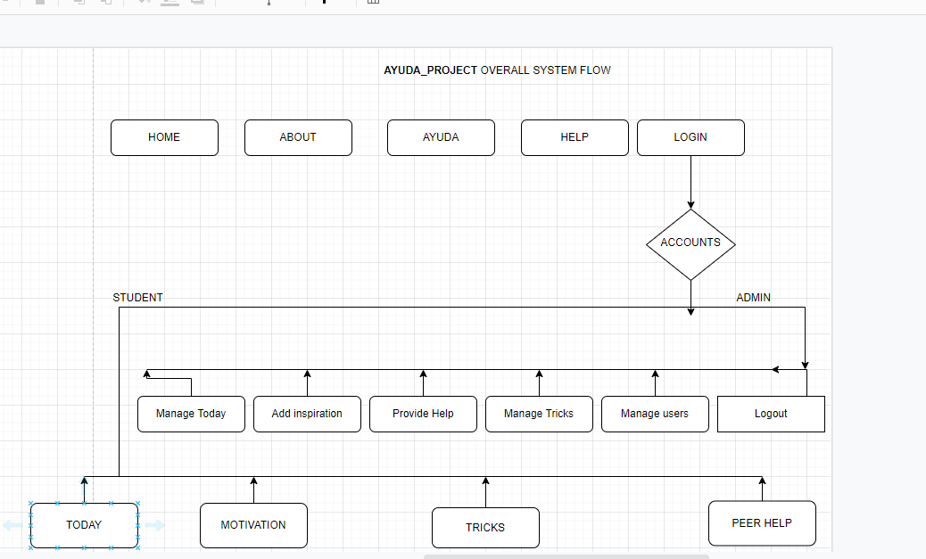
AYUDA_PROJECT overall system flow chart
Here is a designed flow chart of AYUDA PROJECT.

Slide 6
System Implementation

Slide 7
LANDING PAGE

Slide 8
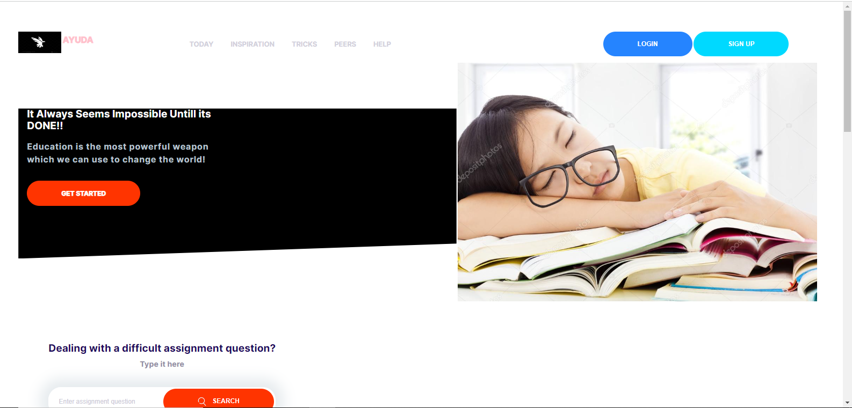

Slide 9
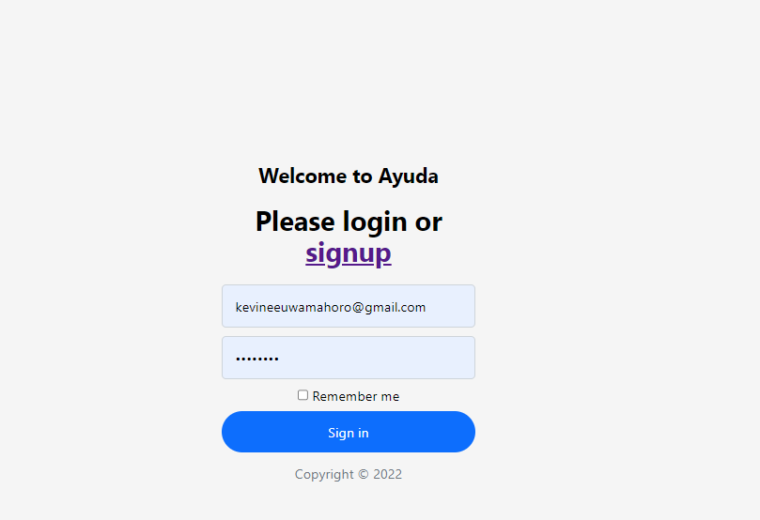
LOGIN PAGE

Slide 10
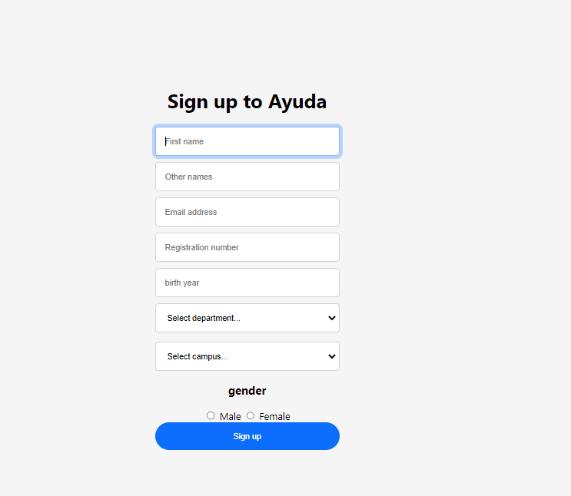
SIGN UP PAGE

Slide 11
STUDENT INTERFACE

Slide 12
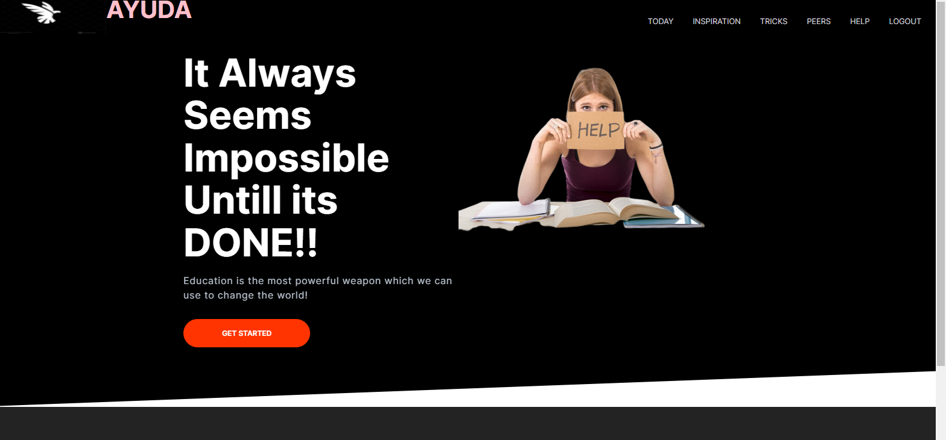

Slide 13
ADMIN INTERFACE

Slide 14
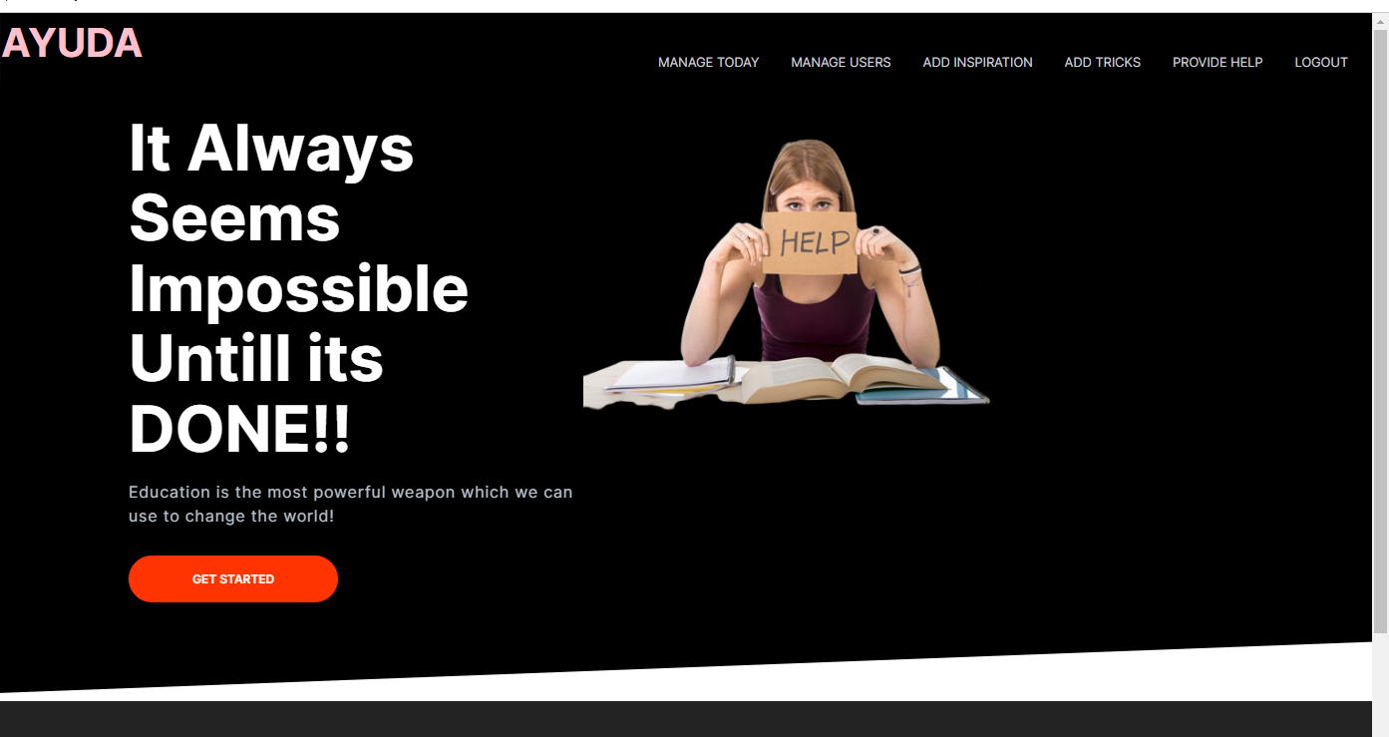

Slide 15
FOOTER INTERFACE FOR admin

Slide 16


Slide 17
Footer interface for student

Slide 18


Slide 19
AYUDA HELP PAGE

Slide 20
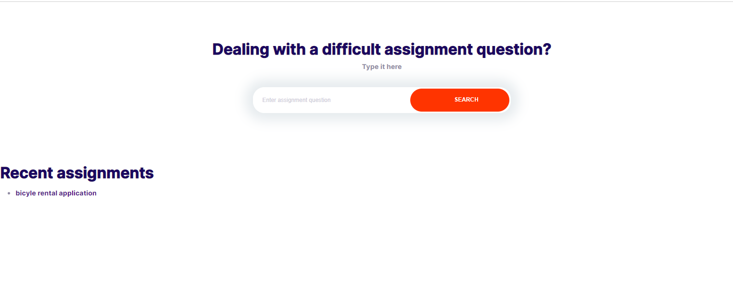

Slide 21
TODAY PAGE

Slide 22
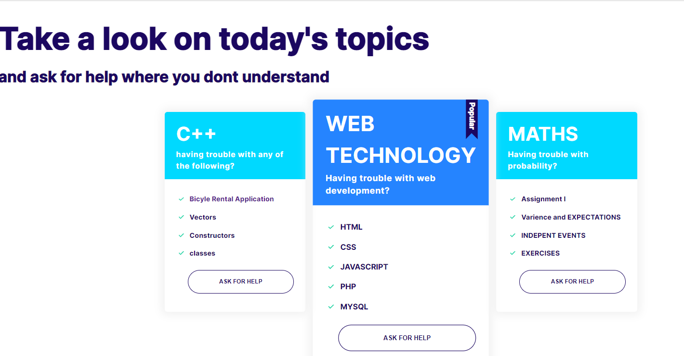

Slide 23
Manage users page. This page is for admin

Slide 24
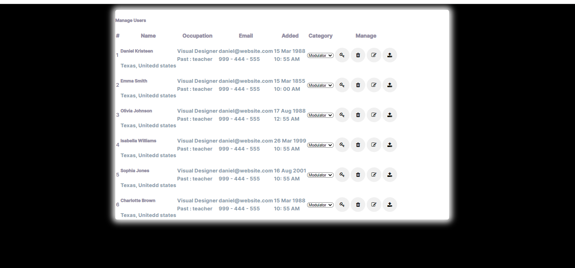

Slide 25
AYUDA DATABASE

Slide 26
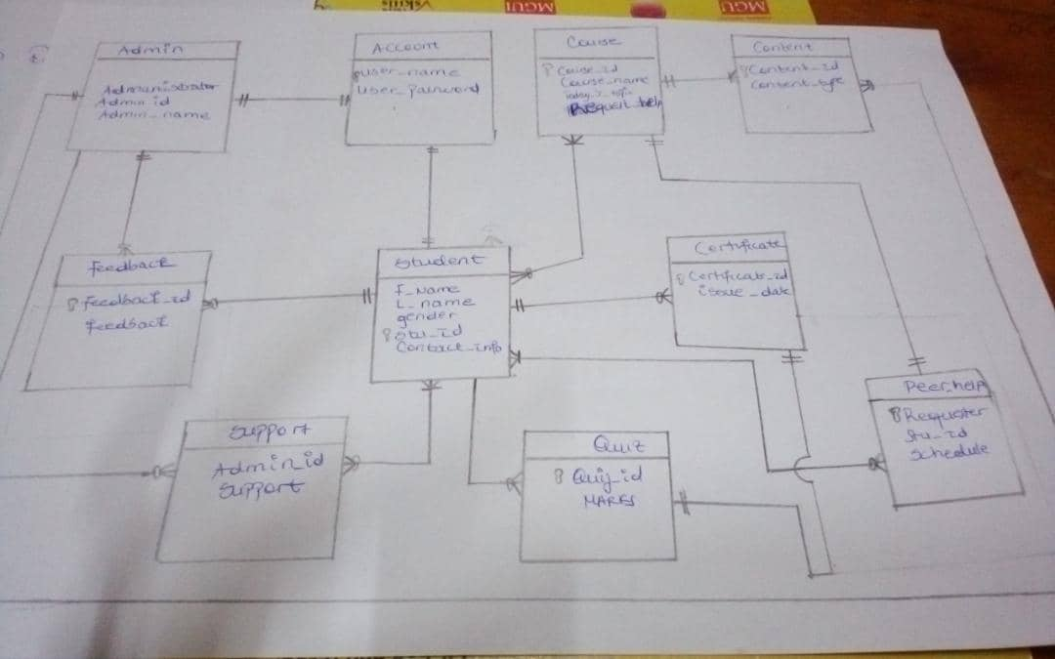

Slide 27
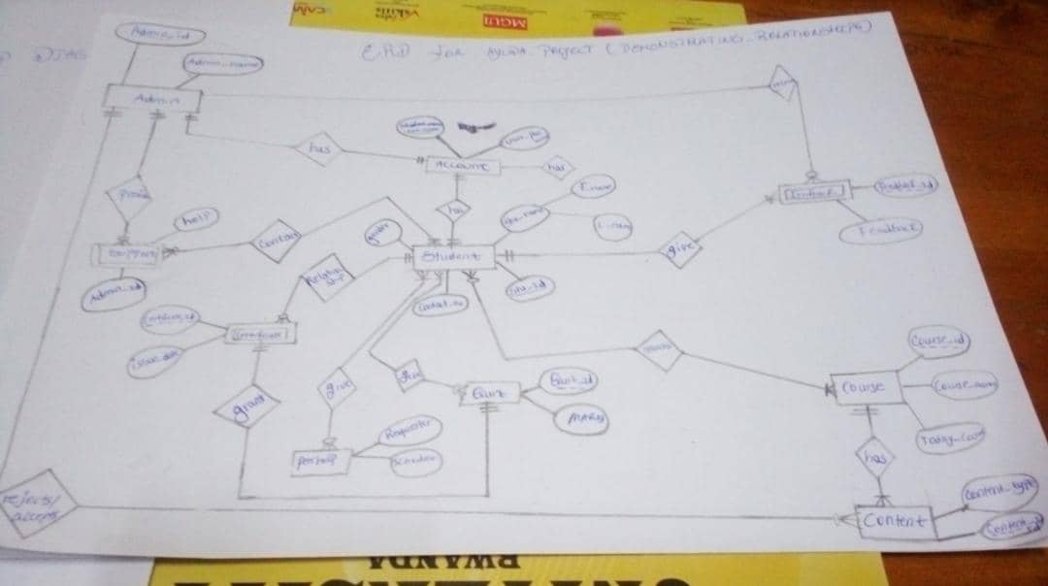

Slide 28
This information comes from sign up form to ayuda database. I used a php file to write codes and created adatabase using mysql

Slide 29
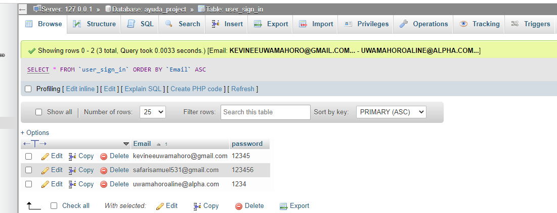

Slide 30
This information comes from signup page

Slide 31
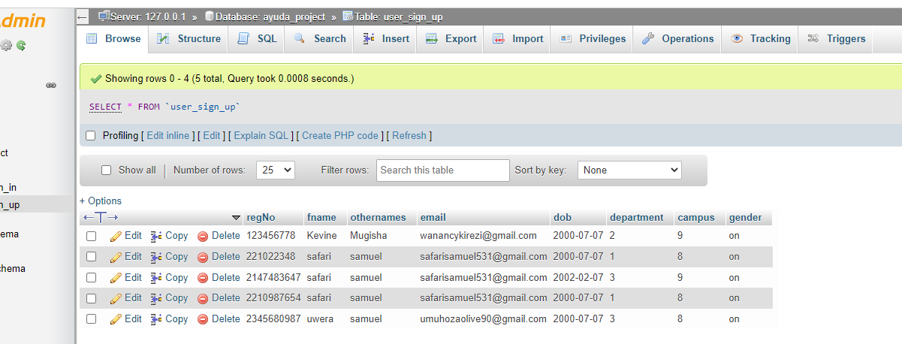

Slide 32
This information comes from a javascript file

Slide 33
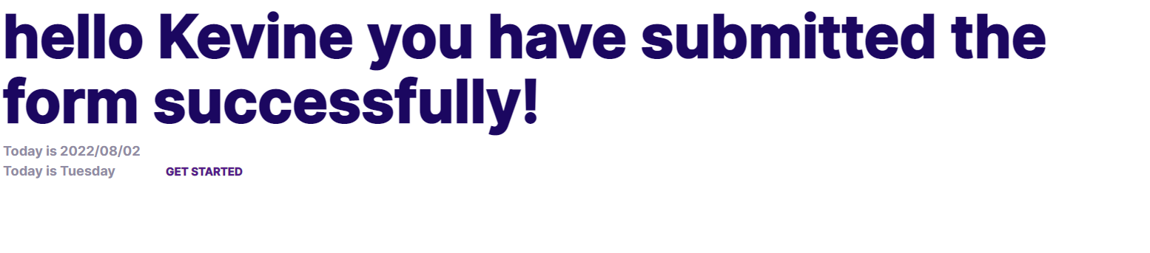

Slide 34
conclusion
Based on the deadline I was given,
I was able to implement my project by 60%,
The remaining 40% is because I wasn’t able to add enough javascript in order to have a fully functional front-end for my project.
But I will continue to do so because I intend to finish this project so that my class can use it.
Lessons I Learned:
To have confidence in my self
To create a database and interact with my sql
Webdesign,php and javascript.

Slide 35
The beneficiaries of my project are: My collegues from CSE

